Slide 1
National Weather Service Southern Region
Forecast Office’s Operational Experiences
Melinda Hinojosa
National Weather Service
Southern Region Headquarters
Fort Worth, Texas

Slide 2
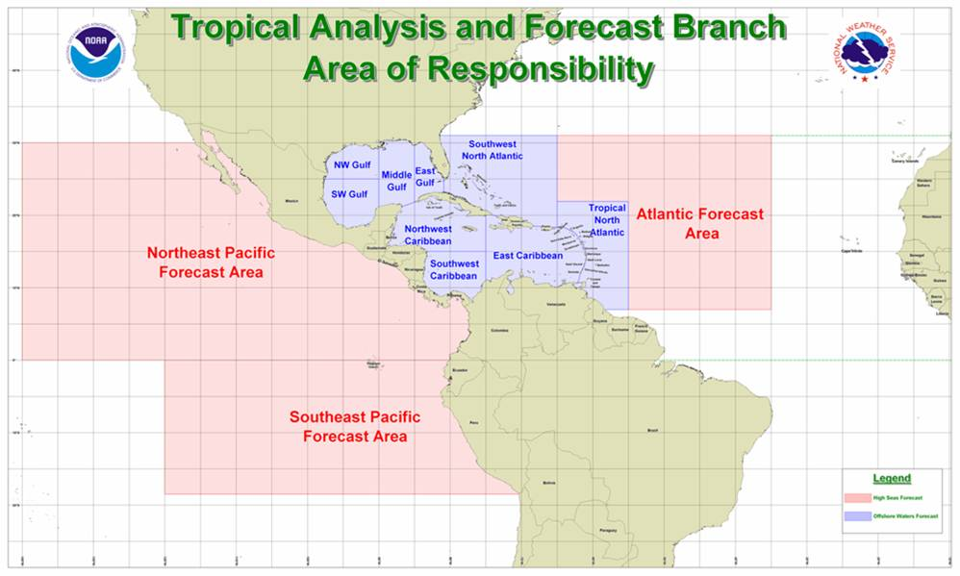

Slide 3
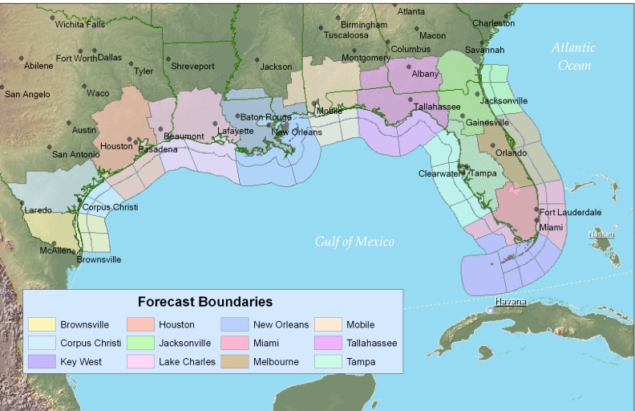

Slide 4
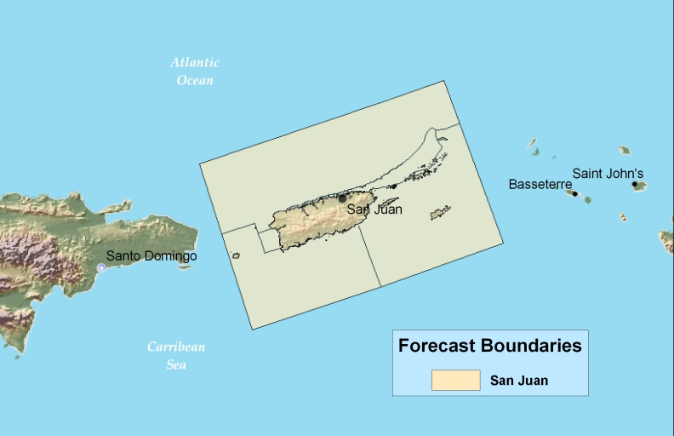

Slide 5
How is satellite surface vector wind (SVW) data currently utilized at your office?
It is used here by many of us as much as ship and buoy data.
Currently we use Quickscat. It is extremely useful when available. We use it to monitor forecast trends, onset of tropical cyclone winds across the area, and/or to adjust forecasts particularly offshore. It is not rare to see, due to lack of data offshore, advisory flags going up when this data is available and it is good.

Slide 6
How is satellite surface vector wind (SVW) data currently utilized at your office?
Marine forecasters at our office use the surface vector wind data to supplement the vast data void due to the lack of observations from the buoys and NOS tide gage sites that used to have met packages (Hurricane Rita destroyed most of them across our area).
The winds may be used to confirm trough position and strength in the gulf or winds offshore, but it is rarely available.
We use Quickscat and GOES Satellite Derived Winds in an attempt to verify initial conditions during the forecast process and also to ascertain if a forecast update is necessary.

Slide 7
How is satellite surface vector wind (SVW) data currently utilized at your office?
We use the QuikSCAT winds to supplement the few observation platforms in the western Gulf of Mexico. This is particularly useful during landfalling tropical systems and during tropical events of weaker proportions, such as inverted troughs, coastal troughs and slow moving weakly defined features.
Barely used due to being temporally infrequent. Also, as with many of these types of things, the training investment by NWS has been slim to none when the data are first made available. Initiatives/technologies like this always seem to be on the internet first and then some day it shows up in AWIPS. Then when we get it, only some use it. We should actually make it part of our daily briefing procedure, but have not yet done so.

Slide 8
How is satellite surface vector wind (SVW) data currently utilized at your office?
We occasionally use QuikSCAT. However we do not use it that often as the data rarely covers our marine area in a timely manner with regard to fcst preparation.
Unfortunately, since the data is not timely (frequently 3 or more hours old, and before issuance of marine forecasts) it is not fully utilized. When it has been used, it helps to verify against model winds and forecast trends.
We routinely use QuikSCAT winds to obtain ocean/Gulf wind data in areas not obtained by buoys. It also allows us to see how models are performing and how much confidence to put into them.

Slide 9
How is satellite surface vector wind (SVW) data currently utilized at your office?
Quikscat is used here as an essential short term forecast and verification tool, as we have no buoys. The data is used both for the local marine area, as well as for synoptic evaluation across the entire Atlantic and Carib. It is very helpful in fine tuning the local marine forecast from available GFS and NAM guidance, for identifying synoptic features such as tropical waves, trofs, and frontal systems, and is invaluable in swell forecasting as fine scale details in the wind field can be identified by Qscat and not picked up by the GFS and WWIII output.
Several forecasters use quikscat data via either AWIPS or online website.

Slide 10
How has satellite surface vector impacted your day-to-day operations?
Due primarily to temporal resolution issues, the impact is not large, but again when available it can be extremely useful for the applications mentioned earlier.
Other than occasional observations from our SAWRS observers (mainly from oil production platforms), it's our only source of observations for the coastal waters.
There is little to no impact on day to day operations, because the temporal resolution makes the data rarely useful.
Limited availability and masking of the data near the coast limits the value, so overall the impact is rather low. At times it is very useful in lending greater confidence to the models or current forecast. In marginal situations, it can help to determine whether an advisory is required.

Slide 11
How has satellite surface vector impacted your day-to-day operations?
Day to day operations will continue to move forward, if the SVW are no longer available. However, there is reassurance in knowing we have access to additional reliable data. Especially over areas that have no observational data.
When it is used as comparisons between the models, it gives us an idea of which model is performing better. It also helps to estimate wind sea conditions. For example, if derived winds were measured to be 15 or 20 knots east of our coastal waters, we can be confident in assuming that seas could be near exercise caution criteria over a portion of our marine area. Comparisons between buoys and satellite winds show very good correlation.

Slide 12
How has satellite surface vector impacted your day-to-day operations?
The data is as essential as buoy data would be, if available, and is used in day to day operations by all forecasters. It is often the only in situ data available to validate our marine forecasts.
If a forecaster is debating over going with advisories over the waters, the quikscat fills a large data void over our offshore waters. The swath that comes through our waters usually gets into AWIPS about an hour before our coastal waters forecast is due. Also...in the summer time the quikscat data is useful for locating the ridge axis for the Bermuda High. We have a lightning climatology database that gives us the best chances for thunderstorm development based on the location of this ridge axis.

Slide 13
Questions?
Melinda.Hinojosa@noaa.gov

