Slide 1
Welcome

Slide 2

Training Curriculum
Based on TIP 43: Medication-Assisted Treatment for Opioid Addiction in Opioid Treatment Programs
Module 9: TIP Chapter 10

Slide 3
Course Goals
The goals of this training are to…
Familiarize you with the content of TIP 43; and
Increase your awareness of issues related to medication-assisted treatment of opioid addiction.

Slide 4
Module 9: Medical Problems
During this module, you will:
Investigate considerations for assessing medical problems in MAT patients;
Study acute infections which commonly occur in MAT patients;
Identify infectious diseases frequently found in MAT patients; and
Examine treatment concerns for disabilities, pain management, and other conditions in MAT patients.

Slide 5

Medical Problems

Slide 6
Medical Assessment
Some medical problems are more prevalent and severe in people addicted to opioids.
These conditions can be life-threatening.
Many patients in MAT have chronic diseases.
Management of chronic pain for MAT patients is particularly challenging because of the role of opioids in pain treatment.
General approach in OTPs is to remain alert and knowledgeable, facilitate preventive measures, and provide ongoing medical and emergency care.

Slide 7
Medical Assessment: Integrated Services
Applicants with medical issues may sometimes be denied treatment admission for addiction because an OTP cannot manage their medical needs.
Unavailable or fragmented services may cause patients to leave MAT prematurely or relapse.
Many medical problems associated with opioid addiction should be treated either within the OTP or through liaisons with outside specialists and programs.

Slide 8
Medical Assessment: Integrated Services
Medical services for the most common medical problems should be provided at the OTP, with expansion to other medical services.
Each OTP should clearly define the medical services it offers on site versus by referral.
OTPs should establish links with medical providers and programs skilled in treating problems that go beyond the direct services of the OTP.

Slide 9
Medical Assessment: Referral Services
Patients need to understand an OTP’s policies regarding services provided on site versus by referral.
Referral services should be part of a patient’s opioid addiction treatment plan.
Primary care responsibility should be established either on site or through a community provider.
OTPs also should inform local hospitals about their services when a MAT patient is admitted to a hospital.
OTP staff should be ready to help patients understand procedures and care received off site.

Slide 10
Medical Assessment:
Routine Testing and Followup
OTPs should establish protocols for both assessment of acute problems and periodic reassessments. Recommendations include routine testing for:
  Hepatitis A, B, and C; syphilis and other sexually transmitted diseases; TB; HIV infection; hypertension; diabetes; and
  Liver and kidney functions.
Physical examinations of patients in MAT should be performed at least annually.
Tuberculin tests should be performed every 6 to 12 months, depending on regional factors.

Slide 11
Acute Infections
OTP medical staff, in particular those performing intake assessments, should recognize most potentially life-threatening infections related to opioid abuse.
Some of these conditions can mimic opioid or intoxication withdrawal.
Patients may be unaware of the severity of their condition or may attribute their symptoms to withdrawal.
Because patients are focused on avoiding withdrawal, their descriptions of their histories may be unhelpful.

Slide 12
Acute Infections: Endocarditis
Infection of the inner lining of the heart and its valves.
Should be considered in any patient with recent injection marks and fever or a newly appearing heart murmur.
Previously treated endocarditis might produce persistent heart murmur.
Patients who have survived endocarditis by having a valve replacement are at increased risk.
Fever in patients with a heart murmur always merits careful investigation.

Slide 13
Acute Infections: Soft-Tissue Infections
Soft-tissue infections, such as abscesses and cellulitis, involve inflammation of skin and subcutaneous tissue, including muscle.
Contaminated injection sites often swell and become tender.
A fluctuant abscess might need incision and drainage.
Patients with abscesses or cellulitis might not have fever.

Slide 14
Acute Infections: Necrotizing Fasciitis
Necrotizing fasciitis, also called flesh-eating infection, is usually caused by introduction of the bacterium Streptococcus pyogenes into subcutaneous tissue.
The infection spreads along tissue planes and can cause death from overwhelming sepsis within days without much evidence of inflammation.
Some patients may lose large areas of skin, subcutaneous tissue, and even muscle.
Case fatality rates from 20 to more than 50 percent have been reported.

Slide 15
Acute Infections: Necrotizing Fasciitis
Should be considered when pain at an injection site is more severe than expected from redness or warmth at the site.
Edema, fever, hypotension, and high white blood cell counts are additional clues.
Treatment includes extensive debridement and intravenous antibiotics.
Earlier ingestion of antibiotics may result in partial treatment of necrotizing fasciitis and modify its diagnosis and course.

Slide 16
Acute Infections: Wound Botulism
Caused by Clostridium botulinum, usually found in contaminated food.
Causes loss of muscle tone, including respiratory muscle weakness, making it life threatening.
Presenting symptoms and signs (difficulty swallowing or speaking, blurred vision, and impaired body movements) may mimic signs of intoxication.
An epidemic among people who injected drugs occurred in the 1990s, particularly in California.

Slide 17
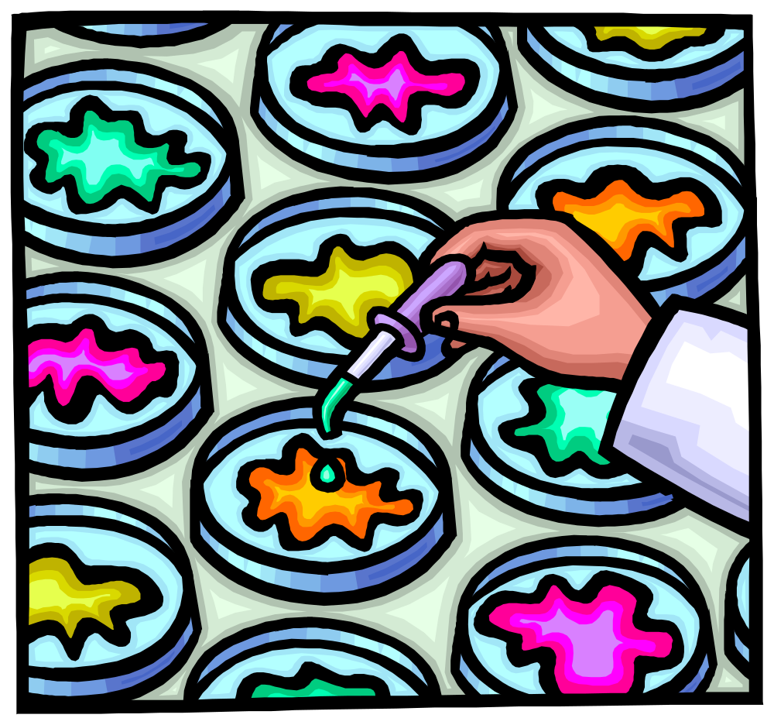
Name That Disease!

Slide 18
Patients with Disabilities
OTPs increasingly must address the needs of disabled patients.
TIP 29, Substance Use Disorder Treatment for People With Physical and Cognitive Disabilities, discusses the requirements of the Americans with Disabilities Act.
Many patients with AIDS have disabilities such as visual or hearing impairments, or they may lack the strength to visit an OTP.
Prevalence of illicit drug use may be higher for persons with disabilities than for others.

Slide 19
Patients with Disabilities: Home Dosing
Home dosing is an important option for patients whose disabilities preclude daily OTP visits.
Some patients are ineligible. Those with medical problems that affect neurological functioning may be unable to manage their medication without supervision.
Patients who are medically compromised and continue to abuse substances usually are ineligible for take-home dosing.
These patients pose major challenges for OTPs, and treating them requires creative planning.

Slide 20
Patients with Disabilities: Home Dosing
For patients who do not meet take-home eligibility criteria, home dosing sometimes can be negotiated.
Some OTPs identify someone to assist with dosing. These individuals can be educated about treatment medications and made responsible for picking them up, ensuring safe storage, and administering them.
For patients who cannot identify such people, OTPs might negotiate medication support through the Visiting Nurses Association or comparable programs.

Slide 21
Patients with Disabilities: Home Dosing
Some OTPs deliver medication directly to disabled patients’ homes, but such arrangements may be impractical, and delivery often is expensive.
Switching from methadone to LAAM might ease the accessibility problem somewhat, but the future availability of LAAM is doubtful.
Buprenorphine might also might be considered for home dosing.

Slide 22
Patients with Disabilities: Home Dosing
Some OTPs deliver medication directly to disabled patients’ homes, but such arrangements may be impractical, and delivery often is expensive.
Switching from methadone to LAAM might ease the accessibility problem somewhat, but the future availability of LAAM is doubtful.
Buprenorphine might also might be considered for home dosing.

Slide 23
Hospitalization of MAT Patients
OTP physicians should communicate with the attending physician and hospital health care team.
A patient in MAT will probably require larger doses of medication for anesthesia; adequate pain relief may require additional medication.
Hospital staff should prevent patients from obtaining and using illicit substances or abusing prescription drugs.
Some patients in MAT are hospitalized frequently. OTP staff members may be able to monitor such patients to facilitate early treatment.

Slide 24
General Medical Conditions and MAT
As patients become engaged in MAT, they are more likely to take better care of themselves.
Medical care should be identical to that given patients not in MAT.
General advice on diet, exercise, smoking prevention, and stress management should be integrated into MAT.
Age and risk-appropriate medical screening should be discussed with patients during regular examinations.

Slide 25
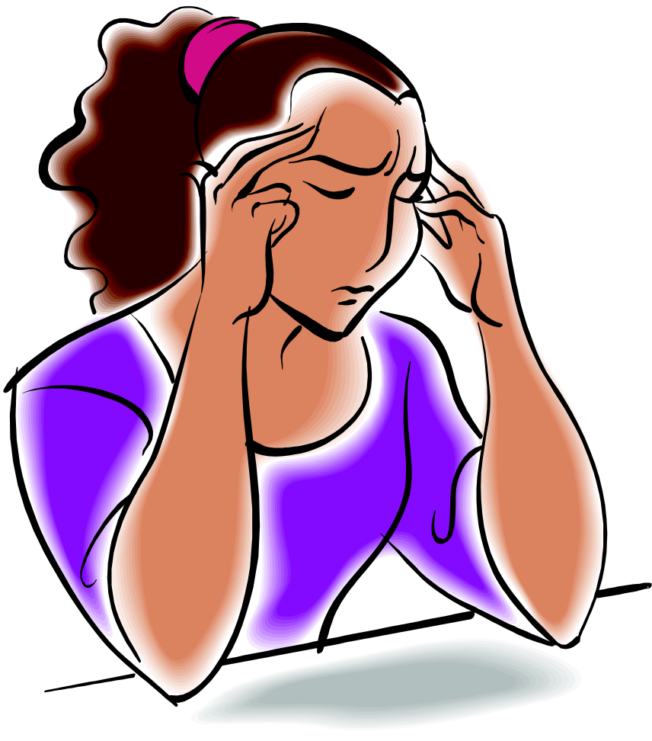
Pain Management

Slide 26
Module 9: Medical Problems

Slide 27
Training Curriculum
Based on TIP 43: Medication-Assisted Treatment for Opioid Addiction in Opioid Treatment Programs
Module 9: TIP Chapter 10

