Slide 1



Director’s Update of the
National Centers for Environmental Prediction
COPC Meeting
NOAA Science Center, Camp Springs, Maryland
November 28, 2001
Dr. Louis Uccellini
Director, NCEP
“Where America’s Climate and Weather Services Begin”

Slide 2
Overview
Computer Status
Model Status
MOA Status
Cooperative Activities

Slide 3
IBM SP
Benchmark performance ~ 46 times C90
Phase II upgrade completed
  Part 1 of Phase II – Dec 5
  Past 2 of Phase II – Feb 13
  Four 375 MHz CPUs per node
  2176 compute processors in 38 frames
    128 newly acquired processors for climate
  Two systems; one for operations, one for development
  544 compute nodes
  8 MB L2 cache per CPU
  2 GB memory per node
  14.7 TB disk subsystem
  200 TB robotic tape system

Slide 4
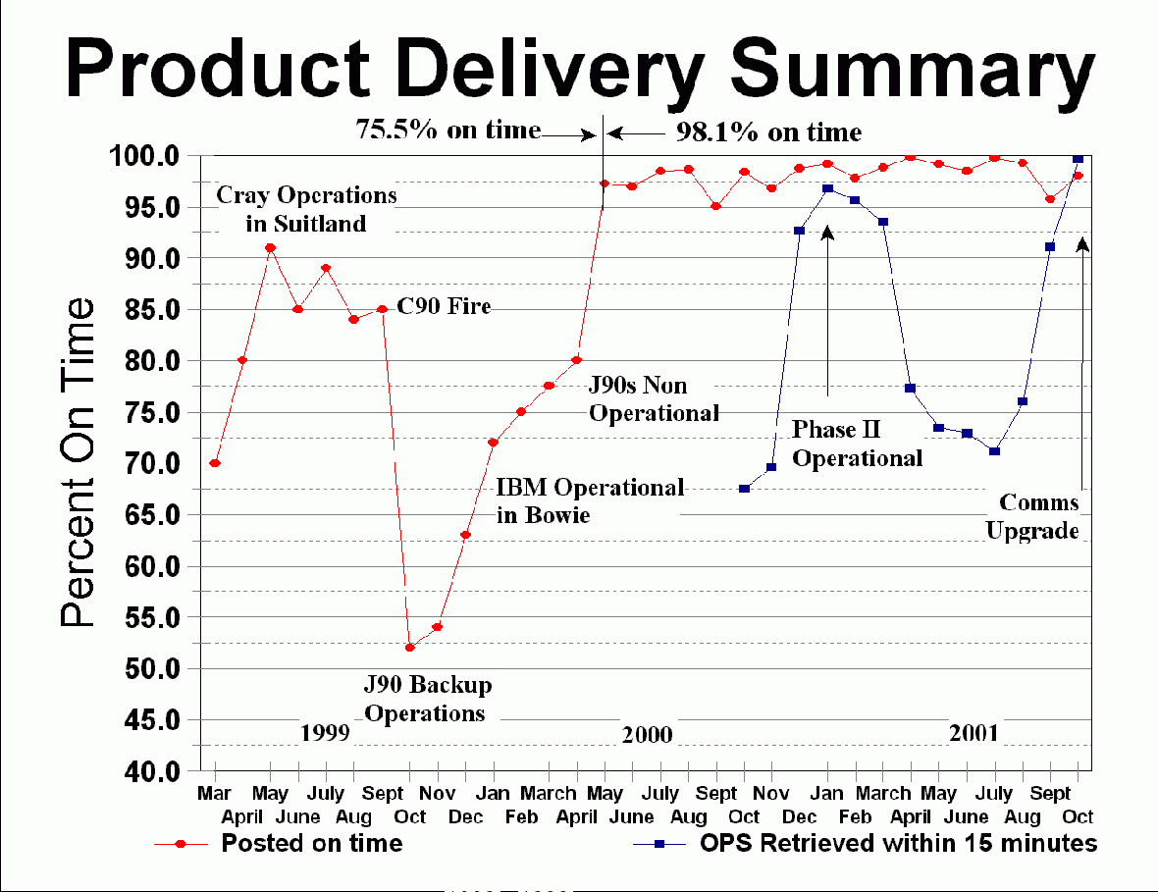

Slide 5
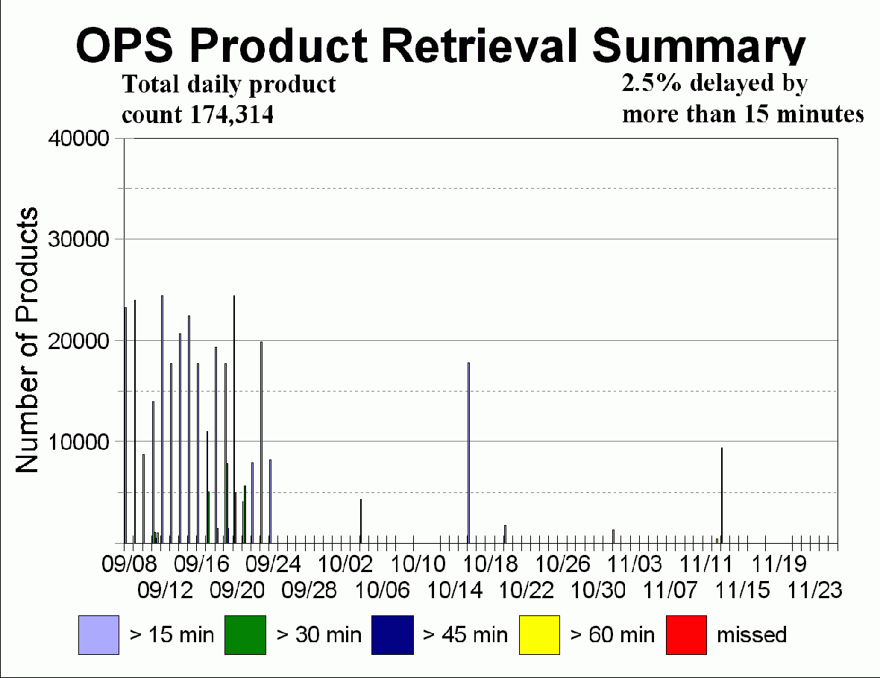

Slide 6
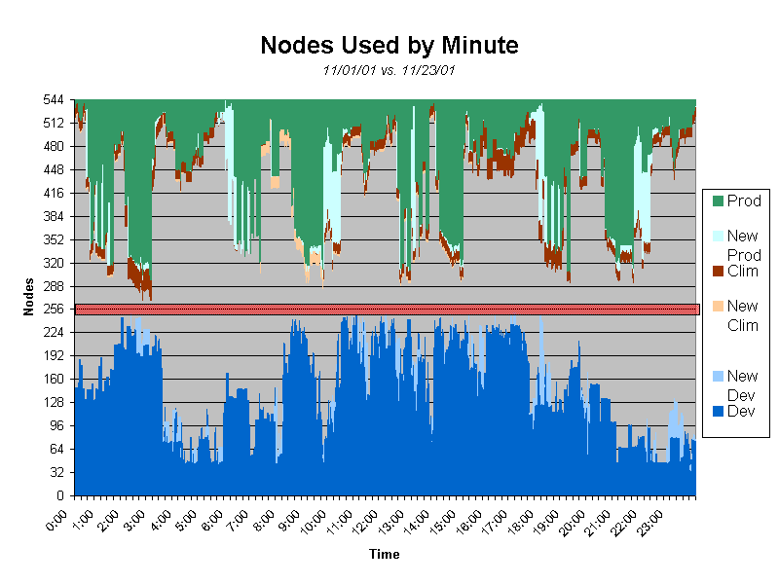

Slide 7
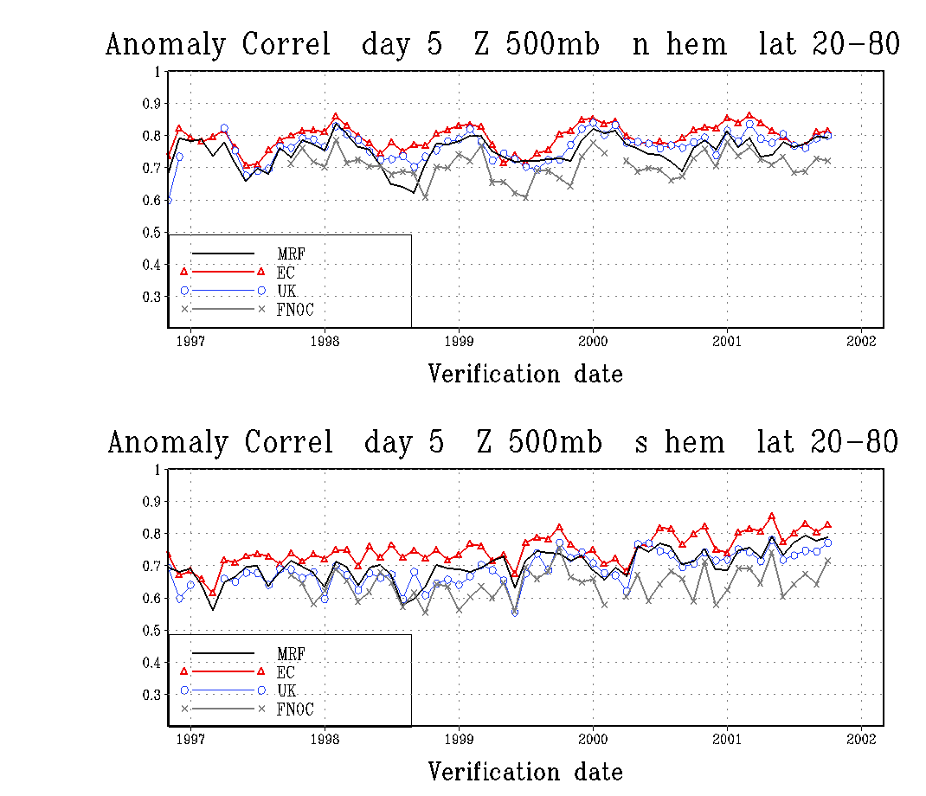
Last updated Nov 2, 2001

Slide 8
Global Model Implementation
May 15, 2001
Physics Package Changes
  Inclusion of cloud condensate as a history variable
  Use of cloud condensate in radiative transfer calculations
  Inclusion of cumulus momentum mixing
Analysis Upgrades
  Stronger quality control for AMSU radiances
  Refinement of hurricane relocation algorithm

Slide 9
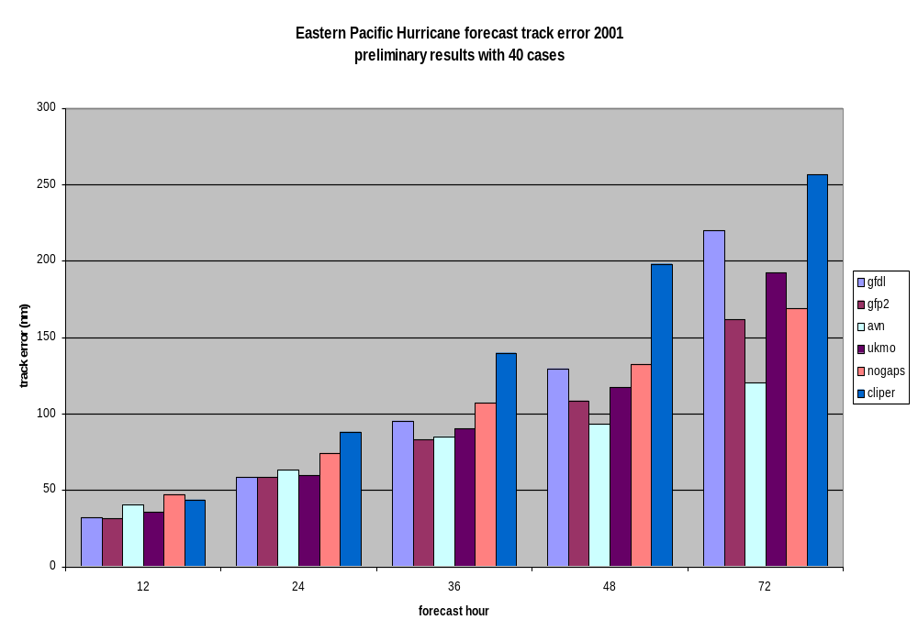

Slide 10
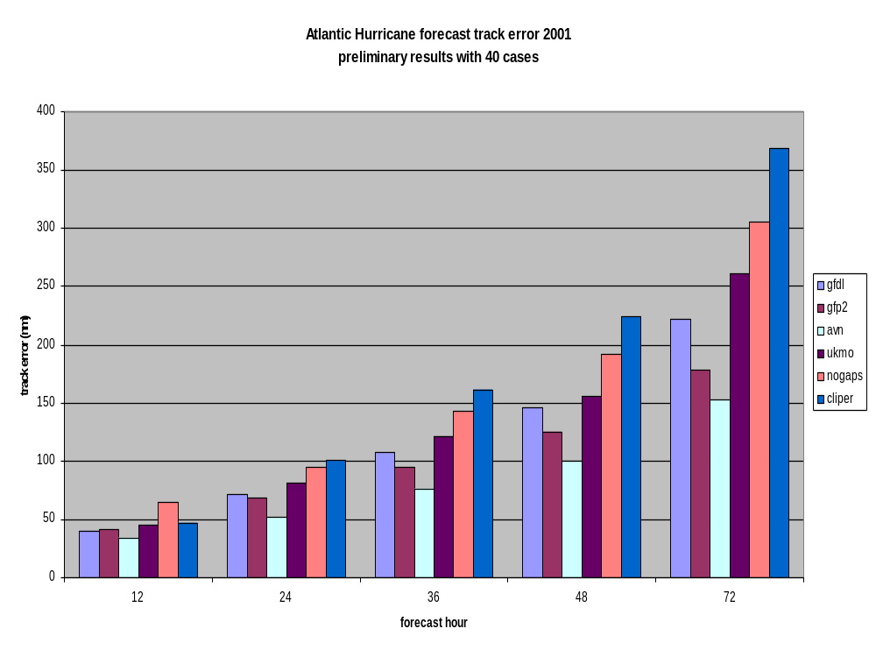

Slide 11
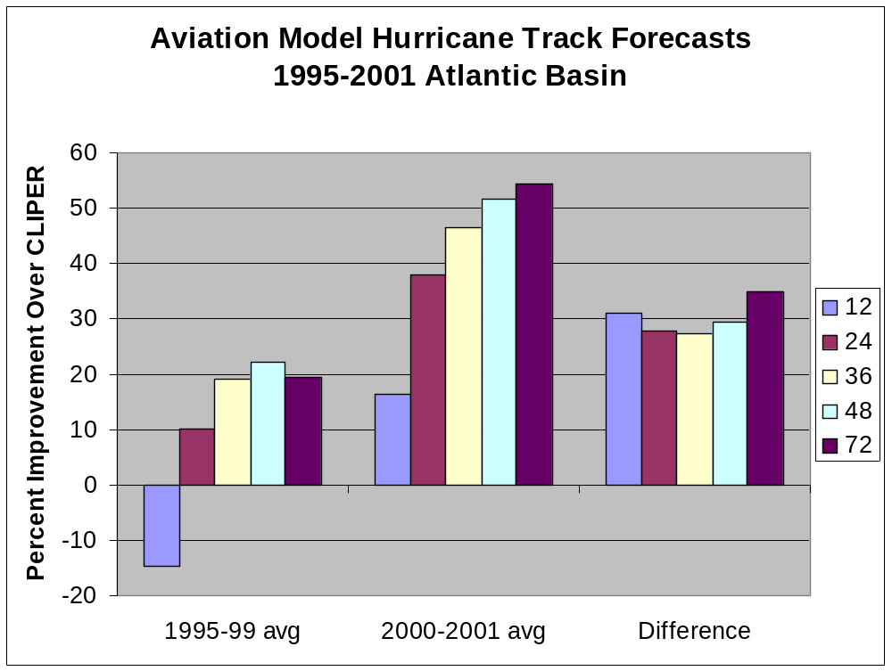

Slide 12
Climate Model Status
Additional nodes installed on IBMSP August 2001
First operational run of Seasonal Forecast Model initiated on September 6, 2001
T62 (200km) L28 configuration
  7 month forecast with 20 member ensemble
  21 year hindcast with 10 member ensemble for a climatology of the model for the month when the forecasts are initiated, to derive anomalies of the model forecasts to be used for CPC product generation.

Slide 13
Eta Model Implementation
July 24, 2001
Assimilation of observed precipitation during the EDAS
Changes to the land-surface physics
Modifications to the 3DVAR analysis to improve mass-wind balance constraint

Slide 14
Eta Model Implementation
November 27, 2001
Resolution increases
  Horizontal from 22 km to 12 km
  Vertical from 50 levels to 60 levels
New gridscale cloud+precip scheme
  Necessitates changes to precip assimilation
3DVAR analysis
  Use of 1b radiances (consistent with global)
  More scalable code

Slide 15
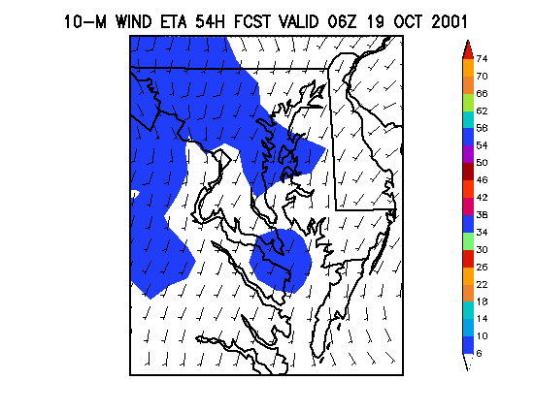
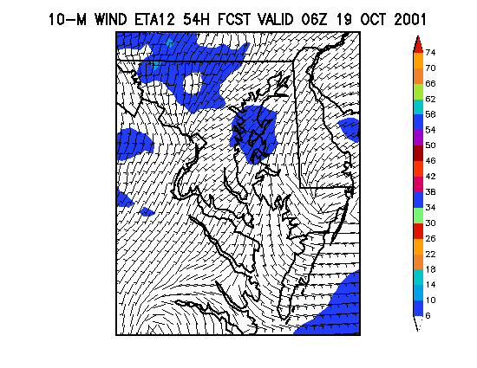
Surface winds 22km vs 12km

Slide 16
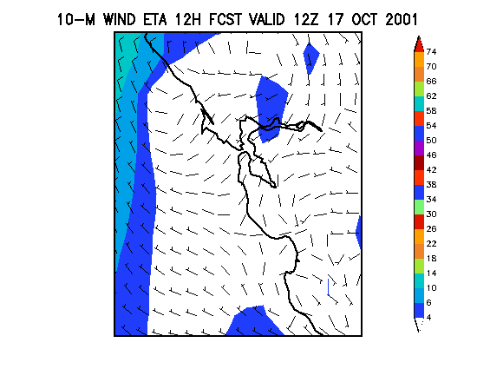
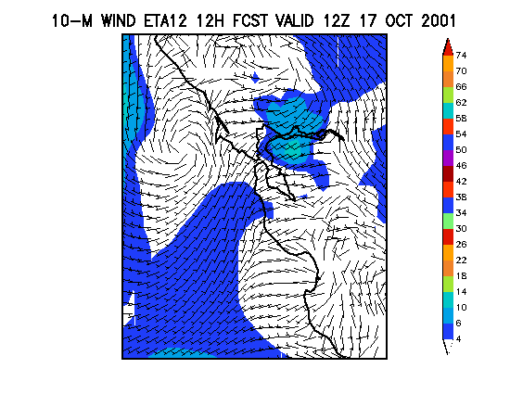
Surface winds 22km vs 12km

Slide 17
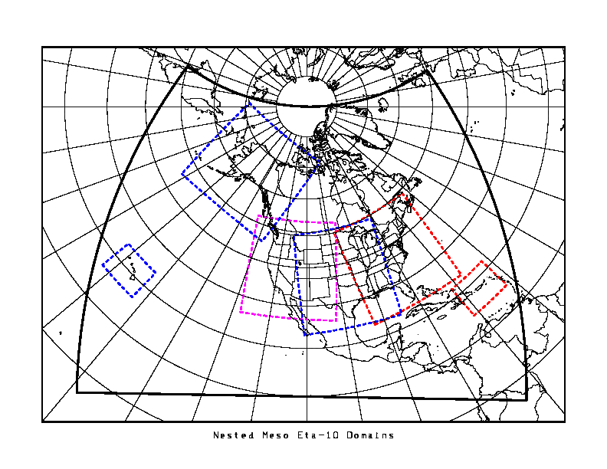
Fixed Domain Eta “Nests”
High-resolution regional Eta forecasts "nested" inside of the parent Eta (12km/60 lev resolution)
Running six nested domains
Hawaii and Puerto Rico twice per day
Alaska, East, West, Central U.S. once per day
Alaska is 12km resolution, rest are 10 km
mid-year 2002, nests reduced to 8km (Alaska 10km) and imbedded in 12km non-hydrostatic Eta
Output available on NCEP ftp
server

Slide 18
Short Range Ensemble Forecast System
10 Members (5 Eta, 5 RSM)
48 km resolution
Run twice daily from 09Z and 21Z to 63 hours
  Products available ~same time as 12Z and 00Z Eta
Regional breeding for initial condition perturbations
Lateral boundary conditions from 9 hr old global ensemble

Slide 19
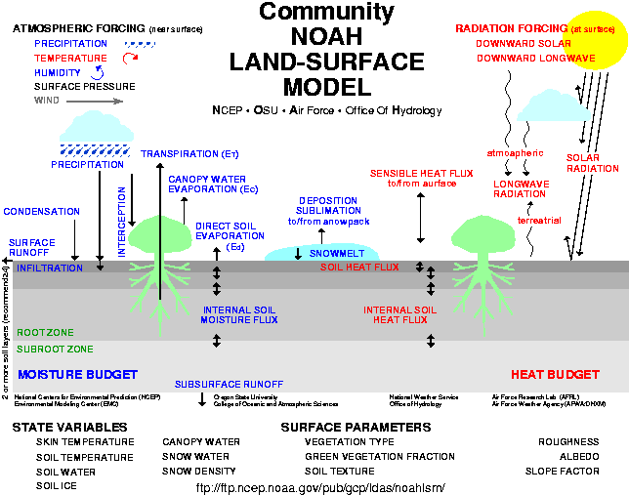

Slide 20
Status of NOAH Land Surface Model
Latest upgrade implemented in Eta/EDAS on 24 Jul 2001
Latest upgrade also implemented during Jul-Oct 2001 in
  Regional Reanalysis
  NCEP real time prototype national land data assimilation system
  NASA/NCEP joint real time prototype global LDAS
  AFWA AGRMET system (USAF operational LDAS)
  U. Arizona LSM objective calibration system

Slide 21
Future Plans for NOAH LSM
Propagate latest NOAH LSM into NCEP global modeling systems
  All global systems presently use mid-90's NOAH
  Testing to begin 2nd Quarter 2002
Unify NCEP and NCAR LSMs for 2002 release in WRF model

Slide 22
NOAA Wave Watch III
Replaced all previous operational wave models at NCEP on March 9, 2000
  Global model at 1x1 deg lat-lon resolution from 78S to 78N, run twice daily out 126 hours
  Nested regional models for Alaskan Waters and Western North Atlantic (both 0.25x0.25 deg) run twice daily out 126 hours
All models run from GDAS/AVN and ice analysis and use a spectral discretization with 24 directions and 25 frequencies
GFDL driven hurricane version run during Atlantic hurricane season.

Slide 23
NOAA Wave Watch III Future Plans
Implementation of Eastern North Pacific regional model (0.25x0.25 deg) by Fall 2002
Cooperative projects
  Near-shore swell forecasts on West Coast (CDIP, Scripps, UCSD)
  Bar forecast for Humbold Bay (Eureka WFO)
Coupling and Data Assimilation
  In development and discussion phase

Slide 24
Planned 2002 Implementations
Eta Model
  Extend off–time runs to 84 hrs – January
  Upgrade physics package – May
  Upgrade package for 3DVAR & Assimilation – November
GFDL
  Either two grid system (1/2 & 1/6 degree) or three grid system (1/2, 1/6, & 1/12 degree) – May
RUC Model
  Increase resolution from 40 to 20 km - TBD

Slide 25
Planned 2002 Implementations (cont.)
Global Model
  Increase resolution to T254 (~55km)
  More to come
Global Ensembles
  Resolution increase to T126 (~105km) out to 7 days – April
Coastal Ocean Forecasting System – June
Wave Model
  Eastern Pacific Region Wave Model – June
  Eastern Pacific Hurricane Wave Model RTTE – June
Climate Model
  Implement weekly global ocean data assimilation system for climate forecasting – September

Slide 26
Current Cooperative Activities
Washington VAAC Backup by AFWA
Provision of AGRMET data to NCEP by AFWA
NCEP use of DoD MSRC Computational Resources (at NAVO)
WRF
Pacific Winter Reconnaissance Program (Zoltan Toth; extended to 2 + months this winter)
JCSDA

Slide 27
MOAs in Progress
MOA between NCEP and AFWA regarding Daily Transmission of Agriculture Meteorological Model data.
  Signed by both parties as of November 27, 2001
MOA between NCEP, W-VAAC and AFWA for exchange of information and backup support of the W-VAAC
  In initial stages
  Focal point – Dave Weinbrenner

Slide 28
Summary
NCEP is in good shape
  Computer
    Development/operations
    New procurement on schedule
  Models
    Models enhanced, performance improved
  Infrastructure
    Supporting operations (supercomputer to workstation environment)
Several important changes planned for 2002
  Global model system
  Eta, RUC, GFDL, Wave Watch III
  Getting ready for WRF

Slide 29
Appendix

Slide 30
NCEP Production Suite
Production Suite
  532 codes – 20 utilizing message passing (use MPI)
  2.4 million lines of code & script
  Schedule http://www.ncep.noaa.gov/NCO/PMB/prod_overview/
  GIF Images http://www.ncep.noaa.gov/NCO/PMB/nwprod/analysis/
Major Model Runs
  Rapid Update Cycle – 40 Km/40 Lvl (hourly)
  Eta Model – 22 Km/ 50 lvl (4 times daily – 84 hrs, off-time 48 hrs)
  NGM (twice daily)
  Aviation Run – T170 75km/42 lvl (4 times daily – on-time 126 hrs, off-time 84 hrs)
  Medium Range Forecast – T170 75km/42 lvl – 168 hrs; T62 210km/28 lvl – 384 hrs (once per day – 16 days)

Slide 31
NCEP Production Suite
(continued)
  Global Data Assimilation (4 times daily)
  GFDL Hurricane 18km/18 lvl (on demand – 4 storms, 4 times daily – on-time 126 hrs, off-time 78 hrs)
  Wave Watch III – 1 x 1.25 deg (2 times daily – 126 hrs)
  Regional Ensembles (10 members twice daily at 48 km)
  Global Ensembles (10 members twice daily, T126 105km/42 lvl – 84 hrs, T62 210km/28 lvl – 2 times daily – 16 days )
  Global Climate Forecasts (20 members – 6 month forecast, 1 per month)

Slide 32
2001 Implementations
Eta Model
  Extend runs to 84 hrs – March 20
  FOUS to 60 hrs – May 15
  Nested “Threats runs” Real Time Test and Evaluation (RTTE) – April 25
  Available on NCEP ftp server
  Assimilate Precip, Upgrade land-surface model – June 26
  12 km/60 lvl – November 27
GFDL Model
  Coupled Ocean-Atmosphere model (Atlantic & Gulf only) – May 22
Regional Ensembles
  Available on NCEP ftp server only – June 5
  10 Members twice daily at 48 km

Slide 33
2001 Implementations (continued)
OC3 Line Upgrade
  (155 Mbits/sec between OOS and NCEP) – September 23
Global Model
  Prognostic Cloud Water, Convective Scheme, Tropical Storm relocation package – May 15
Global Ensembles
  Extend high resolution (T126) from 60 to 84 hrs – January 9
Wave Model
  North Atlantic Hurricane Wave Model – June 12
Global Climate Model
  Final Operating Capability – Nov 6

Slide 34
Product Availability Schedule
MODEL Time* Late**
NGM MOS: 02+45 10 min
Eta 60 hr fcst: 03+00 10 min
Aviation 120 hr fcst: 04+15 10 min
Wave Model: 04+40 10 min
Hawaii Regional Spectral: 06+100 10 min
MRF 384 hr fcst: 07+50 10 min
RUC 12 hr fcst (on-time, 3 hourly): hh+45 5 min
RUC 3 hr fcst (off-time): hh+40 5 min
Complete list available at: http//www.ncep.noaa.gov/PMB/NCO/Proposed_Delivery_Targets
* Relative to Synoptic Time
** 15 minutes is current for all

Slide 35
NCEP Backup Configuration
AFWA MM5 for Eta AWIPS grids (4 cycles/day for CONUS)
FNMOC NOGAPS for AVN AWIPS grids and fax products
FNMOC WW3 for Global Ocean Wave AWIPS grids
FNMOC GFDN Hurricane model in place of GFDL model
UKMET backup for WAFS
FSL hourly RUC2 for AWIPS grids

Slide 36
NCEP Quarterly Backup Test
Most recent Backup Test completed 10 October 2001
  Products disseminated from backup processing instead of NCEP production for 12Z cycle
  RH grids from NOGAPS had problems (fixed)
  Output Wave Model flipped (fixed)
Next live test planned for January 2002
  30 day notification to users

Slide 37
NCEP’s Contribution to Homeland Security
Phase I
  Routine runs of the ARL HYSPLIT dispersion model from 12 km Eta model (15 sites 4 times daily) - Nov
Phase II
  On call 4 km Eta run on any of 16 predefined regions covering all of U.S. – Jan 02
Phase III
  Routine 4 km Eta over CONUS – TBD
Phase III will require additional computational resources
  Acquire Funding
  Adjust NCEP production schedule
  Offload portion of NCEP processing

