Slide 1
Development of a Lab-Scale Flame Propagation Test for Composite Fuselages

Slide 2
Introduction
With the increased use of non-traditional materials for modern aerospace applications, fire test methods must be continually updated and re-evaluated in order to maintain a high level of passenger safety
  Application of fire tests to modern materials
  Re-evaluation of pass/fail criteria
  Introduction of new safety threats with new materials
  Develop new standards or test methods to address these issues
Composite materials (carbon fiber-epoxy) are being used in places where aluminum was traditionally used
  Fuselage skin
  Structural members – stringers and formers
  Seat frames
  Fuel tanks
There is a need to evaluate the fire properties of these materials to ensure there is not a decreased level of safety

Slide 3
Composite Fuselage
There is a need to evaluate the fire properties of a composite fuselage
  Burnthrough
  Toxicity
  In-flight burnthrough
  Flame propagation
This objective of this study is to determine whether a composite fuselage will pose a flame propagation hazard
  Identify potential scenarios where a threat may be present
  Evaluate threat with full or intermediate scale test
  Analyze results to determine if there is an increased risk
  Use full/intermediate scale test results to develop a lab-scale test for future certification purposes

Slide 4
Evaluation of Flame Propagation Risk
An intermediate scale test was performed using the foam block fire source
Different configurations of the fire source, thermal acoustic insulation, and composite panel were attempted
Test results indicated that the material being evaluated did not present a flame propagation hazard
Other composites or composites of varying thicknesses may pose a threat

Slide 5
Development of Lab-Scale Test
Use the results from previous intermediate scale test as a baseline for a “pass”
  The intermediate scale test results were used to certify that specific material for use in aircraft
  The intermediate scale test will not suffice for certification, however, as it is a large test and takes time and money to perform
  Certification tests must be performed when varying the material (different epoxies, thicknesses, etc.)
  The lab scale test must provide the same discretion as the intermediate scale test, but be more efficient to perform
Radiant Panel Test Apparatus
  The radiant panel test is very useful for evaluation flame propagation tendencies for materials
  The test is a “surface” test, as radiant heat and the burner impingement are applied to the material surface
  Material thickness and thermal conductivity play a large role in this test
  Test parameters must be adjusted to account for composite materials of varying thicknesses (warm-up time, flame exposure time, radiant heat energy, etc.)
  Task here is to determine if the radiant panel test will be useful for evaluating the flame propagation threat of composite materials

Slide 6
Previous Work on Composites
FAA Report DOT/FAA/AR-07/57 (Quintiere et al.) entitled “Flammability Properties of Aircraft Carbon-Fiber Structural Composite”
Investigated a material manufactured by Toray Composites America to meet Boeing Material Specification 8-276
Key objective was to investigate the heating and burning properties of the material with various methods
  Cone calorimeter
  Microscale combustion calorimeter
  Thermogravimetric analysis
  Differential scanning calorimeter
  Flame spread apparatus
  Thermal conductivity apparatus
  OSU and smoke chamber

Slide 7
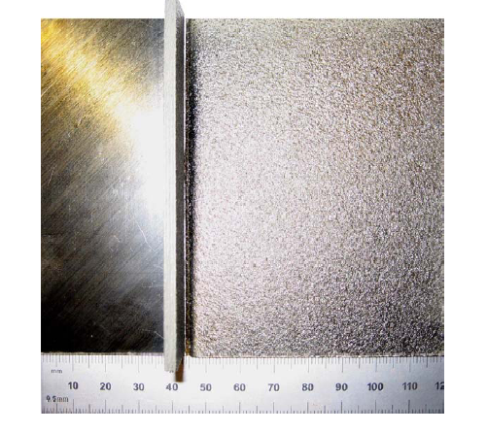
Material Details
Toray Composites, BMS 8-276
  [-45, 0, 45, 90]2s 16 plies
  Material is composed of carbon fibers (7µm dia.) and resin
  3.2 mm thick (0.125 in.)
  Density = 1530 kg/m³ (95.5 lb/ft³)
  60% by volume carbon fibers
  Resin density = 1220 kg/m³ (76 lb/ft³)
  Typical char fraction of resin ~ 25%

Slide 8
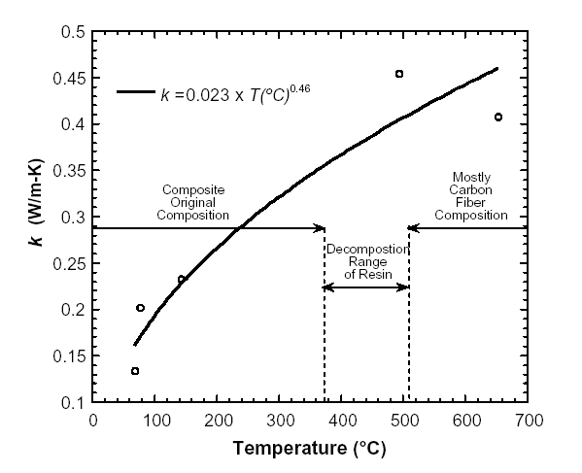
Properties
Resin is primary fuel for reactions
  Escapes the material through pores in the matrix
  Heating causes material to swell as internal pressures rise
  Flame jets can protrude from the material due to pressure release
  Properties change as material changes in shape
    Density decreases
    Thermal conductivity of matrix decreases
  Both flaming and non-flaming combustion can occur
    Resin can produce flaming combustion
    Char and carbon can smolder on the surface without flame
Thermal conductivity was measured with a home-built apparatus
  Measurements were made over a range of temperatures relevant to combustion
  Heat loss errors were found with the apparatus, possibly up to 20% difference
  More accurate methods are needed
  Despite the errors, the dependency of thermal conductivity on temperature is clear

Slide 9
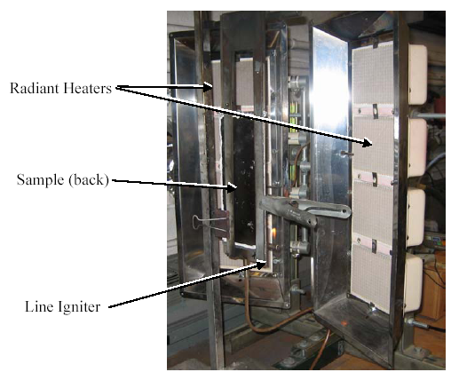
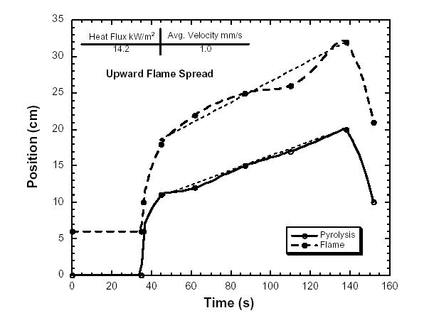
Flame Spread Experiments
Critical heat flux was found from cone calorimeter measurements
  Piloted ignition: 17.5 kW/m² (1.5 BTU/ft²s)
  Non-piloted ignition: 31.5 kW/m² (2.8 BTU/ft²s)
Apparatus was developed in the work of Panagiotou and Quintiere
  Vertically mounted specimen
  Surface exposed to radiant heat is 6 x 25 cm (2.4” x 9.8”)
  Pre-heat time of 4 min was used to create thermal equilibrium on sample surface (found from critical heat flux for piloted ignition)
  Flame spread is only a function of heat flux for this pre-heating condition, as flame speed is dependent upon surface temperature
Key findings
  Exposed heat flux of 1.25 BTU/ft²s
  Pilot flame in contact entire test
  Flame spread of approx 7” over 2 ½ min
  Pyrolysis spread of approx 12.6” over 2 ½ min

Slide 10
Preliminary FAATC Measurements
BMS 8-276, 0.125” thickness, 20” x 9.5”
Radiant Panel Test, configured for 25.856(a)
  1.5 BTU/ft²s at zero position
    15 sec. pilot flame application
      Result: No propagation, no after flame
    4 min. pre-heat, 30 sec. pilot flame application
      Result: No propagation, no after flame
    Turned sample 180°, 30 sec. pilot flame application (~6 min pre-heat)
      Result: 3 sec. after flame, no propagation
    Re-applied flame for 1 min
      Result: 6 sec. after flame, no propagation
    Damaged Panel, 15 sec. pilot flame application
      19 sec. after flame, no propagation
    Pilot flame applied to rear edge of panel, 15 sec pilot flame application
      Result: >15 sec. after flame, no propagation

Slide 11
Configuration 1
15 sec. flame application
No propagation or after flame

Slide 12
Configuration 2
4 min. pre-heat
30 sec. flame application
No propagation or after flame

Slide 13
Configuration 3&4
Rotated sample 180°, -> ~6 min pre-heat
30 sec. flame application
3 sec. after flame no propagation
Re-applied flame for 1 min
6 sec. after flame, no propagation

Slide 14
Configuration 5
Damaged Panel
15 sec. flame application
19 sec. after flame, no propagation

Slide 15
Configuration 6
Pilot flame applied to edge
15 sec. flame application
>15 sec. after flame, no propagation

Slide 16
Summary of Initial Testing
Results:
  Test conditions for 25.856(a) are not severe enough to produce any result
  4 minute pre-heat not sufficient to produce any result
  ~6 minute pre-heat was able to produce short after flame
  Delamination and damage to panel caused significant after flame
  Application of flame to edge of panel caused significant after flame
  After flame seems to behave like a candle, where fuel is drawn to the flame through the panel like a candle
  Combustible gases seem to escape through the edges, which causes after flame at the edge
  Sample frame should be constructed to completely block off the edges and only allow for surface to be exposed

Slide 17
Status
Work is in the initial phase right now
Initial work will involve tooling with the radiant panel and different composite material plaques to observe how the material behaves in this test
  Vary sample size, thicknesses
  Vary radiant heat and flame exposure times
Gather samples of different composite materials for intermediate and lab scale tests
Perform intermediate and lab scale tests, change test parameters such that the intermediate and lab scale results correlate

Slide 18
Questions or Comments?
Contact:
Robert Ochs
DOT/FAA Tech Center
Bldg. 287
Atlantic City Int’l Airport, NJ 08405
(609)-485-4651
robert.ochs@faa.gov

