Slide 1
Novian Health’s Response to FDA’s Request for Comments
Potential for a Registry of Breast Cancer Treatment Using Thermal Ablation Devices
Docket No. FDA-2008-N-0280

Slide 2
Cancer-related Thermal Ablation Registries
FibroAdenoma Cryoablation Treatment (FACT)
Cryo On-Line Database (COLD) – prostate
High Intensity Focused Ultrasound (HIFU) Prostate Cancer Treatment Clinical Registry
American Breast Laser Ablation Therapy Evaluation (ABLATE) – in planning stages

Slide 3
Standardized Registries Can Provide Data on Margin Status & Re-treatments
A registry is an efficient method to collect larger data sets over longer time periods on outcomes beyond recurrence.
Thermal ablation procedures without subsequent excision can leverage advances in imaging technologies to demonstrate effectiveness.
Standard practice is to obtain clear margins, often requiring a 2nd surgical procedure.
  20-50% re-treatment rates cited at ASBS Conference, 4/08
It is absolutely unacceptable to have tumor cells directly at the cut edge of the excised specimen.
-Dowlatshahi K, Dieschbourg JJ. Shift in the surgical treatment of non-palpable breast cancer: tactile to visual. Breast Cancer Online. 2005.
-Aziz D, Rawlinson E, Narod SA, et al. The role of reexcision for positive margins in optimizing local disease control after breast-conserving surgery for cancer. Breast J. Jul-Aug 2006;12(4):331-337).
-Singletary SE. Surgical margins in patients with early-stage breast cancer treated with breast conservation therapy. Am J Surg. Nov 2002;184(5):383-393).

Slide 4
Our Technology: Novilase™ ILT Breast Therapy
Interstitial Laser Therapy (ILT) - minimally invasive alternative to lumpectomy; uses stereotactic image guidance, 2 small (14G) needles and local anesthesia
FDA clearance for fibroadenomas (May ‘07)
2 US sites currently fully functional & treating benign breast tumors (2 add’l sites trained)
Patient registry “ABLATE” currently being implemented
Malignant trial initiation planned for early ‘09

Slide 5
ILT Clinical Experience
ILT Breast Cancer Study:
  70 procedures in 63 patients, 1, 3 & 6 mo follow-up, no serious AEs
    65 procedures in malignant; 5 procedures in benign
    56 patients had surgical excision + pathology
      Overall tumor ablation was 95% based on volume and 89% based on linear dimension
    9 procedures in malignant without surgical excision
      Followed with x-ray and ultrasound; 77% showed no evidence of residual tumor
    2.5-3.5cm zone of necrosis surrounded ablated tumor
    ILT is safe and effective for ablating breast tumors up to 2cm
-Dowlatshahi K, Francescatti DS, Bloom KJ. Laser therapy for small breast cancers. Am J Surg. Oct 2002;184(4):359-363.
-Dowlatshahi K, Dieschbourg JJ, Bloom KJ. Laser therapy of breast cancer with 3-year follow-up. Breast J. May-Jun 2004;10(3):240-243.
-Dowlatshahi K, Dieschbourg JJ. Shift in the surgical treatment of non-palpable breast cancer: tactile to visual. Breast Cancer Online. 2005.

Slide 6
Our ABLATE Registry Goals are to:
Monitor long term safety and efficacy of Novilase™ Breast ILT in real world application by collecting large volumes of data
Help refine, improve and/or validate best practices and breast tumor standards of care
Report findings to the breast cancer community and public health authorities to support further research (transparency)
Track tumor re-treatment and recurrence

Slide 7
ABLATE Oversight
Scientific
  Novian Health Scientific Advisory Board (comprised of national breast cancer specialists)
  Am Soc Breast Surgeons involvement is being considered
Technical
  Alquest CRO (specializes in medical devices)
Sponsorship/Funding
  Novian Health

Slide 8
ABLATE Key Data Elements
  Patient demographics
  Medical history
  Tumor characteristics
  Equipment & device attributes
  Device application
  Imaging/guidance modalities
  Anesthesia
  Pathological dx
  Follow up appt results
  Adjuvant therapies
  Care path
  Clinical outcomes
  Treatment complications
  Recurrence, survival
  Adverse events
  Cosmetic satisfaction
  Pain rating
  Breast center code/info
  Patient volume at site

Slide 9
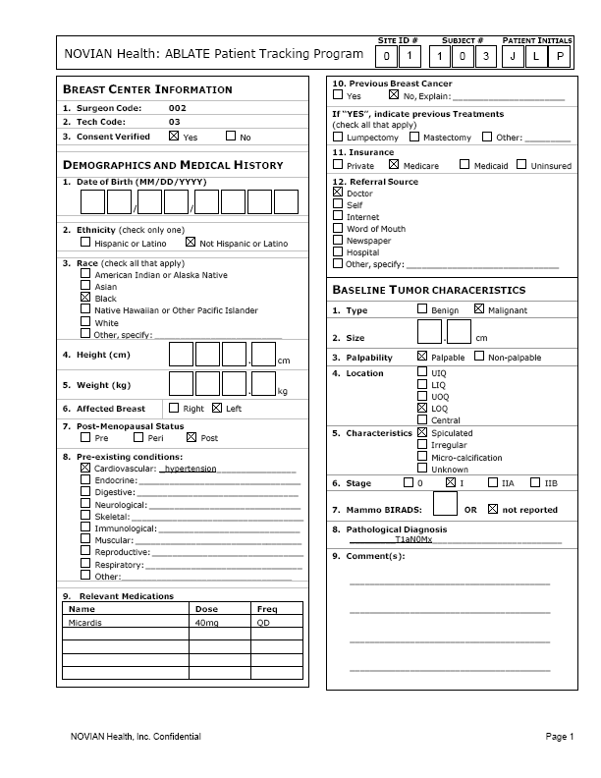
Example of data collection form used in compiling, reporting and publishing ABLATE patient registry data ==>
DRAFT

Slide 10
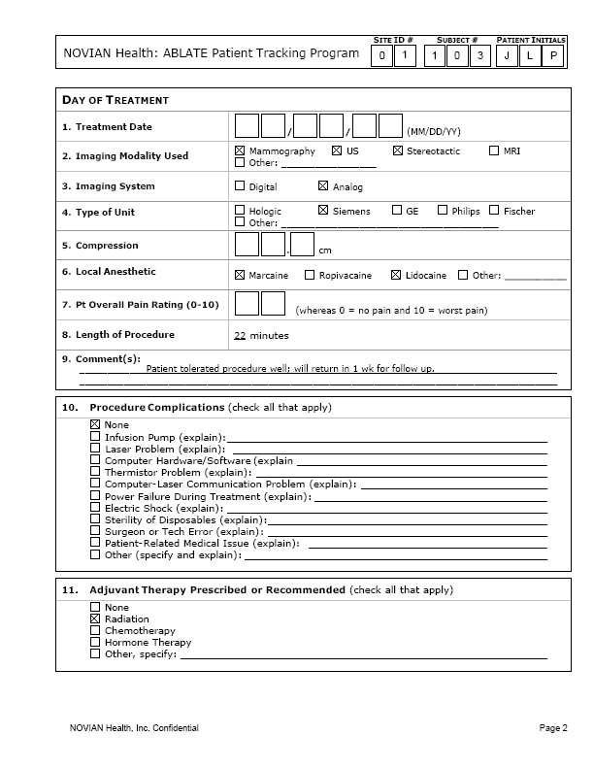
Stakeholder Benefits: Consistent and Reliable Reporting
DRAFT

Slide 11
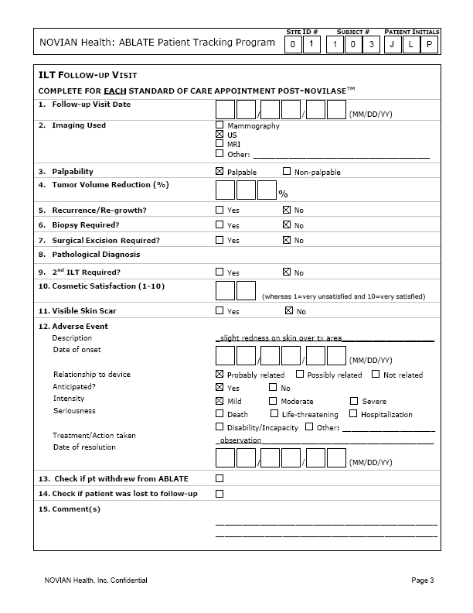
Continued…
DRAFT

Slide 12
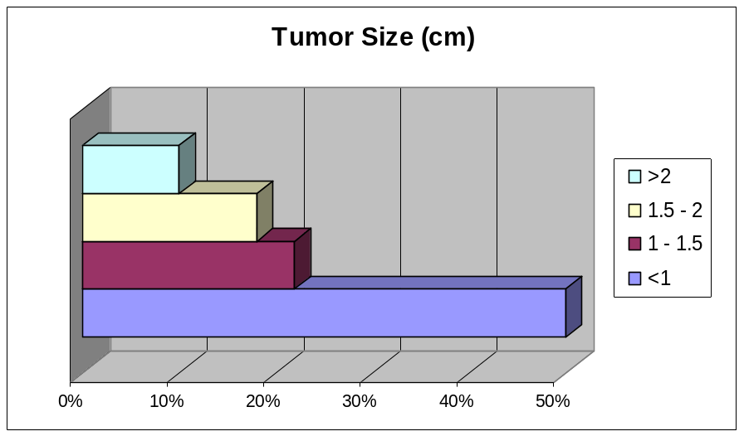
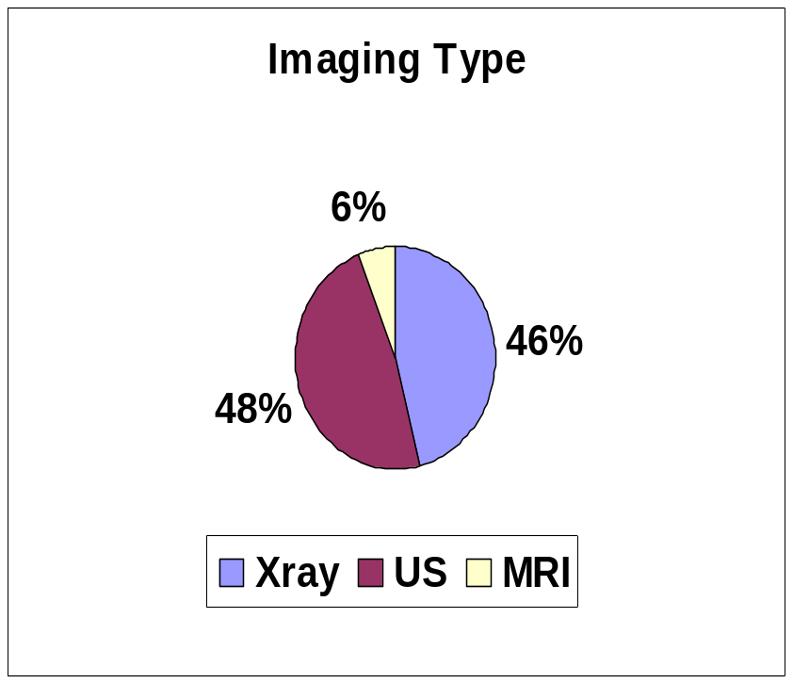
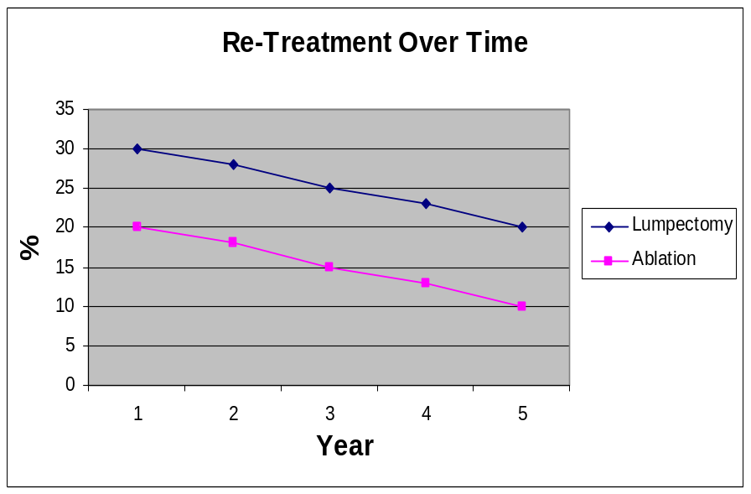
Outcomes may be graphed, charted and mapped to illustrate trends and comparisons
For illustration purposes only…

Slide 13
Case Study Example of a 7 Year Follow-up
 | Tx (2000) | Week 1 | Month 1 | Month 3 | Month 6 | Year 1 (2001) | Year 2 (2002) | Year 3 (2003) | Year 4 (2004) | Year 5 (2005) | Year 6 (2006) | Year 7 (2007)
Pain | Minimal (local anes) | None | None | None | None | None | None | None | None | None | None | None
Cos-mesis |  | Light swell-ing |  |  | Excell-ent | Excell- ent | No scar | No scar | No scar | No scar | No scar | No scar
Size | 2 cm |  |  | Smaller by US & phys exam | 40% reduc-tion | Debris; no mass | Shrunk-en | Stable/scar-ified | Stable/scar-ified | Stable/scar-ified | Stable/scar-ified | Stable/scar-ified
Imag-ing | Stereo-guided; CDUS |  | Xray & US | Xray & US | Xray & US | Xray & US | Xray & US: normal/necrotic | Xray & US: normal | Xray & US: normal | Xray & US: normal | Xray & US: normal | Xray & US: normal
Path | Pre-tx core needle biopsy |  |  | Needle core biopsy: necro-sis |  | Oily cyst aspir-ated
Palp-ability |  |  |  |  | Barely palp-able | Impal-pable | Impal-pable | Impal-pable | Impal-pable | Impal-pable | Impa-lpable | Impal-pable
Large volume long term tracking data can be charted and mapped

Slide 14

To be launched in Fall 2008…
Novian Health is interested in collaborating with the FDA and other clinical entities on thermal ablation registries.

Slide 15
Who is Novian Health?
Medical device company - Chicago, IL
Developed, tested, and patented a minimally invasive procedure called Novilase™ that uses ILT (controlled heating) for the ablation of breast tumors as an alternative to lumpectomy
Mission: To provide women with a minimally invasive alternative to lumpectomy
For more info: www.novianhealth.com

Slide 16
Guidance & Resources
Kocgil OD, Baykal N. An integrated approach to breast diseases and breast cancer registry and research: BDRS as a web-based multi-institutional model. Comput Biol Med. Oct 2007;37(10): 1414-1425.
Gliklich, RE, NA Dreyer, eds. ``Registries for Evaluating Patient Outcomes: A User's Guide.'' AHRQ Publication No. 07-EHC001-1. Rockville, MD: Agency for Healthcare Research and Quality. April 2007.
Gliklich, RE, Dos & Don’ts for Designing Patient Registries. Outcome: Thompson Interactive & AHC Media LLC, 2008.
Goldberg, SN, et al. ``Image Guided Tumor Ablation: Standardization of Terminology and Reporting Criteria,'' Journal of Vascular and Interventional Radiology 2005; 16: 765-778.

