Slide 1
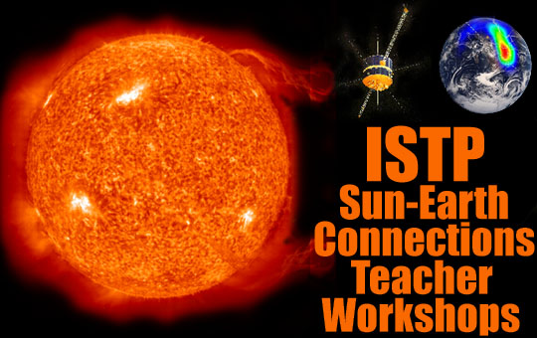
The Magnetosphere
Mauricio Peredo August 11, 1999

Slide 2
Fundamental Concepts about the Sun-Earth Connection
The Sun is dynamic
We live in the atmosphere of the Sun
Earth responds to the changing Sun - that response is known as Space Weather
Scientists study the Sun-Earth Connection using data from spacecraft, ground stations, supercomputers, and rocket experiments (i.e.the ISTP Program)
Mauricio Peredo August 11, 199

Slide 3
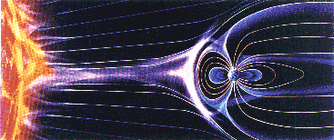
The Magnetosphere
Region around an object where the dominant force on a moving charged particle is the magnetic force from the magnetic field of the object
The term “Magnetosphere” was proposed in 1959 by Thomas Gold of Cornell University to refer to the Earth’s magnetic environment

Slide 4
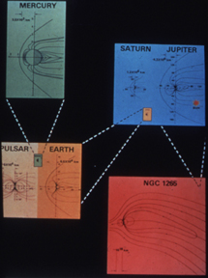
Magnetospheres of Different Objects
The universe is divided by magnetic bubbles within bubbles ranging from the planetary, stellar, and perhaps galactic and local group scale.

Slide 5
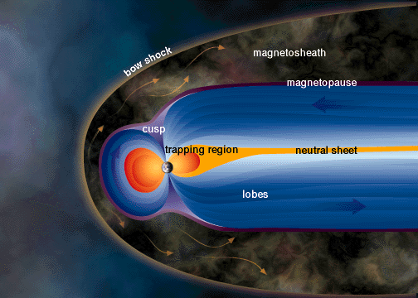
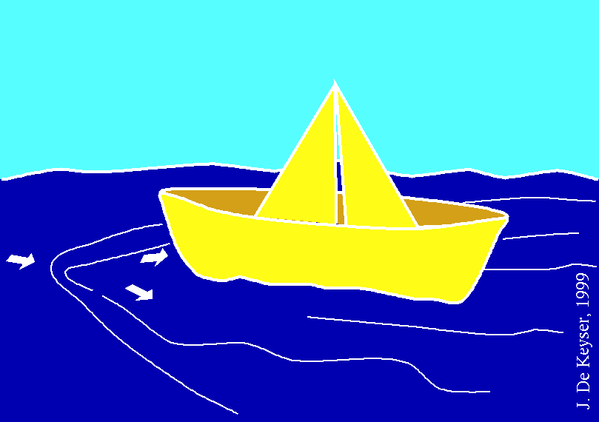
The Bow Shock
Because the solar wind flow is supersonic, a bow wave is formed in front of the Earth’s magnetosphere.
Much like the bow wave in front of a fast boat.

Slide 6
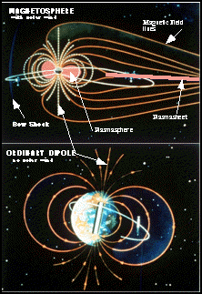
Earth’s Magnetosphere
The Earth is a huge magnet, and its magnetic influence extends far into space.
The solar wind stretches the “magnetosphere” creating a long tail.
The N-S pointing of a compass needle was discovered
in China around the year 1000; in 1600 William Gilbert
in London showed it could be explained by the Earth being a huge magnet.

Slide 7
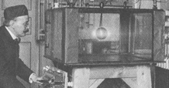
The “Terella”
Gilbert used a spherical magnet, which he called "terrella", or little Earth.
He moved a small compass over the surface of the terrella and demonstrated that it always pointed towards its magnetic poles.
Kristian Birkeland and his Terella in the late 1800’s

Slide 8
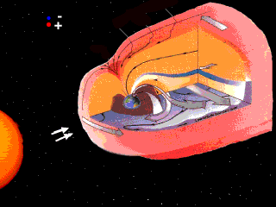
Our Shield in Space
The magnetosphere is thus a cavity where we are shielded from the solar wind.
Electric and magnetic forces - tied to electric currents - control the behavior of charged particles.
In the 1830s a world-wide network of magnetic observatories was established and showed that, occasionally, magnetic disturbances occurred on a global scale. Von Humboldt named them magnetic storms.

Slide 9
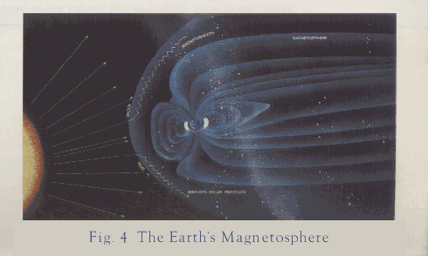
Connection to the Sun
By the end of the 19th century some relations between solar events and magnetic variations on Earth were noticed.
In 1930, Sidney Chapman and Vincent Ferraro proposed the Sun sent out huge clouds of electrically neutral plasma, and that magnetic storms arose when those clouds enveloped the Earth

Slide 10
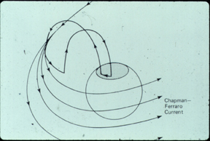
The Magnetopause
The Chapman-Ferraro current is created by the solar wind impacting on the Earth's magnetic field. It creates the boundary of the magnetosphere.

Slide 11
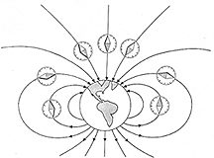
Earth’s Magnetic Field
Field lines in Earth’s magnetosphere resemble those of a bar magnet - they converge where the magnetic force is strong, and spread out where it is weak.
Michael Faraday introduced the concept of field lines in 1846. He called them lines of force and believed they had “physical” meaning..

Slide 12
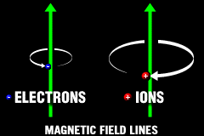
Ion & Electron Motion
In space, charged particles tend to become attached to the field lines on which they reside, spiraling around them while sliding along them, like beads on a wire.

Slide 13
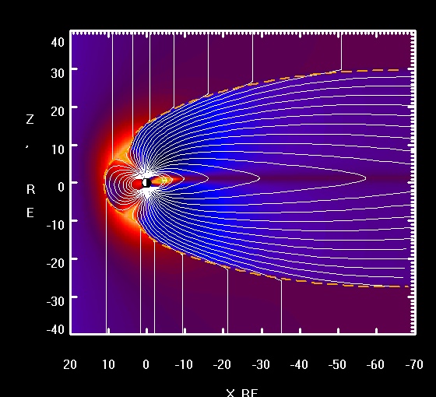
How can you tell if you are in a magnetosphere?
A charged particle shot in the same direction as the magnetic field and generally towards the body will hit the body.
Typically invisible to the naked eye, motion of charged particles along magnetic field lines was captured during chemical release experiments.

Slide 14
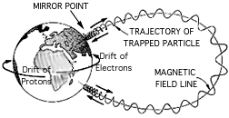
Particle Motion: Trapped Particles
As they spiral into a region of strong field, charged particles are reflected back along the magnetic field line.
Such particles are thus “trapped” and bounce back and forth between opposite hemispheres.
Birkeland’s terella experiments showed particle focusing into the poles. Poincare solved the mathematical motion near isolated magnetic pole.

Slide 15
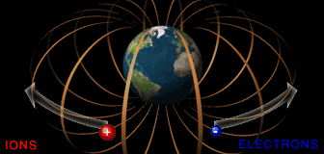
Particle Motion: Drifting Particles
Under the influence of magnetic forces, ions and electrons drift around the Earth in opposite directions.
This motion creates an electric current - the Ring Current - that flows clockwise around the earth when viewed from above.

Slide 16
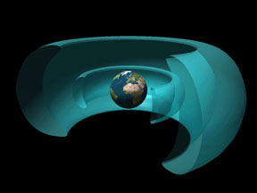
The Radiation Belts
The Earth actually has two radiation belts of different origins.
The inner belt, discovered by Van Allen, is a by-product of cosmic radiation.
Populated by protons of 10-100 MeV energy it can, on prolonged exposure, pose a hazard to instruments and astronauts.

Slide 17
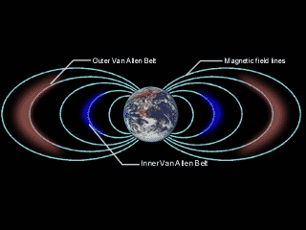
Outer Radiation Belt
The outer radiation belt is nowadays seen as part of the plasma trapped in the magnetosphere.
It corresponds to the more energetic (~1MeV) particles of the ring current.
The outer belt is far more variable and its plasma is replenished from the tail during magnetic storms and substorms.

Slide 18
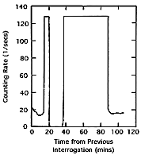
Radiation Belt Discovery
In response to the Soviet Sputnik, the US launched Explorer 1 in Jan 31, 1958, equipped with a Geiger counter.
Explorer 3, launched in Mar 26, 1959 further documented the “saturation” of the counter as the spacecraft traversed the radiation belt.

Slide 19
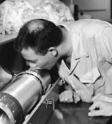
Project Argus
In Oct 1957, Nicholas Christofilos proposed to detonate small atomic bombs in space and create an “artificial” radiation belt.
Project Argus was carried out above the South Atlantic in Aug-Sep 1958 and studied by Van Allen with Explorer 4.
The artificial belts decayed over a few weeks.

Slide 20
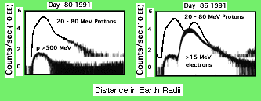
“Starfish” and Nature’s own Surprises
Following 3 Soviet tests with large bomb explosions, the US “Starfish” H-bomb test was conducted in July 1962 west of Hawaii.
The intense artificial belt from the blast disabled 3 s/c and some of its particles persisted over a year.
In Mar 1991,nature created its own extra belt following a strong compression of the magnetosphere. It remained when CRRES failed at the end of 1991.

Slide 21
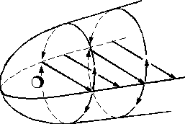
The Magnetotail
Away from the Sun, the magnetosphere stretches over 200 Re, eventually connecting to the solar wind.
This region of the magnetosphere is quite dynamic; ions and electrons are often energized here.
Here too, electric currents play a key role in particle dynamics. The cross-tail current joins the magnetopause currents to form a “theta” shape..

Slide 22
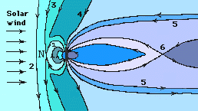
Magnetic Substorms
Solar wind plasma that manages to enter the magnetosphere slowly falls toward the plasma sheet.
Energy accumulates until it can’t be contained, and particles are explosively released toward Earth along field lines.

Slide 23
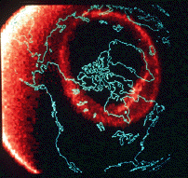
Ground Signature of Substorms: Aurora
Traveling along magnetic field lines, the accelerated particles reach the Earth along an oval region about the magnetic pole.
The aurora is seen to expand and contract as the magnetotail lobes swell and shrink.
POLAR is the first spacecraft capable of imaging the aurora simultaneously in visible, ultraviolet and X-ray wavelenghts.

Slide 24
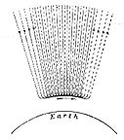
Electric Currents from Space
Reporting in 1903 on his expeditions to the auroral zone, Kristian Birkeland proposed that magnetic disturbances were caused by large electric currents flowing down the length of auroral formations.
Later these were called auroral electrojets.

Slide 25
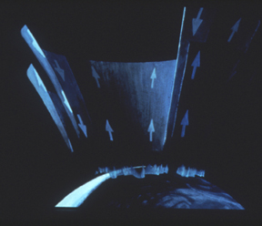
Electric Currents from Space
An artist's conception of magnetic-field-aligned current systems (Birkeland currents).
To this day, the path taken by this currents far from Earth remains unknown.
The total current flowing into/out of the ionosphere is approximately 2 Million Amperes.

Slide 26
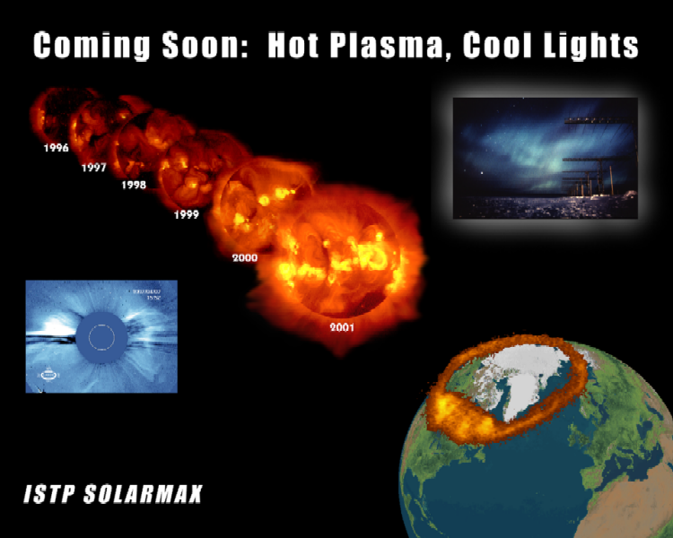
Preview of Talks to Follow

