Slide 1
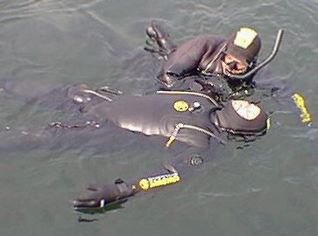
Rescue Techniques
Presented by the NOAA Diving Center
Seattle, Washington

Slide 2
Global View
Preventing accidents
What causes accidents
Panicked diver at the surface
Panicked diver underwater
Unconscious diver at the surface
Unconscious diver underwater
Removing the diver from the water
Post rescue care
Key Points

Slide 3
Introduction
Need & Value: Every diver must be able to save himself, his buddy, and other divers. You need to be able to recognize and prevent problems before they escalate to an emergency. You need to learn what to do for various rescue situations, so you will be prepared to save yourself or another diver when called upon to respond.
Effect: You will learn to recognize situations that require interventions and proven actions to take to rectify potential emergencies. You will be prepared to apply rescue skills.

Slide 4
Preventing Accidents - 1
Physical fitness
Proper training
Proper equipment
Equipment properly serviced
Pre-dive safety checks
Diving within your training and experience level
Following proper diving procedures
Staying together as buddy teams

Slide 5
Preventing Accidents - 2
Thorough pre-dive safety checks are the most important part of the dive. This is your opportunity to diffuse potential problems before you enter the water.
Always check:
  The cylinder is full
  Air is all the way on quarter turn off
  Cylinder cam band was dipped in water before it was attached to the cylinder
  The cam band is not at an angle and is very tight
  Low pressure inflator hose is connected to the BCD and / or the dry suit all the way, and the inflator works

Slide 6
Preventing Accidents - 3
Your weight belts are on correctly – right hand release and will not become trapped in any piece of equipment if it becomes necessary to drop the belt
You know how to release all of the weight you and your dive buddy are wearing
Both BCDs inflate and hold air
You know where your buddies alternate air source is and how to use it
You both have a knife and it can be reached with either hand
You are diving within your training and within your physical abilities

Slide 7
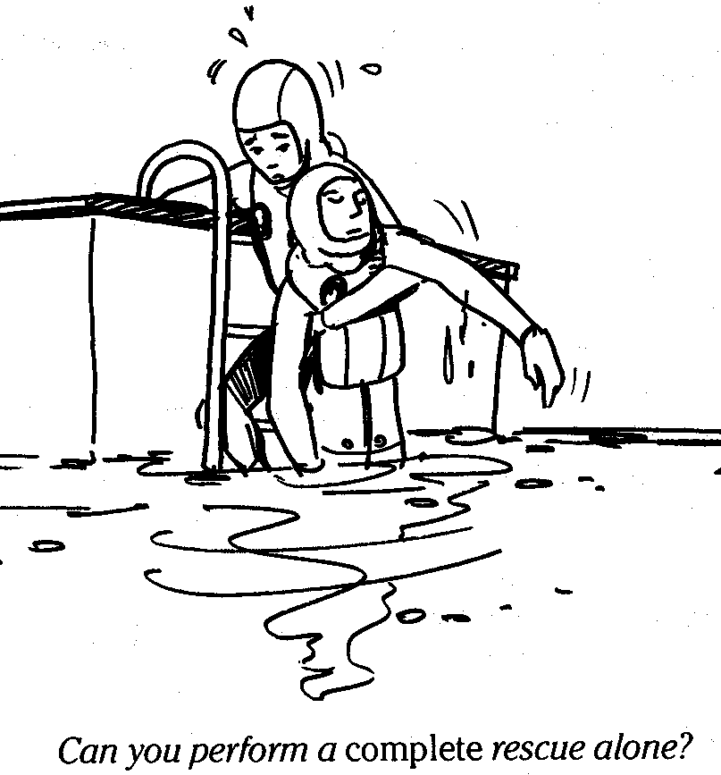
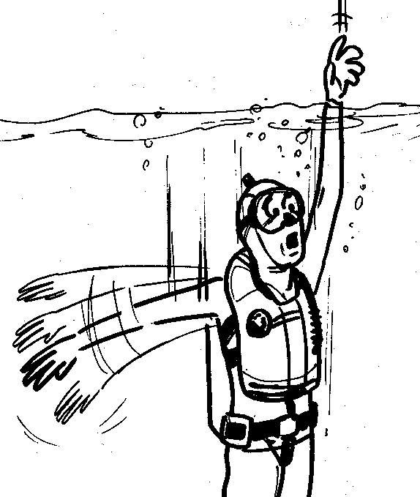
Factors That Contribute to Accidents
Stress
Anxiety
Fatigue
Fear
Panic
Equipment problems
Buddy separation
Diving beyond our training and abilities
Poor pre-dive safety checks

Slide 8
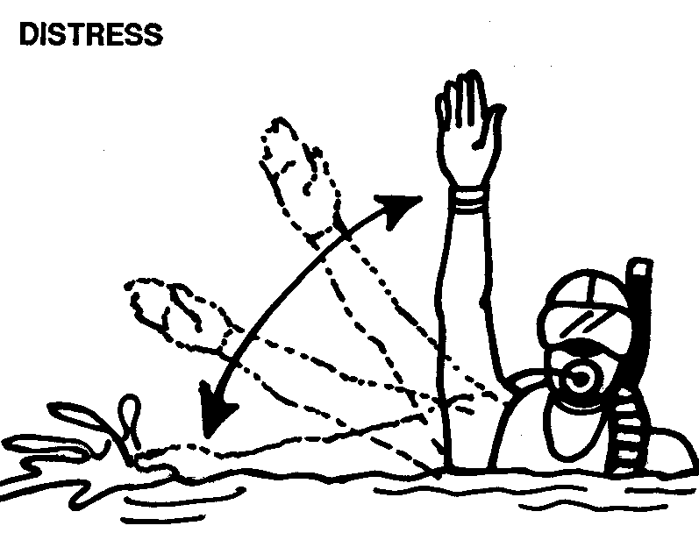
Stressors
Example: the unknown or unexpected can cause apprehension. Some divers may respond in ways inappropriate to survival
Diver stressors: exposure, illness, exhaustion, injury, personality, experience, fears, equipment problems, poor visibility, buddy separation, depth, darkness, currents, disorientation, entanglement, narcosis, hypoxia, dehydration

Slide 9
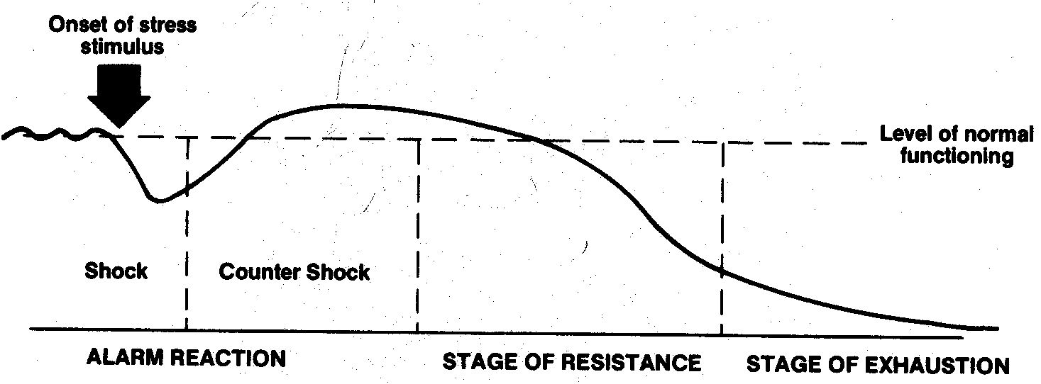
Anxiety & Panic
Stress, anxiety, panic & fatigue:
  Adrenalin excites the body’s flight or fight mechanism
  Increases breathing, heart rate, nervous system activity
  As anxiety increases, awareness & performance decreases
  Left unchecked this leads to panic or the uncontrolled & irrational reaction to perceived danger
  Active versus inactive panic
  Critical factor in the progressive steps of panic is whether or not a problem arises after one is stressed
  Will victim be able to self-rescue?
  Rescuer alert for signs of change (fatigue, etc.) in victim’s behavior

Slide 10
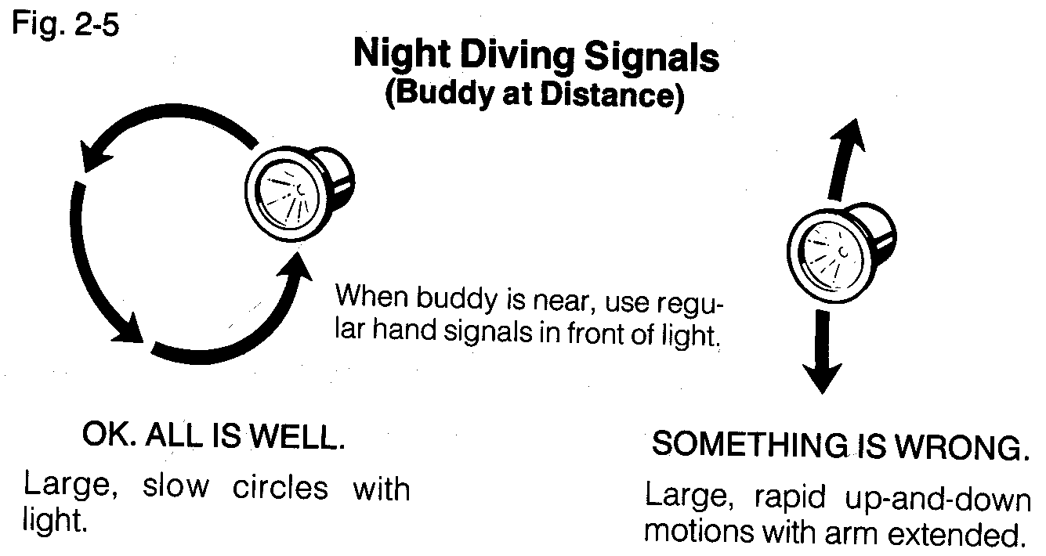
Emergency Signs & Signals
Day
  Waving arm(s) over head
  Unresponsive
  Obvious signs of struggle
  Out of air signal
  Rocking of outstretched hand
  Mask on forehead at surface
Night
  Rapid up and down motion of light
  Mask on forehead at surface

Slide 11
Self-Rescue - 1
Self rescue steps:
  Recognize and assess the situation
  The problem may be solvable underwater
  Don’t panic / don’t hold your breath and bolt to the surface
  Once at the surface / establish positive buoyancy inflate BCD / dry suit / drop weight belt
  Reduce physical activity
  Gain control of respiration
If assistance is needed, wave your arms above your head / shout for assistance

Slide 12
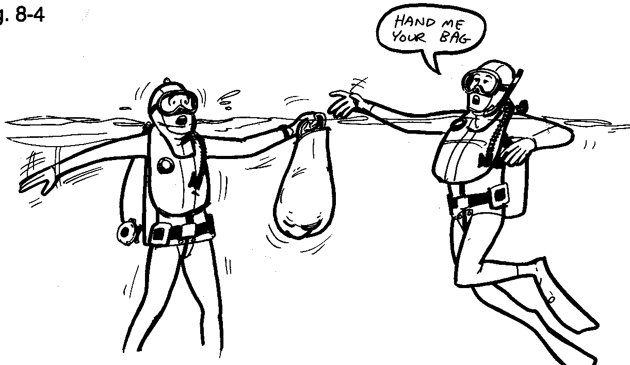
Self-Rescue - 2
Know how to handle equipment failure, loss, out-of-air options
Where is your buddy? Your buddy is your alternate air source
Physiological
  Minimize exposure risks
  Energy and body-heat conservation
  Decompression & surface intervals
Exertion
  Hydration level and cramp removal
  Level of fitness and experience

Slide 13
Panicked Diver at the Surface - 1
A diver in distress at the surface will usually put their mask on their forehead and spit out their regulator
If they are beginning to panic they may forget to do the one thing that will most likely solve the problem
Establish positive buoyancy
Shout at the diver “inflate your BC, drop your weight belt”
If they do not respond, offer them another source of buoyancy

Slide 14
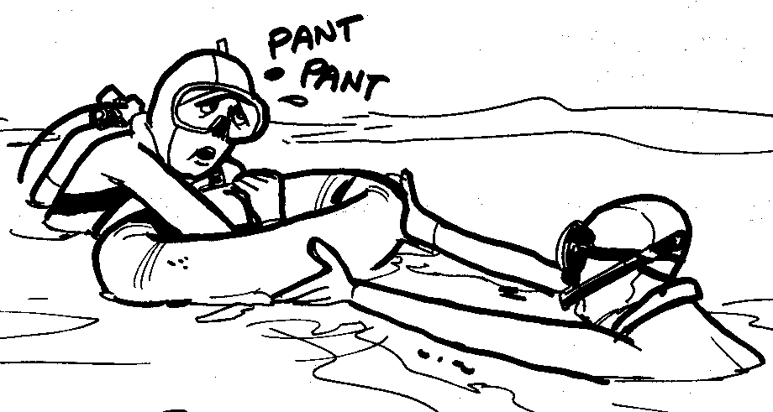
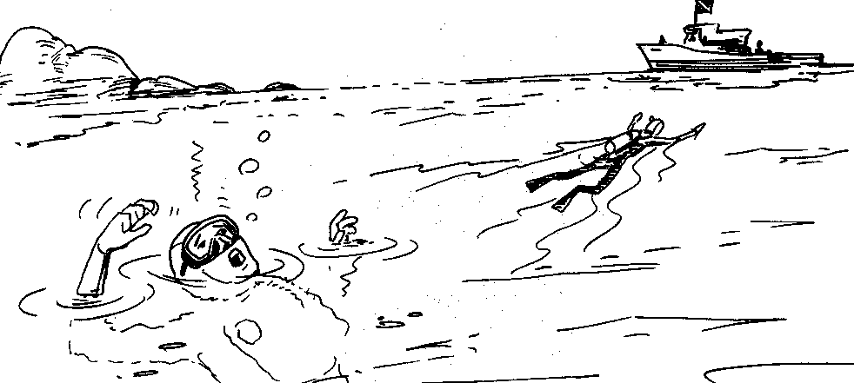
Panicked Diver at the Surface - 2
Undesirable “Natural” aquatic responses:
  Body in vertical position, head back and above water, mouth open
  Rapid breathing or breath-holding
  Arms flailing above the water
  Clinging and climbing
  Ineffective leg kicks

Slide 15
Panicked Diver at the Surface - 3
If the panicked diver does not respond to your commands, don’t offer yourself as flotation
Establish ample buoyancy for yourself
Approach the panicked diver from behind
With your left hand grab hold of the tank valve
Grab the scuba bottle between your knees
With your right hand, reach around in front and release the weight belt

Slide 16
Panicked Diver at the Surface - 4
If a panicked diver gets a hold of you and won’t let go you may have to deflate your BCD and go back under water
Then, from underwater you can approach the diver from in front and release their weight belt

Slide 17
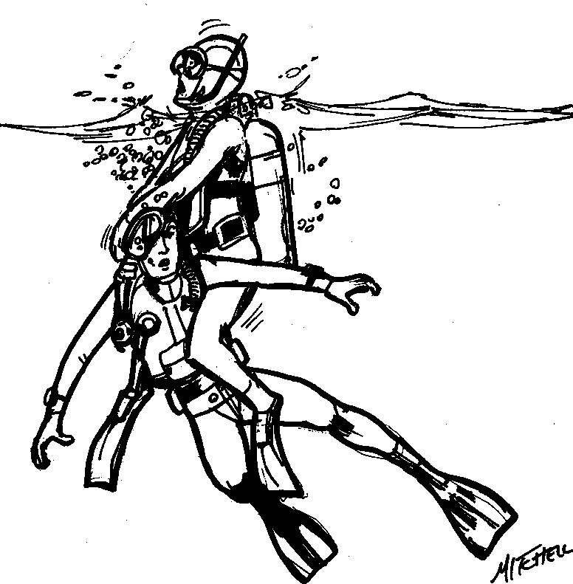
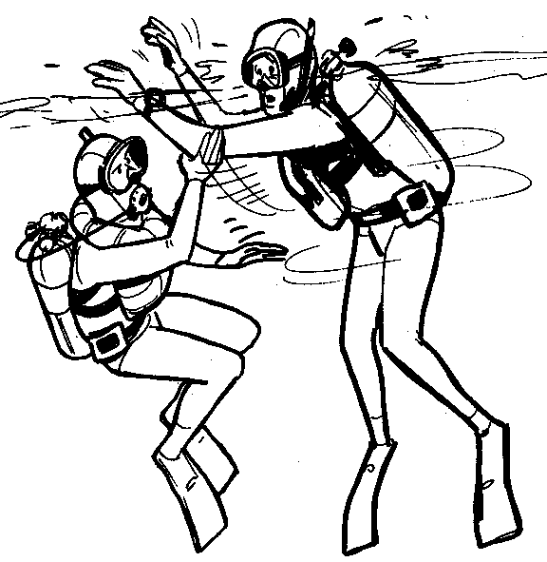
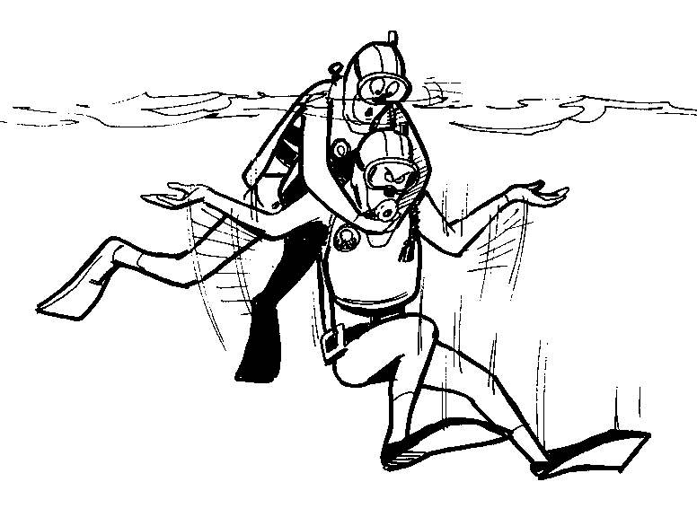
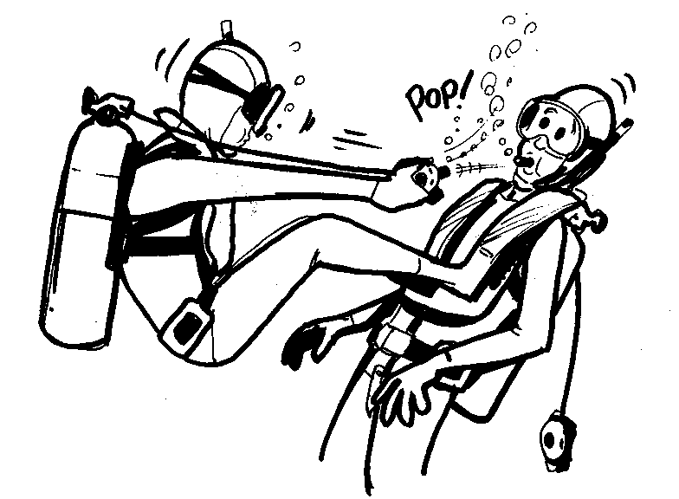
Panicked Diver at the Surface - 5
Defenses & releases:
  Block grasping attempts
  Get behind victim and hold tank valve
  Push yourself down and push victim upward
  Tuck head and push victim’s elbows upward
  Put knee against diver and push backward
  Submerge and swim away

Slide 18
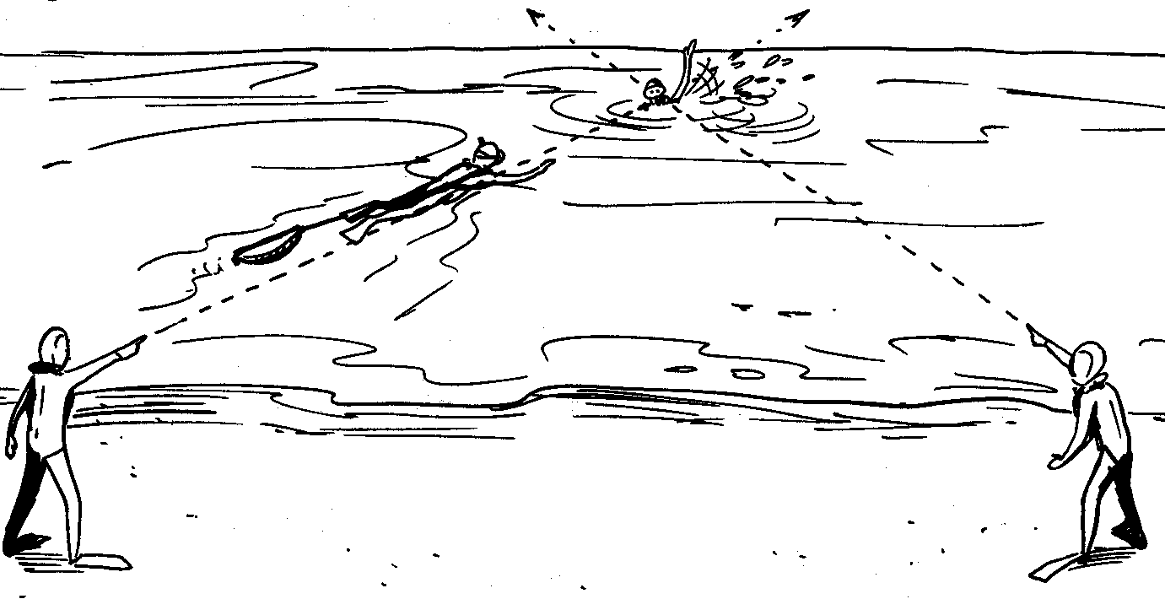
Panicked Diver at the Surface - 6
Always maintain a visual bearing on victim
  Spotters, head above water entry
Assess situation, determine plan of action
Rescue swimmer:
  Dressed for exposure and recovery
  Rescue swim - pace yourself
  Assess victim’s condition, establish communication
  Extend flotation or establish victim buoyancy
  If victim does not grab float, physically support victim and establish buoyancy at surface
  Recognize the problem, severely distressed divers may not signal for help
  Act quickly. The panicked diver struggles for approx. 60 seconds. Self-help is not always possible

Slide 19
Panicked Diver Underwater - 1
Be prepared to use your alternate air source, the panicked diver may take your primary regulator
Try to approach them from the front so you don’t startle them and compound the problem
Try and calm the diver / hold on to them firmly and assist with the problem
Anticipate early in entanglement situations, assistance and more air for the trapped diver may be needed

Slide 20
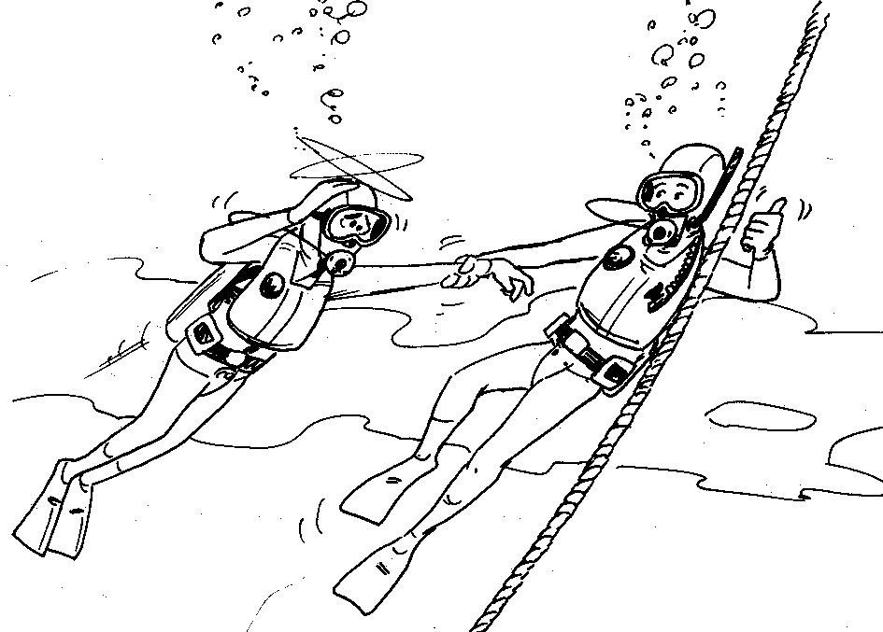
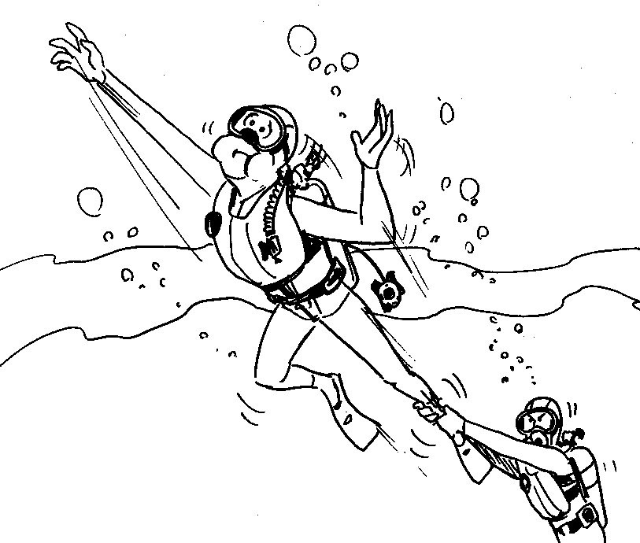
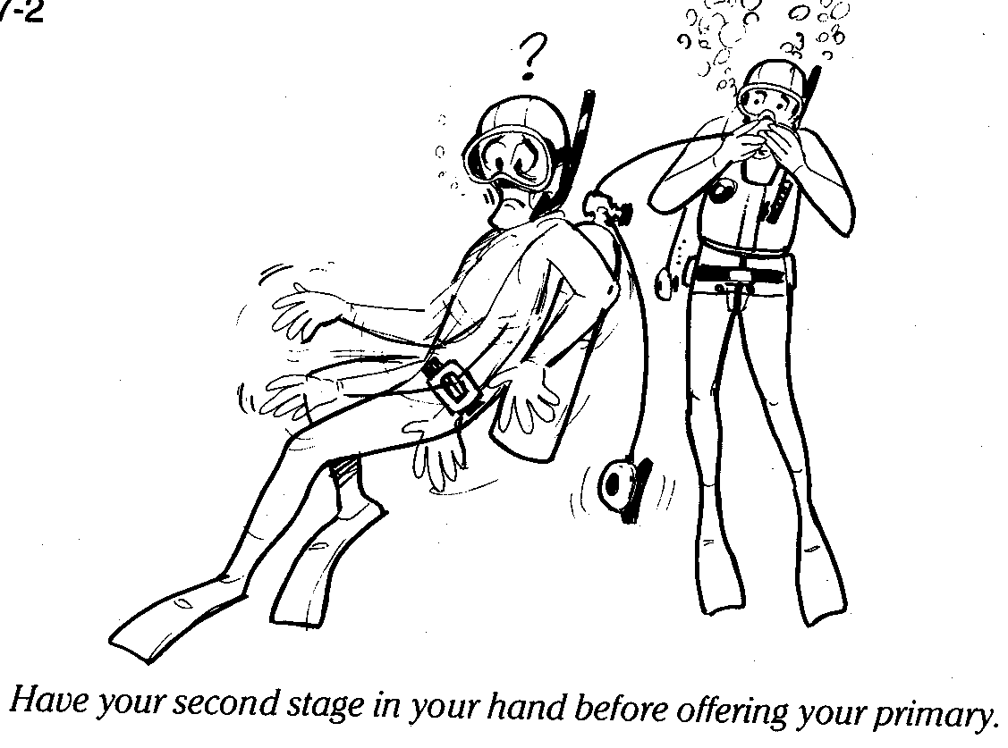
Panicked Diver Underwater - 2
Use of up / down line for reference
Support from side or back if panicky
Alternate air sources
  Octopus
  Spare air
  Poor man’s octopus
Control the bolt for
the surface…..

Slide 21
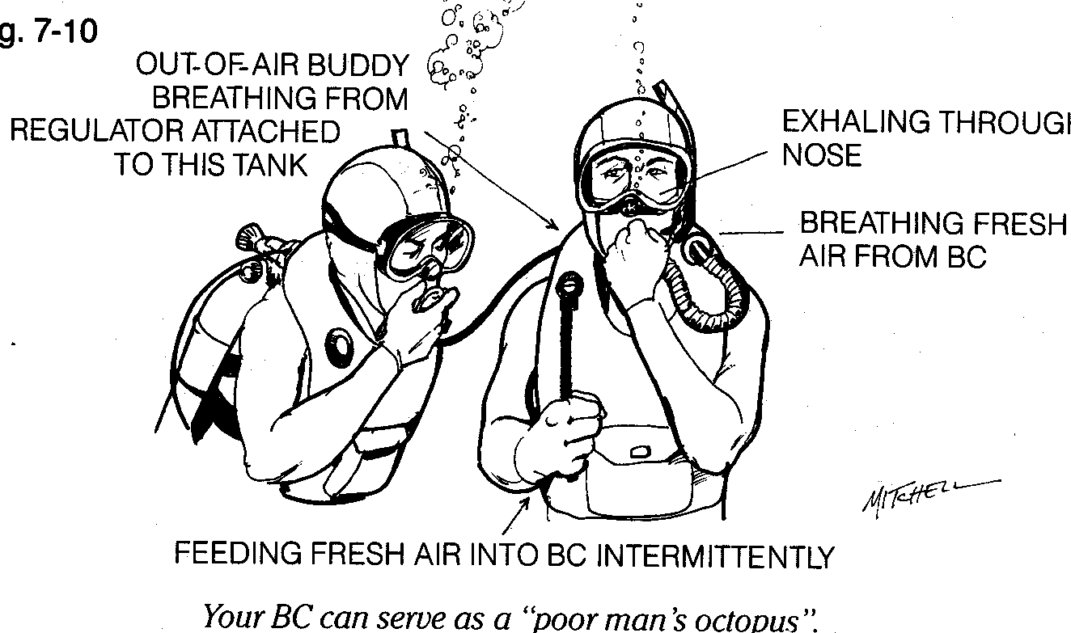
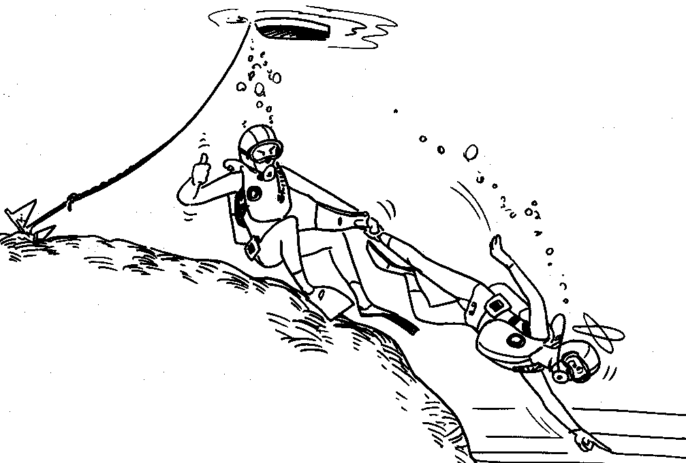
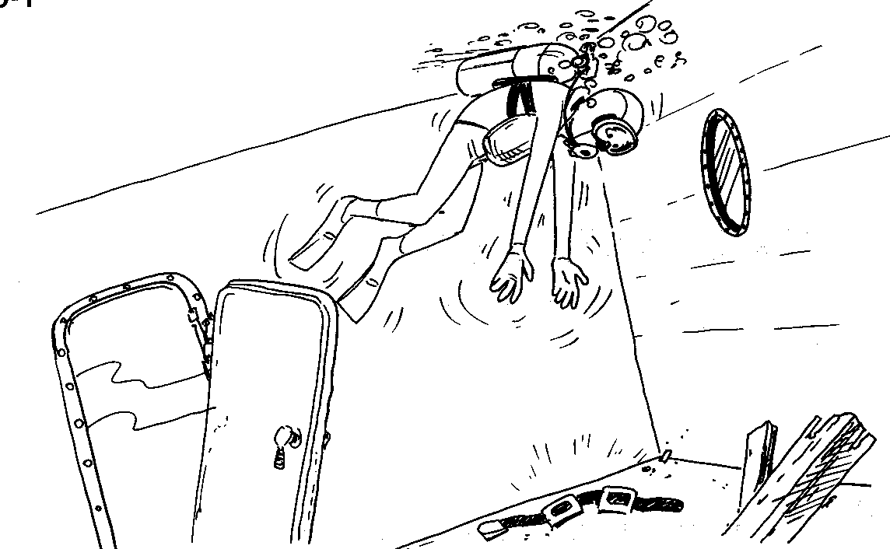
Panicked Diver Underwater - 3
Flexibility to think and adapt skills & equipment
Pre-dive planning with buddy
  Scenarios
  Problem solving

Slide 22
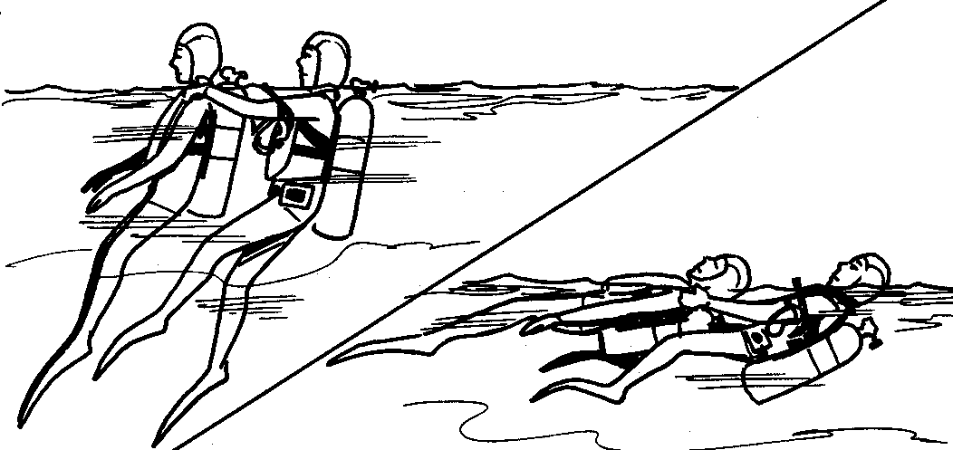
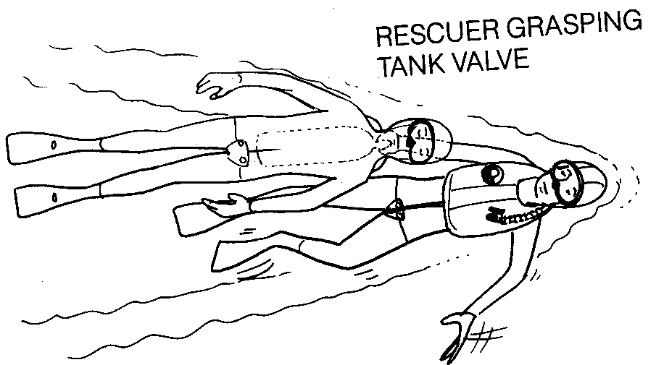
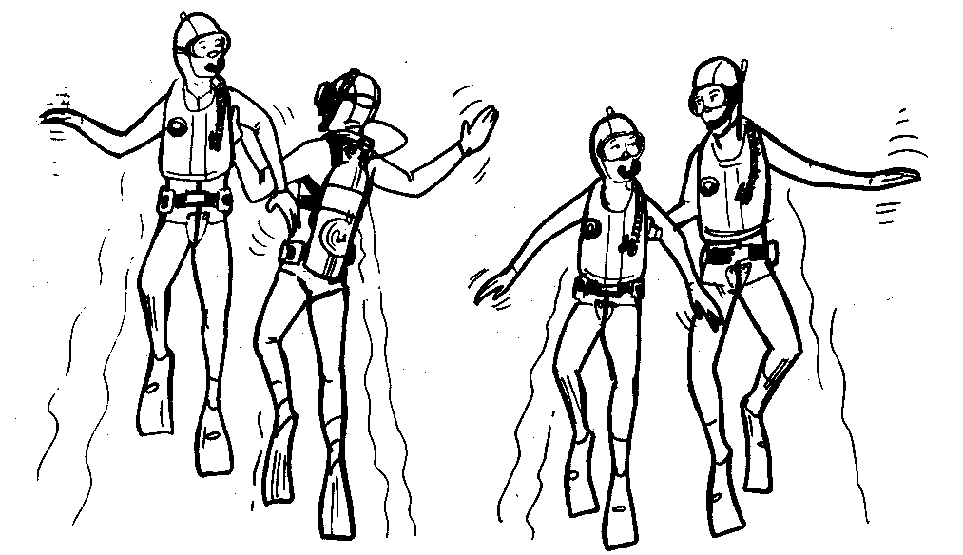
Conscious Diver at the Surface
For a conscious diver:
  Call for assistance, establish communication
  Assess mental state: rational or irrational
  Establish buoyancy
  Assess problem. Can diver self-rescue?
  Transport distressed victim
    Tank tow
    Talk to person being assisted
    Account for buddies
    Tired swimmer push (option)

Slide 23
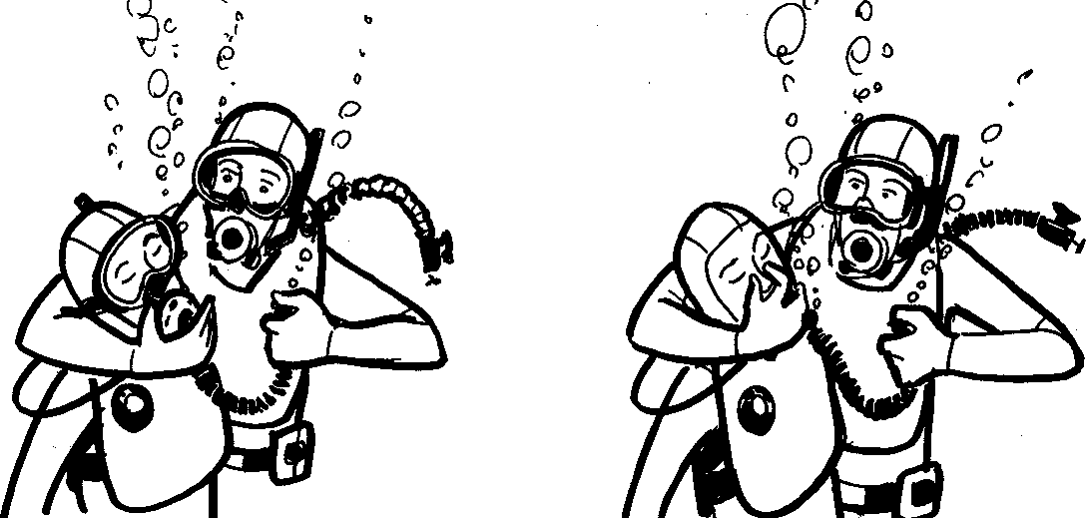
Surfacing Unconscious Diver - 1
Breathing victim
  Modified “head lock”
    Arm around head
    Hold airway open and regulator in mouth
  Vertical Swimming Ascent
    Rescuer elbow in base of chest
    Hold regulator in mouth with hand
    Hold onto tank valve with other hand for control

Slide 24
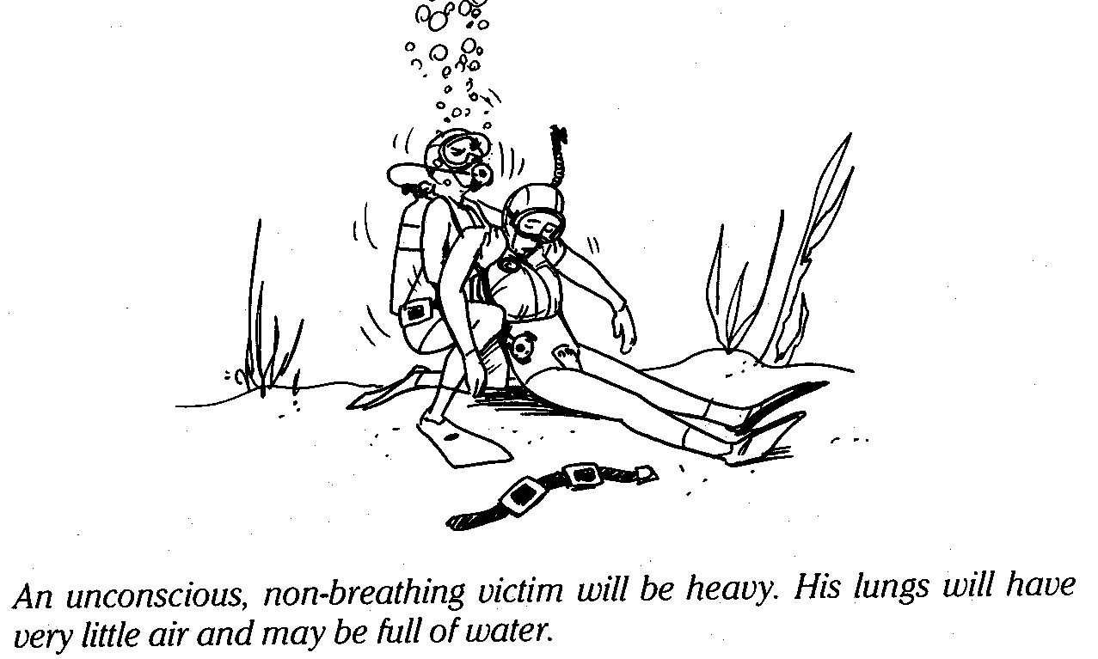
Surfacing Unconscious Diver - 2
    Swim Victim Up
    Remove mask if flooded and pinch nose
    Swim to surface as fast and as safe as possible

Slide 25
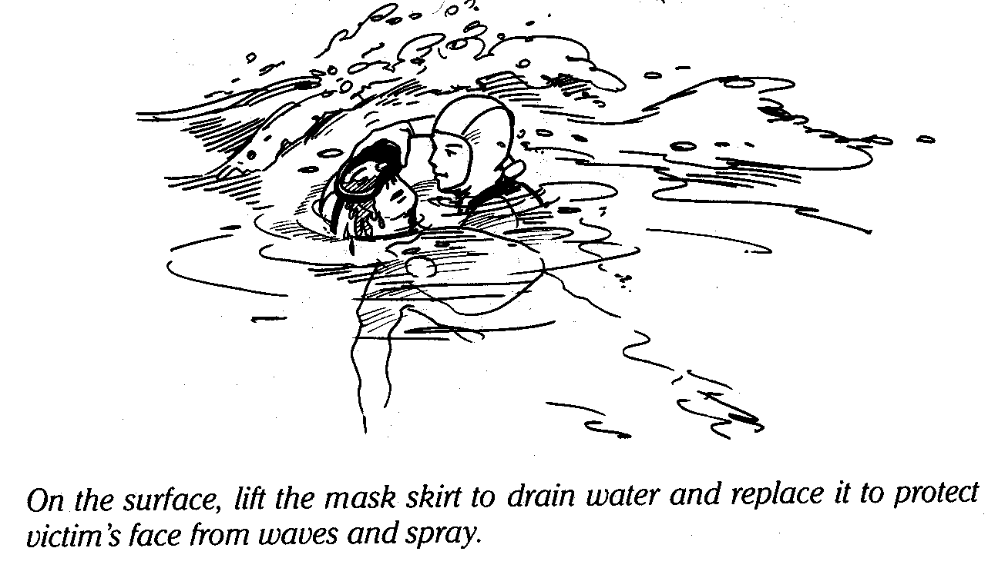
Surfacing Unconscious Diver - 1
Non- breathing victim
  Approach victim
  Check responsiveness
  Remove weight belt
  Establish positive buoyancy
  Position head for open airway
  Surface using vertical swimming ascent
  with ‘do-si-do’ position
  Flare fins or victim to control ascent rate

Slide 26
Surfacing Unconscious Diver - 2
  Must get victim to surface quickly and safely
  DO NOT DELAY ASCENT!
  Protect yourself, release victim if uncontrolled ascent develops!!
Or use “send him up” technique
  “Send him up” – last option
  Make victim positively buoyant and release to surface
  Not recommended if direct access to surface is obstructed (kelp, cave, wreck, ledge, etc.)

Slide 27
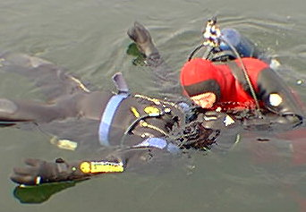
Non-Breathing Diver at Surface - 1
  Use “do-si-do” hold (rescuer’s left arm under victims left arm and grasping tank valve / BCD or head cradle position
  Push up with left arm and push down on forehead with upper arm, pinching nose during rescue breaths
  Tilt victim toward rescuer
  Airway clear of water, mucous, blood
  Pinch nose, seal mouth, and
  deliver slow rescue breath
  Pocket mask is useful for ARB.
  Can be carried in BC pocket

Slide 28
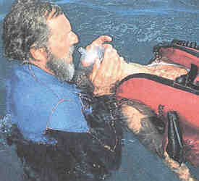
Non-Breathing Diver at Surface - 2
Objectives:
  Maintain dry, open airway
  Minimal interruption of rescue breathing
Rate: 1 breath every 5 seconds or 2 breaths every 10 seconds
CPR cannot be done effectively in the water
Do not attempt pulse check. Ventilate and transport
  Unable to feel a pulse through wet suit material
  Hands encumbered by gloves, numb from cold

Slide 29
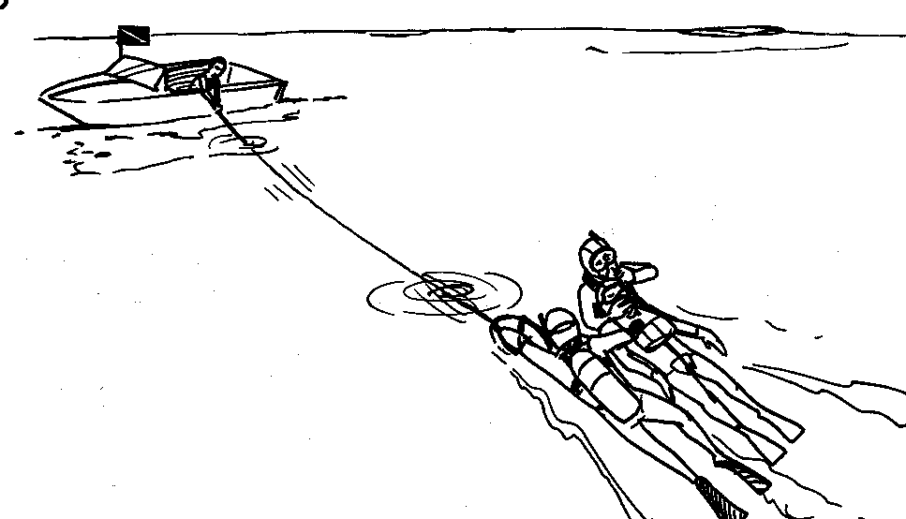
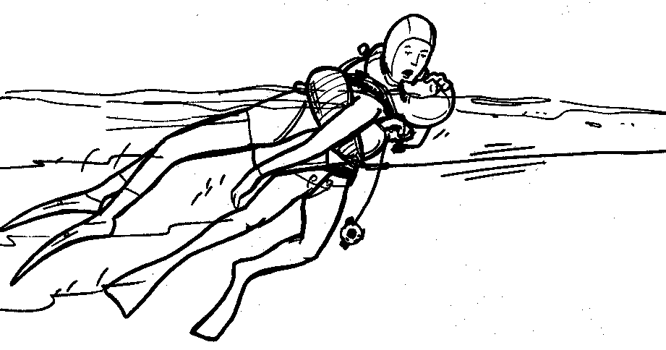
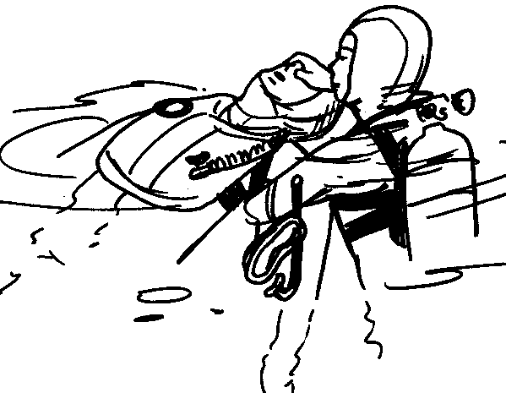
Non-Breathing Diver at Surface - 3
Call for assistance
Approach quickly at surface
  Pull victim to face-up position
  Establish buoyancy, drop weight belt
Use left-side “do-si-do” position
Deliver rescue breaths and transport
Remove mask if not breathing
Drain mask and keep in place for breathing
victim

Slide 30
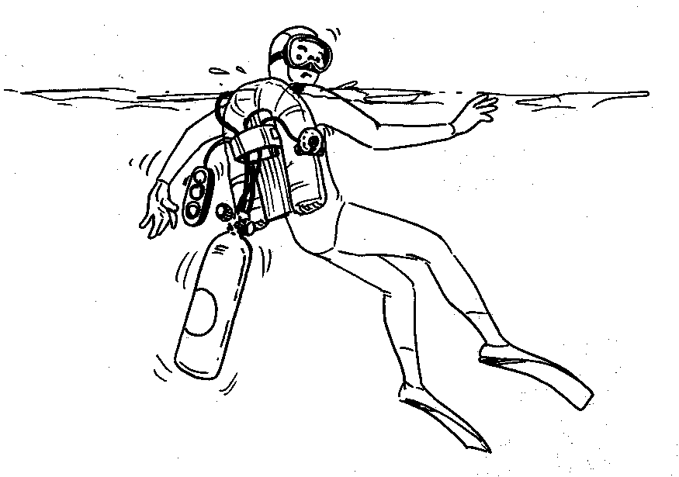
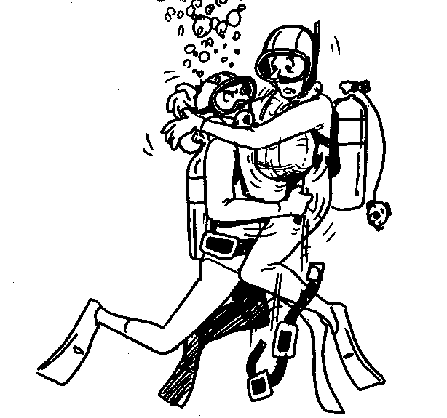
Equipment Removal
Be familiar with buddy’s equipment
Release weight belt to aid buoyancy
Removal of other equipment necessary prior to exiting?
Remove equipment in 5-10 second steps, ventilating victim between
Equipment retained for analysis

Slide 31
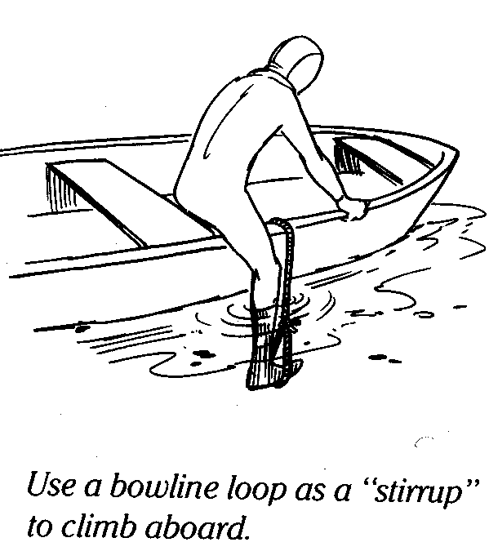
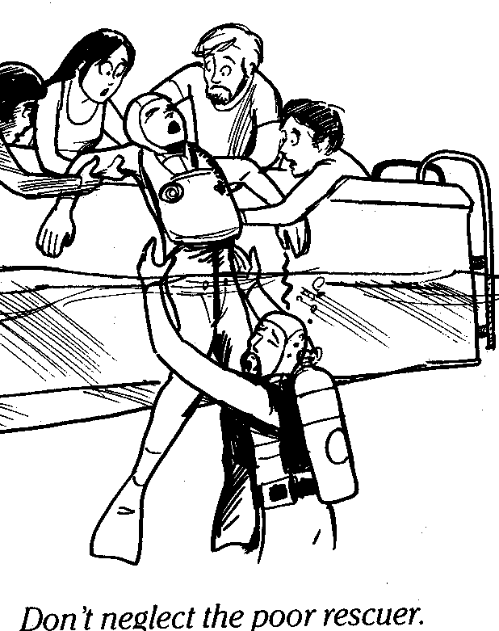
Rescue Exits
Considerations:
  Victim kept as horizontal as possible
  Minimal interruption of rescue breathing
  Recovery equipment on site and ready
  Fatigued Rescuer
Recommended methods:
  Horizontal float and drag
  3-person hammock carry
  Parbuckling
  Ladder or backboard lift

Slide 32
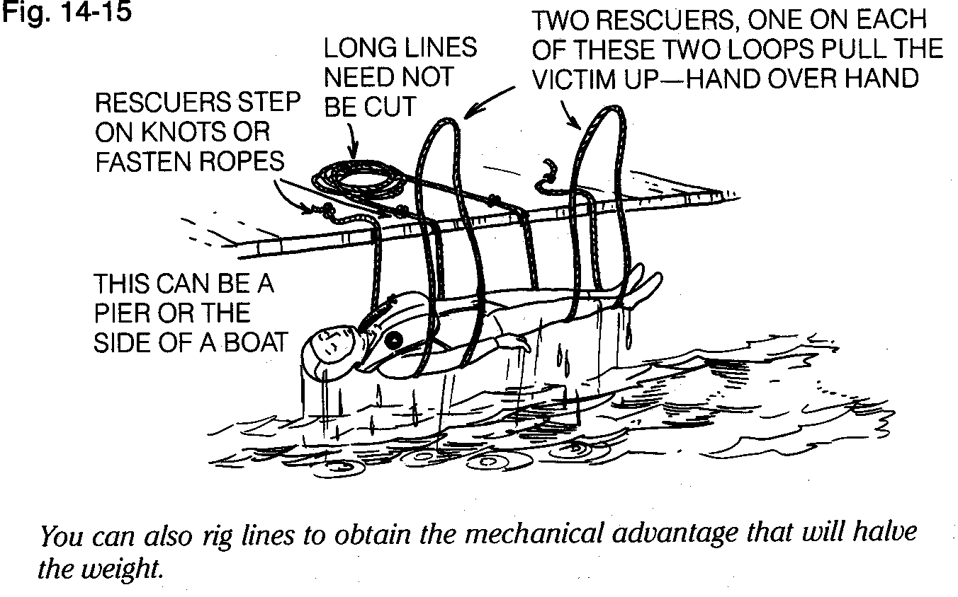
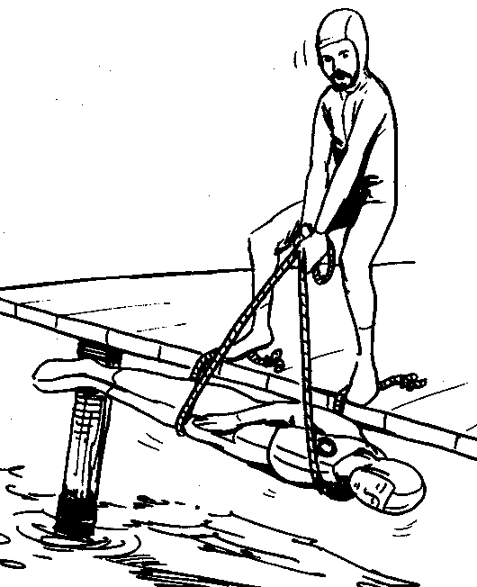
Parbuckle Exit
Position lines (“W”)
Keep tension on lines
Place victim’s arms beside head for support
Keep victim horizontal while lifting!
Do not step back if standing on line!

Slide 33
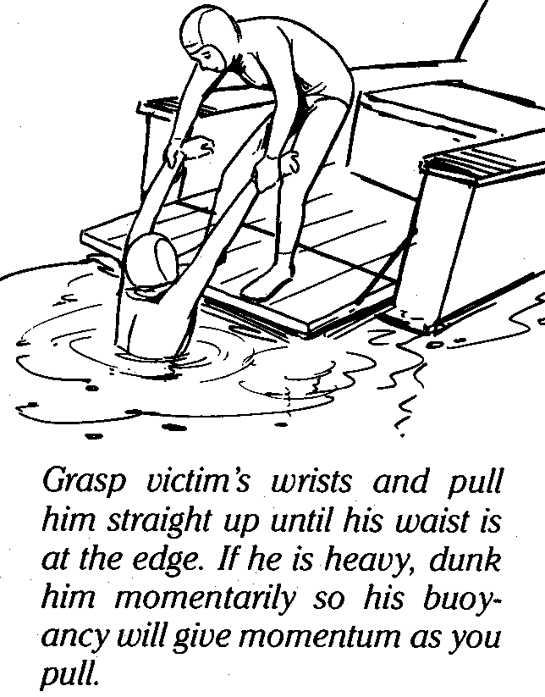
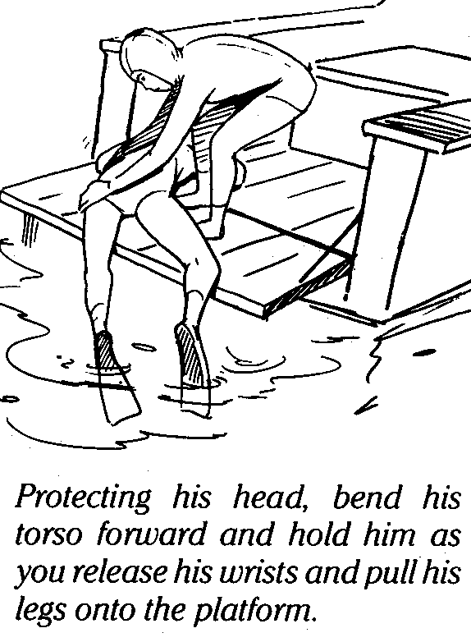
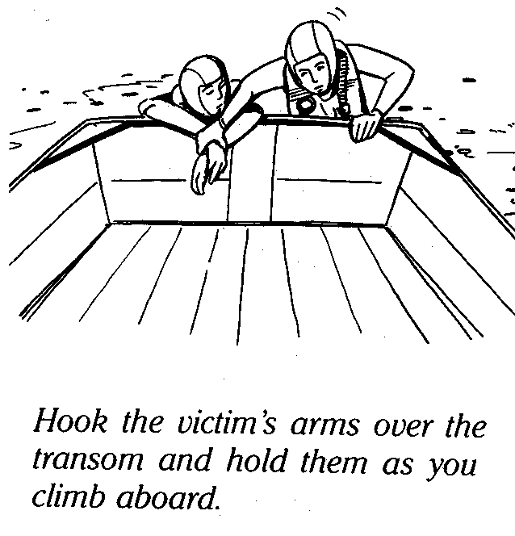
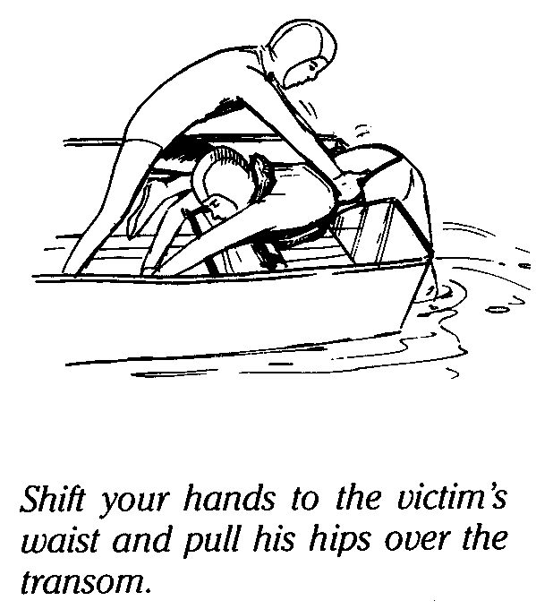
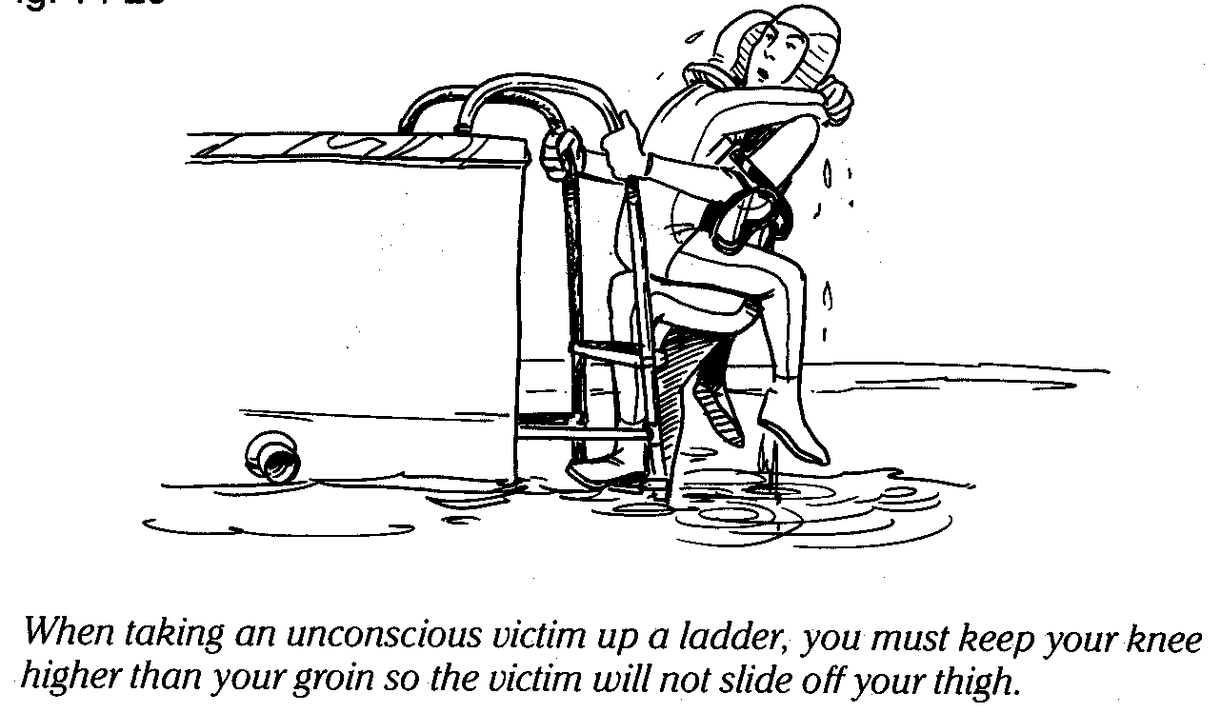
Specific Exits - 3
For small boat exits:
  A levered backboard
  Ladder and BC carry or ladder carry
  If victim unconscious, rescuer exits
  first
  If victim conscious, victim exits first

Slide 34
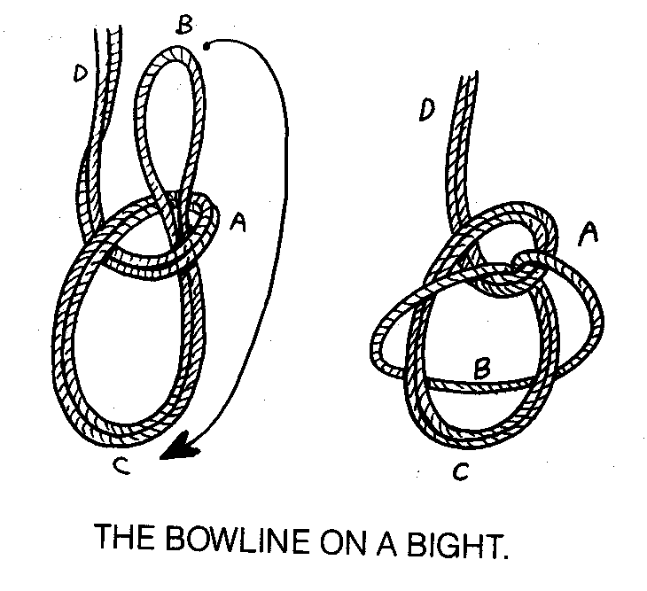
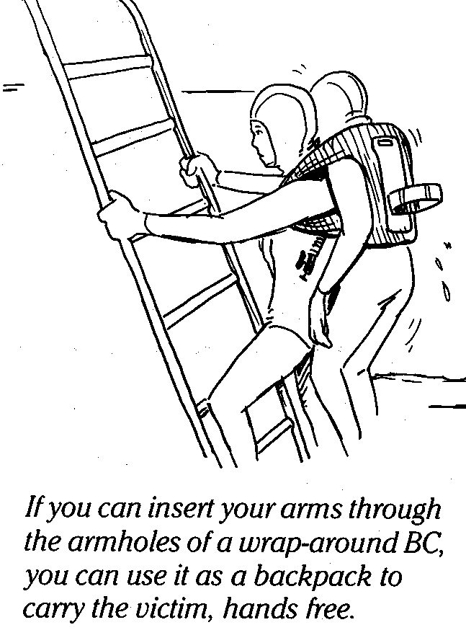
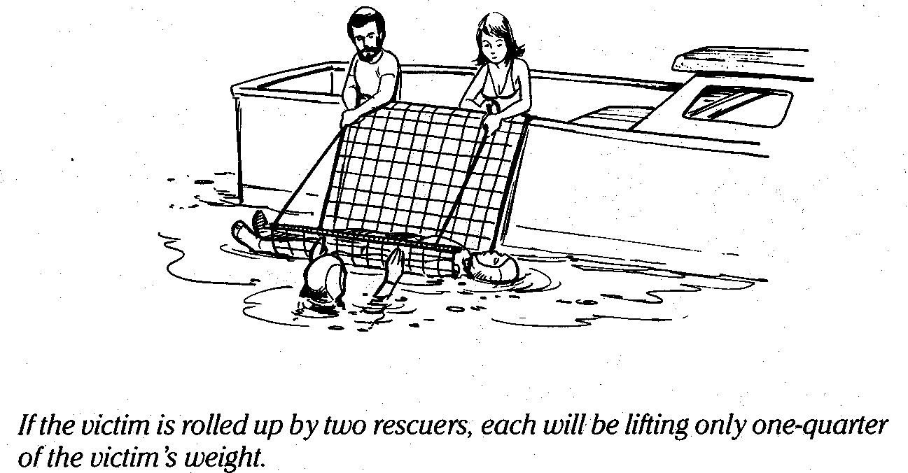
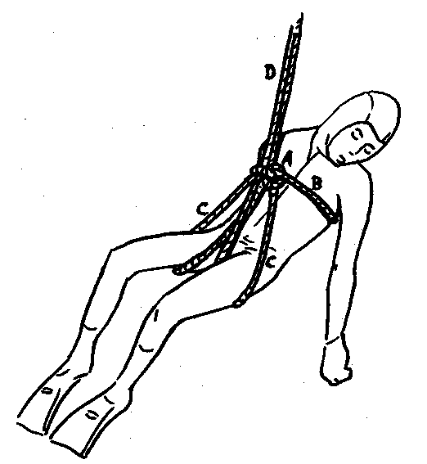
Specific Exits - 4
For large vessels, piers, or cliffs:
  Use a backboard / multiple lifting lines for
  control
  Use proper straps, slings and hardware
  Deck crane & safety / cargo netting

Slide 35
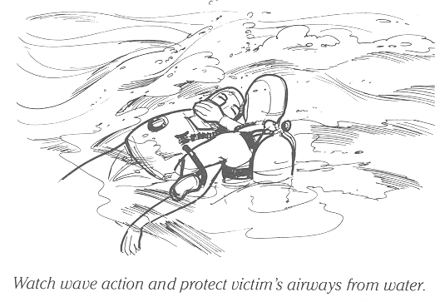
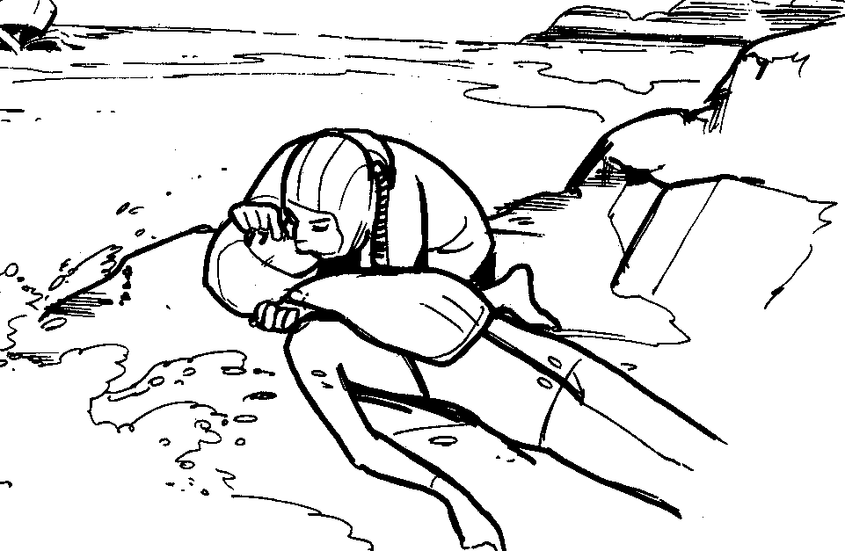
Specific Exits - 5
For surf or rocky shore exits:
  Time period of swells
  Turn into breaking waves
  Seal victim’s mouth & nose before waves break
  Ride swell onto rocks
  Drag or roll victim up rocks
  Quickly move to less exposed platform

Slide 36
Post-Rescue
Stabilize victim, control shock and hypothermia
Transfer to next level of care as required
Investigate events leading up to accident
Evaluate how the situation could have been prevented
Evaluate victim’s and rescue team actions
Identify correct / incorrect actions
Address deficiencies in events
Have equipment inspected
Review rescue
If necessary, improve / update emergency action plan

Slide 37
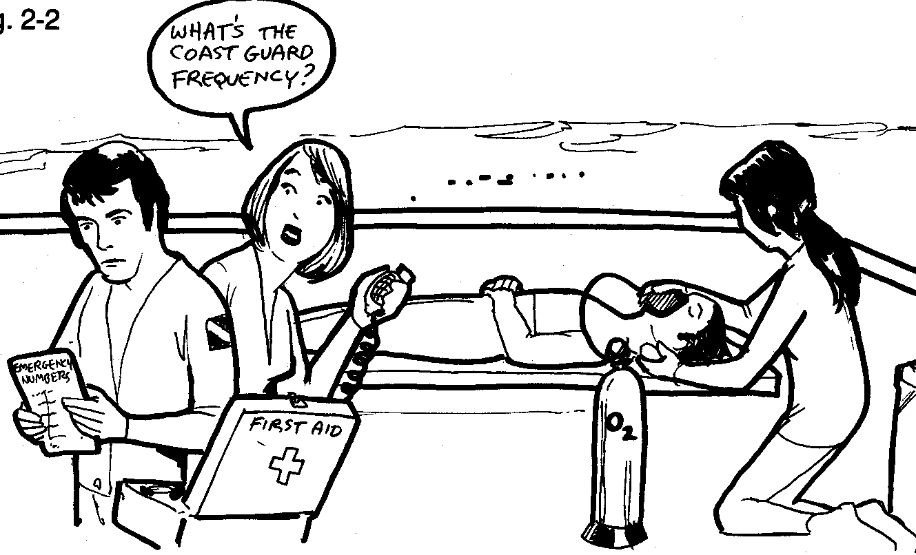
Rescue Training
Preparation:
  Training:
    CPR & First Aid
    Oxygen First Aid
    Scuba Diving First Aid
    Rescue techniques
    Rescue equipment
    Personnel
Review emergency procedures & accident response plans
Plan & delegate
Transportation
Drills & skill maintenance (required annually)

Slide 38
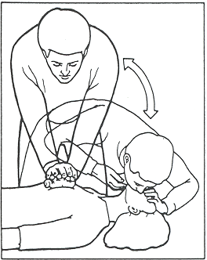
Skill Proficiency
Frequently review & practice rescue skills so they are easily recalled (if you are in doubt = time to refresh)
Maintain certifications, attend advanced training
Rescue techniques will vary with circumstances
Practice skills under a variety of scenarios & conditions
Plan and organize for emergencies before every dive
Inspect & maintain readiness of support equipment

Slide 39

Rescue Equipment
Rescue floatation
Marker buoy
Throwing line
Search lines
Recovery system
Rescue breathing mask
Diver’s first aid kit
Blankets & water
Oxygen delivery system
Personnel delegated
Communications & emergency contact information
Designated chase boat
Accident Management Evacuation plan (each location)

Slide 40

Key Points
Pre dive safety checks are the most important part of the dive
Diving accidents may have multiple injuries
Recognize and be able to control the signs of stress
Before rescuing others, you must be able to self-rescue
Assess the situation--assistance required or self-rescue possible? Monitor closely for changes
Do no further harm
Practice skills frequently
Keep track of your buddy
Don’t be the next victim

