Slide 1
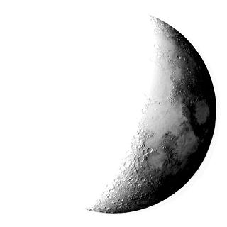
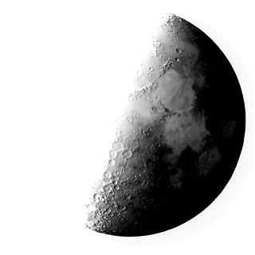
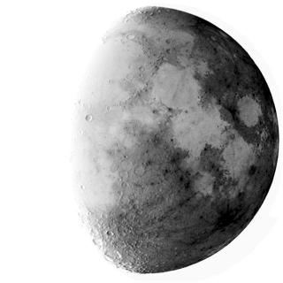
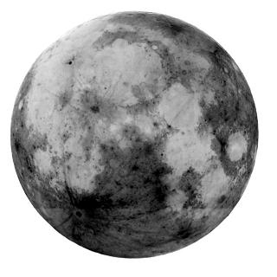
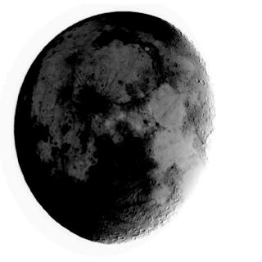
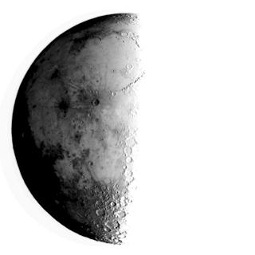
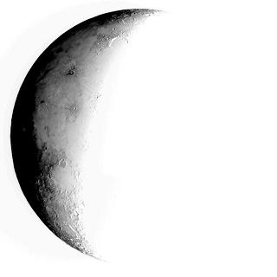
Tactile Lunar Phases
Observing, predicting, and interpreting the phases of the Moon is an important part of the space science curriculum in grades K-8. These inverse grayscale images taken with the Yerkes rooftop telescopes can be converted into tactile format with thermal expansion machines, and used by blind students in activities that involve observing, predicting, and modeling the lunar cycle.

Slide 2
Tactile Lunar Phases
Observe, Classify, Organize, Think About, Predict
Inverse grey images of moon phases
taken with the Yerkes 8inch Rooftop Telescope have been prepared for copying onto swell-form paper which is then processed through a thermal graphics machine.
This process creates tactile images for students who are blind or visually impaired or anyone whose learning is enhanced by using the sense of touch.

