Slide 1
Stability & Constructability
Optimization Opportunities in the
Design & Construction of Underground Space
Chris Laughton PhD, PE, C.Eng.
Project Manager for Underground Design & Construction Fermi National Accelerator Laboratory.

Slide 2
Optimization Potential
Some project are rigid -> core functions override engineering preferences for most stable & most practical
  Point-Connecting or Corridors - utility, transit, accelerators, beamline detectors (Long Baselines?)..
  Mining – “ore-centric” layouts, short-term access, low FOS
Some projects are more flexible….
  Hydropower, storage (dry good and fluids), public spaces - engineers can pick host rock, orientations, shapes, dimensions..
DUSEL openings may have some flexibility - potential to optimize key engineering aspects of the design to enhance self-supporting ability of rock and improve practicality and safety of construction while respecting core functions

Slide 3
End-User Requirements
Space
  Alignment, cross-section, volume (detectors), connections..
Structures (end-user driven)
  Soffit: Anchors, partitions, rails, cranes, trays, racks, shields..
  Invert: stability against vibrations, destress, overstress, swell..
Services (ideally some reuse of construction utilities)
  HVAC, Water, Power, Communication, Data Acquisition..
ES&H (on-site and off-site)
  Egress, access, air quality, noise, groundwater, lighting etc..
Document Needs -> before developing solutions (data first)
  Integrate design and construction engineers’ preferences in to the Baseline.
  Early Integration - fewer changes, time/cost savings.

Slide 4
Geology, Geology, Geology
Explore before you draw..pick the best host rock mass..
  Modicum of data/rational analyses needed at start - simple is OK
  RMC’s guidance only ~ questionable application in high stress?
  Modeling is a powerful, but good input is critical..garbage in..
Likely Stability Issues at DUSEL:
  Stress-Driven Yield and/or Burst (overstress)
  Gravity-Driven Fall-Out (blocks, wedges, soil-like fill)
  Water pressure and inflow (erosion, shear strength reduction)
  Combinations of the above
Early Site Investigation Objectives (reduce uncertainties):
  Rock - Intact rock strengths
  Stress - In Situ Stress levels/orientations
  Fracture - Discontinuities
  Water - head, permeability, estimates flow locations and rates)

Slide 5
DUSEL Rock Mass Assumptions..
Basis of Conceptual Design ~ data + assumptions
  Representative Behaviors (routine variability)
  Local Adversities ~ frequency/severity
  Pre-SI Baseline Documentation of both Knowns & Unknowns -> no more sophisticated than the data can support!! (KIS, S)
  More assumptions = more contingency
  Rule #1 - avoidance preferred to mitigation (e.g. SI first)
Pending SI - assume a hard & blocky rock mass
  Relatively strong and abrasive intact rocks 100MPa+
  Containing fractures and fracture zones, some with water
  Subject to significant stress at depth

Slide 6
Stability of Underground Openings
Underground, two forms of instability often observed:
Geo-structurally-controlled, gravity-driven processes leading to block/wedge fall-out
Stress driven failure or yield, leading to rockburst or convergence
(after Martin et al. IJRM&MS, 2003)
Note: structure and stress can act in combination to produce failure and adding water can exacerbate failure or reduce the FOS against failure through the action of flow and/or pressure

Slide 7
Orientation of Major Excavations
Consider Orientation with respect to Stress Field and Geo-Structure (discontinuity-bound blocks/wedges)
  1) If there is a major fault or fracture zone in the volume of a major excavation find a new site! (e.g data before design!)
  2) If a single dominant discontinuity set is present
    Minimize gravity-driven fall-out by placing the long axis of the excavation sub-perpendicular to the strike of the discontinuity set.
  3) If multiple sets are present avoid placing the long axis parallel to any - give more weight to sets most likely to cause instability.
  4) If high stresses are unavoidable at a site
    Destabilizing forces..gravity always..rock stress/water pressure sometimes
    A little stress and fracture can aid stability
    Minimize yield, slabbing, rockburst activity avoid placing the long axis of the perpendicular to the principal stress (~15-30 degrees from parallel, after Broch, E. 1979).

Slide 8
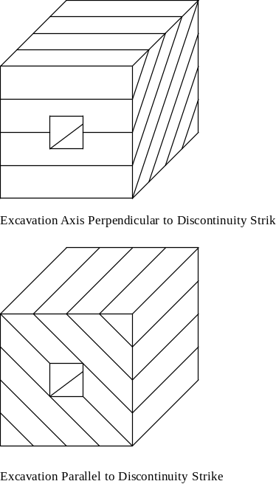
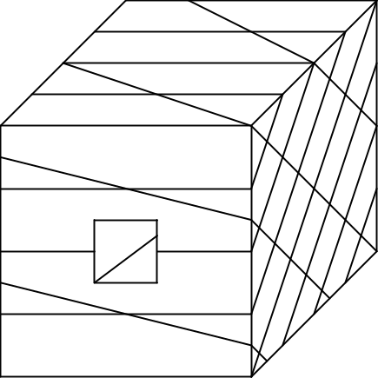
Rock Fracture - Orientation
Single Set of planes of weakness. Stability is a function of Excavation Axis:
  Maximize - Strike Perpendicular
  Minimize - Strike Parallel
More typically multiple sets of planes of weaknesses..
  Maximize by avoiding having any strike close to parallel to axis.

Slide 9
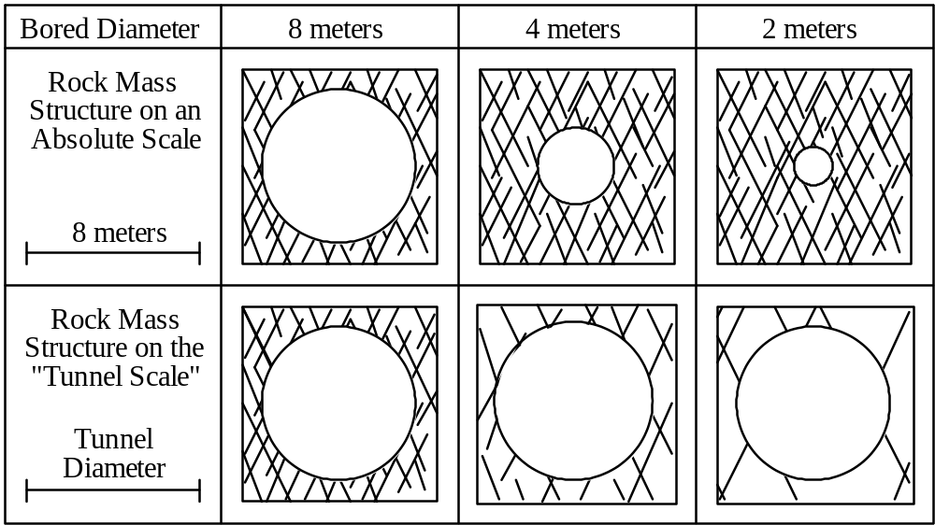
Rock Fracture - Size/Scale Effects
Larger Excavation -> increased potential for blocky fall-out

Slide 10
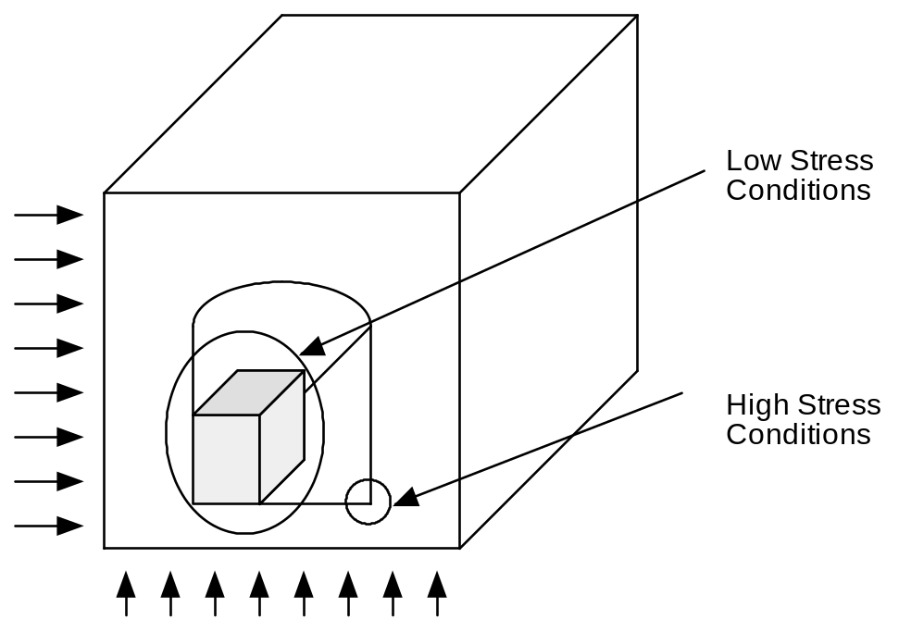
High & Low Stress
Excavation results in stress redistribution at perimeter:
  Low Stress or Tension: mobilized shear strength will be low - Failure!
  High Stress: locally, tangential stresses may exceed rock strength - Failure!
Above conditions can result in fall-out (walls, crown)
  Geometry of fall-out material a key consideration
  Ideally eliminate or limit the zones of both high and low stress around the perimeter

Slide 11
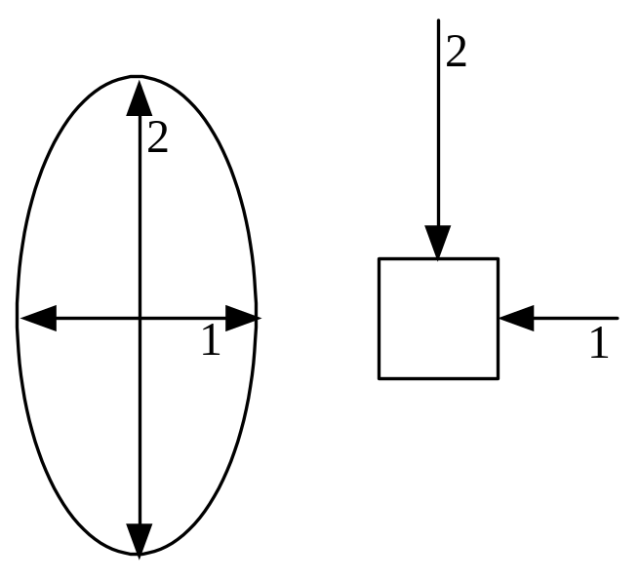
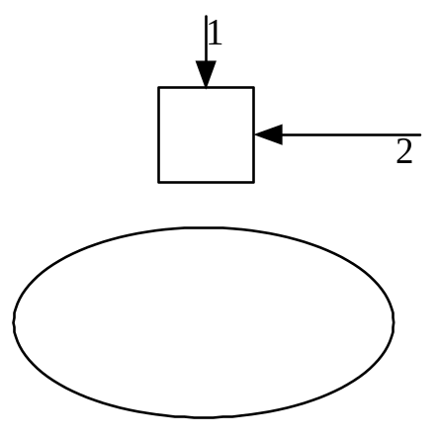
Mitigating Stress -Section Shape
Minimum Boundary stresses occur when the axis ratios of elliptical or ovaloid openings are matched to the in situ stress ratio after Hoek+Brown
Nice to keep the bottom flat. However, some designers go the whole hog (counter arch..), Sauer..

Slide 12
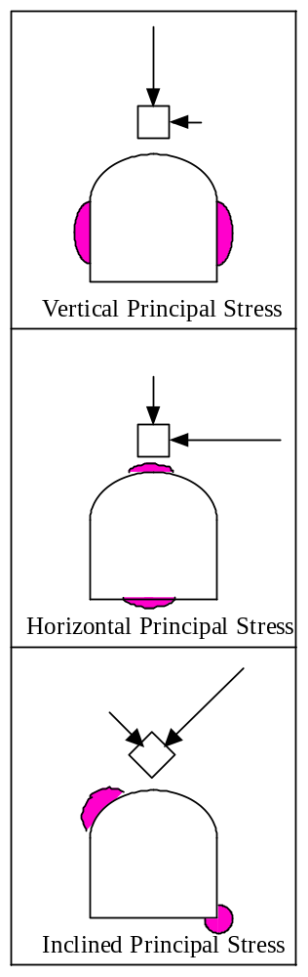
High-Stress Failure Zones
Not always practical to have circular/elliptical sections..
Stress concentration will occur as a function of stress field/orientation and excavation shape
Shaded areas show where rockburst or yield is most likely to occur around a horseshoe opening under three types of principal stress orientation..
  Vertical
  Horizontal
  Inclined
After Selmer-Olsen+Broch

Slide 13
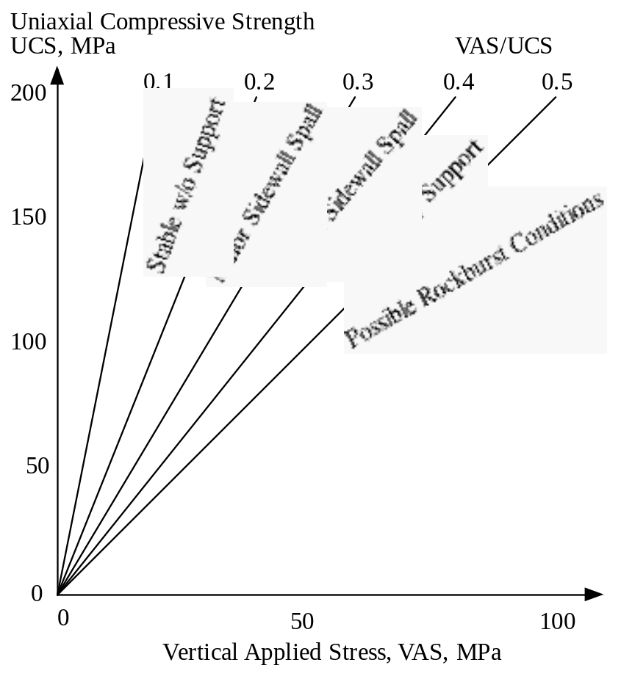
Stress-Driven Instability can be Severe
Severity Prediction?
  relative to Virgin Stress vs. Intact Strength Ratio
Overstress Failures
  Under moderate stress regime aim to even-out the distribution of stresses to avoid local stability problems, as discussed
  Under higher stress localize stress concentrations to reduce unstable area and costs of support…
After Hoek+Brown

Slide 14
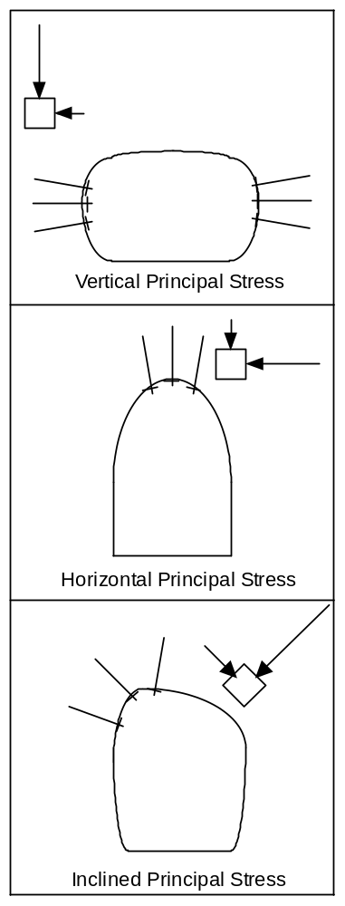
Section & Support Mitigation
Strategy for Minimizing Impact of Overstress
  Vertical Principal Stress
    Reduce potential for buckling/slabbing by avoiding long perimeters sub-parallel to principal stress - “low” excavations
  Horizontal and Inclined Principal Stresses
    Focus and support highly stressed volume at discrete locations around the section by increasing radii of curvature of section to concentrate loading
  bolt support can be used to stabilize areas of concentrated loading
after Selmer-Olsen+Broch

Slide 15
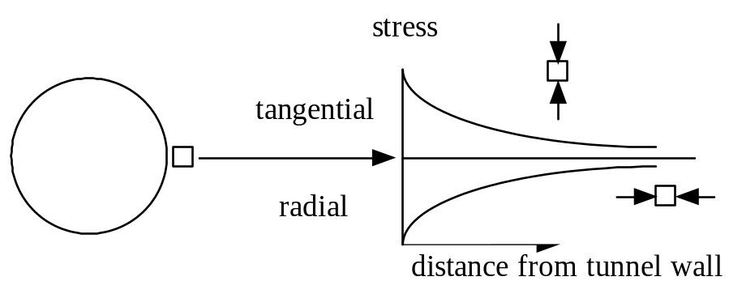
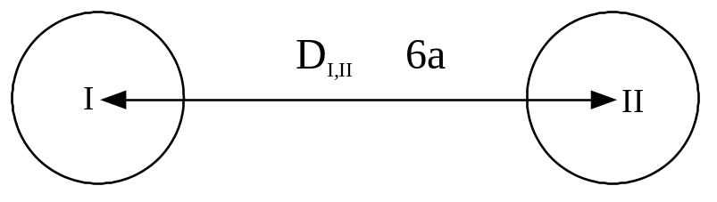
Mitigation Step: Opening Separation
  Virgin stress conditions are modified when openings are made, at the perimeter (hydrostatic stress)
    Radial stress zero
    Tangential stress 2x virgin
  2 circular openings
    Shared diameter, a
    In hydrostatic stress field
    Minimal Interaction if distance between openings centers is greater than 6a
  In high stress situations, ensure openings do not overly encroach on zones of influence
After Brady & Brown

Slide 16
Methods & Means Assumptions
  Drill and Blast preferred
    Flexible Heading Operations can Accommodate
      Alignment and Section Changes
      Support and Treatment Changes
      Pre-Conditioning/Cautious Blasting Options
  TBMs - capable of higher productivity, but
    Rigid Heading Operations
      Changes -> Major Utilization drops (~50-90%)
    Potential R&D tool - exploratory long, straight tunnels + uniform, good rock
  Roadheaders - “Hard-Rock” Challenged
    Potential R&D toll - ref. ICUTROC initiative
  Raise/Blind Bore Equipment
    Inclined/Vertical Shaft Drilling
  Stabilization Measures
    Bolts and Cables (pre-’ post reinforcement..)
    Super Skins/Liners (spray-on, c-i-p..)
    Final Liners (Paint, shotcrete, Gunite, .waterproofing..)

Slide 17
Designing Practical Solutions
Underground Construction Engineers often complain that “the design of a structure is not always made with due respect to modern construction.” (Brannsfor &Nord, Skanska)
To improve the constructability of underground structures it is worthwhile including active construction engineers in the development of the design concepts.. (Laughton, ‘01)
Some examples on improving constructability..

Slide 18
Layout for Optimized Construction
In general capital costs underground are productivity-driven
  In Tunnels..Minimize “Layout Gymnastics”…Avoid
    Steep ramps (>8-10%) = significant productivity reductions (haulage etc.)
    Long curves - long straight sections/short switch-backs preferred
    Mining in close proximity to existing structures - cautious blasting is slower
    Multi-pass sections -> use largest mechanized equipment that can get down!
    Routine Changes -> standardize excavation/support procedures when possible
    Incompatibilities between equipment/materials systems -> match capacities/sizes
    Impractical section transitions -> design/draw as it will be built
  Additionally...in Multi-Pass Operations/Caverns…Avoid
    Bottoms-up Mining -> prefer top-down work under a supported crown
    Wide, short excavations with high span:depth ratios -> benched volumes give higher productivity/require less reinforcement compared to headings
  In Wet Ground…Avoid
    Downhill mining - achieve gravity drainage

Slide 19
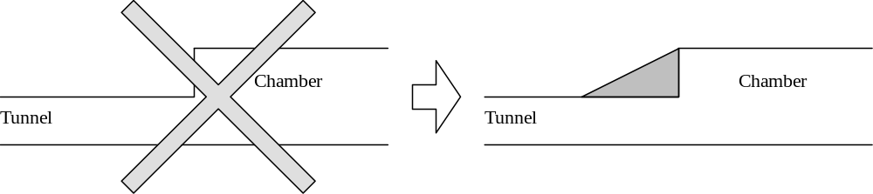
Practicalities..Sections Transitions
Right angled intersections can be problematic
  Drill/blast will typically produce bell-shaped transitions - why not draw it like that (end-user might be able to better adapt installations to reality!)?
Difficult to mine to line and grade
Liable to be under low stress/tension
Selmer-Olsen & Broch
Long-Section

Slide 20
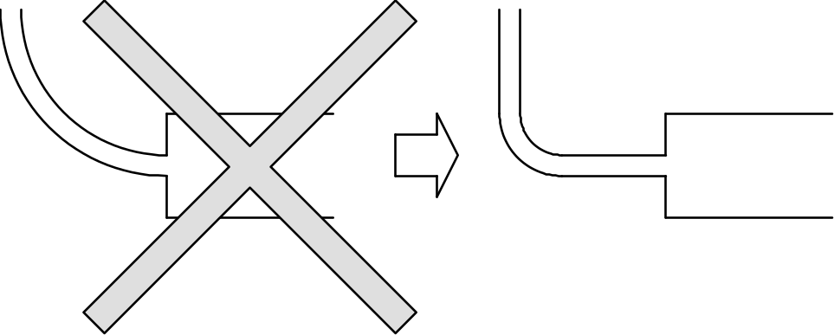
Practicalities..Access Tunnels
Excavation methods of today make it possible to use long inclined drifts.. provided that the drifts are correctly shaped, so that maximum transport capacity is obtained. This cannot be achieved by constructing the drifts as spirals: curves should be kept to a minimum and be as short as possible. Straight reaches promote high speed and consequently greater capacity (also yields improved visibility/safety, ideal passing places etc..).
Plan

Slide 21
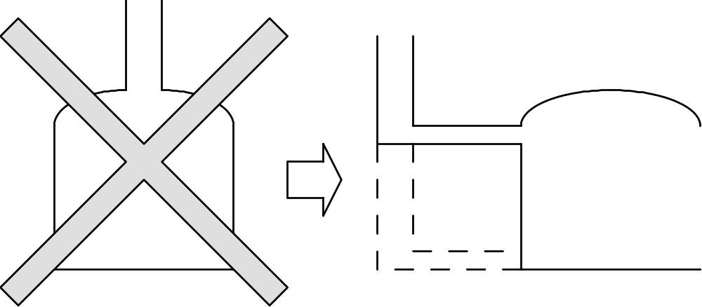
Practicalities..Shaft Access
Rock falls are often a problem if the shaft opens out directly into the rock cavern where work is in progress. It is therefore better to position the shaft somewhat to one side and make a horizontal connection.
Cross-Section

Slide 22
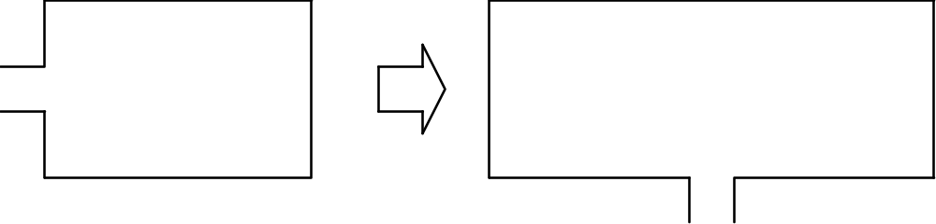
Practicalities..Cavern Access
It is not always self evident where an adit should enter in a rock cavern.
General agreement that if the rock cavern is short, <150m, the adit should come in at the end.
Where the cavern is longer, it maybe more cost-effective to start in the middle and work two faces.
Plan View

Slide 23
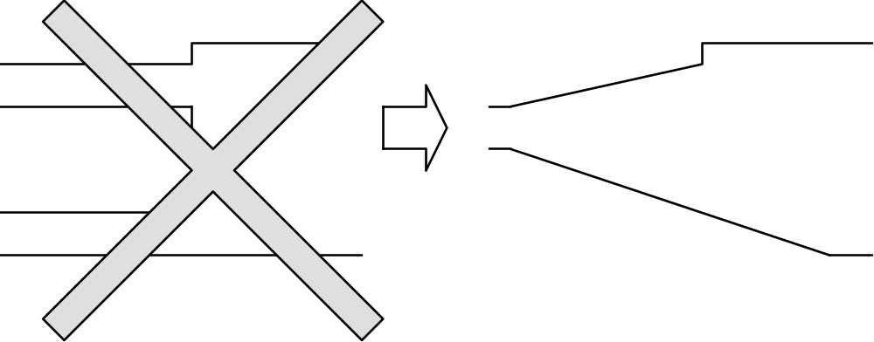
Practicalities - Cavern Access
The cavern long section shown below is suitable for rock caverns where volume is a functional demand. No extra tunnel tunnel is constructed for excvating the benches: it is sufficient to have an inclined drift in the rock cavern.
Long-Section

Slide 24
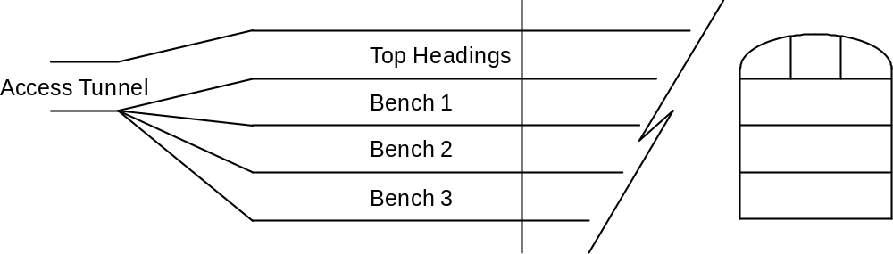
Cavern Cost Study - Layout
Economy in rock cavern construction - oil storage..
Looking for the “cheapest unit volume”
Norwegian experience in hard rock at relatively shallow depth (stress an occasional a problem)
after E.D Johansen, ‘79.
Long-Section
Cross-Section
Hard Rock Cavern - Cost Model Geometry

Slide 25
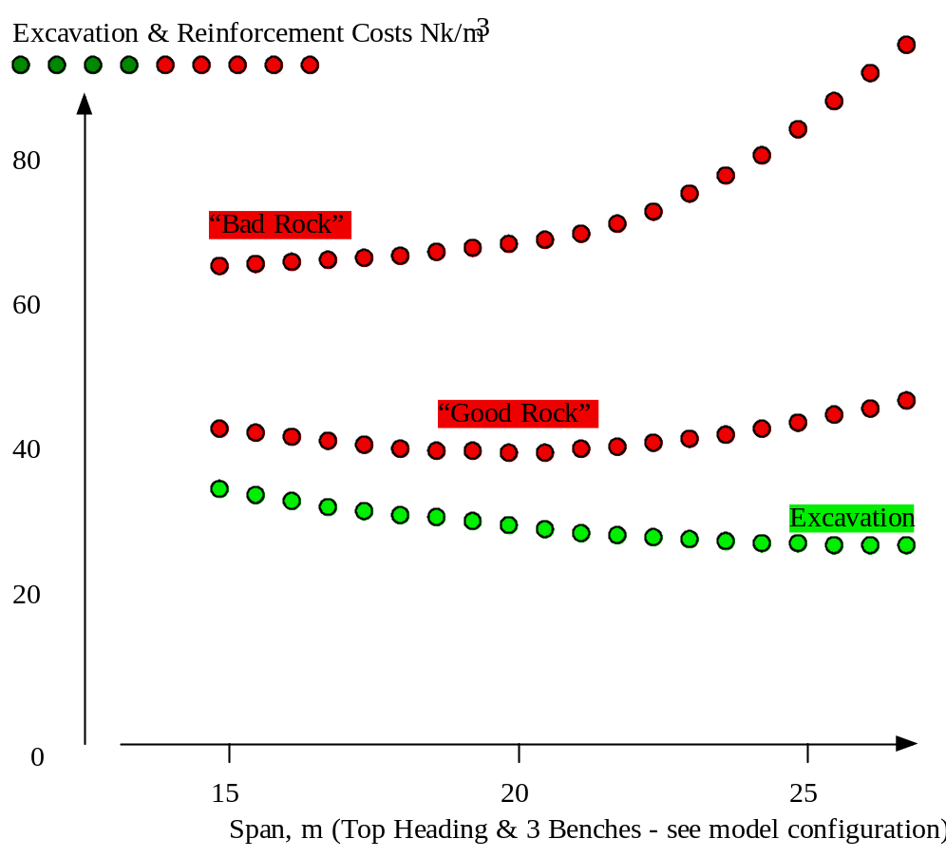
Cavern Cost Study - Findings
Excavation Costs
  Unit cost (Nk/m³) reduced as span increased
  Reduction most marked in the 10-20m span range
Reinforcement Costs
  In good rock - slight drop in unit cost (Nk/m³) calculated with increased span (10-20 m range)
  When rock conditions are less favorable, the costs of reinforcement can increase rapidly with increasing span.

Slide 26
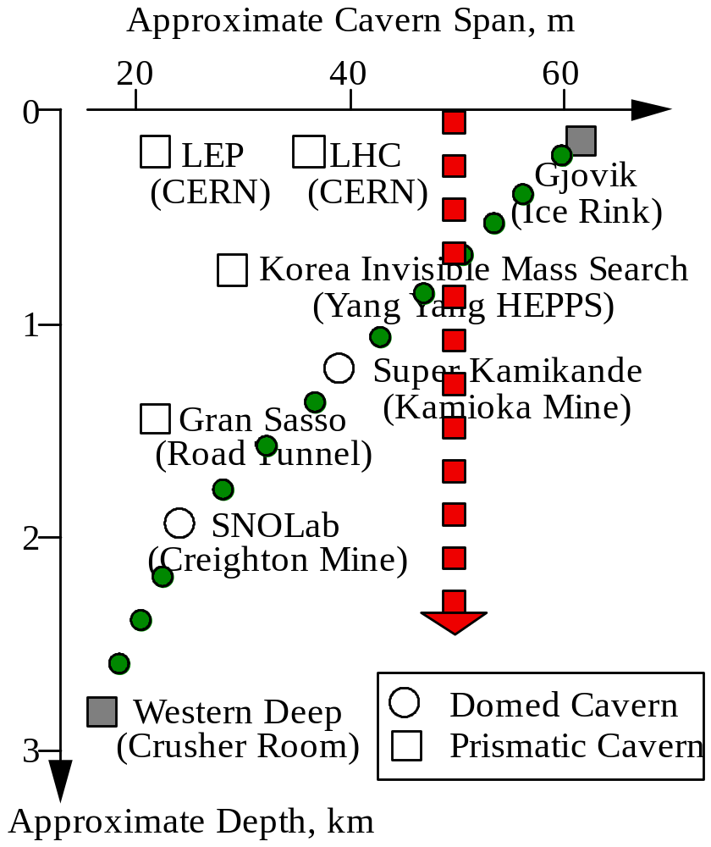
Cavern Cost Study - Conclusions
Rock Caverns with Spans > 20m
  Reductions in excavation cost ~ relatively small compared to potential for increase in reinforcement cost
  Many 20m+ caverns have been built, but
    Reinforcement needs can increase rapidly
    Designers and builders perception of risk will be critical to affordability -> how good is the ground?, how well are its characteristics known?
    Reserve detailed design until the ground is adequately characterized - conduct trade-off design/cost studies before committing to a large span design
Choosing a span greater than the rock mass can reasonably allow is the greatest error a designer can make, after Johansen

Slide 27
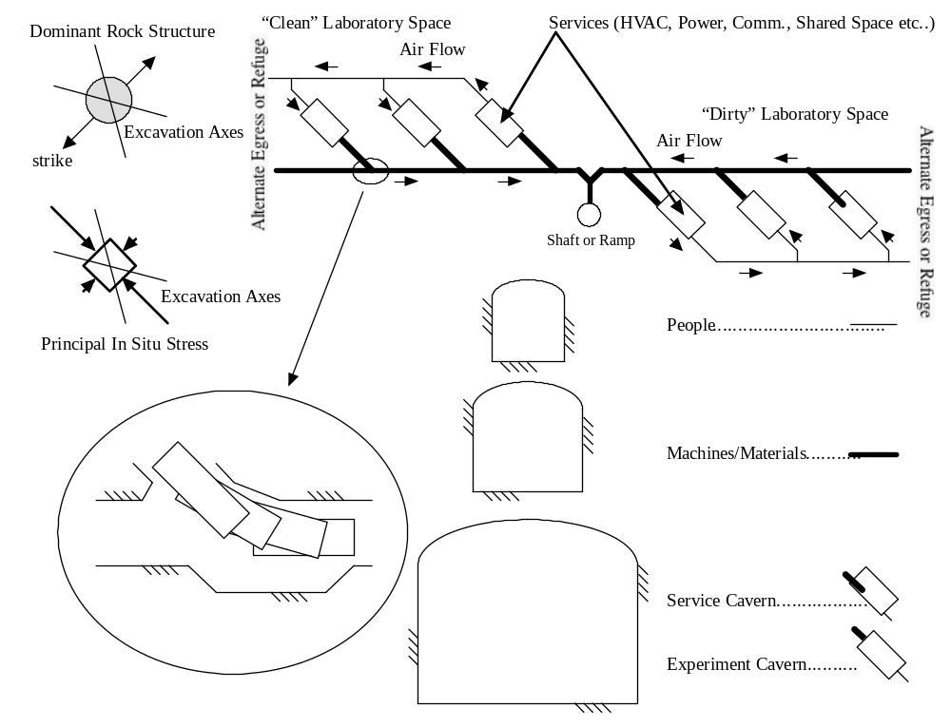
One Possible Generic Lab Layout

Slide 28
Contract Optimization
Clear Definitions
  Scope - including ground behaviors
  Acceptability of Alternates
    Allow bidder to match facility to his/her specific skill-se/tools/materials
  Risk - register/allocate/address
    Risk allocated to party best able to address it
    Pre-qualify
    Streamlined roles and responsibilities
    Authority and responsibilities aligned
  Real-time, on-site decision making
    Variable conditions = variable response (in many contracts some variability may be potentially “unexpected”..DSC)
    Agreement on range of treatment, excavation and support options (Design-as-you-go!)

Slide 29
Concept Development Steps
1) Find a Volume of Rock Mass Suitable to House the Required Underground Opening(s)
  Tie-in to existing excavations etc..
2) Orientation of Long Axis
3) Cross-sectional Size and Shape
4) Inter-Spacing Between Excavations
Ensure that the costs and contingencies that are developed truly reflect the uncertainties in the rock mass conditions and the construction process
after Selmer-Olsen & Broch

Slide 30
Summary - Concept Optimization
Not rocket science but a modicum of engineering input during the concept development may reduce cost and risk..
Not only.. End-User Needs
But also..(if you need it we can build it, but we’d prefer..)
  Design Engineer Preferred (Stability)
    Characterize potential adverse ground behavior(s) - to include realistic worst-case scenarios (forewarned-forearmed)
    Identify the best “rock-compatible” engineering solution(s)
  Construction Engineer Preferred (Practical, Cost-Effective)
    Meet end used demands more safely and at lower cost and risk
    accommodate designer’s range of adverse ground conditions/behaviors
    Assumes change is acceptable (Constructability, VE Review framework)
Early integration of needs and preferences is key
Explore before you draw -> when possible let geology guide design (easier to change the design than the rock!)

Slide 31
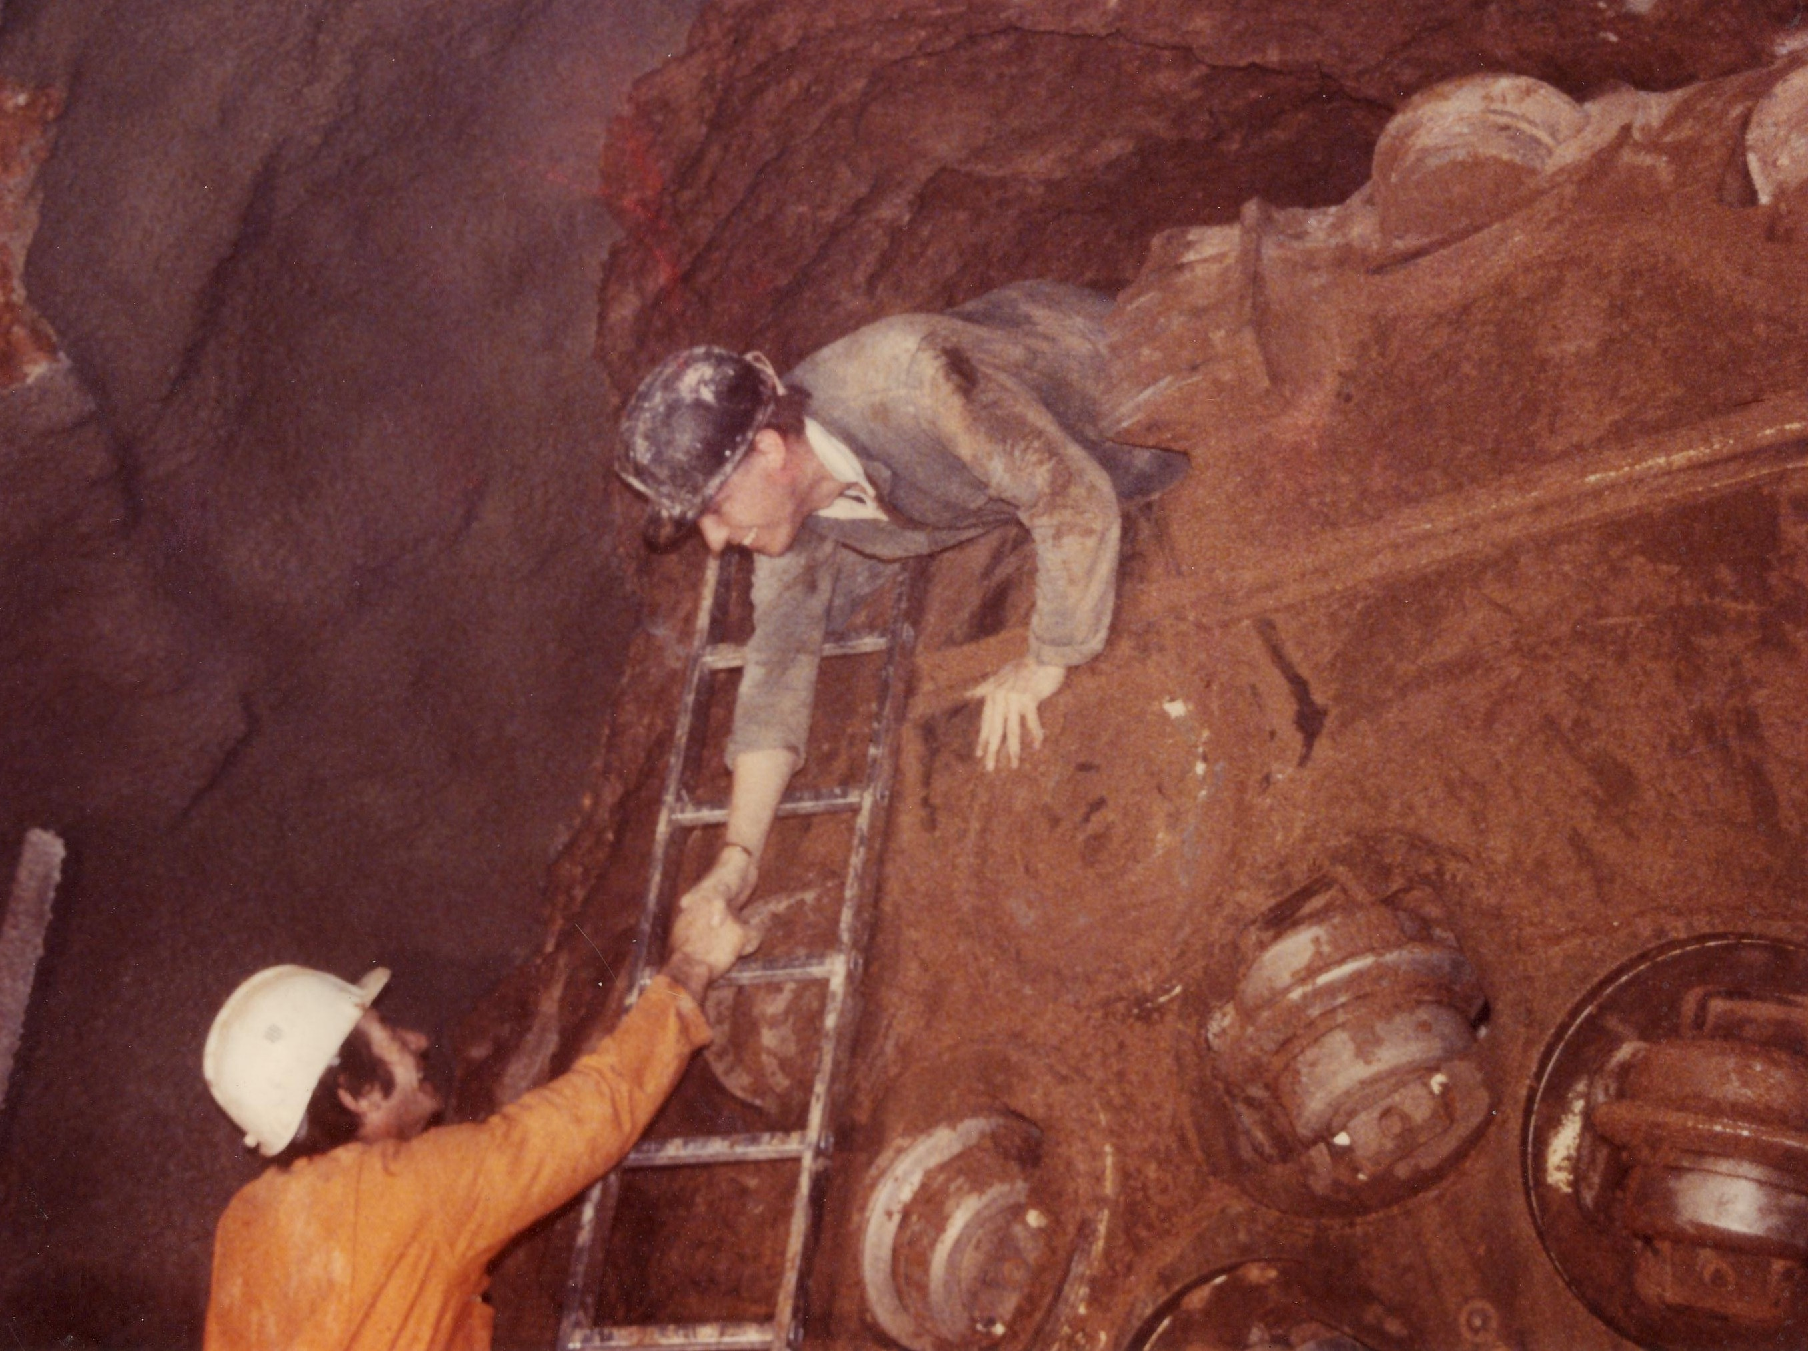
Other Opportunities..
Proposal #99: Wine Storage?
Large Electron Positron
Central California Wine Cave
Thanks for Your Attention

