Slide 1
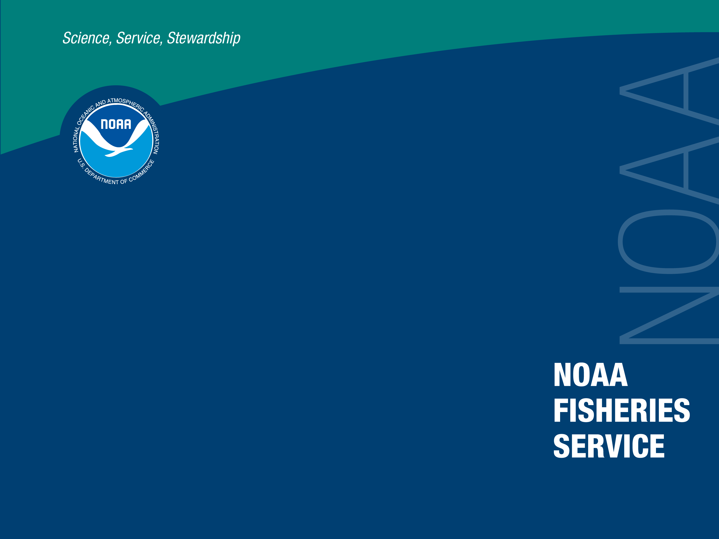
Continuation proposal for:
Rescue and Retrieval of Historic Bering Sea Crab Data
Task Lead: Guy Fleischer
Co-Investigators: Robert J Foy and Beverly A. Malley
NMFS Alaska Fisheries Science Center

Slide 2

Scientific Rationale
There is concern regarding the effects of changing climate on eastern Bering Sea (EBS) crabs, as well as other species in the region.
Historic 1966-1974 EBS crab data includes survey results and fishing data on crab abundance that contains embedded environmental data on bottom temperatures and on-site weather observations.
A relational database will be created that combines existing and archived records and integrates this database with Kodiak Laboratory’s internet homepage for dissemination.
This database serves research and modeling efforts concerning population dynamics, fishery management, and ecology.
Embedded environmental data could be used and integrated with other sources to increase our long-term knowledge of the effects of climatic change.

Slide 3
FY 2008 Accomplishments
35 sets of archived EBS crab data have been scanned and entered into CSV files.
  Sets included 3” binders of archived EBS crab data forms and records containing graphs and tables for the period 1966-1974.
  Emphasis was given specifically to environmental data collected coincident to biological data. Pilot house log pages included weather documentation for barometer, wind, sea, swell, and cloud conditions.
  Eighteen tables were selected that had been typed in Russian and included data from Soviet research vessels and factory ships.
Individual cover sheets were created for each set of data that included instructions, templates, variable lists, and translation keys.
All data have been entered in CSV (comma-separated variables) file formats and scanned on CD-Roms.

Slide 4
FY 2009 Scope of Work Proposed
Our primary focus will be selective scanning and digitization of those archive crab data records that have been identified as containing embedded environmental data on bottom temperatures and on-site weather observations.
  This focus will allow us to be in a position to better increase our long-term knowledge of the effects of climatic change.
Our secondary objective will be to submit annual data records prior to 1975 and to work back sequentially in years. Standardized forms will take precedent over tables and graphs.
The Kodiak Lab’s ultimate goal is to create a relational database that integrates these archived records with the existing 1975-present Oracle database and make this information available on the lab’s internet homepage for dissemination.
May require additional grant support in FY10.

