Slide 1
Congestive Heart Failure
(CHF)
Kathy Green, MS, RN
Patient Health Education
Notes:
Congestive Heart Failure
(CHF)
Kathy Green, MS, RN
Patient Health Education

Slide 2

Heart Failure Incidence and Prevalence
♥ Prevalence
Worldwide – 22 million
United States – 5 million
♥ Incidence
Worldwide – 2 million new cases year
United States – 500,000 new cases year
♥ Afflicts 10 out of every 1,000 people over age 65 in the United States
(Stats from American Heart association - 2002)
Notes:
Heart Failure Incidence and Prevalence
♥ Prevalence
Worldwide – 22 million
United States – 5 million
♥ Incidence
Worldwide – 2 million new cases year
United States – 500,000 new cases year
♥ Afflicts 10 out of every 1,000 people over age 65 in the United States
(Stats from American Heart association - 2002)

Slide 3
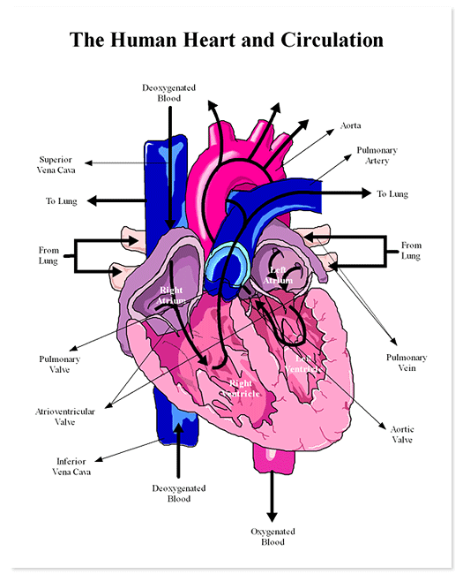
Normal Healthy Heart
♥ Muscle
♥ Four Chambers
♥ Four Valves
♥ Vena Cava – O2 poor
♥ Pulmonary Veins – O2 rich
♥ Aorta
Notes:
Normal Healthy Heart
♥ Muscle
♥ Four Chambers
♥ Four Valves
♥ Vena Cava – O2 poor
♥ Pulmonary Veins – O2 rich
♥ Aorta

Slide 4

What Is CHF ?
♥ The heart does not pump efficiently
♥ The heart is not able to move as much blood as it should with each beat
♥ Organs in the body do not get enough oxygen rich blood that they need to work well
Notes:
What Is CHF ?
♥ The heart does not pump efficiently
♥ The heart is not able to move as much blood as it should with each beat
♥ Organs in the body do not get enough oxygen rich blood that they need to work well

Slide 5

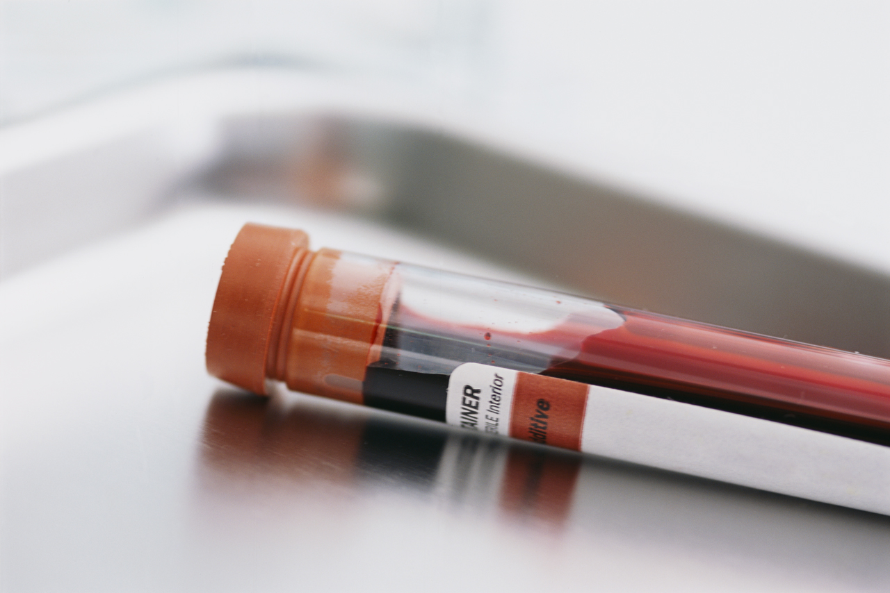
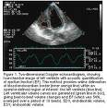
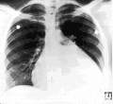
Diagnostic Evaluation
Notes:
Diagnostic Evaluation
Figures

Slide 6
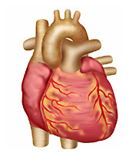
What Causes Heart Failure?
♥ Coronary Artery Disease
♥ Untreated High Blood Pressure
♥ Faulty Heart Valves
♥ Cardiomyopathy
♥ Lung Disease
♥ Diabetes
♥ Infections
♥ Alcoholism
♥ Toxic Drugs
Notes:
What Causes Heart Failure?
♥ Coronary Artery Disease
♥ Untreated High Blood Pressure
♥ Faulty Heart Valves
♥ Cardiomyopathy
♥ Lung Disease
♥ Diabetes
♥ Infections
♥ Alcoholism
♥ Toxic Drugs

Slide 7

2 Types of Heart Failure
Systolic Dysfunction
(Contraction) 2/3 of Patients
♥ The heart becomes weak and enlarged
♥ The weakened heart muscle can’t contract
♥ Not enough blood is pumped from the chambers
Diastolic Dysfunction
(Relaxation)
♥ Chambers don’t fill up so less blood goes to the lungs and body
♥ Stiff heart muscle can’t relax
♥ Not enough blood fills the chambers
Notes:
2 Types of Heart Failure
Systolic Dysfunction
(Contraction) 2/3 of Patients
♥ The heart becomes weak and enlarged
♥ The weakened heart muscle can’t contract
♥ Not enough blood is pumped from the chambers
Diastolic Dysfunction
(Relaxation)
♥ Chambers don’t fill up so less blood goes to the lungs and body
♥ Stiff heart muscle can’t relax
♥ Not enough blood fills the chambers

Slide 8

What is an Ejection Fraction? (EF)
The amount of blood that pumps out of the heart with each beat
♥ Normal EF = 50 – 65%
♥ Damaged Heart Muscle EF = 40%
♥ Potential Heart Transplant EF = 20%
Notes:
What is an Ejection Fraction? (EF)
The amount of blood that pumps out of the heart with each beat
♥ Normal EF = 50 – 65%
♥ Damaged Heart Muscle EF = 40%
♥ Potential Heart Transplant EF = 20%

Slide 9
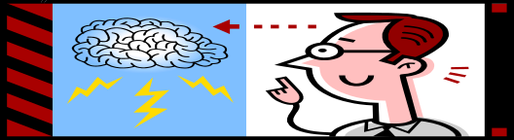
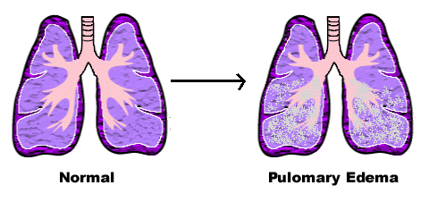
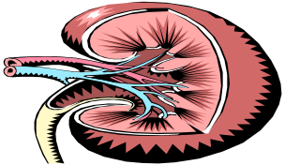
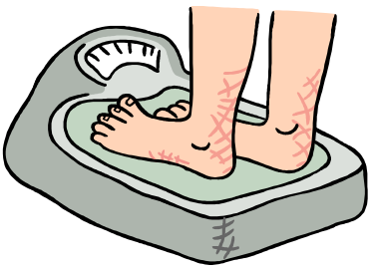
When the EF is Abnormal
What Happens in the Body?
♥ Less blood goes to the brain that may make you feel confused or dizzy
♥ Your lungs may fill up with fluid making you feel short of breath
♥ Your kidneys may not be able to get rid of the fluid
♥ Your belly, ankles and feet may swell up
Notes:
When the EF is Abnormal What Happens in the Body?
♥ Less blood goes to the brain that may make you feel confused or dizzy
♥ Your lungs may fill up with fluid making you feel short of breath
♥ Your kidneys may not be able to get rid of the fluid
♥ Your belly, ankles and feet may swell up

Slide 10
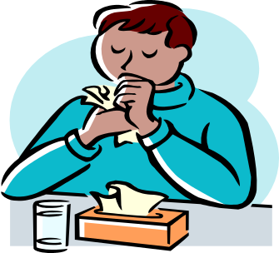

Other Signs and Symptoms of CHF
♥ Extreme Fatigue
♥ Frequent Coughing
♥ Sudden Weight Gain
♥ Chest Pain or Pressure
♥ Nausea, Loss of Appetite or Bloating
♥ Decreased Urination
Notes:
Other Signs and Symptoms of CHF
♥ Extreme Fatigue
♥ Frequent Coughing
♥ Sudden Weight Gain
♥ Chest Pain or Pressure
♥ Nausea, Loss of Appetite or Bloating
♥ Decreased Urination

Slide 11
Do You Know Your EF and Class of CHF?
♥ Why do I need to know my EF and Class of CHF?
Heart Failure is a chronic progressive disease that is not curable but is treatable
Notes:
Do You Know Your EF and Class of CHF?
♥ Why do I need to know my EF and Class of CHF?
Heart Failure is a chronic progressive disease that is not curable but is treatable

Slide 12



New York Heart Association Functional Classification
Class I
No symptoms with ordinary activity
Class II
Slight limitation of physical activity results in fatigue, shortness of breath, chest pain or irregular heart beat
Notes:
New York Heart Association Functional Classification
Class I
No symptoms with ordinary activity
Class II
Slight limitation of physical activity results in fatigue, shortness of breath, chest pain or irregular heart beat

Slide 13
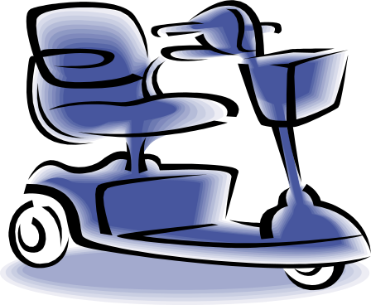
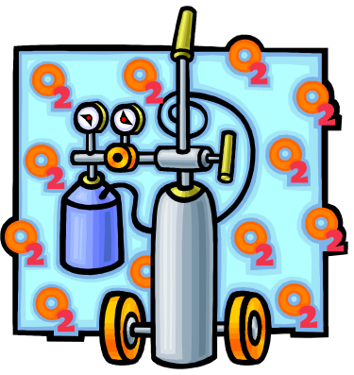
New York Heart Association Functional Classification
Class III
Marked limitation of physical activity.
Comfortable at rest, but less than ordinary physical activity results in fatigue, irregular heart beat, pain or shortness of breath
Class IV
Unable to carry out any physical activity without discomfort
All symptoms in class III even at rest
Notes:
New York Heart Association Functional Classification
Class III
Marked limitation of physical activity.
Comfortable at rest, but less than ordinary physical activity results in fatigue, irregular heart beat, pain or shortness of breath
Class IV
Unable to carry out any physical activity without discomfort
All symptoms in class III even at rest

Slide 14




What Can I Do To Prevent Progression of the Disease?
♥ Become Conscious of Lifestyle Choices!
♥ Make Better Choices…
☺ Quit Smoking
☺ Reduce Weight
☺ Avoid Excess Alcohol and Drugs
☺ Exercise
☺ Take Medication
Notes:
What Can I Do To Prevent Progression of the Disease?
♥ Become Conscious of Lifestyle Choices!
♥ Make Better Choices…
☺ Quit Smoking
☺ Reduce Weight
☺ Avoid Excess Alcohol and Drugs
☺ Exercise
☺ Take Medication

Slide 15
Self Care Strategies
♥ Take an active part in your care
♥ Communicate with your healthcare team (Healthwise for Life)
♥ Be knowledgeable about your health
♥ Take your medication as prescribed
* Never run out of medications
♥ Treat high cholesterol, diabetes and irregular heart beat
Notes:
Self Care Strategies
♥ Take an active part in your care
♥ Communicate with your healthcare team (Healthwise for Life)
♥ Be knowledgeable about your health
♥ Take your medication as prescribed
* Never run out of medications
♥ Treat high cholesterol, diabetes and irregular heart beat

Slide 16

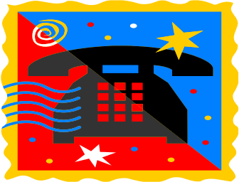

Self Care Strategies
♥ Keep high blood pressure under control
♥ Salt restrictions
♥ Daily weights and record
♥ Health Buddy
♥ Look for swelling
♥ Immunizations
♥ Manage stress
Notes:
Self Care Strategies
♥ Keep high blood pressure under control
♥ Salt restrictions
♥ Daily weights and record
♥ Health Buddy
♥ Look for swelling
♥ Immunizations
♥ Manage stress

Slide 17

Early Symptoms of Heart Failure
♥ A weight gain or loss of 2 or more pounds in 1 day, or 4 pounds in 1 week
♥ Confusion, restlessness or lightheaded
♥ A feeling of fullness or bloating in your stomach
♥ Cough, shortness of breath, swelling
♥ Fatigue, lose of appetite, or nausea
Notes:
Early Symptoms of Heart Failure
♥ A weight gain or loss of 2 or more pounds in 1 day, or 4 pounds in 1 week
♥ Confusion, restlessness or lightheaded
♥ A feeling of fullness or bloating in your stomach
♥ Cough, shortness of breath, swelling
♥ Fatigue, lose of appetite, or nausea

Slide 18

Urgent Symptoms of Heart Failure
♥ Increased shortness of breath while resting or trouble sleeping
♥ Waking up suddenly at night due to difficulty breathing
♥ A need to sleep sitting up or a need for more pillows than usual
♥ A fast irregular heart beat, a racing heart that makes you feel dizzy, or like you are going to pass out
♥ Coughing up pink frothy mucus
Notes:
Urgent Symptoms of Heart Failure
♥ Increased shortness of breath while resting or trouble sleeping
♥ Waking up suddenly at night due to difficulty breathing
♥ A need to sleep sitting up or a need for more pillows than usual
♥ A fast irregular heart beat, a racing heart that makes you feel dizzy, or like you are going to pass out
♥ Coughing up pink frothy mucus

Slide 19
Time Is Life
♥ Know the warning signs
♥ Heart disease is the leading cause of death in women
♥ Take one aspirin unless you are allergic to it
♥ Make a plan and share it with your family
♥ Don’t delay call 911
Notes:
Time Is Life
♥ Know the warning signs
♥ Heart disease is the leading cause of death in women
♥ Take one aspirin unless you are allergic to it
♥ Make a plan and share it with your family
♥ Don’t delay call 911

Slide 20


Symptoms of Heart Failure
Call 911
♥ Chest discomfort or pain that lasts more than 15 minutes that is not relieved with rest or nitroglycerin
♥ Severe, persistent shortness of breath
♥ Loss of consciousness
Notes:
Symptoms of Heart Failure
Call 911
♥ Chest discomfort or pain that lasts more than 15 minutes that is not relieved with rest or nitroglycerin
♥ Severe, persistent shortness of breath
♥ Loss of consciousness

Slide 21
Question?
Post Quiz Introduction to Heart Failure
Evaluation Form
Notes:
Question?
Post Quiz Introduction to Heart Failure
Evaluation Form

Slide 22






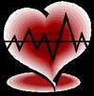


The End
Notes:
The End

