Slide 1
First Wall Issues:
ITER to DEMO
D.G. Whyte, B. Lipschultz
Plasma Science & Fusion Center, MIT, Cambridge USA
Greenwald Panel, FESAC Meeting
August 8, 2007

Slide 2
First-Wall & PSI becoming increasingly important and difficult as we move from present tokamaks → ITER → demonstration fusion power plants
Issue / Parameter | Present Tokamaks | ITER | DEMO | Consequences
Quiescent energy exhaust GJ / day | ~ 10 | 3,000 | 60,000 | active cooling max. tile thickness ~ 10 mm
Transient energy exhaust from plasma instabilities ΔT~ MJ / A_{wall}(m²) / (1 ms)^{1/2} | ~ 2 | 15 | 60 | require high T_{melt/ablate} limit? ~ 60 for C and W surface distortion
Yearly neutron damage in plasma-facing materials displacements per atom | ~ 0 | ~ 0.5 | 20 | evolving material properties: thermal conductivity & swelling
Max. gross material removal rate with 1% erosion yield (mm / operational-year) | < 1 | 300 | 3000 | must redeposit locally limits lifetime produces films
Tritium consumption (g / day) | < 0.02 | 20 | 1000 | Tritium retention in materials and recovery

Slide 3
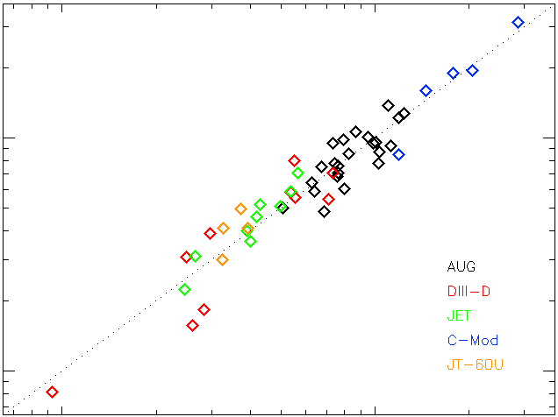
Upstream peak power exhaust:
SOL Width ~ R leads to q_{//,max} ~ 2-3 GW/m² in reactor
Daunting engineering task, but can we access physics in present devices?
ARIES-AT
Whyte et al. ITPA 07 Garching
P_{SOL}=0.7 (P_{α}+P_{aux})
10⁹
ITER
q_{//,sep}
(W/m²)
10⁸
10⁸
10⁹
q_{//,sep} = 1.43x10⁴ q⊥^{0.86} q_{cyl} ^{1.03}

Slide 4
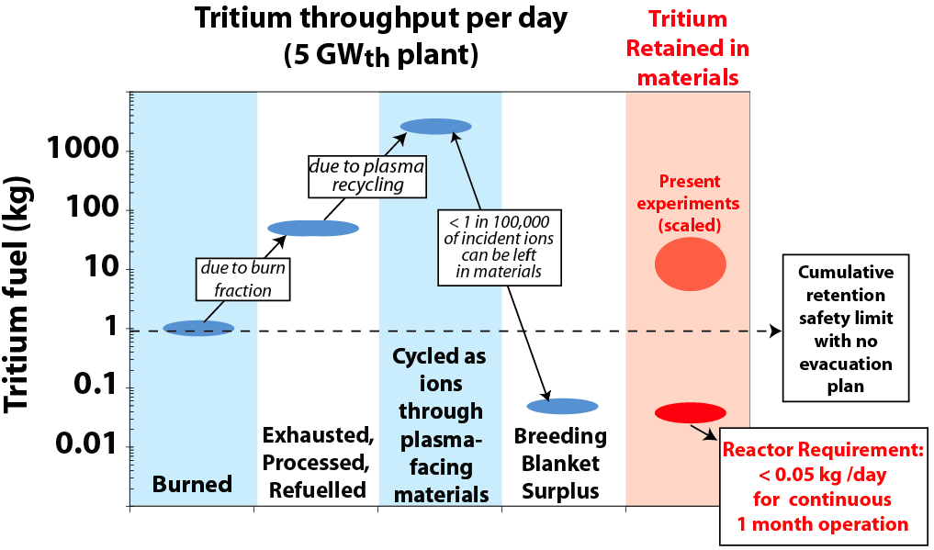
Tritium/fuel control and retention represents the single largest step between present devices/ITER and a DEMO

Slide 5
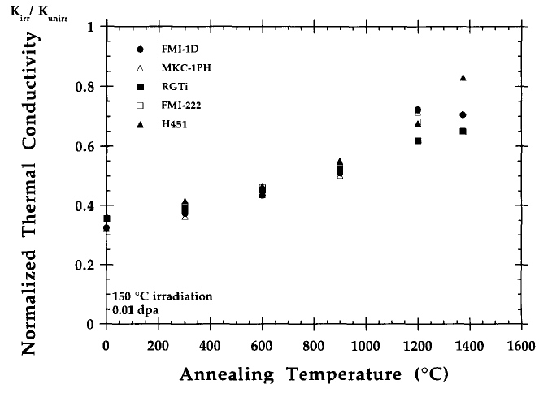
High materials temperatures seem mandatory to control fuel retention and anneal neutron damage:
What temperature will be required?
L. Snead, T. Burchell,
J. Nucl. Mater. 224 (1995) 222.
Wampler et al. J. Nucl. Mater.
176 & 177 (1990) 987
100
Thermal conductivity restored
by high-T annealing
D retained (%)
1000 C
JT-60U tokamak (Tanabe et al. ITPA Toronto 06)
0
Film Location | T_{max} (K) | (H+D) / C
Front-face | >1000 | 0.01
Behind tile | 420 | ~ 1
Anneal T (C)

Slide 6
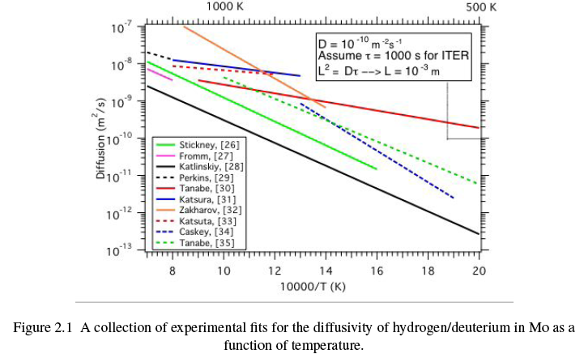
Both long pulse AND high temperatures required to reach true particle equilibrium in first wall.
G.M. Wright, Ph.D. thesis, U. Wisc 2007
10⁴
Seconds required
To permeate
1 cm thick
armour
10⁶
10⁸
ITER
ambient T

Slide 7
Summary
The requirements for a sustainable fuel cycle and wall viability push us strongly to investigate first walls with much higher ambient temperatures
  Tritium recovery, suppression of retention in codeposits.
  Walls and particles in equilibrium
  Annealing of neutron damage
  Technological requirement: gas cooling + peak heat load removal
A key physics / design issue will be the selection of the ambient temperature that provides the appropriate trade-offs between temperature limits (e.g. heating from transients), desired high power density, and high temperature benefits such as tritium recovery.
  Exponential T dependences demand experimental demonstration / testing.
“Hot-wall” tokamak operation would investigate a physics, operational and technological path that seems vital to fusion’s success, but which no one else, including ITER, is pursuing.
  Must be coupled with a concentrated effort on PSI science and diagnosis + sustainment physics.

Slide 8
Additional Materials

Slide 9
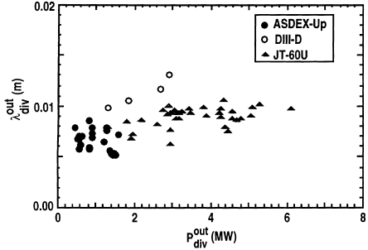

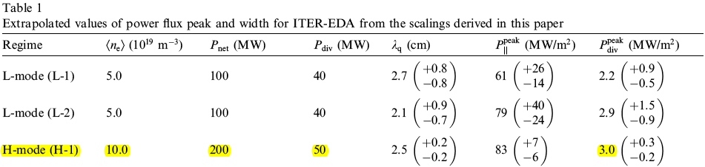
Cross-device study that showed no dependence of λ_{q} with R, also revealed a scaling of λ_{q} ~ P^{0.5} that results in favorable extrapolation to ITER & reactors
ARIES-AT: q_{peak} ~ 6 MW/m²

Slide 10
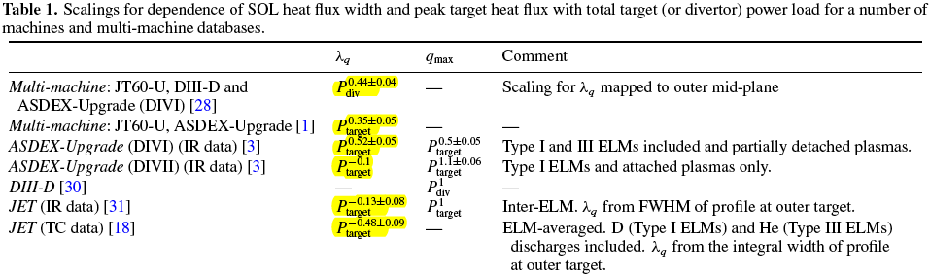
Target heat removal is the highest priority in edge design, but the strategy forward is confused by the lack of consistent or compelling empirical scalings
“All than can be strongly concluded
from Table 1 [scalings for SOL heat flux] is that
there is a need for improved experimental
measurements and a theory-oriented
approach for making extrapolations
for the target heat flux..”
Tokamak Physics Update: Power and Particle
Control, A. Loarte, et al. Nucl. Fusion 47 (2007) S203.

Slide 11
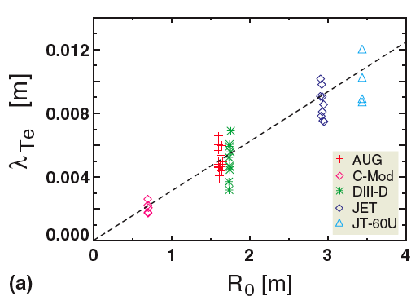
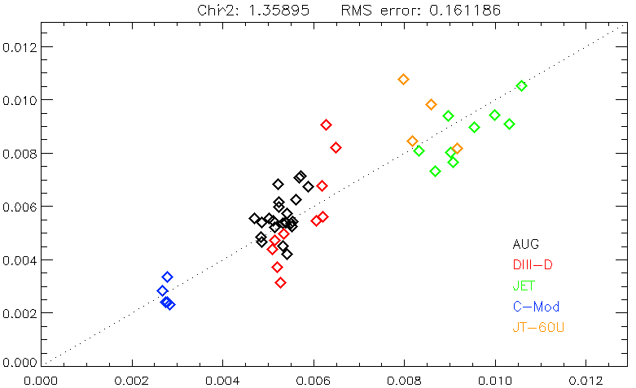
As Kallenbach¹, we find λ_{T} ~ R.
Further regression analysis shows λ_{T} is invariant with P_{SOL} and insensitive to other global and separatrix parameters
1 Kallenbach,et al. JNM 337-339 (2005) 381.
Whyte et al. ITPA 07 Garching
λ_{T} (m)
λ_{T} ~ R^{1.1±0.1} q*^{0.15±0.2} P_{SOL}^{0.01±0.05} n_{sep}^{0.2±0.06}
The invariance with P_{SOL} counter-indicates the scaling expected from
⊥ conduction

Slide 12
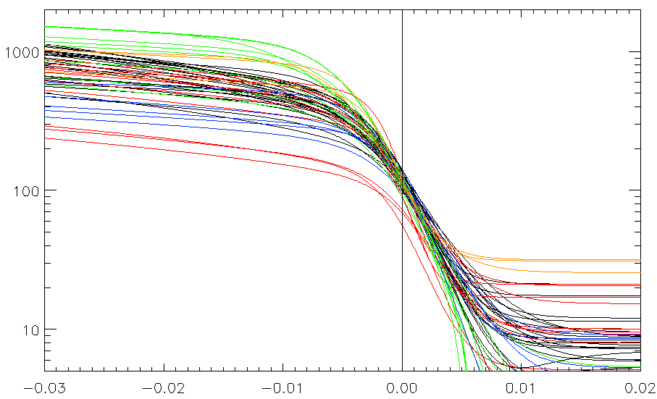
The separatrix seems to exhibit a critical gradient scale length set by R
AUG
DIII-D
JET
C-Mod
JT-60U
T_{e} (eV)
Whyte et al. ITPA 07 Garching
ΔR_{sep} / R_{o}

Slide 13
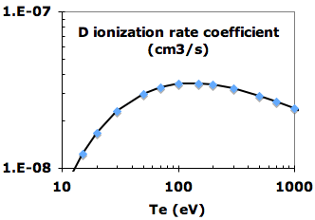
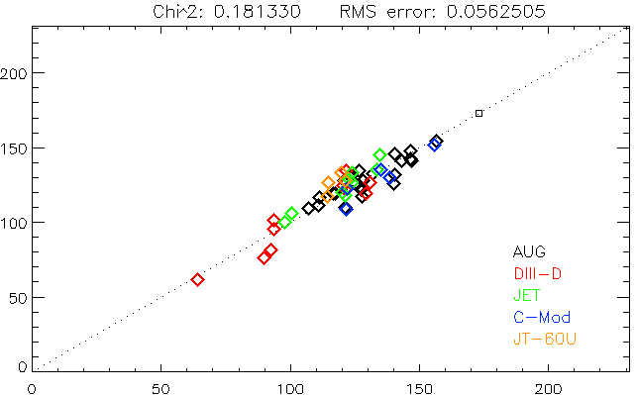
The scaling gives (P/R)^{2/7} as the figure-of-merit to set upstream separatrix T_{e}
Consistent with original derivation by Lackner¹, who argued T_{e} /E_{atom} should be matched for edge similarity if SOL width scaled as R.
Upstream atomic rates vary weakly with T, e.g. D ionization rates match within few percent between present devices & ITER..
  Upstream atomic physics constraint can probably be dropped from similarity requirements, as it is in core.
ITER
T_{e.sep} (eV)
Whyte et al. ITPA 07 Garching
T_{e,sep} = 1.09 (P_{SOL}/R)^{0.28±0.02} q_{cyl}^{0.6±0.07}
¹ Comm. Plasma Phys. Controlled Fusion 15 (1994) 359.

Slide 14
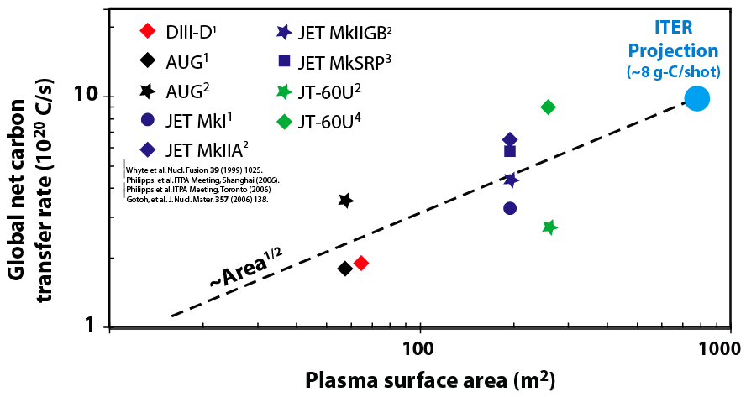
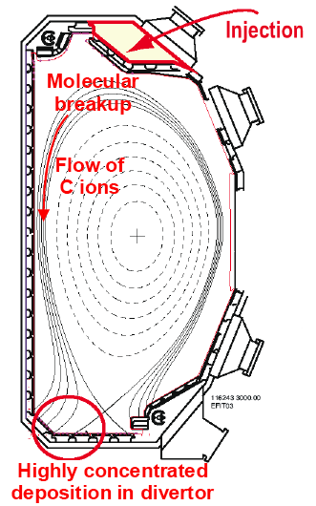
“Archeological” deposition measurements:
Tokamak plasmas effectively net “transfer” carbon from one location of the wall to another
¹³CH₄
Whyte, Stangeby et al. IVC 07 Stockholm
McLean et al APS 04
13-C isotope tracer experiments support idea that C is transferred from main-wall “limiters” to inboard divertor
Controlling mechanisms of main-wall erosion sources, long-range transport and deposition balance are not well understood.

Slide 15
Operational consequences of 10²¹ C/s global transfer rate demonstrate necessity for high ambient temperature to control Tritium retention in carbon films.
Ambient wall temperature | T/C | # Pulses to reach 350 g T limit in ITER* | # days to T-limit in DEMO ¹ | # days lifetime for “limiters” in DEMO ²
~ 400 K | ~ 0.3 | 500 | ~ 6 | ~240
> 1000 K | ~ 0.01 | >10⁴ | ~ 230
Whyte et al. IVC07 Stockholm
* ITER is water-cooled
T_{ambient} ~ 400K
1 Assumes 1 kg safety limit
2 Assumes 20 m² limiter surface

Slide 16
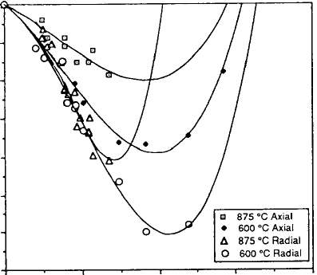
14 MeV neutron-induced damage set lifetime limits for graphitic fusion materials
Neutron induced shrink/swell in N3M graphite
0
End of
lifetime
% Dimension Change
3
T. Burchell, J. Nucl. Mater.
179-181 (1991) 205.
0
20
40
Displacements per atom

