Slide 1
From Twistors to Calculations

Slide 2
Precision Perturbative QCD
Predictions of signals, signals+jets
Predictions of backgrounds
Measurement of luminosity
Measurement of fundamental parameters (α_{s}, m_{t})
Measurement of electroweak parameters
Extraction of parton distributions — ingredients in any theoretical prediction
Everything at a hadron collider involves QCD

Slide 3
AdS/CFT Duality
Strong-coupling N =4 supersymmetric gauge theory
⇔ String Theory on AdS₅ × S⁵
for large N_{c} , g² N_{c} ⇒ perturbative supergravity
Maldacena (1997)
Gubser, Klebanov, & Polyakov; Witten (1998)
Strong–weak duality
Many tests on quantities protected by supersymmetry
D’Hoker, Freedman, Mathur, Matusis, Rastelli, Liu, Tseytlin, Lee, Minwalla, Rangamani, Seiberg, Gubser, Klebanov, Polyakov & others
More recently, tests on unprotected quantities
Berenstein, Maldacena, Nastase; Beisert, Frolov, Staudacher & Tseytlin; Minahan & Zarembo; & others (2002–4)

Slide 4
A New Duality
Topological B-model string theory
⇔
N =4 supersymmetric gauge theory
Weak–weak duality
Computation of scattering amplitudes
Novel differential equations
Witten (2003)
Roiban, Spradlin, & Volovich; Berkovits & Motl; Vafa & Neitzke; Siegel (2004)
Novel factorizations of amplitudes
Cachazo, Svrcek, & Witten (2003)

Slide 5
Witten, hep-th/0312171
Cachazo, Svrček & Witten, hep-th/0403047, hep-th/0406177, hep-th/0409245
Bena, Bern & DAK, hep-th/0406133
DAK, hep-th/0406175
Brandhuber, Spence, & Travaglini, hep-th/0407214
Bena, Bern, DAK & Roiban, hep-th/0410054
Cachazo, hep-th/0410077; Britto, Cachazo, & Feng, hep-th/0410179
Bern, Del Duca, Dixon, DAK, hep-th/0410224

Slide 6

The Amazing Simplicity of N=4 Perturbation Theory
Manifestly N=4 supersymmetric calculations are very hard off-shell — much harder than ordinary gauge theory
offshell
onshell

Slide 7
But on-shell calculations are much simpler than in nonsupersymmetric theories:
  4-pt one-loop = tree × one-loop scalar box
  Green & Schwartz (1982)
  5, 6-pt one-loop known & simpler than QCD
  Bern, Dixon, Dunbar, DAK (1994)
  all-n one-loop known for special helicities
  Bern, Dixon, Dunbar, DAK (1994)

Slide 8

Parke–Taylor Amplitudes
Pure gluon amplitudes
All gluon helicities + ⇒ amplitude = 0
Gluon helicities +–+…+ ⇒ amplitude = 0
Gluon helicities +–+…+–+ ⇒ MHV amplitude
Holomorphic in spinor variables
Parke & Taylor (1986)
Proved via recurrence relations
Berends & Giele (1988)

Slide 9

Correlators in Projective Space
Nair (1988)
Null cones ⇔ points in twistor space
Penrose (1972)
Spinors are homogeneous coordinates on complex projective space CP¹
Current algebra on CP¹ ⇒ amplitudes
Reproduce maximally helicity violating (MHV) amplitudes

Slide 10





Spinors
Want square root of Lorentz vector ⇒ need spin ½
Spinors , conjugate spinors
Spinor product
(½,0) ⊗ (0, ½) = vector
Signature – + + +: complex conjugates
Signature + + – –: independent and real
Helicity ±1:
⇒ Amplitudes as pure functions of spinor variables

Slide 11


What is Twistor Space?
Half-Fourier transform of spinors: transform , leave alone ⇒ Penrose’s original twistor space, real or complex
Definite helicity: introduce homogeneous coordinates Z_{I}
⇒ CP³ or RP³ (projective) twistor space
Supertwistor space: with fermionic coordinates ψ^{A}
Back to momentum space by Fourier-transforming μ

Slide 12
Strings in Twistor Space
String theory can be defined by a two-dimensional field theory whose fields take values in target space:
  n-dimensional flat space
  5-dimensional Anti-de Sitter × 5-sphere
  twistor space: intrinsically four-dimensional ⇒ Topological String Theory
Spectrum in Twistor space is N = 4 supersymmetric multiplet (gluon, four fermions, six real scalars)
Gluons and fermions each have two helicity states

Slide 13

Color Ordering
Separate out kinematic and color factors (analogous to Chan-Paton factors in open string theory)

Slide 14
Curves in Twistor Space
Each external particle represented by a point in twistor space
Witten’s proposal: amplitudes non-vanishing only when points lie on a curve of degree d and genus g, where
  d = # negative helicities – 1 + # loops
  g ≤ # loops
Obtain amplitudes by integrating over all possible curves ⇒ moduli space of curves
Can be interpreted as D₁-instantons

Slide 15

Novel Differential Equations
Amplitudes with two negative helicities (MHV) live on straight lines in twistor space
Amplitudes with three negative helicities (next-to-MHV) live on conic sections (quadratic curves)
Amplitudes with four negative helicities (next-to-next-to-MHV) live on twisted cubics
Fourier transform back to spinors ⇒ differential equations in conjugate spinors

Slide 16




Differential Equations for Amplitudes
Line operators
Should annihilate MHV amplitudes
Planar operators
Should annihilate next-to-MHV (NMHV) amplitudes

Slide 17


Slide 18
Even String Theorists Can Do Experiments
Apply F operators to NMHV (3 – ) amplitudes:
products annihilate them! K annihilates them;
Apply F operators to N²MHV (4 – ) amplitudes:
longer products annihilate them! Products of K annihilate them;
Interpretation: twistor-string amplitudes are supported on intersecting line segments
Simpler than expected: what does this mean in field theory?

Slide 19
Parke–Taylor Amplitudes
Pure gluon amplitudes
All gluon helicities + ⇒ amplitude = 0
Gluon helicities +–+…+ ⇒ amplitude = 0
Gluon helicities +–+…+–+ ⇒ MHV amplitude
Holomorphic in spinor variables
Parke & Taylor (1986)
Proved via recurrence relations
Berends & Giele (1988)

Slide 20


Cachazo–Svrcek–Witten Construction
Vertices are off-shell continuations of MHV amplitudes
Connect them by propagators i/K²
Draw all diagrams

Slide 21
Corresponds to all multiparticle factorizations
Not completely local, not fully non-local
Can write down a Lagrangian by summing over vertices
Abe, Nair, Park (2004)

Slide 22
Practical Applications
Compact expressions for amplitudes suitable for numerical use
Compact analytic expressions suitable for use in computing loop amplitudes
Extend older loop results for MHV to non-MHV

Slide 23


A New Analytic Form
All-n NMHV (3 – : 1, m₂, m₃) amplitude
Generalizes adjacent-minus result DAK (1989)

Slide 24
Computational Complexity
Exponential (2^{n–1}–1–n) number of independent helicities
Feynman diagrams: factorial growth ~ n! n^{3/2} c ^{–n}, per helicity
  Exponential number of terms per diagram
MHV diagrams: slightly more than exponential growth
  One term per diagram
Can one do better?

Slide 25

Recurrence Relations
Berends & Giele (1988); DAK (1989)
⇒ Polynomial complexity per helicity

Slide 26

Recursive Formulation
Bena, Bern, DAK (2004)
Recursive approaches have proven powerful in QCD
Can formulate higher-degree vertices and reformulate CSW construction in a recursive manner

Slide 27
Degenerate Limits of Curves
CSW construction: sets of d intersecting lines for all amplitudes
Vertices in CSW construction ⇔ lines in twistor space
Crossing points in twistor space ⇔ propagators in momentum space
d disconnected instantons
Original proposal: single, connected, charge d instanton
Two inequivalent ways of computing same object

Slide 28
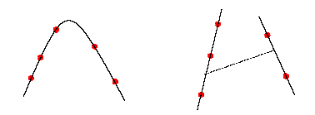
Underlying Symmetry
Integrating over higher-degree curves is equivalent to integrating over collections of intersecting straight lines!
Gukov, Motl, & Nietzke (2004)

Slide 29
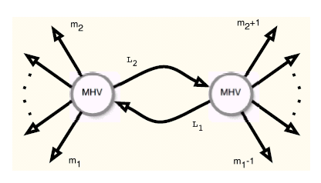
From Trees To Loops
Sew together two MHV vertices
Brandhuber, Spence, & Travaglini (2004)

Slide 30


Simplest off-shell continuation lacks iε prescription
Use alternate form of continuation
⇒
to map the calculation on to the cut + dispersion integral
Brandhuber, Spence, & Travaglini (2004)
Reproduces MHV loop amplitudes
originally calculated by Dixon, Dunbar, Bern, & DAK (1994)

Slide 31
Unitarity Method for Higher-Order Calculations
Bern, Dixon, Dunbar, & DAK (1994)
Proven utility as a tool for explicit calculations
  Fixed number of external legs
  All-n equations
Tool for formal proofs
Yields explicit formulae for factorization functions
I-duality: phase space integrals ⇔ loop integrals
cf. Melnikov & Anastasiou
Color ordering

Slide 32


Unitarity-Based Calculations
  Bern, Dixon, Dunbar, & DAK (1994)
At one loop in D=4 for SUSY ⇒ full answer
(also for N =4 two-particle cuts at two loops)
In general, work in D=4-2Є ⇒ full answer
van Neerven (1986): dispersion relations converge
Reconstruction channel by channel: find function w/given cuts in all channels

Slide 33



Unitarity-Based Method at Higher Loops
Loop amplitudes on either side of the cut
Multi-particle cuts in addition to two-particle cuts
Find integrand/integral with given cuts in all channels
In practice, replace loop amplitudes by their cuts too

Slide 34
Twistor-space structure
Can be analyzed with same differential operators
‘Anomaly’ in the analysis; once taken into account, again support on simple sets of lines
Cachazo, Svrček, & Witten; Bena, Bern, DAK, & Roiban (2004)
Non-supersymmetric amplitudes also supported on simple sets
Cachazo, Svrček, & Witten (2004)

Slide 35
Direct Algebraic Equations?
Basic structure of differential equations
D A = 0
To solve for A, need a non-trivial right-hand side; ‘anomaly’ provides one!
D A = a
Evaluate only discontinuity, using known basis set of integrals ⇒ system of algebraic equations
Cachazo (2004)

Slide 36
Challenges Ahead
Incorporate massive particles into the picture
⇒ D = 4–2ε helicities
Interface with non-QCD parts of amplitudes
Reduce one-loop calculations to purely algebraic ones in an analytic context, avoiding intermediate-expression swell
Twistor string at one loop (conformal supergravitons); connected-curve picture?

Slide 37
Another Amazing Result:
Iteration Relation
Anastasiou, Bern, Dixon, DAK (2003)
This should generalize

Slide 38
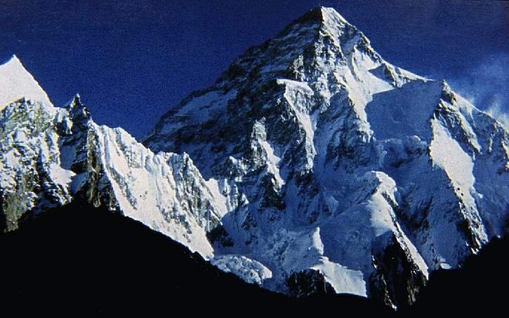
Notes:
Picture of K2

