Slide 1
Development of an Evidence-
Based Acute Care Screen
Anna Alt-White, PhD, RN
Connie Case, BSN, RN
Jackie Hind, MS
Karin Kirchhoff, PhD, RN
Beverly Priefer, PhD, RN
Maude, Rittman, PhD, RN
JoAnne Robbins, PhD
Paula Sullivan, MS
Helen Werner, PhD, RN

Slide 2
QUERI RRP: Purpose
Systematically evaluate research literature
  Identify risk factors
  Define best practices for dysphagia screening in specific populations
Using evidence, determine which risk factors and best practices are appropriate for screening all patients admitted to acute care units as required by the national VHA directive.

Slide 3
August 2007
Objectives
Define screening vs clinical bedside assessment
Determine if screen should include a water test
Identify search terms for systematic review

Slide 4
Screening
ASHA, Scottish Intercollegiate Guidelines Network (SIGN), Perry (2001) Martino (2000, 2005), Logeman(1999)
Process/procedure to identify patients at risk for dysphagia
  Risk rather than diagnosis
  Referral to SLP
Literature definitions primarily in context of screening for dysphagia in patients with stroke
Notes:
Missing here is statement equating screening with diagnosis

Slide 5
Working Definition of Screening
Process used by nurses to identify those all newly admitted inpatients who are at risk for dysphagia and who need to be seen by an SLP for further evaluation
Notes:
In addition to determining definition of screening, we also looked to published guidelines.

Slide 6
Search terms
Incidence
Signs/Symptoms
Screening tests including water tests (many different terms)
Notes:
3ounce, sip test, 50ml, Burke,

Slide 7
March 2008: Develop Screening Questions
Literature Search
  1990-2007
  Adults
  English
  Broad
Reviewed literature abstracts
3 Guiding systematic reviews
  Perry 2001
  Martino 2000 and 2005
Articles since 2004

Slide 8
Findings
Majority of articles based on stroke patients
Incidence depended on when assessed
Variety of signs associated with dysphagia
  Drooling, abnormal gag, choking, wet voice
Inconsistency of terminology
  Screening vs clinical bedside exam
Notes:
Inconsistency of terms
Inconsistency of terms
Inconsistency of terms: screening vs clinical bedside exam Different outcome measures: dysphagia as determined by aspiration on VSS, aspiration, respiratory infection; different professional performing exam—slp, md rn, dds

Slide 9
Findings (cont)
Tests varied considerably as to what assessed
Gold standard: VSS vs FEES
  VSS not standardized, order of presentation, pill optional
Different outcome measures
  Dysphagia as determined by aspiration on VSS, aspiration, respiratory infection
Different professionals performing exam
  SLP, MD, RN, DDS
Notes:
Inconsistency of terms
Inconsistency of terms
Inconsistency of terms: screening vs clinical bedside exam Different outcome measures: dysphagia as determined by aspiration on VSS, aspiration, respiratory infection; different professional performing exam—slp, md rn, dds

Slide 10
Consensus Development of Screening Questions
No water test
  Inconsistent data
  Training issue (4-8 hours training sessions)
Signs discussed in literature rejected
  Gag
  Self-report
  Voluntary cough

Slide 11
Screening Questions
Dysphagia Risk Assessment Questions: Place check in box for any “yes” answer
Diagnosis of new stroke, head and neck cancer, or traumatic brain injury
Modified texture Diet/Eating maneuvers (e.g.chin tuck; head turn)
Unable to follow commands
Wet gurgly voice
Drooling while awake
Tongue deviation from midline
If any of above boxes checked, keep patient NPO, notify provider, and send speech pathology consult.
Unable to complete screen. Reason: Ventilator, unconscious

Slide 12
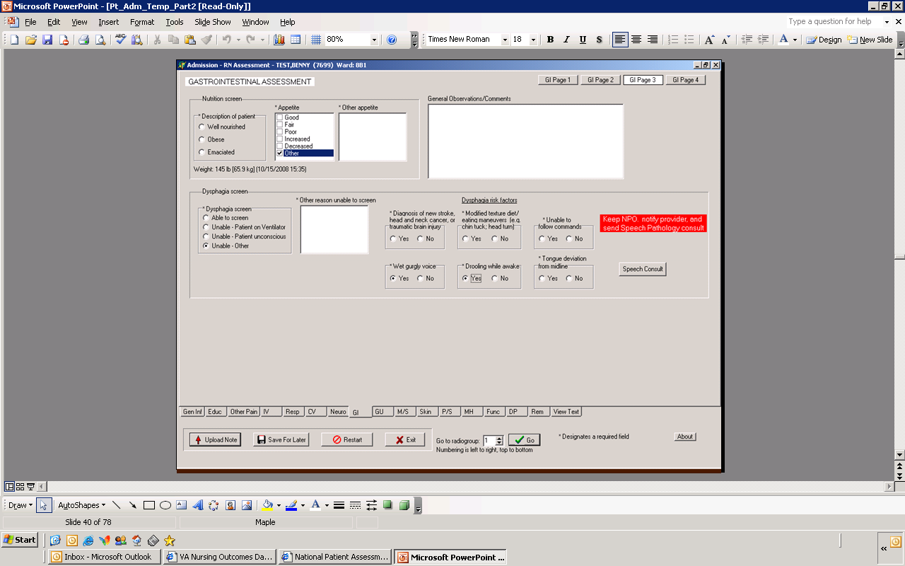
Current Status: Pilot Testing
Pilot testing

Slide 13
Dysphagia Screening and Stroke Initiatives

Slide 14

JC Guide for Primary Stroke Center Certification (Rev 10/08): Dysphagia Performance Measurement
Patients with ischemic or hemorrhagic stroke who undergo evidence-based bedside testing protocol approved by the hospital before being given any food, fluids, or medication by mouth.

Slide 15
2003 VA/DoD Guidelines
G-1 Assessment of Swallowing (Dysphagia) Recommendations
All patients have their swallow screened prior to initiating oral intake of fluids or food, (no mention of medication) utilizing a simple valid bedside testing protocol. (ECRI, 1999; Perry & Love, 2001; Martino, Pron, & Diamant, 2000) (QE: II-2; Overall Quality: Fair; R: B)

Slide 16
Stroke Dysphagia Initiatives
VA/DoD/AHA Stroke Rehabilitation Guidelines Update
VA HSR&D Stroke Toolkit

Slide 17
Canadian Stroke Guidelines:CMAJ 12/2/08
Best Practice Recommendation 6.1: Dysphagia assessment
Patients with stroke should have their swallowing ability screened using a simple, valid, reliable bedside testing protocol as part of their initial assessment, and before initiating oral intake of medications, fluid or food

Slide 18
SIGN (Scottish Intercollegiate Guidelines Network) Stroke Guidelines 2008
On admission, people with acute stroke should have their swallowing screened by an appropriately trained healthcare professional before being given any oral food, fluid, or medication.
If the admission screen indicates problems with swallowing, the person should have a specialist assessment of swallowing, preferably within 24 hours of admission and not more than 72 hours

Slide 19
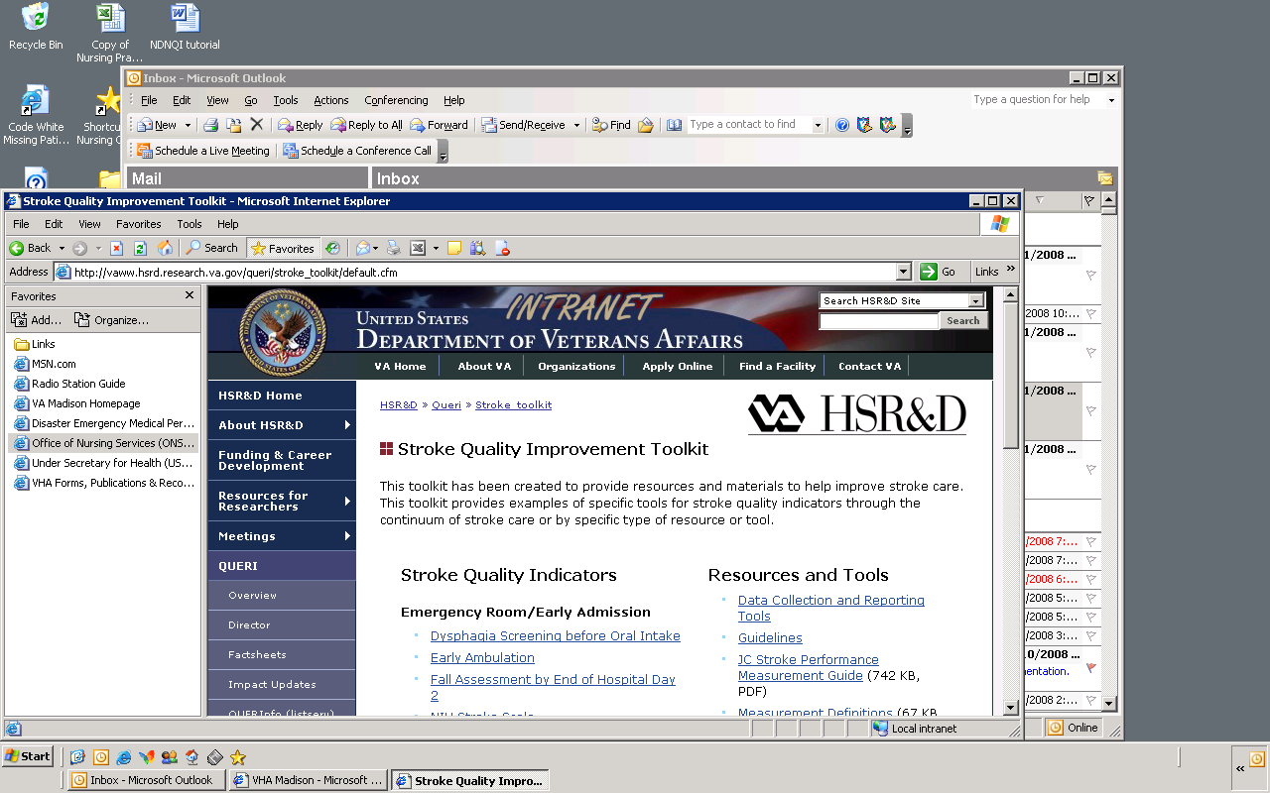
VA Stroke Quality Improvement Toolkit

Slide 20
VA Stroke Quality Improvement Toolkit
Dysphagia screen uses Indianapolis screen

Slide 21
Screening prior to initiation of Food, Fluid, Medications
Medications not part of 2003 VADoD Guidelines
Concerns regarding medications
  None of the studies evaluate safe medication swallowing
  Videofluroroscopic studies do not necessarily include pill swallowing performance
  Swallowing pills is a different process than swallowing fluids or food
  Patients vary considerably in their pill taking behavior

Slide 22
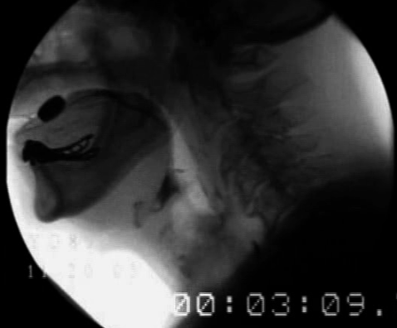
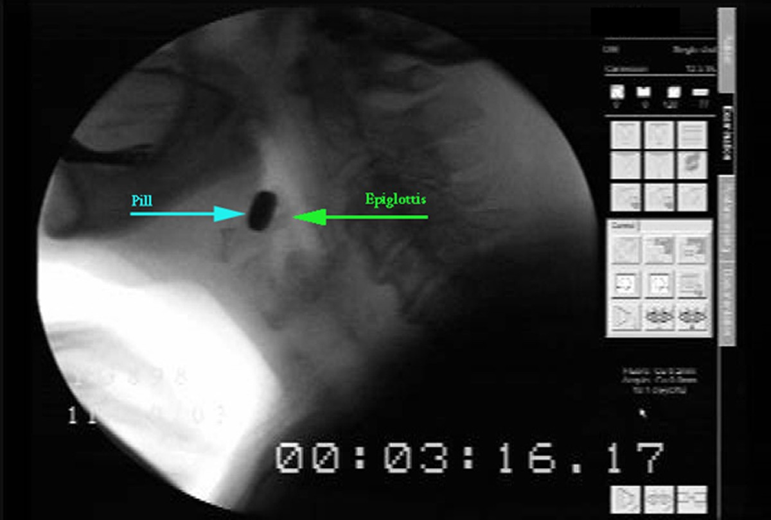
Pill Swallowing
Robbins et al, Madison VA GRECC

Slide 23
Discussion Questions
What is the purpose of dysphagia screening by nursing?
  Referral to the next level of care vs detection of aspiration
Should the VA have a common voice regarding dysphagia screening across programs?
How should the nursing screen be validated?
  What data should we collect for validation?
How should medication safety be assessed?
What is the best way to implement dysphagia screening by nursing

