Slide 1
Spotlight Case August 2006
Physical Diagnosis: A Lost Art?

Slide 2
Source and Credits
This presentation is based on the August 2006
AHRQ WebM&M Spotlight Case
See the full article at http://webmm.ahrq.gov
CME credit is available through the Web site
  Commentary by: George Thompson III, MD, and Abraham Verghese, MD, University of Texas Health Sciences Center
  Editor, AHRQ WebM&M: Robert Wachter, MD
  Spotlight Editor: Tracy Minichiello, MD
  Managing Editor: Erin Hartman, MS

Slide 3
Objectives
Appreciate the decline in proficiency and reliance on physical exam skills among health care providers
List barriers to performance of comprehensive physical examinations
List interventions that may increase competence in physical exam skills

Slide 4
Case: Physical Diagnosis: A Lost Art?
A 57-year-old male with T8 paraplegia from a remote gunshot wound, hypertension, and diastolic dysfunction presented from home with 1 week of intermittent fevers, chills, increasing shortness of breath, and low back discomfort. Due to neurogenic bladder, the patient performed self-catheterization daily. Initial physical exam was recorded as follows:

Slide 5
Case: Physical Diagnosis: A Lost Art?
General: Mild respiratory distress with audible wheezing
Vitals: Blood pressure 110/62, Pulse 106, respiratory rate 18, Temp 37.8˚, Room air saturation 100%
HEENT: Crusting periorbitally, no edema, extraocular movements intact, pupils equal round and reactive, dry tongue
Neck: No meningismus

Slide 6
Case: Physical Diagnosis: A Lost Art?
Resp: Increased work of breathing with diffuse rhonchi, crackles bilaterally
Cardiovascular: Tachycardic without murmurs or gallops, normal apical impulse, 2+ pulses throughout, no lower extremity edema
Abdomen: Normal active bowel sounds with some tenderness to palpation over the suprapubic area

Slide 7
Case: Physical Diagnosis: A Lost Art?
Skin: Stage I gluteal cleft decubiti
GU exam: Deferred
Neuro: Strength 5/5 upper extremities, 1/5 bilaterally lower extremities with flexion contractures; sensation absent below T8

Slide 8
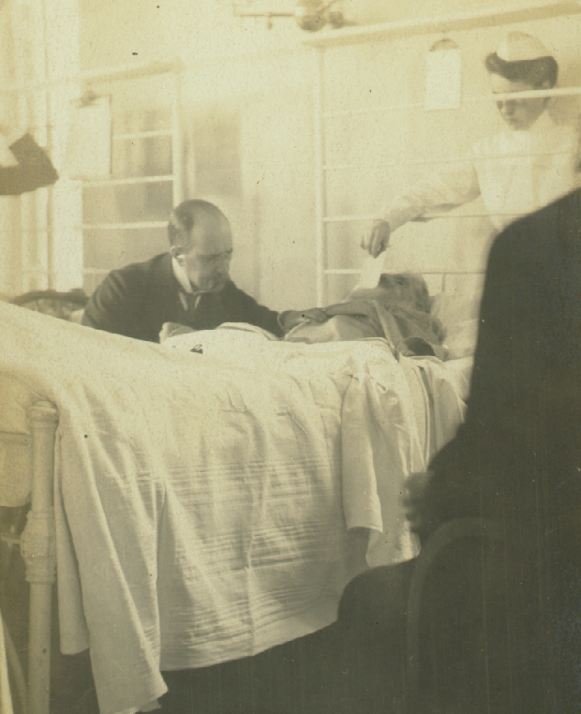
The Art of Physical Examination
The history and physical exam remain the backbone of medical evaluation and assessment
"Observe, record, tabulate, communicate. Use your five senses….Learn to see, learn to hear, learn to feel, learn to smell, and know that by practice alone you can become expert."
  Sir William Osler
Sir William Osler at a patient's bedside. Reprinted with permission.
Photograph reprinted with permission of The Alan Mason Chesney Medical Archives of The Johns Hopkins Medical Institutions.
Notes:
Photograph reprinted with permission of The Alan Mason Chesney Medical Archives of The Johns Hopkins Medical Institutions.

Slide 9
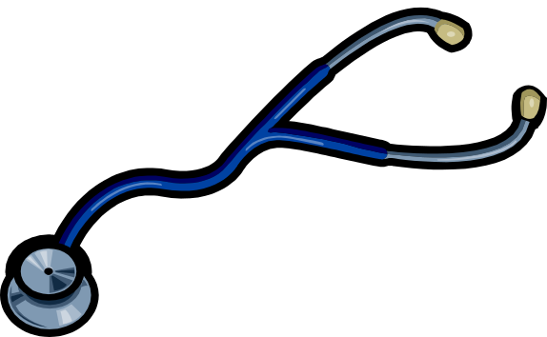
The Art of Physical Examination
Advances in laboratory and imaging technology, along with the pace of modern medicine, have resulted in the physical examination being abbreviated, undervalued,
and viewed as redundant

Slide 10
The Art of Physical Examination
Skill and familiarity with certain bedside maneuvers and confidence in eliciting physical signs declining
Increased dependence on aid of radiologist or first-tier laboratory data
Skills in getting data back and arranging for tests to be done are valued as much or more than eliciting physical findings
Emphasis on data illustrated by "rounds" at computer, PDA, not at bedside

Slide 11

The Art of Physical Examination
Physician reimbursement increasingly volume-driven
  Little or no financial reward for one's ability to pick up subtle physical examination findings
  Little time for detailed examination
Reflexive ordering of tests to traverse assorted diagnostic algorithms

Slide 12
The Physical Examination
Higher sensitivity and specificity offered by laboratory and radiologic testing makes it more likely that a physician might be reluctant to make a clinical diagnosis that could be readily made at the bedside

Slide 13
Case (cont.): Physical Diagnosis: A Lost Art?
Initial labs were significant for a white blood cell count of 20.9 with 82% segs, bicarbonate of 19, blood urea nitrogen of 27, and creatinine 1.7. Urinalysis revealed 2+ protein, +nitrite, 3+leukocyte esterase, 3+ blood, 10-25 white blood cells, and 10-25 red blood cells. Electrocardiogram revealed sinus tachycardia only. Chest radiograph revealed a bilateral interstitial edema pattern.

Slide 14
Case (cont.): Physical Diagnosis: A Lost Art?
The initial assessment by the female night float resident was sepsis from a urinary tract source and acutely decompensated diastolic heart failure. The patient was managed with afterload reduction, diuresis, oxygen, and intravenous antibiotics, and was evaluated for myocardial infarction with serial enzymes and electrocardiograms.

Slide 15
How Are Our Physical Exam Skills?
Recent study cites inability of ICU personnel to accurately determine the jugular venous pressure, calling for central venous access for determination of this parameter
  Medical students performed best, residents and attending physicians were least accurate at JVP assessment
  Medical students had participated in weekly physical exam training
  Residents/attendings admitted to infrequent attempts to routinely assess JVP
Cook DJ. Am J Med Sci. 1990;299:175-178.
Notes:
1. Cook DJ. Clinical assessment of central venous pressure in the critically ill. Am J Med Sci. 1990;299:175-178. http://www.ncbi.nlm.nih.gov/entrez/query.fcgi?cmd=retrieve&db=pubmed&dopt=abstract&list_uids=2316561

Slide 16
Why Do We Order So Many Tests?
"Defensive" medicine in an increasingly litigious environment
Loss of confidence in our abilities to extract meaningful information from the physical examination

Slide 17
Consequences of Ordering So Many Tests
The consequences of excessive reliance on diagnostic tests to convey information that should have been elicited on physical examination are twofold
  Time delay (often a day or two) in diagnosis as one awaits the test results
  The patient is exposed to the risk and side effects of tests that may not be necessary

Slide 18
The Physical Exam: Patient Perspective
Patients clearly value the physical exam
  90% of patients expected their blood pressure to be measured, and their heart, lungs, abdomen, and reflexes be examined
  Even if not essential to actual patient care, skilled exam is critical to the development of the physician-patient relationship
  Earns trust, patient confidence, may increase patient compliance
Oboler SK, et al. Ann Intern Med. 2002;136:652-659.
Notes:
3. Oboler SK, Prochazka AV, Gonzales R, Xu S, Anderson RJ. Public expectations and attitudes for annual physical examinations and testing. Ann Intern Med. 2002;136:652-659. http://www.ncbi.nlm.nih.gov/entrez/query.fcgi?cmd=retrieve&db=pubmed&dopt=abstract&list_uids=11992300

Slide 19
Case (cont.): Physical Diagnosis: A Lost Art?
The next morning, the patient was handed off to the daytime medical team. Genitourinary examination was again "deferred," and the treatment plan continued. Later that day, the attending physician examined the patient and found ecchymotic, edematous scrotal skin, a purulent perirectal fistulous tract, and perirectal crepitus.

Slide 20
Case (cont.): Physical Diagnosis: A Lost Art?
Urology and general surgery were contacted immediately. Shortly thereafter, the patient underwent surgical debridement for Fournier's gangrene, a life-threatening form of necrotizing fasciitis of the perineal area.

Slide 21
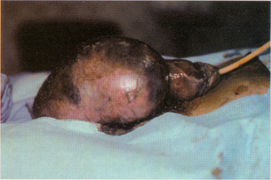
The Case of Necrotizing Fasciitis
Predominantly a clinical diagnosis, which can be made at the bedside
Direct visualization of the involved area is critical
Delay in diagnosis can be deadly
Example of Fournier's gangrene in a different patient. Reprinted with permission.
Photograph reprinted from Jiang T, et al. Fournier gangrene associated with Crohn disease. Mayo Clinic Proceedings, 2000;75:647-649, with permission.
Notes:
Photograph reprinted from Jiang T, Covington JA, Haile CA, Murphy JB, Rotolo FS, Lake AM. Fournier gangrene associated with Crohn disease. Mayo Clinic Proceedings. 2000;75:647-649, with permission.

Slide 22
Deferring Part of the Exam
Common practice of "deferring" aspects of the physical examination viewed as "non-essential" was responsible for this patient's initial incorrect diagnosis

Slide 23
Barriers to Comprehensive Physical Exam
The "hand off"
  Rely on previous caregiver's report of physical exam
The targeted physical exam
  Failure to examine parts of the body that seem unlikely to contribute to the presenting complaint
Patients unable to voice complaints
  Paraplegia
Economides E, Stevenson LW. Am Heart J. 1998;136:6-9.
Powell HS, et al. Acad Med. 2006;81:286-289.
Notes:
4. Economides E, Stevenson LW. The jugular veins: knowing enough to look. Am Heart J. 1998;136:6-9. http://www.ncbi.nlm.nih.gov/entrez/query.fcgi?cmd=retrieve&db=pubmed&dopt=abstract&list_uids=9665211
5. Powell HS, Bridge J, Eskesen S, Estrada F, Laya M. Medical students' self-reported experiences performing pelvic, breast, and male genital examinations and the influence of student gender and physician supervision. Acad Med. 2006;81:286-289. http://www.ncbi.nlm.nih.gov/entrez/query.fcgi?cmd=retrieve&db=pubmed&dopt=abstract&list_uids=16501278

Slide 24
Barriers to Comprehensive Physical Exam
Lack of confidence in performing physical exam on opposite sex, lack of chaperone
Lack of role models
Lack of requirement to demonstrate competence in physical exam
  In the United States, internists can become board certified without having their skills at the bedside tested by certifying examiners
Economides E, Stevenson LW. Am Heart J. 1998;136:6-9.
Powell HS, et al. Acad Med. 2006;81:286-289.
Notes:
4. Economides E, Stevenson LW. The jugular veins: knowing enough to look. Am Heart J. 1998;136:6-9. http://www.ncbi.nlm.nih.gov/entrez/query.fcgi?cmd=retrieve&db=pubmed&dopt=abstract&list_uids=9665211
5. Powell HS, Bridge J, Eskesen S, Estrada F, Laya M. Medical students' self-reported experiences performing pelvic, breast, and male genital examinations and the influence of student gender and physician supervision. Acad Med. 2006;81:286-289. http://www.ncbi.nlm.nih.gov/entrez/query.fcgi?cmd=retrieve&db=pubmed&dopt=abstract&list_uids=16501278

Slide 25
Take-Home Points
Physical exam skills appear to be declining as reliance on laboratory and radiologic testing has increased
Revival of the art of physical diagnosis will require increased role modeling by faculty and senior residents of such skills, and demonstration of competence for board certification
Proficiency in physical examination skills may lead to fewer missed diagnoses, improved physician-patient relations, and more economically sound medical care

