Slide 1


Infectious Disease Society of America
Andrew T. Pavia M.D.
University of Utah

Slide 2
Background
IDSA identified several key public policy priorities for action
Based on importance, potential role of IDSA in bringing stakeholders together and influencing policy
  Antimicrobial Availability Task Force
  Pandemic Influenza Task Force

Slide 3
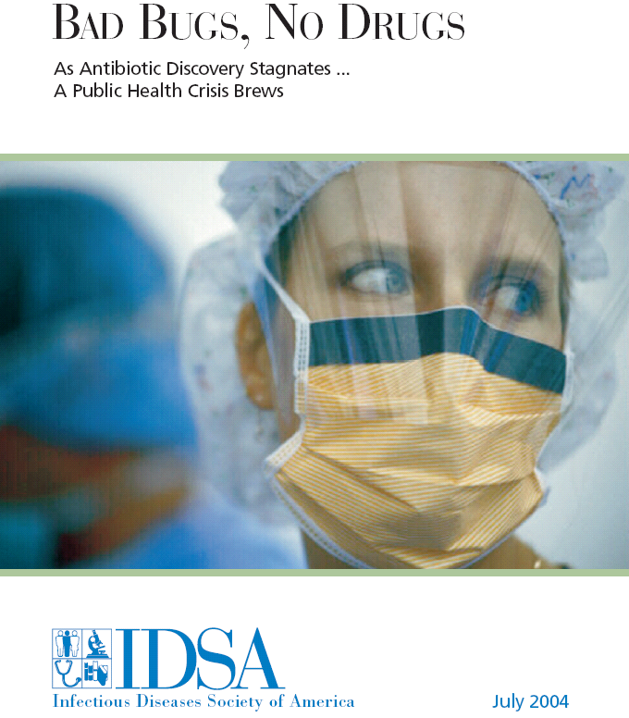
www.idsociety.org/badbugsnodrugs

Slide 4
Bad Bugs, No Drugs
Targets
  Scientific and medical community
  Industry
  Public
  Policymakers
Premise: Crisis is here, responses must be initiated now.
Lays out menu of specific remedies

Slide 5
Recommendations in Bad Bugs, No Drugs
Recommendations for Congress
Recommendations for FDA
Recommendations for NIAID
New funding needed

Slide 6
Recommendations for Congress
Commission to develop priorities
Statutory incentives
  Supplemental intellectual property protection for investment in R and D
  Provide tax incentives for R and D
  Provide FDA with statutory flexibility to deal with targeted pathogen rather than type of infection
  Create guaranteed market

Slide 7
Additional recommendations for Congress
Statutory incentives for small biotech companies entering field
Incentives for companies that develop needed diagnostics
Liability protections for companies that receive FDA approval for antibiotics that treat targeted pathogens
Limited antitrust exemptions for companies that seek to work together to expedite research on targeted antibiotics

Slide 8
Recommendations for FDA
Publish updated guidelines for clinical trials of anti-infectives
Encourage imaginative clinical trial designs that focus on efficacy against resistant pathogens
Develop and clearly define acceptable surrogate markers in trials for resistant pathogens
Work with NIAID to accelerate bench to bedside process for new anti infectives
Grant accelerated approval status to products targeted for resistant pathogens

Slide 9
Recommendations for NIAID
More aggressively expand bench to bedside development research
Increase number and size of grants for development of agents for resistant pathogens
Explore programs similar to those between NCI and FDA to expedite drug development and deployment

Slide 10
New Funding Needed
Increase funding to CDC for monitoring epidemiology of resistant pathogens
Increase funding for NIAID on translational research on treatment of resistant pathogens
Increase funding to FDA to support development and review of targeted antimicrobials

Slide 11
Concrete goals
Report card on the first meeting
What deliverables will go on the report card for this meeting?
  Specific
  Pathway
  Menu
Opportunities
  Bioshield 2
  S.B. 3 Preparedness Act of 2005

Slide 12
Opportunities for recommendations
Regulatory process
  Funding for CBER
  Identify legislative and diplomatic ways to speed harmonization
  Facilitate communication
Stockpiles
  Revenue recognition
Liability issues
  Strengthen VCIP
  Tort reform – standards of scientific evidence

Slide 13
Opportunities for recommendations
Incentives
  Valuation of vaccines
  Market
  Education
  Legislative incentives
    Facilitate new entrants
    Encourage R and D
    Maintain existing players
    Improve inter agency coordination

Slide 14
Vaccine supply issues are cross cutting
Overlap with:
  Antiviral and Antibiotic supply
  Emerging infections and other Public Health
  Biodefense
  Pandemic preparedness
Changes most often introduced in response to crisis

