Slide 1
SPECIMEN HANDLING: from patient bedside to the laboratories
(clinical, commercial and public health)
Patricia A. Somsel, Dr.P.H.
Michigan Department of Community Health

Slide 2
Challenges of Emerging Diseases
*********KNOWLEDGE GAPS*********
Epidemiology and Surveillance:
  What is the etiologic agent?
  How is it transmitted? How infectious is it?
  What are the risk factors for acquisition?
  What is the case definition? (a moving target)
  How long is the agent shed?
  When are antibodies demonstrable?
  How do we distinguish from other diseases?

Slide 3
*********KNOWLEDGE GAPS*********
Diagnostic:
  How long is the agent shed?
  When are antibodies demonstrable?
  How do we distinguish clinically from other diseases?
  How stable is the organism?
  How can we test for the agent? (sensitivity)
  What are the appropriate specimens? (What body tissues/products carry the organism?)
  What cross-rxns can we expect? (specificity)

Slide 4
*********KNOWLEDGE GAPS*********
Prevention/Safety/(Treatment)
  What are the risk factors for acquisition?
  How to handle infected patients in health care setting? In the community? Contacts?
  How to protect HCWs?

Slide 5
Health Care Issues with
Emerging Diseases

Slide 6
INFECTION CONTROL
How is the agent transmitted?
How is the agent inactivated?
What, if any, isolation precautions are necessary for the patient?
What, if any, personal protective equipment is necessary for HCWs?

Slide 7


Slide 8
INFORMED CONSENT
For Investigational tests, not yet FDA approved, performance characteristics not yet verified by testing laboratory
Confusing to physicians
Confusing to patients
Confusing to labs – what to do w/o consent?
Notes:
With SARS, a different 3 page consent required for serology and PCR testing

Slide 9
SPECIMEN COLLECTION
• What are appropriate specimens for diagnosis of an emerging disease? Multiple, non-standard, confusing to nursing staff and physicians alike.
  -Culture
  -Serology
  -PCR
  -EM/Microscopy
• HCWs may lack appropriate training to collect and hold samples until transported to lab.

Slide 10
Laboratory* Issues with
Emerging Diseases
* Clinical, Public Health and Commercial

Slide 11
LABORATORY SAFETY
and Specimen Integrity
What specimens may contain viable organism?
What personal protective equipment is appropriate?
What engineering practices are needed?
Will handling of the agent result in amplification and an increase in risk for laboratorians?
How best to store specimens to reduce lability?
Notes:
BSL-2, BSL-3?
Not just the microbiology specimen is of concern
25% of the labs in MI lack BSC!

Slide 12
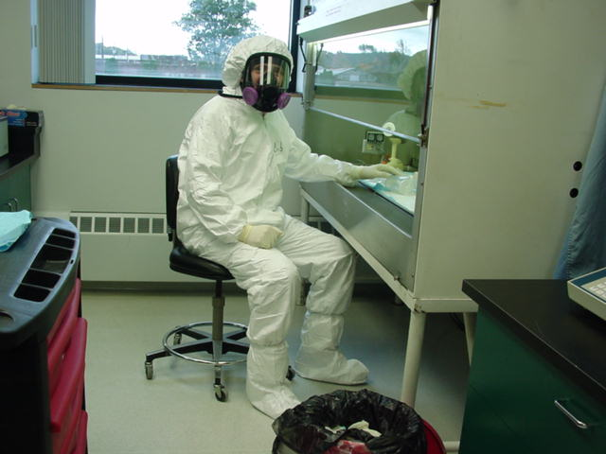

Slide 13
Packing and Shipping
DOT Hazardous Materials Regs
IATA Dangerous Goods Regs
Diagnostic Specimen vs Infectious Substance?
At what temperature? How far do specimens need to travel?
  Room temperature
  Refrigerator temperature (2-8ºC)
  Frozen
    -20ºC (freezer packs)
    -70ºC (dry ice)
Notes:
How will your specimen travel?
How long will it be in transit?

Slide 14
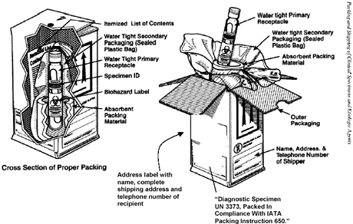
Notes:
Clinical labs, like all labs, have the added burden of having to certify those handling specimens have received training, a big hurdle for labs. For example, if a hospital has a SARS patient, but no one in the lab is officially trained to package and ship, what do they do? Cooperate with PH and defy the regulations or forego sending the specimen and thwart the investigation?

Slide 15
Consequences of Shipping Regs for Clinical Labs?
$$$$$$$ Expense to clinical lab which is not reimbursed by third party payers
Confusion
Lack of compliance
Loss of Specimens unacceptable for testing
Lack of test data to support diagnosis
Notes:
Our PHL system depends, to a large extent, upon specimens submitted on the goodwill of understaffed clinical microbiology departments who function beyond the knowledge of their administrators of the expenses incurred.

Slide 16
Public Health Laboratory Issues with
Emerging Diseases

Slide 17
Public Health Lab Testing
Surveillance
Diagnosis
Notes:
PH testing for infectious diseases fills two purposes, unlike clinical and commercial labs. PHL provide surveillance information for PH purposes, as well as on a more limited basis, providing diagnostic assistance to the clinician.

Slide 18
Tests for New Diseases
Historical Perspective
  Syphilis
  Lyme Disease
  HIV
Current status of WNV testing
Where will we go with SARS? Monkeypox?
Notes:
-tests change as disease is better characterized
-case definition changes as tests change and disease is better characterized
-surveillance easier when disease better characterized and tests more broadly available, as long as reporting is adequate

Slide 19
When PH Labs Don’t Do the Testing……
Will PH get a report of positive test?
What test was used?
Does it meet ‘case definition’?
Will a sample be forwarded to a PHL for ‘gold standard’ test if result does not meet ‘case definition’?

Slide 20
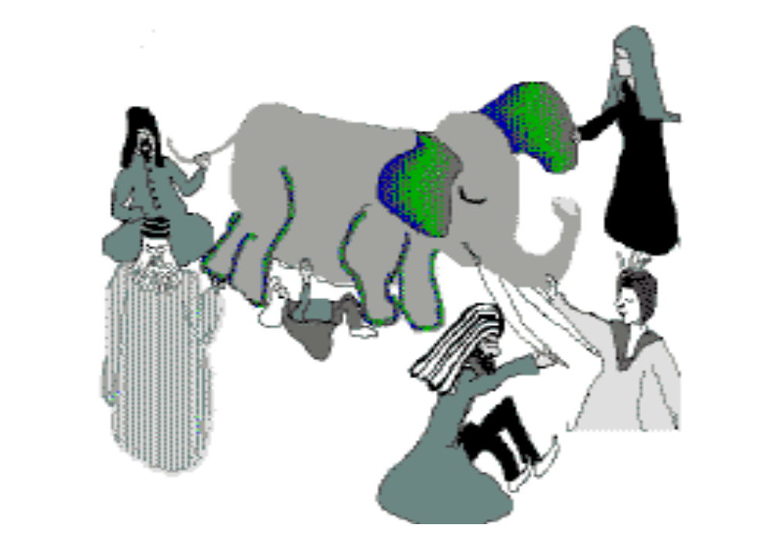

Slide 21
Conclusions
SPHLs are an essential link between clinical labs and commercial labs and the federal agencies recognizing new diseases; the health of our citizens and our nation will improve with our cooperation.
PHLs and manufacturers should collaborate to develop commercial diagnostics for emerging pathogens.
We’re all in this together.

Slide 22


