Slide 1
NIH Roadmap Re-engineering the Clinical Research Enterprise
Clinical Research Networks and NECTAR Update
Dr. Jody Sachs
Division for Clinical Research Resources
National Center for Research Resources
September 21, 2006 Council

Slide 2
NIH Roadmap Strategy
Interdisciplinary Research
Pioneer Award
Nanomedicine
Training
National Clinical
Research Associates
Public Private
Partnerships
Bench
Bedside
Practice
Building Blocks Pathways
Molecular Libraries
Bioinformatics and
Computational
Biology
Structural Biology
Nanomedicine
Clinical
Research
Informatics
Integrated Research
Networks
Clinical outcomes
Translational
Research
Initiatives
Notes:
The Roadmap Strategy has explicitly included the integrated delivery systems from its inception.
(This is from a Dr Zerhouni briefing, Feb 2004.)

Slide 3








Molecular
Libraries
and Imaging
Re-engineering the
Clinical Research
Enterprise
Building Blocks,
Biological Pathways
and Networks
Clinical
Enterprise
Structural
Biology
Implementation
Groups
Public-Private
Partnerships
Bioinformatics and
Computational Biology
High-risk
Research
Interdisciplinary
Research
Nanomedicine
New Pathways to Discovery
Research
Teams
Notes:
These are the major initiatives within the Roadmap.
Re-engineering the Clinical Research Enterprise is the initiative that will be discussed in this presentation using the two most significant examples, CTSA and NECTAR.
(This is from a Dr Zerhouni briefing, Feb 2004.)

Slide 4

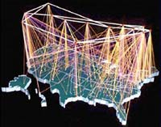
Integrating Clinical
Research Networks
National Electronic Clinical Trials and Research Network
NECTAR
Link existing networks so clinical studies and trials can be conducted more effectively
Ensure that patients, physicians, and scientists form true “Communities of Research”
Notes:
General notion of integration within and between clinical research networks.
Introduces NECTAR.

Slide 5
NECTAR Pilot Projects and Inventory of Networks
Complementary programs:
  NECTAR focuses on linking organizations together
  CTSA focuses on the academic institutions
CTSA builds the homes for clinical and translational science. CTSA emphasizes internal and inter-institution nationwide interoperable informatics.
NECTAR and the CRN Inventory discover best practices for existing clinical network management. The NECTAR Pilot Projects explore how to integrate and expand clinical networks.

Slide 6
NECTAR Pilot Projects and Inventory (FY04-FY06)
CRN Inventory provided current status of about 250 clinical research networks
http://www.ClinicalResearchNetworks.org
NECTAR Pilot Projects have broad coverage:
  Medical disciplines (cancer, heart, critical care, psychiatry, transplant)
  Populations/settings (primary care, rural, minority, HMO)
  Ages (pediatric, adult, geriatric)
  Information systems (data standards, informatics, tools, platforms)
  Geographic locations (U.S./Global)
Notes:
Long Range Goals:
To develop networks based on common infrastructure elements, e.g., informatics, governance, common language, and training activities, that conduct research in both academic and clinical care settings
The inventory, executed by Westat, did an extensive survey of clinical research networks, the results were analyzed and discussed in a large meeting in June 2006. The result is a living document on the web at the URL shown. Changes are being made as networks change and as new networks are identified.
There are 12 Pilot Projects in NECTAR today, quite varied, as shown.

Slide 7
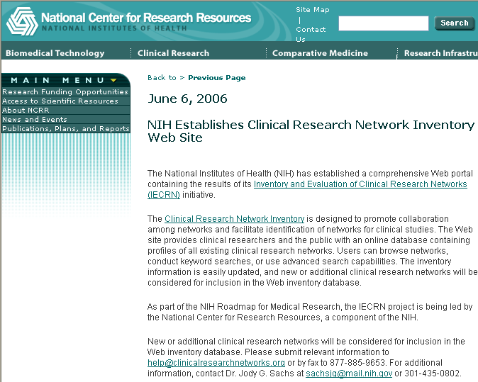
Clinical Research Networks Inventory http://www.ncrr.nih.gov/IECRN_announce.asp

Slide 8
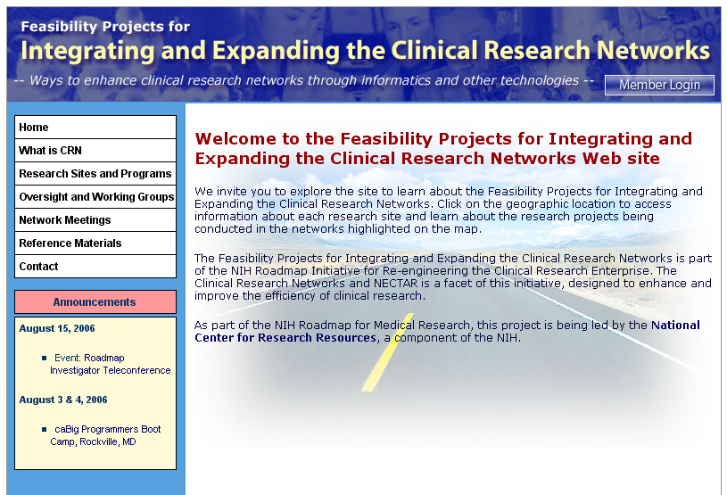
NECTAR Network Projects
www.cceb.upenn.edu/roadmap
    Long Range Goals:
    To develop networks based on common infrastructure elements, e.g., informatics, governance, common language, and training activities, that conduct research in both academic and clinical care settings

Slide 9
Feasibility Network Projects
Overall themes
Making systems interoperate
  Standards
  Open Source
  Brokering
Integrating informatics in support of Translational research
Cross-disciplinary: organisms, tissues, cells, genes
  Balancing clinical and research needs
Reducing barriers to research
  Regulatory issues
  Workflow
  Human Performance
Disseminating knowledge into practice
  Best Practices
  Cross-fertilization
  Communication

Slide 10
Feasibility Projects Scope
Examples:
Test new approaches to IRB Coordination
PRISM: IRB Readability Tool CCSN (Larson)
Improve Data Management System in Clinical Research
Honest Broker and Clinflo Tracker (Clauw)
Harmonize Blood and Bone Marrow Registry Global
A Glowable Network Exchange System (Confer)
Define Cardiology and TB Data Standards
CTN Best Practices (Harrington) & TB Trial Network (Dukes-Hamilton)
Conduct Clinical Trials in Community Setting
InterTrial (Johnson)

Slide 11
National Leadership Forum
May 31 and June 1, 2006
DoubleTree Hotel, Rockville, Maryland http://nihroadmap.nih.gov/publicmeetings.asp
Engage CRN leaders in building a common framework for dialogue on the NIH Roadmap initiative; present candidate “best practices”
Support cross-network exchange in the CRN community
Provide a springboard to ongoing dissemination of information and practice models to the CRN community

Slide 12
Clinical Research Network
Snapshot 2006 View
Findings from the Clinical Research Networks Inventory:
51% were established in the last six years
60% are government funded
half serve group or individual practices
newer networks were more likely to study minorities or underserved or rural population
Standards Challenges
There are currently no standards defined for clinical research
60% have developed some kind of standard
Reports are available on the IECRN web site: https://www.clinicalresearchnetworks.org/reports.asp

Slide 13

Clinical Research Networks
Future Needs:
Reduced costs, startup time, overall duration, duplication for clinical trials
Increased public awareness and participation in clinical research
Enhanced access of clinical research data by researchers & regulatory organizations

Slide 14

NIH and the President’s Health Information Technology Strategic Plan
Transform Clinical
Practice
Interconnect
Physicians
Optimize Efficiency and Productivity of Biomedical Research
Basic exploration
  Bioinformatics and computational biology
Accelerate research translation
  Regional translational research centers
Research IT systems
  NECTAR
  caBIG
  Vocabularies
  Standards
Empower
Patients
Improve
Population
Health
Notes:
There is a natural connection between the needs of translational research and healthcare IT.
This is being explored within the context of NECTAR, CTSAs and directly with our partners in DHHS: especially AHRQ and HRSA.
NCRR and AHRQ jointly organized a successful meeting (including research and industry) on this topic in May. Results are feeding the Nationwide Health Information Network (NHIN) process run by the DHHS/Office of the National Coordinator for Health IT.
This is very exciting, to harness the record-keeping capability of a growing nationwide health IT system to support many forms of clinical and translational research (in addition to epi. and so on) has enormous potential.

Slide 15
Informatics Developments Relevant To Clinical Research www.ncrr.nih.gov/CRinformatics/mitre.asp
NCRR engaged the non-profit MITRE Corporation in early 2006 to track informatics developments relevant to clinical research, and to provide strategic advice in this area.
Public reports are part of the MITRE deliverables to NCRR. Three reports are already on the NCRR website, additional reports ready in September.
NARCC attendees have copies of the three published reports and two that are in final draft.

Slide 16
MITRE Informatics Reports
Office of the National Coordinator for Health Care Information Technology (ONC)
Electronic Health Records (EHRs) in Academic Medical Centers
cancer Biomedical Informatics GridTM (caBIGTM )
caBIGTM : Opportunities and Challenges for Use Beyond Cancer [DRAFT]
caBIGTM : Conceptual View of Use Beyond Cancer [DRAFT]
The first five reports plus a glossary were distributed. Additional reports are in preparation.

