Slide 1


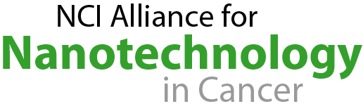
NCI Alliance for Nanotechnology in Cancer:
Research Advances and Development of Clinical Applications
Anna D. Barker, Ph.D.
Deputy Director, National Cancer Institute
National Cancer Advisory Board Meeting
June 14, 2006

Slide 2
The Potential of Nanotechnology
Nanotechnology has the potential to be the key enabler for the transition of molecular-based science into the clinic, facilitating major advances in the early detection, diagnosis, and treatment of cancer.

Slide 3

Detection, Treatment, Prevention:
Nanotech from Bench to Bedside
Real-time Therapeutic Monitoring
High sensitivity
Gene/protein detection
Real-time therapeutic monitoring
Ultrasensitive
Biomarker Detection
Target Identification and
Validation
Lead Development
Animal Studies
Clinical Trials
Early Detection
Diagnosis
Treatment
Patient
Care
High Content
Cellular Assays
Contrast and Optical Imaging Agents
Multifunctional Targeted Nanoparticles

Slide 4
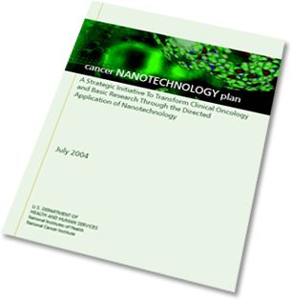
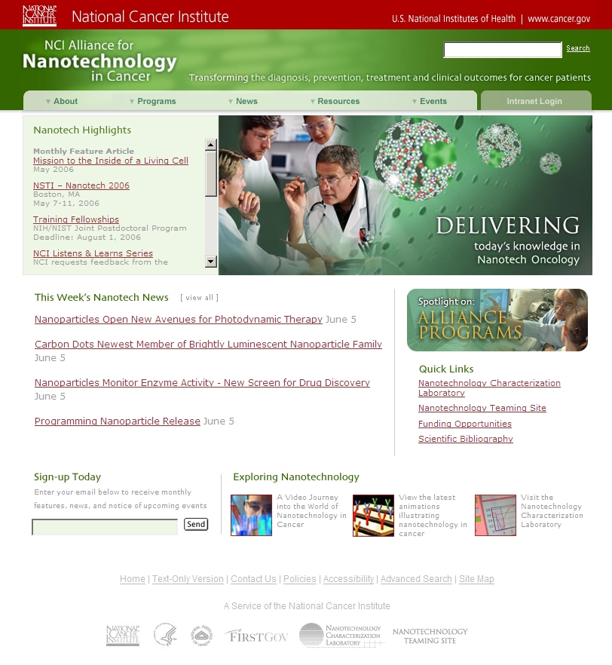
NCI Strategic Approach to Nanotech
Early investments
  Novel technologies through the Unconventional Innovations Program
  since 1998
Counsel from the community
  Input from the scientific, cancer research and advocacy communities
Planning a comprehensive effort
  Cancer Nanotechnology Plan to drive systems-level change and catalyze product development
Launch of the Alliance
  NCI Alliance for Nanotechnology
  in Cancer in 2004
Milestone-driven execution
  Defined programs; collaborators; milestones; reporting processes

Slide 5
NCI Alliance for Nanotechnology in Cancer
Goals:
Research tools to identify new biological targets
Agents to monitor predictive molecular changes and prevent precancerous cells from becoming malignant
Imaging agents and diagnostics to detect cancer in earliest, most easily treatable, pre-symptomatic stage
Multifunctional targeted devices to deliver multiple therapeutic agents directly to cancer cells
Systems to provide real-time assessments of therapeutic and surgical efficacy
Novel methods to manage symptoms that reduce
quality of life

Slide 6
NCI Nanotech Alliance Programs
Centers of Cancer Nanotechnology Excellence
Nanotechnology Platforms for Cancer Research
Multidisciplinary Research Teams
  Training
  Interagency Collaborations
Nanotechnology Characterization Laboratory

Slide 7
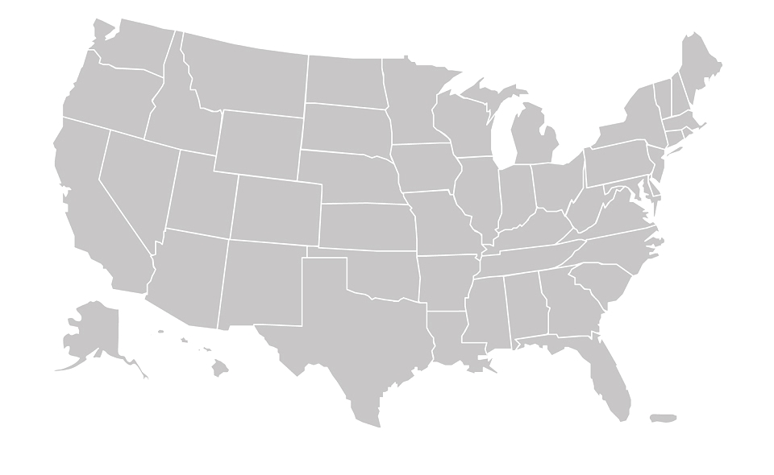
NCI Nanotech Alliance Program Awards
Nanotechnology Platform for Pediatric Brain Cancer Imaging and Therapy, University of Washington, Seattle, Wash.
Integrated System for Cancer Biomarker Detection, Massachusetts Institute of Technology, Cambridge, Mass.
Novel Cancer Nanotechnology Platforms for Photodynamic Therapy and Imaging, Roswell Park Cancer Institute, Buffalo, N.Y.
Multifunctional Nanoparticles in Diagnosis and Therapy of Pancreatic Cancer, State University of New York, Buffalo, N.Y.
MIT-Harvard Center of Cancer Nanotechnology Excellence, Cambridge, Mass.
DNA-linked Dendrimer Nanoparticle Systems for Cancer Diagnosis and Treatment, University of Michigan, Ann Arbor, Mich.
Detecting Cancer Early with Targeted Nano-probes for Vascular Signatures, University of California, San Francisco, Calif.
Nanotherapeutic Strategy for Multidrug Resistant Tumors, Northeastern University, Boston, Mass.
Photodestruction of Ovarian Cancer: ErbB3 Targeted Aptamer-Nanoparticle Conjugate, Massachusetts General Hospital, Boston, Mass.
Nanomaterials for Cancer Diagnostics and Therapeutics, Northwestern University, Evanston, Ill.
Metallofullerene Nanoplatform for Imaging and Treating Infiltrative Tumor, Virginia Commonwealth University, Richmond, Va.
Center for Cancer Nanotechnology Excellence Focused on Therapy Response, Stanford University, Palo Alto, Calif.
Hybrid Nanoparticles in Imaging and Therapy of Prostate Cancer, University of Missouri, Columbia, Mo.
Nanosystems Biology Cancer Center, California Institute of Technology, Pasadena, Calif.
Center of Nanotechnology for Treatment, Understanding, and Monitoring of Cancer, University of California, San Diego, Calif.
The Siteman Center of Cancer Nanotechnology Excellence at Washington University, St. Louis, Mo.
Carolina Center of Cancer Nanotechnology Excellence, University of North Carolina, Chapel Hill, N.C.
Nanotechnology Platform for Targeting Solid Tumors, The Sidney Kimmel Cancer Center, San Diego, Calif.
Near-Infrared Fluorescence Nanoparticles for Targeted Optical Imaging
University of Texas M. D. Anderson Cancer Center, Houston, Texas
Emory-Georgia Tech Nanotech-nology Center for Personalized and Predictive Oncology, Atlanta, Ga.
Centers of Cancer Nanotechnology Excellence (8)
Cancer Nanotechnology Platform Partnerships (12)

Slide 8
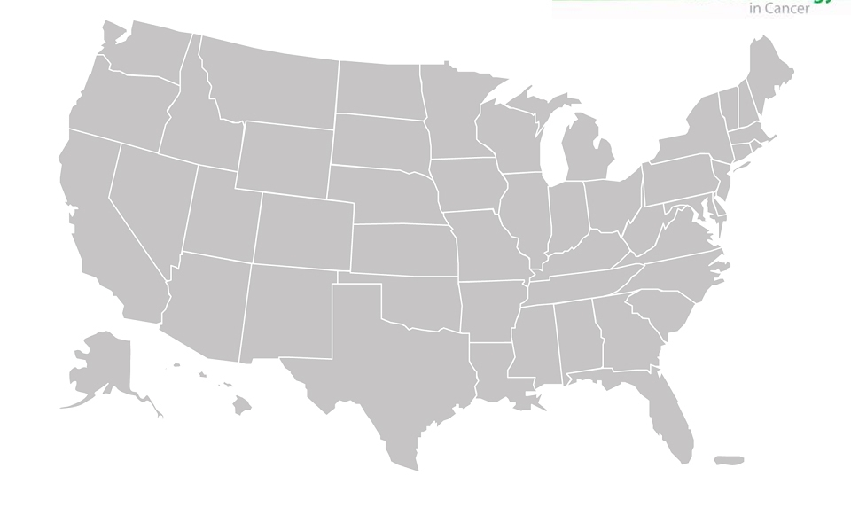
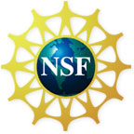
NCI-NSF Nanobiotechnology Collaboration:
Training the Next Generation
Building Leadership for the Nanotechnology Workforce of Tomorrow, University of Washington, Seattle, WA – Marjorie Olmstead, PI
Nanomedical Science and Technology, Northeastern University, Boston, MA – Srinivas Sridhar, PI
NanoPharmaceutical Engineering and Science, Rutgers University, New Brunswick, NJ – Fernando Muzzio, PI
Integrative Nanoscience and Microsystems, University of New Mexico, Albuquerque, NM –
Diana Huffaker, PI
IGERT Training Grants (4)

Slide 9
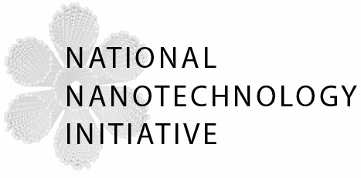

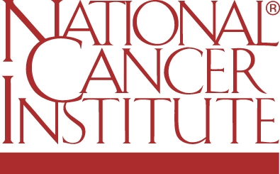

Interagency Collaborations
Standards/Precision Measurement Capabilities
Training
Dissemination
of Results
Public Interface
Interpret Data on Environment, Health and Safety
Shared Data and Platforms

Slide 10
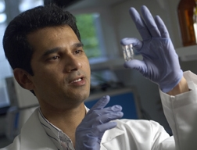

Nanotechnology Characterization
Laboratory (NCL)
NCL Role:
  Interface with CCNEs, individual investigators, NIST and FDA
  to develop standards and characterization data for nanoscale materials
  Perform preclinical toxicology, pharmacology, and efficacy testing of nanoscale devices
  Formulate and validate
  protocols for physical, in vitro, and
  ADME/tox characterization
  of nanoparticles

Slide 11
Novel Attributes of the
NCI Nanotech Alliance
Steady interaction among Alliance participants and the community through:
Governance Committee
Continual evaluation of project programs through performance milestones
Teleconferences
Technology Transfer, Intellectual Property, and Communications Working Groups
Website with “Knowledge Environment” and secure Intranet for Alliance members
Advocacy involvement on an ongoing basis

Slide 12
NCI Nanotech Alliance:
The Challenge and Deliverables
Produce tangible solutions which are clinically applicable, in a short period of time
Medical community expects significant advances:
  Where solutions are currently non-existent
  Where replacement technologies are superior to existing methods
Identify “early successes”
Program as viable addition to existing NCI funding portfolio:
  Well interconnected
  Truly produces a paradigm change

