Slide 1
Informationist Services at the NIH Library
Susan Whitmore
Chief, Information & Education Services Branch
NIH Library
U.S. Department of Health and Human Services
June 2008

Slide 2
NIH Library Setting
National Institutes of Health in Bethesda, Maryland
NIH has 20,000 employees, about half are in scientific or clinical positions
Library has 54 full-time employees and 20 contractors
Biomedical research library that supports U.S. government agency engaged in translational bench-to-bedside research
Library services available through website and informationist service

Slide 3
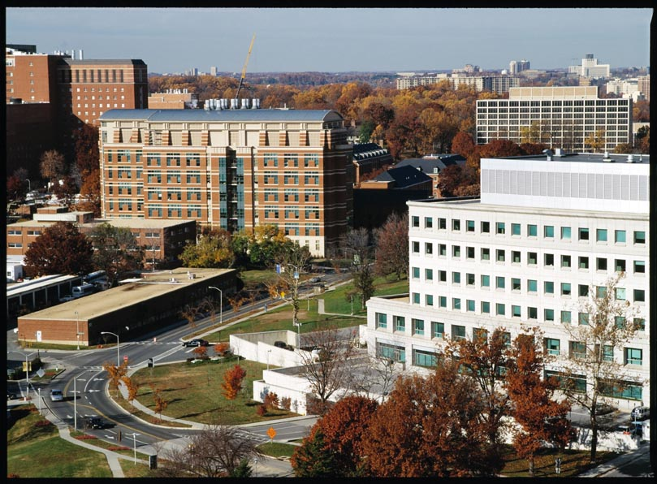

Slide 4
Informationists at NIH
Program started in 2001
Currently 14 informationists serving over 40 groups in 16 institutes or centers
Information specialists trained in information science and a specific subject area – biomedicine, behavioral or social sciences
Embedded in clinical or research environment
Collaborators

Slide 5
Initiating the Service
Endorsement by management
Team mentor
Acculturation

Slide 6
Training in Scientific or Clinical Subjects
NIH courses
Local universities and colleges
Online courses
CEU and conference attendance
Tailored in-house courses
Tuition and release time

Slide 7
Job Responsibilities - Clinical
Rounds
Protocol development and review
Database knowledge or access
Analysis of literature
Individualized instruction
Manuscripts
Current awareness

Slide 8
Job Responsibilities - Research
Bibliometric analysis of the literature
Manuscripts
Journal clubs
Database development and population
Chemical structure, patent and competitive intelligence literature searches
Analyze microarray data
International efforts

Slide 9
Informationists – Bringing the Library to the Researcher
Robison, R., D.G. Cooper, M.E. Ryan. 2007. NIH Research Festival Poster
Qualitative research
Key informant interviews and critical incident reporting
Clinical 72%, Research 12%, Administrative 8%, Other 8%
Interview questions

Slide 10
Major Themes – Robison et al.
Skills of informationist
  Bibliographic expert
  Portal to unfamiliar resources
Impact of informationist
  Time-saver
  Trainer
  Library interface
Perceptions of informationist
  Teammate

Slide 11
How Do You Know If You Are Successful?
Metrics
Critical incidents
Survey

Slide 12
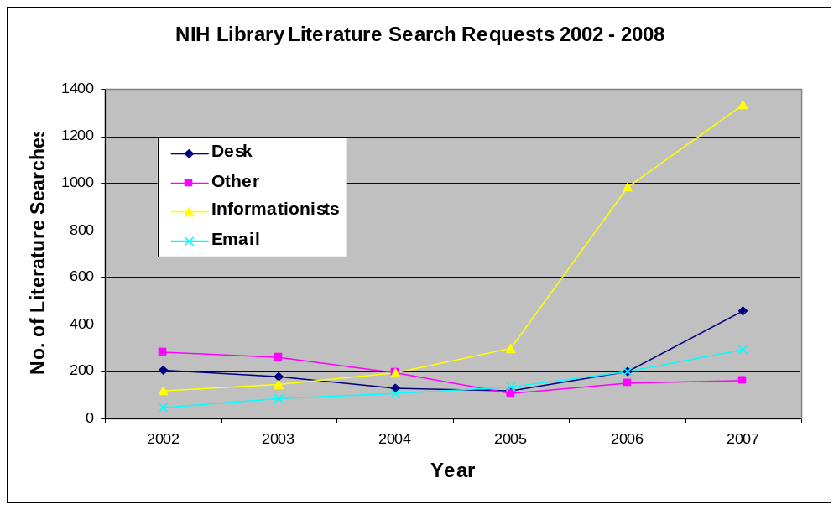
Metrics – Literature Searching

Slide 13
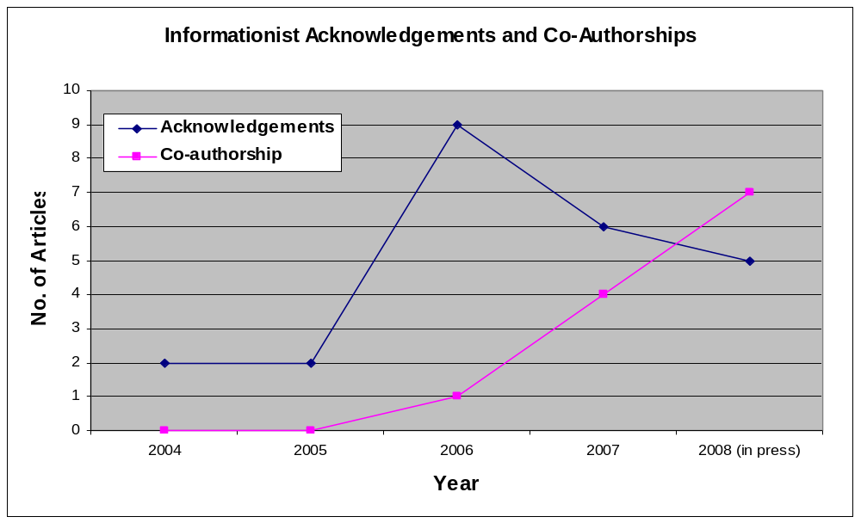
Metrics - Acknowledgements and Co-Authorship

Slide 14
Critical Incidents Database
Comments – “…besides you are part of our team”
Cash award from client – “..I want to show off one of our own”
Office space
Acceptance – “Gee, it really is helpful to have your assistance”
Request for informationist service
Fill in for research staff
Request to be co-author of systematic review
Request to provide course module/training for new fellows

Slide 15
Survey
Focus group 2003, surveys in 2004 & 2006
Major survey findings:
  More able to pursue answers to their questions
  Time less of an obstacle
  Information easier to find
  Wider range of resources consulted
  Informationist added expertise, found info they wouldn’t have found, added thoroughness, saved them time, reduced workload
  Loyalty to informationist
  Recognition of value of subject expertise
Need for more research – local and multisite

Slide 16
Lessons Learned
Get high level buy in
Find a mentor
Be flexible
Develop subject expertise
Be visible

Slide 17
Contact Information
Susan_whitmore@nih.gov
301-496-1157
Whitmore, S.C., S. F. Grefsheim, J.A. Rankin. Informationist programme in support of biomedical research: a programme description and preliminary findings of an evaluation. Health Information and Libraries Journal 25: 135-141. 2008.

