Slide 1




Transforming Translation:
Harnessing Discovery for Patient & Public Benefit
A Report to the National Cancer Advisory Board
from the Translational Research Working Group
June 15, 2007 - Bethesda, Maryland
Ernest Hawk, MD, MPH
NCI/OD/Office of Centers, Training & Resources
Lynn Matrisian, PhD
Vanderbilt-Ingram Comprehensive Cancer Center
William Nelson, MD, PhD
Sidney Kimmel Comprehensive Cancer Center at Johns Hopkins
Notes:
Luxury of understanding a disease well enough for it to be prevented
Knowledge has come about very quickly…adenomas only recognized as precursor lesions within the last 50 years
Inspiring – so much is known, and humbling – so much is unknown

Slide 2
NIH Mission Statement
“Science in pursuit of fundamental knowledge about the nature and behavior of living systems
&
the application of that knowledge to extend healthy life and reduce the burdens of illness and disability”
http://www.nih.gov/about/index.html#mission.htm

Slide 3
Translational Research Working Group
Charge:
Evaluate the current status of NCI’s
investment in translational research
& envision its future in an inclusive, representative & transparent manner

Slide 4
NCI’s “Bench to Bedside & Back” Research Infrastructure & Programs
CPTAC
CCNE
NCDDG
CCR
DCEG
DCB
DCP
DCCPS
DCTD
OCTR
OTIR
Cross-NCI
Integrated
Systems
Biology
MMHC
RAID/
RAPID
58 centers; ~$130 M/year
ICMIC
NTROI
EDRN
DCP/DCTD
Phase I/II Trials Programs
Cooperative
Groups
CCOPs
PO1s
SPOREs
Intramural Program
RO1s
61 centers; ~$240 M/year
Cancer Centers
Basic
Phase I Trials
Phase II Trials
Phase III/IV Trials
“Translational Science”
“Clinical Trials”

Slide 5
Why Convene a TRWG? Why Now?
Major advances in
cancer biology
Resources
Changing environment
Growth
Diversity
Competition
UNTENABLE
Business as Usual?
Magnitude
Translational systems
that cannot keep pace
Expectations
Opportunities
Time

Slide 6
TRWG’s Activities
Recruited leadership & members
Reviewed 11 foundational documents
Analyzed Clinical Trials Working Group process for ideas, challenges & lessons learned
Developed web-based communication platform (www.cancer.gov/trwg)
Gathered public input on key questions & proposed solutions
  Public Roundtable I (Phoenix) + web – February 2006
  Industry/foundation/society Roundtable (Philadelphia) – April 2006
  Public Roundtable II (Atlanta) + web – November 2006
Analyzed NCI’s current investments in TR
  Portfolio analysis – Process analysis
Mapped 6 developmental pathways to clinical goals
Constituted 6 subcommittees
  Organization & funding – Prioritization
  Core services – Project management
  Training/workforce – External integration

Slide 7
TRWG Subcommittees
Overall Leadership | Organization & Funding | Core Services Coordination | Prioritization
Hawk, Ernest | Gray, Joe | Cowan, Kenneth | Tlsty, Thea
Matrisian, Lynn | Reid, Brian | Schnall, Mitchell | Schilsky, Richard*
Nelson, Bill | Bast, Robert* | Bigner, Darell | Abbruzzese, James
 | Caligiuri, Michael | Buetow, Kenneth | Emanuel, Peter
 | Cote, Richard | Doroshow, James | McGrath, Gail
 | Dennis, Phillip | DuBois, Raymond | McTiernan, Anne
 | Gomez, Jorge | Jacks, Tyler | Mohla, Suresh
 | Gritz, Ellen | Look, A. Thomas | Perez-Soler, Roman
 | Hait, William | Maslow, David | Rabkin, Charles
 | Kerr, David | Schlom, Jeffrey | Weiner, Louis
 | Scheinberg, David
 | Simon, Richard
 | Sullivan, Daniel
*Serving on more than one subcommittee, as able
Blue = Co-chairs

Slide 8
TRWG Subcommittees
Project Management | Training & Workforce | External Integration
Lawrence, Theodore | Lyerly, H. Kim | Courtneidge, Sara
Limburg, Paul | Olopade, Olufunmilayo | Gordon, Gary
Collins, Jerry | Bast, Robert* | Alberts, David
Esserman, Laura | Dubinett, Steven | Anderson, Kenneth
Fenton, Laurie | Hong, Waun Ki | Cheever, Martin
Nichols, Cherie | McLeod, Howard | DiBisceglie, Adrian
Sellers, Thomas | Moore, Ida “Ki” | Downing, Gregory
Sidransky, David | Oberholtzer, John Carl | Gilmer, Tona
Srivastava, Sudhir | Schilsky, Richard* | Lubenow, Anne
 |  | Pazdur, Richard**
 |  | Sigal, Ellen
*Serving on more than one subcommittee, as able
**FDA was represented by various employees
Blue = Co-chairs

Slide 9

TRWG’s Definition of
Translational Research
Research that transforms scientific discoveries arising in the lab, clinic or population into new clinical tools & applications that reduce cancer incidence, morbidity & mortality
Lab
New Tools &
New Applications
Clinic
Population
www.cancer.gov/trwg

Slide 10
The Translational Continuum*
Refining the TRWG’s Scope of Activity
Basic Science
Discovery
Promising molecule or gene target
Candidate protein biomarker
Basic epidemiologic finding
Early Translation
Partnerships & collaboration (academia, government, industry)
Intervention development*
Phase I/II trials
Late Translation
Phase III trials
Regulatory approval
Partnerships
Production & commercialization
Phase IV trials – approval for additional uses
Payment mechanism(s) established to support adoption
Health services research to support dissemination & adoption
Dissemination*
To community health providers
To patients & public
Adoption
Adoption of advance by providers, patients, public
Payment mechanism(s) in place to enable adoption
Focus of TRWG
*New drug, assay, device,
behavioral intervention,
educational materials, training
Interface with CTWG
& its Recommendations
*President’s Cancer Panel, 2004-2005 Annual Report

Slide 11
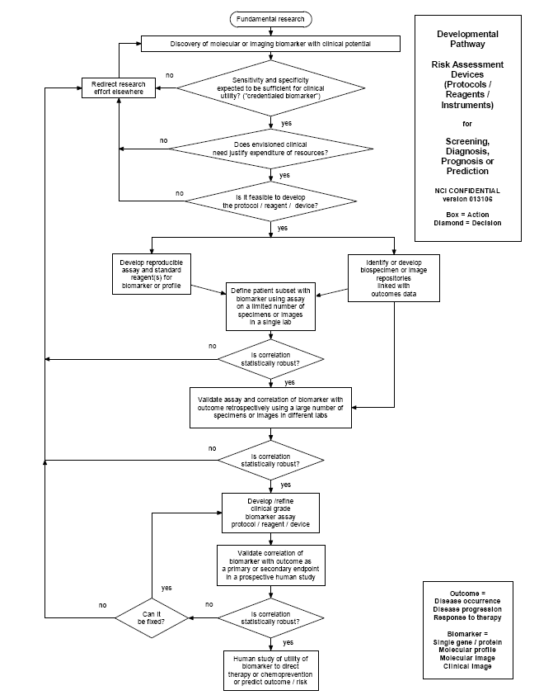
Pathways to Clinical Goals
Risk Assessment
(for screening, diagnosis, staging, response assessment, prognosis, or prediction)
Biospecimen-based (protocols, reagents, instruments)
Image-based
(agents, techniques)
Interventions
Agents
(drugs or biologics)
Immune response modifiers
Interventive devices
Lifestyle alterations
www.cancer.gov/trwg

Slide 12
The Convergence of Risk- & Intervention-Related Pathways in Translational Progress
Fundamental Discovery
in Lab, Clinic, or
Population
Parallel
Translational
Efforts
Develop, Optimize, Validate
Develop, Optimize, Validate
Intervention
Develop, Optimize, Validate
Assessment Tool for
Endpoint//
1. Agent (Drug/Biologic)
Assessment Tool for
Cohort
Selection
Evaluation of Target Effects
2. Immune Response Modifier
1. Risk Assessment Device
1. Risk Assessment Device
3. Interventive Device
2. Imaging BIomarker
2. Imaging Biomarker
4. Lifestyle Alteration
Intervention, Cohort, &
Endpoint (ICE) of an
Early Phase Clinical Trial

Slide 13
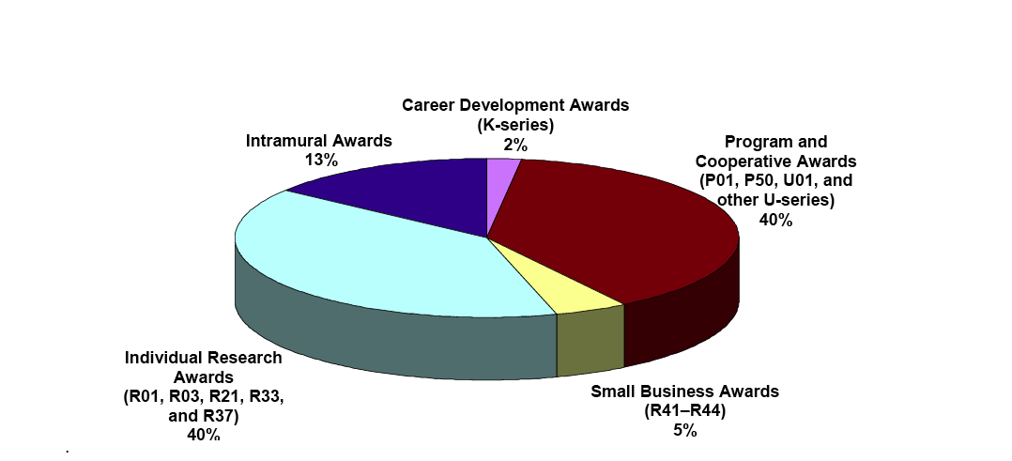
Portfolio Analysis of NCI’s
Translational Research Funding in FY04
$1.3B of $4.4B budget (~30%)
  May be overestimated by 20-40%
56% awarded to institutions with NCI-designated cancer centers
Distributed across funding mechanisms

Slide 14
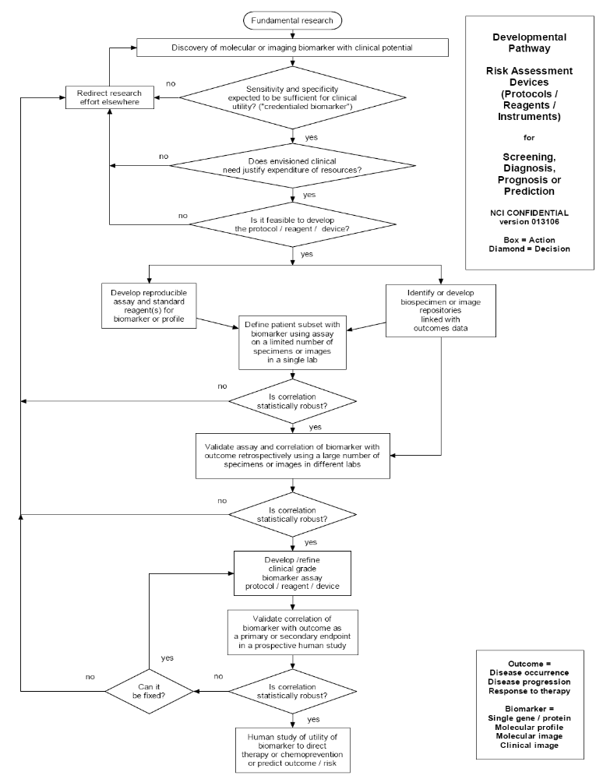
The Challenge of Early Translation
How can we best assure that
  The most promising concepts enter the developmental pathways?
  Concepts that enter advance to the clinic or to productive failure?
  Progress is as rapid, efficient & effective as possible?

Slide 15
Translational Research Working Group Report
Summary Vision
Build a focused, collaborative, multi-disciplinary enterprise, tailored to the distinctive requirements of early translational research, which transforms and strengthens this essential link
from discovery to patient & public benefit

Slide 16
Translational Research Working Group Report
Key Objectives
Improve coordination & collaboration & instill a culture of active, goal-oriented management
Improve identification of the most promising opportunities through a transparent & inclusive prioritization process driven by scientific promise & clinical need
Tailor new & existing funding programs to facilitate progress & incentivize researcher participation
Enhance operational efficiency & effectiveness for individual projects and their many supporting activities

Slide 17
Common Themes of TRWG Initiatives
A - Coordinated Management
  Facilitate TR through a flexible, integrated NCI organizational approach
  Achieve a shared understanding of the nature and scope of TR activity
  Set priorities through a systematic and transparent process involving all stakeholders
B - Tailored Funding Programs
  Refine existing programs to promote translational success
  Create new programs for prioritized projects and to promote industry collaboration
C - Operational Effectiveness
  Provide key project management resources
  Coordinate supporting core services
  Promote collaborations among NCI, academia, industry and foundations
  Enhance training and career incentives

Slide 18
Dr. Matrisian

Slide 19
Coordinated Management
Recommended Initiative A1
Establish a coordinated NCI-wide organizational approach to manage the diverse early translational research portfolio, reduce fragmentation and redundancy, and ensure that resources are focused on the most important and promising opportunities.
  Scope of Clinical Trials Advisory Committee (CTAC) extended to provide external oversight to translational research
  Translational Research Operations Committee including NCI Divisions, Centers and Offices to provide internal management structure
  Translational Research Support Office created within Coordinating Center for Clinical Trials to provide operational support
  CTAC Special Working Groups established to address Minority and Underserved Populations and Rare and Pediatric Cancers

Slide 20
Coordinated Management
(Initiative A1)
Relationship of Proposed TRWG Coordinated Management Entities
Clinical Trials Advisory Committee
Advisory
NCI Director
Direct Report
Chair
Advisory
Support
Coordinating Center for Clinical Trials
Translational Research Support Office
Support
Translational Research Operations Committee
“Oversight”
Special Working Groups
Minority & underserved populations
Rare & pediatric cancers
Support
Extramural group
Intramural group
New entity

Slide 21
Coordinated Management
Recommended Initiative A2
Designate a specific portion of the NCI budget for early translational research to facilitate coordinated management, long-term planning, and prioritization among opportunities and approaches as well as to demonstrate NCI’s commitment to translational research.
  Target to be established by Clinical Trials Advisory Committee – anticipated to be in 25-35% range
  Budget to encompass four early translational research components
    Solicited (RFA/PA-directed) programs
    Unsolicited, investigator-initiated awards identified as translational by new coding system
    New funding programs recommended by TRWG Report
    Operational expenses associated with implementing TRWG Initiatives

Slide 22
Coordinated Management
Recommended Initiative A3
Develop a set of award codes that accurately captures the nature and scope of the early translational research portfolio to enable a complete, shared understanding of NCI’s total investment, help identify gaps and opportunities, and demonstrate the extent of translational activity to the public.
  New award codes to reflect key elements of the six TRWG developmental pathways to clinical goals
  New codes to be integrated with existing NCI coding and portfolio analysis systems
  Seek input on best practices from other federal agencies (e.g. DOD) with relevant coding systems

Slide 23
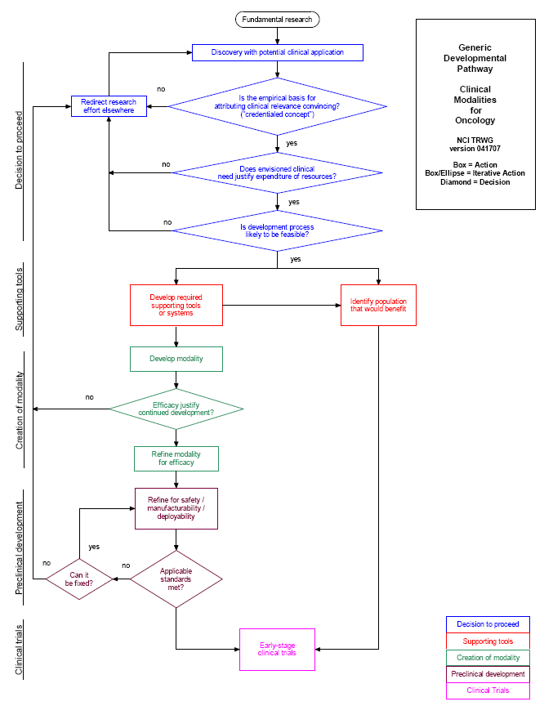
Coding Grant
Applications to the Translational Research Developmental Pathways:
Decision to proceed
Supporting tools
Creation of modality
Preclinical development
Clinical trials
www.cancer.gov/trwg

Slide 24
Coordinated Management
Recommended Initiative A4
Create a transparent, inclusive prioritization process to identify the most promising early translational research opportunities based on scientific quality, technical feasibility and expected clinical or public health impact.
  Process to be managed by a Translational Research Prioritization Working Group of the Clinical Trials Advisory Committee
  Prioritization process to be carried out annually in a systematic and transparent manner
  Process will identify specific targets for new special awards while also informing existing translational research funding initiatives

Slide 25
Coordinated Management
(Initiative A4)
Relationship of Proposed Prioritization Process with Coordinated Management Entities
Clinical Trials Advisory Committee
Advisory
NCI Director
Direct Report
Chair
Support
Advisory
Coordinating Center for Clinical Trials
Translational Research Support Office
Support
Translational Research Operations Committee
“Oversight”
Translational Research Prioritization Working Group
Support
Extramural group
Intramural group
New entity

Slide 26
Current Approach
Recommended Prioritization Process
Proposed Additional Approach
NCI-initiated solicitations
  Generated within Branches/Divisions
    Scientific premise, portfolio analysis, proposed budget, evaluation metrics
  Approved by Executive Committee
  Approved by BSA/BSC
  Second-level review & award concurrence by NCAB
Investigator-initiated projects
  Peer-review’s project-specific scientific priority score
  Mild programmatic discretion at the Branch or Divisional level
  Second-level review & concurrence by NCAB
Translational Research Prioritization Working Group
Broad public input (RFI)
10 ideas chosen for detailed analysis
scientific validity
feasibility
clinical need
public (vs. a private sector) priority
5 concept packages
Public comment
2-3 Special
Awards
Inform existing NCI initiatives

Slide 27
Tailored Funding Programs
Recommended Initiative B1
Modify guidelines for multi-project collaborative early translational research awards to focus research on advancing specific opportunities along a developmental pathway toward patient benefit, and to reward collaborative team science.
  Incorporate project milestones
  Require a development/commercialization strategy
  Promote and reward collaborations
  Allow budgetary flexibility for projects that meet milestones
  Review panels to include industry scientists, non-academic health professionals, program managers from foundations and patient advocates as well as academic translational researchers

Slide 28
Tailored Funding Programs
Recommended Initiative B2
Improve processes and mechanisms for review and funding of investigator-initiated early translational research to incentivize researchers to propose such studies.
  Analyze translational research study section membership and practices
  Pursue NIH-wide initiative to examine value of distinctive R-series and P-series mechanisms for supporting investigator-initiated translational research

Slide 29
Tailored Funding Programs
Recommended Initiative B3
Establish Special Translational Research Acceleration Project (STRAP) awards to advance a select number of especially promising early translational research opportunities identified through the newly created prioritization process.
  Solicit proposals annually for specific opportunities
  $10M of new awards annually beginning in year 3 (FY2010), steady state of $50M in annual STRAP funding after 5 years
  STRAP program requirements:
    Project plan through early stage human studies
    Project management plan
    Specific development milestones and timeline
    Development/commercialization strategy

Slide 30
Proposed STRAPs Complement Existing Mechanisms
15% CLINICAL
COOP
CCOP
Ph I/II
35% TRANSLATIONAL
PO1
STRAP
STRAP
RAID
RAPID
PO1
R01
NTROI
SPORE
R01
EDRN
M
M
H
C
R01
50% BASIC
R01
PO1
R01
R01
R01
R01
Integrative
Systems Biology
Cancer-related biology
R01
R01
R01
PO1
Fundamental biology
R01
R01
R01

Slide 31
Dr. Nelson

Slide 32
Tailored Funding Programs
Recommended Initiative B4
Establish a program for joint NCI/industry funding of collaborative early translational research projects that integrate the complementary strengths of both parties to pursue opportunities that are more attractive as a combined effort.
  Establish an Industry Relations Working Group to lay groundwork for negotiation of collaborative funding arrangements
  $5M of new awards annually beginning in year 4 (FY2011), steady state of $25M in annual funding after 5 years
  RFA-directed solicitation and award process
  Program requirements:
    Project plan through hand-off to industry partner
    Joint industry/academic Steering Committee
    Negotiated intellectual property/licensing plan
    Specific development milestones and timeline

Slide 33
Tailored Funding Programs
Recommended Initiative B5
Integrate access to GMP/GLP manufacturing and other preclinical development services more effectively with high-priority, milestone-driven early translational research projects to better address this often rate-limiting step in moving a product forward to early human testing.
  Preclinical milestone reviews integrated with review processes for NCI developmental resources program (RAID, RAPID or DCIDE) to avoid duplicative review
  No change in current review process for investigator-initiated applications to RAID, RAPID or DCIDE
  Development experts involved in earlier milestone reviews to help identify and solve potential obstacles in toxicology, pharmacology or manufacturing

Slide 34
Operational Effectiveness
Recommended Initiative C1
Build a project management system involving staff both at NCI and at extramural institutions to facilitate coordination, communication, resource identification and access, and management of milestone-based progress for multi-disciplinary, early translational research projects.
  Overall system coordination provided by Translational Research Support Office (TRSO)
  Project-specific management for existing programs provided by program staff and for new STRAP and academic/industry awards by TRSO
  NCI project managers work in collaboration with institutionally-based project managers
  Formal project management training will be provided as needed

Slide 35
Operational Effectiveness
Recommended Initiative C2
Coordinate core services essential for early translational research to reduce duplication and ensure that high quality services are readily accessible to all projects and investigators.
  Identify and analyze existing core services for redundancy
  Consolidate redundant core services with emphasis on primary role of Cancer Centers as providers of core services
  Develop comprehensive, publicly-accessible database of core services
  Establish regional centers of excellence for highly technical, equipment or resource intensive core services that are inefficient to operate locally

Slide 36
Operational Effectiveness
Recommended Initiative C3
Improve standardization, quality control and accessibility of annotated biospecimen repositories and their associated analytic methods to strengthen this key translational resource.
  Reinforce standardization and specimen and data sharing efforts of the Office of Biorepositories and Biospecimen Research (OBBR) including an informed consent template for future use of tissue
  Modify program guidelines to incorporate OBBR’s First Generation Biorepository Guidelines
  Provide funding for guideline-compliant biospecimen collection in clinical trials
  Assist OBBR in developing new approaches to creation of a national biospecimen repository network
  Develop standardized analytic methods for biospecimens

Slide 37
Operational Effectiveness
Recommended Initiative C4
Develop enhanced approaches for negotiation of intellectual property agreements and agent access to promote collaborations among industry, academia, NCI and foundations.
  Work with Technology Transfer Branch (TTB) to coordinate development of model agreements and best practices
  Work with TTB to evaluate alternative approaches to resolving intellectual property issues such as patent pools and government-industry consortia
  Evaluate the feasibility of developing or enhancing a range of possible NCI-operated agent repositories

Slide 38
Operational Effectiveness
Recommended Initiative C5
Increase NCI interaction and collaboration with foundations and advocacy groups to capitalize upon their complementary skills and resources for advancing early translational research.
  Establish leadership position responsible for coordinating interactions with foundations and advocacy groups
  Implement more systematic, structured approach to interaction with foundations and advocacy groups
  Include foundation/advocacy representative in translational research Prioritization Working Group
  Explore approaches to avoiding duplicative proposal review
  Develop funding partnerships for targeted TR projects
  Work with foundations and advocacy groups to enhance outreach re tissue donation and image collection

Slide 39
Operational Effectiveness
Recommended Initiative C6
Enhance training programs and career incentives to develop and maintain a committed early translational research workforce.
  Develop Program Announcement highlighting training opportunities for early translational research
  Establish Translational Research Training Working Group to make recommendations on the training of clinician-scientists, PhD scientists and PhD nurses for TR
  Expand regulatory affairs training
  Revise funding programs and award guidelines to reward TR
  Collaborate with other organizations to adjust academic reward practices to enhance TR career support and incentives

Slide 40
Principles Guiding Timeline and Budget
Organizational and administrative initiatives should be initiated ASAP
Prioritization process must be in place before STRAPs can commence
Budget for administration will be kept to a minimum by leveraging existing structures
Recommended extramural funding programs will require < 1% of the NCI budget

Slide 41
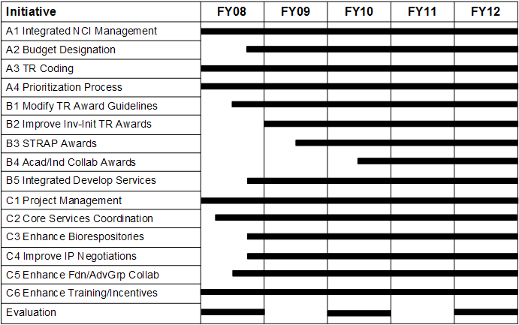
TRWG Initiative Summary Timeline

Slide 42
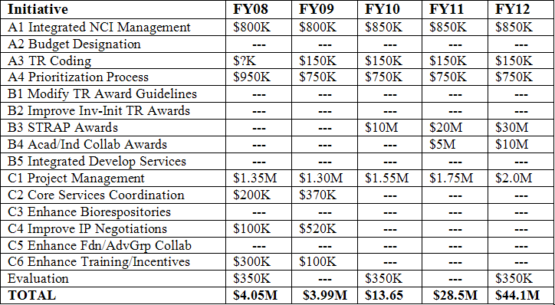
TRWG Initiative Summary Budget

Slide 43
Dr. Hawk

Slide 44
Context for the TRWG Recommendations
Unrestricted mission, yet aware of current realities
No impact on Discovery Research
  Should remain “unmanaged”
Firmly committed to the vision
  TRWG’s assessment of the challenges (why?)
  TRWG’s goals (what?)
Strived to identify “responsible” implementation strategies (when, who, how?), so recommendations are:
  Reasonably detailed
  Intentionally incremental
  Representative of a consensus view
Aware that implementation plans should be flexible to adjust to the environment

Slide 45
Proposed Next Steps
Publish the six pathways to clinical goals
Develop translational research award codes based on pathways
Implement communications plan for TRWG Report
Convene an internal working group to discuss implementation strategies

Slide 46
Acknowledgements
National Cancer Institute
  Anna Barker, PhD
  Jim Doroshow, MD
  Gary Dorfman, MD
  Maureen Johnson, PhD
  Jennifer Kwok
  Anne Lubenow
  Cherie Nichols, MBA
  John Niederhuber, MD
  Henry Rodriguez, PhD, MBA
  Lisa Stevens, PhD
  Jaye Viner, MD, MPH
Science & Technology Policy Institute
  Oren Grad, MD, PhD
  Judy Hautala, PhD
  Maureen McArthur
  Alexis Wilson
  Brian Zuckerman, PhD
Science Applications International Corp.
  Jeff Zalatoris, PhD
NOVA Research
  Janet Braun
  Ray Butler
  Erin Milliken, PhD
  Dana Young, JD
Vanderbilt University
  David Dilts, PhD, MBA
  Lynn Matrisian, PhD
  Vanessa Hill
Johns Hopkins University
  Bill Nelson, MD, PhD
Jane Reese-Coulbourne, MS, MBA
…and the 57 Other Members of the Translational Research Working Group

Slide 48
Back-ups

Slide 49
Potential Programmatic Utility of Developmental Pathways
Experimental Design
  Efficiently plan, define, & explain
    Scientific goals and process
    Timeline
    Required resources
Project Management
  Predict potential impediments by stage
  Measure progress
  Evaluate causes of delays/accelerations
  Guide redesign as necessary/appropriate
Support Collaborations & “Hand-offs”
  Predict, plan, & facilitate timing & requirements re: critical interfaces
  Anticipate budgetary implications of shared T&E/resources
Support Fiscal Management
  Toll-gated installments (reward mechanisms?)
  Demonstrate return on investment by “hitting”/exceeding target

Slide 50
TRWG Products
TR definition
Six developmental pathways to clinical goals
Portfolio analysis
  Review of NCI’s current TR activities
Process analysis
  Case studies of 20 examples of translation in practice
Draft final recommendations

Slide 52
Obstacles to TR Progress –
From the TRWG’s Perspective

Slide 53
Obstacles to Meeting the Challenge
Insufficient coordination & integration across NCI results in a fragmented TR effort that risks duplication & may miss important opportunities
Absence of clearly designated funding & adequate incentives for researchers threatens the perceived importance of TR within the NCI enterprise
Absence of a structured, consistent review & prioritization process tailored to the characteristics & goals of TR makes it difficult to direct resources to critical needs & opportunities

Slide 54
Obstacles to Meeting the Challenge
TR core services are often duplicative & inconsistently standardized, with capacity poorly matched to need
Multidisciplinary nature of TR & the need to integrate sequential steps in complex development pathways warrants dedicated project management resources
Insufficient collaboration & communication between basic & clinical scientists & the paucity of effective training opportunities limits the supply of experienced translational researchers
Inadequate collaboration with industry delays appropriate developmental hand-offs

Slide 56
TRWG Members – Broad Expertise

Slide 57
Programmatic Representation on the TRWG (CRISP Database, 2000-2006)
Cancer Centers (7)
  David Alberts
  Michael Caligiuri
  Kenneth Cowan
  Raymond Dubois
  Peter Emanuel
  William Hait
  H. Kim Lyerly
Industry (4)
  Martin Cheever
  Sara Courtneidge
  Tona Gilmer
  Gary Gordon
EDRN (2)
  David Sidransky
  Sudhir Srivastava
Advocates (3)
  Laurie Fenton
  Gail McGrath
  Ellen Sigal
SPOREs (14)
  James Abbruzzese
  Kenneth Anderson
  Robert Bast
  Darell Bigner
  Richard Cote
  Steven Dubinett
  Laura Esserman
  Joe Gray
  Waun Ki Hong
  Lynn Matrisian
  William Nelson
  Olufunmilayo Olopade
  David Sidransky
  Thea Tlsty
Clinical Study Consortia (5)
  David Alberts
  Michael Caligiuri
  James Doroshow
  Paul Limburg
  Richard Schilsky
P01s (17)
  David Alberts
  Kenneth Anderson
  Robert Bast
  Michael Caligiuri
  Richard Cote
  Steven Dubinett
  Raymond Dubois
  Gary Gordon
  Joe Gray
  Waun Ki Hong
  Theodore Lawrence
  A. Thomas Look
  H. Kim Lyerly
  Brian Reid
  David Scheinberg
  Mitchell Schnall
  Thomas Sellers

Slide 58
Programmatic Representation on the TRWG
(CRISP Database, 2000-2006)
R01s (30)
  Kenneth Anderson
  Robert Bast
  Michael Caligiuri
  Martin Cheever
  Richard Cote
  Sara Courtneidge
  Adrian DiBisceglie
  James Doroshow
  Steven Dubinett
  Raymond Dubois
  Peter Emanuel
  Ellen Gritz
  William Hait
  Theodore Lawrence
  Paul Limburg
  A. Thomas Look
  H. Kim Lyerly
  Lynn Matrisian
  Anne McTiernan
  Ida “Ki” Moore
  William Nelson
  John Carl Oberholtzer
R01s (cont.)
  Olufunmilayo Olopade
  Roman Perez-Soler
  Brian Reid
  David Scheinberg
  Thomas Sellers
  David Sidransky
  Thea Tlsty
  Louis Weiner
Training/Education (15)
  David Alberts (R25, T32)
  Robert Bast (K12, T32)
  Michael Caligiuri (T32)
  James Doroshow (K12)
  Raymond Dubois (T32)
  Peter Emanuel (T32)
  Waun Ki Hong (T32)
  H. Kim Lyerly (K12, T32)
  Lynn Matrisian (T32)
  Ida “Ki” Moore (T32)
  Olufunmilayo Olopade (T32)
  David Scheinberg (K12)
  Mitchell Schnall (T32)
Training/Ed (cont.)
  Thomas Sellers (R25)
  Louis Weiner (K12)
Federal Gov’t (17)
  Kenneth Buetow (CB)
  Jerry Collins (DCTD)
  Phillip Dennis (CCR)
  James Doroshow (DCTD)
  Gregory Downing (OTIR)
  Jorge Gomez (OCTR)
  Ernest Hawk (OCTR)
  Anne Lubenow (OC)
  David Maslow (DEA)
  Suresh Mohla (DCB)
  Cherie Nichols (OSPA)
  John Carl Oberholtzer (OCTR)
  Richard Pazdur (FDA)
  Charles Rabkin (DCEG)
  Jeffrey Schlom (CCR)
  Richard Simon (DCTD)
  Sudhir Srivastava (DCP)
  Daniel Sullivan (DCTD)

Slide 59
TRWG Expertise in Various Populations
Head & Neck
  Waun Ki Hong
  David Sidransky
Lung
  Phillip Dennis
  Steven Dubinett
  Laurie Fenton
  Waun Ki Hong
  Roman Perez-Soler
Stomach/Esophagus
  Ernest Hawk
  Paul Limburg
  Brian Reid
Pancreas
  James Abbruzzese
Liver
  Adrian DiBisceglie
  Theodore Lawrence
  Charles Rabkin
Colorectum
  James Doroshow
  Raymond Dubois
  Ernest Hawk
  Paul Limburg
  Richard Pazdur
  Jeffrey Schlom
Breast
  Kenneth Cowan
  Laura Esserman
  Joe Gray
  William Hait
  H. Kim Lyerly
  Anne McTiernan
  Olufunmilayo Olopade
  Mitchell Schnall
  Thomas Sellers
  Thea Tlsty
Ovary/Gyn
  David Alberts
  Robert Bast
  Thomas Sellers
GU
  Richard Cote
Prostate
  William Nelson
Brain
  Darrel Bigner
Skin
  David Alberts
Leukemia/Lymphoma
  Michael Caligiuri
  Peter Emanuel
  A. Thomas Look
  David Scheinberg
Myeloma
  Kenneth Anderson

Slide 60
TRWG Expertise in Special Scientific Areas
Prevention
  David Alberts
  Adrian DiBisceglie
  Steven Dubinett
  Raymond Dubois
  Laura Esserman
  Gary Gordon
  Ellen Gritz
  Ernest Hawk
  Waun Ki Hong
  Paul Limburg
  Lynn Matrisian
  Anne McTiernan
  William Nelson
  Olufunmilayo Olopade
  Charles Rabkin
  Brian Reid
  Thomas Sellers
  David Sidransky
  Sudhir Srivastava
  Thea Tlsty
Pediatrics
  Peter Emanuel
  A. Thomas Look
Survivorship
  Ida “Ki” Moore
Genetics
  Kenneth Buetow
  Joe Gray
  Olufunmilayo Olopade
  William Nelson
  Charles Rabkin
  Thomas Sellers
  David Sidransky
Imaging
  Daniel Sullivan
  Mitchell Schnall
Drugs/Immunologics
  James Abbruzzese
  David Alberts
  Kenneth Anderson
  Martin Cheever
  Jerry Collins
  Michael Caligiuri
  Sara Courtneidge
  Kenneth Cowan
  James Doroshow
  Tona Gilmer
Drugs/Immunologics (cont.)
  Gary Gordon
  William Hait
  Ernest Hawk
  Waun Ki Hong
  Paul Limburg
  H. Kim Lyerly
  William Nelson
  Richard Pazdur
  Roman Perez-Soler
  David Scheinberg
  Jeffrey Schlom
  Richard Schilsky
  Ellen Sigal
  Richard Simon
  Louis Weiner
Biobehavior
  Ellen Gritz
  Anne McTiernan
Preclinical Models
  Lynn Matrisian
  Suresh Mohla
  Thea Tlsty

Slide 62
Details of the TRWG Portfolio Analysis

Slide 63
NCI Programmatic Involvement in Developmental Pathways
Pathway Steps Pathway | Early Development of Intervention | Enabling technologies (e.g., assays, repositories, models) | Refinement | Manufacturing/ Production | Early-stage trials
Agents (not including imaging agents) | SPORE, NCDDG, CCNE, R01, P01, Z01 | MMHCC, CPTAC, SPORE, NCDDG, CCNE, R01, P01, Z01 | SPORE, RAID, RAPID, NCDDG, CCNE, R01, P01, Z01 | SPORE, RAID, RAPID, CCNE, R01, P01, Z01 | Cancer Centers, Cooperative Groups, SPORE, DCP Phase I/II, DCTD Phase I/II, R01, P01, Z01
Immune Response Modifiers | SPORE, NCDDG, CCNE, R01, P01, Z01 | MMHCC, SPORE, NCDDG, CPTAC, CCNE, R01, P01, Z01 | SPORE, RAID, RAPID, NCDDG, CCNE, R01, P01, Z01 | SPORE, RAID, RAPID, R01, P01, Z01 | Cancer Centers, Cooperative Groups, SPORE, DCTD Phase I/II, R01, P01, Z01
Risk Assessment Devices (Biomarkers) | SPORE, EDRN, CPTAC, CCNE, R01, P01, Z01 | MMHCC, EDRN, CPTAC, CCNE, R01, P01, Z01 | SPORE, EDRN, CCNE, R01, P01, Z01 | SPORE, CCNE, R01, P01, Z01 | SPORE, EDRN, R01, P01, Z01
Risk Assessment Devices (Imaging, Imaging Agents, and Imaging Devices) | SPORE, ICMIC, NTROI, CCNE, R01, P01, Z01 | MMHCC, CPTAC, ICMIC, NTROI, CCNE, R01, P01, Z01 | SPORE, ICMIC, NTROI, DCIDE, CCNE, R01, P01, Z01 | SPORE, ICMIC, NTROI, DCIDE, CCNE, R01, P02, Z01 | Cancer Centers, CIP Quick Trials, SPORE, ICMIC, NTROI, R01, P01, Z01
Interventive Devices | SPORE, CCNE, R01, P01, Z01 | MMHCC, CPTAC, SPORE, CCNE, R01, P01, Z01 | SPORE, CCNE, R01, P01, Z01 | SPORE, R01, P01, Z01 | SPORE, Cancer Centers, Cooperative Groups, R01, P01, Z01
Lifestyle Interventions | SPORE, R01, P01, Z01 | MMHCC, MMHCC, SPORE, R01, P01, Z01 | SPORE, R01, P01, Z01 | SPORE, R01, P01, Z01 | Cancer Centers, SPORE, Cooperative Groups, R01, P01, Z01

Slide 64
Portfolio Analysis: Key Findings
Awards are not adequately categorized to provide meaningful, detailed quantitative assessments of translational content
TR is funded by most NCI Divisions, Offices & Centers
TR is funded by a range of mechanisms – individual, collaborative, & facilitated
The majority of TR awards are to NCI-designated Cancer Centers
www.cancer.gov/trwg

Slide 65
Portfolio Analysis:
Program and Cooperative Awards
Award Category | Translational Awards | Total Active Awards | % Translational | TR Award Funding in FY04 ($M)
P01* | 107 | 207 | 51.7% | $215.0
P20 | 8 | 34 | 23.5 | 3.0
SPORE* (P50) | 58 | 58 | 100 | $131.7
ICMIC (P50) | 7 | 7 | 100 | 15.8
EDRN (U01/U24) | 28 | 28 | 100 | 21.8
MMHCC (U01) | 10 | 23 | 43.5 | 8.1
Other U01 | 122 | 209 | 58.4 | 98.6
U19 | 5 | 18 | 27.8 | 3.7
NTROI (U54) | 3 | 3 | 100 | 3.8
Other U54 | 10 | 19 | 52.6 | 13.0
U56 | 4 | 40 | 10.0 | 3.1
*P01s and SPOREs are multi-component awards that typically include both research projects & core facilities.

Slide 66
Portfolio Analysis: Drug Development Programs & Infrastructure Mechanisms
Award Category | Translational Awards | Total Active Awards | % Translational | TR Award Funding in FY04 ($M)
DDG | 18 | 18 | 100% | $11.1
RAID | 45 | 45 | 100 | 16.3
RAPID | 19 | 19 | 100 | 3.1
Award Category | Translational Awards | Total Active Awards | % Translational | TR Award Funding in FY04 ($M)
P30* | 54 | 61 | 88.5% | $212.5
R24 | 8 | 43 | 18.6 | 1.5
U24 | 8 | 14 | 57.1 | 6.0
Extramural Cores (P01, P30, P50) | 1,165 | 1,364 | 85.4 | N/A
*Only Comprehensive and Clinical Cancer Centers were included here, not the Basic Cancer Centers.

Slide 67
Portfolio Analysis: Individual Research,
Small Business & Intramural Awards
Funding Mechanism | Translational Awards | Total Active Awards | % Translational | TR Award Funding in FY04 ($M)
R01 | 1,161 | 4,450 | 26.1% | $447.0
R03 | 150 | 320 | 46.9 | 8.1
R21 | 288 | 599 | 48.1 | 43.8
R33 | 62 | 121 | 51.2 | 24.2
R37 | 11 | 74 | 14.9 | 6.6
R41 | 28 | 42 | 66.7 | 4.7
R42 | 12 | 19 | 63.2 | 3.8
R43 | 87 | 246 | 35.4 | 13.3
R44 | 102 | 176 | 58.0 | 39.4
Z01 | 257 | 630 | 40.8 | 164.4
Totals* | 2,789 | 7,933 | 35.2 | 1,330.4
*“Totals” show amounts for all Program and Cooperative Awards, Developmental Program Projects, Career Development Awards, Individual Research Awards, Small Business Awards, and Intramural Awards, & it excludes the amounts for the Infrastructure Mechanisms.

Slide 68
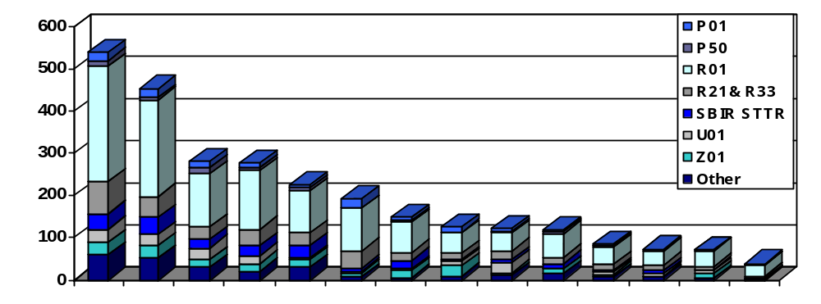
Total Number of Translational Awards in FY04
(>/= 25% Relevant to these Disease Sites)
Number of Awards in FY2004
Lung Cancer
Lymphomas
Myelomas
Leukemias
Brain Tumor
Breast Cancer
Prostate Cancer
Ovarian Cancer
Pancreatic Cancer
Gynecologic Cancers
Head and Neck Cancers
Urinary System Cancers
Gastrointestinal Cancers
Skin Cancer and Melanoma
Disease Site
“Other” includes P20, P30, R03, R24, R37, U19, U24, U54, and U56 awards. K-series awards and U10 awards are not included.
www.cancer.gov/trwg

Slide 69
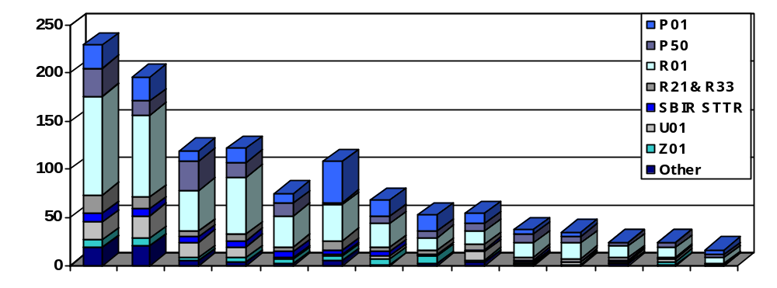
Total FY04 Spending for Translational Awards
(>/= 25% Relevant to these Disease Sites)
Millions of Dollars
Lung Cancer
Lymphomas
Myelomas
Leukemias
Brain Tumor
Breast Cancer
Prostate Cancer
Ovarian Cancer
Pancreatic Cancer
Gynecologic Cancers
Head and Neck Cancers
Urinary System Cancers
Gastrointestinal Cancers
Skin Cancer and Melanoma
“Other” includes P20, P30, R03, R24, R37, U19, U24, U54, and U56 awards. K-series awards and U10 awards are not included.
Disease Site
www.cancer.gov/trwg

Slide 70
Extramural Core Facilities Sponsored
Through SPORE, P01, & P30 Mechanisms
Frequency Distribution
Number of Institutions
Number of Core Facilities Per Institution
Number of Core facilities includes all Basic, Clinical, & Comprehensive Cancer Center (P30) Core facilities, and all SPORE & P01 Core facilities identified from the SPORE website, CRISP database, and abstracts.

Slide 72
Drawing Inspiration from Pasteur
“To the individual who devotes his/her life to science nothing can give more happiness than when the results immediately find practical application. There are not two sciences. There is science and the application of science, and these two are linked as the fruit is to the tree.”
Louis Pasteur, 1822-95

