Slide 1
caBIG Workspace Overview, Scope and Needs
Integrative Cancer Research
Washington, D.C.
February 19 & 20

Slide 2
Contents
Goals of this Session
Workspace Structure
Workspace Operations
Workspace Participants and Scope
Workspace Needs

Slide 3
Workspace Breakout Session - Goals
Learn about the relevant projects at the NCICB and at other Cancer Centers
Review the needs and interests of participating pilot Cancer Centers
Review requirements for developer projects and recommend specification and sequence for activities
Evaluate existing and recommended projects as the basis for testing and integration by Adopter Centers
Discover sources of data within the Workspace which can be shared on the grid as part of the pilot program
Discuss group coordination and future meeting schedule
Draft action plan summarizing conclusions

Slide 4
Purpose of this Presentation
Start today’s discussion from a common understanding
- Overview of caBIG Workspaces in general (structure and operations)
Set the stage for the Workspace specific discussions
- Understand the scope and needs of the Integrative Cancer Research Workspace

Slide 5
Contents
Goals of this Session
Workspace Structure
Workspace Operations
Workspace Participants and Scope
Workspace Needs

Slide 6
Workspace Definition
Central structures of the caBIG pilot initiative
Areas where caBIG pilot project activities are grouped and coordinated
Encompass activities with a common focus, addressing identified Cancer Center needs
Create products and solutions including tools, standards, data and documentation
Share and test products and solutions amongst pilot participants
Develop products and solutions which will ultimately be open and shared among the cancer research community

Slide 7
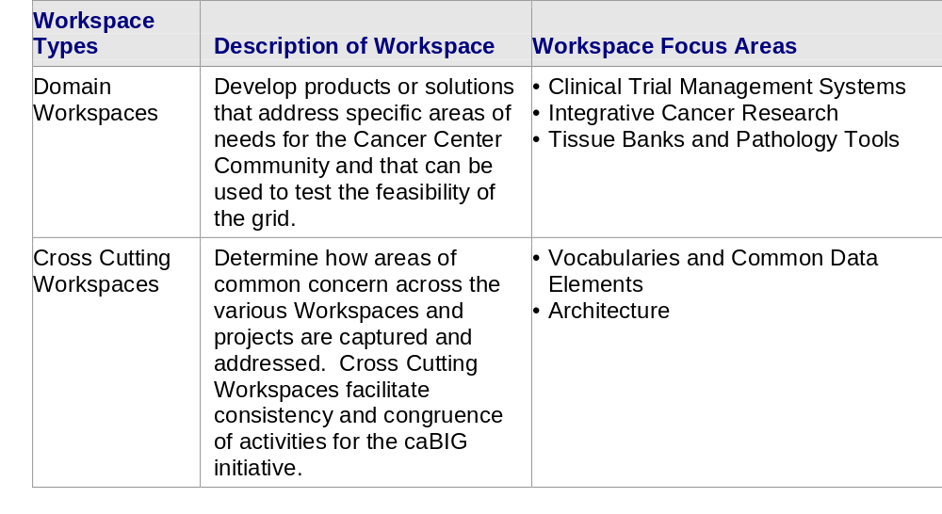
Workspace Types
There are two types of Workspaces – Domain and Cross Cutting
Integrative Cancer Research is a Domain Workspace

Slide 8
Workspace Roles
Developer
An NCI-designated Cancer Center selected and funded by NCICB to participate in a specific Workspace to undertake software or solution development activities.
Adopter
An NCI-designated Cancer Center selected and funded by NCICB to undertake formal testing, validation and application of products or solutions developed by Workspace Developers.
Workspace Working Group
A group of NCI-designated Cancer Center members (and other invited stakeholders) funded to provide guidance and support for Workspace activities. The Working Group includes representatives from the Developer and Adopter teams.

Slide 9
Workspace Roles
Domain
WORKSPACE
Domain
WORKSPACE
Domain
WORKSPACE
Cross Cutting
WORKSPACE
Architecture
Workspace
Working Group
Workspace
Working Group
Workspace
Working Group
Developer
Developer
Adopter
Developer
Adopter
Developer
Cross Cutting WORKSPACE
Developer
Developer
Developer
Vocabularies & Common Data Elements
Adopter
Developer
Workspace
Working Group
Developer
Developer
Developer
Developer
Developer
Adopter
Adopter
Workspace
Working Group
Clinical Trial Mgmt System
Integrative Cancer Research
Tissue Banks & Pathology Tools

Slide 10
Contents
Goals of this Session
Workspace Structure
Workspace Operations
Workspace Participants and Scope
Workspace Needs

Slide 11
Workspace Principles of Participation
Support the spirit, vision, goals and principles of the caBIG initiative as a whole
Collaborate effectively with other Workspace participants and groups to support specific and overarching goals
Collaborate effectively with other Workspaces and Working Groups (Workspace and Strategic levels) to support specific and overarching goals
Undertake activities with integrity and objectivity
Perform activities in a consensus driven manner
Respect and capitalize on the skills and merits of individual participants
Act in accordance with the caBIG Oversight Board and Master Contractor guidelines and processes

Slide 12
Workspace Communications
The success of the caBIG network relies on communication and coordination between caBIG participants
Mechanisms will be established to ensure effective communications both within Workspaces and between Workspaces/Working Groups
  e.g., Face-to-face meetings
  e.g., Electronic Program Updates
  e.g., Web based tools
The Cross Cutting Workspaces and the Strategic Level Working Groups address issues of common concern across caBIG and will promote communications across Workspaces

Slide 13
Workspace Performance
As part of undertaking Workspace activities, Workspace participants are asked to:
Perform in accordance with their contracts and charters
Meet agreed work plans, milestones and deliverable schedules
Support processes as delineated by the caBIG coordination and oversight groups, including those for performance planning, monitoring and reporting
Support the vision, goals and principles of caBIG
Perform activities within agreed scope and budget

Slide 14
Workspace Coordination
Workspace participants are responsible for the coordination of their Center level caBIG related projects and activities according to agreed Statements of Work and contracts
Overarching coordination of Workspace activities is undertaken by the Master Contractor (contracting team appointed by NCICB)
Workspace participants are asked to support processes established by the Master Contractor to ensure the coordination of caBIG activities

Slide 15
Contents
Goals of this Session
Workspace Structure
Workspace Operations
Workspace Participants and Scope
Workspace Needs

Slide 16
Workspace Participants – Integrative Cancer Research
Cancer Center Developers
Cancer Center Adopters
Workspace Working Group
• Burnham Institute
• Dartmouth – Norris Cotton
• Duke University
• Georgetown University – Lombardi
• University of California San Francisco
• University of Chicago
• University of Iowa – Holden
• University of North Carolina-Lineberger
• Cold Spring Harbor
• Memorial Sloan-Kettering
Fox Chase
• Thomas Jefferson University – Kimmel
• Washington University-Siteman
• New York University
• Memorial Sloan-Kettering
• Oregon Health and Science University
• Wistar
• University of South Florida-H. Lee Moffitt
• University of Pennsylvania – Abramson
• Vanderbilt University – Ingram
• Columbia University – Herbert Irving
• Meyer L. Prentis-Karmanos
• University of Michigan
• Northwestern University – Robert H. Lurie
• (Plus – Representatives from each Developer and Adopter site.)

Slide 17
Integrative Cancer Research Workspace Scope
This Workspace provides tools and systems to enable integration and sharing of information among cancer researchers
These tools will ultimately:
  Facilitate the integration of data not only from different centers, but also data of different types
  Enable translational and integrative research
  Provide for the integration of data from “bench to bedside”, “bedside to bench” and from “bench to bench”

Slide 18
Integrative Cancer Research Workspace Scope
This Workspace focuses on:
  Extension and implementation of tools to enable researchers to integrate and share data collected from a variety of heterogeneous sources
  Data sources will include de-identified patient clinical data and information collected from a variety of high-throughput research techniques
  caBIG-enable a wide range of tools particularly useful to cancer researchers, with a focus on enabling translational research
  Make data and analytical bioinformatics methods more useful to cancer researchers
  Data and analysis should be capable of being shared with colleagues, and transparently integrated with other, related data

Slide 19
Contents
Goals of this Session
Workspace Structure
Workspace Operations
Workspace Participants and Scope
Workspace Needs

Slide 20



The common needs helped shape priority areas for the caBIG pilot activities
Database & Datasets
Imaging Tools & Databases
Integration
High Performance Computing
Pathways
Clinical Trial Management Systems
Licensing Issues
Laboratory Information Management Systems (LIMS)
Meeting
Microarray & Gene Expression Tools
Proteomics
Tissue
Banks
& Pathology
Remote/Bandwidth
Visualization & Front-End Tools
Statistical Data Analysis Tools
Vocabulary & Ontology Tools & Databases
Integrative Cancer Research
Meta-Project
Common Data Elements (CDE) & Architecture
Center Integration & Management
Tissue & Pathology Tools
Access to Data
Translational Research Tools
Distributed General Data Sharing & Analysis Tools
Staff Resources
Clinical Data Management Tools & Databases
0
5
10
15
20
25
30
35
Number of Needs Reported
Notes:
Three areas of critical need were identified based on this information and these facilitated the groupings of pilot project activities into three Workspaces:
(1) Clinical Trial Management Systems
(2) Integrative Cancer Research
(3) Tissue Banks and Pathology Tools

Slide 21
Integrative Cancer Research: Center Needs
Example needs within the Workspace, from August 2003 Cancer Center Cooperative Development Meetings.
Need a comprehensive bioinformatics infrastructure to support the integration of clinical and basic science data (10+ Centers)
Need community-shared platforms for sharing data with collaborators (Multiple Centers)
Managing large amounts of data challenging
Better Gene Expression tools
Want access to large amount of gene expression data, especially in breast cancer
Better caBIG systems for handling and exchanging pathway data
Need tools for cross-platform analysis of proteomics data
Posting of raw data for data mining as opposed to just results ( E.g. research data warehouses)
Need access to data from other Cancer Centers

