Slide 1

DOE SUPPORT OF NUCLEAR MEDICINE RESEARCH
Alan B. Packard, Ph.D.
Vice President
Radiopharmaceutical Sciences Council
Society of Nuclear Medicine

Slide 2
What is the
Society of Nuclear Medicine (SNM)?
The SNM is an international society established in 1954
Serves >16,000 members including physicians, scientists, and technologists
Promotes research and education in diagnostic and therapeutic applications of radionuclides
Fosters basic research in Molecular Imaging
Facilitates 16M Nuclear Medicine procedures each year in the U.S. for the management of patients in oncology, cardiology, and neurology

Slide 3
Directives and the Role of DOE
Atomic Energy Commission (AEC) was established to explore “Atoms for Peace”
AEC (now DOE) has supplied radionuclides for peaceful applications since 1946
AEC was authorized and directed to promote research activities in the development of medical and biological applications of radionuclides

Slide 4
Highlights of Nuclear Medicine Research Supported by DOE (I)
1946 Rectilinear Scanner (UCLA)
1958 ⁹⁹Mo/^{99m}Tc Generator (BNL)
1959 Gamma Camera (Donner Lab, LBNL)
1970s mIBG development (U. of Michigan)
1970s PET (Wash. U., U. of Penn., UCLA)
1976 [¹⁸F]FDG synthesis (BNL)
1978 PET with BGO (UCLA)

Slide 5
Highlights of Nuclear Medicine Research Supported by DOE (II)
1988 ^{99m}Tc-MIBI – myocardial perfusion agent (MIT, HMS)
1990s Micro PET (UCLA)
1990s PET-receptor gene imaging (UCLA)
1990s PET tracers for drug addiction (BNL)
1990s PET for diagnosis of oncologic, cardiologic, and neurological diseases

Slide 6
Highlights of Nuclear Medicine Research Supported by DOE (III)
1990s Estrogen receptor imaging (Wash. U., U. of IL)
1990s Radiolabeled antibodies for therapy
1990s Antibodies for imaging infection
1990s α-emitting radionuclides for therapy
2000 PET studies for accurate assessment
        of therapeutic intervention
2000 PET imaging of gene expression

Slide 7
AEC’s “Atoms for Peace” Legacy
The funding has:
Supported basic research in physics and chemistry of Nuclear Imaging
Funded development and innovations in equipment of Nuclear and Molecular Imaging
Accelerated translational research from bench to clinical applications
Generated outstanding leading researchers in Nuclear Medicine and Molecular Imaging

Slide 8
Basic and Translational Research and Development Grants (2004)
Individual Investigators grants - 44
National Lab. Multi-Investigators projects - 25
SBIR Grants
  Phase I 8
  Phase II 8
  Total 85

Slide 9
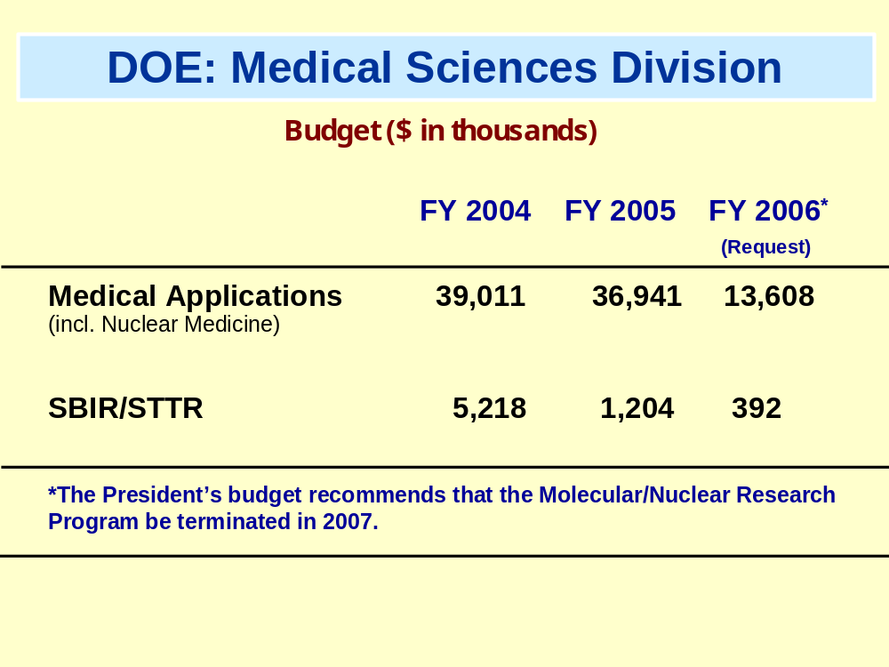

Slide 10
Effects of Program Termination
  Weakening of the leadership position of the U.S. in “Atoms for Medical Use” and “Bench-to-Bedside” programs
  Challenging the productivity and creativity of NM professionals
  Slowing advances in a highly innovative branch of medicine
  Delaying improvements in patient care
  Impeding the development of outstanding scientists in the field

Slide 11
Importance of Continued Funding
These severe consequences can be avoided only by the continuation of this program, which supports basic research in “Nuclear Medicine” that is not funded by other mechanisms
Therefore, on behalf of the >16,000 members of the SNM, I urge the nation’s leaders not to terminate this vitally important funding

