Slide 1

Hip Fracture Prevention
The Benefits of Hip Protectors

Slide 2
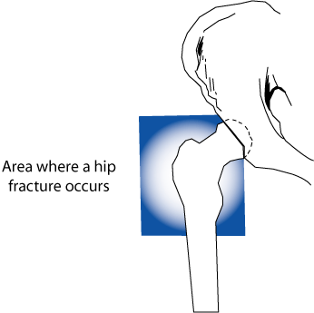
What is a Hip Fracture?
A fracture of the proximal femur (Zuckerman 1996)
Locations
  Trochanter Region
  Femoral Neck

Slide 3
Hip Fracture Facts
3-5% of falls in older adults result in fractures
  Hip Fractures are one of the common types of fractures (Cooper 1992; Wilkins 1999)
    Other common types include vertebrae, forearm, leg, ankle, pelvis, upper arm and hand (Scott 1990)
Hip fracture rates increase with age
  85 year olds are 10 to 15 times more likely to suffer a hip fracture than people ages 60-65 (Scott 1990)

Slide 4
Hip Fracture Facts
In 1999, 338,000 hospitalizations were the result of hip fractures (Popovic 2001)
  Most patients are hospitalized for only on week (Popovic 2001)
  25% of community-dwelling older adults are institutionalized for at least one year (Magaziner 2000)

Slide 5
Hip Fracture Facts
Compared to other fall-related fractures, hip fractures result in:
  More deaths
  Most severe health problems
  Reduced quality of life (Wolinsky 1997, Hall 2000)

Slide 6
Hip Fracture Facts
Hip Fractures occur more often and cost more than other fractures (CDC 1996)
  Incidence rate of 73.9 per 10,000
    the next highest rate was 21.8 per 10,000 for Proximal humerus fractures
  The total excess cost related to hip fracture was $18,152 in 1991-92
    the next highest total treatment cost was $11,411 for a non-hip femoral fracture

Slide 7
Hip Fracture Facts
By 2040:
  Over 500,000 hip fractures a year are expected (Cummings 1990)
  Total annual cost of treating hip fractures is projected to reach $240 billion (Schneider 1990)

Slide 8
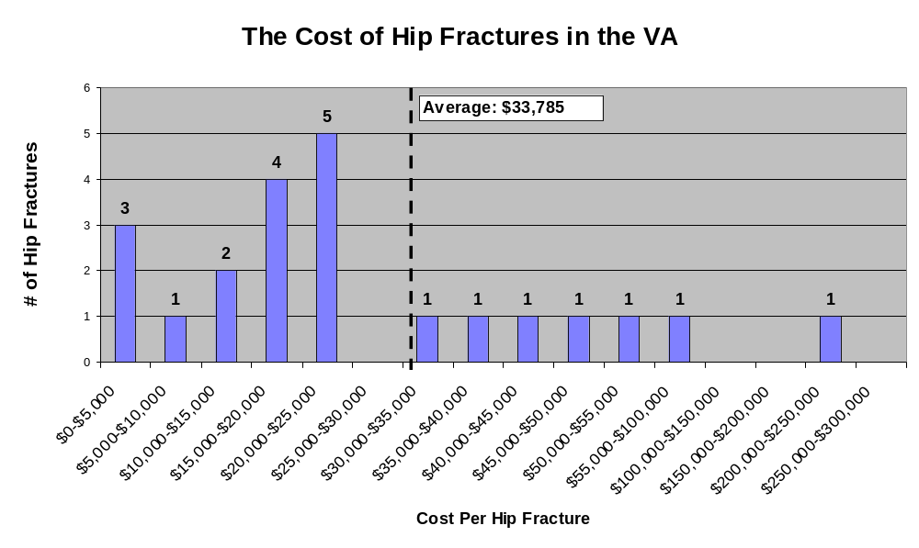
Hip Fracture Facts
The average cost of treating hip fractures for participants at Patient Safety 202 was $33,785

Slide 9
What Can We Do?
Fall prevention
  One way to reduce the number of hip fractures is to institute fall prevention measures
  Goal: Reduce the number of anticipated falls – or falls that we can expect to occur
  Examples:
    Removing Environmental Hazards
    Bed/Wheelchair Alarms
    Medication Management
    Redesigning Environment – slip resistant flooring in bathrooms/showers

Slide 10
What Can We Do?
Injury prevention
  Another way to reduce the number of hip fractures is to reduce the risk of serious injury
  Goal: Reduce the risk of injury from unanticipated and anticipated falls
  Examples:
    Using hip protectors on high fall or fracture risk patients
    Placing floor mats at patient’s bedside
    Redesigning Environment – flooring that absorbs impact of falls

Slide 11
Trends in Hip Fracture Prevention
In the past, the focus has been on interventions that reduce the number of falls
  Facilities made great strides, but realized it is very difficult, if not nearly impossible to prevent all falls
If we can’t prevent every fall what can we do?
  Participants in 4th Annual Evidence-Based Falls Prevention Conference (2003) moving toward injury prevention

Slide 12
Trends in Hip Fracture Prevention
Effective hip fracture prevention must include BOTH
  Fall Prevention Methods
  Injury Prevention Methods

Slide 13
Trends in Hip Fracture Prevention
Falls & Restraint Reduction
  JCAHO does not allow use of restraints for fall prevention
  Decreasing restraint use can lead to more falls and injuries
  Must increase the use of fall and injury prevention measures
  Using hip protectors on patients who frequently fall can increase their freedom

Slide 14
References
Centers for Disease Control and Prevention. Incidence and costs to Medicare of fractures among Medicare beneficiaries aged >65 years—United States, July 1991–June 1992. MMWR 1996;45(41):877–83.
Cooper C, Campion G, Melton LJ. Hip fractures in the elderly: a world-wide projection. Osteoporosis International 1992;2(6):285–9.
Cummings SR, Rubin SM, Black D. The future of hip fractures in the United States. Numbers, costs, and potential effects of postmenopausal estrogen. Clinical Orthopaedics and Related Research 1990;252:163–6.
Hall SE, Williams JA, Senior JA, Goldswain PR, Criddle RA. Hip fracture outcomes: quality of life and functional status in older adults living in the community. Australian and New Zealand Journal of Medicine 2000;30(3):327–32.
Magaziner J, Hawkes W, Hebel JR, Zimerman SI, Fox KM, Dolan M, et al. Recovery from hip fracture in eight areas of function. Journal of Gerontology: Medical Sciences 2000;55A(9):M498–507.

Slide 15
References
Popovic JR. 1999 National Hospital Discharge Survey: annual summary with detailed diagnosis and procedure data. National Center for Health Statistics. Vital Health Statistics 2001;13(151):154.
Schneider El, Guralnik JM. The aging of America: impact on healthcare costs. Journal of the American Medical Association. 1990;263(17):2335-40
Scott JC. Osteoporosis and hip fractures. Rheumatic Diseases Clinics of North America 1990;16(3):717–40.
Wilkins K. Health care consequences of falls for seniors. Health Reports 1999;10(4):47–55.
Wolinsky FD, Fitzgerald JF, Stump TE. The effect of hip fracture on mortality, hospitalization, and functional status: a prospective study. American Journal of Public Health 1997;87(3):398–403.
Zuckerman, JD. Hip Fracture. New England Journal of Medicine. 1996 June 6;334(23):1519-25

