Slide 1



HUMAN ERROR IN AVIATION OPERATIONS:
ideas for the transfusion medicine arena
Loukia D. Loukopoulos
R. Key Dismukes
Human Factors Division
NASA Ames Research Center
Moffett Field, CA, USA
APRIL 2002

Slide 2
OUTLINE
Human error: definition and scope
Error in aviation
  approach: past and current
  learning from past mistakes
  monitoring current system
  interventions
  cognitive themes
Error in (transfusion) medicine
  new era of thought
  learning from past mistakes
  monitoring current system
  interventions
Strategies for reducing error

Slide 3
ERROR: Definition
A failure arising from
  an action that was not completed as intended
  a plan for action that was inadequate to begin with
Slips & Lapses (skill-based)
  occur at storage or execution stage (memory and attention errors)
Mistakes (rule- and knowledge-based)
  occur at judging or inference stage (planning errors)
    (Reason, 1990)
Ultimate outcome (detected or undetected, mitigated or leading to further errors, catastrophic or inconsequential) is not part of the definition

Slide 4
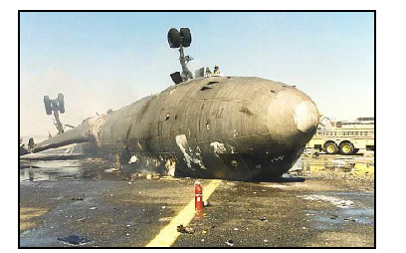
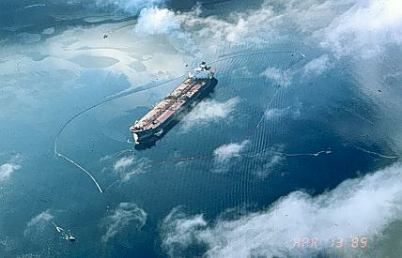
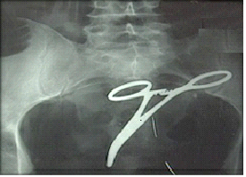
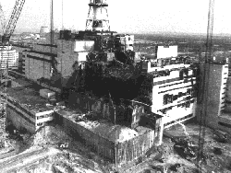
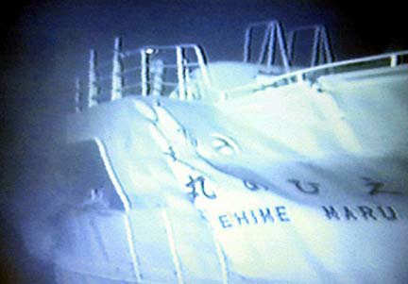
Notes:
Fedex 14 MD-11, crash during landing, Newark, NJ
Newark, July 1997
Exxon Valdez, 1989
Chernobyl, 1986
USS Greeneville, 2001

Slide 5

ACCIDENTS
INCIDENTS
ERRORS (UNREPORTED
OCCURRENCES)
Notes:
Errors = building blocks of tomorrow’s accidents and incidents; esp. when they happen in conjunction with other blocks in this part of pyramid

Slide 6
STATISTICS on ERROR
Aviation (U.S. air carriers)
  2 errors per flight (LOSA data, 2001)
  <0.3 fatal accidents/ 100,000 flight hours annually
  60-80% of accidents involve human error (Foushee 1984)
Hospital admissions
  1,000,000 people injured/yr by errors in treatment at hospitals in US (Marx,2001)
  44,000-98,000 errors are fatal (= 1 jumbo jet crash per day) (IOM report 1999, Leape, 1999)
  UK: 40,000 errors are fatal (QuIC report, 2000)
Drug administration
  1 in 5 injuries or deaths annually in hospitals (AHRQ 1991)
  7,000 deaths annually (QuIC report, 2000)
Anesthesia
  2,000-10,000 deaths/yr (Cooper, Newbower, & Kitz, 1985)
  exposure similar to that of aviation (20x107 passenger boarding vs. 20x106 anesthetics)
Surgery
  48-66% of adverse events at hospital (Gawande, 2001)
ICU
  2 errors per day (Leape, 1994)
Emergency medicine
  8-10% disagreement in interpretation of radiographs by emergency physicians and radiologists (later) (Espinosa & Nolan, 2000)
Notes:
Error in 60% of flights (LOSA data, 2001)
Measured vs. estimated rates
Definitions: error, adverse events, fatal error
Hospital admissions vs. procedures
Transfusion errors: including OR transfusions?
Source: random sample of reports, all reports, direct observation?
Preventable events?
Most often, only fatal errors reported - what is the baseline?
hospital errors: diagnostic, equipment failure, infections, transfusions, misinterpretation of orders
UK: 11% of patients in hospital experienced an adverse event; 50% were preventable (Vincent ,Neale, & Woloshynowych, 2001)
3000 mistakes in less than 2 years at VA hospitals in US, 1 in 4 mistakes fatal) (VA Medical Inspector, 1999)
ICU: 2 errors per day (= 2 dangerous landings per day at ORD, 32,000 checks deducted from the wrong banking account per hour)
Currently almost 20 States have implemented mandatory reporting systems to improve patient safety (QuIC report, 2000)
Gawande: using data from Harvard medical practice study, 1992; UT/CO study, 1999

Slide 7
STATISTICS on ERROR
Blood transfusion
  1 in 12,000 transfusions 1 in 33,000 results in ABO-incompatible red blood cell transfusion (Linden, Paul, & Dressler, 1992)
  1 in 19,000 transfusions (Linden, Wagner, Voytovich, & Sheehan, 2000)
    Sources of error: misidentification of patient or blood at bedside; wrong unit issued; phlebotomy error
    Contributing factors: same or similar names, use of oral vs. computer orders, rush situations, simultaneous handling of specimens, interruptions
  1 per 16,000 transfusions in UK (Williamson, Cohen, Love, et al., 2000)
  Risk of transfusion-associated infection = 1 in 300,000
  1 in 600,000 to 800,000 transfusions result in fatal HTR (hemolytic transfusion reaction) (Linden, Paul, & Dressler, 1992, Sazama, 1990)
  1 in 2,000,000 transfusions result in fatal HTR (Linden, Wagner, Voytovich, & Sheehan, 2000)
  Risk of transfusion-associated HIV infection = 1 in 1,000,000
Notes:
1 in 200,000 components transfused in hospitals (est?) (JHACO)

Slide 8
ERROR IN AVIATION

Slide 9
PAST APPROACH
ERROR IN AVIATION
Name and blame
  If pilot/crew had followed training and SOPs (standard operating procedures) he or she would not have made an error
  Pilot/crew was not careful enough
Self-blame
  How could this have happened to me?!
  I was not paying enough attention
Self-denial
  This would never happen to me (us)
  This will never happen to me (us) again
Why?
  Easier to point the finger
  Hindsight bias
  Apparently isolated incidents
  Emotionally (politically) satisfying
  Lack of understanding of human cognitive processes
Blame and punish (or at least blame and train)
Quick-fix approach

Slide 10
SHIFT IN APPROACH
ERROR IN AVIATION
“Grounding” of aircraft upon return from mission (WWII pilots)
  Fitts & Jones, 1947: features of airplane cockpits
Shift focus from operator to system
Simply trying hard will not prevent errors
Error is a symptom
Accidents result from combination of events/factors
Active errors: whose effects are felt almost immediately
  performance of the “front-line” operators (sharp end)
Latent errors: whose effects may be hidden for long, becoming evident only when they combine with other factors
  management leadership, philosophy, response
  (Reason, 1990)
Notes:
WWII pilots “grounded” numerous aircraft post-mission when they pulled the gear instead of the flap handle
Fitts & Jones, 1947: features of airplane cockpits systematically influenced the way in which pilots made errors
(handles looked and felt the same and were co-located)
How many occurrences of an error before we stop blaming the operator and start focusing more on whether the mission, the workplace and/or the procedures need re-design?
Latent: reaction and response to mishaps, philosophy of operations, maintenance, equipment, staffing

Slide 11
ERROR IN AVIATION
SHIFT IN APPROACH
LATENT
ACTIVE
Adapted from Reason, 1990
Notes:
Can be seen at two levels: slices are elements of production of a complex system
Decision makers (management dealing with balancing productivity and safety; allocates money, equipment, people, time)
Line management (operations, training, maintenance)
Preconditions (condition of equipment, skill of workforce, work schedule)
productive activities (human-machine integration)
Defenses (safeguards against foreseeable hazards)
Or as elements of process within the complex system (e.g., Preflight)
Read and sign paperwork (weather, clearance)
Conduct exterior inspection
Conduct cockpit inspection
Brief cabin crew
Preflight checklist

Slide 12
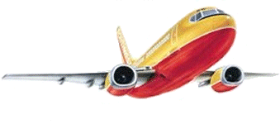
ERROR IN AVIATION
SHIFT IN APPROACH
Systems Approach
safety does not reside in a person, device, or department, but emerges from interactions between the system components
S
H
CHECKLIST
1. Xxx slkj
2. xlkdaf;j alsk
3. S;lk
4. aslkj
E
L
Adapted from Edwards, 1988
Notes:
SHEL model:
Software: procedures, manuals, checklists, symbology etc
Environment: working conditions, weather
Hardware: aircraft and components
All surround Liveware: human element (pilot, ATC, ground staff)
Whole system operates within the context of broad social, political, economical and natural constraints that are usually beyond the control of the Liveware.

Slide 13
CURRENT APPROACH
ERROR IN AVIATION
Cannot eliminate human error
Error is not deterministic but probabilistic
Humans have cognitive limitations
Focus on making system less error prone and more error tolerant
Activities directed at improving safety:
  Technology: e.g., GPWS, TCAS, navigation aids, landing aids
  Research: basic and applied, databases
  Operations: standardized, explicit procedures (flows, checklists)
  Training: standardized, recurring, incl. performance evaluation
  Regulation: inspection, enforcement
  All above aspects: include human performance issues (e.g., fatigue)
Dramatic reduction of worldwide aviation accident rate since 1950
Notes:
Error is not deterministic (cannot predict when it will happen), but probabilistic (can predict the factors that increase its probability)
Unique human capabilities – same that make human vulnerable
e.g., ability to divide attention
Advanced Qualification Program (AQP): voluntary alternative to the traditional regulatory requirements, reviewed and approved by FAA, mandatory elements
About 25 carriers are now training under an AQP program
Focus on making system less error prone (less likely to create conditions that could result in human error) and more error tolerant (more capable of withstanding errors without catastrophic results)

Slide 14
ACCIDENT INVESTIGATIONS
LEARNING from PAST MISTAKES
All aviation accidents on U.S. soil investigated by one entity (NTSB) since 1967
  large (>150 page) “standardized” comprehensive report
    Operations, Structures, Powerplants, Systems, Air Traffic Control, Weather, Survival Factors, Human Performance
  accumulation of large body of data – enables monitoring of aviation system and compilation of reports
  reports are published, publicly available, discussed widely
  shift in thinking is evident!
Most accidents attributed to error (NSTB1995 report on 1978-1990 major US air carrier accidents)
  Errors committed by flight crew causal or contributing factors in
  42.3% of all (fatal and non-fatal) accidents
  55.8% of fatal accidents
  Error types: procedural (24%), monitoring/challenging (23%), and tactical/decision (17%)
Notes:
Procedural: fail to make callouts, fail to initiate checklists, improper conduct of checklists
Tactical decision: failure to execute a go-around, or missed approach
Monitoring: failure to challenge a tactical decision error

Slide 15
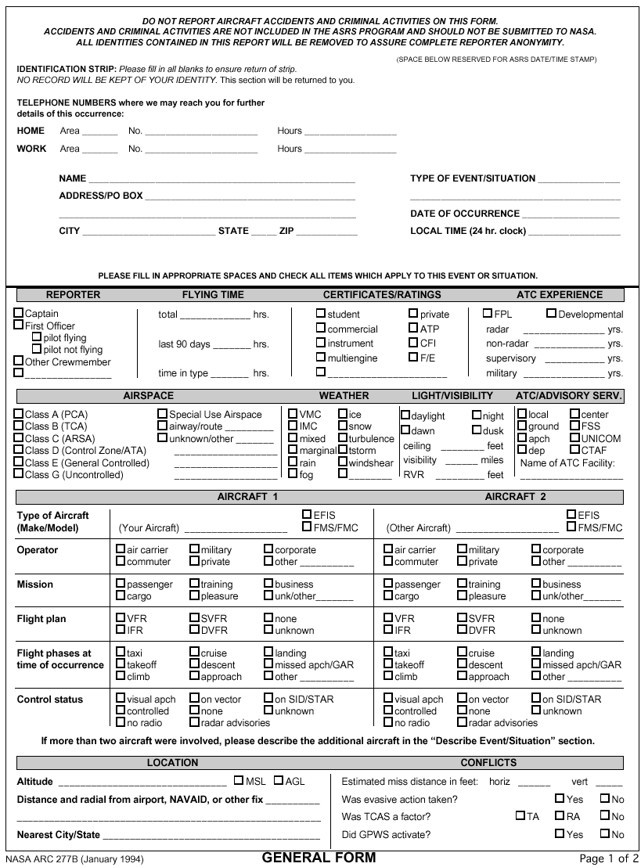
LEARNING from PAST MISTAKES
INCIDENT REPORTS
CHIRP (U.K.), SECURITAS (Canada), CAIRS (Australia), VARS (Russia), TACARE (Taiwan), KCAIRS (Korea)
GAIN (Global Aviation Information Network, FAA)
Aviation Safety Reporting System (ASRS)
  1976 (NASA/FAA)
  Voluntary submissions by users of the National Aviation System
  Reports of unsafe occurrences and hazardous situations
  Guaranteed confidentiality and limited immunity (if submitted within 10 days accidents and criminal activities not protected)
  De-identified database publicly available
  Identifies deficiencies in National Airspace System
  Provides data for planning future procedures, operations, facilities, equipment
  Output: Alert Messages, Callback, pilot newsletters, research articles, search requests, FAA & NTSB quick responses
496,000 reports (average 2860 reports/month)
>200 search requests in CY2000

Slide 16
LEARNING from PAST MISTAKES
INCIDENT REPORTS
Reasons for success
  Owned and managed by non-regulatory agency
  Voluntary
  No-penalty; immunity = incentive for timely reporting
  Broad information sources
    pilots, mechanics, flight attendants, air traffic controllers, ground personnel
    air carrier, general aviation, cargo, military
    manufacturers, airport operators
  Regular feedback to aviation community
  Not anonymous, allows for follow-up (until de-identification)
Led to significant regulatory changes (fatigue, sterile cockpit)
Lessons learned
  Reporting bias (who submits and what gets reported)
  Requires powerful analytic tools for data-mining (APMS, QUORUM)
  Private ownership allows for even faster responses - ASAP
Notes:
Reporting bias: no baseline, must report all errors and events that could have led to errors
APMS
develop and document the methodologies, algorithms, and procedures for data management and analyses to enable users to interpret easily their implications regarding the safety and efficiency of operations. APMS is intended to be a developer of system guidelines and an engine of technology transfer to the U.S. aviation industry and to the vendor community, that serves it. It has been recognized as key to the future development of the system-wide monitoring capability of the Aviation Safety Program and for the FAA's GAIN program.
QUORUM
To support the analysis and retrieval of ASRS reports based on the narrative text field contained within each report, a suite of text processing methods called QUORUM has been developed. QUORUM is useful for modeling situations that are described in narrative accounts of incidents and accidents. Further, it can use these models to identify prominent yet distinguishing characteristics of the situations, and can relevance-rank collections of incidents according to these representative characteristics.
ASAP
An in-house ASRS: developed, shared, and dealt with only within airline
Currently in use by 16 US airlines
Voluntary reports of safety issues, within 24 hours, not involving criminal activity
Reviewed by airline event Review committee

Slide 17
MONITORING CURRENT SYSTEM
AUDITS
Line Operations Safety Audit (LOSA) (Helmreich, UTexas, 1992)
Jumpseat observations of crew during regularly scheduled flights
  Demographics
  Attitude/Perception
  Safety interview
  Flight description: narrative, threats, operational complexity
  Crew performance: errors and violations, undesired aircraft states, technical data, threat and error management
Utilized by 20 air carriers since 1992 (some now doing own LOSAs)
Data used to
  assess system safety and id issues for action
  provides airlines with feedback on their own operations
Findings
  Average of 2 errors per (routine) flight
  77% errors inconsequential; 64% errors undetected by crew
Notes:
Non-punitive!
LOSA form:
Demographics
Attitude/Perception
Safety interview
Flight description: narrative, threats, operational complexity
Crew performance: errors and violations, undesired aircraft states, technical data, threat and error management

Slide 18
MONITORING CURRENT SYSTEM
IN-FLIGHT DATA
Flight Operational Quality Assurance (FOQA)
First established in Europe and Asia
Now utilized by 33 non-US and 4 US airlines
Obtain and analyze data recorded in flight
  up to 500 aircraft system parameters
  determine if pilot, aircraft systems, or aircraft itself deviates from typical operating norms
  measure deviations from up to 80 predefined events (= exceedances) (e.g., descent rate during approach)
  identify problems in normal operations and correct them before they contribute to incidents or accidents
  periodically, airlines aggregate exceedances over time to determine and monitor trends

Slide 19
INTERVENTIONS
TRAINING: classroom
Crew Resource Management (CRM) (5th generation)
  shift from training only technical aspects of flying
  address individual and team behavior and attitudes
  consider human performance limiters (fatigue, stress) and nature of human error
  suggest behavioral strategies as countermeasures
    leadership
    communication
    briefings
    monitoring
    decision making
    review and modification of plans
Shift to Error Management Training
  Recognize potential threats, detect errors, manage error outcome

Slide 20
INTERVENTIONS
TRAINING: simulator
Line Oriented Flight Training (LOFT)
Full-mission simulation of specially-designed scenaria
  normal operations
  challenging situations (e.g., weather diversions, equipment failures)
Instructor evaluates both flying skills and behavioral markers (CRM)
Pilots receive feedback about individual and team performance
Challenges
  More effective if tailored to reflect operations specific to organization
  Must be followed by effective debrief (Dismukes, McDonnell, & Jobe, 2000)
  Should include realistic concurrent task demands: interruptions, distractions, delays

Slide 21
COGNITIVE THEMES
VULNERABILITIES
It is the same cognitive mechanisms that afford humans unique capabilities and skills that give rise to limitations and vulnerabilities
Interruptions & Distractions
  defer/delay tasks (prospective memory)
  disruption or removal of environmental triggers
Automaticity
  goal and result of training
  no control over timing and accuracy
  habit capture
Expectations and assumptions
Sidetracking
Preoccupation

Slide 22
CAPTAIN
Ask for flaps
Ask for taxi clearance
Monitor radios
Receive taxi clearance
Form mental picture of taxi route
Check for obstacles
Start taxiing
Perform PRETAKEOFF Flow
Ask for PRETAKEOFF Checklist
Monitor radios
Monitor traffic
Maintain positional and situational awareness
Monitor Tower
Receive clearance
BELOW-LINE flow
Ask for BELOW-LINE items
Line up with runway
TAXI: real life demands
FIRST OFFICER
Set flaps
Request taxi clearance
Monitor radios
Receive taxi clearance
Acknowledge taxi clearance
Form mental picture of taxi route
Check for obstacles
Perform PRETAKEOFF Flow
Start PRETAKEOFF Checklist
Monitor radios
Monitor traffic
Monitor position on airport chart
Taxi Checklist complete
Monitor CA and aircraft movement
Switch to Tower and monitor
Receive clearance
Acknowledge takeoff clearance
BELOW-LINE flow
Start BELOW-LINE items
PRETAKEOFF Check complete
Environmental conditions
(compiled observations)
Ramp and/or Ground?
Flaps
before takeoff
Check charts
busy frequency
busy frequency
Keep trying
no time, familiarity
Double-check charts
no time, familiarity
De-icing pad
Delayed engine start
De-icing
Checklist
Before/After Start
Checklist
T
A
X
I
Resume
checklist
M
O
N
I
T
O
R
short taxi, no time
N1 S
Stabilizer Trim
"0" Fuel Weight
V Speeds
FMC Preflight
CDU
Seatbelt And Harness
Trim
Start Levers
Wing Flaps
Compass Indicators
Altimeters
Pitot Heat
Engine & Wing Anti-ice
Engine Start Switches
Flight Controls
APU
Takeoff Briefing
Program, set, verify
traffic, FO busy)
Extended taxi delay
Just-in or
new load data
short taxi, no time
Ask for
Checklist
Restart engine
Repeat checklists
Keep head
up/ outside
New flight release?
Calculate & reset
Performance data
New/ Additional
taxi instructions
Inform Company
(new #s, delays)
Remember to follow aircraft
Identify aircraft to follow
Cross check with CA
Remember taxi instructions
Id taxiways and turns
Stow OPC
Interruption
Remember to hold short
Id correct place to hold short
Resume
checklist
no time, familiarity
APU?
Landing
lights
Radar?
Change in
takeoff runway
Change in
takeoff sequence
Consult
charts
Attendant Call
Cockpit Door
Transponder
Packs
Engine Bleed Switches
Master Caution
Repeat
Checklist?
Accept/Plan/Request
new runway
no time
Brief
New runway
Strobes
no time
FMC update
Shoulder
harness
Shoulder
harness
Loukopoulos, Dismukes, & Barshi, 2000
TAKEOFF
Notes:
Real life: far from sterile
Forced to CTM
Sheer volume
Items out of sequence
Additional items
Novel combinations of tasks
Each addition/deferral presents a vulnerable point and creates an opportunity for an error

Slide 23
CAPTAIN
Ask for flaps
Ask for taxi clearance
Monitor radios
Receive taxi clearance
Form mental picture of taxi route
Check for obstacles
Start taxiing
Perform PRETAKEOFF Flow
Ask for PRETAKEOFF Checklist
Monitor radios
Monitor traffic
Maintain positional and situational awareness
Monitor Tower
Receive clearance
BELOW-LINE flow
Ask for BELOW-LINE items
Line up with runway
TAXI: errors observed (ASRS reports)
FIRST OFFICER
Set flaps
Request taxi clearance
Monitor radios
Receive taxi clearance
Acknowledge taxi clearance
Form mental picture of taxi route
Check for obstacles
Perform PRETAKEOFF Flow
Start PRETAKEOFF Checklist
Monitor radios
Monitor traffic
Monitor position on airport chart
(Delayed engine start)
Taxi Checklist complete
Monitor CA and aircraft movement
Switch to Tower and monitor
Receive clearance
Acknowledge takeoff clearance
BELOW-LINE flow
Start BELOW-LINE items
PRETAKEOFF Check complete
CA briefed and FO set wrong flaps for aircraft type - warning horn at takeoff
“Rushed” by aircraft pulling into same gate - omitted flaps - aborted takeoff
Forgot to request new flight release after 1 hr ground stop
Congested frequency - delay - start taxi mistakenly assuming clearance rec’d
Omit - overrun runway hold line
Assumed only need to contact ramp - taxied onto active runway behind gate
Forget to confirm tug clear -
taxi into tug
Mistook clearance to other aircraft for own - taxi without clearance
Fail to stop when lost - other aircraft had clearance canceled
N1 S
Stabilizer Trim
"0" Fuel Weight
V Speeds
FMC Preflight
CDU
Seatbelt And Harness
Trim
Start Levers
Wing Flaps
Compass Indicators
Altimeters
Pitot Heat
Engine & Wing Anti-ice
Engine Start Switches
Flight Controls
APU
Takeoff Briefing
Busy running checklist -
force other aircraft to go around
Preoccupied with new departure clearance and packs-off operation and omit - aborted takeoff
Confuse position - taxi into ditch
Omit or incorrectly set- warning horn at takeoff
Busy starting engine & running delayed engine xlist and taxi xlist - runway incursion
Omitted checklist and has not restarted engine #1 - delay
Forget to turn ignition switch on - overtemp engine
Misunderstand tower instructions - taxi onto runway w/o clearance
Inadvertently hit flip-flop switch - delay
New FO on IOE expected to hear “position and hold” - runway incursion
Attendant Call
Cockpit Door
Transponder
Packs
Engine Bleed Switches
Master Caution
APU bleed source - lost both packs in flight - enter pre-stall buffet while troubleshooting
Squawk incorrectly set during preflight - rush and fail to notice error before takeoff
Loukopoulos, Dismukes, & Barshi, 2000
TAKEOFF

Slide 24
SO WHAT CAN AVIATION TELL US ABOUT ERROR IN (transfusion) MEDICINE?

Slide 25
AVIATION ~ MEDICINE
Dynamic environment
  contrary to training and expectation
  impossible to capture in written procedures and manuals
All phases complex
  (preflight, pushback, taxi, takeoff, climb, cruise, descent approach, landing, taxi, shut down)
  (collection, storage, transport, compatibility testing, delivery)
High information load
  detect and interpret cues from multiple sources
  prioritize demands and responses
Concurrent task demands
Multi-disciplinary, team situation
  professional, national, organizational cultures at play (language, values)
Increasing interaction with technology and automation
Variable workload (hours of boredom, moments of terror)
? Training (continuous, evaluative vs. ?)
? Risk (multiple passengers + SELF vs. single patient)
? Ultimate responsibility (Pilot in Command vs. ?)

Slide 26
AVIATION ~ MEDICINE
Comparison survey of OR + ICU and cockpit
Doctors, nurses, fellows, and residents vs. pilots
(Sexton, Thomas & Helmreich, 2000)
Medical staff more likely to deny the effects of fatigue on performance (60%) than pilots (26%)
  Self-ratings of fatigue at time of task performance show higher rates of denial (NASA fatigue studies)
94% of pilots and intensive care staff advocated flat hierarchies vs. only 55% of consultant surgeons
Asymmetrical perception of teamwork and status in team
  Surgery vs. anesthesia
  ICU doctors vs. nurses
Notes:
Surgery generally reports good teamwork with anesthesia, but anesthesia staff do not necessary hold a reciprocal perception
ICU doctors report high levels of teamwork with nurses, but nurses do not hold reciprocal perception

Slide 27

ERROR IN MEDICINE
CURRENT APPROACH (U.S.)
Institute of Medicine report (1999) established national goal of reducing the number of medical errors by 50% over next 5 years
  Establish a national focus to create leadership, research, tools, protocols to enhance the knowledge base about safety
  Identify and learn from medical errors through mandatory and voluntary reporting systems
  Raise standards and expectations for improvements
  Implement safe practices at delivery level
One week later, the President directed a coordination task force to evaluate these recommendations and respond with a strategy
  Feb 2000: endorsed IOM goals and strategy

Slide 28
LEARNING from PAST MISTAKES
INCIDENT REPORTS
HOSPITALS
  VA PSRS (Patient Safety Reporting System)
    mandatory at all VA hospitals in U.S.
  new - PSRS in coordination with NASA
MEDICATION ADMINISTRATION
  MERS (Medication Error Reporting System)
  MedMARx
  MedWatch
TRANSFUSION MEDICINE
  MERS-TM
  SHOT (Serious Hazards of Transfusion) – U.K.
MEDICAL DEVICES
  ECRI (International Medical Device Reporting System)
  MAUDE (Manufacturer and User Device Experience) database
Notes:
MERS: U.S. Pharmacopoeia (private)
MedMARx: Pharmacopoeia

Slide 29
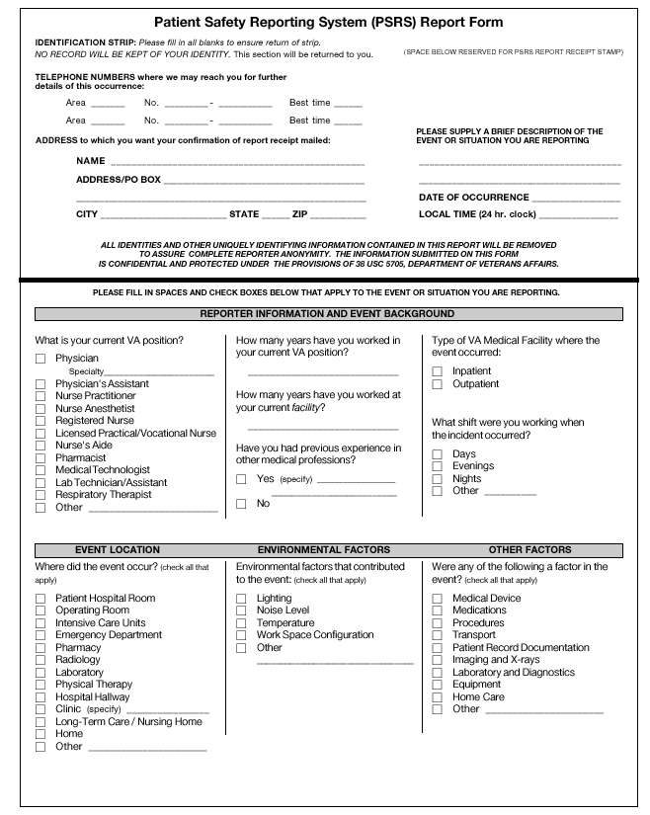
LEARNING from PAST MISTAKES
MEDICATION ADMINISTRATION
12-month period MedMARx data, 1999 (U.S. Pharmacopoeia, 2000)
6224 medication errors reported (only 3% resulted in patient harm)
  Error types: omission, improper dose/quantity, unauthorized drug
  Error causes: performance deficit , procedure not followed, knowledge deficit
Most reported contributing factor in all phases of medication use (prescribing, documenting, dispensing, administering, monitoring): distractions
Notes:
True causes may lie deeper and may be more complex. Need to probe further than surface analysis of causes...

Slide 30
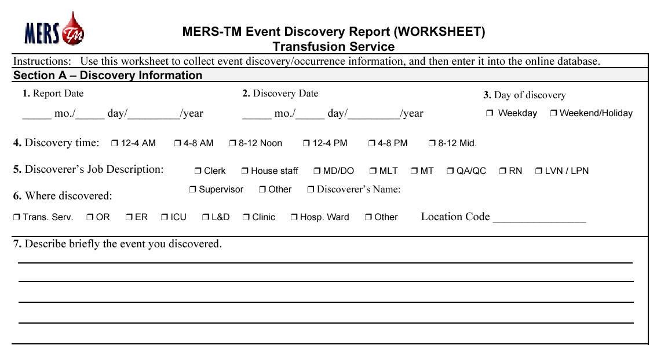
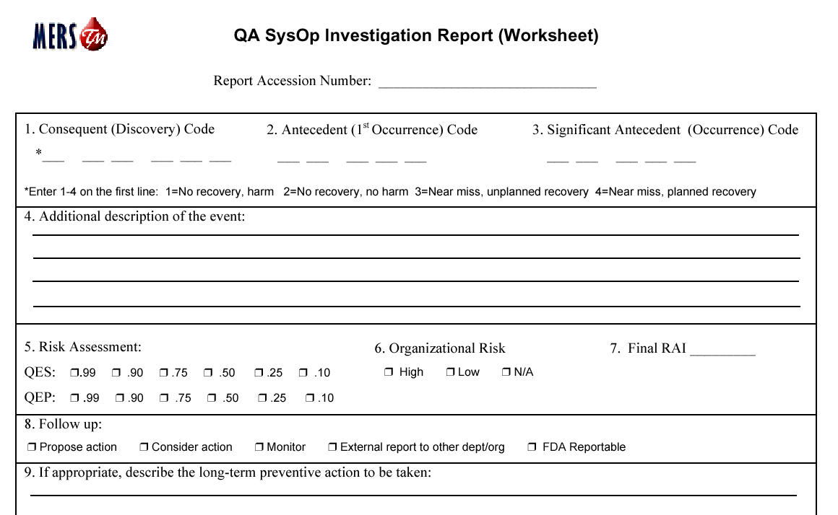
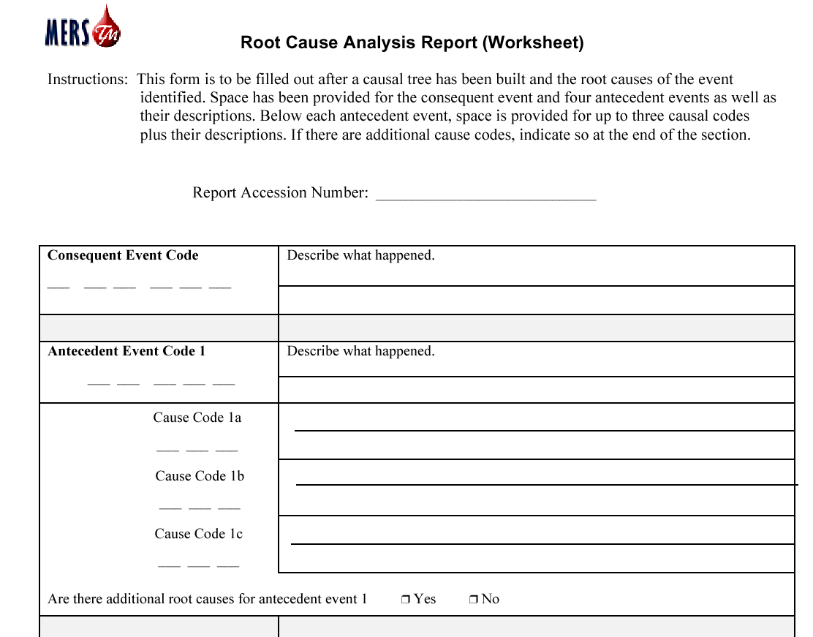
LEARNING from PAST MISTAKES
TRANSFUSION INCIDENT REPORTS
Medical Event Reporting System for Transfusion Medicine (MERS-TM)
FDA (Food and Drug Administration) published a final rule effective May 7, 2001, requiring hospitals and blood centers to maintain a method to report, investigate, and track errors and accidents.

Slide 31
LEARNING from PAST MISTAKES
TRANSFUSION INCIDENT REPORTS
Serious Hazards of Transfusion (SHOT)
Started 1996
Confidential, voluntary submission of reports of deaths and major adverse events
Hospitals in U.K. and Ireland
Cumulative data for 1996-2000 (N=910) (SHOT Annual Report, 1999/2000)

Slide 32
MONITORING CURRENT SYSTEM
FIELD STUDIES & SURVEYS
TRANSFUSION
Compare data from reporting system (AIR) and direct observation (DO) (Whitsett & Robichaux, 2001)
  Component identification errors = 55% (DO) vs. 17% (AIR)
SURGERY
Interviews at 3 Boston teaching hospitals (Gawande, 2001)
  70% of errors involved 2 or more clinicians
  Areas for quality improvement
    inexperience and supervision
    communication (esp. at handoff)
    fatigue/workload
Notes:
Transfusion: 202 transfusions over 18 months at Emory U. hospital
DO reveals more about SOPs (deviations from and problems with) and don’t get reported (definition of error, no consequence)
AIR complements DO by adding info on non-observed phases (storage) and actual consequences of errors

Slide 33
MONITORING CURRENT SYSTEM
FIELD STUDIES & SURVEYS
EMERGENCY DEPARTMENT
Average of 30.9 interruptions per 180 min study period
Average of 20.7 breaks-in-task in same study period
(Chisholm, Collison, Nelson, & Cordell, 2000)
5.1 patients simultaneously under a physician’s care
37.5 min/hr spent managing 3 or more patients concurrently
Interruption every 12.6 minutes
(Hymel & Severyn, 1999)
ANESTHESIA
Critical incident analysis: structured interviews
Human error involved in 68% of incidents reported
(Cooper, Newbower, & Kitz, 1984)
OPERATING ROOM
Jumpseating in the operating room (Sexton, Marsch, Helmreich, Betzendoerfer, Kocher, & Scheidegger, 1998)
Notes:
Although anesthesiologists make up only 5% of physicians in US, a is acknowledged as leading medical specialty in addressing issues of patient safety. (GABA 2000)
Critical incident technique adapted by Cooper from aviation
Analysis of closed malpractice claims
AIMS (Australia)
As in aviation, simulators have facilitated the exploration of SA
66% of errors in simulator were classified as human error (DeAnda & Gaba, 1990)
At least 50% of all blood units, by estimate, are transfused by anesthesiologists (Krombach, Kampe, Gathof, Deifenbach, & Kasper, 2002)

Slide 34
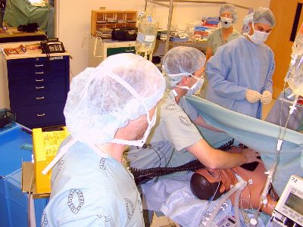
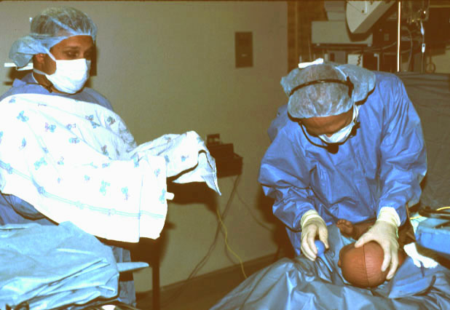
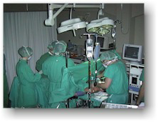
INTERVENTIONS
TRAINING: simulators
Operating Room (Palo Alto, CA)
Simulated Delivery Room (Palo Alto, CA)
Operating Room, University of Basel, Switzerland

Slide 35
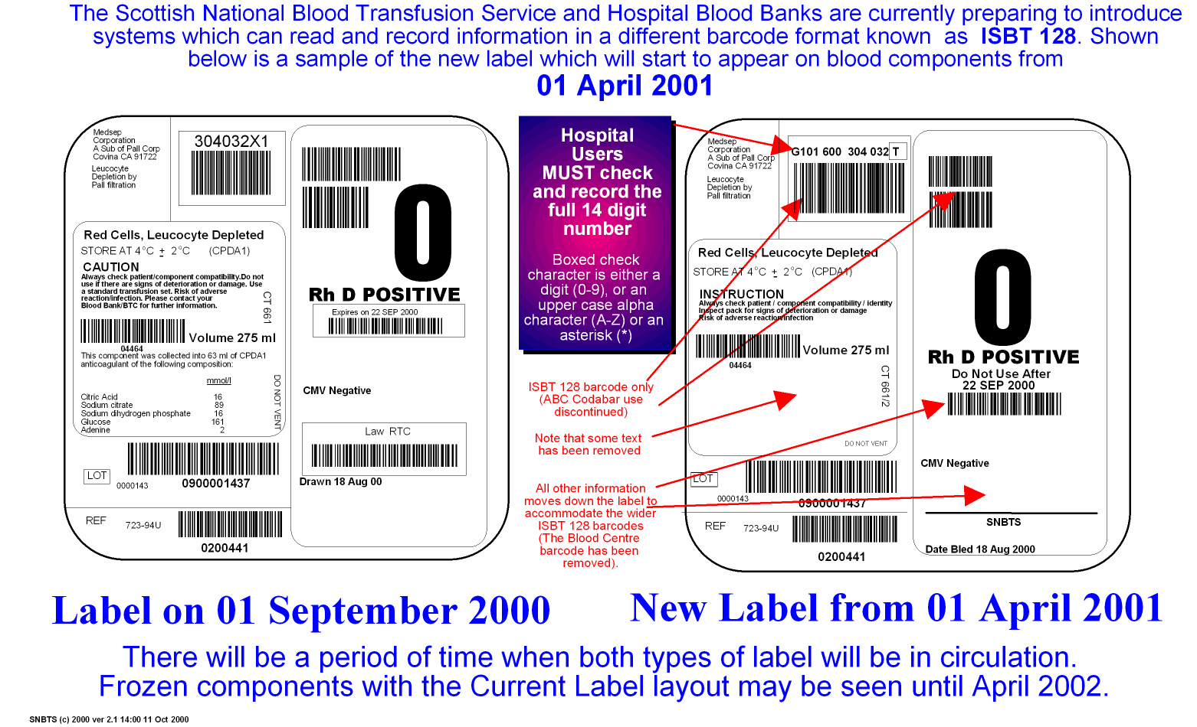
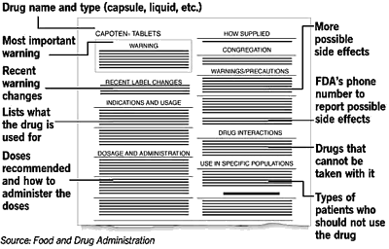
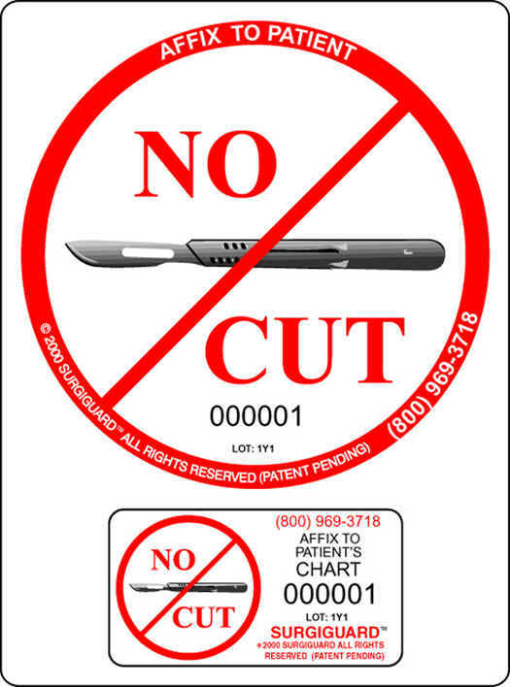

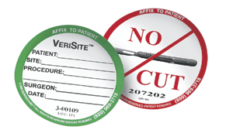
INTERVENTIONS
TECHNOLOGY & REGULATION
Source: Scottish National Blood Transfusion Service, ISBT 128
Source: VA Hospitals,
Bar Code Medication Administration
Source: SurgiGuard
Notes:
Bar Code Medication Administration (BCMA)
Medication bar codes on patients’ wristbands, IV tags, and medication
packages, scanned by hand-held, wireless devices before meds given to patient
System was introduced into VA and has reduced medication errors
By 70% at relatively low cost (Gebhart, 1999). This approach was
Adopted by how AVIS checked in returned rental cars

Slide 36
STRATEGIES TO REDUCE ERRORS
Proactive vs. reactive approach
Active involvement by all involved (management → operators)
Develop and promote philosophy
  invite communication
  safety #1 priority
  share findings and results
Set ambitious targets for error reduction initiative
Develop tracking mechanisms to expose errors and “near misses”
Thoroughly investigate errors, including a root cause analysis
Employ a systems approach
Allocate adequate resources
Ensure competence = every professional’s highest responsibility
Understand before you fix
Use results of Human Factors research

Slide 37
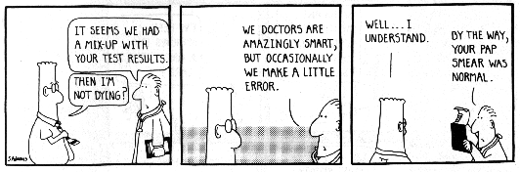
Hellenic Blood Transfusion Society
2nd Panhellenic Congress
April 2002

Slide 38
TRANSFUSION: case study
Boston VA Medical Center
60 year old man with history of esophageal cancer. Underwent a series of surgeries and follow-up procedures. He was severely ill and the highest risk category patient. During the last procedure he suffered a cardiac arrest. In the process of reviewing the circumstances of his death it was discovered that he had received 2 units of packed red blood cells typed and cross matched for another patient. Acute hemolytic reaction secondary to incompatible ABO transfusion was identified as the immediate cause of death.
Findings:
Each discipline (surgeon, anesthesia, nursing) identified comprehensive procedures for the identification of the patient prior to the procedure. This is not, however, an integrated process. Each utilizes procedures specific to their discipline.
A nurse assigned to assist did not participate in the patient id procedures; however he subsequently participated in the verification of blood prior to administration. The omission of checking the patient’s ID (writs) band, by those participating in the verification was critical. Members of the anesthesia who participated in the verification also participated in the care of the patient who preceded this patient in OR #7 and had, by then, begun to confuse the two patients. This was further precipitated by the storage of the previous patient’s blood in the refrigerator marked for OR #7 following completion of the case and his transfer to the recovery room. The patient’s blood was later found to be stored and marked for OR #6.
Confirmation of patient identification as reflected on the ID (wrist) band was omitted during the verification process used for both units of blood.

