Slide 1
A Tour of AHRQ Prevention Tools for Clinicians
On-Time Prevention of Pressure Ulcers in Nursing Homes
Thursday, September 27, 2007; 3:30 – 5pm
Susan D. Horn, PhD
Institute for Clinical Outcomes Research
699 E. South Temple, Suite 100
Salt Lake City, Utah 84102-1282
801-466-5595 (T) 801-466-6685 (F)
shorn@isisicor.com

Slide 2
ON-TIME PREVENTION OF PRESSURE ULCERS IN NURSING HOMES
Objectives
Build partnerships / Develop interdisciplinary team capacity to promote faster QI in LTC
Integrate evidence-based research on pressure ulcer prevention into long term care daily workflow
Redesign clinical care planning processes using standardized documentation and timely feedback reports

Slide 3
Research Based Best Practices
Nursing Home Study (NPULS) 1996-1997
6 long-term care provider organizations
109 facilities
2,490 residents studied
1,343 residents with pressure ulcer; 1,147 at risk
70% female, 30% male
Average age = 79.8 years
Funded by Ross Products Division, Abbott Laboratories

Slide 4
Long Term Care CPI Results
Outcome: Develop Pressure Ulcer
Horn et al, J. Amer Geriatr Soc March 2004; 52(3):359-367
General
Assessment
Incontinence
Interventions
Nutrition
Interventions
Staffing
Interventions
+ Age ≥ 85
+ Male
+ Severity of Illness
+ History of PU
+ Dependency in
>= 7 ADLs
+ Diabetes
+ History of tobacco use
+ Dehydration
+ Weight loss
+ Mechanical devices for the containment of urine (catheters)
- Disposable briefs
- Toileting Program
- Fluid Order
- Nutritional Supplements
  standard medical
- Enteral Supplements
  disease-specific
  high calorie/high
  protein
- RN hours per resident day >=0 .5
- CNA hours per resident day >= 2.25
Medications
- SSRI + Antipsychotic

Slide 5
Common Challenges Across Facilities
Inefficient Processes
Incomplete Documentation
CNAs: untapped resource
Communication Breakdowns / Lack Standard Processes
Clinical Decision Support Needs

Slide 6
Step 1: Build Partnerships
Empower all members of a facility team
Front-line workers actively participate in QI activities, including CNAs: bottom-up approach
Share across facilities

Slide 7
Step 2: Standardize Documentation
Comprehensive documentation for front-line workers
Redesign work flow – consolidate documentation
Allow individual facility customization
Encourage inter-facility sharing
Observe facilities come to consensus over time

Slide 8
Comprehensive Standardized Documentation
CNA
Daily flow sheet
Single form replaced multiple logs, clipboards, bedside charts
Reduced redundant documentation “document one time, in one place”
PrU Tracking Sheet
Wound RN standardized PrU documentation: tracks resident risk and pressure ulcer status
Information used to compile summary reports

Slide 9
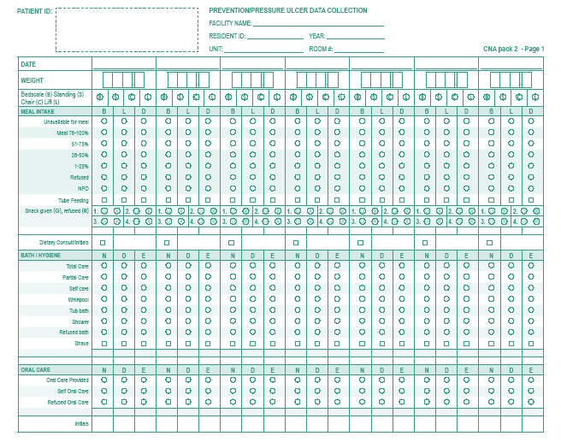

Slide 10
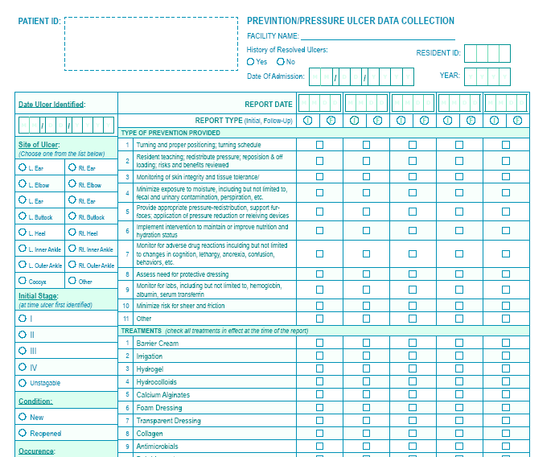

Slide 11
Step 3: Timely Feedback Reports
Use comprehensive standardized documentation data
First reports provide feedback on documentation completeness
Other reports target alerts for specific components of care
Summarize clinical information in variety of formats for use by RNs, MDS coordinators, dieticians, CNAs, wound RN, etc.
Reports contribute to individualized care planning processes

Slide 12
Timely Reports focus on Pressure Ulcer Prevention
Weekly Reports
Nutrition Report / Weight Summary
Behavior Report
Pressure Ulcer Report
Priority Report
Monthly Reports
Health Status Summary Report

Slide 13
Example: Nutrition Report
Stratified by Risk
Provide ‘BIG picture’ over time, not just snapshot of one shift or one day
Nutrition Summary
  Meal intake for 4 weeks
  Fluid intake for 4 weeks
  Diet order
  Supplement product
  Weight change since last week
  Existing pressure ulcer
  History of resolved ulcer
Weight Summary
  Weight 180 days prior
  Weight 30 days prior
  Weight for each of past 4 weeks
  Weight change since last week
  5-10% weight loss past 30 days
  >10% weight loss past 180 days

Slide 14
Nutrition Report
What are uses of the Nutrition Report?
Identify which meals are not being eaten
Promote use of nutritional supplements
Identify need for consistent weights

Slide 15
Example: Priority Report
Identifies residents at risk
Decreased meal intake
Weight loss
Increased incontinence episodes
Increased behavior problems
Existing red areas on skin
History of pressure ulcer in last 90 days

Slide 16
Benefits of
Timely Feedback Reports
Access to summarized information for clinical decision-making
Improve response time between identification of resident need and intervention
  Identify residents at risk for pressure ulcer development
Transform from paper to data culture
  Link reports to documentation elements

Slide 17
Step 4: Integrate into Daily Workflow
Comprehensive forms replace (not supplement) previous forms
Importance of front-line CNA observations stressed
Feedback is based on documentation
Feedback contributes to care plan updates

Slide 18
Results
Decrease Pressure Ulcer Development
Increase Adherence to Best Practices
Increase Staff Accountability and Satisfaction
    Inclusion of front-line workers in QI efforts
    Comprehensive documentation at point of care
    Communication among care team improved
Reduce Inefficiencies
    # documentation forms for CNAs
    CNA time looking for documentation book
    Time to compile reports for State Regulators and MDS
    Time for Wound RN to summarize and report data
Improve State Survey Process
Establish a foundation for EHR

Slide 19
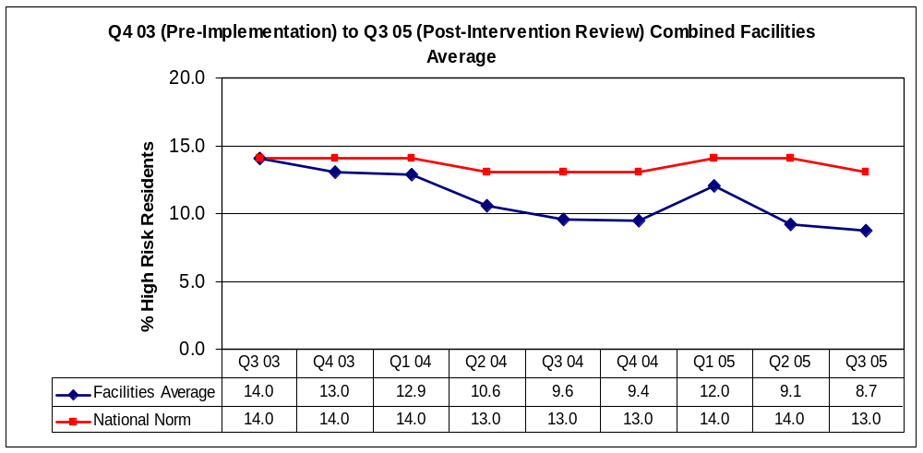
Impact On Pressure Ulcer QMs
The combined facilities’ average shows an overall reduction of 33% in the QM % of high risk residents with pressure ulcer from pre-implementation to initial post-implementation time periods
National Norm
Combined Facilities
Q4 03 – Q3 05% Change = - 33%
Source: CMS Nursing Home Compare; Facility QM data reports

Slide 20
Summary of Key Program Benefits
Improve Quality
Improve clinical decision making: integrate reports into day-to-day workflow
Identify residents at high risk early
Timely communication among multi-disciplinary team members
QI Collaboration
Receive technical assistance from QI experts
Collaborate with peers to share experiences and best practices

Slide 21
Summary of Key Program Benefits (cont)
Improve CNA Documentation
Consolidate current documentation
Standardize data elements and eliminate redundancy
Audit and train for accuracy
Gain Efficiency
Reduce time spent searching for multiple sources of information
Automated reports replace manual compilation of resident information
Increase Morale
Empower multidisciplinary teams with CNAs as important members
CNAs see importance of their work

Slide 22
Available On-Time Tools
CNA documentation
  http://ahrq.gov/research/ltc/pucnaform.pdf
On-Time Reports
  http://ahrq.gov/research/ltc/pusamplerep.pdf
Video and other resources
  http://ahrq.gov/research/puwebcast.htm

