Slide 1


Prevention Research Today
Elias A. Zerhouni, M.D.
Director, National Institutes of Health
Steps to a Healthier US: Putting Prevention First
Baltimore, MD – April 15, 2003

Slide 2
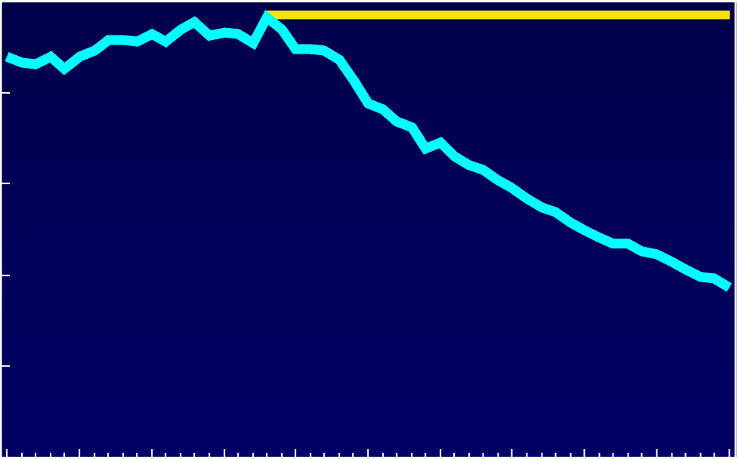
Coronary Heart Disease
Age-Adjusted Death Rates: Actual and Expected
United States, 1950-2000
500
400
~ 1,329,000 Projected Deaths
in 2000
300
Deaths per 100,000
815,000 Deaths
Prevented in 2000
200
100
~ 514,000 Actual Deaths
in 2000
0
1950
1955
1960
1965
1970
1975
1980
1985
1990
1995
2000
Year

Slide 3
Estimated U.S. Incidence of and Mortality from AIDS
1981-2001
More than 80 new drugs in development
Nearly 3X the number of vaccines in Phase I since 2001
90
Incidence
1993
80
Deaths
70
60
Prevalence
50
Number of Cases/Deaths
(Thousands)
40
30
20
Number of Cases or Deaths
10
0
81
82
83
84
85
86
87
88
89
90
91
92
93
94
95
96
97
98
99
00
01
Year
*Adjusted for reporting delays

Slide 4

New Challenges
New threats
  Biodefense
  New health threats (West Nile, others)
Emerging health Issues
  Obesity (4.6% to 15% of children and adolescents)
  Diabetes (incidence has doubled)
  Age-related diseases, for example,
  Alzheimer’s Disease, Macular Degeneration
  From acute to chronic diseases

Slide 5
Obesity Trends* Among U.S. Adults
BRFSS, 2001
Source: Mokdad A H, et al. J Am Med Assoc 1999;282:16, 2001;286:10.

Slide 6
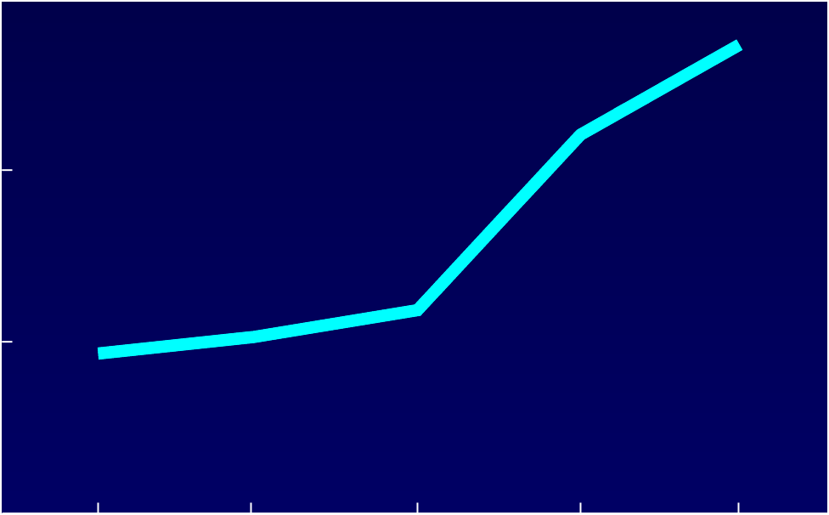
Prevalence of Obesity among
Children and Adolescents
Age 6-19 Years
15
13.6
10
11.0
Percentage
5
5.9
5.1
4.6
0
1963-1970
1971-1974
1976-1980
1988-1994
1999

Slide 7
Prevalence of Diagnosed Diabetes
in the United States
Diagnosed (1960-1998) and Projected Diagnosed (2000-2050) Cases
30
25
20
Diagnosed cases
15
People (millions)
10
5
Projected diagnosed cases
0
1960
1970
1980
1990
2000
2010
2020
2030
2040
2050
Year
Data for 1960-1998 from the National Health Interview Survey, NCHS, CDC.
Projected data for 2000-2050 from Boyle JP, et al, Diabetes Care 24:1936-40, 2001.

Slide 8
Prevention Initiative
President Bush’s FY 2004 budget plan calls for $100 million additional to fund a new initiative to prevent diabetes, obesity and asthma through community initiatives:
  State programs to motivate and support responsible health choices that would reduce the burden of preventable disease
  Community initiatives to promote and enable healthful choices, especially those focused on youth and older Americans
  Health care and insurance systems that put prevention first and reduce people’s risk factors for chronic disease and reduce potential health care complications

Slide 9
Need for new strategies
Revolution in biomedical sciences
New challenges and opportunities
Accelerate pace of life science discoveries
  Post- genome implications
  More rapid translational processes
Need for new approaches
  Orders of magnitude more effective than current approaches
  Molecular prevention and behavioral modification research

Slide 10
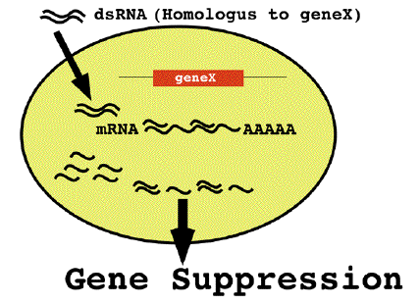
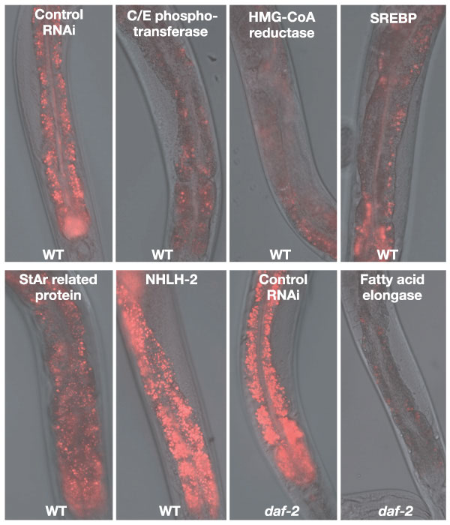
New Discoveries in Obesity Research
Using RNA interference (RNAi)
Thin
Worm
Source: Ashrafi, K., Chang, F.Y., Watts, A.G., Kamath, R.S., Ahringer, J., and Ruvkun, G., "Genome-wide RNAi analysis of Caenorhabditis elegans fat regulatory genes,” Nature, Vol. 421, pp. 268-272.
305 genes
112 genes
Obese
Worm
Normal Worm

Slide 11
Disease Prevention and
Health Promotion
An integral part of the research mission
One-fourth of the overall NIH budget
Prevention Research Continuum – Reflects breadth of investigational areas
Educate and train the next generation of prevention scientists
Educate the public and health professionals

Slide 12

Phases of the Prevention Research Continuum
1
Hypothesis
Development
2
Methods
Development
3
Controlled
Intervention
Trials
4
Defined
Population
Studies
5
Implementation
Projects
Research Training
Public and Professional Education

Slide 13

Phase 1 - Hypothesis Development
1
Hypothesis
Development
2
Methods
Development
3
Controlled
Intervention
Trials
4
Defined
Population
Studies
5
Implementation
Projects
Framingham Heart Study; Honolulu Heart Study (NHLBI)
Study of Relationship Between Air Pollutants and School Absenteeism in Southern California (NIEHS)
Study of Women’s Health Across the Nation: SWAN (NIA)
Arthritis Among Latinos: A Study Based on National Data (NIAMS)

Slide 14
Phase 2 - Methods Development
1
Hypothesis
Development
2
Methods
Development
3
Controlled
Intervention
Trials
4
Defined
Population
Studies
5
Implementation
Projects
Early Detection Research Network to Develop Molecular Markers of Early Cancer (NCI)
Sacramento Neighborhood Alcohol Prevention Project (NIAAA)
Assessment Measures for Alzheimer’s Disease Primary Prevention Trials (NIA)

Slide 15
Phase 3 - Controlled Intervention Trials
1
Hypothesis
Development
2
Methods
Development
3
Controlled
Intervention
Trials
4
Defined
Population
Studies
5
Implementation
Projects
Dietary Approaches to Stop Hypertension: DASH and DASH-sodium (NHLBI)
Vitamin Intervention for Stroke Prevention Trial (NINDS)
Fall Prevention Program for High-Risk Elderly Women (NINR)
Selenium and Vitamin E Prostate Cancer Prevention Trial-SELECT (NCI)

Slide 16
Phase 4 - Defined Population Studies
1
Hypothesis
Development
2
Methods
Development
3
Controlled
Intervention
Trials
4
Defined
Population
Studies
5
Implementation
Projects
Centers for Research to Reduce Oral Health Disparities (NIDCR)
Trial of Activity in Adolescent Girls: TAAG (NHLBI)
The Study of Tamoxifen and Raloxifene (STAR) to Prevent Breast Cancer in High-Risk Women (NCI)
The National Longitudinal Study of Adolescent Health: Add Health (NICHD, other Institutes)

Slide 17
Phase 5 - Implementation Projects
1
Hypothesis
Development
2
Methods
Development
3
Controlled
Intervention
Trials
4
Defined
Population
Studies
5
Implementation
Projects
Enhanced Dissemination and Utilization Centers: EDUCs (NHLBI)
State Models for Oral Cancer Prevention and Early Detection (NIDCR; NCI)
5-A-Day Campaign (NCI, CDC, ACS, Produce Industry, etc.)
Community Wide Program to Prevent Adolescent Alcohol Use (NIAAA)
Environmental Health Community Programs (27 Centers funded by NIEHS)

Slide 18

NIH Roadmap
Re-engineering the Clinical
Research Enterprise
“We need to more quickly translate our discoveries into practice.”
Integrated Clinical Research Networks
Clinical Research Informatics
Training
Public Trust
Translational Research
GOAL
A More Efficient National “Bench to Bedside”
Clinical Research System

Slide 19

National Clinical Research System
National Network
Local Networks
Regional Networks

Slide 20
Healthy People 2010
Translation and application of research evidence that benefits the public health community
Goals and objectives based on sound scientific research evidence
Important DHHS instrument to guide planning and implementation of effective prevention strategies

Slide 21








NIH
Investing in People’s
Health

Slide 22
Our ultimate goal is to prevent disease and disability
Research Is Key to Success

Slide 23
Public and Professional Education
“The National Diabetes Education Program (NIDDK and CDC)
National Asthma Education and Prevention Program (NHLBI)
Obesity Education Initiative (NHLBI)
PDQ Cancer Screening and Prevention Summaries, Trial Registry; Cancer Information Service (NCI)

Slide 24
NIH Roadmap
Re-engineering the Clinical
Research Enterprise
“We need to more quickly translate our discoveries into practice.”
Integrated Clinical Research Networks
Clinical Research Informatics
Training
Public Trust
Translational Research
GOAL
A More Efficient National “Bench to Bedside”
Clinical Research System

