Slide 1
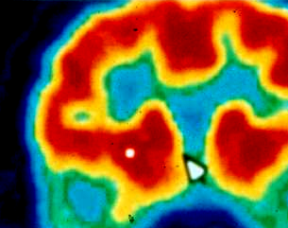
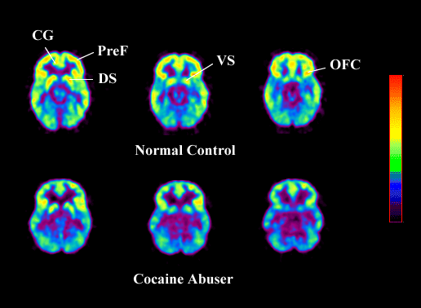


Understanding & Treating
A Major Research Priority
for NIDA
Co-Occurring Conditions:
Nora D. Volkow, M.D.
Director
National Institute on Drug Abuse

Slide 2
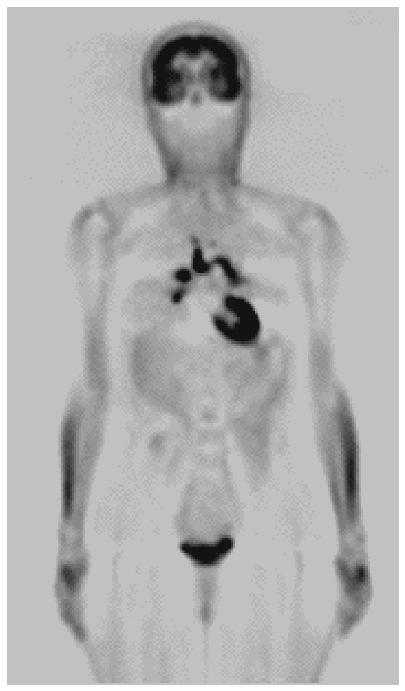



Medical
Addiction
DRUGS
Economic
Social

Slide 3
HISTORY
BIOLOGY
- previous history
- expectation
- learning
DRUGS
- genetics
- circadian rhythms
- disease states
- gender
BRAIN
MECHANISMS
ADDICTION
ENVIRONMENT
- social interactions
- stress
- conditioned stimuli

Slide 4

Priority Areas for NIDA
Prevention Research (Children and Adolescents)
genetics
development
environment
co-morbidity
Treatment Interventions (New Targets &
New Strategies)
HIV/AIDS Research

Slide 5
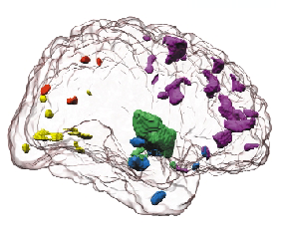
Drug Addiction is a Developmental Disease that Starts in Adolescence and Childhood
1.6%
1.4%
1.2%
1.0%
% in each age group who develop first-time cannabis use disorder
0.8%
0.6%
Brain areas where volumes are smaller in adolescents than young adults.
0.4%
Sowell, E.R. et al., Nature Neuroscience, 2: 859-861, 1999
0.2%
0.0%
5
10
15
18
25
30
35
40
45
50
55
60
65
70
Age
Age at cannabis use disorder as per DSM IV
NIAAA National Epidemiologic Survey on Alcohol and Related Conditions, 2003

Slide 6
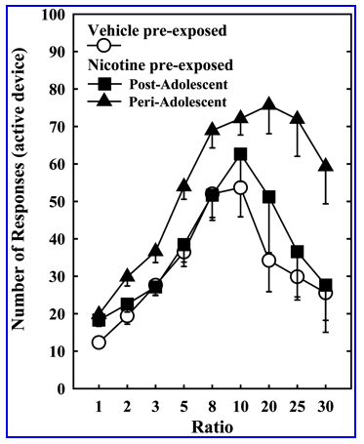
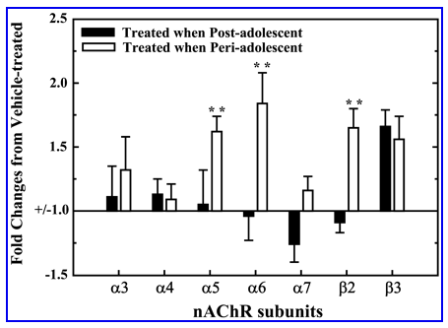
Animals Pre-Exposed to Nicotine During
Peri- and Post-Adolescence Differed
During A Between Session
Progressive Ratio Schedule for
Nicotine Self Administration
For Transcript Levels of Different
Subunits of the nAChRs in
the Ventral Midbrain
Source: Adriana, W. et al., J of Neurosci, 23(11), pp. 4712-4716, June 1, 2003.

Slide 7
Addictive Disorder
Addictive Disorders
Often Co-Exist With
Mental Disorders
Mental Disorder

Slide 8
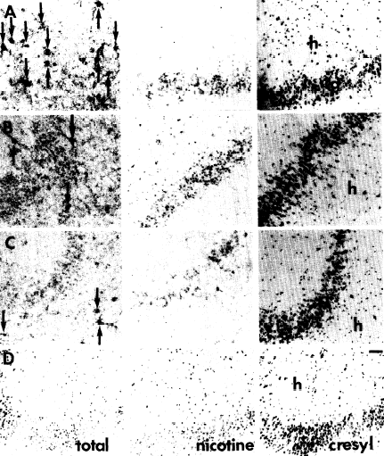
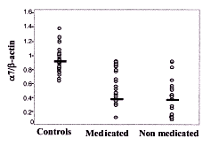
Comorbidities: Smoking Epidemiology
Schizophrenic Patients
have Fewer Nicotinic
Receptors in Hippocampus
mRNA Levels of
α7 AChR are Lower in
Schizophrenic Patients
normal population: 23%
alcoholism: 90%+
other addictions: 90%+
schizophrenia: 85%
depression: 80%
control
subjects
schizophrenic
patients
Perl, O et al., FASEB Journal,
17, pp. 1948-1950, October 2003.
Source: Freedman et al,
Biol Psychiat 38, 22-33, 1995

Slide 9
The Adjusted Effect of ADHD &
Pharmacotherapy on SUD Incidence
Unmedicated ADHD
vs Controls
OR (95% CI)
Medicated ADHD
vs Unmedicated ADHD
OR (95%CI)
Any SUD at Follow-up
Alcohol A/D
Marijuana A/D
Cocaine/Stimulant A/D
Tobacco A/D
6.3 (1.8-21.4)
5.8 (1.7-19.3)
3.1 (0.8-12.5)
7.5 (0.3-163.4)
0.85(0.15-4.8)
0.15 (0.04-0.6)
0.16 (0.05-0.57)
0.42 (0.11-1.7)
0.20 (0.02-2.1)
2.4 (0.5-12.3)
Untreated ADHD was a significant
risk factor for SUD in adolescence
Pharmacotherapy was associated with a
reduction in risk for SUD in ADHD youth
Source: Biederman J. et al., Pediatrics, 104(2) August 1999.

Slide 10
Priority Areas for NIDA
Prevention Research (Children and Adolescents)
genetics
development
environment
co-morbidity
Treatment Interventions (New Targets &
New Strategies)
HIV/AIDS Research

Slide 11
Community
Bedside
Bench

Slide 12
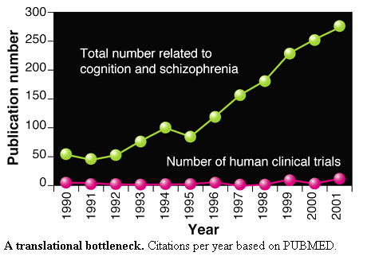
TRANSLATIONAL BOTTLENECK
Source: Hyman, S.E. and Fenton, W.S. Science, 299, pp. 350-351, January 17, 2003.

Slide 13
Percentage of Recommended Care Received
Senile cataract
Breast cancer
Prenatal care
Low back pain
CAD
Hypertension
Congestive heart failure
Cerebrovascular disease
COPD
Depression
Orthopedic conditions
Osteoarthritis
Colorectal cancer
Asthma
Benign prostatic hyperplasia
Hyperlipidemia
Diabetes mellitus
Headache
UTI
Community-acquired pneumonia
STDs
Dyspepsia and peptic ulcer disease
Atrial fibrillation
Hip fracture
Alcohol dependence
0
20
40
60
80
100
Source: McGlynn, E.A., NEJM, 348, pp. 2635-2645, June 26, 2003

Slide 14
Defining Health Services Research
A multidisciplinary field that examines how:
social factors,
financing systems,
organizational structures and processes,
health technologies and
personal beliefs and behaviors
access to and utilization of healthcare,
quality and cost of healthcare, and
our health and well-being.
affect
Ultimately, the goals of health services research are to
identify the most effective ways to organize, manage,
finance, and deliver high quality care

Slide 15


CJ-DATS Criminal Justice Drug Abuse Treatment Studies
Research Centers
Coordinating Center

Slide 16
Priority Areas for NIDA
Prevention Research (Children and Adolescents)
genetics
development
environment
co-morbidity
Treatment Interventions (New Targets &
New Strategies)
HIV/AIDS Research

Slide 17
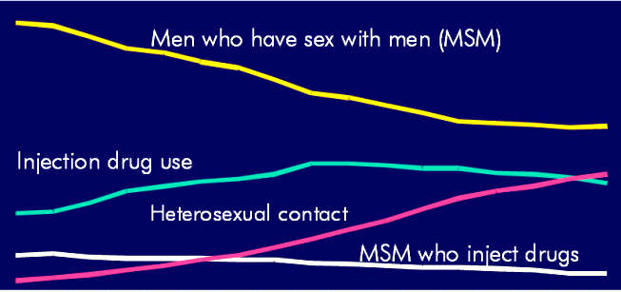
Proportions of AIDS Cases Among Adults & Adolescents
by Exposure Category and Year of Diagnosis,
1985 - 2001, United States
70
Men who have sex with men (MSM)
60
50
% of Cases
40
Injection drug use (IDU)
30
20
Heterosexual contact
Percent of Cases
10
MSM who inject drugs
0
1986
1988
1990
1992
1994
1996
1998
2000
Year of Diagnosis
Source: Centers for Disease Control and Prevention (CDC)
Notes:
Proportion of Estimated Adult/Adolescent AIDS Cases, by Exposure Category and Year of Diagnosis, 1985-2000, U.S.
The proportional distribution of AIDS cases by exposure category has shifted since the beginning of the epidemic. Whereas in 1985, men who have sex with men (MSM) accounted for the greatest proportion of diagnosed AIDS cases, the proportion has decreased from nearly 65% of cases diagnosed in 1985 to approximately 40% of cases diagnosed in 2000.
The proportion of estimated AIDS cases attributed to injection drug use increased between 1985 and 1994, then remained stable or declined, accounting for approximately 27% of diagnosed cases in 2000.

Slide 18
The Consequences of Drug Abuse and Addiction Disproportionately
Affect Minority Populations in the U.S.
100%
6
4
1
12
15
23
80%
11
16
60%
50
40%
70
65
20%
26
0%
Population
Drug Abuse/
IDUs with
Dependence *
HIV-AIDS **
White
Black
Hispanic
Other
Sources: * 2002 NSDUH, DHHS, SAMHSA, 2003.
** CDC HIV/AIDS Surveillance Report 2002.

Slide 19
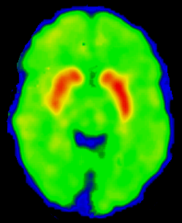
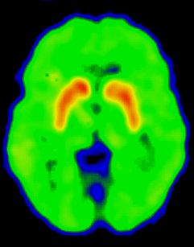
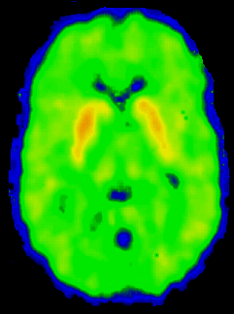

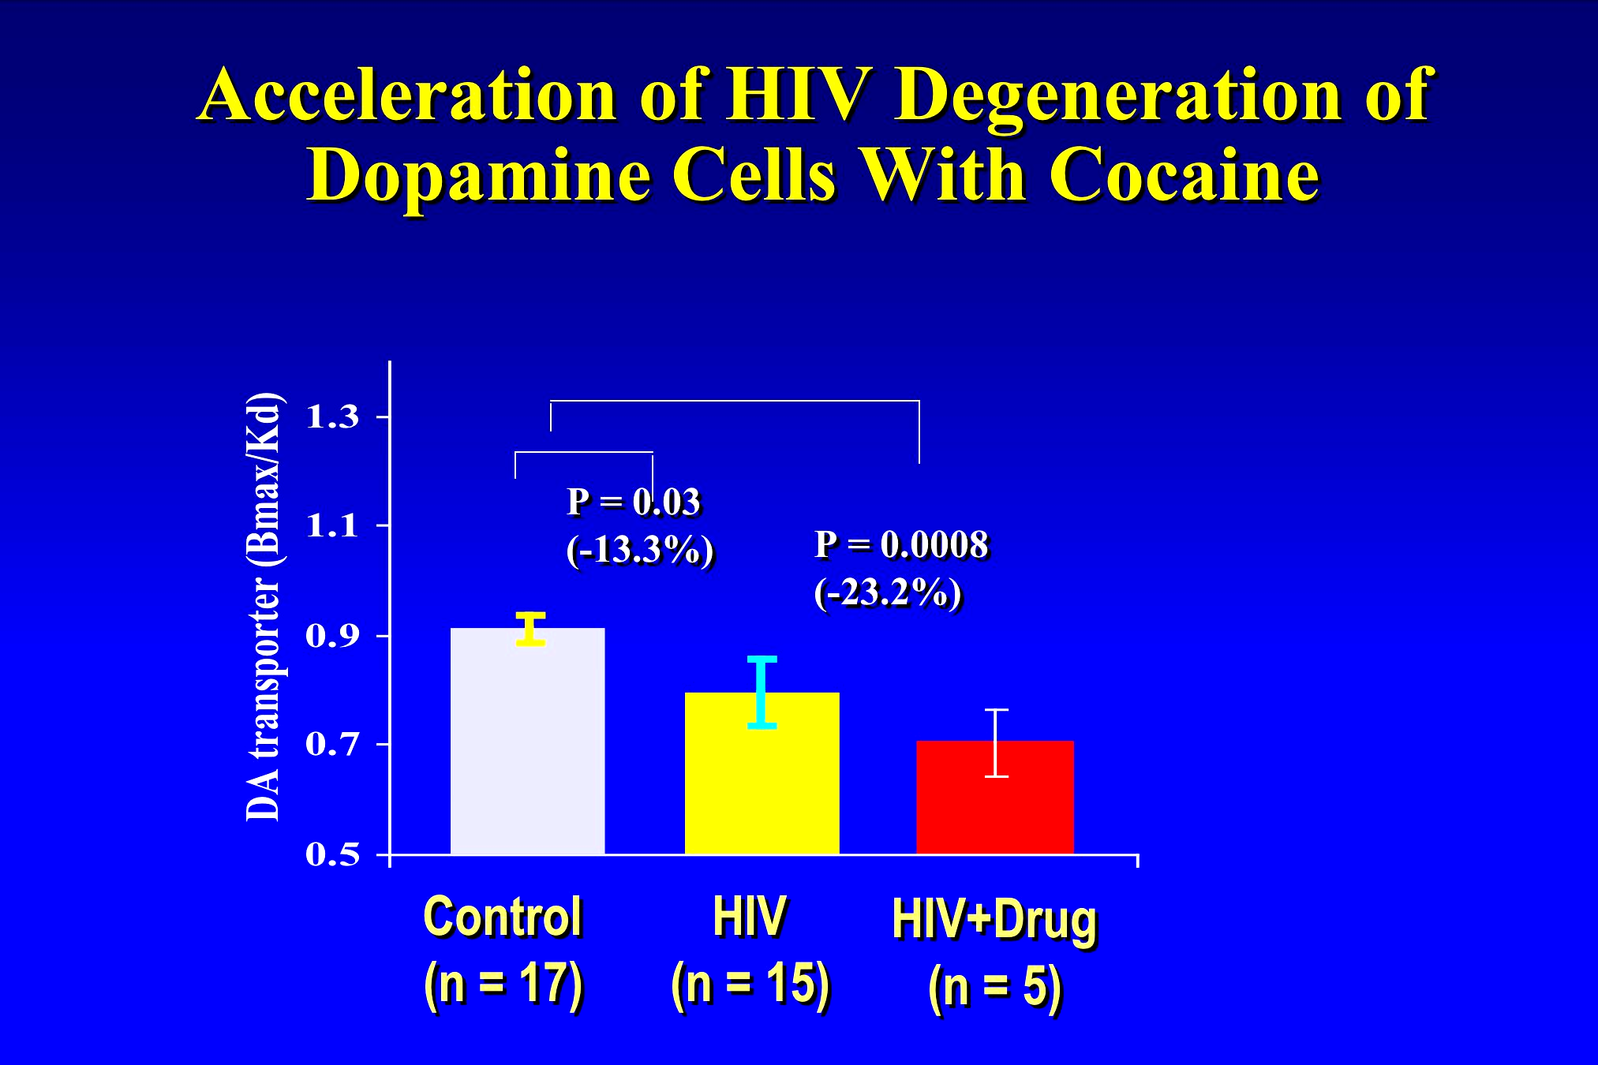
Acceleration of HIV Degeneration of Dopamine Cells With Cocaine
Seronegative
HIV
HIV + Drug
Notes:
Generalized cerebral atrophy most prominent in the frontal and temporal regions as well as basal ganglia atrophy with its shrinkage of the head of the caudate is noted.
Diffuse periventricular white matter high signal intensity lesions are seen on a T2 weighted image.

Slide 20
White
House
ONDCP
DHHS
DOJ
DOE
DEA
AHRQ
FDA
NIH
SAMHSA
HRSA
NIDA
NIMH
NIAAA
NIDA
Working With Other Agencies
Is Enabling Us To…
Ensure that our research is
responsive to public need
Translate research findings
into relevant clinical practice

Slide 21
PAs and RFAs Relating to
Co-Occurring Disorders
Pharmacotherapy to Treat the Comorbidity of
Alcohol and Substance Use Disorders (PAS-03-029)
(with NIAAA)
Enhancing State Capacity to Foster Adoption of
Science-Based Practices (RFA-DA-05-002) (with SAMHSA)
HIV/AIDS, Severe Mental Illness and Homelessness
(PA-04-024) (with NIMH and NIAAA)
Coming Soon…
NIDA/NIMH Program Announcement on
Services Research for Co-Occurring
Mental and Substance Abuse Disorders

Slide 22

NIDA’s Initial Goals Based on
The Blue Ribbon Report
# 1 Implement a standard definition of Health Services Research
#2 Increase research on organizational, management, and economic issues to enhance policy, programs and practices
#3 Lead and collaborate in the development of standards for evidence-based practice
#4 Evaluate causal associations

Slide 23
Health Services Research
Task Force Members
Co-Chairs:
Thomas McLellan, PhD,
Constance Weisner, DrPH, MSW
Andrea Barthwell, MD Richard Frank, PhD
Caryn Blitz, PhD Warren Hewitt, MS
Rick Catalano, PhD James Inciardi, PhD
Mady Chalk, PhD Marguerita Lightfoot, PhD
Linda Chinnia, MEd Isaac Montoya, PhD
Lorraine Collins, PhD Claire Sterk, PhD
Wilson Compton, MD, MPE Janet Wood, MBA, MEd
Michael Dennis, PhD

