Slide 1
Integration, the other I-Word
Denni McColm, CIO
Citizens Memorial Hospital

Slide 2
Interoperability
Capability to exchange data with systems from different vendors.
. . . where patient records are available electronically virtually anywhere in the world.

Slide 3
Integration
One system deployed across the continuum of care / across providers, hospitals
One database, one EMR
EMR that crosses care settings & providers

Slide 4
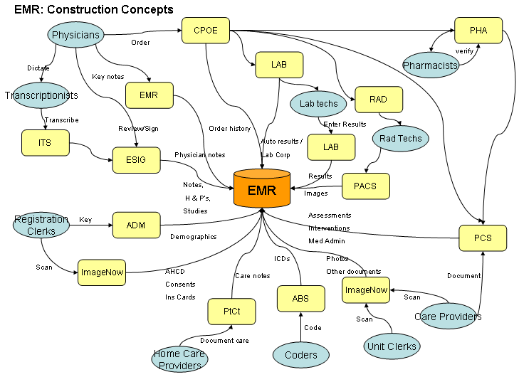

Slide 5
Integration & Interoperability
Integrated at local or regional level
Integrated across the continuum and/or across providers
Integrated system interoperable using new standards

Slide 6
The CMH Story
About Citizens Memorial Hospital
  74 Beds
    Medical/Surgical, ICU, OB, Psychiatry
  16 Physician Clinics
  Home Care & Hospice Services
Citizens Memorial Health Care Foundation
  5 Long Term Care Facilities
  Residential Care
Bolivar Family Care Center
Central Care Cancer Center
TCTI, Nursing School

Slide 7
Project Infocare
One EMR, patient-centered, integrated
All visits from across continuum of care
No paper charts in the hospital and one LTC
100% of admitting physicians use CPOE in hospital & LTC facilities
EMR available in hospital, LTC facilities, CMH-owned physician clinics, independent clinics, and by remote access
Visits in EMR from physician clinics and emergency department, implementation of full clinical documentation in process

Slide 8
Consensus Around Integration
Project Goals
  Enhance access to care
  Improve continuity of care
  Provide physician connectivity
  Gain operational efficiency
  Support facilities & services expansion
  Push quality & performance improvement

Slide 9
Project Infocare Vision
Enable a patient to enter anywhere into the continuum of care and have a personal identity that is maintained across that continuum
Physicians and other caregivers will have access to all of that patient’s medical information within the healthcare continuum
Notes:
Vision statement adopted during implementation planning

Slide 10
Guidelines for Acquisition
Common system solutions will be implemented for like functions where the system can meet 70%-80% of department or facility requirements which will provide for operational integration across the continuum of care.

Slide 11
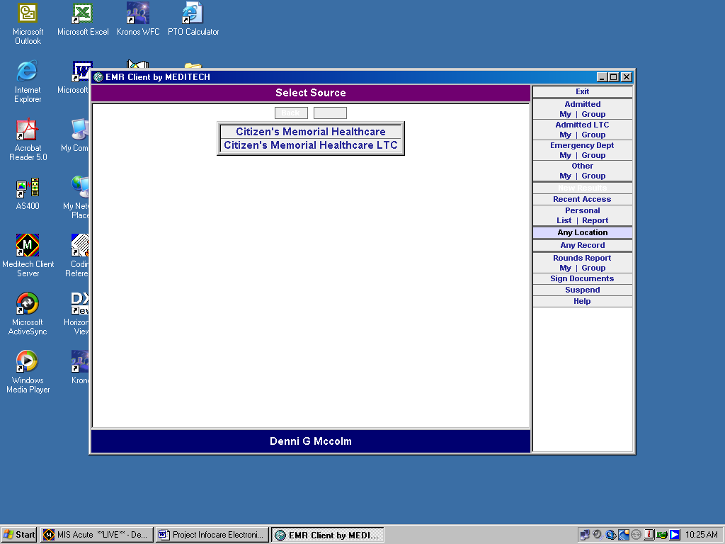
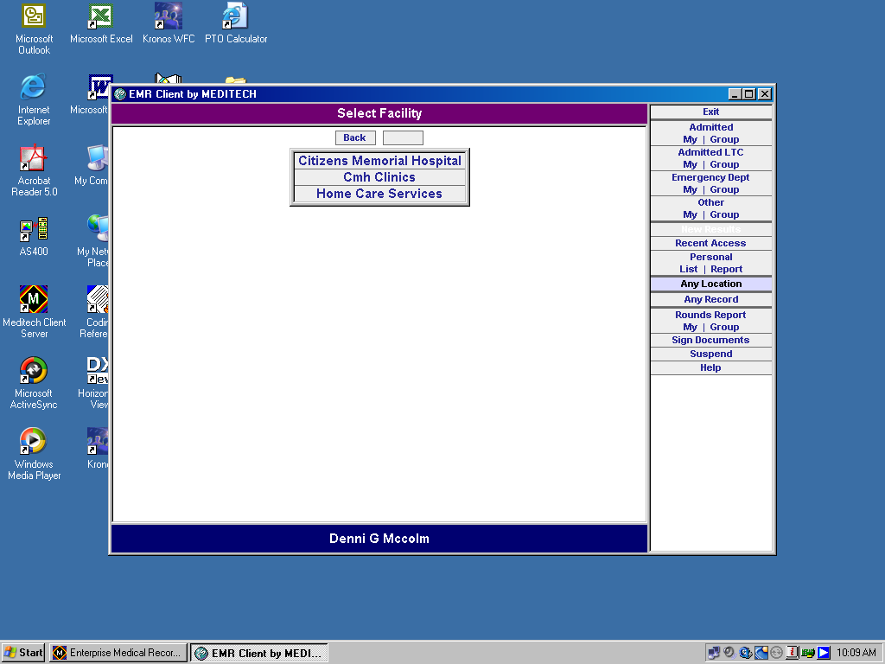
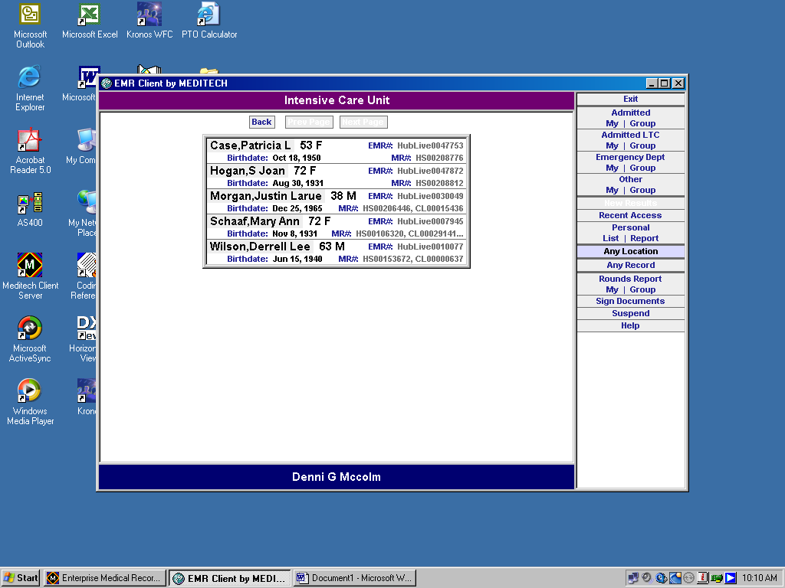
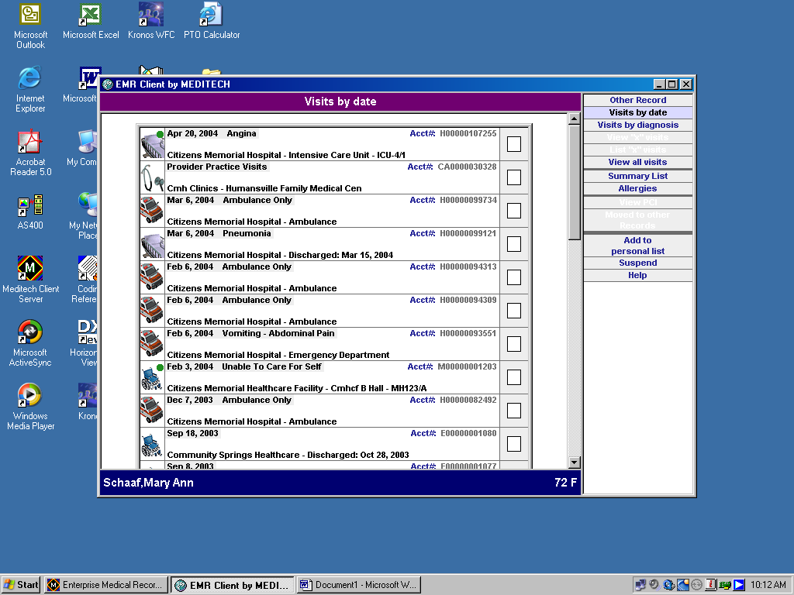
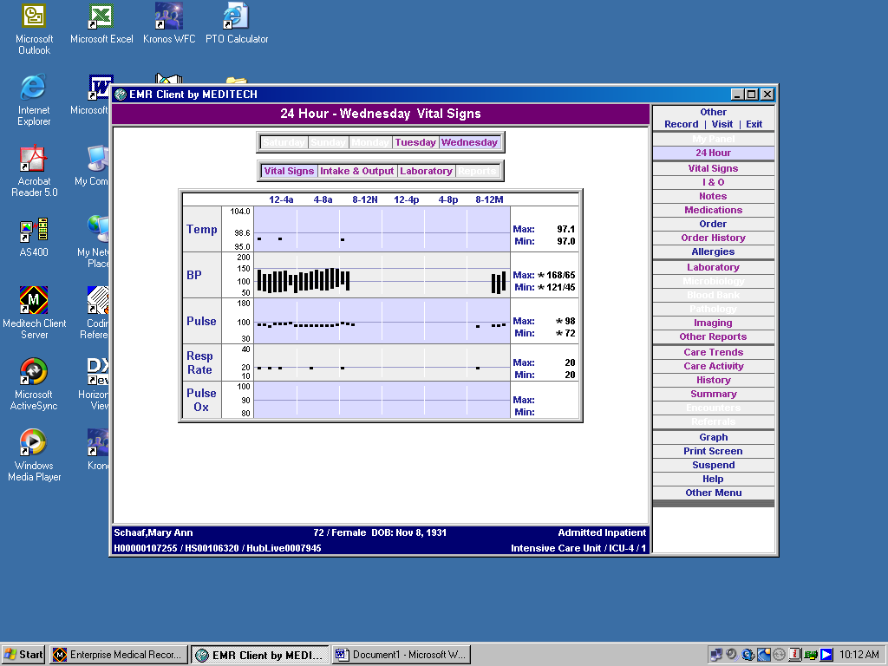
PATIENT
NAMES
HERE

Slide 12
Results
64,860 patient records in EMR since inception in December, 2002
Each patient has, on average, six visits in the EMR from across the continuum.
92% of patients seen in the past year were “known to the system” (i.e. they already had a record in the EMR)

Slide 13
Value of Integration
$$$$$
Information Sharing
Byproducts

Slide 14
$$$$ Benefits of Integration
$6,000,000 investment spread over multiple settings
  Software, implementation, network, devices, staff time & benefits, travel & training
Sharing of technical expertise
Reduction in receivables

Slide 15
Information Sharing Benefits
Always available, always current
Coordination of care - transitions across care settings non-issue
Information to support physicians in providing quality care

Slide 16
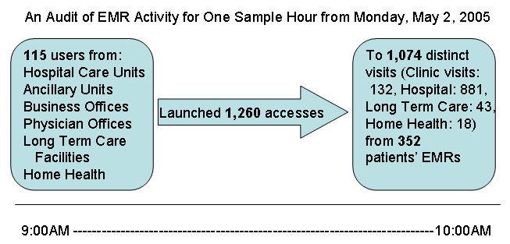

Slide 17
Other Benefits
Learning curve for providers
Scheduling where the patient is
Staff sharing across settings
Patient Friendly registration processes (good-bye to the medical clipboard!!)

Slide 18
Lessons Learned about Integration
Extensive planning adds value
  Needs, acquisition, implementation
  Include administrative support
  Involve building consensus
  Develop written agreements
Variations across the continuum
  Adapt without compromising patient-centeredness
Respect the I-Word

Slide 19
Coming . . .
Physician Clinics Electronic Ambulatory Record (1 down, 15 to go)
Emergency Department full clinical documentation and ordering (2 phases down, 2 to go)
Bedside Medication Verification
Evidence-based clinical decision support
Patient Portal

Slide 20
Integration, The other I-Word
Provides quality & efficiency
Promotes patient safety through information availability
Reduces the “hassle factor” for physicians
Plus – when the rest of the world is ready for interoperability – we’ll have a lot of data to share

