Slide 1
caBIG Workspace Overview, Scope and Needs
Clinical Trial Management Systems
Washington, D.C.
February 19 & 20

Slide 2
Rules for Today’s Meeting
We want to hear ALL and ANY ideas
No idea, no question, no comment is too dumb
Check egos at the door
Let’s not get hung up on bits and bytes
Apologies in advance to any toes we have stepped on

Slide 3
Contents
Goals of this Session
Workspace Structure
Workspace Operations
Workspace Participants and Scope
Workspace Needs

Slide 4
Workspace Breakout Session - Goals
Learn about the relevant capabilities at the participating cancer centers and the NCICB
Review the needs and interests of participating pilot Cancer Centers
Discuss workspace requirements
Review requirements for potential developer projects and identify key, near term milestones and activities.
Review existing caBIG compliant solutions as the basis for early testing and integration by Adopter Centers
Discover sources of data within the Workspace which can be shared on the grid as part of the pilot program
Discuss group coordination and future meeting schedule
Draft action plan summarizing conclusions

Slide 5
Purpose of this Presentation
Start today’s discussion from a common understanding
  Overview of caBIG Workspaces in general (structure and operations)
Set the stage for the Workspace specific discussions
  Understand the scope and needs of the Clinical Trial Management Systems Workspace

Slide 6
Contents
Goals of this Session
Workspace Structure
Workspace Operations
Workspace Participants and Scope
Workspace Needs

Slide 7
Workspace Definition
Central to the caBIG pilot initiative
Areas where caBIG pilot project activities are grouped and coordinated
Encompass activities with a common focus, addressing identified Cancer Center needs
Create products and solutions including tools, standards, data and documentation
Share and test products and solutions amongst pilot participants
Develop products and solutions which will ultimately be open and shared among the cancer research community

Slide 8
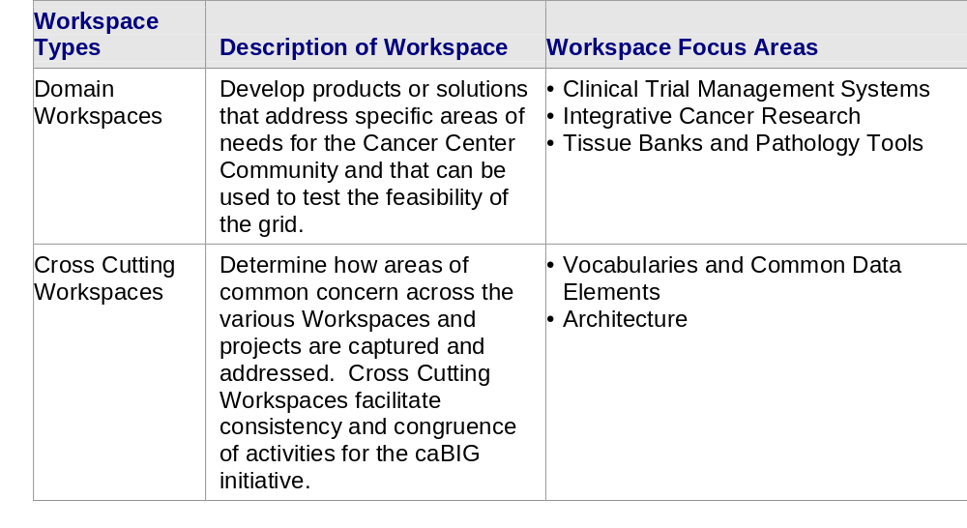
Workspace Types
There are two types of Workspaces – Domain and Cross Cutting
Clinical Trial Management Systems is a Domain Workspace

Slide 9
Workspace Roles
Developer
An NCI-designated Cancer Center selected and funded by NCICB to participate in a specific Workspace to undertake software or solution development activities.
Adopter
An NCI-designated Cancer Center selected and funded by NCICB to undertake formal testing, validation and application of products or solutions developed by Workspace Developers and existing caBIG compliant solutons.
Workspace Working Group
A group of NCI-designated Cancer Center members (and other invited stakeholders) funded to provide guidance and support for Workspace activities. The Working Group includes representatives from the Developer and Adopter teams.

Slide 10
NCICB
caBIG Oversight Board
Master Contractor
Clinical Trial Mgmt System
Integrative Cancer Research
Tissue Banks & Pathology Tools
Cross Cutting Workspace
Architecture
Workspace
Working Group
Workspace
Working Group
Workspace
Working Group
Developer
Developer
Adopter
Developer
Adopter
Developer
Developer
Developer
Developer
Cross Cutting Workspace
Vocabularies & Common Data Elements
Adopter
Developer
Workspace
Working Group
Developer
Developer
Developer
Developer
Developer
Adopter
Adopter
Workspace
Working Group
Domain Workspace
Domain Workspace
Domain Workspace
Strategic Level Working Groups

Slide 11
Contents
Goals of this Session
Workspace Structure
Workspace Operations
Workspace Participants and Scope
Workspace Needs

Slide 12
Workspace Principles of Participation
Support the spirit, vision, goals and principles of the caBIG initiative as a whole
Collaborate effectively with other Workspace participants and groups to support specific and overarching goals
Collaborate effectively with other Workspaces and Working Groups (Workspace and Strategic levels) to support specific and overarching goals
Undertake activities with integrity and objectivity
Perform activities in a consensus driven manner
Respect and capitalize on the skills and merits of individual participants
Act in accordance with the caBIG Oversight Board and Master Contractor guidelines and processes

Slide 13
Workspace Communications
The success of the caBIG network relies on communication and coordination between caBIG participants
Mechanisms will be established to ensure effective communications both within Workspaces and between Workspaces/Working Groups
  e.g., Face-to-face meetings
  e.g., Electronic Program Updates
  e.g., Web based tools
The Cross Cutting Workspaces and the Strategic Level Working Groups address issues of common concern across caBIG and will promote communications across Workspaces

Slide 14
Workspace Performance
As part of undertaking Workspace activities, Workspace participants
are asked to:
Perform in accordance with their contracts and charters
Meet agreed work plans, milestones and deliverable schedules
Support processes as delineated by the caBIG coordination and oversight groups, including those for performance planning, monitoring and reporting
Support the vision, goals and principles of caBIG
Perform activities within agreed scope and budget

Slide 15
Workspace Coordination
Workspace participants are responsible for the coordination of their Center level caBIG related projects and activities according to agreed Statements of Work and contracts
Overarching coordination of Workspace activities is undertaken by the Master Contractor (contracting team appointed by NCICB)
Workspace participants are asked to support processes established by the Master Contractor to ensure the coordination of caBIG activities

Slide 16
Contents
Goals of this Session
Workspace Structure
Workspace Operations
Workspace Participants and Scope
Workspace Needs

Slide 17

Clinical Trial Management Systems: Workspace Goals
Improve clinical research productivity
Integration of the clinical trials infrastructure with the research infrastructure (in conjunction with Integrated Cancer Research Workspace)
Allow sharing of de-identified data across trials and sites
Facilitate greater standardization of coding, vocabulary, nomenclature and data collection methods as part of clinical trials
Define specifications to be followed by developers of new or existing clinical trials systems intended to be compatible with caBIG
Consistency with NIH Roadmap direction (http://nihroadmap.nih.gov/).

Slide 18
Clinical Trial Management Systems:
Workspace Participants
Developers
Adopters
Working Group
• University of Pittsburgh
• City of Hope
(Plus-existing
caBIG-compatible
tools from NCICB)
• Wake Forest University
• Duke University
• University of California Irvine – Chao Family
• Case Western Reserve University – Ireland
• University of Pennsylvania – Abramson
• University of California San Francisco
• Yale University
• Northwestern University – Robert H. Lurie
• University of Nebraska – Eppley
• University of Iowa – Holden
• University of Minnesota
• University of Wisconsin
• Vanderbilt University – Ingram
(Plus – Representatives from
each Developer and Adopter
site.)

Slide 19
Clinical Trial Management Systems: Workspace Scope
Near-term:
  Adoption of existing tools that are already caBIG-compatible or can be quickly made caBIG-compatible
  Development of a strategic vision for the workspace, detailed specifications, and a defined path for migration
  Work with Integrated Cancer Research Workspace on clinical trials interoperability with other domains
  Work with vocabulary workspace to facilitate greater standardization of coding, vocabulary, and nomenclature
  Work with architecture workspace to define specifications for caBIG compatibility, and to define infrastructure requirements
Ultimately, the efforts should result in a set of related and interoperable tools for clinical data management, arising from the efforts and specific interests of all the Workspace participants

Slide 20
Contents
Goals of this Session
Workspace Structure
Workspace Operations
Workspace Participants and Scope
Workspace Needs

Slide 21



Clinical Trials Management Systems: Challenges
Heavily manual, paper-based processing
“Islands of Information”
Syntactic interfaces vs. semantic interoperability
Variable/conflicting vocabulary, coding and nomenclature standards
Every trial is “de novo”
Time/money spent on building
infrastructure, rather than scientific
and research endeavors
Sociological barriers to change
Tarzan
Wants
Steak
Cheetah
Provides
Meat

Slide 22

Results – Examples from
Drug Discovery/Development
In 2002, FDA only approved 17 drugs, the lowest rate of approval in nearly 20 years
Each year, more than 80,000
clinical trials are conducted
in the US and about 95 percent
of these are still paper base
$800 million and 15 years to bring a new drug to market

Slide 23
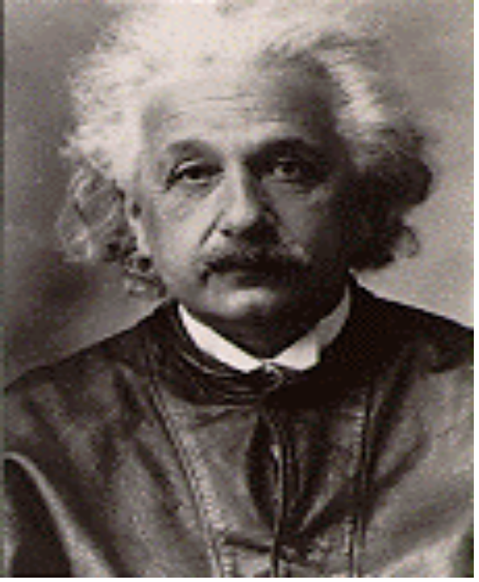
Need for a New Approach
“The world we have created today has problems which cannot be solved by thinking the way we thought when we created them”
- Albert Einstein
Albert Einstein

Slide 24

Clinical Trials Management Systems: Needs
Improved productivity
  Paper follows the work, rather than driving the work
  Manual processes significantly reduced
Eliminate “islands of information”
  Computational semantic interoperability
  Sharing of de-identified clinical data
New, innovative approaches clinical research
Advance discoveries from bench to
bedside and back
  Integration of clinical trials and research infrastructure

Slide 25
Trials vs. Research Infrastructure at NCICB
Trials Infrastructure Research Infrastructure
caARRAY
NCICB App Server
Clinical App Server(s)
Security
MAGE
Presentation
caDSR
Security
caMOD
Business
caBIO
caBIO
Data
EVS
HL7 SDK
HL7 V3 XML
Clinical
Operational
DB
De-identified
HL7 DB
De-identification Service

Slide 26
Clinical Components
Services
  Participant Registry
  Adverse Events
  And more …
Toolkits
  HL7 RIM SDK
  Patient De-identification
  Security
  And more …
Engines
  Workflow Engine
  Report Generator
  Document Management
  Messaging
  And more …
Services
Toolkits
Engines
caBIG Infrastructure

Slide 27
CTMA and the University of Pittsburgh Clinical Trials Research Core
Administrative and Regulatory Management
Clinical Research Management
Financial Management
Study Parameters Development
Data mining and De-Identification
Patient Enrollment
PI Research
Development
CT Enrollment
& Patient care
Research
Development
Trial Setup
New Idea
Generation
Patient
Enrollment
Data
Analysis
Patient
Treatment
Financial
& Billing
Reporting &
Administration
Data mining
& Analysis
CT Reporting &
Administration

Slide 28
Critical Success Factors (1)
Completeness and strength of vision
  Scientific and clinical requirements well understood
Participants challenge everything and are innovative
in looking for solutions to problems.
Community willing/able to accept radical change
New technology implemented in new ways with new results
Team approach.
Participants are open and honest about issues/problems.

Slide 29

Critical Success Factors (2)
All participants have a clear and common understanding of project goals, objectives, timelines, deliverables, etc.
Participants (full-time and part-time) attend meetings as required and adhere to deadlines and schedules.
Detailed planning and close tracking of project progress.
Adherence to established scope and avoidance of scope creep.
Superheroes that live the mission

Slide 30
It’s a Team Effort!
Developers
Adopters
Working Group

