Slide 1
NIH Governance:
The NIH Steering Committee and Working Groups
Raynard S. Kington, M.D., Ph.D.
Deputy Director, NIH
Scientific Directors Meeting
November 21, 2007

Slide 2
Definition of Governance
The process through which a group of people who come together to accomplish an end makes decisions that direct their collective efforts (Institute on Governance)

Slide 3
Purpose of NIH Governance System
Provide efficient, transparent, and shared governance at NIH.
Purview includes corporate governance issues.
  Maintain stewardship over corporate resources,
  Provide policy oversight to assure achievement of NIH’s mission, and
  Assure that mechanisms are in place so that NIH is operating within established standards.
Issues are those that have NIH-wide implications other than the setting of scientific priorities.
  Includes those that affect all ICs or where actions taken by one or more ICs have implications for other ICs or the collective NIH.
  Does not include IC-specific issues that have no implications for other ICs or the collective NIH.
  Does not include the setting of scientific priorities – reserved for the “Committee of the Whole”.

Slide 4
Background
2003
NIH Director tasked Funding Advisory Review Board (FARB) with developing governance models for IC Directors’ consideration.
Operating premise – shared governance, with active participation of the IC Directors, will foster collaborative identification of corporate issues and transparent decision-making.
Two options developed by FARB.
  Option 1 – NIH Steering Committee with standing/ad hoc Working Groups for corporate functions other than setting of scientific priorities.
  Option 2 – NIH Steering Committee without Working Groups but with enhanced authority for OD functional leaders.
IC Directors expressed strong preference for Option 1.

Slide 5
IC Directors’ Decision
Continue to formulate NIH-wide scientific direction and priorities through participation of the NIH Director with all IC Directors.
Establish Steering Committee
  IC Directors (3 permanent, remainder rotating).
  Chaired by NIH Director.
  Has governance purview for all corporate functions, resources, or policies other than the setting of corporate scientific direction and priorities.
  Would bring issues of highest significance to all IC Directors.
Establish Working Groups for major corporate functions.
  Chaired by IC Director who is a member of the Steering Committee.
  OD functional Deputy/Associate Director would co-chair.
  Would subsume functions of most current advisory committees.
NIH Director
IC Directors
(for scientific priorities)
NIH Steering
Committee
Chair: NIH Director
RES
1
RES
2
RES
3
RES
4
RES
…24
CSR
CC
CIT
OD/
ORFDO
Facilities
WG
DDM EOs
Management
and Budget WG
HR Subcommittee
DDIR SDs
Intramural
Research WG
DDER EPMC Reps.
Extramural
Research WG
CIO ITMC Reps.
IT WG
Reporting relationship
Advisory relationship
Governing relationship

Slide 6
Steering Committee
Membership
  Director, NIH – Chair
  Permanent Members – Directors NCI, NHLBI, and NIAID
  Rotating Members – Balance of small and medium-size Institutes
  Ex-Officio Member – Deputy Director, NIH
Rotating members appointed initially for one year, later to an additional 2 or 3 years to establish rotation.
Meetings are on the first and third Thursday and are principals only.
Agendas provided to all IC Directors/OD small staff in advance and summary of actions taken provided the same day.

Slide 7
Working Groups
Co-chaired by SC Member and senior OD functional head
  Management and Budget – Co-Chair, Deputy Director for Management
  Extramural – Co-Chair, Deputy Director for Extramural Research
  Intramural – Co-Chair, Deputy Director for Intramural Research
  Facilities – Co-Chair, Director, Office of Research Facilities
  Information Technology – Co-Chair, NIH Chief Information Officer
  OPASI (formed 2005)– Co-Chair, Director, OPASI
Role is to make corporate policy and resource recommendations to the Steering Committee and provide oversight; it is not to manage the function.
Issues related to Science Policy, Legislation and Communication are coordinated by Deputy Director, NIH and brought directly to the Steering Committee.

Slide 8
General Principles in Forming Working Groups
Committee size should be large enough to provide sufficiently broad views but small enough to be manageable.
Members do not “represent” their ICs or their professional community
Membership should contain one or more IC Directors in addition to co-chair.
Membership should contain mix of subject matter experts.
Working Groups should be appropriately staffed (usually by office of senior staff co-chair).
Nominations are proposed by Co-chairs (with input from IC Directors) and approved by NIH Director

Slide 9
Governance System Continues to Evolve
Initial HR subcommittee of MBWG later disbanded
Formation of OPASI Working Group (Fall, 2005)

Slide 10
Office of Portfolio Analysis and Strategic Initiatives Working Group
Tasks identified in Charter include:
Develop formal criteria for the types of initiatives that fall within the purview of OPASI.
Define, in broad terms, the parameters/dimensions of initiatives to be considered/supported.
Determine the most appropriate processes for review and evaluation of initiatives.
Develop guidance on the periodicity/timeframe for assessing and launching initiatives (e.g., incubation in OPASI v. graduation to ICs).
Over time, the role of the WG will evolve to monitor the overall effectiveness of the office, advise on policy and planning issues, and forecast the need for changes in its activities. Ultimately, the need for such a working group may dissolve, as the work of OPASI becomes institutionalized.

Slide 11
Governance System Continues to Evolve
Initial HR subcommittee of MBWG later disbanded
Formation of OPASI Working Group (Fall, 2005)
Review of Steering Committee Functioning (February, 2006)

Slide 12
Review of NIH Steering Committee (February, 2006)
Findings:
General agreement that the governance model has brought a discipline and efficiency to decision-making that heretofore has not existed; Steering Committee members thought their additional workload was worth the investment in time.
Some IC Directors not on SC do not consider the decision-making process to be sufficiently transparent and feel disenfranchised
Identifying and addressing corporate issues by the Working Groups is the key to the success of the governance model but there appear to be growing pains.
Succession planning is critical to ensure that IC Directors rotating on to the Steering Committee have been active in Working Groups and ready to assume the role of Chair of a Working Group.

Slide 13
Review of NIH Steering Committee (February, 2006)
Recommendations:
No structural changes to the governance model.
Present recommendation of the Steering Committee to the IC Directors on a regular basis; more rigorously identify issues of significance to all IC Directors that should be presented for final resolution; and hold regular retreats.
Establish an intranet site to post information related to the Steering Committee and the Working Groups.
Promote wider Working Group consultation with interested parties and better define the role of the Working Groups vis-à-vis other Committees:
  In developing policy proposals, WGs should identify and consult with appropriate interested parties.
  WG co-chairs should review their charter with representatives of their counterpart committees and revise as necessary to more clearly distinguish their respective roles.
Promote the objective of addressing the most pressing corporate issues by establishing an Agenda Setting Committee to identify corporate issues for action.
Promote succession planning by asking that WG co-chairs “groom” IC Directors on their Working Group; also, develop a comprehensive NIH-wide leadership development/succession planning program needs to be developed.
Promote continuous improvement by regularly evaluating the governance process.

Slide 14
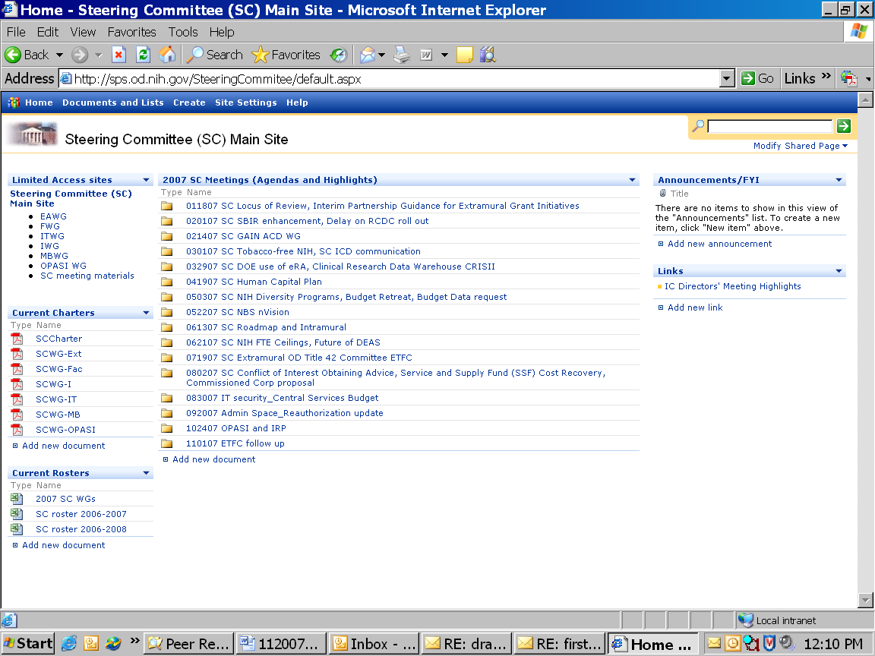

Slide 15
Communication
Recently initiated Principals-only IC Directors briefing by a Steering Committee member summarizing discussions of issues at previous SC meeting
8-8:30 prior to all IC Directors’ meetings

Slide 16
Governance System Continues to Evolve
Initial HR subcommittee of MBWG later disbanded
Formation of OPASI Working Group (Fall, 2005)
Review of Steering Committee Functioning (February, 2006)
Review of Working Group Functioning (forthcoming)

Slide 17
Issues Addressed by Steering Committee
Annual Process
Recommendations for Central Services Organizations’ budgets.
Recommendations for FTE allocations.

Slide 18
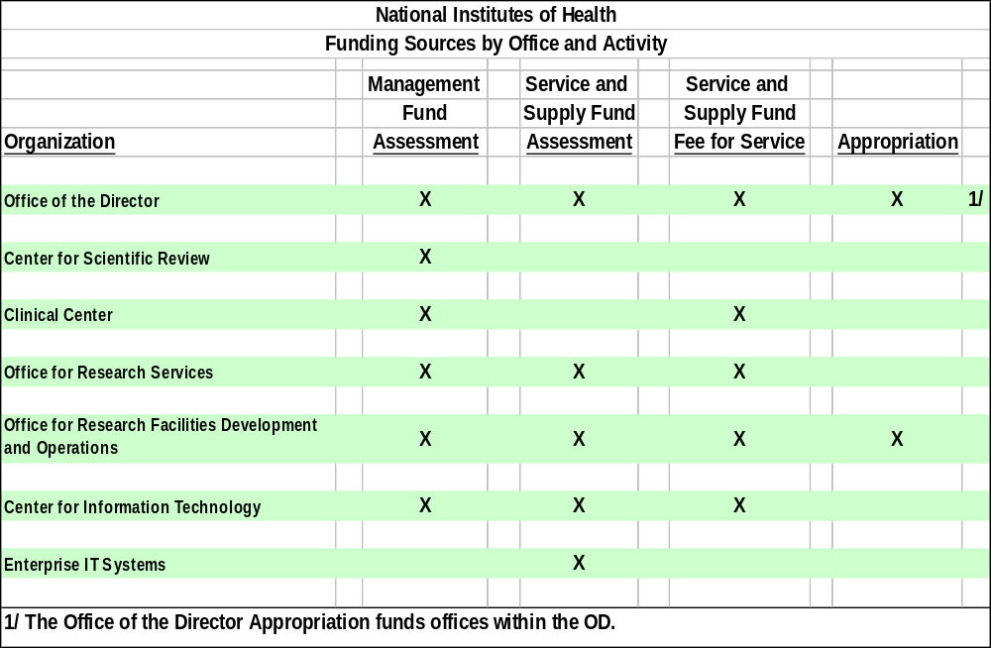
Funding Sources by Office/Activity

Slide 19
Budgetary Decision-Making Process
EAWG: Drs. Landis/Ruiz Bravo
CSR Director:
Dr. Scarpa
IWG: Drs. Sieving/Gottesman
CC Director: Dr. Gallin
ORS Director: Dr. Johnson
ITWG: Drs. Katz/Jones
Acting CIT Director: Dr. Jones
IT Enterprise Systems
MBWG: Dr Nabel; Ms. Barros
Unanticipated Needs
FWG: Dr. Insel/Mr. Wheeland
ORF Director: Mr. Wheeland
Department Taps
NIH Steering Committee
OD CSAC: Dr. Alexander
Office of the Director:
Dr. Kington
IC Directors
Buildings & Facilities
ORF Director: Mr. Wheeland
Director, NIH
Dr. Zerhouni

Slide 20
MBWG Budget Review Process- 2008
Followed the premise that the role of the MBWG is to integrate priorities; the Working Groups are to perform detailed budget review.
For FY 2008, the MBWG requested FTE and dollar information, by fund, for commitment base, FY 2007 level, FY 2007 level -2%, and an optional professional judgment budget.
Presentation provided by Working Group co-chairs.
Appeal process following initial review to ensure that the MBWG did not overlook any major issues.

Slide 21
Issues Addressed by Steering Committee
Administrative Restructuring Advisory Committee (ARAC) Recommendations
Administrative Space Guidance
Basic Behavioral and Social Science Research
Bench to Bedside Program
Campus Master Plan
Clinical Research Curriculum Award
Clinical Research Data Warehouse
Corporate Reporting and NBS Accounting Classification Structure
Data Safety and Monitoring Board Policies
DEAS
A-76 Related Employee Transitions

Slide 22
Issues Addressed by Steering Committee (cont.)
Extramural T42(f) Policies
Genome-Wide Associations Studies Policies
Use of eRA by Other Federal Agencies
Human Capital Plan
Intramural Clinical Research Blue Ribbon Panel Recommendations
Intramural Graduate Partnership Program and MSTP
IT Security
Knowledge Management Governance
Loan Repayment Program
Locus of Review
Minority and Health Disparities Reporting
Model Organism Sharing Policy
NBS/nVision

Slide 23
Issues Addressed by Steering Committee (cont.)
NIH Diversity Program Policies
NIH Ethics Office Reorganization
Open Access/Public Access
Pandemic Flu Action Plan
Peer Review Advisory Committee Structure
Performance Management Program (PMAP)
Risk Management Program
Public-Private Partnership Policy
Roadmap Implementation
SBIR/STRR Programs
Scientific Review and Evaluation Award (SREA) Program
Tobacco-free NIH Campus Policy
T32 Training Grant Tuition Policy

Slide 24
The End

