Slide 1
Root Cause Analysis –
Faculty Development
Edward J. Dunn, MD, MPH and Craig Renner, MPH
VA National Center for Patient Safety
edward.dunn@med.va.gov www.patientsafety.gov
Notes:
Note:

Slide 2
“Location” in the Curriculum Toolkit
Content
Pt. Safety Introduction
Human Factors Engineering
Pt Safety Interventions
Root Cause Analysis
Instructor Preparation
Swift and Long Term Trust
“Selling the Curriculum” to Peers and Leadership for Lasting Change
Etc.
Alternative Education Formats
Pt Safety Case Conference (M&M)
Pt Safety on Rounds (Modulettes)
One-month Elective
Etc.

Slide 3
Overview
What is RCA?
Why do an RCA
Why involve residents in RCA?
  As team member
  As implementer of key action plan
  tangible entry for ACGME “procedure log”
Tips on getting started w/ RCA
Notes:
[Human beings are hard-wired not to be able to do a good root cause analysis.]
Adult learning = experiential is most effective
Root cause analysis is potentially a learning tool for a resident to become a better doctor – as well as a way to identify and fix system hazards.

Slide 4
Objectives for Learners
1) Create teachable moment for systems thinking
2) Introduce them to a tool/process that they will be part of in the future
3) Demonstrate common pitfalls when trying to do critical safety analysis

Slide 5
What is Root Cause Analysis?
(RCA)
Process for identifying contributing/ causal factors that underlie variations in performance associated with adverse events or close calls
Process that features interdisciplinary involvement of those closest to and/or most knowledgeable about the situation

Slide 6
Where Did it Come From?
Derivative of Failure Mode Effect Analysis (FMEA) - reliability engineering for US Military (1949) to determine effect of system and equipment failures
FMEA use by NASA for Apollo space program (1960s)
FMEA in US manufacturing (1960s-70s)
US Auto Industry FMEA Standards implemented (1993)

Slide 7
NCPS RCA Model
A rigorous,legally protected and confidential approach to answering:
- What happened? (event or close call)
What happened that day?
What usually happens? (norms)
What should have happened? (policies)
- Why did it happen?
- What are we going to do to prevent
it from happening again? (actions/outcomes)
- How will we know that our actions improved patient safety? (measures/tracking)

Slide 8
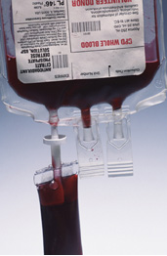
RCA Goals
Find out:
  What happened?
  Why did it happen?
  What do you do to prevent it from happening again?
  How do we know we made a difference?
For details see either: http://vaww.ncps.med.va.gov/RCAtrain.html
http://www.patientsafety.gov/tools.html

Slide 9
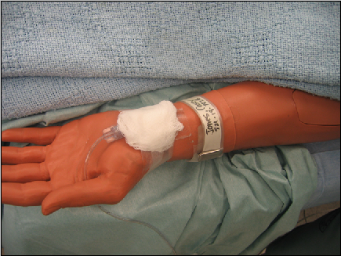
RCA Goals (expanded)
A tool in the systems approach to prevention, not punishment, of adverse events
A tool in the effort to build a “culture of safety”
A process for identifying basic or contributing causes
A process for identifying what can be done to prevent recurrence
A process for measuring and tracking outcomes

Slide 10
Why involve residents in RCA?
Residents know what happens at the microprocess level
Residents are future leaders in healthcare
Either as team member or as implementer of key action plan
Resident/Fellow Participation in Patient Safety Activities - Baseline
  Analysis of National RCA database (many caveats)
    Residents as RCA team members < 30 (< 0.1%)
    All physicians ~ 15%!
  Questionnaire of 7 VA sites
    RCA team members = 7 (four from Atlanta)
    RCA interviewee or consultant = 18
    HFMEA interviewee or consultant = 6
    Misc activities (action plans, safety committee) = 31

Slide 11
ACGME “procedure log”
One of only a few “tangible” items for a log
Research-type or QI-type projects more involved
  Pragmatics make these more difficult than RCA
  RCA is about as “real” as you can get
Involvement and innovativeness in RCA can be measured (e.g., competency)
ACGME core competency – “Systems based Practice”

Slide 12

RCA Model
Focuses on prevention, not blame or punishment (cornerstone: no one comes to work to make a mistake or hurt someone)
Focuses on system level vulnerabilities rather than individual performance
- Communication - Environment/Equipment
- Training - Rules/Policies/Procedures
- Fatigue/Scheduling - Barriers

Slide 13
RCA Model
An analysis which identifies changes that can be made in systems through either re-design or development of new processes, equipment or approaches* that will reduce the risk of the event or close call recurrence.
*Human Factors Engineering actions work best
(But, training, writing policies, and reminders to “pay more attention” are generally ineffective)

Slide 14
When is an RCA Done?
For any adverse event or close call*
  - determined by leadership or SAC score
For all JCAHO designated “sentinel events”
  *Close calls occur dozens to hundreds of times more frequently than the adverse event they are the harbinger of … it makes sense to learn from close calls, instead of waiting for a catastrophe to occur.

Slide 15
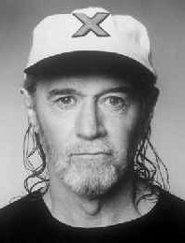
When two planes nearly collide, they call it a “near miss.” It’s a NEAR HIT. A collision is a “near miss.” BOOM! “Look, they nearly missed!”
George Carlin
The Absurd Way We Use Language
<www.georgecarlin.com>

Slide 16

Notes:
Example of a “near miss” – meaning a hit!

Slide 17
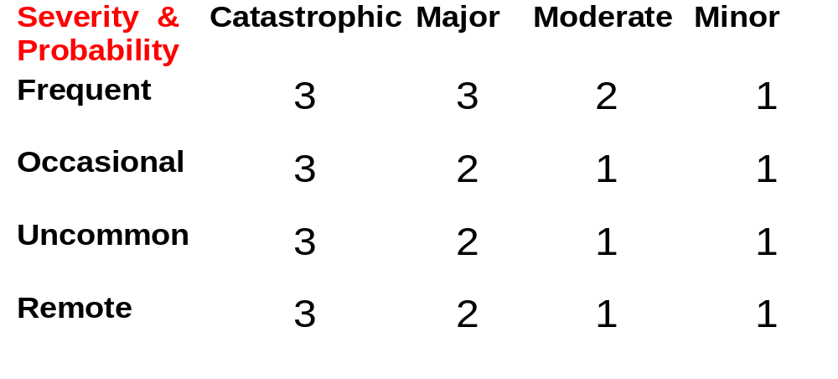
A Decision Making Tool (SAC)
The Safety Assessment Code (SAC) score is a risk estimate that considers both the actual and potential consequences of a situation. Close calls can point out system level vulnerabilities as powerfully as actual events. All actual and potential SAC = 3 need an RCA.
3 = highest risk 2 = intermediate risk 1 = lowest risk

Slide 18
Why is an RCA Important?
It’s a method that helps to:
- Keep our focus on designing-in safety for all staff, rather than modifying an individual’s performance … it moves us beyond blame
- Stay honest about safety as a real priority - - not just an “official” priority - - through the strength of actions taken and outcomes measured

Slide 19
Why Use a Particular Method?
Because none of us can think of all the questions relevant to complex systems on our own
Because we each bring our own personal and professional knowledge and biases to the table
Why reinvent the wheel every time?

Slide 20
When not to do an RCA?
Intentionally unsafe acts
Criminal acts
Situations involving alcohol/ substance abuse by employees
Alleged or sustained patient abuse
If any of these 4 situations come up during an RCA, the RCA is halted. The CEO/Facility Director is then advised to take an independent administrative approach. (RCA findings remain confidential/protected, and are not shared with the CEO or others, as prescribed by law.)

Slide 21
How RCAs Work
An event or close call meriting an RCA occurs
CEO/Facility Director signs the Charter Memo, initiating the RCA Team
RCA Team completes the work (within 45 calendar days of when the facility became aware an RCA was needed)
CEO is de-briefed by the Team and concurs or non-concurs with proposed actions, and signs-off on the RCA (CEO non-concurrence requires explanation and additional or revised actions by the RCA Team)
RCA actions will be measured for effectiveness in preventing future adverse events or close calls

Slide 22
Key RCA Roles
Top Leaders - The success of any and all patient safety initiatives depends upon visible leadership support (e.g., town meetings, storytelling, “coaching”, greeting teams, participating on a Team, participating in de-briefs, incentives/awards, etc.)
Advisor - Ensures a “no blame” approach, provides Just-In-Time training and ongoing consultation (e.g., flow charting, development of root causes, actions, outcome measures)
Team Leader - Keeps the team on task to ensure root causes are found and effective preventive actions are developed, on time

Slide 23
Key RCA Roles
Recorder - Responsible for entering information into RCA document (live, real time documentation during Team’s meetings)
Team Members - Full and active participation and commitment to the RCA process (simulate the event/close call, review documents and literature,conduct interviews, develop root cause statements and action plan, participate in leadership de-briefing)

Slide 24
Overview of Steps
Charter an inter-disciplinary team (4-6 people)
  Those familiar and un-familiar with the process
Flow diagram of “what happened?”
  Triggering questions to expand this view
  Site visits and simulation to augment
  Interviews with those involved or those with similar job
Resources (articles - NPSF, online databases – MAUDE)
Root cause/contributing factors developed
  Five rules of causation to guide/push the team deep enough
  Cause and Effect Diagram, etc

Slide 25
Overview of Steps (cont.)
Feedback to reporter(s)
Lessons learned (not necessarily focus of RCA)
Development of Actions (remedies)
  Stronger – physical, permanent, human factors based
  Weaker – procedural, temporary, increase vigilance
Development of Outcomes measurement
Communicated to senior management and signed off

Slide 26
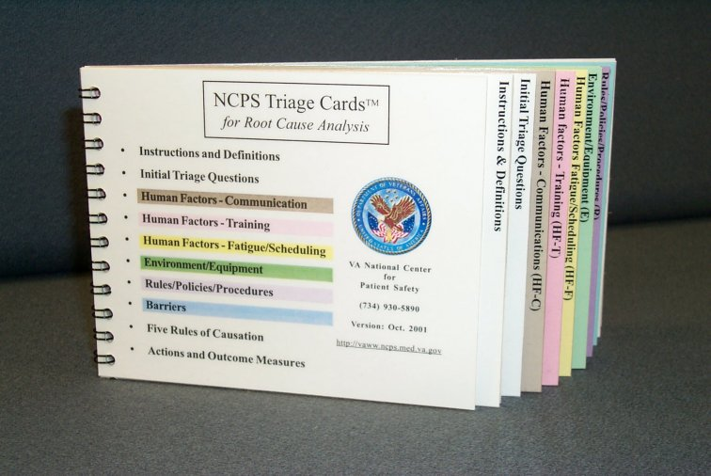
Triage Cards
Notes:
[Human beings are hard-wired not to be able to do a good root cause analysis.]
Simulate logical sequence of RCA in preparation for RCA exercise. Ask participants to have book in front of them. Plan to briefly discuss content and utility of book that will be relevant to RCA exercise. Proceed in the following order:
1) Read case
2) Construct flow diagram of events in chronological sequence
3) Review initial triage questions (pages 1 and 2)
4) Identify issues in case relating to 6 categories of questions (communication,training, fatigue, environment/equipment, barriers, rules - policies) What are the issues in this case?
5) What are the gaps of information needed for understanding of this event? Where to look for answers?
Review literature
Interview individuals involved in the event
Consultation with experts on subject matter
“Field Trip” to site of event
6) Use triage questions to guide interviews, consultations, and literature
7) After you understand what happened, formulate causal statements – stay within 5 rules of causation
8) Reflect on lessons learned
9) Brainstorm about solutions to reduce/prevent probability for recurrence
10) Assign responsibility for implementation to one individual
11) Develop measures for effectiveness of action steps and assign individual responsibility for measurement

Slide 27
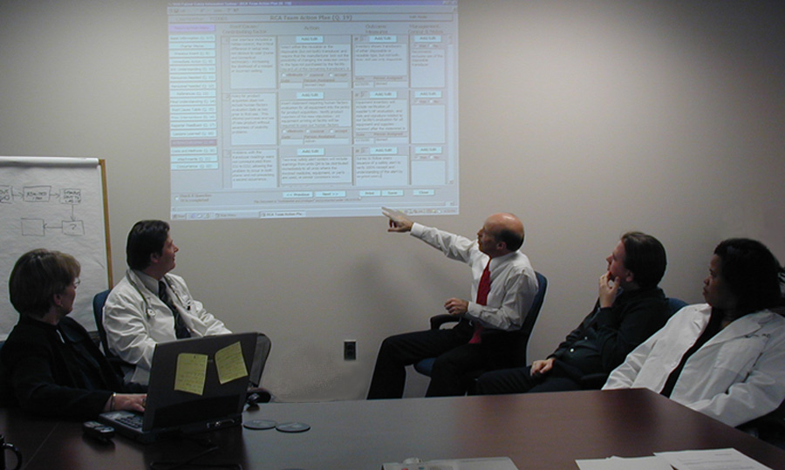
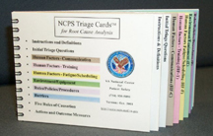
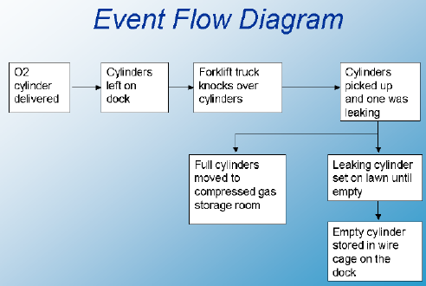
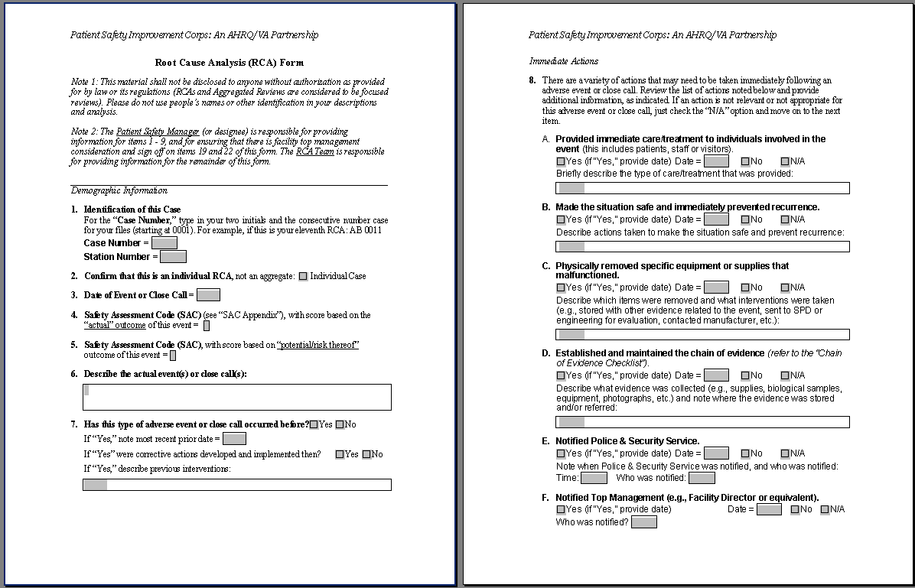
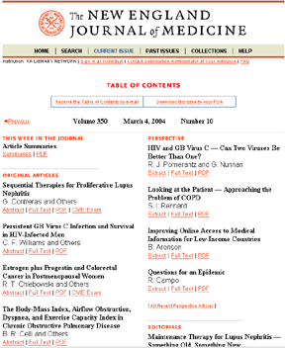
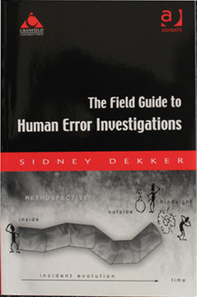
RCA Team in Action
Notes:
In this photo group members work using a computer with projection so that everyone on the team can see what is being documented as the evaluation of the event or close call progresses.
inter-disciplinary : [ Ask for groups’ suggestions for who may participate – ideas:] MD, Chief of Service, Resident; Dietary; Nurse, Medical Reference Librarian, Biomedical Engineer, Safety Engineer, Unit Clerk, Housekeeping, Ancillary Services – RT, PT etc., Social Work

Slide 28
RCA
Role Play

Slide 29
Case Summary
82y/o female
200cc coffee ground emesis
BP: 90/60 restored to 117/60
Temp: 97 degrees F
Pulse: 90 and regular
HCT: 30 (her baseline)
WBC: 17,0000
UGI: stomach filled w/ clots & Active bleeding from duodenal ulcer controlled w/ cauterization
Tx Plan
  ICU, blood transfusion, serial HCTs, IV Protonix
What happened?
  HCT dropped
  Pt became hypotensive
  Pt went into respiratory distress
  Blood not available
  Pt expired
Notes:
82 yo female admitted from Nursing Home through ER w/ chief complaint of weakness and Hx of 200 cc “coffee-ground” emesis 2 hours prior. Gastric lavage in ER – coffee-grounds to clear effluent. BP 117/60 decreased to 90/60 but restored w/ IV fluids. Temp 97 degrees, pulse 90 and regular. Hct 30 % (her baseline) and WBC 17,000. Sent to GI endoscopy suite.
UGI Endoscopy revealed: “stomach filled w/ clots. Active bleeding from duodenal ulcer controlled w/ cauterization… Rec. treatment plan – ICU for observation, blood transfusion, HCT every 6 hrs. X 3, IV Protonix.” Plan discussed w/ admitting medical resident who signed off to on-call resident at 5:30 PM.
ICU was full that evening. After discussion between residents, the patient was admitted to nursing unit on Medicine service ~ 6 PM. At 11:30 PM, nurse found patient to be in respiratory distress and hypotensive. On-call Medical resident called to bedside (1st time he had seen this patient – busy night w/ 4 admissions). After quickly reviewing the chart, he ordered a 2 unit stat blood transfusion and asked for most recent Hct. Hct 19% (nurse had not seen this report – she had 7 patients that night). Blood Bank reported back to unit that the patient had not had a type and cross-match, and that no blood was available for this patient. CPR initiated, but the patient expired @ 11:55 PM.

Slide 30
Cast
RCA Team Leader (Patient Safety Manager) …..Craig Renner
Staff Nurse (RN Team Leader on 4 North) …..Linda Williams
Chief Medical Resident(Resident, Internal Medicine)…..John Gosbee
RCA Team Advisor (Chief of Medical Staff) …..Ed Dunn
RCA Team Recorder(Director of Pharmacy)…..Mary Burkhardt
Chief of Medicine (Residency Program Director) …..Margaret Kirkegaard
Admitting Medical Resident ….. Carol Samples
GI Medicine Consultant ….. Rodney Williams Cast
Notes:
Cast – box will scroll when in presentation mode.

Slide 31
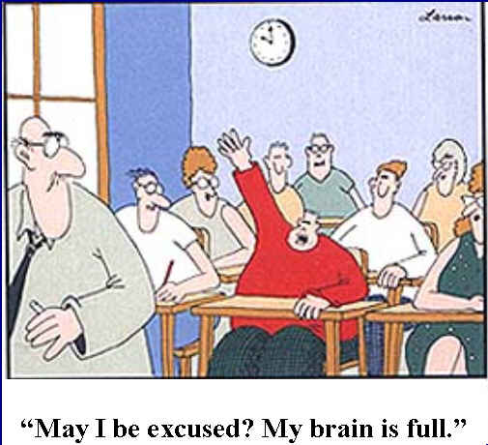

Slide 32
RCA exercise (simulation)
Integrates all the tools
Note that the “mock cases” are quite detailed
  Because they have to be!
Each of your tables will have an advisor/instructor who should also be the recorder in your exercise
Start by reading the case and constructing a flow diagram on the flip chart
Notes:
Ed will fix this slide –

Slide 33
Pneumothorax Case

Slide 35
82 yo female admitted from Nursing Home through ER w/ chief complaint of weakness and Hx of 200 cc “coffee-ground” emesis 2 hours prior. Gastric lavage in ER – coffee-grounds to clear effluent. BP 117/60 decreased to 90/60 but restored w/ IV fluids. Temp 97 degrees, pulse 90 and regular. Hct 30 % (her baseline) and WBC 17,000. Sent to GI endoscopy suite.
UGI Endoscopy revealed: “stomach filled w/ clots. Active bleeding from duodenal ulcer controlled w/ cauterization… Rec. treatment plan – ICU for observation, blood transfusion, HCT every 6 hrs. X 3, IV Protonix.” Plan discussed w/ admitting medical resident who signed off to on-call resident at 5:30 PM.
ICU was full that evening. After discussion between residents, the patient was admitted to nursing unit on Medicine service ~ 6 PM. At 11:30 PM, nurse found patient to be in respiratory distress and hypotensive. On-call Medical resident called to bedside (1st time he had seen this patient – busy night w/ 4 admissions). After quickly reviewing the chart, he ordered a 2 unit stat blood transfusion and asked for most recent Hct. Hct 19% (nurse had not seen this report – she had 7 patients that night). Blood Bank reported back to unit that the patient had not had a type and cross-match, and that no blood was available for this patient. CPR initiated, but the patient expired @ 11:55 PM.

