Slide 1
The Continuum of Clinical Research and the Investment in Translational Research for Improved Patient Care
Linda P. Fried, M.D., M.P.H.
Professor and Director,
The Johns Hopkins Center on Aging and Health
And
The Division of Geriatric Medicine and Gerontology

Slide 2
Life Expectancy and Health Status
At age 65, people can now expect to live another 15-20 years, on the average
Health status during this time is of great importance:
  30% robust
  50% have 2 or more diseases
  40% have difficulty walking or doing other essential activities
  7-10% are frail

Slide 3
Goal: Health in Aging

Slide 4
Research on Health in Aging: Where we stand
Issues that affect health and well-being with aging
Health needs of older adults differ from younger
Substantial evidence: factors that may be responsive to prevention or treatment
Evidence that prevention and treatment make a difference in health

Slide 5
Disease Prevention with Aging
Many of the “inevitable consequences of aging” in 1950 are not inevitable in 2003

Slide 6
Chronic Diseases
Most treatable; many preventable
Prevention and treatment make BIG differences in patient outcomes and quality of life

Slide 7
Impact of Effective Prevention: Change in U.S. death rates,
1950-1997
 | Age Group | % change
Heart Disease | 65-74 | -58%
 | 75-84 | -54%
 | 85+ | -31%
Stroke | 65-74 | -76%
 | 75-84 | -65%
 | 85+ | -46% (Bureau of the Census)

Slide 8
Explanation for Decline in Death from Heart Disease and Stroke
Primary Prevention 25%
  Exercise, diet, risk factor modification
Secondary Prevention 29%
  Exercise, diet, risk factor modification
Treatment 43%
  Medications, exercise, diet, angioplasty
  Optimal disease management
      Hunnink et al, JAMA 1997

Slide 9
Heterogeneity of health with aging
Diseases
Comorbidity/Multimorbidity
Cognitive Impairment/Dementia
Sensory impairments: vision, hearing
Psychosocial factors
Geriatric Conditions: Frailty, Falls
Disability and dependency

Slide 10
Disability: A 75 year old woman with arthritis of knees, fear of falling
Difficulty: Duration(yrs) Response
  Walk ½ mi 10 Stopped
  Stairs 2-3 Hold rail
  Heavy housework 2 Stopped
  Light housework 2 Do less
  Carry groceries 1 Stopped

Slide 11
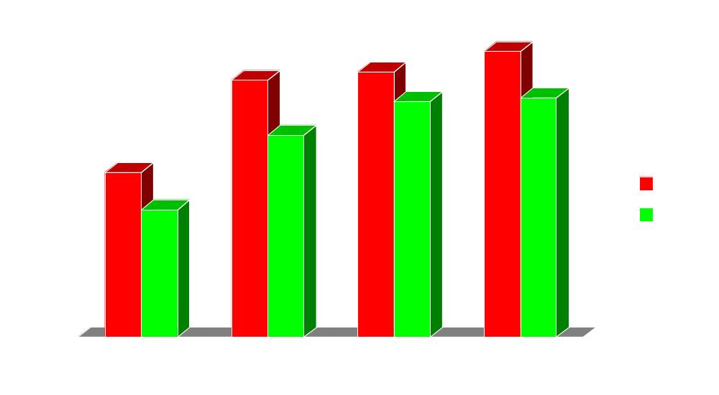
Decline in Disability
Individuals 65 Years and Older
1984 - 1993
Percent Reporting Difficulty
Source: Freedman & Martin, Am.J.Public Health., 88:1451-1462, 1998.
Notes:
Study from RAND analyzed trends during the period 1984 to 1993 in the prevalence of functional limitations within the 50 and over population. The extent of improvement varied by age group, with the smallest gains occurring among 50-64 year olds and the largest among those 80 and over. Data from SIPP, nationally representative, household-based Survey of Income and Program Participation. There were improvements across most subgroups, but the rate of functional limitations remained highest among the oldest, women, the unmarried, Hispanics, the least educated and those without liquid assets. Blacks were more likely to report difficulty than whites. For the 65+ age group there was :
A 4.9 percent point decline in difficulty seeing newsprint (from 21.7 to 16.8%)
A 7.2 percentage point decline in difficulty lifting and carrying a 10-pound weight, such as a bag of groceries (from 33.8 to 26.6%)
A 4.0 percentage point decline in difficulty climbing a flight of stairs without resting (from 34.9 to31.0%)
A 6.1 percentage point decline in difficulty walking a quarter mile, about three city blocks (from 37.6 to 31.5%)

Slide 12
Frailty in Aging: Escalating Knowledge of a High Risk State
7-10% of community-dwelling older adults
  Weak, low energy, slow, low activity, thin
Vulnerable – especially with stressors
High risk for adverse outcomes
  Hospitalization, poor outcomes with hospitalization,
  falls,
  disability and loss of independence,
  death

Slide 13
Likely Causes of Frailty, 2005
Aging
Inflammation
hematologic
musculoskeletal
neurologic
Hormones
Frailty
Genetics
Disease

Slide 14
Discovery of causes of frailty – at all levels: biology, physiology, symptoms
Basis for discovering treatments, prevention
Determine which most effective
Applications to both clinical care, community health approaches
On the near horizon: next 10 years

Slide 15
Factors Influencing the Decline in Disability Rates – Could also decrease frailty
Education
Declines in the prevalence of several chronic diseases
Changes in nutrition and public hygiene
Improved health promotion and medical therapy
Notes:
Source: Manton, Chronic disability trends in elderly United States populations: 1982-1994, PNAS 94:2593-2598, 1997.
Education- better educated persons tend to more readily adopt healthy behaviors, are more likely to have had better medical care , are better equipped to comply with complex and long-term medical treatments (e.g., hypertension, diabetes), more likely to exhibit fewer disabilities even with chronic conditions, and possible association with decreased risk of AD.
Declines in prevalence of chronic disease - declines in cardiovascular disease, cholesterol levels, and smoking for individuals 65 - 74.
Improvements in public hygiene and sanitation - decrease in Helicobacter pylori tied to long-term declines in gastric cancer and changes in peptic ulcer prevalence thru improvements in water quality. Long-term declines in stroke and gastric cancer tied to reduced use of salt as a food preservative as refrigeration became more widely used. Better regulation of commercial food processing and livestock management including thermal processing of meats, may have reduced the prevalence of food-borne pathogens possibly contributing to atherosclerosis. Food supplementation - vitamins. Changes in lifestyle - reduced smoking rates in successive birth cohorts.
Impact of medical therapy on disability prevalence is hard to assess because many treatment innovations for chronic diseases are recent. Exogenous estrogens were used in 1985 by 3 million U.S. postmenopausal women. In 1995, nearly 10 million are taking estrogens, with benefits for osteoporosis, cardiovascular disease, and possibly AD. Aspirin may reduce the risk of colorectal cancer and recurrences of stroke and heart disease. NSAIDS & AD, etc. may contribute to future decline.

Slide 16
Potential for Translation of Research into Health Benefits
Multiple levels:
  Designing communities to support successful aging
  Roles to remain productive, socially engaged, maintain activity: “use it or lose it”
  Improved physical activity, nutrition
  Targetted therapies: depending on health status and risk

Slide 17
Potential for Prevention and “Compression of Morbidity”

Slide 18
Research on Health in Aging
Challenges
Multiple causes; many systems affected
Older adults are heterogeneous
Changing biology closely tied to clinical well-being
Social factors matter
SOLUTIONS
Multidisciplinary teams
Research & translation to match complexity of health in aging
Continuum of research: basic and clinical discoveries needed to improve health
Social factors/ environment matters

Slide 19
Aging Research: future directions
From systems biology to clinical symptoms: frailty, dependency, delirium, dementia
Community-based research: how to keep aging population (20% >65) healthy, independent
Outcomes: clinical trials for prevention and/or treatment
Multidisciplinary teams organized around problems
  Population-based research can evaluate how decreased function in multiple systems leads to bad outcomes - together
  Basic mechanisms: mitochondrial dysfunction with aging?
  Clinical research: improving strength, well-being if frail
  Health Services research: caring for frail people
Implementation to improve health

Slide 20
Translation: Continuum of Research
7/1. The Clinical Problem
2. What are the important health issues? Population-based and Clinical Evidence
6. Ultimate Causes:
Genetics – Environment
Laboratory Populations
-- Modifiable Pathways --
Clinical Trials
3. Population-based and clinical evidence
- Potential for prevention; keys to causes, targets for treatment
5. Many causes, many systems involved:
Modifiable Pathways
Population Laboratory
4. Laboratory:
-Physiology: subclinical components and mechanisms
-Biology: Ultimate cause

Slide 21
Science of translation: poised to be worked out in multidisciplinary teams in aging research
Phase I Translation:
  from bench to therapeutics
  Translation between research disciplines to understand mechanisms of disease, frailty, disability
Phase II Translation: of research into practice:
  Improved care (eg: frailty: from therapeutics to hospital design to improve safety);
  Science of criteria for implementation
  How to get older adults to utilize discoveries: health behaviors, health management

Slide 22
Research on Health in Aging: On the cusp of a new era
Scientists are learning how to work in translational teams
Knowledge of health issues in aging mature
BUT:
  NOT ENOUGH CLINICAL AND POPULATION-BASED RESEARCHERS ON AGING
  NO ORGANIZATION RESPONSIBLE FOR - AND WITH RESOURCES - TO ADDRESS THE FULL PICTURE: WHAT PROBLEMS MUST BE SOLVED
  NIA FUNDING AT AN ALL-TIME LOW: 15th percentile
  THE NEXT FRONTIER: LEARNING HOW TO TRANSLATE DISCOVERIES INTO IMPROVED HEALTH – BUT LITTLE FUNDING TO DO THIS

Slide 23
Clinical Research on Health and Aging
Potential: rapid translation into improved care
BARRIERS/SOLUTIONS:
  Who is responsible for the big picture?
  Make investment with 10-15 year horizon
  Enhance funding to NIA NOW to reap benefits when baby boomers are getting Social Security; Charge NIA with developing the science of Phase II translation
  Charge a research organization with responsibility for doing Phase 2 translation, prevention & care (AHRQ?)
  Organization and financing of health care that matches the needs, health issues of older adults

Slide 25
People Now LIVE With Chronic Diseases
AGE | 0 | 1 | >2
18-44 | 75% | 18% | 7%
45-64 | 45% | 30% | 25%
> 65 | 20% | 28% | 52%
NHIS 2000

Slide 26
Comorbidity Associated with Health Care Utilization and Cost: WHAS I
# Diseases (% of total) | Hospital’d % | Home Health Cost | Total health Costs
0-1 (13%) | 20% | $ 352. | $4,947.
2 (21%) | 27% | $ 290. | $4,624.
3-4 (55%) | 28% | $ 553. | $6,492.
>4 (12%) | 38% | $ 826. | $6,135.
Weiner, 2003

Slide 27
Factors in Healthy Aging:
Cardiovascular Health Study
Older adults free of chronic disease (no CVD, COPD, Cancer) and alive after 7 years of follow-up:
Associated factors:
Behavioral: Physical activity,
No smoking
No obesity
Disease management: HBP, DM, HDL
Burke et al, J Amer Ger Soc, 2001

Slide 28
Increasing heterogeneity with aging
65 years and older:
  Self reported health:
    Excellent/Very good: 38%
    Good: 33%
    Fair: 22%
    Poor: 8%
        Guralnik, Fried, et al
        Women’s Health and Aging Study
        Baltimore, MD

Slide 29
Trajectories of change in health status vary with aging
AGE

Slide 30
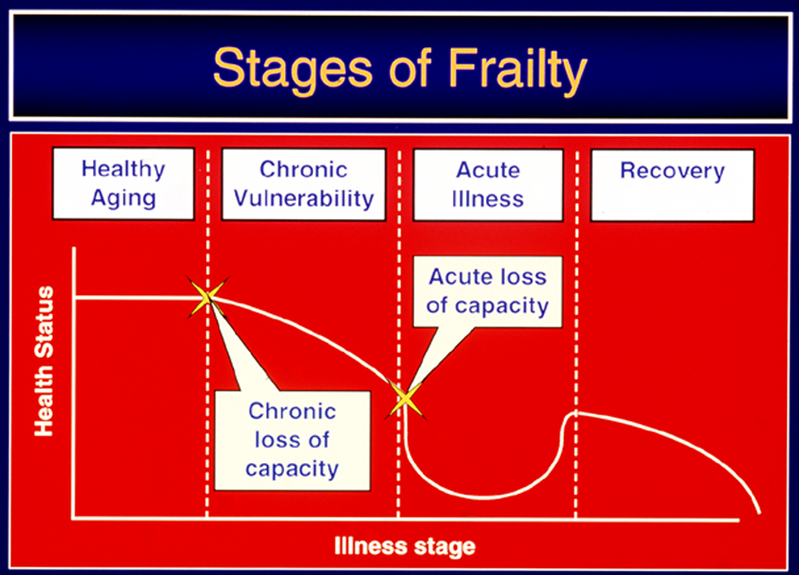

Slide 31
Declines in strength with aging:
15% per decade
Etiologies:
Sarcopenia (loss of muscle mass)
Inflammmation
Inactivity/disuse
Disease
Undernutrition

Slide 32
Physical disability in community-dwelling persons 70 and older, U.S.
Difficulty: Men Women
- walking 30% 33%
- IADLs 13% 7%
- ADLs 22% 17%
NCHS, 1999

Slide 33
Current Aging-related Research Activity
(with caveats)
Aging related research throughout both campuses; also GRC
  Basic Research: Basic biology of aging, frailty
  e.g.: decreased telomere length with aging
  oxidative stress with aging; DNA repair
  Clinical and Population-based Research
  e.g.: congestive heart failure differs in old
  preventive health care for older adults
  Health Services Research/ Health care policy
  e.g.: Reimbursement; longterm care models

Slide 34
A new breed of aging-related research: premises
Recognizes core issues in older people:
  Heterogeneity of health status in people >65
  Chronic disease is the norm, complicated by frailty and disability, as well as dementia;
  Outcomes expand: disability as well as disease, mortality
  Physiology, Risk/vulnerability, needs, and effective health care models vary with health status
  Health status – and care - inherently multifactorial
  On many important questions, research must be multidisciplinary to validly capture complexity

Slide 35
Implications
Effective prevention must be tailored to health status level and may vary by prognosis (2 75 y/o’s: 1 robust, 1 nh)
Risk: emergence delirium after surgery; mortality
To manage CHD/CHF (or any chronic disease) in older adults – have to understand competing risk from comorbidities, other treatments etc.
Health care models that are tailored to health status are more effective

Slide 36
Frailty: Silent and elusive – but important contributor to health outcomes as people age

Slide 37
Current aging-related research:
A new form maps to roadmap
Example: Frailty in older adults: determining what it is, what causes it, risk and opportunities for intervention:
  Multidisciplinary questions,
  Multidisciplinary research will answer
  Aging research and training: inherently suited to roadmap

Slide 38
Modal Pathway- 2005
Molecular & Genetic
?
Physiology
Syndrome
Weakness
Weight loss
Slowed performance
Exhaustion
Low activity
Outcomes
Falls
Disability
Dependency
Death
↑ IL-6, CRP
↑ Factor VIII
↑ D-Dimer
Glucose intolerance
↓IGF-1, DHEA-S
↑ Cortisol
Fried, et al., Gerontology 2001
Walston, et al., Archives of IM 2002
Disease
Leng, et al., JAGS 2002
Leng, et al., Aging 2004

Slide 39
Multisystem Alterations May Underlie Loss of Reserves, Frailty
↑ SNS activity
Altered hormones
PHYSIOLOGIC
Glucose intolerance
Inflammation
↓ Hematopoiesis
Mitochondrial Dysfunction
Altered hormones, Environmental factors
Altered cellular metabolism
>
>
>
MOLECULAR & GENETIC
↑ Free radicals
Cellular senescence
>
↑ DNA damage
Altered telomeres
Genetic Variation

Slide 40
Weight Loss
•
>
Clinical Presentation
•
Sarcopenia
•
>
↓ physical activity
>
•
•
>
Strength
Exhaustion/ ↓ exercise tolerance
↓ Motor performance
Physiologic Vulnerability
Physiologic Dysregulation
Cellular Function, Molecular and Genetic Characteristics

Slide 41
Treating Frail Patients To Prevent Adverse Outcomes
Prevention of frailty:
  Preventing onset
  Improving frailty
  Preventing outcomes
Treating the frail patient at times of stressors to decrease risk

Slide 42
Aging, Homeostatic Mechanisms and Frailty
Operational Definitions for Studies on Aging
Frailty as accelerated decline in anatomical integrity and function across multiple physiological systems. The “replacement therapy” approach is unlikely to be effective.
Physiological Parameter
65
Age
100

Slide 43
To figure out frailty:
Physiologists and molecular biologists: many systems
Quantitative, integrative biology: dynamic responsiveness of system(s)
Collaboration between:
  Population based scientists able to look at many systems at a time – plus:
  Basic scientists
  Physiologists
  Clinicians – to take back to bedside

Slide 44
Treatments for Frail, Hospitalized Older Adults
Minimize the stressors that worsen frailty:
  deconditioning, weakness, undernutrition
  dehydration
  isolation, sleep deprivation
  medication side effects
  consider risk for procedures
  (Tinetti, Inouye, Fiatarone, Evans)

Slide 45
Treatments for Frail, Hospitalized Older Adults
Prevent the adverse outcomes of frailty:
  confusion, delirium
  falls
  disability and dependency

Slide 46
Institutional Approaches to Preventing Adverse Outcomes of Frailty in Hospitalized Patients
Geriatric Consultation
Inpatient Geriatric Assessment
Rehabilitation; “prehab”
ACE Units (Landefeld, Palmer et al)
Hospital Elder Life Program (Inouye et al)
Home Hospital (Burton, Leff)

Slide 47
WHAT we DO Matters with aging:
Improving Health Outcomes
Physical Activity
Cognitive Activity
Social engagement:
  Meaningful, productive roles
  Leaving a legacy
  Social networks and support

Slide 48
Lack of activity and engagement associated with adverse health outcomes for older adults.
Social isolation
Non-stimulating environments
Sedentariness
Little sense of purpose

Slide 49
What people do affects their health outcomes: Experience Corps
Improved strength, energy
Decreased falls
Improved cognitive functioning; executive function
Less depression
To be determined:
  Preventing frailty, disability
  Maintenance of independent functioning
      Fried, Rebok, Carlson, Glass, McGill et al, 2004

Slide 50
Opportunities and challenges of an aging population
Health promotion and prevention
Creating images and roles of aging that are alternatives to “rocking chairs and decrepitude”
Determining the societal benefits of having as many older adults as children
Creating the knowledge and institutions to support healthy and successful aging of individuals and to evolve communities to support successful aging.

Slide 51
Physical Disability in Older Adults
Severe impact on individuals, families, society
Crucial health outcome
Understanding etiology would provide a basis for:
  Identifying those at high risk, screening;
  Prevention and treatment
  Compression of morbidity
  (Katz 1983; Fries 1980)

Slide 53
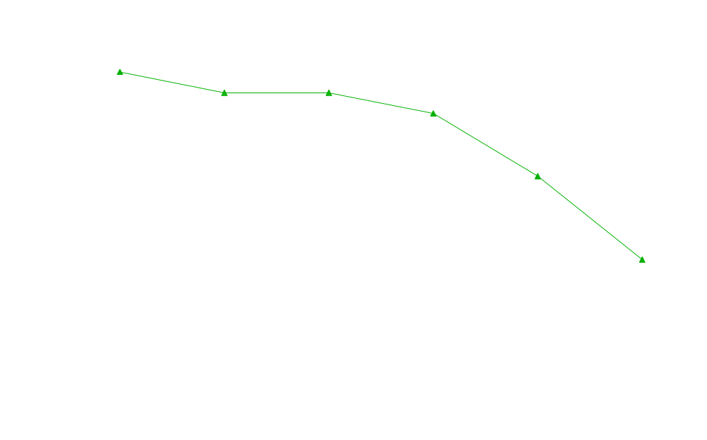
Performance Measures: Knee Extensor Strength
kg
Heavy housework
Walk Up 10 Steps
Shopping
Bathing
Dressing
Bed
Transferring
*A

