Slide 1
NIH Public Trust Initiative COPR Update
October 26, 2007
Initiative Co-Chairs
Dr. Patricia A. Grady
Director, National Institute of Nursing Research
Dr. Yvonne T. Maddox
Deputy Director, National Institute of Child Health & Human Development
Notes:
COPR October 26, 2007.v4 (Everyone's comments included)

Slide 2
NIH Public Trust Initiative
Mission Statement
The mission of the NIH Public Trust Initiative (PTI) is to enable the public to understand and to have full confidence in the research that NIH conducts and supports across the country and throughout the world.
Notes:
COPR October 26, 2007.v4 (Everyone's comments included)

Slide 3
NIH Public Trust Initiative:
Steering Committee
Patricia Grady
Yvonne Maddox
Jeffrey Abrams
Barbara Alving
Nicole Johnson Baker
Alexis Bakos
John Burklow
Zeke Emanuel
Roger Glass
Lisa Kaeser
Raynard Kington
Alan Krensky
Cliff Lane
Amy Patterson
Cliff Poodry
Joan Schwartz
Co-Chair, Director, NINR
Co-Chair, Deputy Director, NICHD
Acting Assoc. Director, Div. Cancer Treatment, NCI
Director, NCRR
COPR Member
Program Director, NIH NINR
Assoc. Director for Comm., NIH OD
Chair, NIH Department of Bioethics
Director, FIC
Senior Program Analyst, NIH NICHD
Deputy Director, NIH
Director, Office of Portfolio Analysis and Strategic Initiatives
Clinical Director, NIAID
Director, Office of Biotechnology Activities, NIH OD
Director, Div. Minority Opp. & Res., NIH NIGMS
Asst. Director, OIR
Notes:
COPR October 26, 2007.v4 (Everyone's comments included)

Slide 4
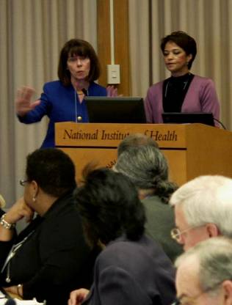
NIH Public Trust Initiative:
Public Trust Liaison Group
Representatives from
  Institutes
  Centers
  Offices of the Director
Notes:
COPR October 26, 2007.v4 (Everyone's comments included)

Slide 5
NIH Public Trust Initiative
NIH Partners in Research Program (PIR)
Notes:
COPR October 26, 2007.v4 (Everyone's comments included)

Slide 6
Partners in Research (PIR)
Inspired by:
COPR Workshop
Inventory of NIH activities
Feedback from across the country
NIH Leadership
Notes:
COPR October 26, 2007.v4 (Everyone's comments included)

Slide 7
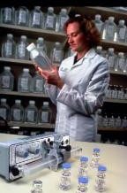
Partners in Research (PIR)
Develop research partnerships between community leaders and NIH-supported scientists
Develop innovative research activities to:
  Study methods to engage and inform the public regarding health science
  Improve public understanding of the benefits of publicly funded research
  Increase scientists’ understanding of and outreach to the public in their research efforts
Notes:
COPR October 26, 2007.v4 (Everyone's comments included)

Slide 8


Partners in Research (PIR)
Objectives:
Communicate importance and value of public’s role in the research process
Improve communication of health-related findings to communities
Convey information about community needs to NIH investigators
Notes:
COPR October 26, 2007.v4 (Everyone's comments included)

Slide 9
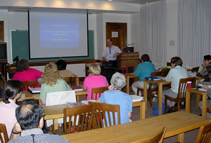
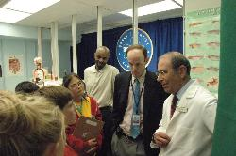
Partners in Research (PIR)
Two phases:
Phase I: Grant support for the proposed innovative activities of the Community Leader-Scientist partnership
Phase II: NIH Partners Workshop
Notes:
COPR October 26, 2007.v4 (Everyone's comments included)

Slide 10
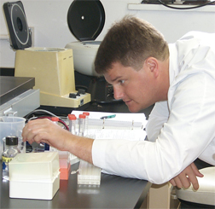
Partners in Research (PIR)
Notice of Intent to Publish – August 29, 2007
RFA publication date – October 12, 2007
RFA receipt date for applications – January 11, 2008
Small Research Grant mechanism (R03)
Approx 40 partner pairs
$50,000 per grant for each of 2 years
Notes:
COPR October 26, 2007.v4 (Everyone's comments included)

Slide 11
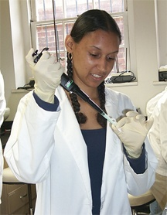
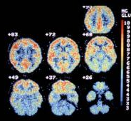
Partners in Research (PIR)
Eligibility Requirements:
Members of underrepresented groups are encouraged to apply
An institution may submit more than one application in response to this RFA provided each application is scientifically distinct.
Foreign organizations are not eligible to apply for these grants.
Applications must be submitted on behalf of at least two partner Investigators, representing a scientific/medical institution and a community institution.
Notes:
COPR October 26, 2007.v4 (Everyone's comments included)

Slide 12

Partners in Research (PIR)
Applicants should address:
Purpose of the research activity/
question to be addressed
The significance of the project
Design of innovative activities
How it increases public understanding of biomedical and/or behavioral research
Notes:
COPR October 26, 2007.v4 (Everyone's comments included)

Slide 13

Partners in Research (PIR)
Application should include:
A detailed plan developed by the two investigators highlighting how collaboration and information exchanges will occur
Notes:
COPR October 26, 2007.v4 (Everyone's comments included)

Slide 14

Workshop
NIH Partners Workshop
Notes:
COPR October 26, 2007.v4 (Everyone's comments included)

Slide 15
Workshop
Purpose of Workshop:
Provide update on Partnerships' progress and experience
Discuss “lessons learned” thus far
Provide a mid-term evaluation of the PIR Program
Notes:
COPR October 26, 2007.v4 (Everyone's comments included)

Slide 16
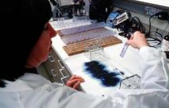
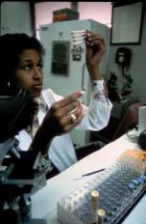
Workshop
Workshop activities will also include:
Update on NIH science activities
Information on NIH Bench-to-Bedside translation and dissemination activities
Interactive discussion sessions
Visits to clinical center/labs of most interest to partner group
Skill Building
Notes:
COPR October 26, 2007.v4 (Everyone's comments included)

Slide 17

Workshop
Approximately 80 participants
All partners must attend
Held in the Bethesda area at the completion of year one
Notes:
COPR October 26, 2007.v4 (Everyone's comments included)

Slide 18
Examples of PIR Projects
HIV/AIDS researchers collaborating with an AIDS advocacy partner to increase participation and adherence in an antiretroviral therapy clinical trial.
Health communication researchers partnering with community service agencies to develop software that “translates” highly technical research results into findings that are more easily understood by the public.
Behavioral researchers working with faith-based organization to test methods for disseminating obesity prevention messages.
Notes:
COPR October 26, 2007.v4 (Everyone's comments included)

Slide 19


PIR Evaluation Plans
Phase 1 Process Evaluation: Post Workshop
  Feedback from the participants in the workshop
  Investigators’ presentation on the success/
  challenges of individual projects
Phase 2 Outcome Evaluation: Post Community-Based Activities
  A compilation and assessment of community-based activities
  Dissemination of the needs of the communities to NIH investigators
  “Improvement in understanding the value of medical science based upon NIH-supported research”
Notes:
COPR October 26, 2007.v4 (Everyone's comments included)

Slide 20
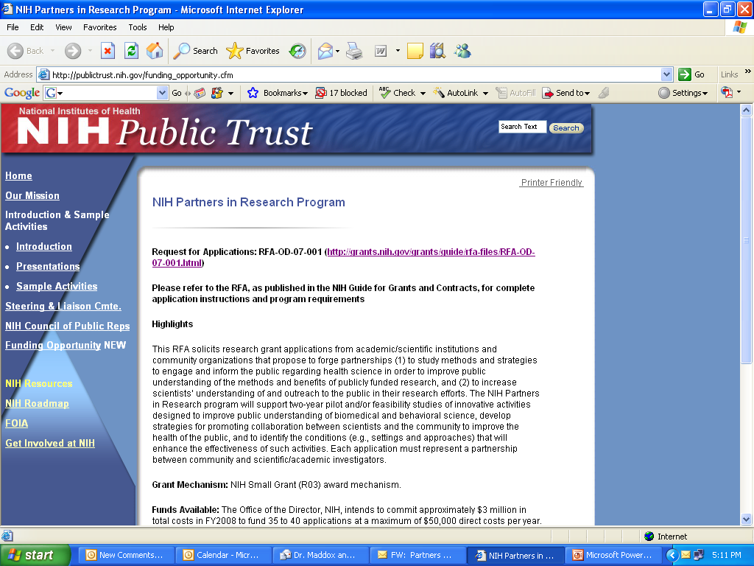
Public Trust Website
Notes:
COPR October 26, 2007.v4 (Everyone's comments included)

