Slide 1
Department of Energy Validation Review of the
LBNL ISM Corrective Action Plan
June 27, 2006
David C. McGraw
Chief Operating Officer
Associate Laboratory Director for Operations

Slide 2
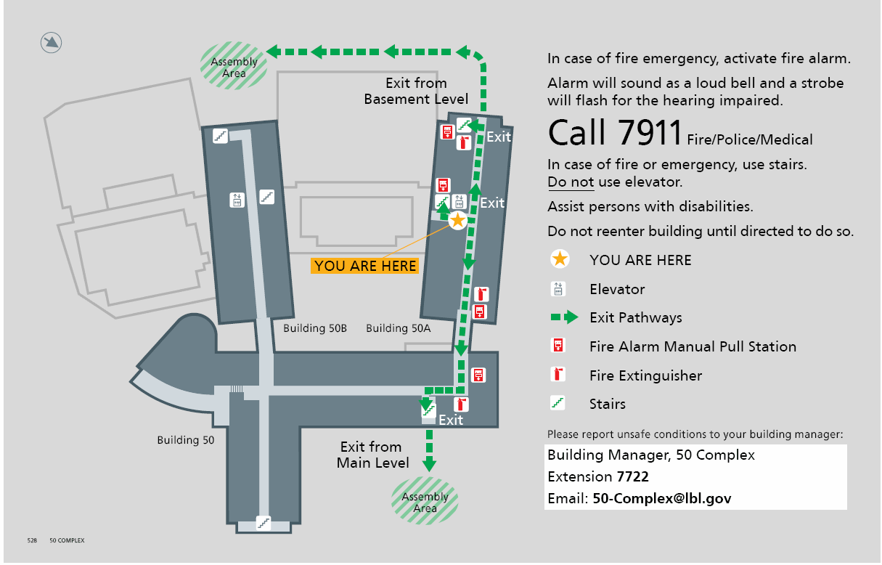
Emergency Evacuation Route: Building 50A Room 5132
50 Complex Bldg. Mgr. John Hutchings x7505
jehutchings@lbl.gov
Deputy Bldg. Mgr. Jose Olivares x6871
jaolivares@lbl.gov

Slide 3
Agenda: DOE Validation Review of the
LBNL ISM Peer Review Corrective Action Plan
Tuesday, June 27, 2006 8:00 Team Organization Mtg. 90-1099 9:00 DOE Caucus/BSO Staff 9:45 Break-Travel to Bldg. 50A-5132 10:00 – 12:00 Briefing from LBNL 10:00 Welcome – Director Steve Chu 10:10 Welcome - David McGraw 10:30 CAP Development Process – Howard Hatayama 11:30 Additional Q&A 12:00 Team/BSO Lunch 1:00 Team Interviews 3:00 Begin Report Writing | Wednesday, June 28, 2006 7:30 Report Writing and Outbrief Presentation 90-1099 11:30 Lunch (Team w/BSO) 1:00 Travel to Bldg. 50B-4205 1:30 Outbrief with BSO 2:00 Outbrief with LBNL 3:30 End of Visit

Slide 4
Berkeley Lab Director
Chief Safety Officer
  Sets the culture and values for safety, environmental protection, and ISM
  Provides the resources and support that employees and safety programs need
  Holds staff accountable for safety performance

Slide 5

Director’s Actions
Directed line managers and PI’s to walk all their spaces to correct safety issues, January 2006
Personally walked spaces with ALDs
Conducting brown-bag sessions around the Lab
Directed Division Directors to reinforce line management responsibility for safety, February 2006
Incorporated safety into every Sr. Leadership Council, Division Directors and area meetings
Commissioned broad-based CAP development team under the leadership of the Acting EH&S Division Director
Approved and submitted CAP to DOE
Issued memo to all staff on supervisor and individual responsibility for safety and on managing project schedules to ensure work is done safely, June 2006

Slide 6
From Poster Child to Problem Child
What happened to ES&H Program at Berkeley Lab?
Is there a lesson for other Office of Science Labs in our experience?
Do we understand the lesson?
  Loss of focus on resources and leadership required for proper execution
  Not paying enough attention to the leading indicators we were collecting
  A sense of complacency due to past success
Contributing factors
  Leadership changes starting in 2003
  Contract competition in 2004

Slide 7
The Orbach Letter and the Need for Intervention:
2005-2006 Safety Record and Other Leading Indicators
Missed TRC and DART goals in FY05
Poor laser safety practices: use of interlocks, inadequate inventory
Electrical safety incidents
Breakdown of administrative safety controls at the Advanced Light Source

Slide 8
Leading Indicators and the Need for Intervention
Communications between LBNL and BSO on safety matters needed significant improvement
LBNL and BSO leadership consensus on need for improved safety performance
BSO calls on UCOP for increased safety oversight
UCOP commissioned ISM Peer Review January 5, 2006

Slide 9
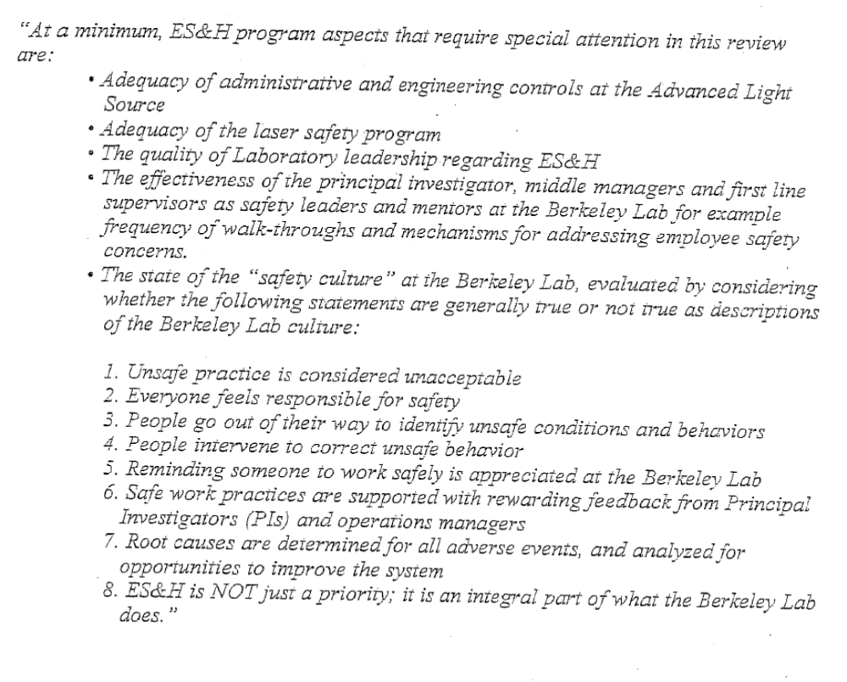
Peer Review Letter

Slide 10
LBNL Peer Review Reviewers
Reviewers
  William A. Bookless, Chair ~ LLNL
  John Cornuelle ~ SLAC
  Dennis Derkacs ~ LANL
  Tom Dickinson ~ NSLS – Brookhaven Laboratory
  George Goode ~ Brookhaven Laboratory
  James Johnson, Jr. ~ Howard University
  Jim Smathers ~ UCLA
Three DOE Observers
  W. Earl Carnes ~ DOE Headquarters
  Ted Pietrok ~ PNSO
  Carol Ingram ~ BSO

Slide 11
Structured Approach
Backlook of Recent Incident Investigations
Root Cause Analysis
A Corrective Action Plan

Slide 12
LBNL Leadership Team is Committed to
ES&H Execution
Accountability at all levels
Clarity around roles and responsibilities
More attention to work controls
Continuous improvement
  Robust metrics
  Benchmarking
  Robust Lessons Learned
Adequate resources
Executive team visibility
An improved governance model
Implementing the Corrective Action Plan

Slide 13
In Addition….
We look forward to recommendations from this validation visit…..

Slide 14
Integrated Safety Management Peer Review
Corrective Action Plan
Development Process
Howard K. Hatayama
Acting Director
Environmental Health and Safety Division
Department of Energy Validation Review of the
LBNL ISM Corrective Action Plan
June 27, 2006

Slide 15
Outline For Today
Corrective Action Plan (CAP) Development
  Cross-cutting CAP Development Team
  Development process
    Extent of condition/backlook review
    Root cause analysis
    Corrective actions development
Corrective actions summary
Current status and next steps

Slide 16
Corrective Action Plan Development Process
Team formation
  Working Group
  CAP Development Team
Plan development process
  Extent of condition/backlook review
  Root cause analysis
  Corrective actions development
Interim actions implemented while CAP was developed

Slide 17
Path to Recovery
Intervention
2005
Indications of decline in safety program
Increased TRC & DART, number & severity of ORPS, etc.
DOE/BSO
UCOP
LBNL
Peer Review
Report, 2/10
2006
Issues, 3/24
Extent of condition:
Peer Review+Backlook
Report, 4/26
Root Cause
CAP, 6/1
2006-07
Implementation of CAP, Validation & Continuous Improvement

Slide 18
Extent of Condition Backlook Review
Purpose: Understand the extent of condition of issues identified by the Peer Review by leveraging the work and knowledge gained from previous assessments and reports
Working Group reviewed eight other assessments and reports covering the period 2003-05
CAP Development Team brainstormed, clarified and critiqued common themes in two intense sessions
Result: More comprehensive and pertinent list of issues

Slide 19
Issues to Root Cause Analysis
Peer Review Issues
Issues from 8 other assessments = “Backlook”
Working Group applies ORPS categories to
search for common themes
CAP Development Team brainstorms, clarifies,
analyzes, reaches consensus on common themes
Working Group synthesizes Team consensus into Issues
(Peer Review + Backlook) 3/24/06
Root Cause Analysis performed resulting in Peer
Review/Backlook Issues Root Cause Analysis, 4/25/06
Working Group bins root causes into 5 categories to
Facilitate corrective action development

Slide 20
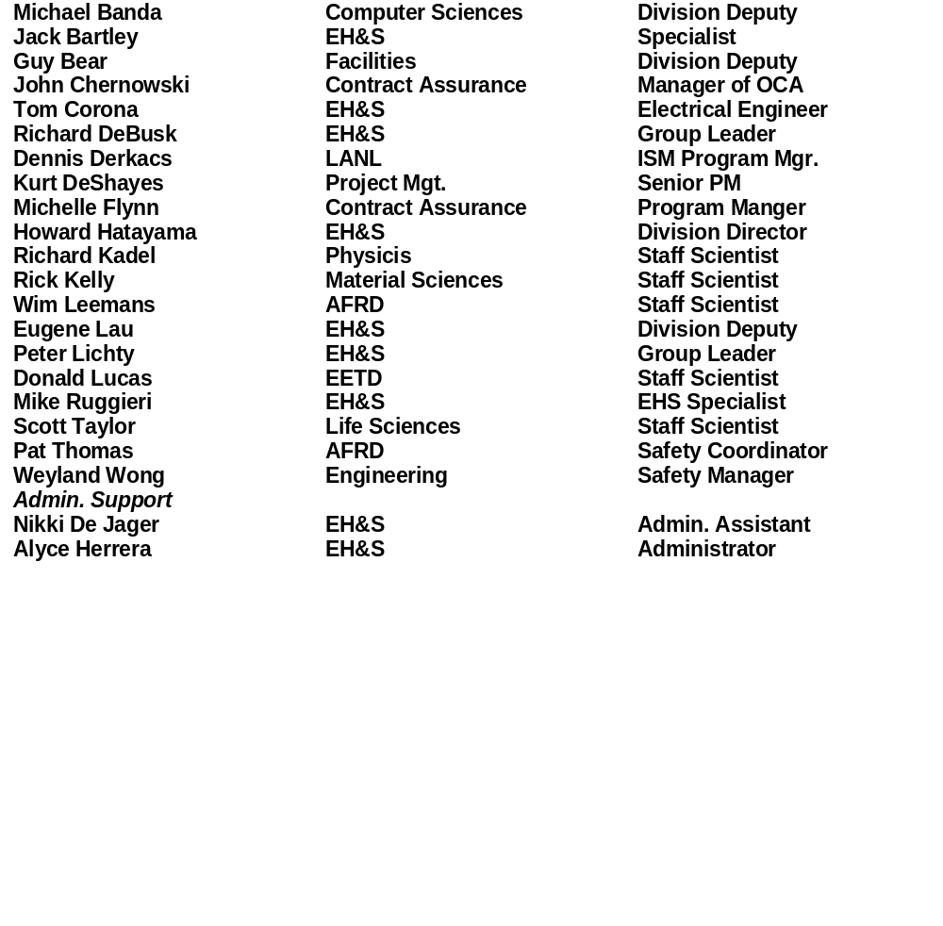
LBNL ISM Peer Review
Corrective Action Plan Development Team

Slide 21
Backlook: Assessments and Reports Reviewed
2006
  Report of the RSC Sub-committee to Investigate and Review ALS Shielding Control Procedures, January
  Berkeley Lab FY05 50 OSHA Recordable Cases: Root Causes and Lessons, January
2005
  Crane, Hoist, Rigging & Forklift Safety Program Assessment, October
  Causal Analysis of 15 Electrical Incidents that Occurred at Berkeley Lab from July 2002 to June 2005, October
  Building 58 Electrical Near Miss Accident: Status Report on Corrective Actions, September
  LBNL Building 58 Electrical Safety Event, June
  LBNL Electrical Safety Self-Assessment, April
2003
  Laser Safety Program Review Panel Report, July

Slide 22
Path to Recovery
Intervention
2005
Indications of decline in safety program
Increased TRC & DART, number & severity of ORPS, etc.
DOE/BSO
UCOP
LBNL
Peer Review
Report, 2/10
2006
Issues, 3/24
Extent of condition:
Peer Review+Backlook
Report, 4/26
Root Cause
CAP, 6/1
2006-07
Implementation of CAP, Validation & Continuous Improvement

Slide 23
Root Cause Analysis
Proceeded with formal Root Cause Analysis based on advice from DOE and acknowledged benefits
Used trained TapRooters
Examined the consolidated list of issues –
“Issues - (Peer Review + Backlook), March 24, 2006”
Results documented in “Peer Review/Backlook Issues Root Cause Analysis, April 26, 2006”

Slide 24
Root Cause Analysis Teams
Team 1
Richard Debusk, EHS
Mike Ruggieri, EHS
Michelle Flynn, OCA
Dennis Derkacs, Advisor
Jack Bartley, EHS
Team 2
Weyland Wong, ENG
Pat Thomas, AFRD
John Chernowski, OCA
Dennis Derkacs, Advisor
Jack Bartley, EHS

Slide 25
Root Cause Methodology
A formal root cause analysis was performed against the issues in the Backlook and Peer Review to support effective corrective action development
The proactive method of TapRoot root cause analysis was used
  Proactive TapRoot begins with assessment issues rather than incident sequence of events
  LBNL considers TapRoot to be a human performance improvement tool
    Helps identify and correct latent organizational weaknesses

Slide 26
TapRoot Steps
1. Validate basic cause (provided from Peer Review and Backlook)
2. Use TapRoot Root Cause Tree to identify basic cause categories
  Human performance, equipment, natural disaster/sabotage, other
3. If human performance is identified as a category, use Human Performance Troubleshooting Guide to identify basic cause categories (15 questions)
4. Evaluate any basic cause category selected to determine root cause

Slide 27
An Example of How the Issues Were
Validated and Root Causes Identified
Reference: “Issues (Peer Review/Backlook),” page 3
ISM Principle 3 – Competence Commensurate with Responsibilities
  Issue 3.1 - There is not a uniform process for educating managers, supervisors, and coordinators on how to make safety an integrated part of activities in the workplace
    It is not clear that all managers are trained to conduct meaningful safety walkarounds
    The role of the safety coordinator varies across LBNL
    The minimum qualifications and training of safety coordinators should be determined and formalized

Slide 28
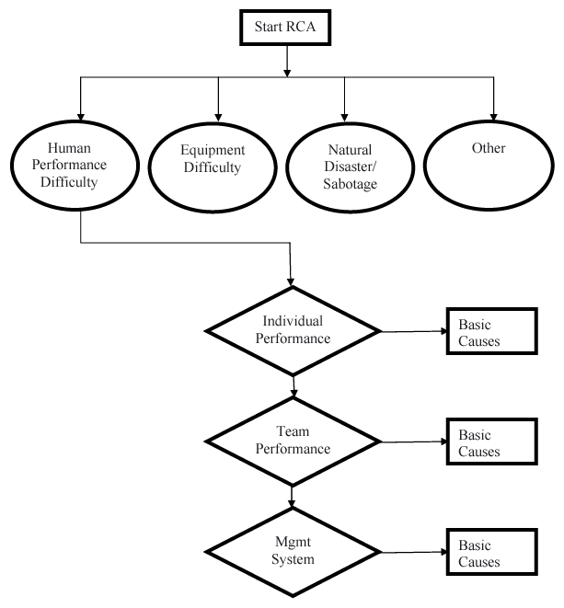
Analysis of Issue 3.1 Through to Identification of Root Cause 3.1.2

Slide 29
Analysis of Issue 3.1 Through to Identification of Root Cause 3.1.2

Slide 30
Results Of Root Cause Analysis
Each issue has a number of root causes
The list of root causes was refined
  Duplication was eliminated
  The TapRoot language was tailored with LBNL- specific terms (standard practice)

Slide 31
Management of Root Causes
Organizing options:
  Sequential listing
  ISM Principles
  Alignment with ISM Principles and Lab organizational structure
    Institution-wide
    Technical/professional

Slide 32
Alignment with ISM Principles and Lab Organizational Structure
Chose alignment option to:
  Enhance understanding of the causes
  Facilitate team assignments
  Recognize interdependence of root causes
  Add coherence to development of corrective actions

Slide 33
Resulting Categories
Line management (LM) execution of ES&H
ES&H assurance mechanisms
Educating managers, supervisors and division safety coordinators (SCs)
Proactive posture on ES&H
Lab-wide work control program

Slide 34
Path to Recovery
Intervention
2005
Indications of decline in safety program
Increased TRC & DART, number & severity of ORPS, etc.
DOE/BSO
UCOP
LBNL
Peer Review
Report, 2/10
2006
Issues, 3/24
Extent of condition:
Peer Review+Backlook
Report, 4/26
Root Cause
CAP, 6/1
2006-07
Implementation of CAP, Validation & Continuous Improvement

Slide 35
Corrective Actions Development Process
CAP Team assigned to each of 5 categories, 5/5/06
Corrective Action Teams develop proposed actions
Proposed actions reviewed with CAP team to test
appropriateness feasibility and eliminate redundancy
Working Group prepares draft CAP
Draft CAP reviewed by Safety Coordinators, Associate
Laboratory Directors, Lab Director
CAP submitted on June 1, 2006

Slide 36
Corrective Action Teams
LM Execution of ES&H | ES&H Assurance | Educate Managers & SCs | Proactive ES&H | Work Control Program
Don Lucas, Staff Scientist, EETD Michael Banda, Div. Deputy, CRD Richard Debusk, Group Leader, EHS | John Chernowski, Manager, OCA Michelle Flynn, Prog. Manager, OCA | Guy Bear, Deputy Director, FAC Weyland Wong, Safety Manager, ENG Jack Bartley, EHS | Eugene Lau, Deputy Director, EHS Michael Ruggieri, Specialist, EHS Peter Lichty, Occupational Medical Director, EHS | Richard Kadel, Staff Scientist, Physics Rick Kelly, Fac & EHS Manager, MSD Scott Taylor, Staff Scientist, LSD
Dennis Derkacs – Advisor
Kurt Deshayes – Project Management

Slide 37
Questions on the CAP Development Process?

Slide 38
Key Elements of the Corrective Action Plan
Corrective Actions, when implemented, will result in sustainable improvements in the five categories:
  Line Management execution of ES&H (12 actions)
  ES&H Assurance (26 actions)
  ES&H Training and Communication (19 actions)
  More proactive ES&H (11 actions)
  Work Planning and Hazard Control (20 actions)
Of this set
  32 actions underway
  7 actions complete or substantially complete

Slide 39
Line Management Execution of ES&H
What are we fixing?
Responsibility for safety is not clearly defined below the principle investigator/staff scientist
Excessive span of control makes working safely a challenge
How are we fixing it?
Define safety management responsibilities for lead post-docs and graduate students
Increase frequency of management walkarounds
Incorporate changes in Lab policies and procedures

Slide 40
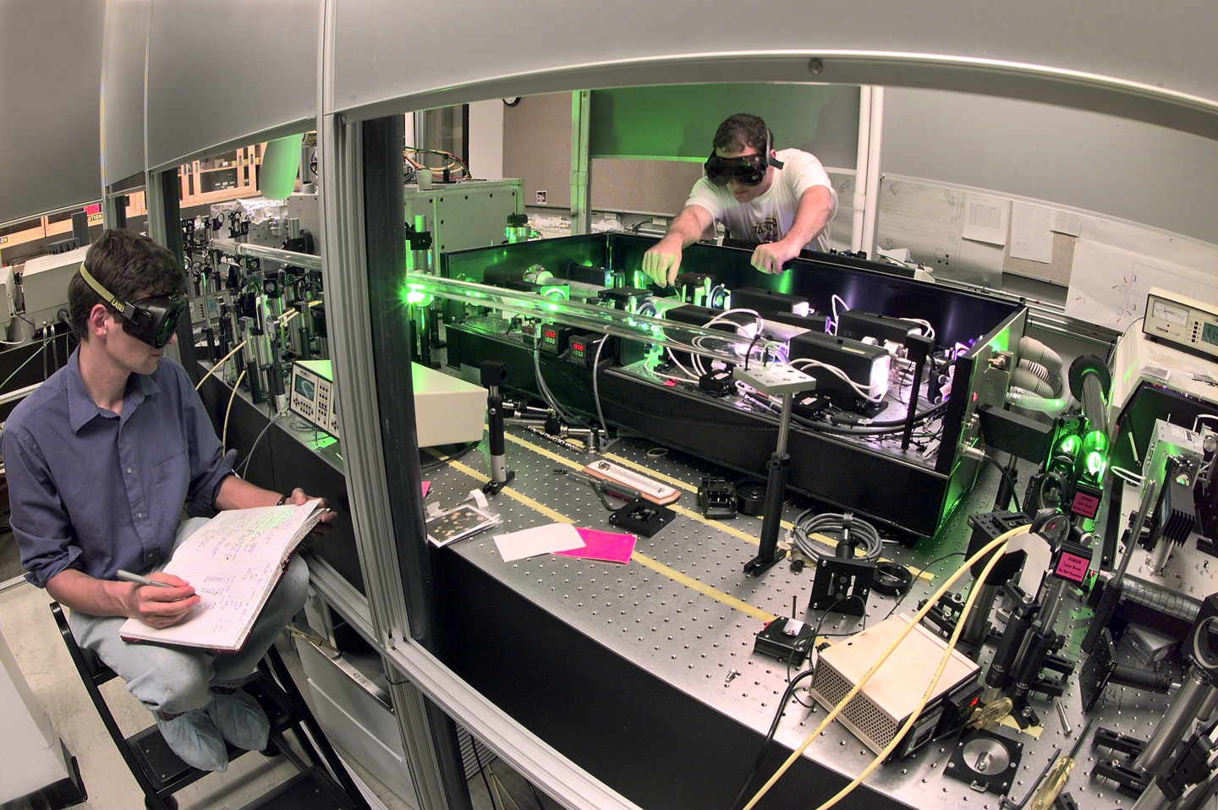
Line Management Execution of ES&H
What have we done about it already?
  Performed walkarounds of all spaces
  Developed management walkaround training
  Enhanced processes and training in Divisions

Slide 41
ES&H Assurance Mechanisms
What are we fixing?
Weakened ES&H technical program assurance
Ability of assurance systems to identify weakness in execution of ES&H
How are we fixing it?
Establish current baseline of ES&H assurance and re-build
Review effectiveness of walkarounds, Integrated Functional Appraisal (IFA) and Management ES&H Review (MESH) and revise criteria
Revise partnership agreement with UCB regarding ES&H

Slide 42

ES&H Assurance Mechanisms
Lawrence Berkeley National Laboratory
2006 Integrated Functional Appraisal
What have we done about it already?
Revised FY06 IFA and MESH criteria
Revised division Self Assessment criteria for 2006-07 assessment year

Slide 43
Educating Managers, Supervisors, and Coordinators
What are we fixing?
Current safety oversight training for managers, supervisors, post-docs and graduate students needs to be aligned with roles and responsibilities
Roles, responsibilities, minimum qualifications and training requirements for Safety Coordinators
How are we fixing it?
Enhance mentoring, safety awareness and training of post-docs and graduate students
Refine walkaround training based on formal requirements and feedback from initial roll-out
Evaluate Safety Coordinator program and revise

Slide 44
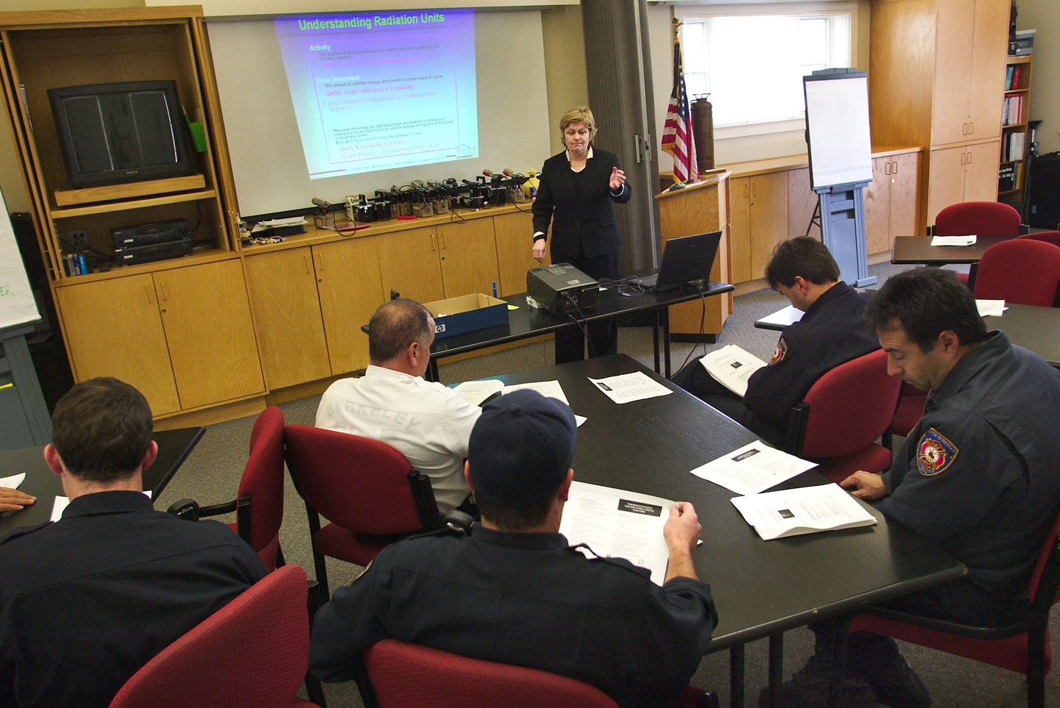
Educating Managers, Supervisors, and Coordinators
What have we done about it already?
  Developed walkaround training
  Established Safety Coordinator review team

Slide 45
Proactive Posture on ES&H
What are we fixing?
Cultural attitudes towards risk-taking and ES&H risk management
Fear and anxiety related to incident reporting
How are we fixing it?
Develop an enhanced communications strategy focused on: quality of work and concern for ES&H
Revise ISM plans, PRDs, and training for line managers to identify and mitigate ES&H risks
Re-orient response away from blame and towards staff safety, lessons learned and preventative measures
Communications to encourage incident reporting

Slide 46
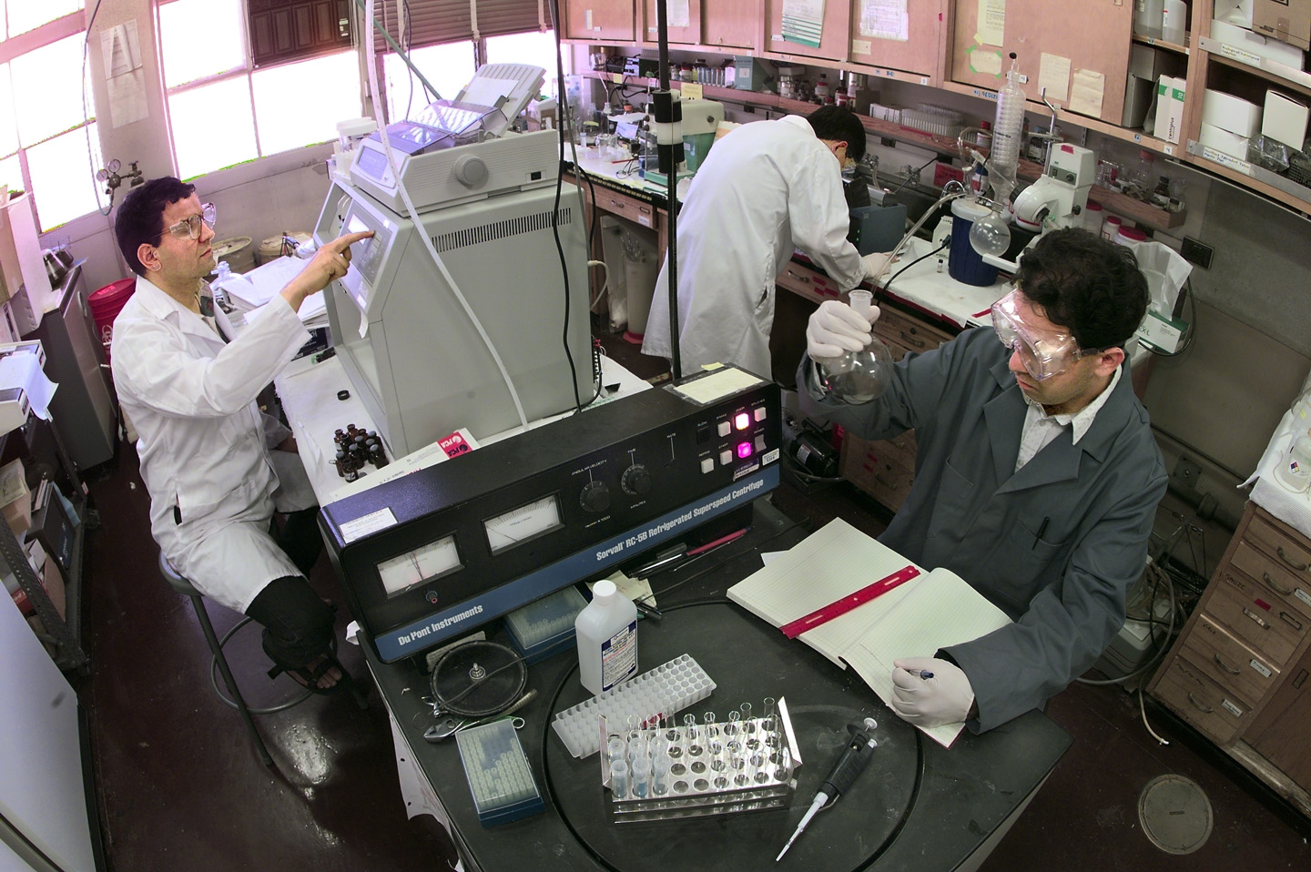
Proactive Posture on ES&H
What have we done about it already?
  Revisions to incident investigations procedure to make it less onerous
  Director’s memo to all Laboratory staff, 6/9/06

Slide 47
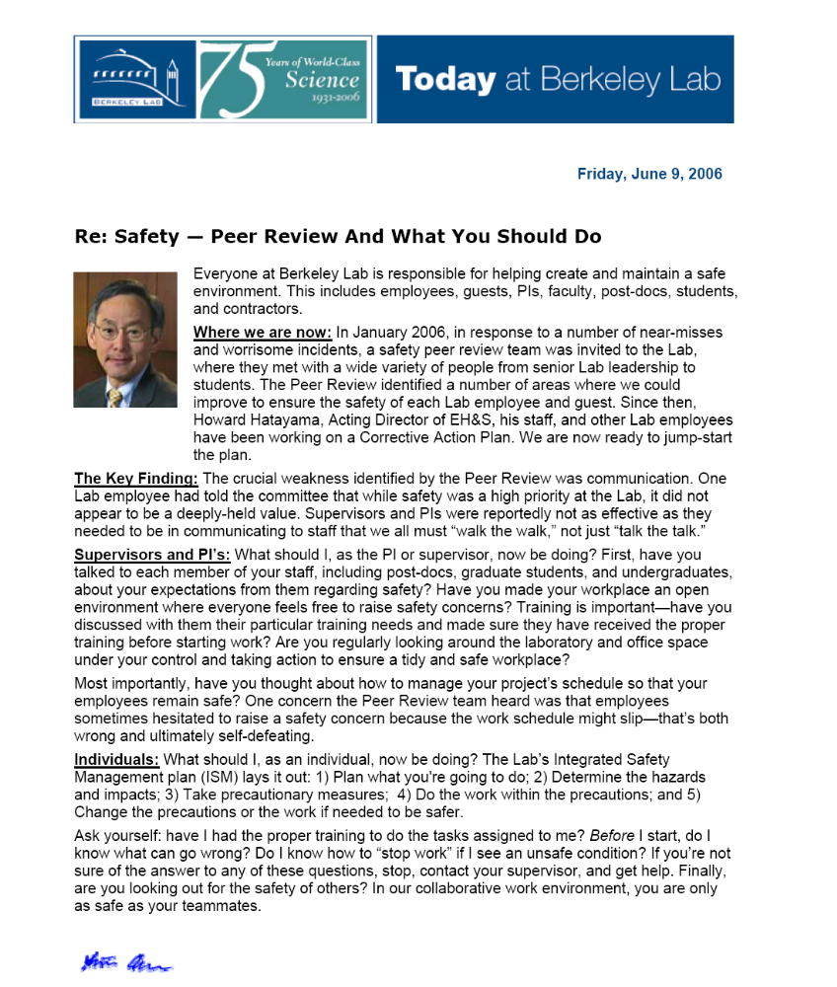

Slide 48
Lab Wide Work Control Program
What are we fixing?
Managing of changes-people/equipment/scope
Informality in line management authorized work
Inadequate change control-staff/equipment/resources
How are we fixing it?
Complete transition of AHDs to electronic and review effectiveness
Formalize policy and procedures for lesser hazards
Review/revise hazard identification policies for facilities, sub-contractors, and vendors
Develop methods to ensure implementation of AHDs

Slide 49
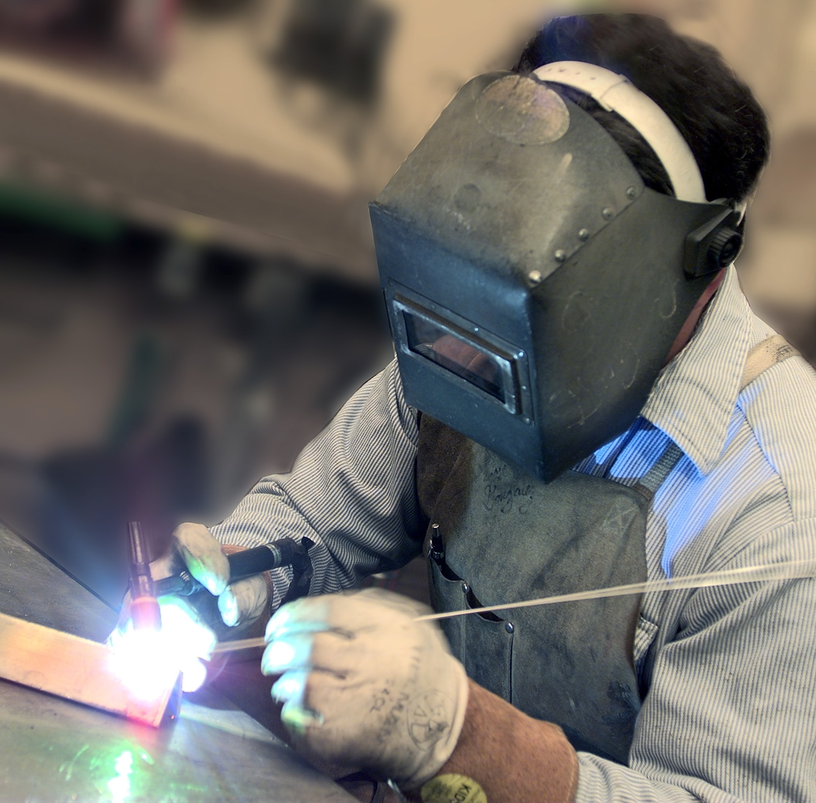
Lab Wide Work Control Program
What have we done about it already?
  Focused FY06 IFA on implementation of formal authorizations

Slide 50
Current Status and Next Steps
Continue implementing interim actions
Identify leads/teams for new CAP tasks
Establish Change Control Board
Follow-up on DOE Validation Team recommendations
Implement and close-out corrective actions
Validation and on-going assurance

Slide 51
So what have we learned from all this?
A great deal of humility
Never lose focus on safety
Pay attention to leading indicators
We will improve
We will meet aggressive metrics

Slide 52



Our Goal:
A safer Laboratory through improved execution of Integrated Safety Management
Active and effective participation of managers, from senior leadership to the mentors in the workplace, as Safety Managers
Tailor training, implement a comprehensive Work Planning and Hazard Control Program, enable proactive EH&S professionals

