Slide 1

Present status and future plan of
RIBF
H. Sakurai
RIKEN Nishina Center for Accelerator-Based Science

Slide 2
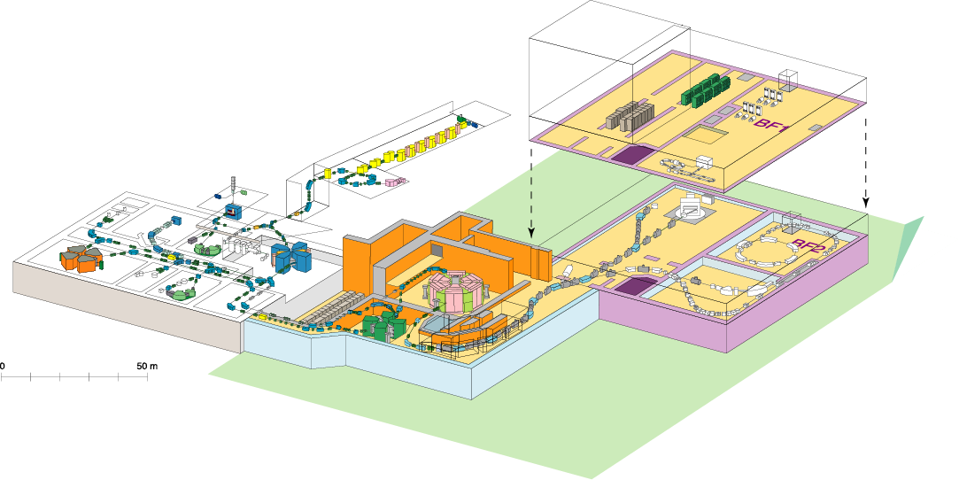
RIKEN RI Beam Factory (RIBF)
Experiment facility
To be funded
In phase II
Old facility
Accelerator
RIPS
GARIS
SHE (eg. Z=113)
60~100 MeV/nucleon
~5 MeV/nucleon
RILAC
SCRIT
AVF
ZeroDegree
SAMURAI
fRC
RRC
SRC
SLOWRI
IRC
RI-ring
BigRIPS
SHARAQ
CRIB (CNS)
350-400 MeV/nucleon
New facility
  Intense (80 kW max.) H.I. beams (up to U) of 345AMeV at SRC
  Fast RI beams by projectile fragmentation and U-fission at BigRIPS
  Operation since 2007
  Phase-I SRC+BigRIPS+ZeroDegree

Slide 3
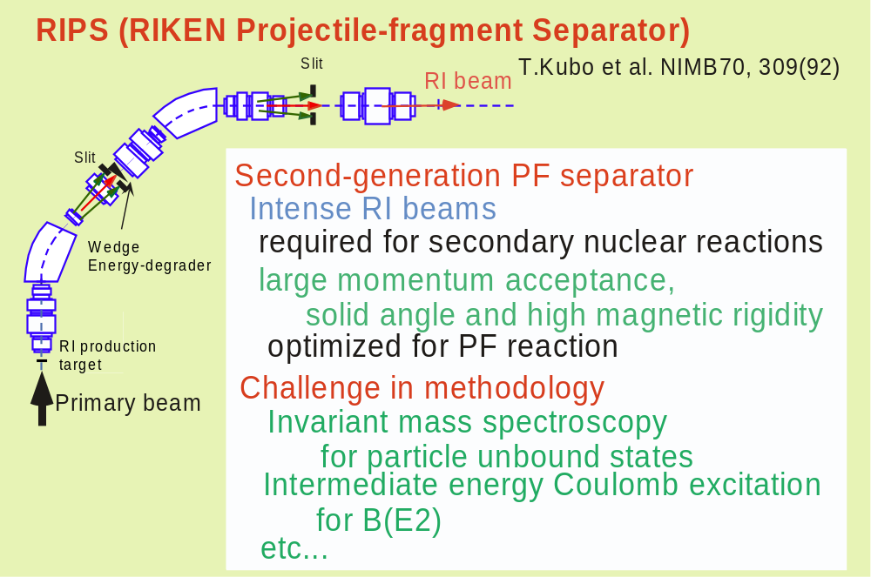
Progress of Research Opportunities with RI Beams
Construction of a dedicated facility for RI beam production
via the projectile fragmentation
1990-
0^{th-}generation at LBL 1st-generation at LISE-GANIL

Slide 4
Challenges in Methodology with fast RI beams at RIPS
~40-70 A MeV and A < 60
transmission method for nuclear radii information
energy-dependence of total reaction cross sections, e.g. ¹¹Be
in-beam gamma spectroscopy for particle bound states
Magicity loss at N=20
Anomaly of B(E2) in ¹⁶C
via Coulomb excitation, (p,p’), Two-step fragmentation,
Recoil-shadow methods, ...
invariant mass spectroscopy for particle unbound states
Large B(E1) in the halo nuclei ¹¹Be, ¹⁹C
Radiative capture cross sections in stellar evolutions :⁷Be(p,γ)⁸B
missing mass spectroscopy
Spectroscopy on the heaviest hydrogen ⁷H
polarized rare-isotope beams for electro-magnetic moments
Anomaly of quadrupole moments in the B isotopes
via beta-NMR techniques

Slide 5
New results obtained at the old facility RIPS:
C-17 and Be-12
Phase-I programs at the new facility
Phase-II status
Summary

Slide 6
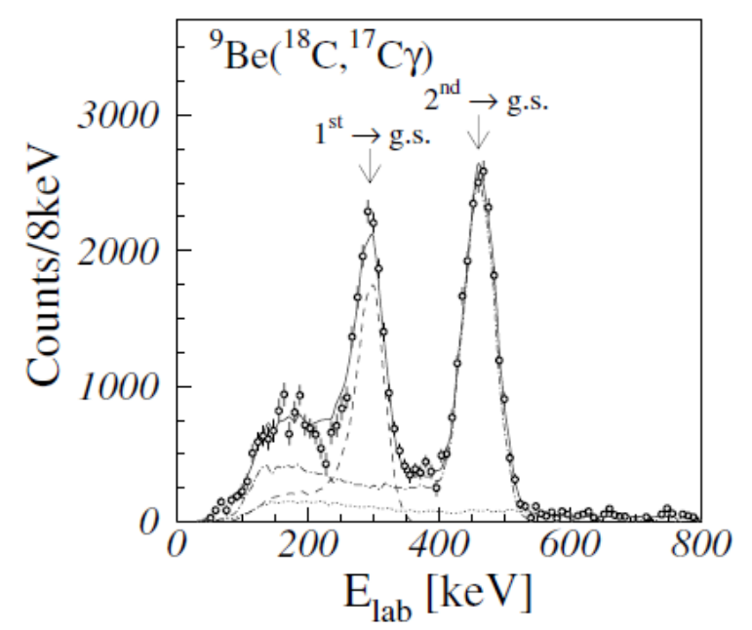
Life-time measurements of excited states in ¹⁷C
Recoil-shadow-method
D. Suzuki, et al., PLB 666 (08) 222
B(E2)
C-16 Imai et al PRL 94 (05) 199202
C-16, 18 Ong et al. PRC 78 (08)014308
¹⁸C+Be -> ¹⁷C + X
(5/2+)
18.9 ± 0.6(stat.) ± 4.7(syst.) ps
583 ± 21(stat.) ± 35(syst.) ps
(1/2+)
3/2+
¹⁷C
B(M1; (1/2⁺) → 3/2⁺) = (1.0±0.1) x 10⁻² [μ_{N}²]
B(M1; (5/2⁺) → 3/2⁺) = (8.2 +3.2/-1.8) x 10⁻² [μ_{N}²]

Slide 7
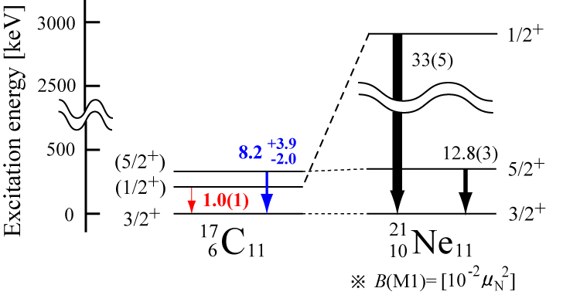
Comparison between ¹⁷C and ²¹Ne
(5/2⁺) ; Almost identical excitation energy and M1 strength
(1/2⁺) ; Low excitation energy and small M1 strength
⇒ Drastic change in the structure of the 1/2+ state
Weak binding -> Ω1/2+ s-wave dominant? (Yamagami, Hamamoto)
SM : Suzuki tensor MF : Sagawa prolate-oblate?

Slide 8
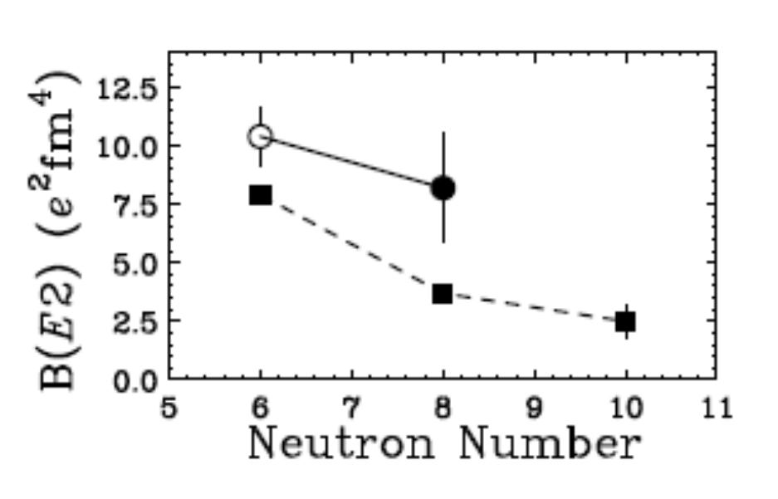
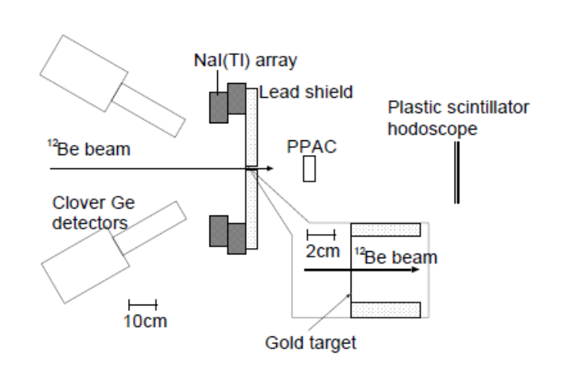
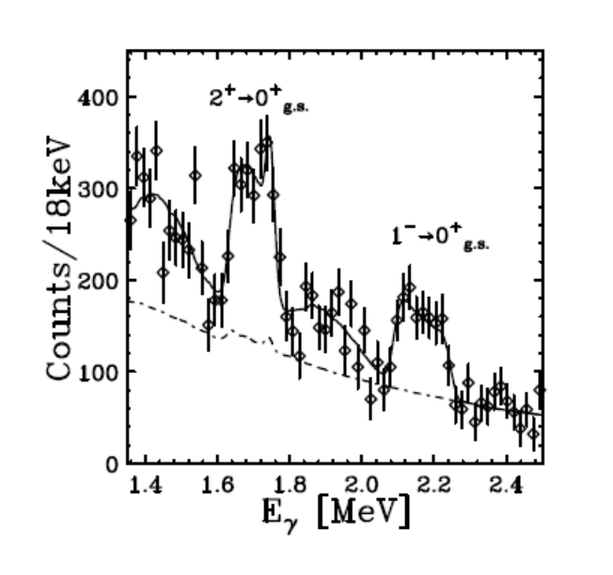
First lifetime measurement of 2⁺ state in ¹²Be
Imai, Aoi et al. PLB, in press
Doppler-shift attenuation method
Be
C
t = 2.5+/-0.7(stat)+/-0.3(sys) ps
B(E2;2->0) = 5.3+/-1.3+/-0.5 (W.U.)
8.2+/-2.2+/-0.8 e²fm⁴
C-14 B(E2)=1.9 W.U.
O-16 B(E2)=3.4 W.U.

Slide 9
RIKEN RI Beam Factory (RIBF)
Experiment facility
To be funded
In phase II
Old facility
Accelerator
RIPS
GARIS
SHE (eg. Z=113)
60~100 MeV/nucleon
~5 MeV/nucleon
RILAC
SCRIT
AVF
ZeroDegree
SAMURAI
fRC
RRC
SRC
SLOWRI
IRC
RI-ring
BigRIPS
SHARAQ
CRIB (CNS)
350-400 MeV/nucleon
New facility
  Intense (80 kW max.) H.I. beams (up to U) of 345AMeV at SRC
  Fast RI beams by projectile fragmentation and U-fission at BigRIPS
  Operation since 2007

Slide 10
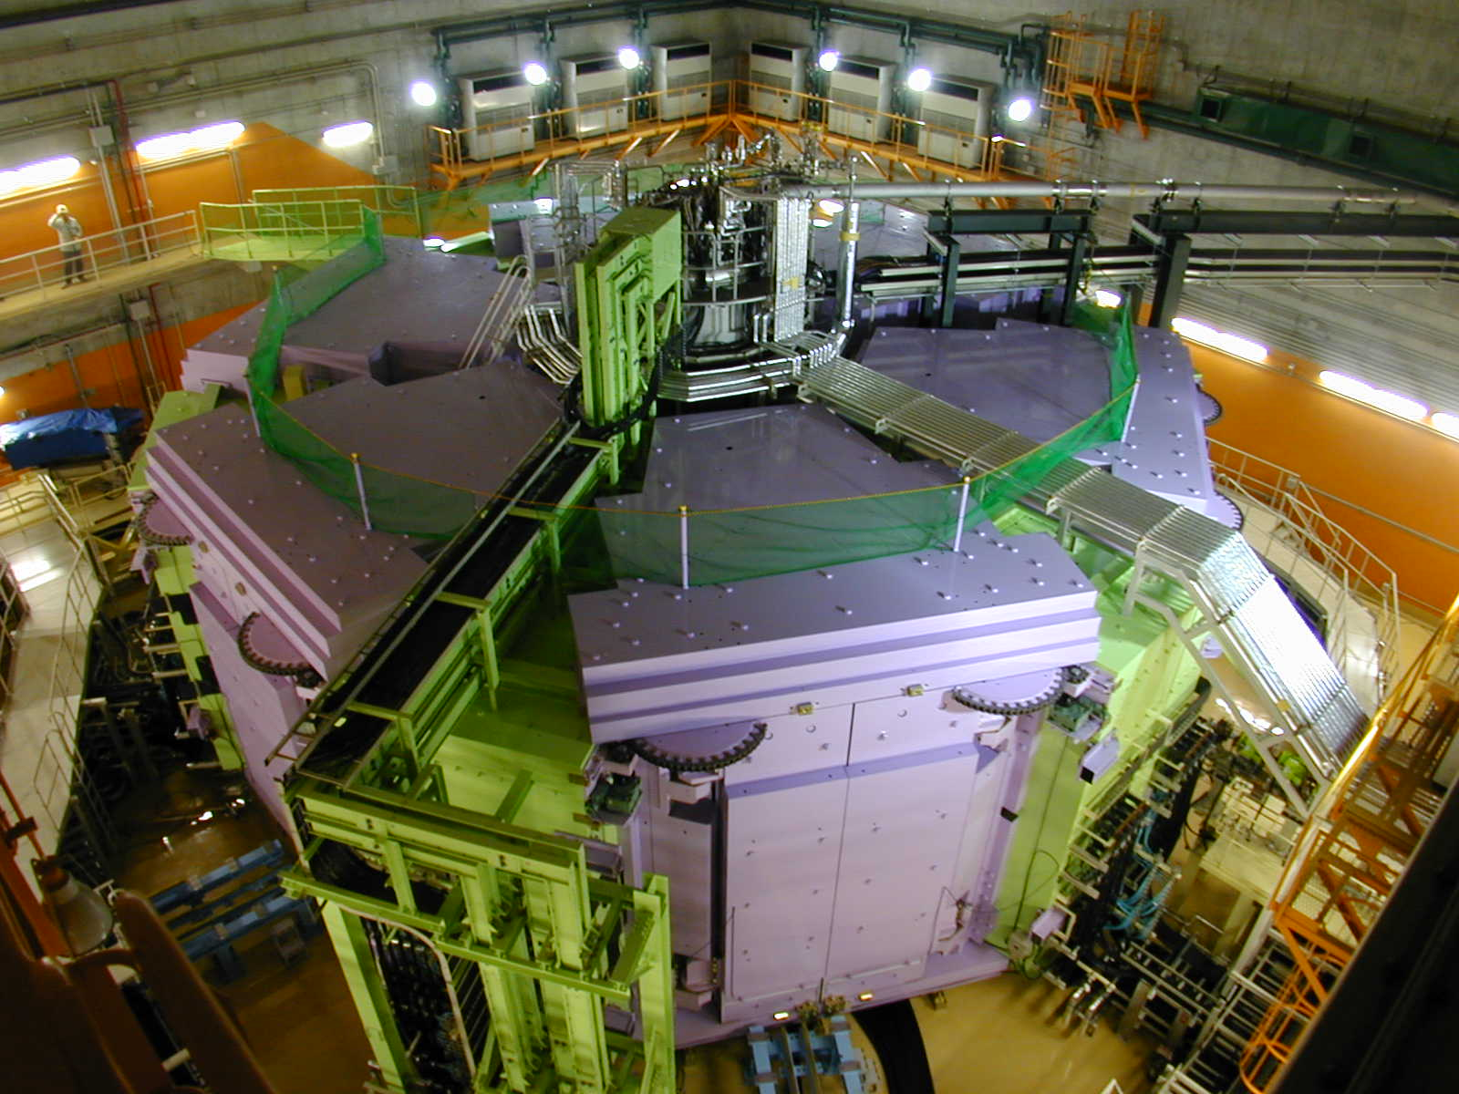
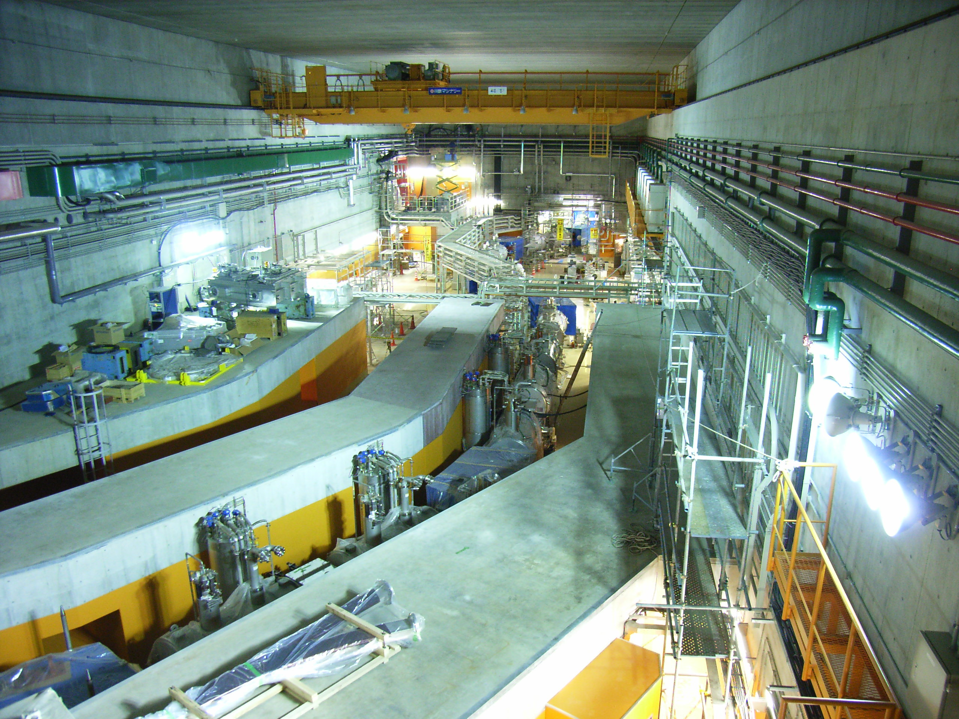
World’s First and Strongest
K2600MeV
Superconducting Ring Cyclotron
SRC
400 MeV/u Light-ion beam
345 MeV/u Uranium beam
BigRIPS
World’s Largest Acceptance
9 Tm
Superconducting RI beam Separator
~250-300 MeV/nucleon RIB
K980-MeV
Intermediate stage Ring Cyclotron (IRC)

Slide 11
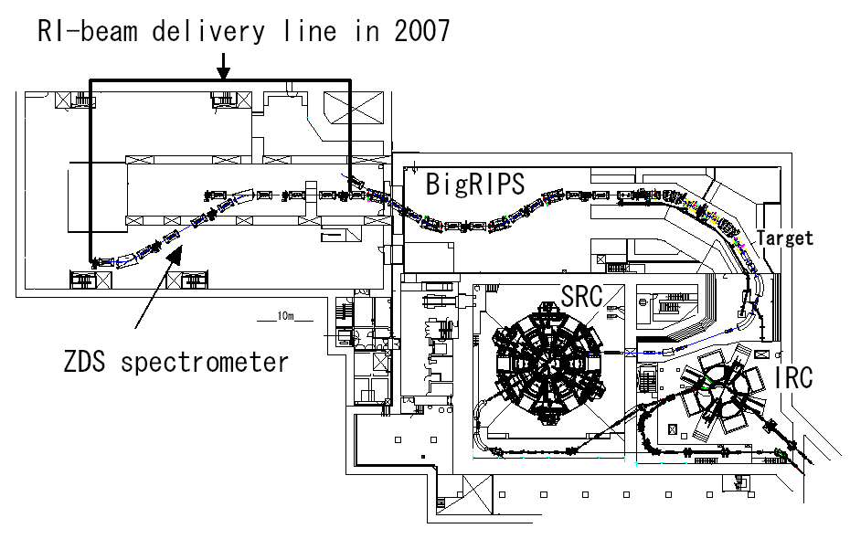
BigRIPS /ZeroDegree (Phase-I)
Exploration into “Isospin Frontier” toward the drip-lines
Reaction study fit for high energy domain 200-300A MeV
BigRIPS Fragment Separator with two stages
high acceptance for fission fragments
pid for RI beams at the second section
ZeroDegree Multi-function BT line
pid for ejectiles in inclusive- and semi-exclusive measurement
medium resolution (p/dp ~ 2000 – 4000)
Experimental set-ups
PID section
RIB production

Slide 12
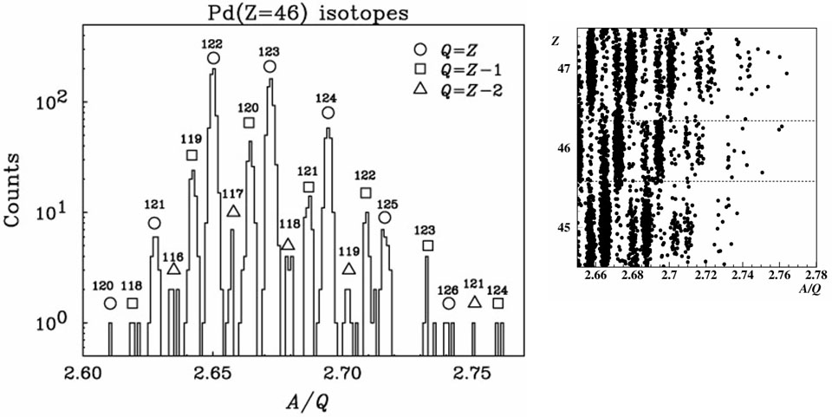
Identification of new isotopes ^{125,126}Pd
T. Onishi et al, JPSJ 77 (08)083201.
125 (22counts)
126 (3counts)
A/Q resolution(r.m.s): 0.041% at Z=46
Bρ resolution (r.m.s): 0.02%
ΔT resolution (r.m.s.): 40 psec
Total dose 3.6x10¹² for 25 hrs
I ~0.01 pnA on average
Cf. ¹²⁴Pd 19 counts, ¹²⁵Pd(cand.) 1count at GSI, 1997
PLB 415, 111 (97); total dose ~1x10¹²

Slide 13
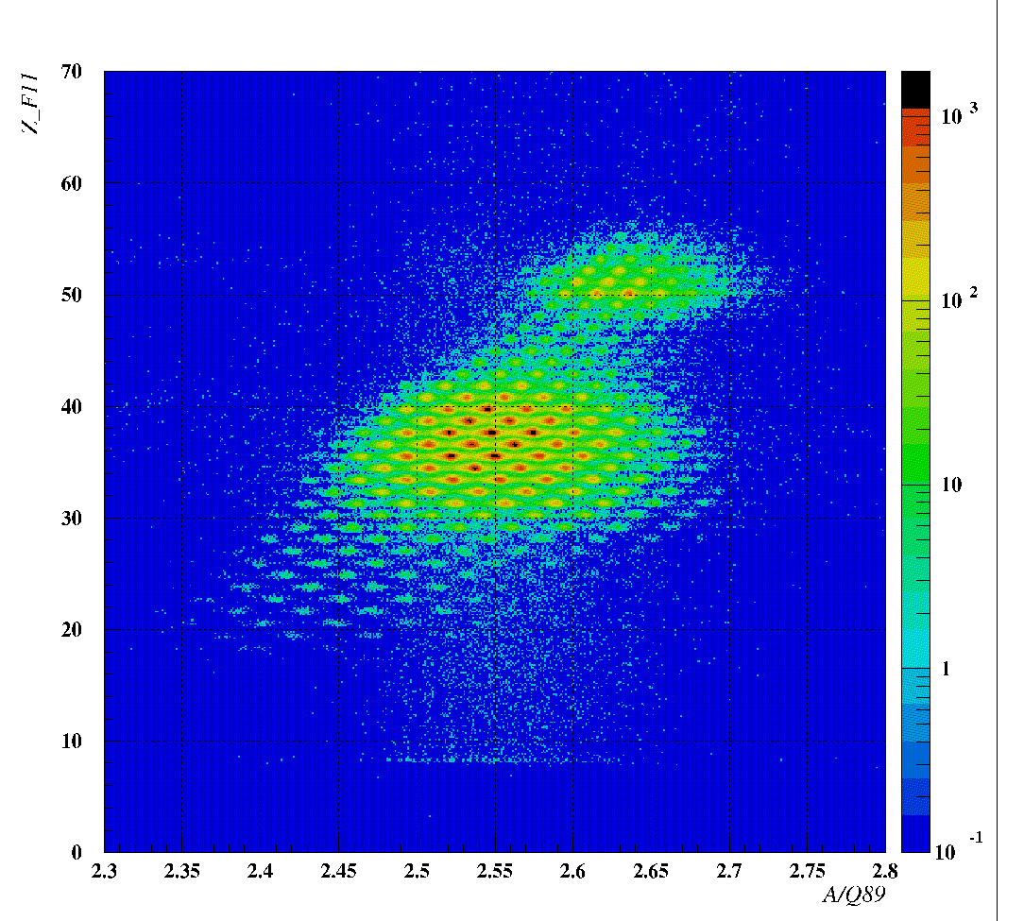
ZeroDegree Commissioning, Nov., 2008
U86+ 345A MeV+ Pb 1.5mm, Bρ01=7.395 Tm, No degrader
BigRIPS standard + ZDS Large Acceptance
Z
A/Q

Slide 14
Phase-I programs at BigRIPS/ZeroDegree 2007~
Rare-Isotope Physics Programs
Fast RI beam production to search for new isotopes
Global survey to search for anomalous regions
Specific programs with deuteron beams
BigRIPS in-flight production of fast rare-isotope beams
Ground state properties and low lying excited states
via decay spectroscopy / transmission method:
particle stability, T_{1/2}, Q_{β}, σ_{R}, Ex.(2⁺)...
Deeply bound pionic states via (d, ³He) at 500 MeV
Three-body force via pol. d+p elastic scattering at 700 MeV
ZeroDegree multi-function beam line for inclusive/semi-inclusive measurements
production of 3rd RI beams
Collectivity and matter distribution
via in-beam gamma / missing mass spectroscopy
One step energy regime 200~300 A MeV
B(E2), B(M1), (p,p), (p,p’), Ex....
Iso-diffusion

Slide 15
in-beam gamma spectroscopy
missing mass spectroscopy
Phase-I layout
β-spectroscopy
total interaction cross sections
(d,³He)
Pol.d+p
ZeroDegree Spectrometer
Experimental set-ups
ZDS: Zero-Degree forward Spectrometer

Slide 16
Summary of Achievements at BigRIPS/ZDS since 2007
2007
Feb. 1st PAC -> Day-One Working Group (Aoi)
to discuss Day-One programs
March First BigRIPS Commissioning with a Kr-86 beam
May BigRIPS Commissioning with a U-238 beam (0.02pnA)
Search for New Isotopes : two new isotopes Pd-125, 126
June BigRIPS Commissioning with a U-238 beam
Sept. 2nd PAC
2008
Feb. 3rd PAC
Nov. ZDS Commissioning with a U-238 beam (0.3pnA)
Search for New Isotopes : more than 20 new isotopes, new isomers
4th PAC
Dec. Day-One Experiments at BigRIPS/ZDS with a Ca-48 beam

Slide 17
DayOne Experiments with a 345 MeV/u Ca-48 Beam
N. Aoi et al.
Four proposed-experiments were combined to form “one” collaboration.
Search for Halo Nuclei: C-22, Ne-31...
In-beam gamma spectroscopy for island of inversion and beyond: Ne-32 etc.
Programs were managed Not proposal-by-proposal but RIB-by-RIB based
to save RIB tuning time and man-powers
to have the best programs according to the beam intensity and
secondary beam intensities (production cross sections)
Max primary beam intensity 175 pnA
Secondary beam intensities are one order of magnitude higher than expected.
Intensities/100pnA: ²²C 10 cps; ³⁰Ne 300 cps; ³¹Ne 10 cps; ³²Ne 5 cps; ⁴²Si 15 cps
Production cross sections at 345 MeV/u are by a factor of 10 larger than at ~70MeV/u(RIPS)
Total interaction cross sections : Ne-29~32, Na-30~34
Coulomb breakup cross sections : C-19, C-22, Ne-31
In-beam gamma spectroscopy : Ne-32

Slide 18
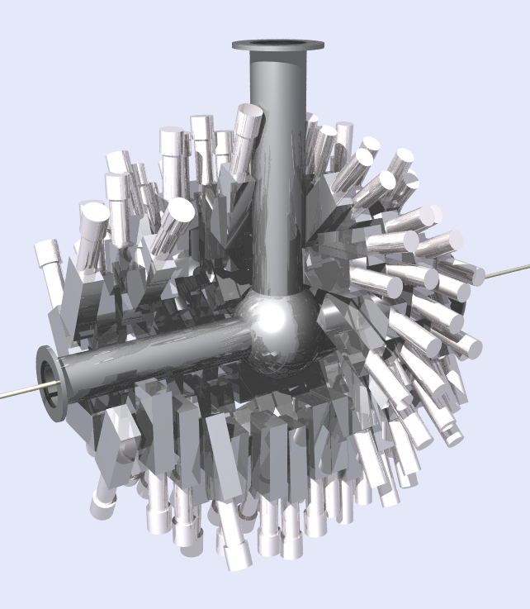
Setup
In-beam gamma spectroscopy
Coulomb breakup
BigRIPS+ZDS
DALI-II
NaI-based gamma Detectors
target
target
total interaction cross sections
at BigRIPS 2nd-stage
ZeroDegree Spectrometer
Experimental set-ups
ZDS: Zero-Degree forward Spectrometer

Slide 19
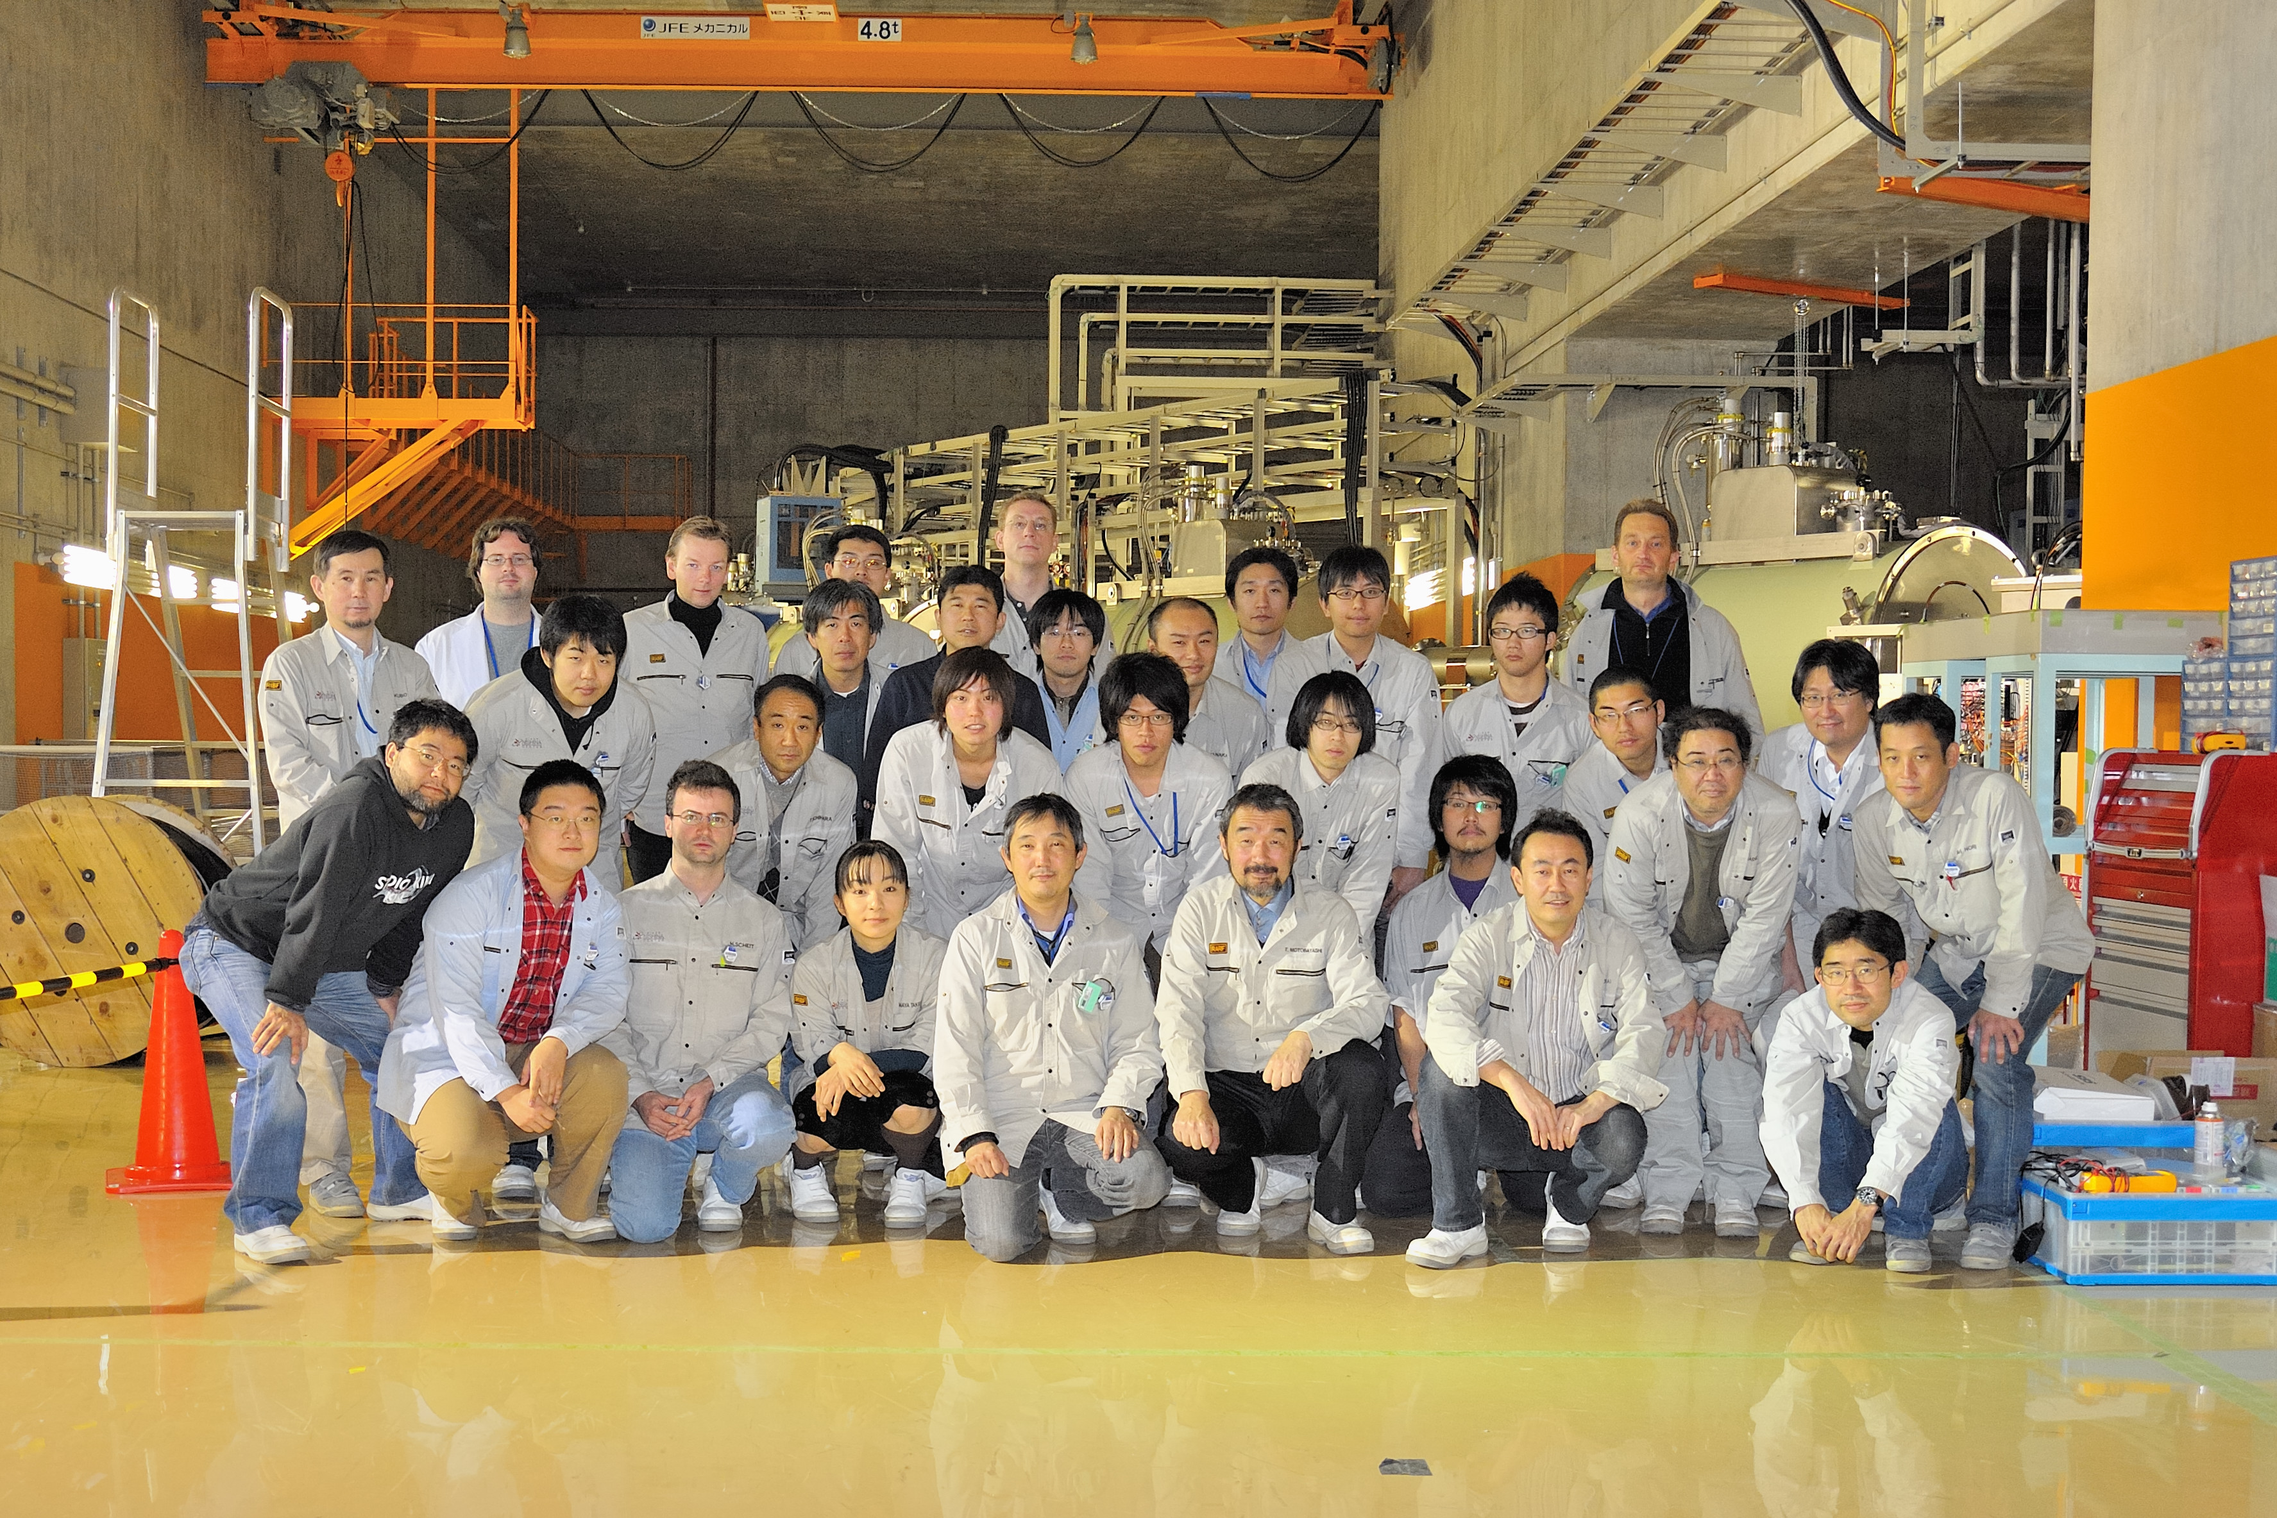
DayOne experiments
12/09/2008 -09:00—12/21 03:00
T. Ohtsubo, S. Takeuchi, H. Scheit, T. Nakamura,
N. Aoi, H. Baba, D. Bazin, S. Deguchi, P. Doornenbal, D. Fang, M. Fukuda, N. Fukuda, H. Geissel,
R. Gernhaeuser, J. Gibelin, Y. Hara, Y. Hashidume, C. Hinke, N. Imai, N. Inabe, S. Ishimoto, K. Itahashi,
S. Itoh, N. Iwasa, T. Izumikawa, D. Kameda, S. Kanno, Y. Kawada, N. Kobayashi, T. Kobayashi,
Y. Kondo, T. Kroell, R. Kruecken, T. Kubo, T. Kuboki, K. Kusaka, M. Lantz, K. Li, P. Maierbeck,
R. Matsumiya, K. Matsuta, S. Michimasa, M. Mihara, Y. Miyashita, S. Momota, T. Moriguchi,
T. Motobayashi, S. Nakajima, T. Nakao, Y. Nakayama, D. Nishimura, S. Nishimura, Y. Ohkuma,
T. Ohnishi, M. Ohtake, N. Orr, H. Otsu, A. Ozawa, H. Sakurai, Y. Satou, T. Shimamura, Y. Shimbara,
S. Shimoura, T. Suda, T. Sumikama, S. Suzuki, T. Suzuki, H. Suzuki, M. Takechi, H. Takeda,
E. Takeshita, N. Tanaka, K. Tanaka, K. Tanaka, Y. Togano, H. Wang, R. Watanabe, Y. Watanabe,
M. Winkler, T. Yamaguchi, Y. Yanagisawa, K. Yoneda, A. Yoshida, K. Yoshida, K. Yoshinaga

Slide 20
Year 2009-2010 Plan
A/Q~2 beams with Z<=8 before summer
Bypass beam line to skip IRC for AVF-RRC-SRC mode
SHARAQ Commissioning with a N-14 beam
Polarized deuteron beam : 3NF ...
Toward more intense beams
A new 18GHz ECRIS for RILAC will be installed in March, 2009
increase of the U beam by a factor of 10
Zn, Xe beam commissioning
R&D efforts for charge strippers
Experimental programs with Ca, U, Xe, Ne in fall-to-winter, 2009-2010
in-beam gamma, decay and missing mass spectroscopy

Slide 21
International network and collaboration
Establishment of International Collaboration Framework
LIA (France), China, EMMI (Germany), JUSTIPEN (USA)
In near future, JUSEIPEN(USA), TRIUMF
The State-of-Art Collaboration between Facility and Detector
RIBF + MUST-2 (one proposal approved at PAC,
more for a MUST-2 campaign)
+ GRETA, AGATA (under discussion)
+ …

Slide 22
Phase-II construction 2007-2012
To maximize the potentials of intense RI beams available at RIBF
http://rarfaxp.riken.go.jp/RIBF-TAC05/
SAMURAI - large acceptance
Kobayashi et al. in 2011
SCRIT - e-RI collision
Wakasugi, Suda et al.
Rare RI Ring – mass
Ozawa et al.
SHARAQ - high resolution
Sakai et al.
SLOWRI- slow beams
Wada et al.
in 2009
RI Spin Lab. at RIPS –pol. RI beam Ueno et al.

Slide 23
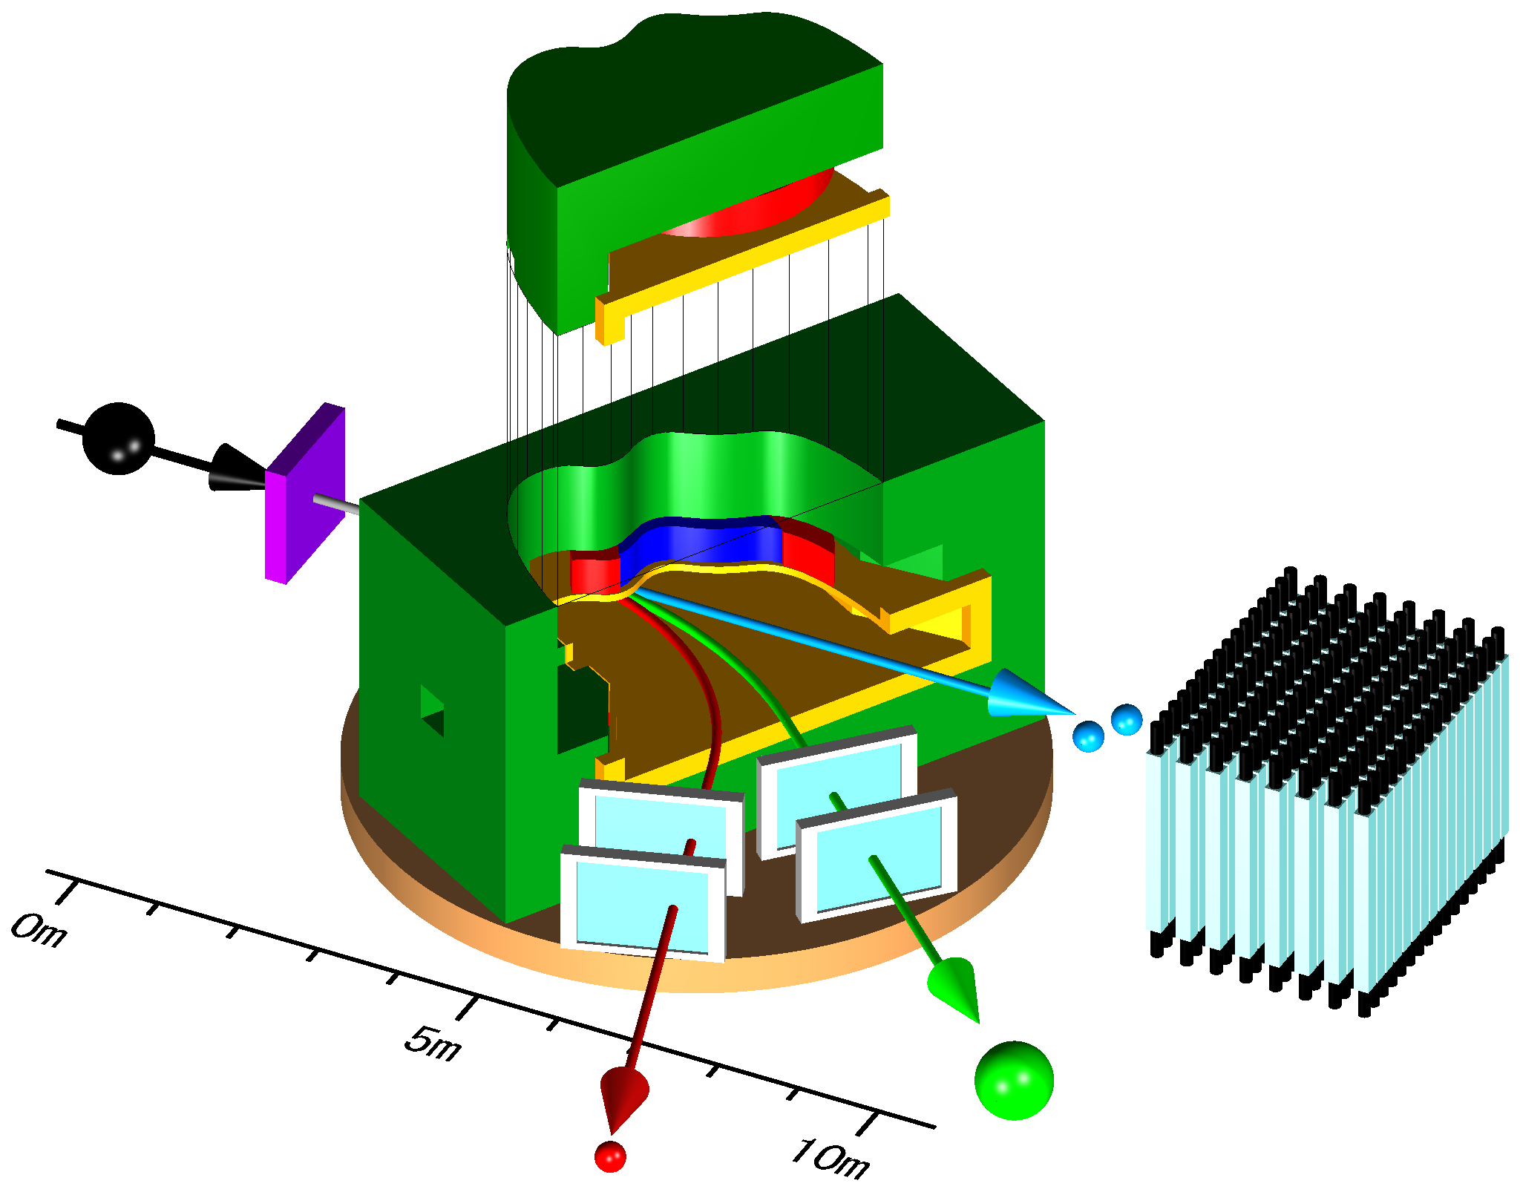
SAMURAI Spectrometer Kobayashi et al 2011-
versatile spectrometer with a large superconducting magnet
a large acceptance
exclusive measurements
neutron measurements
80cm gap, BL~ 7Tm, Bmax=3T
PID limited to A~100
Invariant/missing mass spectroscopy
giant resonances
single particle states via (p,2p) etc
EOS in asymmetric nuclear matter : SAMURAI-TPC
Particle correlations in a few-body system 3NF
Coulomb breakup for radiative capture c.s. (p,γ), (n,γ)
Fission study

Slide 24
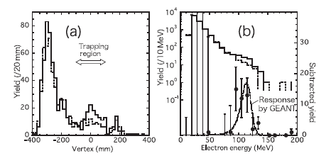
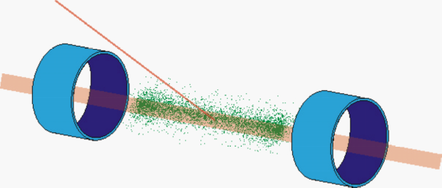
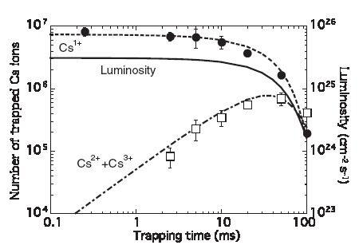
SCRIT Wakasugi et al.
Self-confining Radioactive Ion Target system
realized in an electron-ring for e-RI scattering
Charge form factor measurement
L>10²⁶ /cm²/s for 1 week
->10⁵ pps injection
Feasibility test at KSR, Kyoto-Univ.
Scattered electron
SCRIT
ebeam
RIs trapped by the electron beam
Wakasugi et al., PRL 100, 164801(2008)
Luminosity achieved at KSR, Kyoto Univ.
L=2.4x10²⁵ cm⁻²s⁻¹
7x10⁶ trapped ions during 85ms at 80mA current
SCRIT project in RIKEN
L > 10²⁷ cm⁻²s⁻¹ 80mA(KSR) -> 300mA (New e-Ring)
Photo-fission based ISOL for RI production

Slide 25
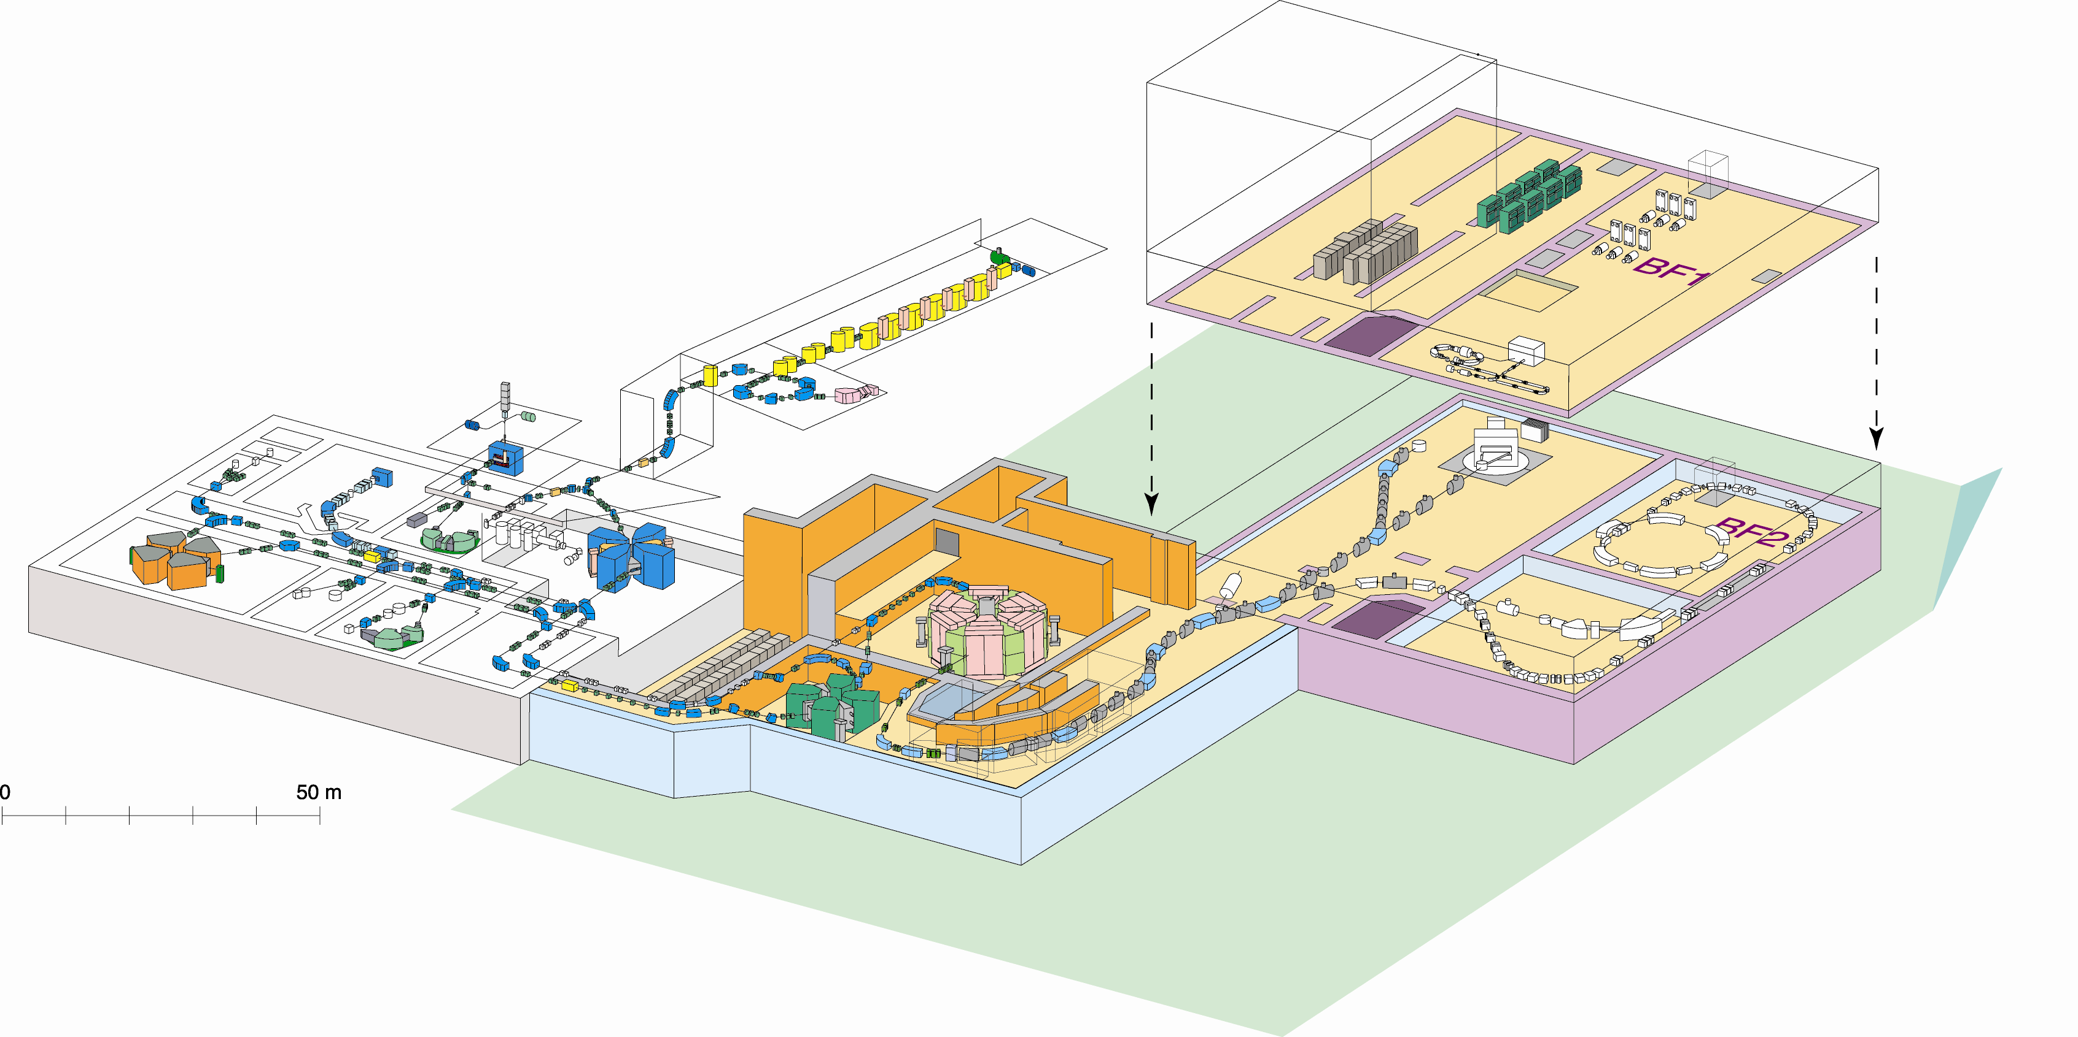
Budget Status and Construction Plan
Approved in FY08
Operation for 5months
Facility Construction
SAMURAI (15M$ for FY08-11
magnet, detectors)
SHARAQ (high resolution)
BT line (2M$ for FY08)
Approved for FY09
Operation for 5months+3days
Construction budget 15M$ for
SCRIT (e-RI)
a new linac-injector
FY10 and later
More operation budget
Other facilities : RI-ring, SLOWRI
SCRIT
ZeroDegree
SAMURAI
SLOWRI
RI-ring
SHARAQ

Slide 26
Summary
Accelerator
Intensity of ²³⁸U is 10 times higher than in last year.
Beam power of ⁴⁸Ca is the world highest.
18GHz ECRIS development completed in this March
In 2009, ~3 pnA for U-238
A new linac injector is being constructed: A few 10 pnA of U in 2010
BigRIPS/ZDS
In 2007, two new isotopes of ^{125,126}Pd; in 2008, more than 20.
ZDS commissioned
Status of new facilities
SHARAQ in March, 2009
SAMURAI will be completed in 2011.
E-ring for SCRIT will be completed in 2010
Experiments
2008, ²³⁸U beam (~0.3pnA), ⁴⁸Ca beam (~100pnA)
2009, 3pnA U, and 400pnA Ca for spectroscopy
PAC
June and December in 2009
http://www.nishina.riken.jp

Slide 28
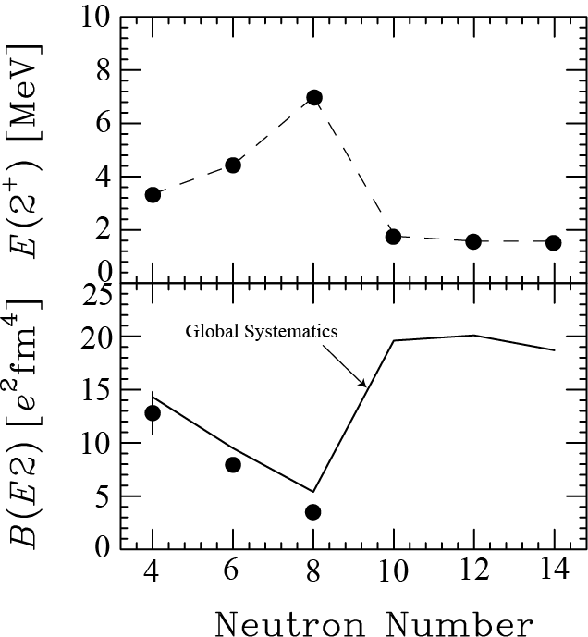

Small B(E2) values of ^{16,18}C
Ong et al. PRC 78 (08)014308
Recoil-shadow-method
based on NaI
C-16
Re-visit at RIKEN
t=18+/-2+/-5 psec
Recoil-Distance-Method
Wiedeking PRL100(2008)152501
t=12 +/-2 psec
S. Raman et al, ADNDT 78,1(2001)
significant discrepancy
from
Raman’s systematics

Slide 29
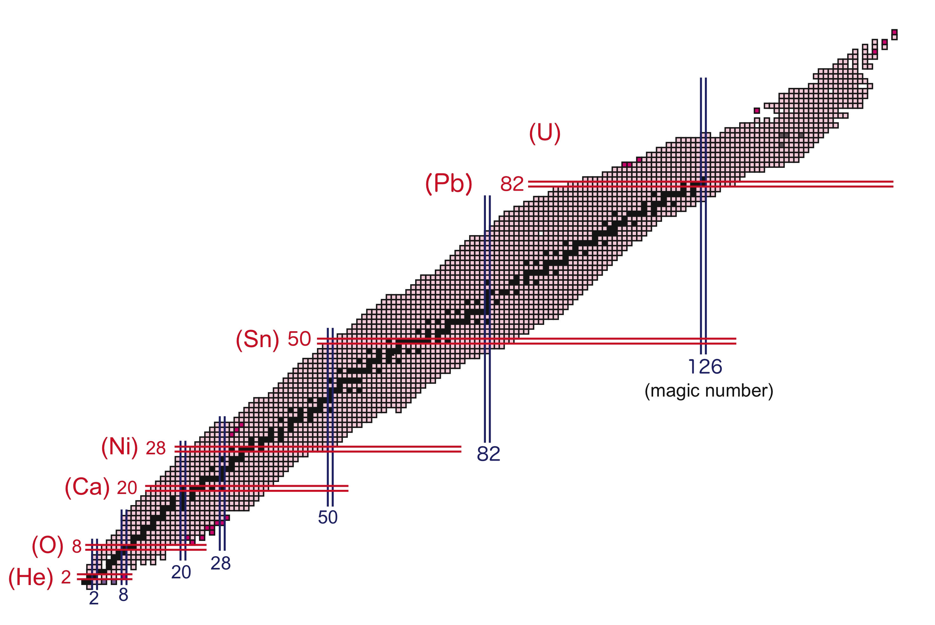
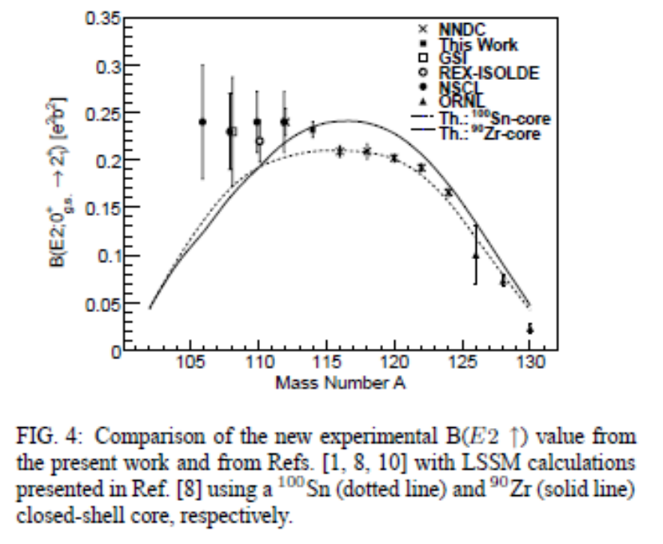
p-n pairing interaction for N=Z nuclei
Z<20 T=0 S=1 pairing ？
Z>20 T=1 S=0 pairing ？
Z~50 α dominance ？
N=50
N=82

Slide 30
Flag ship regions at neutron-rich side
²³⁸U beam
New isotopes between Z=20 to 60
Maaaany new ones !!
R-process path
T1/2 at A>80
Magicity loss at ⁷⁸Ni ??
T1/2, B(E2), Ex(2+), ...
Magicity at N=82 ??
B(E2), Ex(2+), ...
Deformation at A~110 ??
collective states
⁴⁸Ca beam
Neutron drip-line for F-to-Mg isotopes?
Particle stability ³³F, ³⁶Ne, ³⁹Na, ⁴²Mg
p-wave halo ? : ³¹Ne ...
Island of inversion : deformation center at N=22?
B(E2) for ³⁰Ne and ³⁶Mg, etc.
Possible deformation at N=28?
B(E2) and Ex(2+) for ⁴²Si, ³⁸Mg, etc.
Oxygen beyond N=16
Ground and excited states for ^{25, 26}O

Slide 31
ZeroDegree spectrometer : multi-function beam-line
- RI-beam delivery line has been designed to work as spectrometer, in order to be used for studies of secondary reactions of exotic nuclei via inclusive/semi-exclusive measurements, such as in-beam gamma spectroscopy.
The same quadrupoles and dipoles as those of BigRIPS.
- Two-bend anti-mirror symmetric system
T. Kubo et al.
(1)Achromatic large acceptance mode
total flight path length ~ 36m
angular acceptance
Δθ =+/- 45mrad, Δφ=+/- 30mrad
cf. 250A MeV neutron-rich beams
grazing angle
~ 20 mrad for Pb targets
momentum acceptance
Δp/p =+/- 3%
momentum resolution
(x,p)/(x,x) = 1240
maximum magnetic rigidity 7.3 Tm
5 sigma separation in A at A=200
ZeroDegree
Secondary target surrounded by γ-ray detector array
Missing mass detectors etc.

Slide 32

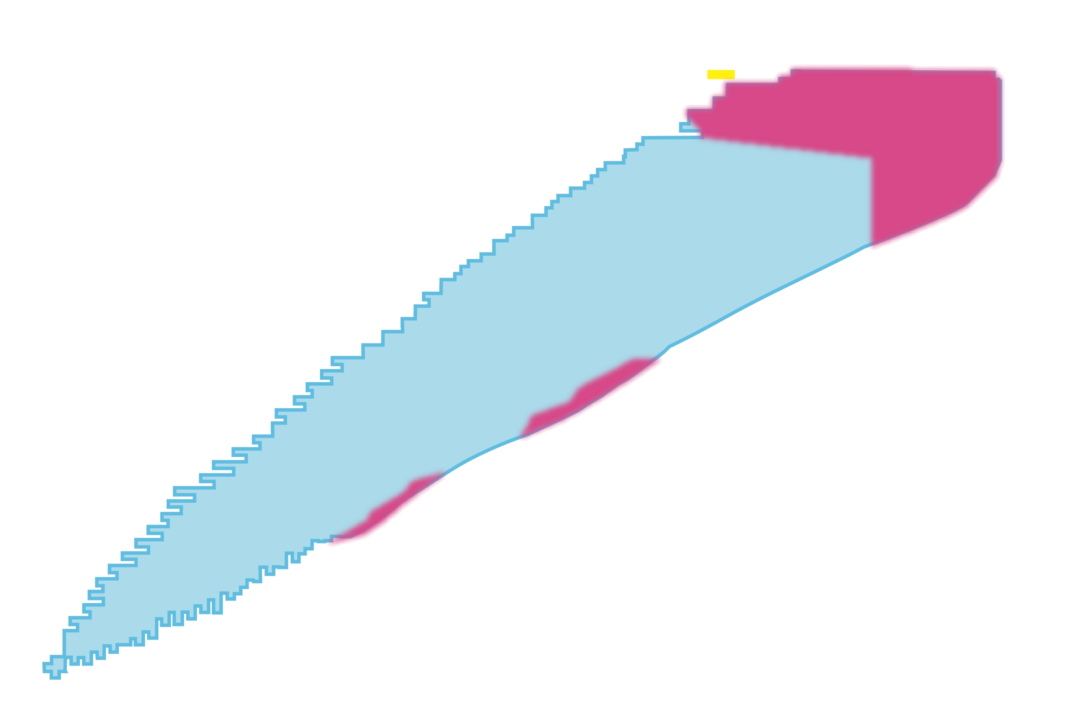
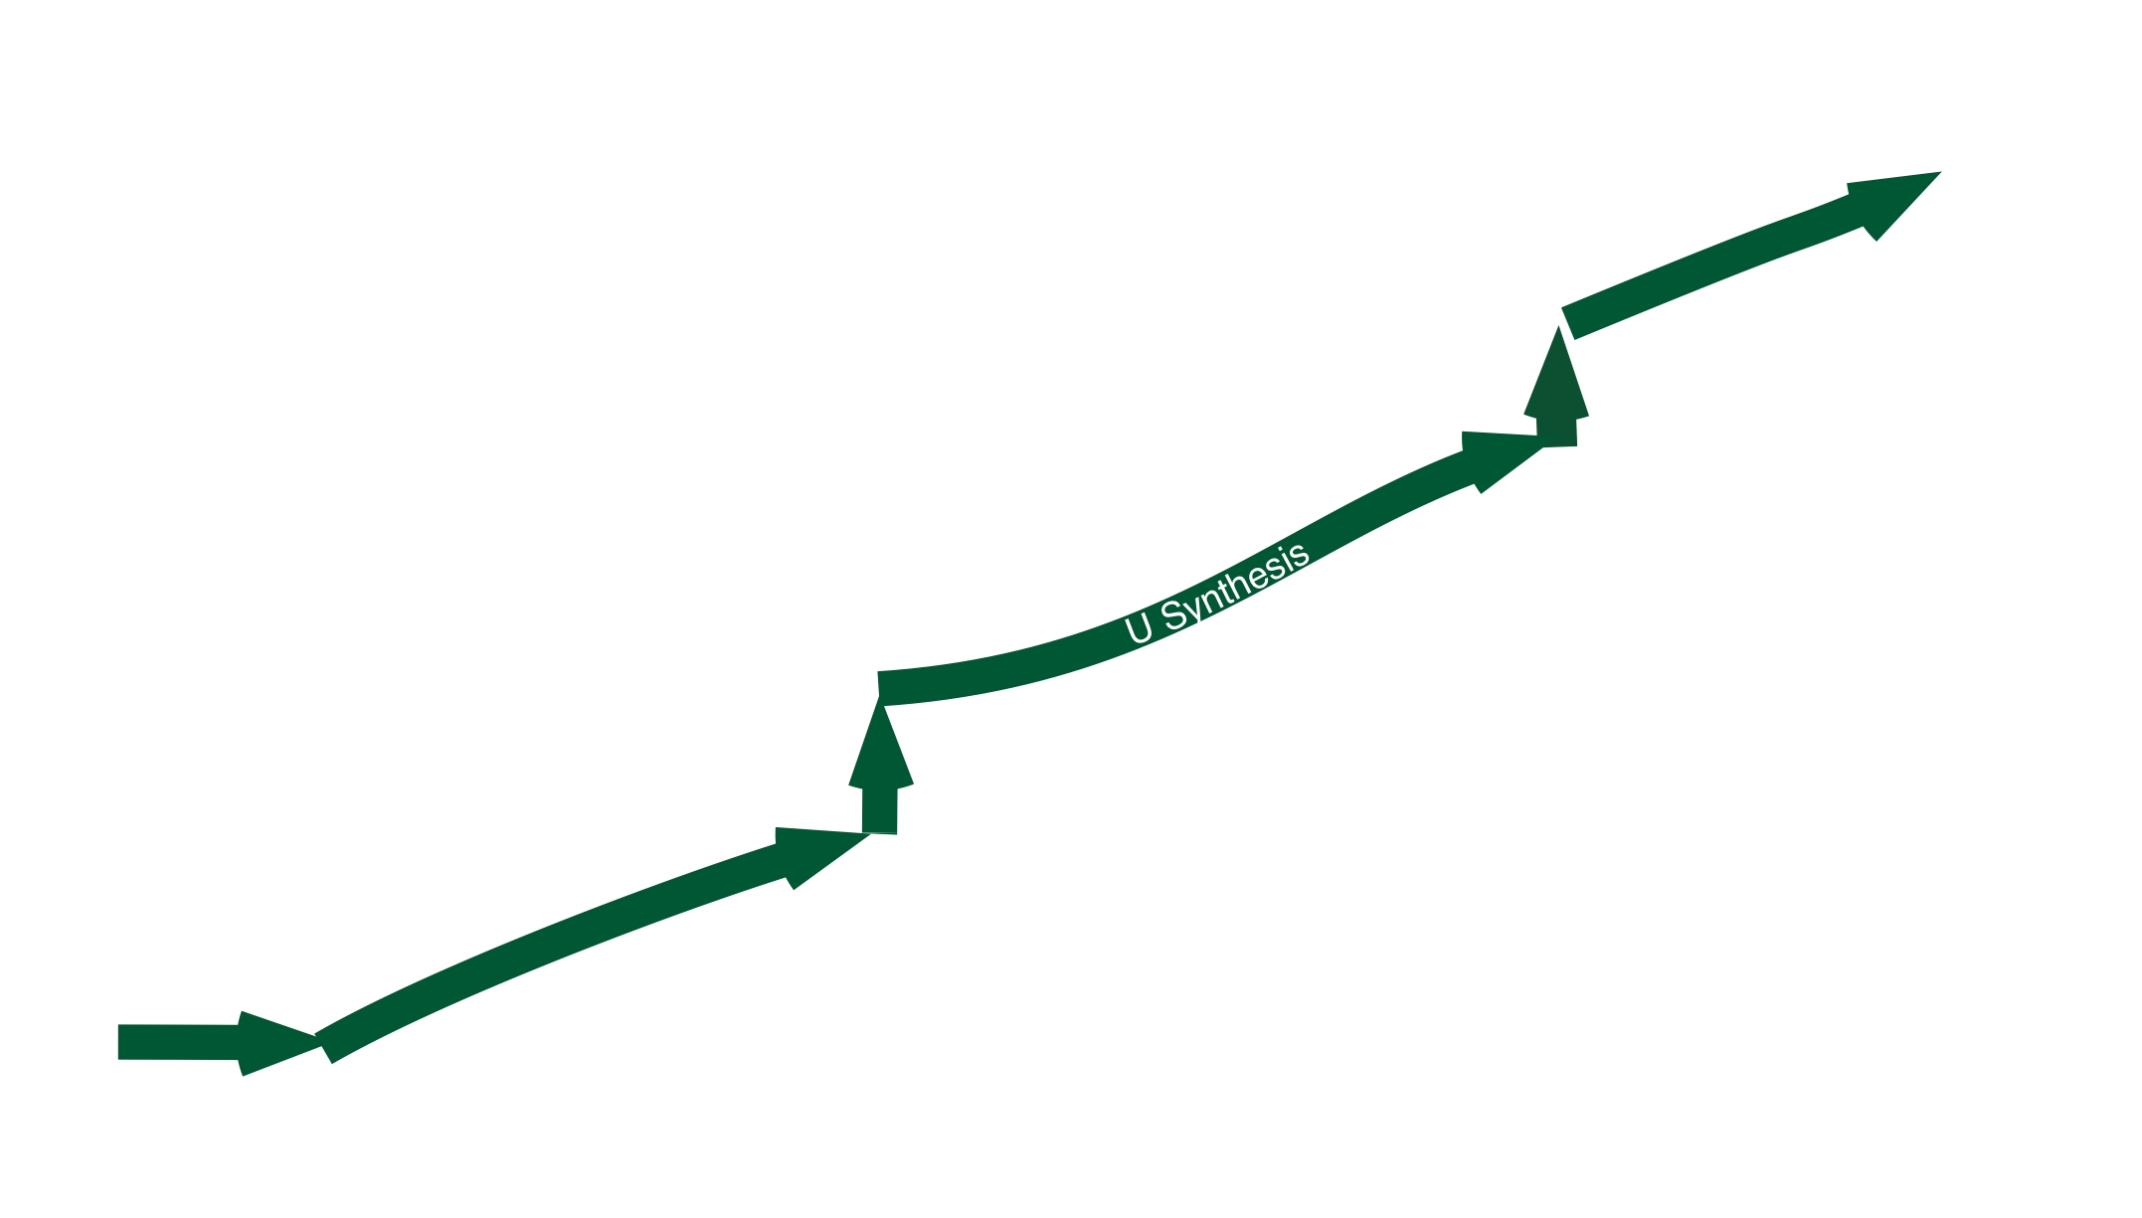
Great expansion of nuclear world by RIBF
Intensity > 1 particle/day
(EPAX@GSI)
Exploration of the Limit of Existence
New Element
²⁷⁸113
04 July 23 18:55
57 fb
protons
Projectile Fragmentation
In-flight U fission & P.F.
⁷⁸Ni ~0.1 particles/sec. (2007)
by 10pnA 350 MeV/u U-beam
10 particles/sec. (goal)
by 1pμA
neutrons

Slide 33
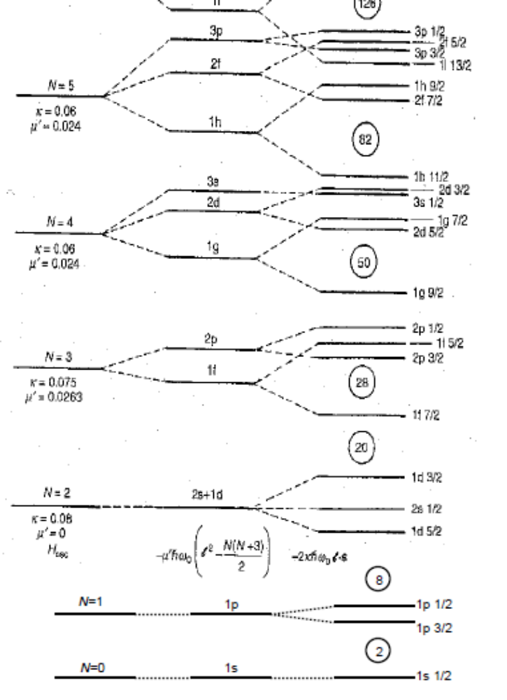
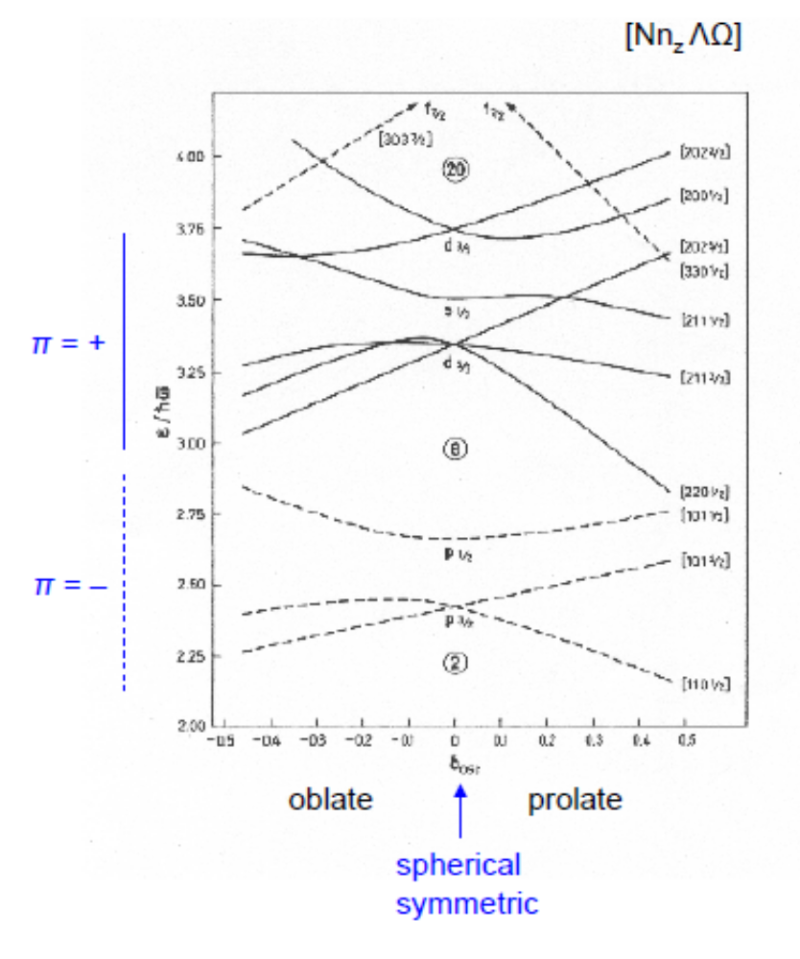

Slide 34
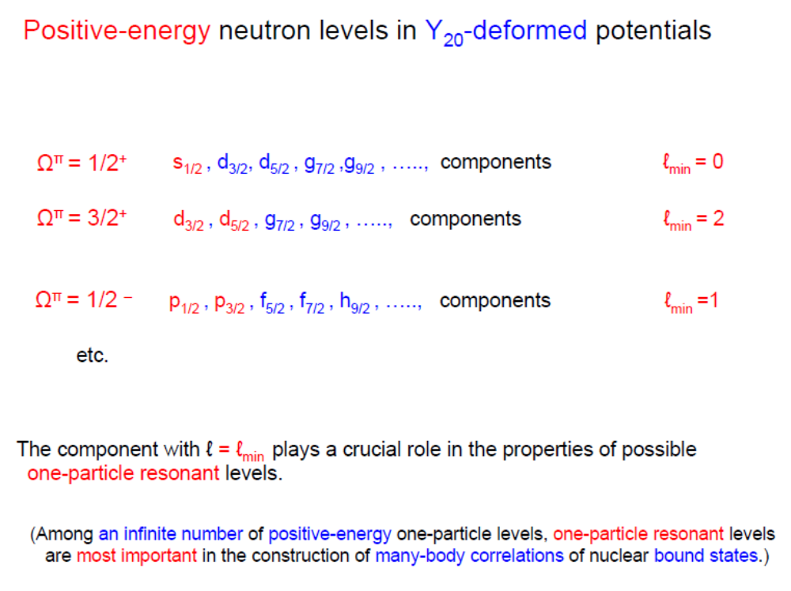
Hamamoto

Slide 35
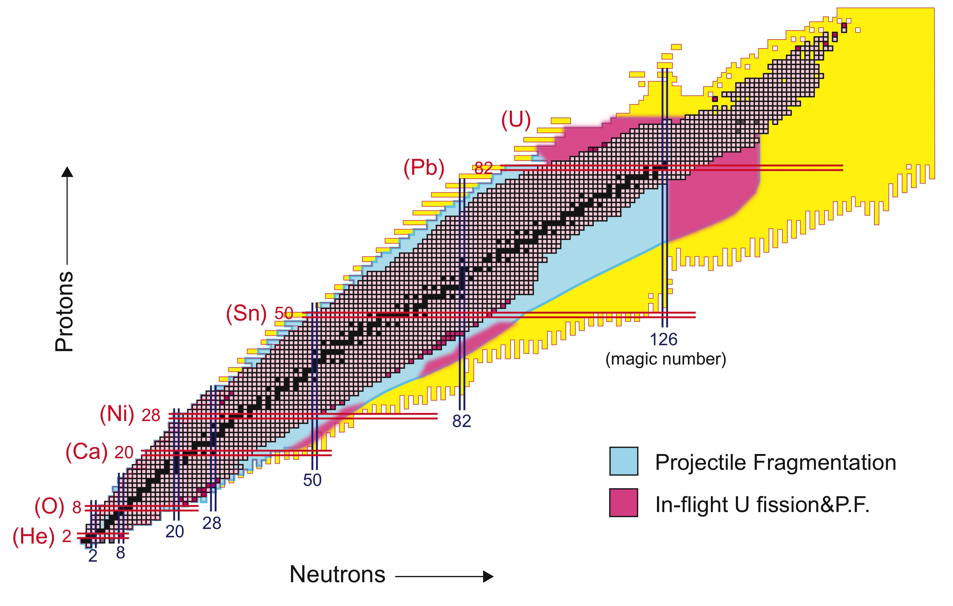
23 New Isotopes
Nov. 2008 run

Slide 36
Year 2009 Plan
A/Q~2 beams with Z<=8 before summer
Bypass beam line to skip IRC for AVF-RRC-SRC mode
SHARAQ Commissioning in March
Experimental programs with deuteron beams and light ion beams
Toward more intense beams
A new 28GHz ECRIS for RILAC will be installed in March, 2009
increase of the U beam by a factor of 10
Xe beam commissioning at 345MeV/u
R&D efforts for charge strippers
Experimental programs with Ca, Kr, Xe and U

Slide 37
Achievements and Commissioning in 2008
At the beginning of 2008
A problem of carry-over oil in the liq. He refrigerators of
the SRC and BigRIPS cryogenic system
Feb.-Sept. to clean up the system and to install additional oil-filters
May-June
Accelerator Commissioning up to IRC, by additional installation of
beam diagnostic monitors
⁴⁸Ca, 114 MeV/u and 270 pnA
²³⁸U, 114 MeV/u and 0.35 pnA (max)
(10 times higher than in 2007)
Test of charge stripper at exit of RILAC with a Xe beam
November, ²³⁸U beam at 345 MeV/u and ~0.3 pnA (max)!!!!!
ZeroDegree Commissioning + Search for New Isotopes
December, ⁴⁸Ca beam at 345 MeV/u and >100 pnA
Search for Halo Nuclei
In-beam gamma spectroscopy for island of inversion and beyond

Slide 38
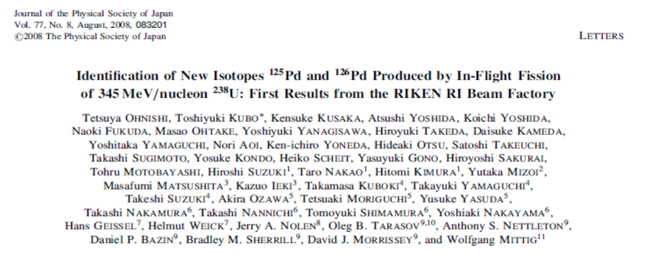
RIKEN, U. Tokyo, Osaka ECU, Rikkyo U., Saitama U, Tsukuba U., TITech
GSI, ANL, NSCL, JINR, GANIL

Slide 39
Achievements and Commissioning Runs in 2007
March, 2007
12th ⁸⁶Kr³¹⁺ beam at 345 MeV/u several pnA.
13th First Production of RI beams with ⁸⁶Kr beam
23rd ²³⁸U⁸⁶⁺ beam at 345 MeV/u 0.002pnA
27th First production of RI beams with ²³⁸U beam
May 16th-June 3rd with ²³⁸U beam at 345 MeV/u and ~0.03 pnA max
Optics with primary beam and secondary beam
Reconstruction, Detector performances, etc
Rough yield measurements w/ Be and Pb targets
Search for New Isotopes (Kubo et al) (5days)
June 29th-July 2nd, with ²³⁸U beam
Detector tests (IC, NaI), etc
Yield survey for ⁸⁰Zn, ¹³⁰Cd, etc

Slide 40
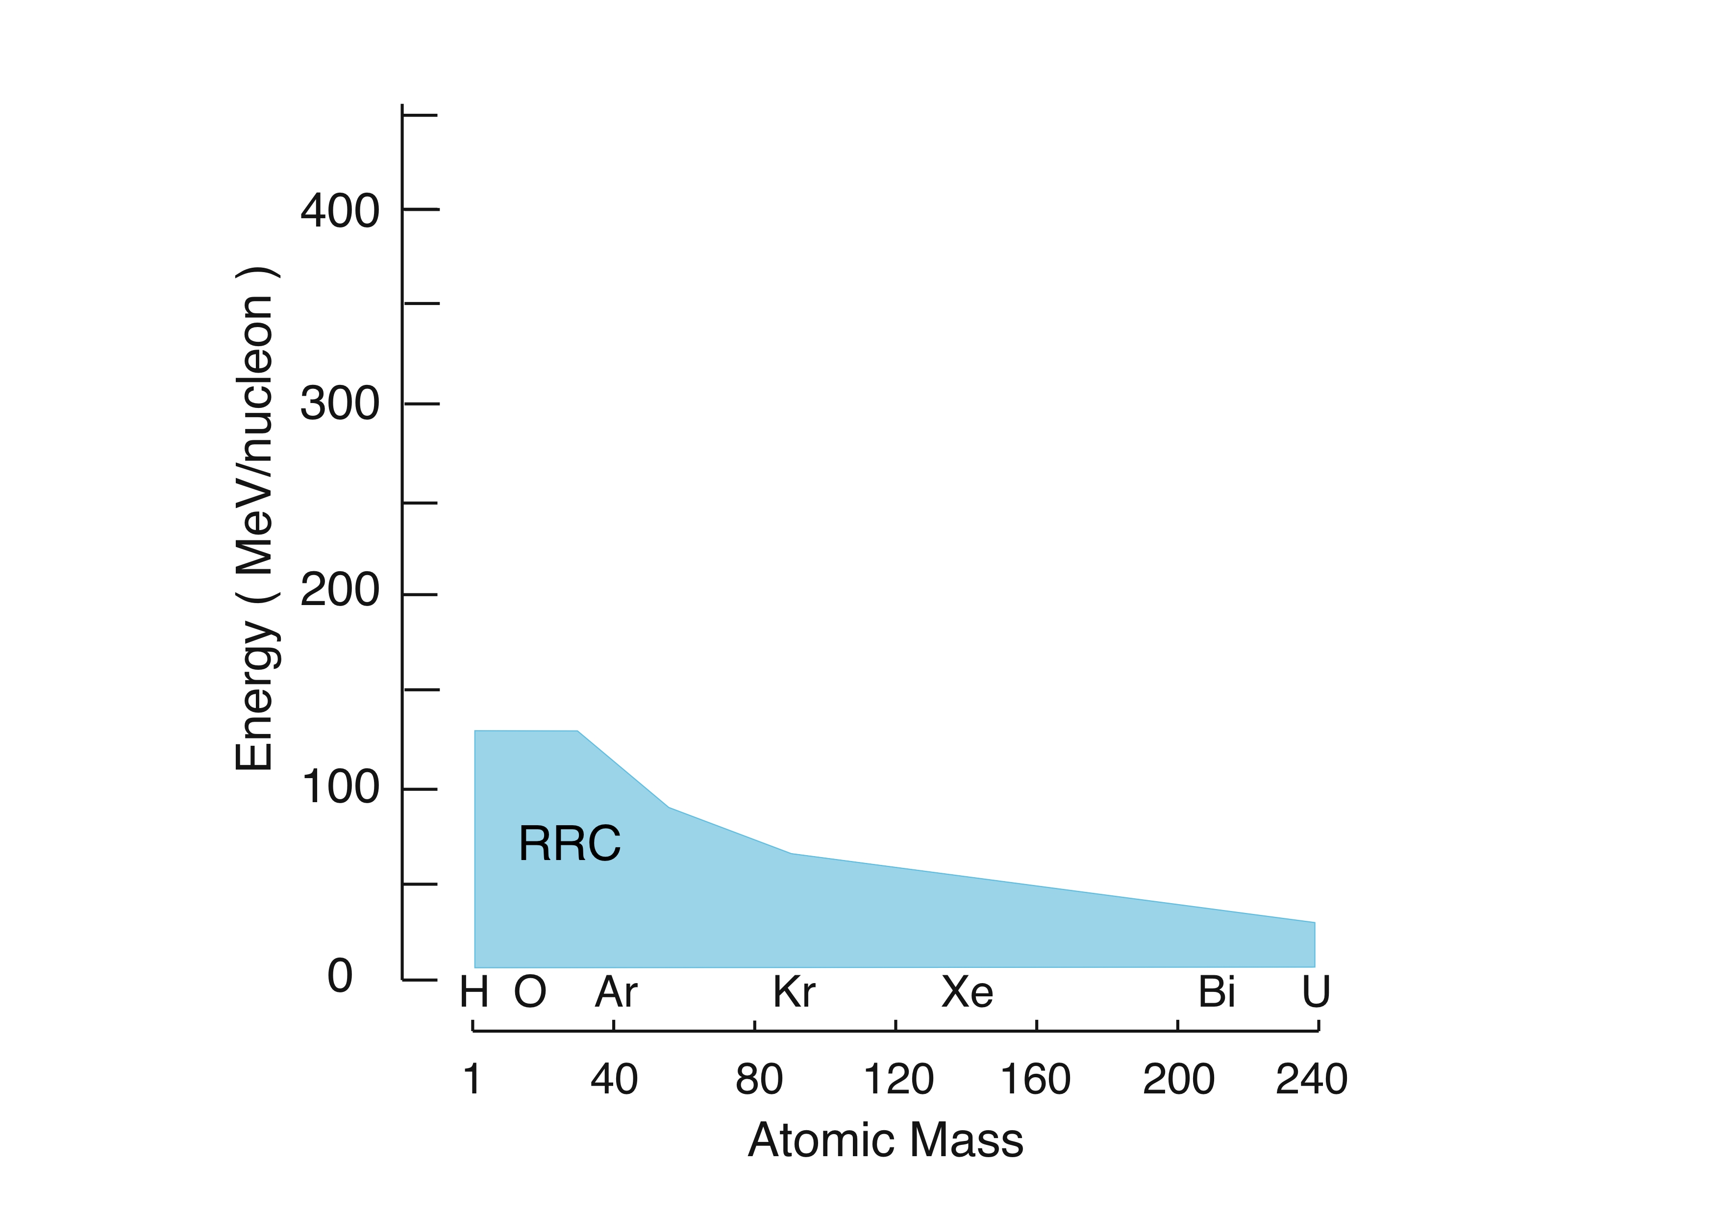
RIBF
Acceleration performance
Performance of RIKEN Accelerator Complex
AVF AVF+RRC+SRC for m/q=2 inc. pol. d
With fRC (SRC)
350 MeV/u
U⁸⁸⁺+ (8Tm)
SRC
I = 1 pμΑ (goal)
With fRC (IRC)
IRC

Slide 41
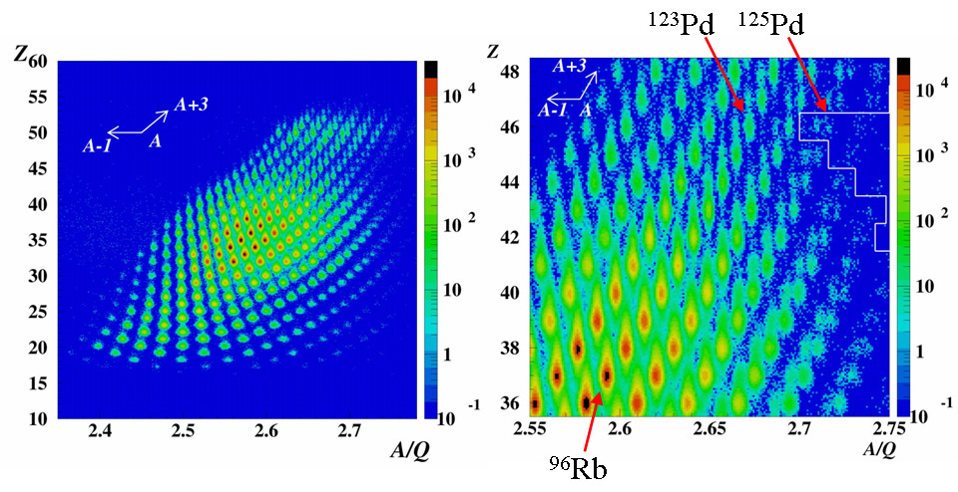
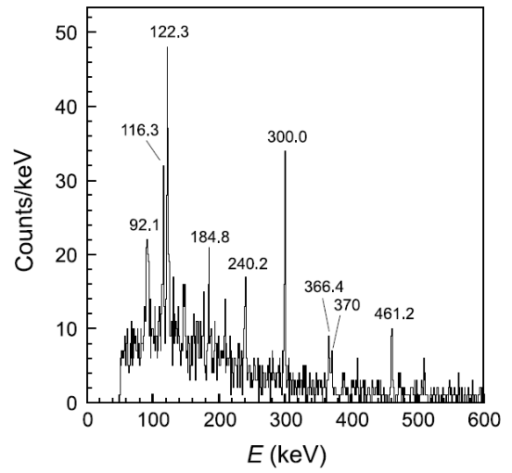
New isotopes of ^{125, 126}Pd
T. Onishi et al, JPSJ 77 (08)083201.
Bρ: 7.438 Tm, ΔP/P=2%
²³⁸U + Be(7mm) at 345 MeV/u
Isomer ⁹⁶Rb
2007 MAY-JUNE
Total dose: 3.6×10¹²

Slide 42
Basic parameters of BigRIPS
T. Kubo et al.
Configuration Two-stage separator
First stage Two bends
Second stage Four bends
Energy degrader Achromatic wedge
Quadrupoles Superconducting
Angular acceptance
Horizontal 80 mr
Vertical 100 mr
Momentum acceptance 6 %
Max. magnetic rigidity 9 Tm
Total length 77 m
Momentum dispersion*
First stage -2.31 m
Second stage 3.3 m
Momentum resolution**(1st order)
First stage 1290
Second stage*** 3300
In-flight fission of ²³⁸U at 350 MeV/u
~ 100 mr
~ 10 %
* At the mid-focus of the stage.
** Those in the case when a 1 mm beam spot is assumed.

Slide 43
Specifications of optical modes
(I) Achromatic: Large acceptance mode
Maximum magnetic rigidity = 7.3 Tm
Angular acceptance Horizontal = +/-45 mrad, Vertical = +/-30 mard
Momentum acceptance = +/-3 %
Momentum dispersion = 2.24 cm/%
Momentum resolution = (X,P)/(X,X) =1240
(II) Achromatic: High resolution mode
Maximum magnetic rigidity = 9.0 Tm
Angular acceptance Horizontal = +/-20 mrad, Vertical = +/-30 mard
Momentum acceptance = +/-3 %
Momentum dispersion = 2.12 cm/%
Momentum resolution = (X,P)/(X,X) = 2120
(III) Dispersive spectrometer mode
Maximum magnetic rigidity = 9.0 Tm
Angular acceptance Horizontal = +/-20 mrad, Vertical = +/-30 mard
Momentum acceptance = +/-2 %
Momentum dispersion = 4.13 cm/%
Momentum resolution = (X,P)/(X,X) = 4130
(IV) Transmission mode

Slide 44
Flag ship regions at neutron-rich side
²³⁸U beam
New isotopes between Z=20 to 60
Maaaany new ones !!
R-process path
T1/2 at A>80
New magicity at ⁵⁴Ca ??
B(E2), Ex(2+), ...
Magicity loss at ⁷⁸Ni ??
T1/2, B(E2), Ex(2+), ...
Magicity at N=82 ??
B(E2), Ex(2+), ...
Deformation at A~110 ??
collective states
⁴⁸Ca beam
Neutron drip-line for F-to-Mg isotopes?
Particle stability ³³F, ³⁶Ne, ³⁹Na, ⁴²Mg
p-wave halo ? : ³¹Ne ...
Island of inversion : deformation center at N=22?
B(E2) for ³⁰Ne and ³⁶Mg, etc.
Possible deformation at N=28?
B(E2) and Ex(2+) for ⁴²Si, ³⁸Mg, etc.
Oxygen beyond N=16
Ground and excited states for ^{24,25, 26}O

Slide 45
Flag ship regions at proton-rich side
¹²⁴Xe beam
⁷⁸Kr beam
New isotopes, Proton-drip line ?
Double magicity at ¹⁰⁰Sn ?
2p decay
rp- process

Slide 46
R&D: Detectors/Targets for Phase-I programs
Particle identification and beam monitoring at high rate
Gas counters with high rate capability at ~10⁶ /sec
delay-line PPAC and MUSIC
Targets
Liquid hydrogen/helium targets for in-beam gamma and invariant mass
thickness 100-250 mg/cm²
Window-less solid hydrogen target for missing mass (p,p), (p,p’)
thickness 3mm -> 1mm (goal)
Polarized proton target
Gamma detectors for fast RI beams (v/c ~ 0.6)
DALI-2 NaI-based ball 19% eff. for 1MeV gamma, 12% resolution
GRAPE Ge-based ball 3% eff. for 1MeV gamma, 1.5% resolution
beta-spectroscopy
Cylindrical active implantation target dedicated to half-life measurements
Double-sided silicon strip detectors as active implantations
missing mass spectroscopy
Recoiled-out proton detectors for proton elastic scattering
Spectrometer for recoiled-out protons emitted at 0 degree

Slide 47
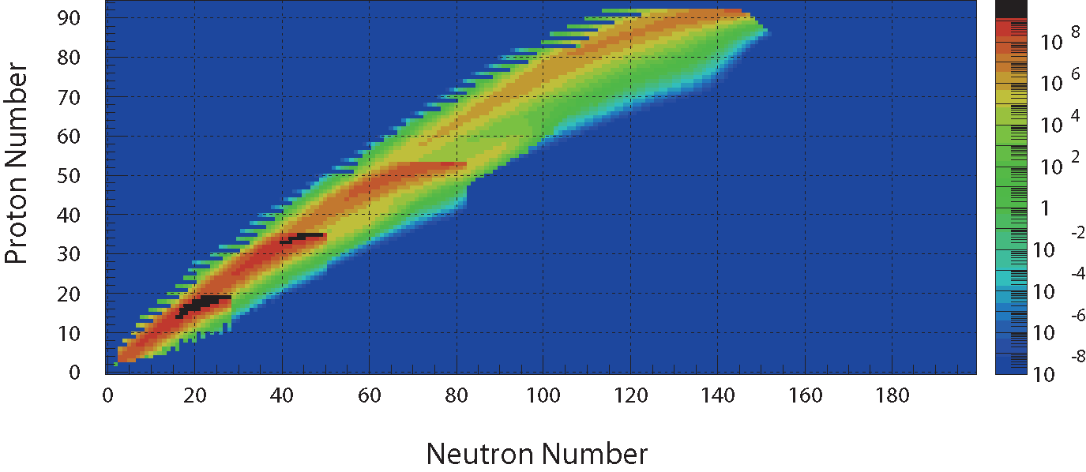
RI beam intensities at BigRIPS for first two years 2008-2009
http://www.nishina.riken.jp/UsersGuide/BigRIPS/intensity.html
Primary beam energy 350AMeV
⁴⁸Ca (200pnA), ⁸⁶Kr (100pnA),¹³⁶Xe (10pnA), ²³⁸U(2pnA)
Secondary beam energy ~250A MeV
Cross sections Fragmentation EPAX-II
Fission GSI-data (U+Be), ABRABLA (Coulomb)

Slide 48
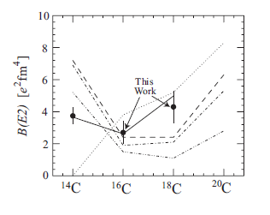
Comparison with B(E2) values from microscopic models
Skyrme HF
Sagawa et al., PRC70, 054316(04)
Shell model
Fujimoto, Thesis, UT, 2003
AMD
Kanada-En’yo, PRC 71, 014310 (05)
AMD+MSD
Thiamova et al., EPJA 22, 461(04)
“No core” shell model
Fujii et al., PLB 650, 9 (07)
In the shell models,
larger sub-shell gap for protons; 0p3/2 - 0p1/2
smaller effective charge e_{n} ~ 0.2e
due to s-wave dominance and week-bound neutrons

Slide 49
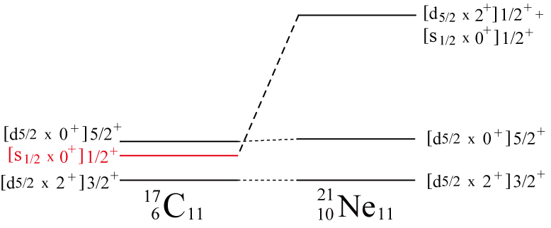
s-wave dominance in the 1/2⁺ state?
3/2⁺ ; the [d_{5/2}×2⁺]^{3/2+} configuration is dominant.
⇒ The 1/2⁺ state of ¹⁷C may have a large amount of
the [s_{1/2}×0⁺]^{1/2+} configuration
since the M1 transition between the s_{1/2} and d_{5/2} orbitals
is forbidden.
The 1/2⁺ state of ¹⁷C may be a halo state ?.

Slide 50
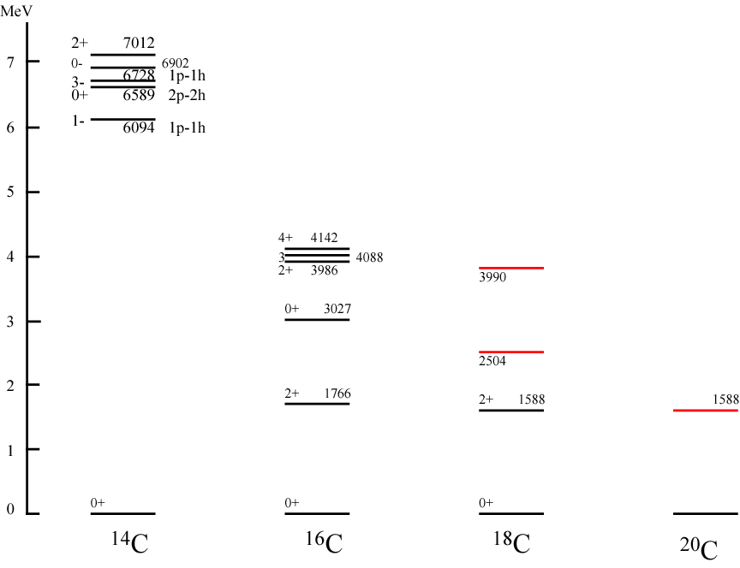
Excited states in even-even C isotopes
¹⁴C double magic ??
4184
GANIL, Eur. Phys. J.A 20, 95 (04)
N=8 gap
Z=6 gap
2934
B(E2)?
N=8
N=10
N=12
N=14

Slide 51
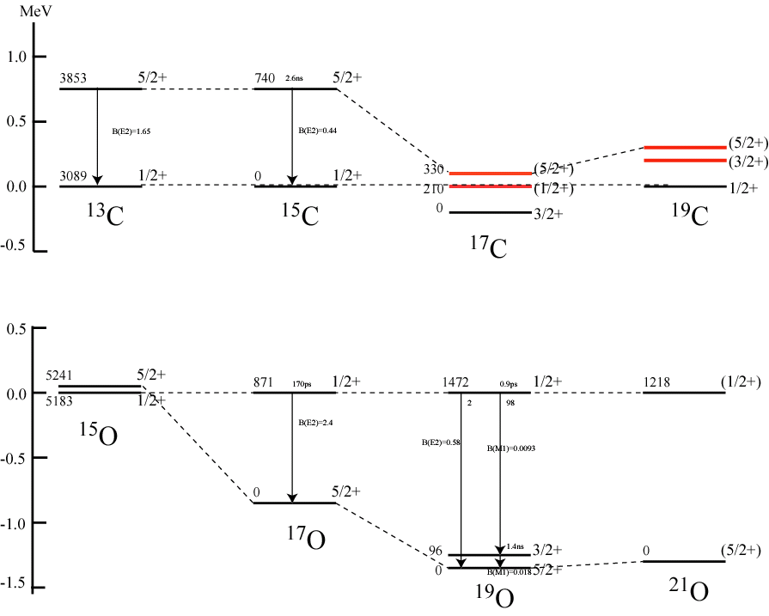
Excited states in the odd C and O isotopes
d_{5/2}
Z.Elekes et al., PLB 614 (05) 174
tentative spin assignments
s_{1/2}
neutron-dominant collective states??
d_{5/2}-s_{1/2}-(d_{3/2})
s_{1/2}
GANIL, PRC69,034312(2004)
d_{5/2}
N=7
N=9
N=11
N=13

Slide 52
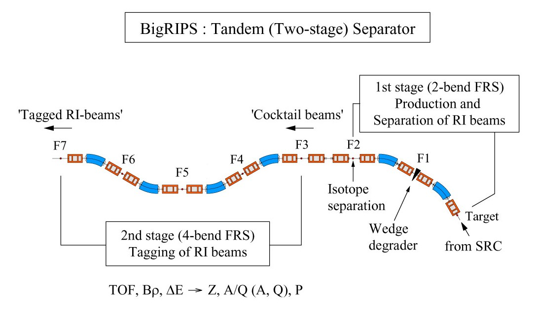
Delivery of tagged RI-beam
Based on two-stage separator scheme
T. Kubo et al.
Cocktail beam A, Z, Q mixed
Tagged beam
Dispersive focus
To RI-beam delivery line & experimental set-ups
TOF& ΔE
Bρ measurement
Identify RI-beam species Z, A/Q by measuring ΔE, Bρ, TOF in an event-by-event mode using beam-line detectors on the 2nd stage. Aim at tagging rate up to 1 x 10⁶ pps.
total reaction cross section measurement with 2nd stage
2ndary target placed at F5

