Slide 1
Accelerator Physics and Commissioning
Mike Syphers
  Introduction
  Accelerator Physics Efforts
  Commissioning Efforts
  Summary/Conclusions

Slide 2
AP & C Activities
Accelerator Physics
  Topics affecting upgrade path for LHC …
  Electron Cloud (via M. Furman, LBNL)
  Interaction Regions & Beam-Beam (via T. Sen, FNAL)
Commissioning
  In addition to other deliverables (e.g., instrumentation) …
  Interaction Region Commissioning (via M. Lamm, FNAL)
  Beam Commissioning (via E. Harms, FNAL)

Slide 3
The Electron-Cloud Effect in LHC
M. Furman
Beam synchrotron radiation is important
  provides source of photo-electrons
Secondary emission yield (SEY) δ(E) is important
  characterized by peak value δ_{max}
  determines overall e– density
e– reflectivity δ(0) is important
  determines survival time of e–
Bunch intensity N and beam fill pattern are important
Main concern: power deposition by electrons

Slide 4
e-Cloud Recent Developments
RHIC ^{(*)}
  CERN e– detectors for IP12
    to be shipped and installed starting July 2005
    testing and calibration during 2006 run
    two dipole magnets, B≤0.2 T (one detector/dipole)
    change in design: RT, not cold region
  Proposal of ion detector (ionization profile monitor)
    ionization of residual gas? possible e– trapping?
  e-cloud maps: paper published PRST-AB (Iriso-Peggs)
  Active search for student or post-doc to replace Ubaldo Iriso
CERN
  New analysis of SPS data (D. Schulte & F. Zimmermann):
    peak SEY δ_{max}~1.4 and e– reflectivity R~0.5 are good solution to fits
  Cryo pumping available for e-cloud power deposition re-estimated: ~0.2 → ~2 W/m (!)
  Bug in ECLOUD code found and fixed: need δ_{max}<1.3 at LHC arcs to not exceed 2 W/m
  Earlier large ion density observations at SPS: gone (detector artifact)
(*) RHIC e-cloud activities not all funded by the LARP program

Slide 5
e-Cloud Recent Developments (contd.)
LBNL
  Simulations for SPS runs (summer ’04) continue (M. Furman, M. Pivi)
    e-cloud effect much less for 75 ns bunch spacing than 25 ns
    other detailed comparisons against CERN simulations (code ECLOUD) starting
    a first 3D, self-consistent, e-cloud simulation of LHC FODO cell: new code^{(*)}
  Participation at HHH2004 (M. Furman, Nov. 2004)
    discussions on e-cloud codes
    some SPS measurements clarified, more plans for LBNL simulations
  Trip to CERN March 21-25, 2005 (M. Furman and Ji Qiang)
    discussions on e-cloud and str-str-BB
    feedback from CERN people on our plans
    status of CERN work
  Summer student has been made an offer
    to start in early June 2005 for 10 weeks
    total student cost: $5k
    possible tasks (TBC): a) simulate LHC power deposition; b) SPS σ_{z} dependence;
    c) simulate RHIC e-cloud detectors
(*) So far funded (at ~90% level) by LDRD

Slide 6
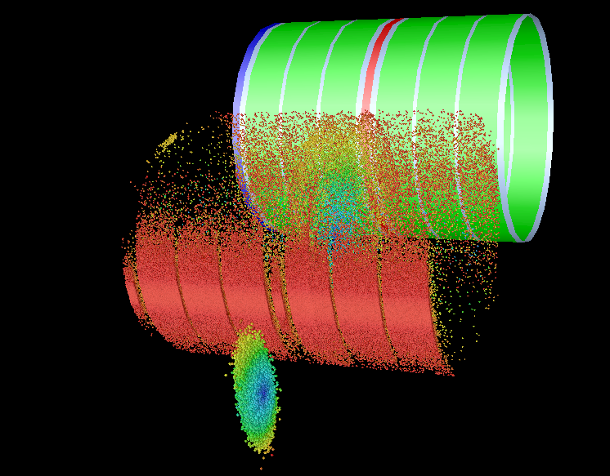
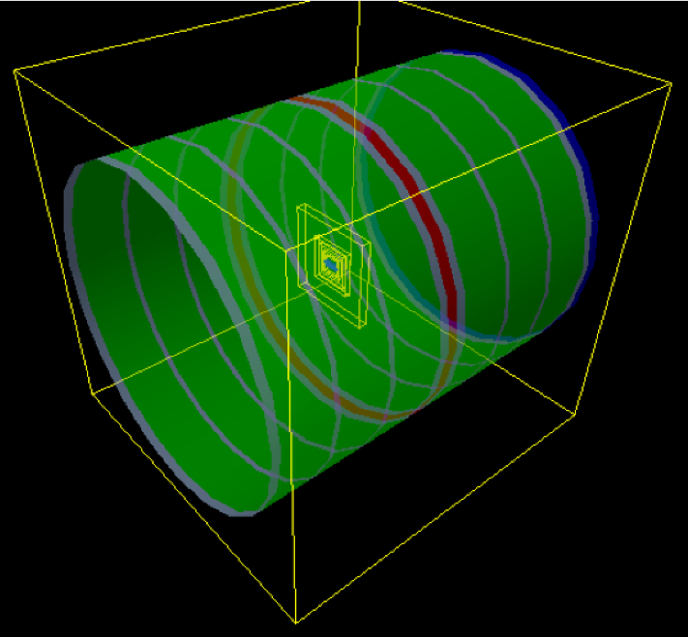
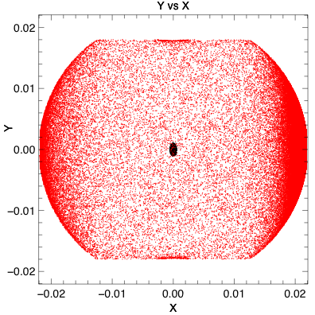
Application of a New 3D e-Cloud Code to LHC
M. Furman, J.-L. Vay: (WARP+POSINST)
1 LHC FODO cell
F B B B D B B B
T=2μs
electrons
(particles colored according to radius)
beam (scaled 10x)
• AMR provides speedup of x20,000 on field solve
Movie...
(Jean-Luc Vay)

Slide 7
e-Cloud Goals
Complete the analysis of June 2004 SPS run (*) (LBNL, FY05)
  especially e– energy spectrum
  goal: constrain SEY model for better predictions for LHC
Additional SPS studies: σ_{z} dependence (LBNL, FY05-06)
  “confusing” lack of correlation between simulations and observations
LHC heat-load estimate: POSINST-ECLOUD benchmarking (*) (LBNL, FY05-06)
Report first cut at defining optimal LHC conditioning scenario (LBNL, FY06-07) (*)
  define optimal fill pattern during first two years of LHC beam ops.
Further 3D simulations for LHC arcs (LBNL, FY06-07) (*)
  bunch trains, beam instability
Report on applicability of Iriso-Peggs maps to LHC (BNL, FY06-07) (*)
  understand physics of map simulation technique
  understand global e-cloud parameter space, phase transitions
Report on e-cloud simulations for RHIC detectors (BNL, FY06-07) (**)
  calibrate code, then predict BBB tune shift
Report on e-cloud simulations for LHC IR4 “pilot diagnostic bench” (LBNL, FY07+)
  have some idea what to expect when high-N beam turns on
(*) strongly endorsed by CERN AP group (communicated by F. Ruggiero and H. Schmickler)
(**) strongly endorsed by CERN vacuum group (communicated by J. M. Jiménez)

Slide 8
Budget Discussion -- Electron Cloud
All above tasks, if funded, would be: 2.4 FTE for FY06, 2.4 FTE for FY07 (LBNL & BNL combined)
Allocated for FY06: 1.0 FTE; includes:
  0.25 FTE (BNL) -- LHC-style detector sims.; 0.75 FTE (LBNL)
  0.75 FTE (LBNL) -- benchmarking, Iriso-Peggs maps, conditioning scenario
If more funding were available, would add following tasks to original scope:
  Validate new 3D code via dedicated simulations/experiments at the LBNL HCX facility (1 FTE FY06, 1 FTE FY07)
  Understand long survival times of e– at SPS (0.75 FTE+$25k for each FY06 and 07)
    evaluate ion trapping mechanism via expts. and simulation
  Measure gas desorption from stray beam particles (1 FTE+$20k FY06)
    helps quantify ion cloud density
  Extend above to NEG coatings (0.5 FTE+$10k FY06)
  Extend above to cold surfaces (1.25 FTE+$250k FY06)
  Emulate BIM via RF-driven electrodes on HCX beam (0.5 FTE+$20k FY06)

Slide 9
Interaction Region and Beam-beam
T. Sen
  Interaction Region Optics for the Upgrade
  Energy Deposition in Interaction Regions
  Beam-beam simulations

Slide 10
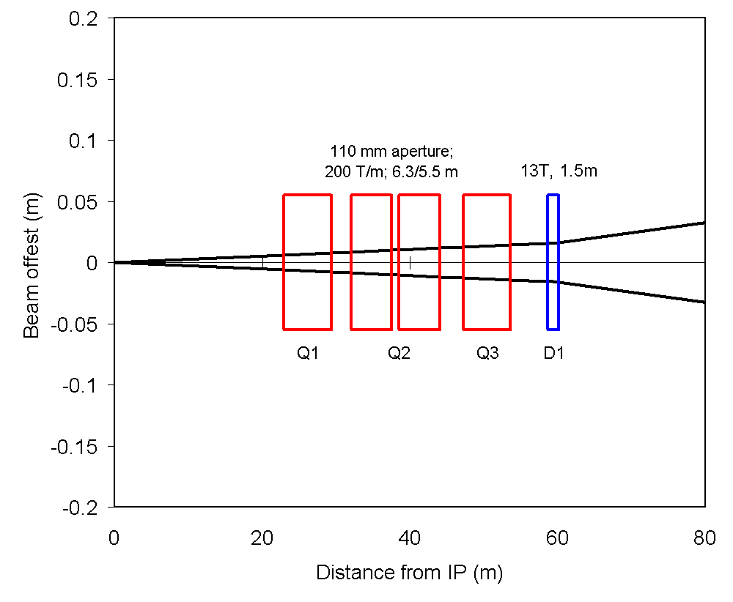
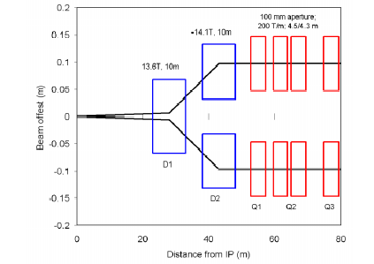
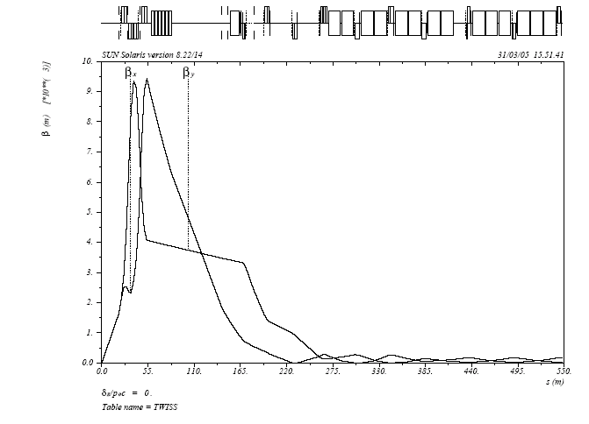
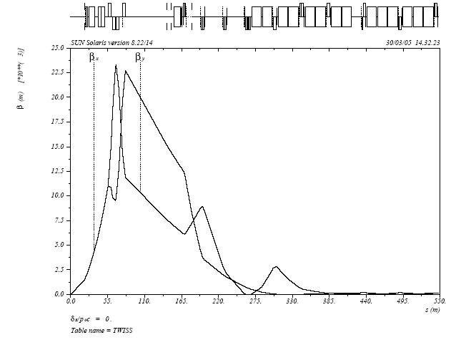
IR Designs for the Upgrade with Triplets
Quadrupoles first
Dipoles first

Slide 11
Optics Features with Quads or Dipoles First
Quads first features
Focusing starts early, lowers beta function in magnets, simplest upgrade path
But,
Beams go off-axis in the quadrupoles => feed-down effects, correction algorithm acts on both beams, 15 long-range interactions on either side of IP
Dipoles first features
Reduces long-range interactions 3 fold, independent nonlinear correction for each beam
But,
Larger β^{max} for the same β* - about 2.5 times larger, higher energy deposition in D1 from charged particles, matching section quads Q4-Q8 will have to be large aperture magnets
β Maximum in Quads
 | Quads first β^{max} [m] | Dipoles first β^{max} [m]
Q1 Q2 Q3 Q4 Q5 Q6 Q7 Q8 Q9 Q10 QT11 QT12 QT13 | 4538 9193 9427 3323 1559 984 285 261 270 153 181 183 173 | 15100 23036 22720 12517 8859 2791 748 2857 693 162 185 183 172

Slide 12
Dipoles First and Doublet Focusing
Features
Requires beams to be in
separate focusing channels
Fewer magnets
Lowers IR chromaticity
Beams are not round at the IP
Polarity of Q1 determined by
crossing plane – larger beam
size in the crossing plane to
increase overlap
Significant changes to magnets
in matching section.
Q1
D2
Q2
IP
D1
D2
Focusing symmetric about IP

Slide 13
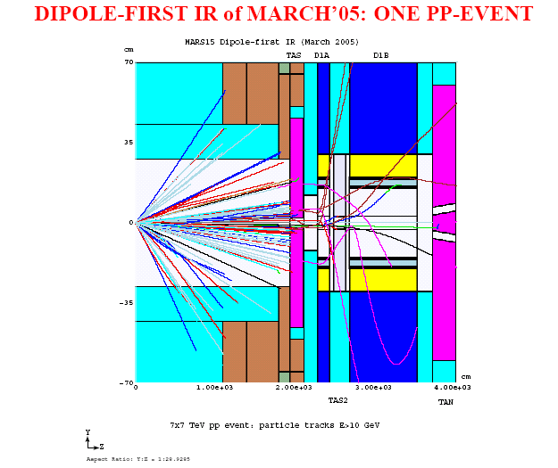
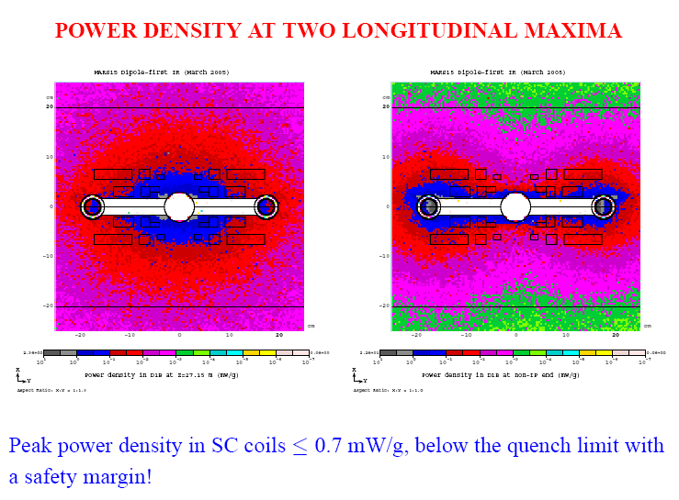
Energy Deposition in Open Mid-Plane Dipole
Strong ties to Magnet program…
Optimized Dipole with TAS2
IP end of dipole is well protected. Magnetized TAS1 is not feasible – estimated field of 20 T-m
Instead, split D1 into 2 dipoles D1A, D1B, Spray from D1A is absorbed by additional absorber TAS2.
Results
  Peak power density in SC coils is below the quench limit with a safety margin
  Heat load to D1 is drastically reduced
  Other radiation issues are mitigated, e.g. estimated lifetimes higher

Slide 14
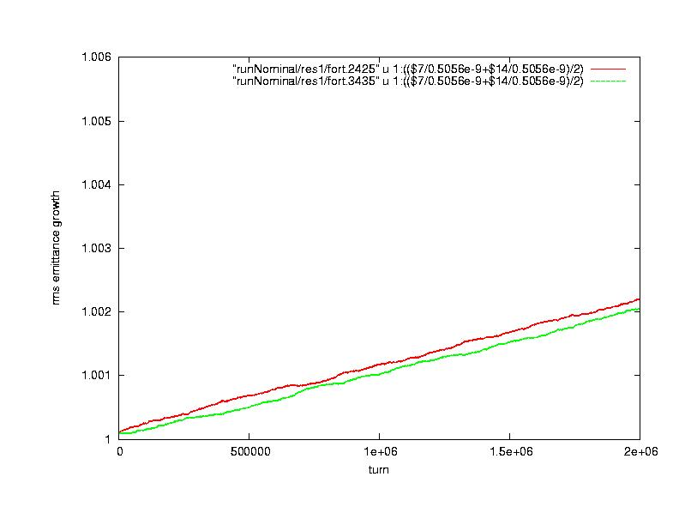
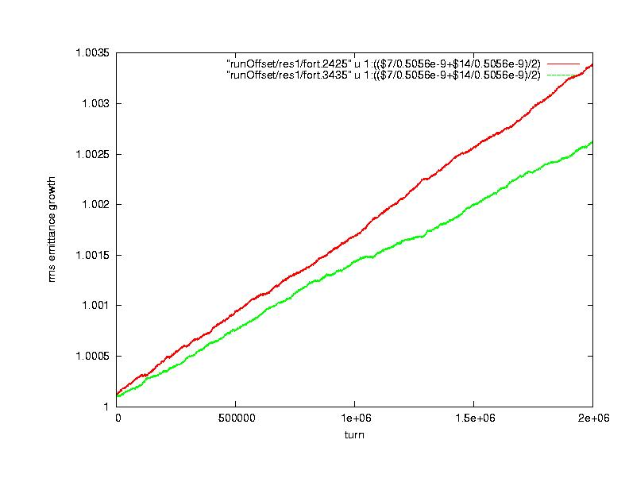
Strong-Strong Beam-Beam Simulations
Strong-strong simulations done with PIC style code Beambeam3D (LBNL)
Emphasis on emittance growth due to head-on interactions under different situations
Beam offset at IP
Mismatched emittances and intensities
Numerical noise is an issue – growth rate depends on number of macro-particles, M. Continuing studies to extract asymptotic (in M) growth rates.
Continuing additions to code: crossing angles, long-range interactions
Nominal case
Beams offset by 0.15 sigma
Emittance growth 50% larger

Slide 15
IR and Beam-Beam Accomplishments in FY05
IR Optics design
  Matched optics for both the quadrupole first and dipole first designs were developed for β* ~0.25m. Maximum quadrupole gradients of 200 T/m suffice for both designs but larger aperture quadrupoles will be required in the matching section for the dipole first design. The possibility of doublet focusing with the dipole first design was also examined for the first time.
Energy Deposition with open mid-plane dipoles
  The simulations show that the original 10m long dipole should be split into two shorter dipoles, 1.5m and 8.5m long respectively, with an absorber placed between them. These and other modifications lower the peak power density in the superconducting coils to below the quench limit with a safety margin, drastically reduce the heat load to the dipoles and mitigate other radiation issues.
Beam-beam simulations
  A strong-strong code was used to study emittance growth with the head-on interactions. Situations such as beam offsets, emittance and intensity mismatches that are likely to lead to emittance growth were studied.
Papers
“Overview of possible LHC IR layouts”, Proceedings of CARE-HHH conference, CERN November 2004.
“Beam-beam simulations of hadron colliders”, Proceedings of CARE-HHH conference, CERN November 2004.
Wire compensation experiments at the SPS in 2004, PAC05

Slide 16
Expected Accomplishments in FY05-06
IR Optics Designs
  Design concepts for the IR upgrade will be explored in greater detail. Matched designs that can be used from injection to collision will be developed. These designs will be developed in collaboration with magnet designers at BNL, FNAL and LBL.
Energy deposition
  Further development of the MARS code, including upgrade of the geometry, visualization, heavy ion and electromagnetic shower modules. Energy deposition calculations will continue for IR1 and IR5 regions at normal operation and accident conditions
Beam-beam simulations
  Continuing development of the Beambeam 3D code. Application to halo formation, luminosity monitor (swept beams).
IR and Beam-beam Workshop
  A workshop focused on IR design concepts, beam-beam compensation and the feasibility of crab cavities will be held near FNAL, October 5-6, 2005

Slide 17
IR and Beam-Beam Tasks -- FY06-07
IR Optics designs
  Quad first – lowest feasible β* consistent with gradients and apertures, field quality
  Dipoles first – Triplet: β*, apertures, gradients, field quality
  Dipoles first – Doublet focusing: explore feasibility
Beam-beam simulations
  Strong-strong beam-beam simulations: emittance growth with swept beams (luminosity monitor), wire compensation, and halo formation (Beambeam3D)
Energy Deposition
  For different IR designs (quadrupole and dipole first), tertiary collimators, and the forward detector regions (CMS, TOTEM, FP420 and ZDC).

Slide 18
Level of Effort in FY06-07: IR & bb
 | BNL FTEs | FNAL FTEs | LBL FTEs
IR design Beam-beam simulations Energy deposition | - - - | 1* - 1* | - 1* -
* - requires new post-doc hire

Slide 19
Wire Compensation Proposal
T. Sen
  Possible new LARP task…
    Motivation for compensation
    Results of SPS experiments
    Beam-beam experiment at RHIC
    Proposal

Slide 20
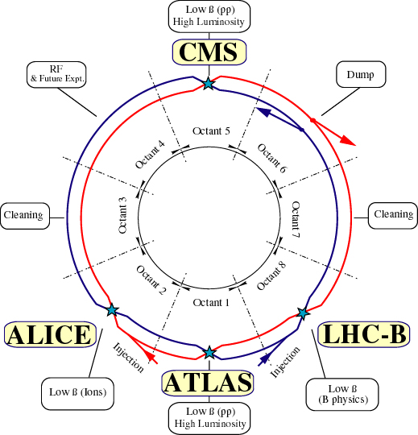
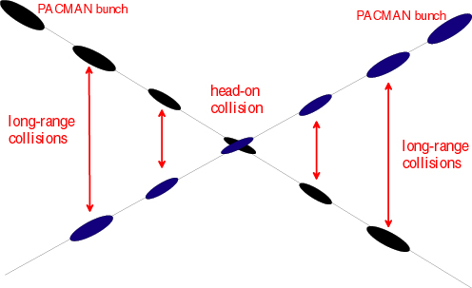
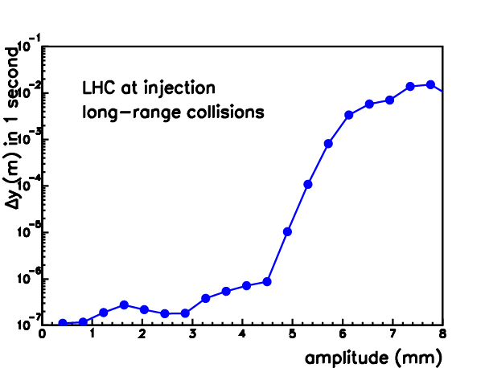
Motivation for Compensation
_x0016_
30 long-range collisions per IP
Long range interactions in the LHC
Long-range interactions enhance diffusion. Tevatron experience

Slide 21
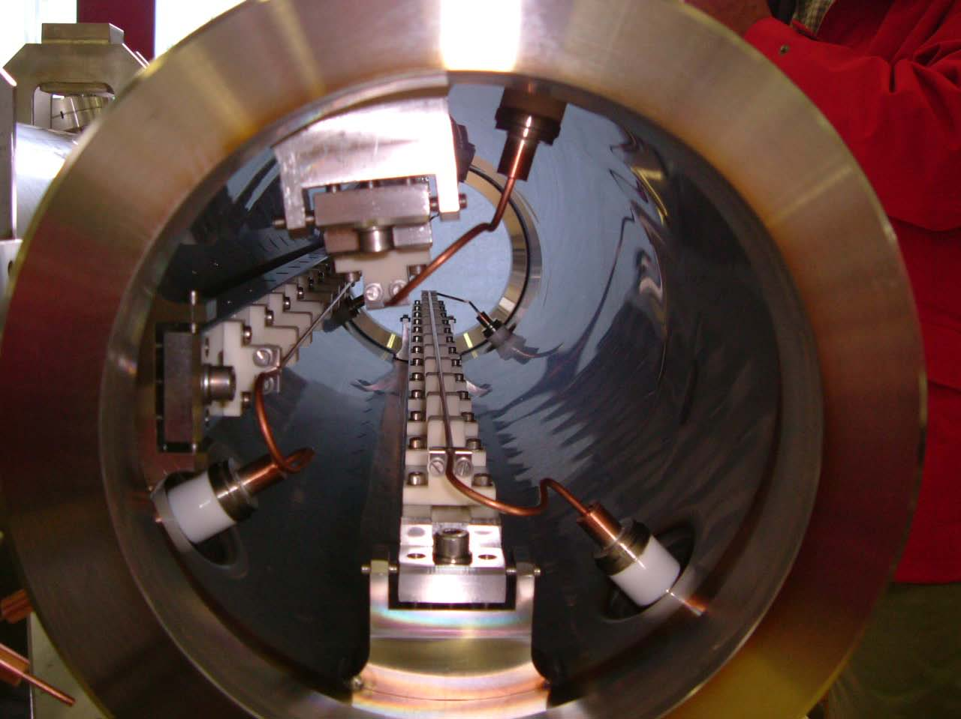
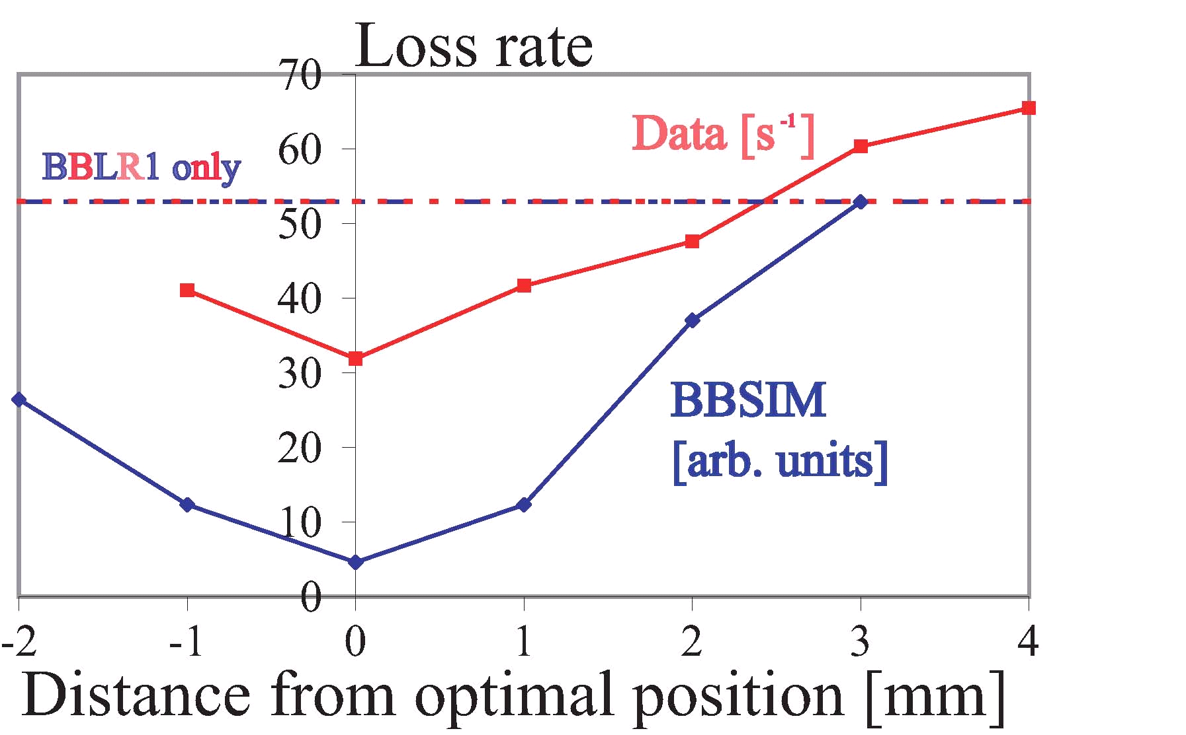
SPS Wire Experiments 2004
F. Zimmermann (CERN)
One beam, two wire compensators BBLR1 and BBLR2. BBLR2 installed in 2004
Studies in July, August, September, November 2004
FNAL LARP participated in July and November studies
Tested: relative alignment, current tolerance, tune sensitivity and different crossing planes.
Prediction of relative alignment tolerance of the 2 wires with BBSIM (FNAL weak-strong code)
Main observation: Compensation of one wire by another worked well in LHC conditions
Simulations: in general good agreement with observations
PAC05 paper: MOPC009

Slide 22
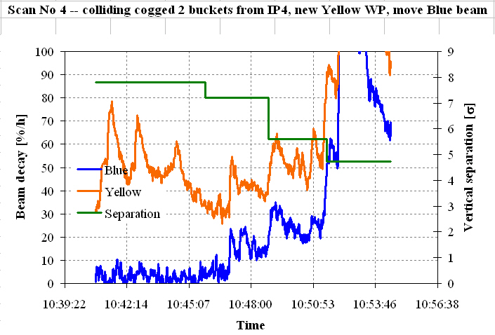
RHIC Beam-Beam Experiment
W. Fischer (BNL)
Phase 1 study – April 28, 2005
FNAL LARP participation (remotely from FNAL)
Goal: Study lifetime. and losses as beam-beam separation is varied
Observations:
  Onset of significant losses for separations below 7σ
  Phenomena is tune dependent
Tunes of blue and yellow beam symmetric about diagonal
Losses in both beams increase with decrease in separation; impact even at ~7 sigma

Slide 23
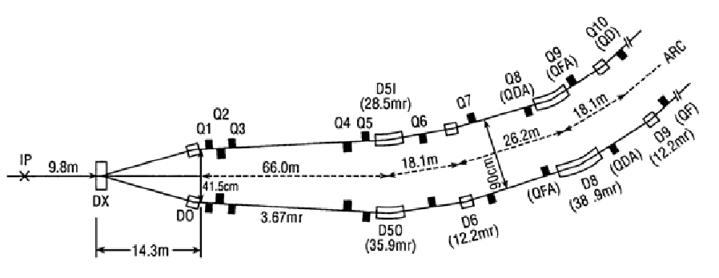
Wire Compensation Proposal
RHIC provides unique environment to study experimentally long-range beam-beam akin to LHC operation
Proposal:
Install wire compensator in RHIC in summer 2006, downstream of Q3 in IR6
Budget Requested for FY06: $230K (Note: $180K more likely)
Statement of work for FY06:
Design and construct a wire compensator (either at BNL or FNAL)
Install wire compensator on a movable stand in one of the RHIC rings
Theoretical studies (analysis and simulations) to test the compensation and robustness
Beam studies in RHIC with 1 proton bunch in each beam and nominal conditions at flat top and 1 parasitic interaction. Observations of lifetimes, losses, emittances, tunes, orbits for each beam-beam separation.
Beam studies to test tolerances on: beam-wire separation compared to beam-beam separation, wire current accuracy, current ripple
RHIC IR
Phase advance from parasitic to wire = 6º
Possible location of wire
Parasitic interaction

Slide 24
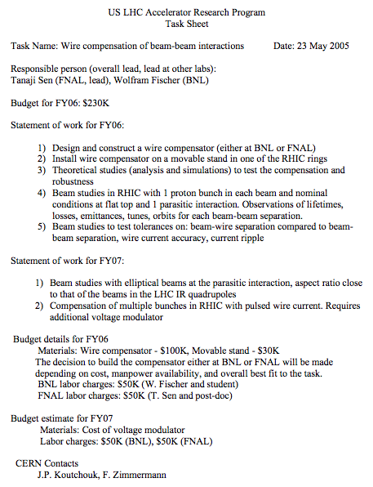
Wire Compensation Proposal -- Task Sheet
LARP Task Sheet has been generated, and agreed upon by FNAL and BNL
T. Sen, FNAL
W. Fischer, BNL
and is awaiting approval by LARP management…

Slide 25
Interaction Region Commissioning
M. Lamm
Above Ground Mechanical Fitup
Installation Oversight and
Hardware Commissioning of US Deliverables

Slide 26
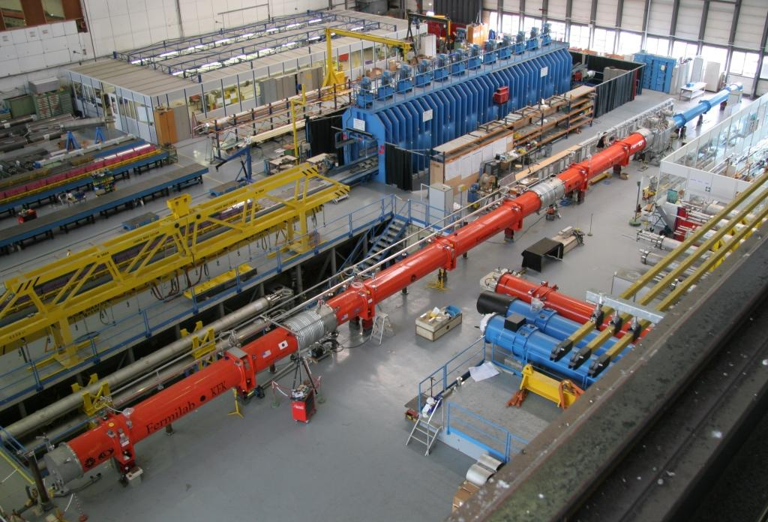
Successful Above Ground Fitup of US Deliverables
LHC Assembly Building March-April 2005
D1 (BNL)
DFBX (LBNL)
Inner Triplet (FNAL)
Completed Tasks:
  Assemble all pieces for complete IR
  Mechanical fitup of interconnects
    Pipes adjustments to install length, dry fit
    Vacuum tests
    Shields, interconnect kits
  Magnets on alignment jacks
  Electrical continuity
Participants: Joseph Rasson (LBNL), Rodger Bossert, Joe Dimarco, Phil Pfund, Tom Page, Tom Nicol, Jim Rife, Michael Lamm (FNAL)

Slide 27
(2) Installation
Time Frame: First sector Fall 2005, throughout FY2006, 07?
  Check mechanical/vacuum/cryo connections
  Check installation procedures
  Review electrical and alignment data
  Installation bugs worked out in Mechanical Fitup
Level of Effort FY06-07
  ~1/3 FTE on First sector
  Less on subsequent sectors (but non zero based on fitup)
Main TD Participants
  Mechanical Engineers (Rasson, Page, Nicol, Bossert, Plate….)
Main CERN Contacts
  Ranko Ostojic AT-MEL and Interconnect team in AT-CRI

Slide 28
(3) Commissioning
Start Fall 2005 (US Deliverables first in LHC to be commissioned!)
  Participation at first through short visits and possibly through remote monitoring
Full Commissioning Task Starts Spring 2006
  We are lining up people to live at CERN in CY 2006
    Cryogenic Expert
      Experienced in Superfluid testing of US Magnets
    Magnet Physicist Magnet powering, quench protection
Expected Hardware Commissioning completion in Summer 2007
Small carryover into beam commissioning to study dynamic heat loads on magnets and cryosystem

Slide 29
Budget Request for FY06-7
Effort is 2-3 FTE’s /Year
Cost is Labor + Salary and Living Expenses
FY06 numbers are lower by ~$150K from original estimates;
  Assumes some costs deferred to FY07

Slide 30
Conclusions -- IR Commissioning
IR HC is an important way for the US to contribute to the LHC project
  Inner triplet HC contribution is established
  Recent new requests in global commissioning could greatly expand our role
Our participation in Inner Triplet Region is limited by funding and ongoing US commitments
  We could do more.
Taking responsibilities in Inner Triplet Region (an area in which the US has a large and unique expertise) could help in the other HC (free up CERN personnel, LARP IR personnel can take on global jobs) if pursued.
Major uncertainties are being addressed:
  Uncertainty in CERN schedule (real schedule now available)
  Lining up the appropriate people at the right time (so far so good)

Slide 31
Beam Commissioning
E. Harms
  Introduction
  Recent Accomplishments
  Expected Accomplishments for FY05
  Vision for Tasks and Budget for FY06-07
  Summary/conclusion

Slide 32
Introduction
Beam commissioning has been one of the cornerstones of LARP since its inception. U.S. involvement in LHC beam commissioning was originally envisioned to include the presence of at least one U.S. accelerator scientist on each LHC commissioning shift.
The structure and tasks of such a presence has evolved. It is currently envisioned that US LARP participation will be as part of Commissioning teams consisting of both CERN and US scientists and engineers. The teams will focus on specific tasks as part of the entire commissioning process.
The list of tasks/teams in currently under development at CERN. Once the prioritized list is received it will be reviewed and potential US candidates will be plugged in where vacancies and abilities lie.

Slide 33
LARP involvement – CERN perspective
In the present US-LARP proposal, resources are allocated for “Beam Commissioning” activities from 2004 onward, rising to more significant numbers by 2007.
  US-LARP commitment has to include long-term individual commitments of around 12 months
  US staff should go to CERN to perform a specific role in the beam commissioning work. It has also been clearly said that CERN has to maintain sufficient expertise, particularly on shift, to ensure long-term exploitation of the machine
With this in mind, it is felt that a very limited number of US-LARP resources could participate in the shift rota. Rather, they would be best suited to the accelerator physics and equipment group support activities

Slide 34
Accelerator Systems and Responsibilities 1
 | System |  | Equipment Group | Beam Physics or Operational aspects
Systems needed pre beam | Control system
 | Applications software
 | Accelerator technical services | TI operations
 |  | Electrical supply
 |  | Cooling & Ventilation
 | Vacuum
 | Cryogenics
 | Access
 | Cold magnets
 | Warm magnets
 | Magnet circuits and power converters
 | Power Interlock System (PIC)
 | Quench Protection and Energy Extraction (QPS)
We know who these are
No or very few names here
Points to address for each system
  What is the specification with beam
  What measurements are needed
  What tools are needed
  What beam is needed
  How much time is needed
This is the meat of
Hardware
Commissioning
from Roger Bailey

Slide 35
Accelerator Systems and Responsibilities 2
 | System |  | Equipment Group | Beam Physics or Operational aspects
Systems needed for beam | SPS extraction, transfer, injection and first turn
 | Multi turn losses and BIS dependability
 | Protection devices other than collimators
 | Collimation system and Halo cleaning
 | Clean Beam Extraction
 | Radio protection
 | Beam Instrumentation | Screens
 |  | BCTs
 |  | BPM, trajectory & orbit correction
 |  | BLM
 |  | PLL for Q, Q’, coupling
 |  | Profile monitors
 |  | Schottky
 |  | Luminosity monitors
 | Vacuum conditions during operation and electron cloud
 | Reference magnet system
 | RF systems and longitudinal beam dynamics
 | Transverse feedback
 | Experimental solenoids and compensations
 | Experimental equipment (Roman pots, velo)
We know who these are
CERN AP interest known here
from Roger Bailey

Slide 36
Accelerator Systems and Responsibilities 3
 | System | Equipment Group | Beam Physics or Operational aspects
Beam based systems | Beam in the injectors
 | Ion beam in the injectors
 | Orbit feedback system
 | Filling efficiency and flat bottom conditions
 | Ramp and squeeze losses and overall quality
 | Machine protection system
 | Optics
 | Mechanical aperture
 | Machine Impedance and collective instabilities
 | Dynamic aperture
 | Lattice corrector settings
 | Triplet corrector settings
 | Lifetimes
 | Separation schemes
 | Crossing angle schemes
 | Collisions and luminosity steering
 | Experimental conditions
 | Ions
No or very few names here
CERN AP interest known here
from Roger Bailey

Slide 37
Accelerator Systems Support
All accelerator systems have to be commissioned and will subsequently require expert support to maintain performance at the required level. For this we will obviously count on the equipment groups who are presently building the hardware systems, but we will also need a number of accelerator physicists to assume responsibility for the beam physics aspects
Three categories of accelerator systems:
  Predominately equipment systems (such as magnet circuits and power converters) requiring little accelerator physics support
  Essentially beam-based systems (such as the machine aperture) requiring a lot of accelerator physics support
  All the rest, requiring both equipment and accelerator physics expertise
For the accelerator physicists the term responsibility here means:
  Ensure beforehand that the system specification is clear and that all necessary tools, including software, are in place for first beam or when required
  Ensure that the system performs to specification as far as the beam is concerned. This will entail ensuring that all the necessary beam measurements are performed during commissioning and that any necessary corrective actions are implemented. All this should clearly be done in close collaboration with the central commissioning team described above
  Provide a link to the LARP personnel associated with the system
from Roger Bailey

Slide 38
Recent Accomplishments
CERN accelerator complex largely off from the fall 2005 through spring 2006; little actual beam activity, but activity nonetheless:
  October ’04: expected participation in (very successful) TI8 commissioning; LARP participation curtailed by schedule conflicts and illness
  January ‘05: U.S. personnel were present at CERN for the ‘Chamonix’ workshop
  March ’05: visit by US personnel to review/discuss list of tasks, plan for CERN staff visits to Fermilab, remote data sharing
  Spring/Summer ’05: series of visits to Fermilab by CERN/LHC operations staff to partner laboratories
    build relationships
    explore possibilities for Remote Monitoring
    discuss LHC/OP task list

Slide 39
Expected Accomplishments for FY05
It is hoped that a clearer understanding of where the U.S. can participate in LHC beam commissioning will begin in short order. The abovementioned ‘task lists’ are seen as critical for further progress.
A long-term presence cannot begin just before first beam; resources need to be allocated to provide for an incremental increase as hardware commissioning begins.
In order for CERN operations staff to begin to experience operation of a superconducting accelerator a series of 6-week visits by LHC shift commissioners is in progress and will continue into the summer.
There is a growing interest in LARP beam commissioning and a commensurate virtual change in size of the LARP contingent.

Slide 40
Fermilab Remote Operations Center
Point of Interest: A Committee has been charged by the Fermilab Director with constructing a plan for a Fermilab Remote Operations Center
  Define the high level requirements for a Remote Operations Center for CMS, LHC accelerator operations, and US/LHC magnet commissioning
  Develop cost and schedule estimates for the implementation of a Remote Operations Center
  Preliminary report by the end of July, 2005 describing requirements and scope.
  Final report including a Resource Loaded Schedule is due by the end of CY2005.
While not funded by LARP, will become essential for LARP personnel interaction with LHC commissioning

Slide 41
Types of Participation
Commissioning Team
at CERN
LARP
Team Member
collaborative beam studies
“real time”
Remote Site
Critical Mass:
consoles, video/audio, eLogs,
meeting space, coffee, etc.
off-line analyses
special responsibility
for communication
with Remote Site
periodic shifts
Four Types of Participation:
Deliverables
  person builds something, visits to install, debug, etc., then leaves; may need remote access
On-site Commissioning
  person has moved to CERN (for ~1 year, say) and works daily with LHC group
1-on-1 Contacts
  person works with a particular person or group located at CERN, with occasional trips to CERN to participate in a study, etc.
Remote Participation
  person is part of a group at Remote Site, participating daily for shorter time periods
    "Training” can be performed at the Remote Site; periodic, shorter trips to CERN working with the "On-site" commissioners; people can continue to work remotely upon return

Slide 42
Vision for Tasks and Budget for FY06-07
While the CERN accelerator complex remains off for the first half of 2006, activities will pick up when the injector complex is re-commissioned and a sector test with beam is performed in fall 2006.
Milestones toward LHC operation
Hardware commissioning continues – LARP involvement?
Injector start up
Sector test
First beam
Commissioning
There should be a LARP presence during pre-beam activities (hardware commissioning, sector test, etc) to gain an understanding of LHC controls and operation before beam commissioning is initiated.

Slide 43
Beam Commissioning Summary
There have been Beam Commissioning activities this year
- clarification of US role, activities
- remote operations
- visits
US personnel will be identified as CERN releases its list of expected tasks
Activity should ramp up as Hardware Commissioning begins in earnest and Sector test is carried out
Awaiting input from Commissioning Task Force

Slide 44
AP & C Budget -- FY05-06
Allocated budget is roughly half of original “blue-sky” requests (actually, even less than half of the very early requests); interest is there to do more
If FY06 budget trimmed another 10%, would need to sacrifice work on e-Cloud and Beam-Beam Wires
  Would not wish to halt either; prefer to slow down if necessary
  These 2 not as “critical” (in the current time line) as others

