Slide 1
Sensor Placement for Contaminant Source Identification
Jonathan Berry (SNL)
Michael Collins (SNL)
William E. Hart (SNL)
Jim G. Uber (UC)
Jean-Paul Watson (SNL)

Slide 2
A New Performance Metric for Sensor Placement
Sensor placement is a key step in the design of a contaminant warning system (CWS)
Existing performance measures used for sensor placement can be broken into two categories
  Detection measures
    Time to detection
    Number of failed detections
  Exposure measures
    Population exposed
    Volume of contaminant consumed
IDEA: define measures that ensure that contaminant sources can be readily identified

Slide 3
Contaminant Source Identification
Goal: predict where the contaminant entered the distribution network
Impact:
  Enable termination of ongoing contamination events
  Facilitate contamination cleanup
Method:
  Numerical source inversion
  Use contaminant concentrations through time
CHALLENGE: this requires enough sensors that are well distributed throughout the distribution network

Slide 4
Topological Uncertainty
Observation: for a given set of sensor locations, the topology of the distribution network induces fundamental uncertainties about the contaminant location
IDEA: consider whether contamination events are distinguishable for a given set of sensors
  For a given set of sensor locations, every contamination event generates a detection pattern: the temporal sequence of detections
  Two contamination events are distinguishable if they have different detection patterns

Slide 5

EXAMPLES
Note: box indicates the location of a sensor
  Contaminant introduced at any junction will be detected
  Cannot distinguish contaminant sources
    Could distinguish sources if you knew the initial concentration levels and amount of decay … be that’s cheating!

Slide 6
A Sensor Placement Model
Assumptions
  Sensors placed at junctions
  Contamination introduced at junctions
  Hydraulic simulation defines the flow of contamination for a contamination event
  Ideal sensors (always detect if contaminant is above a concentration threshold)
Sensor Placement Objective:
Maximize the number of pairs of contamination events that can be distinguished

Slide 7
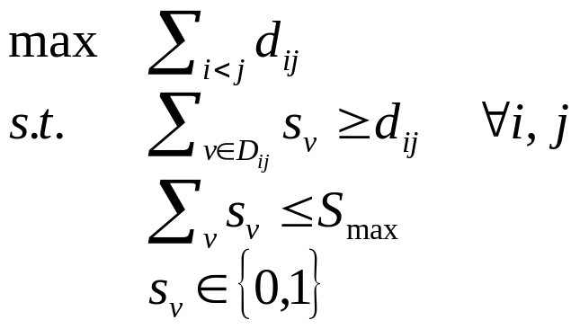
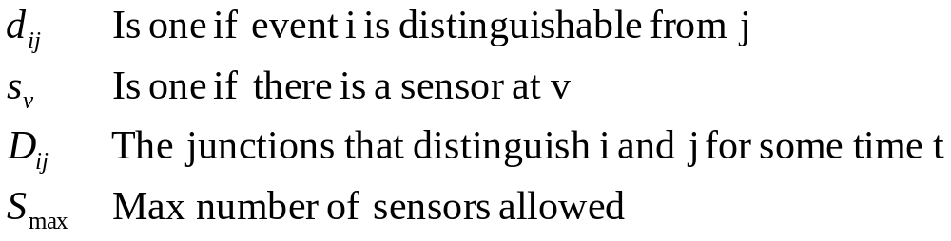
Integer Programming Formulation
Where
NOTE: the contaminant detection sets D_{ij} are determined from water quality simulations

Slide 8
Heuristic Methods
A simple greedy approach
  Let U_{t} be the number of undistinguished pairs after t iterations
  Let U_{v} be the number of undistinguished pairs if the next sensor is placed at v
  Place a sensor at the junction v that maximizes U_{v}/U_{t}
Satisfiability heuristic
  Treat D_{ij} as a clause:
  Reformulate bound on sensors as a clause (nontrivial…)
  Not all events may be distinguishable for a given sensor budget, so we formulate a weighted max-SAT problem
  Can solve with standard solvers: zChaff, Walksat

Slide 9
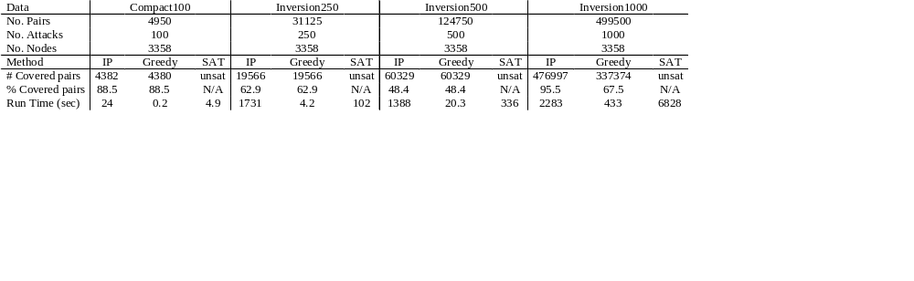
Solver Performance
Note: the memory requirements for the IP scales with the square of the number of contamination events
Problem size is also an issue for heuristics, but perhaps less so...
For example, you can iteratively optimize over subsets of contamination events

