Slide 1
Influenza Virus Vaccine
2008-2009 Strain Selection
Jerry P. Weir, Ph.D.
Director, Division of Viral Products
CBER/FDA
Prepared for
Vaccines and Related Biological Products
Advisory Committee
21 February 2008

Slide 2
VRBPAC Committee Recommendation
Selection of influenza A (H1N1 and H3N2) and B viruses for 2008-2009 influenza vaccines for use in the United States

Slide 3
Why Consider Strain Changes in Influenza Vaccines?
Vaccine efficacy relates to:
Vaccine potency (immunogenicity)
Match of vaccine HA/NA with wild-type viruses
  Antigenic drift of HA/NA continuous in influenza A and B viruses
  Evidence of reduced vaccine effectiveness resulting from antigenic drift observed within 2 years after influenza vaccines first licensed for use in United States

Slide 4
Questions to Be Answered for
Strain Changes Every Year
Are new (drifted or shifted) influenza viruses present?
Are these new viruses spreading in people?
Do current vaccines induce antibodies against the new viruses (HA)?
Are strains suitable for vaccines available?

Slide 5
Review of Influenza Strain Selection for 2007-2008
H1N1
  2006-2007 vaccine contained an A/New Caledonia/20/99-like strain
  An increasing % of antigenically distinguishable H1N1 viruses isolated
  Recommendation made to switch H1N1 vaccine strain to A/Solomon Islands/3/2006-like virus for 2007-2008
H3N2
  2006-2007 vaccine contained an A/Wisconsin/67/2005-like strain
  An increasing % of antigenically distinguishable H3N2 viruses isolated
  No emergence of a well characterized variant group
  No candidate virus for manufacture was available that gave more complete coverage of entire spectrum of H3N2 isolates
  Recommendation made to retain H3N2 vaccine strain similar to A/Wisconsin/67/2005-like virus for 2007-2008

Slide 6
Review of Influenza Strain Selection for 2007-2008 (2)
B
  2006-2007 vaccine contained B/Malaysia/2506/2004-like strain
  Majority of B influenza isolates in February 2007 belonged to the B/Victoria lineage (although both lineages present)
  Recommendation made to retain a B vaccine strain similar to B/Malaysia/2506/2004-like virus for 2007-2008
Vaccine situation during 2007-2008 influenza season
  Recommendations for U.S. vaccine composition same as WHO
  Preparation of vaccine was on schedule and supply plentiful
  Mismatches noticed between strains included in the vaccine and strains circulating in winter of 2007-2008 (H3N2 and B)

Slide 7
Current Licensed seasonal Influenza
Vaccines (U.S.)
Inactivated seasonal influenza vaccines
  Fluzone (Sanofi-Pasteur)
  Fluvirin (Novartis)
  Fluarix (GSK)
  FluLaval (ID Biomedical [GSK])
  Afluria (CSL)
Live attenuated seasonal influenza vaccine
  FluMist (MedImmune)

Slide 8
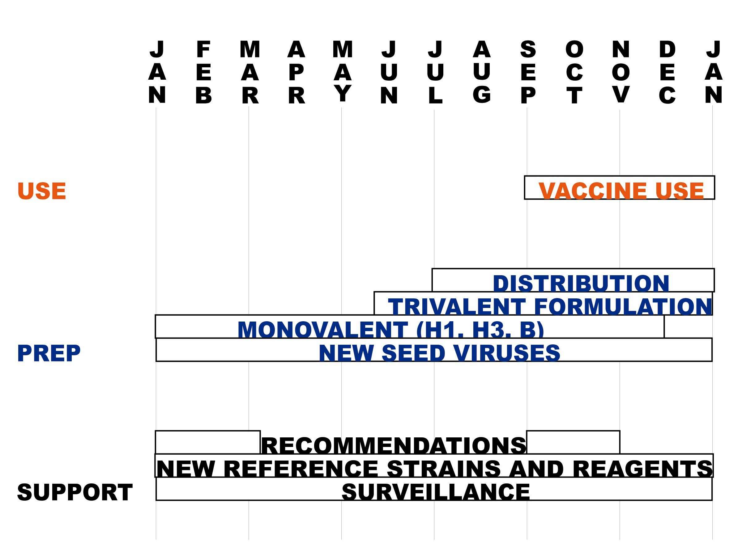
Timelines for Vaccine Production

Slide 9
WHO Consultation on the Composition of Vaccines for the
Northern Hemisphere, 2008-2009
February 11-13, 2008
Analyze the antigenic and genetic characteristics of seasonal influenza strains circulating globally, taking into consideration epidemiological data on influenza obtained from individual countries and regions.
Make recommendations on the composition of the influenza vaccine for the northern hemisphere 2008 - 2009.
  www.who.int/csr/disease/influenza/recommendations2008_9north/en/index/html

Slide 10
WHO Recommendations for Influenza Vaccine Composition
Northern Hemisphere: 2008-2009
“It is recommended that vaccines for use in the 2008-2009 influenza season (northern hemisphere winter) contain the following:
  an A/Brisbane/59/2007 (H1N1)-like virus
  an A/Brisbane/10/2007 (H3N2)-like virus
  a B/Florida/4/2006-like virus”
“As in previous years, national control authorities should approve the specific vaccine viruses used in each country” – CBER and VRBPAC

Slide 11
VRBPAC Committee Agenda
February 21, 2008
Review of recent influenza virus surveillance data in the U.S and vaccine effectiveness
  CDC, Joseph Bresee, M.D.
Review world surveillance and strain characterization
  CDC, Nancy Cox, Ph.D.
Review vaccine coverage and effectiveness; sequence analysis of virus isolates
  DOD, Angela Owens, MPH and Thomas Gibbons, Ph.D.
Review serological responses to current vaccines
  CBER, Zhiping Ye, M.D., Ph.D.
Update on availability & timing of candidate strains and reagents
  CBER, Rajesh Gupta, Ph.D.
Comments from manufacturers
  PhRMA, Tony Colegate (Novartis)
Discuss and recommend which strains should be included for the 2008-2009 influenza virus vaccine in the U.S.

Slide 12
Committee Discussion
What strains should be recommended for the antigenic composition of the 2008-2009 influenza virus vaccine based on:
    the epidemiology and antigenic characteristics of influenza virus strains circulating in human populations
    the serologic responses to circulating influenza viruses of persons immunized with current influenza virus vaccines, and
    the availability of suitable vaccine candidate strains

Slide 13
Options for Strain Composition for
2008-2009 Influenza Vaccines
Influenza A (H1N1)
  Retain current vaccine strain A/Solomon Islands/3/2006-like virus
  Replace current vaccine strain with alternative H1N1 isolate
    A/Brisbane/59/2007 (H1N1)-like virus
    Others
Influenza A (H3N2)
  Retain current strain A/Wisconsin/67/2005-like virus
  Replace current vaccine strain with alternative H3N2 isolate
    A/Brisbane/10/2007 (H3N2)-like virus
    Others
Influenza B
  Retain current B/Malaysia/2506/2004-like virus
  Replace current vaccine strain with alternative
    B/Florida/4/2006-like virus
    Others

