Slide 1
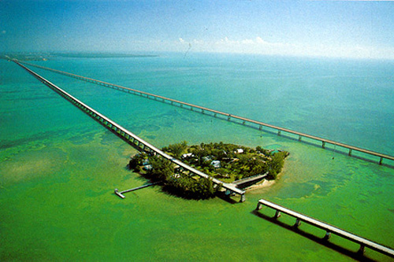

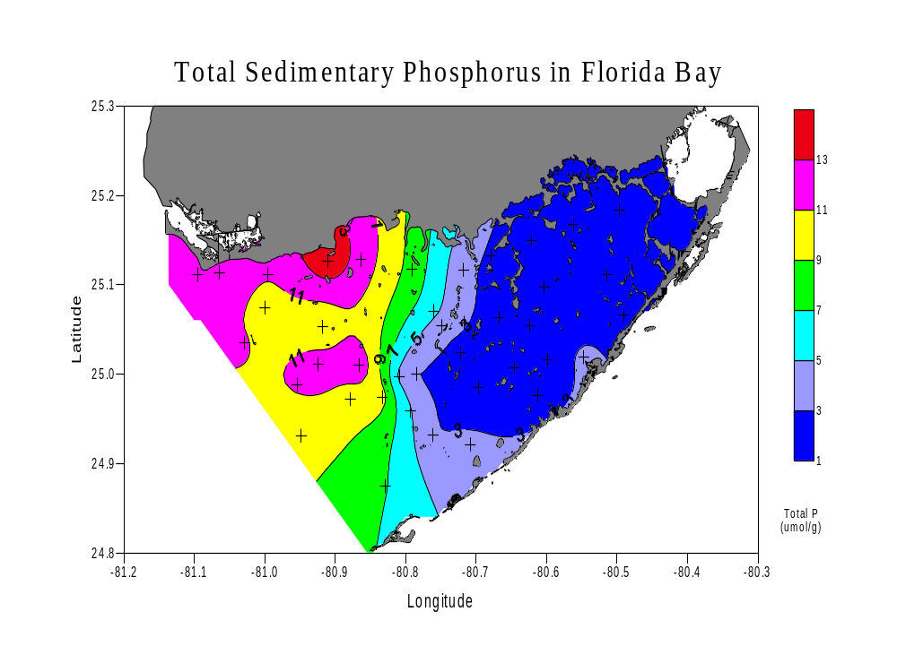
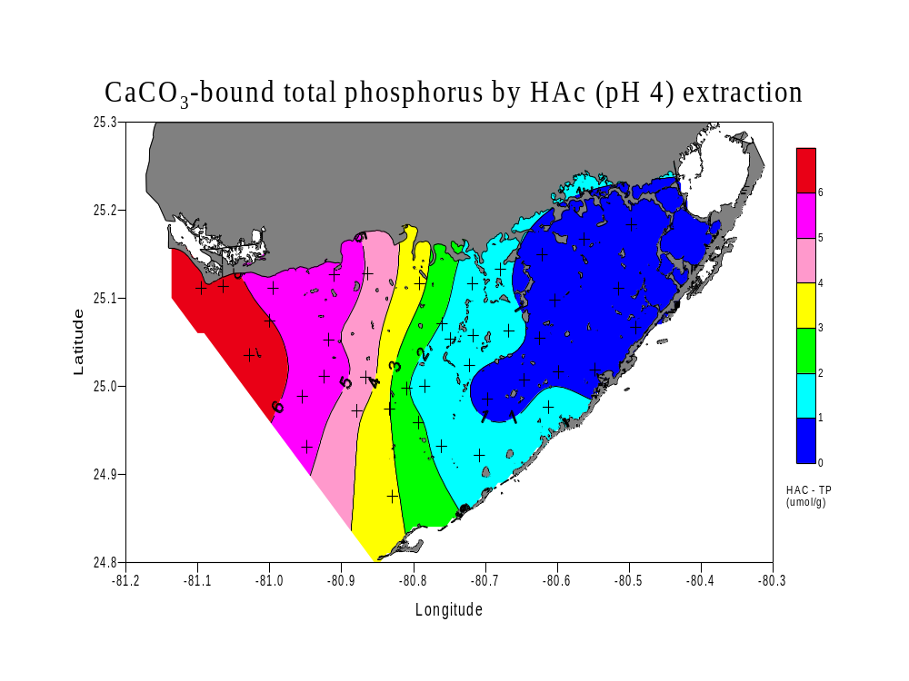
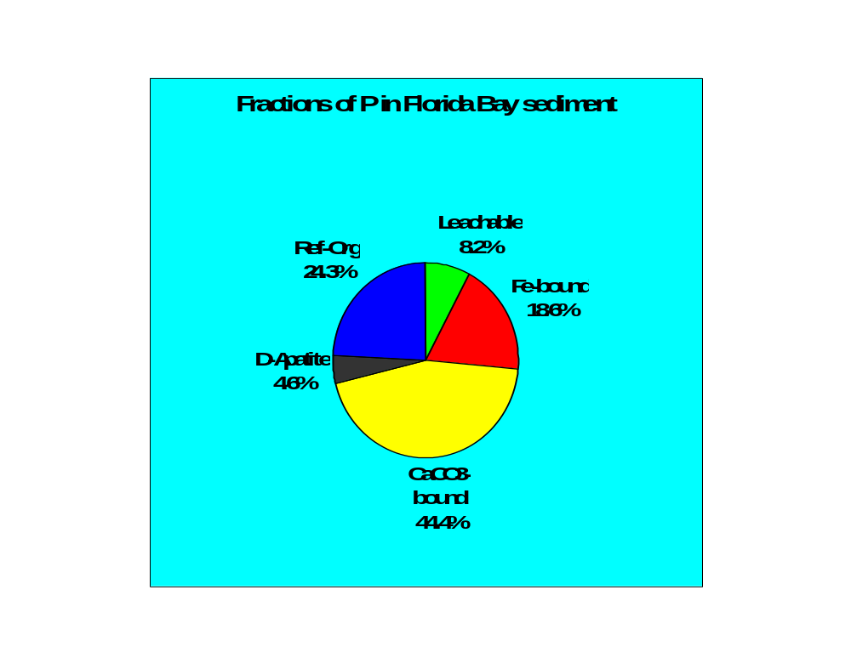
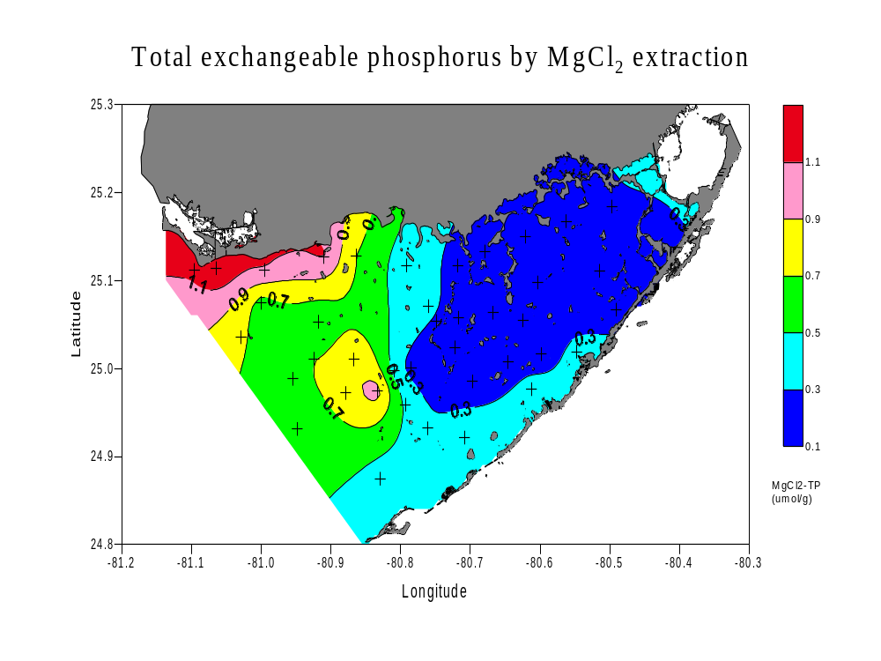
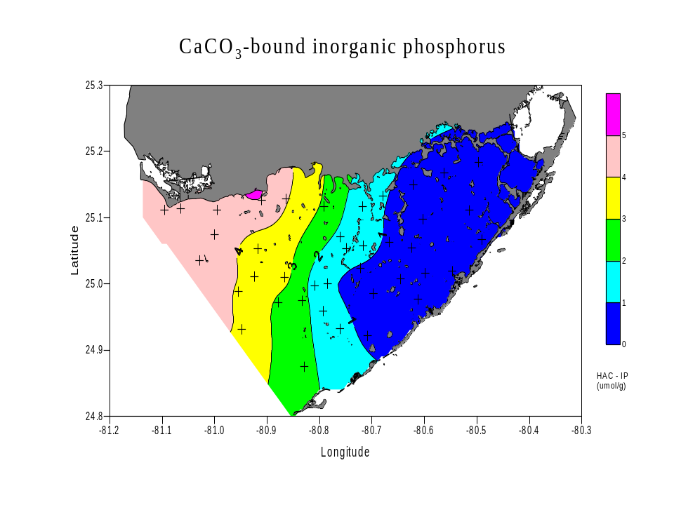
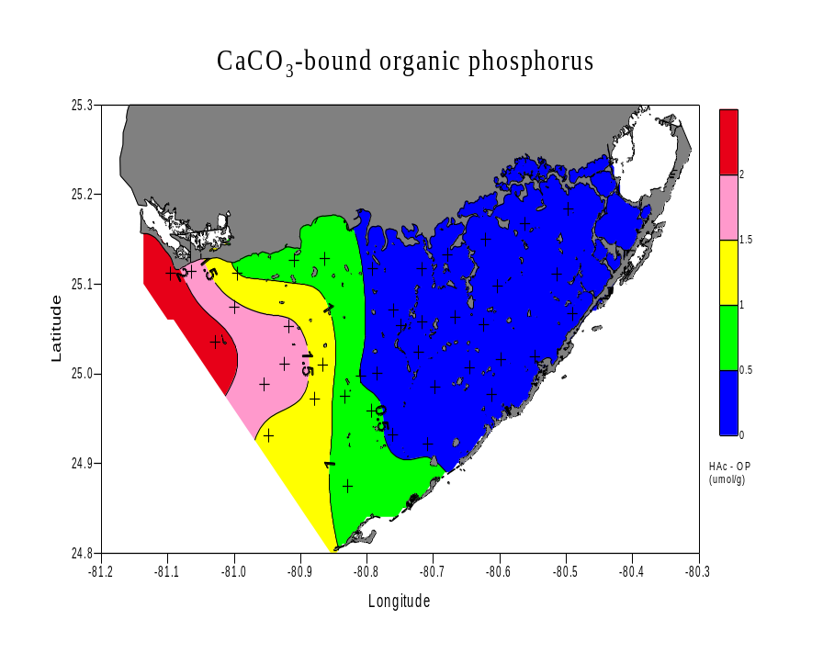
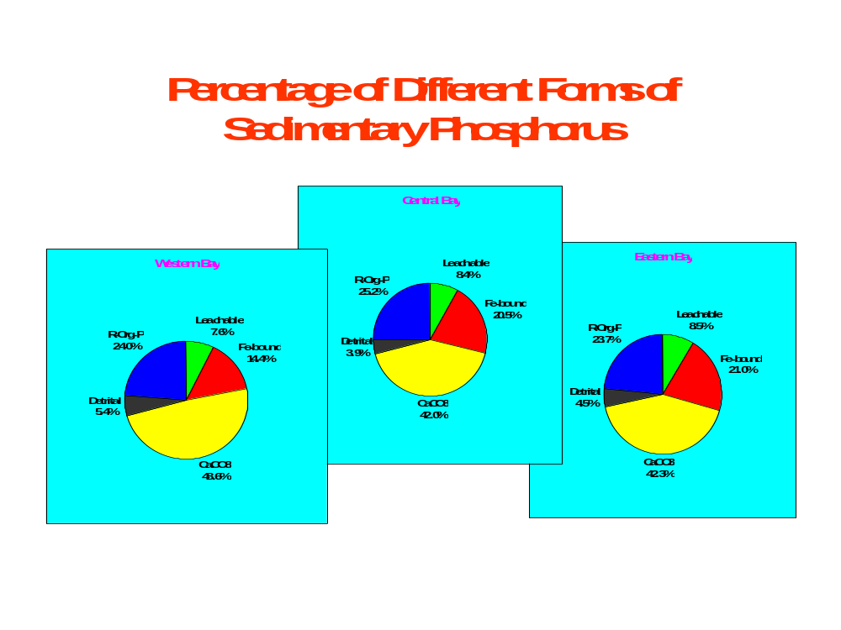
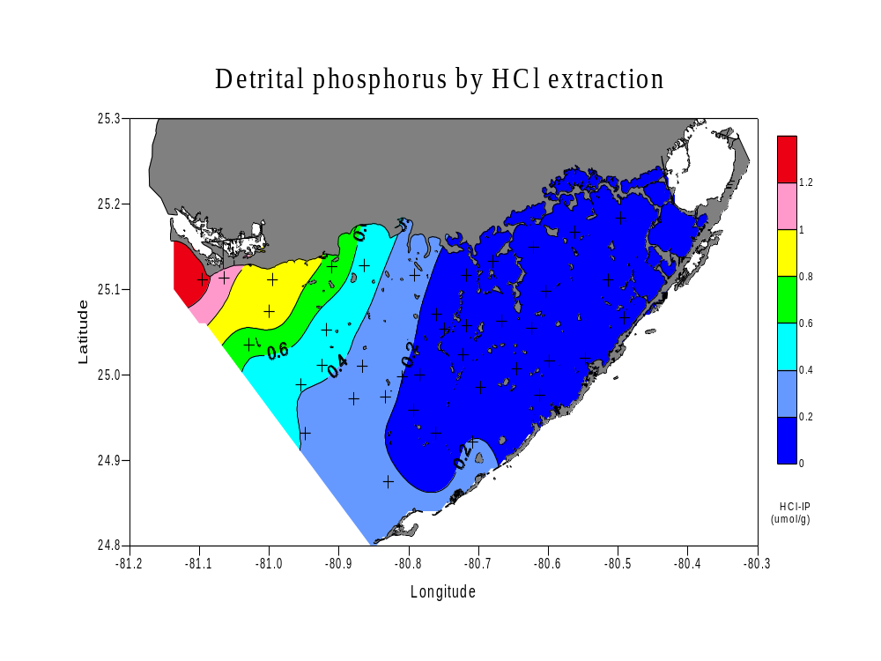
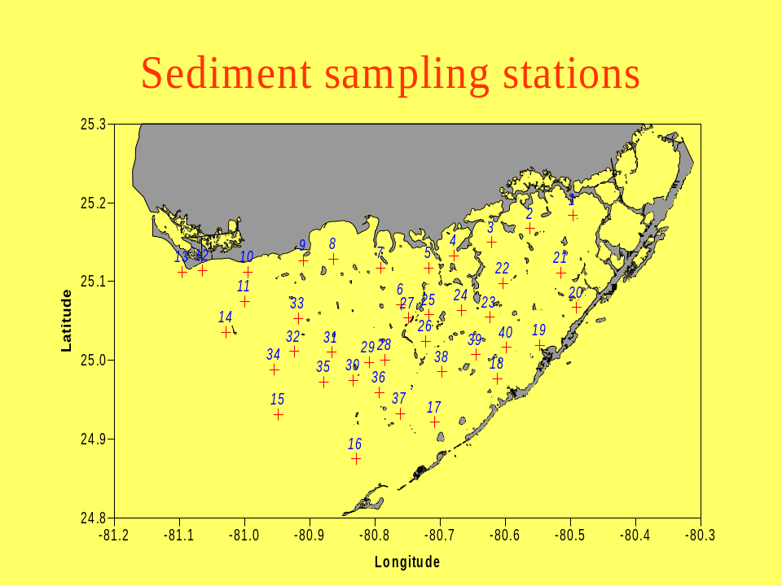
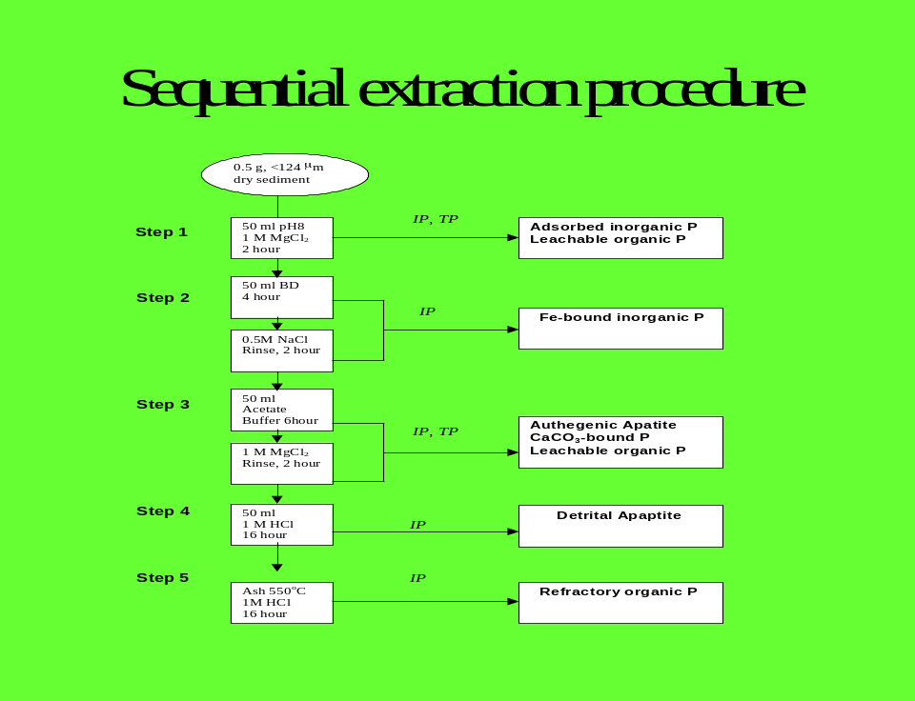
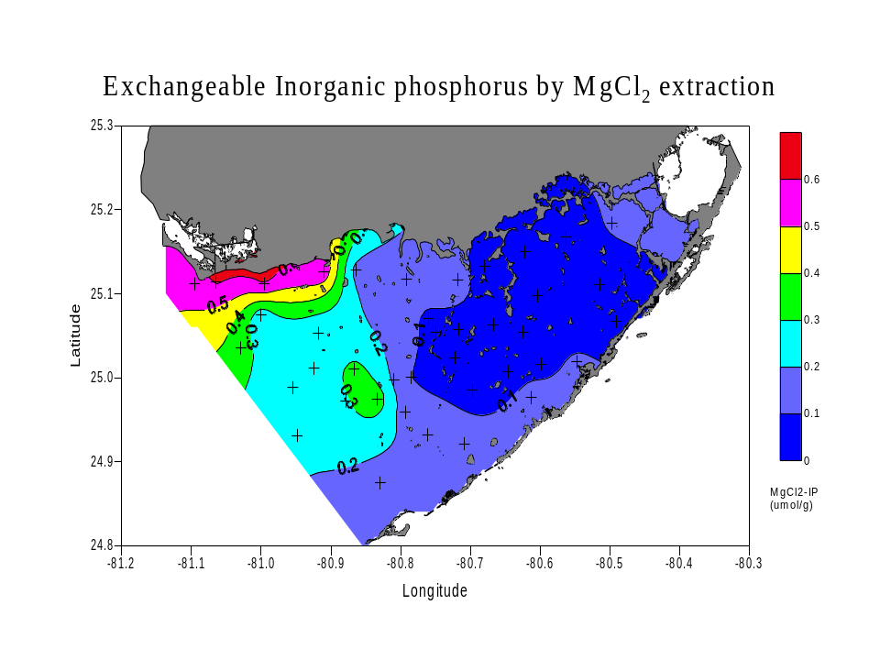
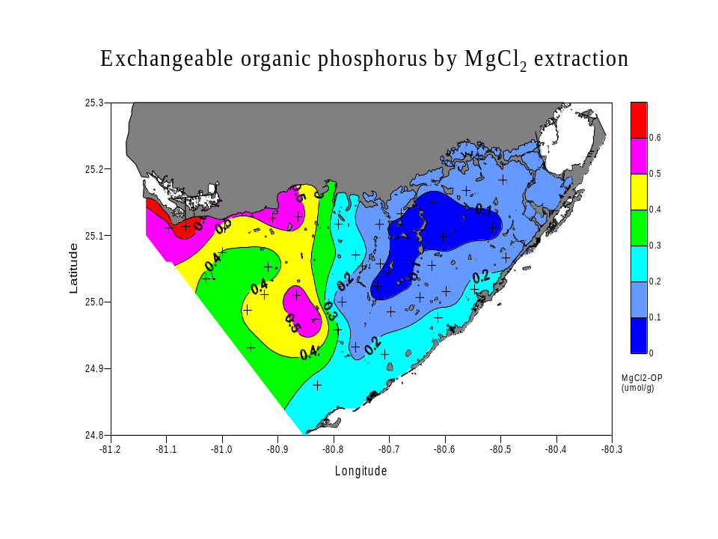
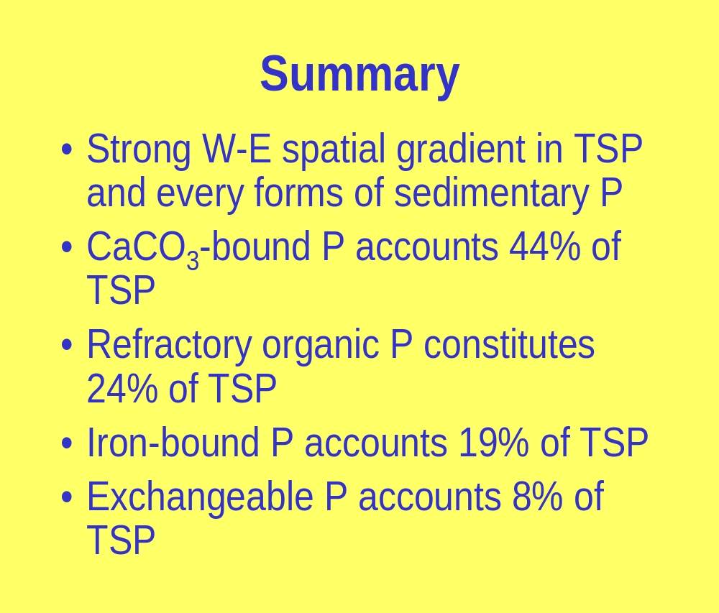
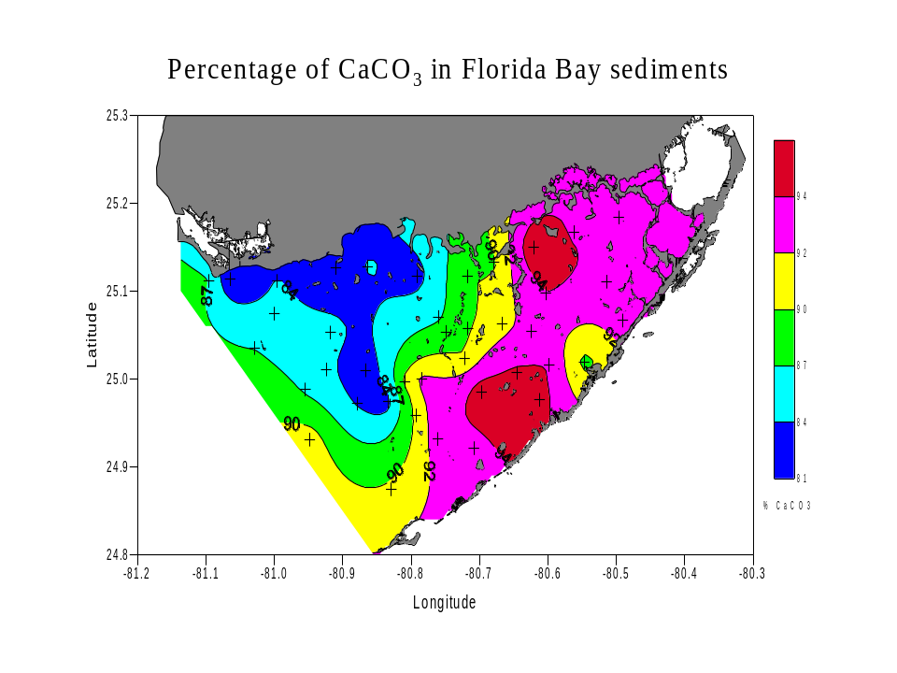
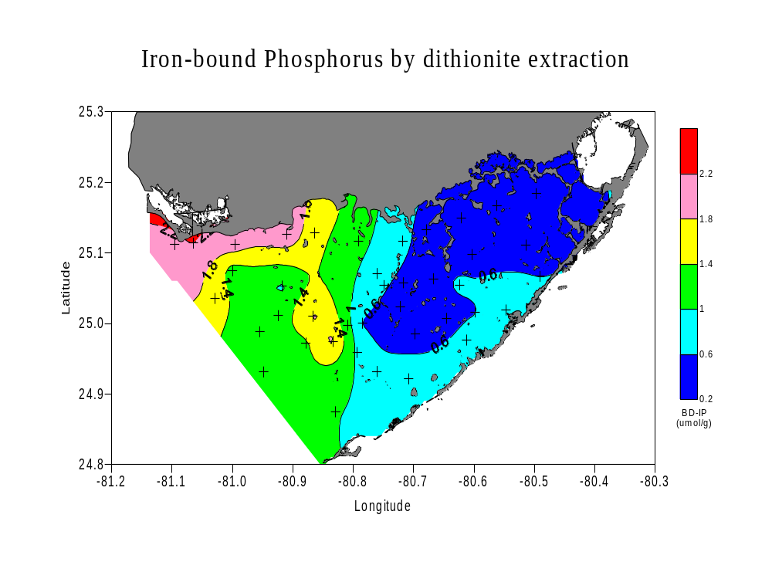
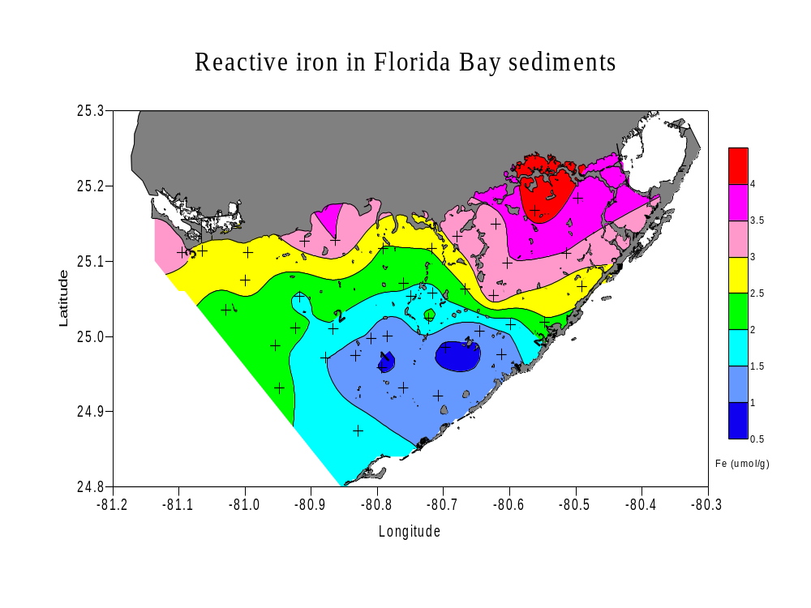
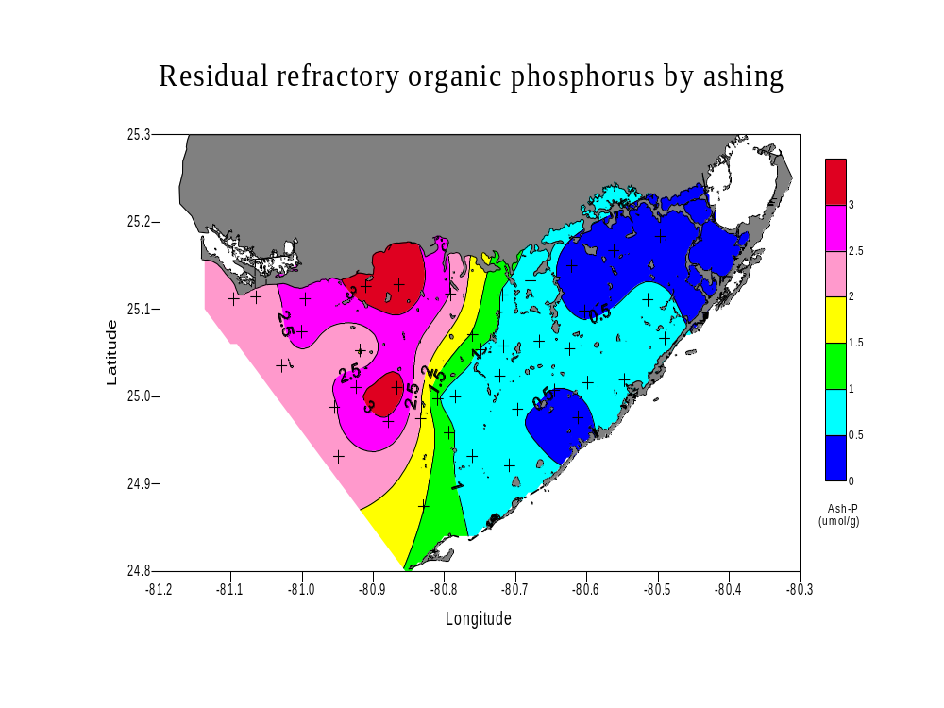
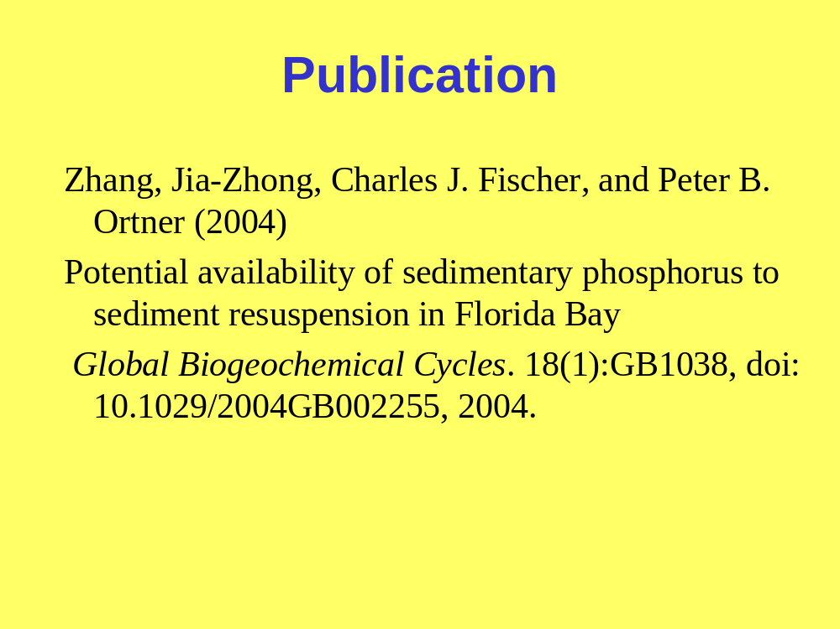
  Spatial Distribution and Abundance of
  Sedimentary Phosphorus in Florida Bay
  Jia-Zhong Zhang and Charles Fischer
  Ocean Chemistry Division, Atlantic Oceanographic & Meteorological Laboratory, NOAA, Miami, FL 33149
ABSTRACT
Applying an improved sequential extraction technique to sediments collected from 40 geographically representative stations in Florida Bay, this study provides the first detailed spatial distribution of total sedimentary phosphorus (TSP) and its partitioning into five chemically distinguishable pools in the surface, fine-grained sediments of the bay. A strong gradient of decreasing TSP concentration was observed from the west (14.6 μmol g⁻¹) to east (1.2 μmol g⁻¹) across the central bay. The spatial pattern of TSP is consistent with distribution of both seagrass and phytoplankton that are limited by available phosphorus in Florida Bay. Among the five pools, the authigenic carbonate fluorapatite, biogenic apatite and CaCO₃-bound phosphorus account for the largest fraction (45%) of TSP, of which inorganic phosphorus is the dominant form, and organic phosphorus accounts for about 30% in the western and north central regions and less than 10% in other areas of Florida Bay. The second largest pools are the refractory organic phosphorus (24% of TSP) and reductant-soluble inorganic phosphorus (19% of TSP). Readily exchangeable phosphorus accounts for 8% of TSP, of which organic phosphorus is 60%. Detrital apatite phosphorus of igneous or metamorphic origin represents the smallest fraction, only 5% of TSP. Spatial distribution of phosphorus and iron in sediments indicates that external sources of these two essential plant nutrients to Florida Bay are spatially separated with phosphorus introduced by west coast waters across the western margin of Florida Bay and iron from freshwater flow into the eastern region.
P=0.57Fe
R2=0.46
Support Provided by NOAA’s South Florida Ecosystem Restoration Prediction and Modeling Program

