Slide 1

MNM Fatal 2008-05
Machinery Accident
February 25, 2008 (Wisconsin)
Sand & Gravel Operation
Dredge Operator
62 years old
12 years experience

Slide 2
Overview
The victim was fatally injured when the
track-mounted excavator he was operating
broke through ice covering a water-filled
ditch. He was using the excavator to free a
dragline frozen to the ice-covered pit floor.

Slide 3
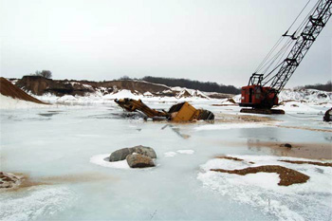

Slide 4
Causal Factor
Management policies, procedures, and
controls were inadequate and failed to
ensure that persons could safely
perform tasks when working in ice
conditions on the pit floor.

Slide 5
Best Practices
When conditions change, examine travelways to evaluate hazards. If the safety of travelways can't be positively determined, do not travel on them.
In locations where travelways are not clearly distinguishable, install barriers, markers, or other warning devices to aid equipment operators, limit travel of mobile equipment, and inform mobile equipment operators of potential hazards.
Stop, Look, Analyze, and Manage, SLAM each task to identify all potential hazards. Initiate action to protect yourself when performing every task.
Wear seat belts when operating self-propelled mobile equipment.

