Slide 1

MNM Fatal 2006-17
Powered Haulage
July 15, 2006 (Puerto Rico)
Sand & Gravel Operation
Truck Driver
61 years old
40 years experience

Slide 2
Overview
The victim was fatally injured when the haul
truck he was operating in the mine
extraction area backed into a water filled
pit.

Slide 3
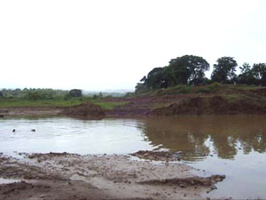
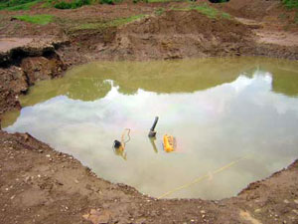

Slide 4
Root Causes
A risk assessment to determine possible hazards and to establish work procedures was not conducted prior to resuming work in the mine extraction area.
Management policies, standards, and controls were inadequate. Examinations had not been conducted to evaluate the hazards at the mine extraction area the day prior to the accident or on the day of the accident. The mine supervisor was on vacation and no one was assigned to conduct the examinations.

Slide 5
Best Practices
Ensure that examinations of ground conditions are conducted in pit areas before commencing work and relay potential hazards to all miners exposed.
In situations/locations where travelways are not clearly distinguishable, markers or other marking techniques should be used to aid equipment operators.
When conditions change, examine travelways to evaluate hazards and install barriers to limit travel of mobile equipment.
Stop, Look, Analyze, and Manage, SLAM each task to identify all potential hazards. Initiate action to protect yourself when performing every task.

