Slide 1

A Systems Development and Implementation Study for 21st Century Software and Security
Third Cyber Security and Information Infrastructure Research Workshop
May 2007
Andrew Loebl, James Nutaro, and Teja Kuruganti
Oak Ridge National Laboratory
{loeblas,nutarojj,kurugantipv}@ornl.gov
Rajanikanth Jammalamadaka
University of Arizona
rajani@ece.arizona.edu

Slide 2
This work was inspired by the lead author’s
experience with projects implementing the
Revolution in Military Affairs. This concept
development was not funded by any combination
of work related to any of these projects.

Slide 3
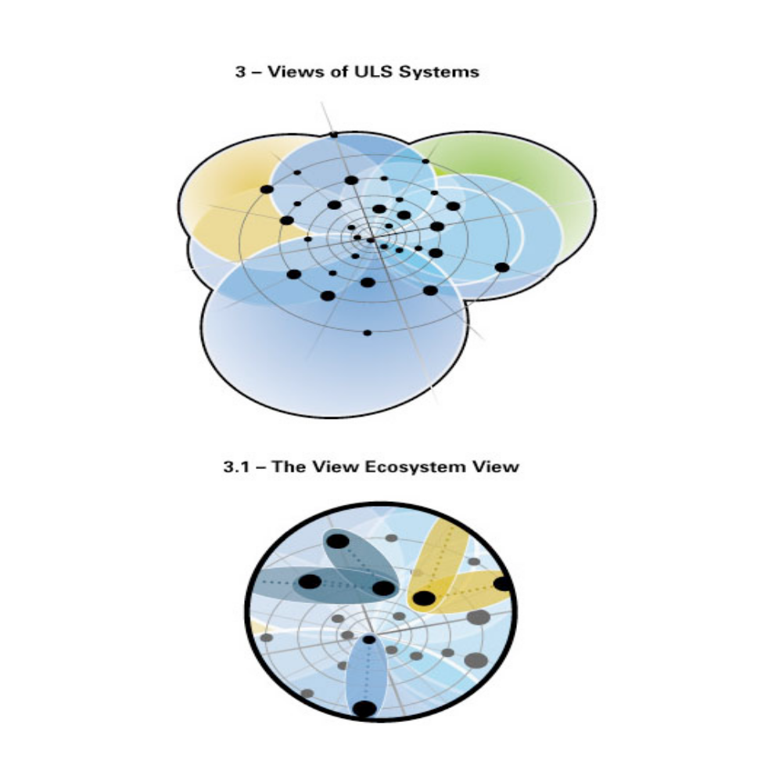
What Is A Modern ‘Software’* System?
Complex (not merely complicated), continuously evolving, interdependent
elements that exhibit functionality far beyond our current “system of systems” concepts.
Design and implementation
merge with updates and
configuration management.
Systems operate naturally
within a domain of constant conflict and
failure while delivering intended results.
*May not be distinguishable as hardware or software

Slide 4
Shaping the Future of Modern Systems
Research:
  Human Attributes Respected
  Machine Attributes Respected
  Computational Emergence
  Foundations for Analysis and Design
  Adaptive Infrastructure
  Adaptive and Predictable System Quality
  Policy, Acquisition, and Management
Generation Characteristics:
  Fast and Correct Development
  Ultra large-, ultra small-scale
  Ultra high-quality, and/or ultra high consistency
  Beyond complexity and cost limits of currently available
hardware and education
  Moore was correct
20th Century technology, concepts, and methods will not suffice

Slide 5
Modern Systems Attributes include;
Networked, Imbedded
      Imbedded systems are rapidly replacing desktop systems for critical applications
      Imbedded systems are becoming more powerful and more flexible
      Imbedded systems will be the invisible systems of the future, with no owner, no administrator, no upgrades or patches, ubiquitous (some negatives here), not stealthy as objective

Slide 6
Implications of Network Imbedded Systems
  Vulnerable systems will be difficult to locate, and impossible to “fix”
  Attackers will use imbedded systems to move silently through the network
  Our current work in network security does not handle this new paradigm well
  At risk will be everything from consumer products to critical infrastructures

Slide 7
Modern Applications Systems Will Be Developed with A Discipline Practiced Only in the Earliest Years of Systems Development
  Computational Methods Formalized:
    Provable solutions
    Mathematically verifiable
    Numerically and computationally closed to insertion or extraction
    tested piecemeal
  Formal Development Framework(s) Standards
    Evolutionary development
    Model based development
    Quantifiable definitions of performance metrics
    Functional/operational decomposition
      Completeness
      Security/integrity

Slide 8
Motivating Factors for Analyzing Security and Information Assurance Requirements for Digitally Based Systems
Complexity
Expectations
Reliability
Pervasiveness
Ubiquity
Integration

Slide 9
Characteristics for a Preliminary Model for Information Assurance and Systems Security
Security related requirements analysis executed
Security and performance requirements empirically understood
Marginal additional assurance of measures considered better understood
Cost consequences in two dimensions better understood

Slide 10
Notional Vulnerability Model Offered for Illustration
Only singular threats considered
Illustrate specification needed to inform requirements determination and design decisions
Expected operational life time of a threat
Appraise performance metrics for essential security processes
Describes expected operational life-time of a threat in terms of; identification and elimination

Slide 11
A Probabilistic Model Formulation
D(td) denotes the probability of identifying the attack within the time interval [0, td] after the attack has begun.
[K(t)|D(td)] is the conditional probability of neutralizing the attack at time t given that the attack was identified at time td.
Dc(td) denotes the probability of not identifying the attack within the time interval [0, td]
[K(t)|Dc(td)] denotes the probability of neutralizing the attack before it is identified
K(t) is probability of neutralizing the attack after a time t, as described by Baye’s theorem as
K(t) = [K(t)|D(td)]D(td) + [K(t)|Dc(td)]Dc(td)
[K(t)|Dc(td)] = 0. Therefore, K(t) is
K(t) = [K(t)|D(td)]D(td)
(The expected lifetime of an attack.)

Slide 12

Notional (cont’d)
k(t) denotes the probability density function of K(t)
This is the quantified vulnerability

Slide 13
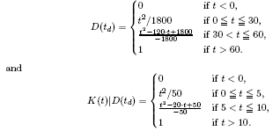
Example 1; GPS Jamming
D(td) denotes the time, in minutes, to detect jammer,
[K(t)|D(td)] is a random variable denoting the
time, again in minutes, to kill jammer following detection
D(td) is a triangular distribution with [0, 60] minutes as end points and a mode of 30
[K(t)|D(td)] is a triangular distribution with [0, 10] minutes as end points and a mode of 5 minutes

Slide 14


Example 1; GPS Jamming (con’t)
K(t) time needed to kill the jammer is
expected attack lifetime is
= 30 minutes

Slide 15
Empirical Understanding Is Valuable
Other distributions of jammer detection and jammer elimination capabilities evaluated in simulations
Adequacy of a requirement to detect within a critical time period can be evaluated
Fundamental relationship between detection and elimination can be studied
Cost to protect against jamming for which durations can be evaluated
Cost to protect against jamming versus other independent threats, like denial of service, can be evaluated
Through and empirical determination, a host of assumptions and scenarios can be evaluated
With experience, other threats can be evaluated, but our notional model must be improved

Slide 16
Conclusions
research needed to develop a quantitative, model based, requirements analysis methodology for security and assurance of vulnerable systems and information for many classes of threat
methods will help produce testable, model based requirements that contribute to security and assurance
  requirements thus produced can be validated
  validations and extents can be communicated clearly to stakeholders and developers, to provide a objective bases for system verification.
significant reduction in lifetime system costs can accrue
  through a quantifiable understanding of requirements and effective, but not merely redundant, application of measures
  extent of experimental development needed to combine and improve measures
  help to inform decision makers about realistic system performance expectations
  ensure that performance expectations are met through more adequate and less expensive system verification, and
  reduce system maintenance costs for this assurance and security purpose.

