Slide 1
Influenza Update 2003
Satellite Broadcast
December 19, 2003
Notes:
Produced for: National Immunization Program and National Center for Infectious Diseases, Centers for Disease Control and Prevention
Produced by: Division of Personnel Development and Evaluation, Public Health Program Planning Office, CDC
Broadcast Friday, December 19, 2003.

Slide 2
Topics
Status of influenza activity in the U.S.
Update of vaccine supply
Current vaccination recommendations
Notes:
We will begin with a discussion of current influenza activity in the United States, including information on influenza associated deaths. We will then update you on the status of the influenza vaccine supply, and recommendations for vaccination

Slide 3
Topics
Influenza laboratory and diagnostics
Antiviral drugs
Infection control
Notes:
Following our discussion of influenza vaccine, we will talk about laboratory diagnosis of influenza, in particular the use of rapid diagnostic tests. This will be followed by information about the use of influenza antiviral drugs, and recommendations for influenza infection control.

Slide 4
Influenza Surveillance
Week ending December 13, 2003
Keiji Fukuda, MD
Notes:
Influenza activity clearly began early this year in the U.S. community. Outbreaks were first reported from Texas in early October and soon were followed by increasing activity each week in other states. During October and November, activity levels generally were higher west of the Mississippi but more recently, influenza is in all areas of the country.
National activity levels have not peaked yet, and we do not know how long activity levels in two states with early activity, Texas and Colorado, appears to be on the decline. I would like to summarize for you our most current influenza surveillance data for week 50, the week ending Decemeber 13, 2003.

Slide 5
Influenza Surveillance in the United States
Laboratory characterization of viruses
Influenza activity as assessed by State and Territorial Epidemiologists
Influenza-like illness surveillance by sentinel providers
Pneumonia and influenza mortality in 122 U.S. cities
Notes:
Let me first briefly describe the influenza surveillance system in the United States. CDC uses four systems to monitor national influenza activity in the United States and these reports typically are put out between October and May of each year. The first system is a group of about 120 WHO and National Respiratory and Enteric Virus Surveillance Laboratories scattered throughout the country. These laboratories, many of which belong to state health departments, help monitor influenza virus activity and the emergence of new influenza strains in the country. These laboratories send information on virus detections and a subset of the isolates to CDC to be characterized further. The second system consists of reports from the state and territorial epidemiologists who report their levels of influenza activity in their local area each week to CDC. These epidemiologists report the activity levels as either sporadic, local, regional, or widespread. The third system consists of about 1,000 sentinel providers located throughout the United States. These physicians report the percentage of all patient visits that are being made to them for influenza-like illness. The fourth system consists of 122 cities that report the percentage of all deaths in their cities attributable to pneumonia or influenza. During severe seasons the percentage of such deaths will exceed the expected baseline or so-called epidemic threshold for several weeks.

Slide 6
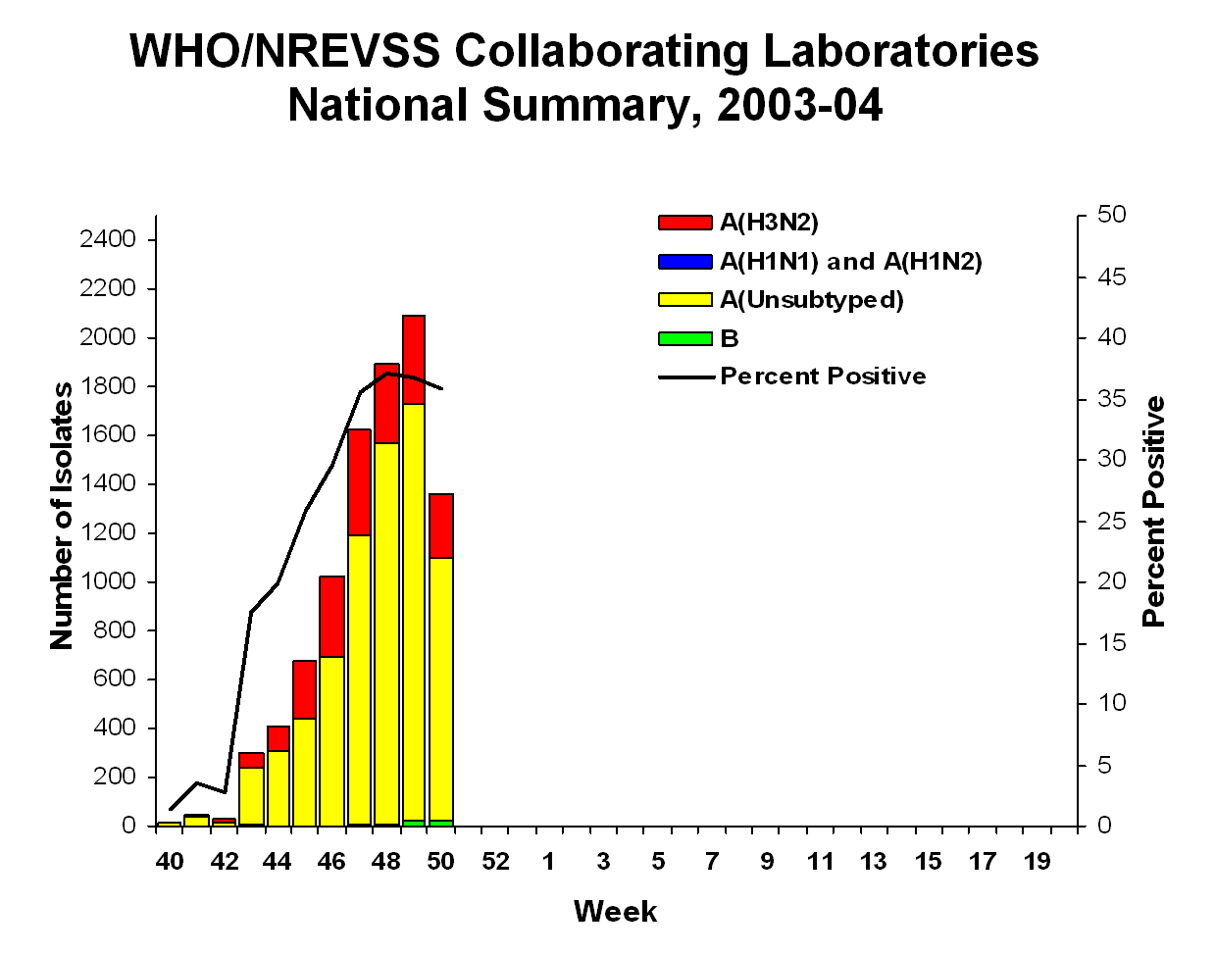
Notes:
Now in this graph here we see a summary of the influenza virus information collected in the U.S. so far. The stack bars represent the number of viruses which have been isolated so far, and the black line represents the percentage of clinical specimens which are testing positive for influenza in the surveillance laboratories. Overall we can see that the 2003-04 season has been dominated by influenza A viruses as shown by the stacked yellow bars which represent influenza A viruses that have not yet been subtyped, and the red bars which represent influenza A (H3N2) viruses. Now through the week ending 50 or the week ending December 13th, national surveillance laboratories have reported detecting 9,395 influenza A viruses and 69 B viruses. 2,113 of the A viruses were subtyped and all of them have been influenza A (H3N2) viruses except one H1 virus. Now although this graph looks like there’s peaking of activity, I do want to put out a caveat that this probably represents a lag in reporting. It won’t be clear until a few weeks later. Now influenza viruses have been reported from all 50 states. 29% of the viruses have come from the southwest central region which represents Arkansas, Louisiana, Oklahoma and Texas, and 28% of the viruses have come from the mountain region which represents Arizona, Colorado, Idaho, and Montana.

Slide 7
Influenza Virus Surveillance
Through December 13, 2003
> 99% of influenza viruses are type A
> 99% of A viruses are H3N2 subtype
  ~ 23% A/Panama/2007/99
  ~ 77% A/Fujian/411/2002
Notes:
Now so far over 99% of all influenza viruses have been A viruses in the country, and of the A viruses that have been subtyped which is 2,113, over 99% of them have been influenza A (H3N2) viruses. Of the 265 H3N2 viruses that have been further characterized for strain typing, 23% have been Panama-strain viruses and 77% have been Fujian-strain viruses.

Slide 8
Influenza Vaccine Virus Selection
3 viruses (H3N2, H1N1 and B)
A/Fujian H3N2 strain not included
  Strains chosen by FDA in February
  A/Fujian detected late
  A/Fujian virus suitable for vaccine manufacture not available in time
Notes:
So at this point let me say a few things about the vaccine since it fits in with the viruses being detected in the country. Influenza vaccine normally contains three viruses: an influenza A (H3N2) virus, an influenza A (H1N1) virus and the B virus. The H3N2 strain contained in the 2003 vaccine is a Panama virus and not an A/Fujian virus. Now there’s several important reasons for this situation that I want to explain. The strains used in the U.S. vaccine are usually selected each year between February and March at a meeting held by the Food and Drug Administration. Now these strains must be chosen by this time each year to provide manufacturers with enough time to produce and distribute vaccine and the Food and Drug Administration with enough time to test lots before they’re released. Now this year global surveillance detected A/Fujian-like viruses late in January. Due to the late detection there was not enough time to find a suitable Fujian-like virus that had been passaged and grown completely in eggs. Most surveillance laboratories worldwide now use cell cultures to isolate influenza viruses. However, by law only viruses grown solely in embryonated eggs can be used for vaccines. This year because the virus emerged so late, there was not enough time to locate such a virus so the decision was made to retain Panama as the H3N2 virus in the vaccine.

Slide 9
2003 Vaccine Effectiveness
A/Panama-like and A/Fujian-like viruses related but antigenically distinguishable
Antibodies to Panama cross react with A/Fujian-like viruses
  Some cross immunity expected
Vaccine effectiveness needed to estimate protection
Notes:
Let me say a few words about the vaccine effectiveness. The A/Fujian-like viruses represent drift variance or mutated viruses that evolved from the A/Panama viruses. Antibodies to A/Panama viruses will cross react with A/Fujian-like viruses but at lower levels. Now because antibodies to A/Panama cross react with Fujian viruses it is expected that this year’s vaccine will provide some degree of protection against A/Fujian viruses. However, the degree of protection is unknown and cannot be estimated by laboratory test results. The vaccine effectiveness can only be estimated by clinical vaccine effectiveness studies. Such studies are underway in the U.S. right now but we do not have results yet.

Slide 10
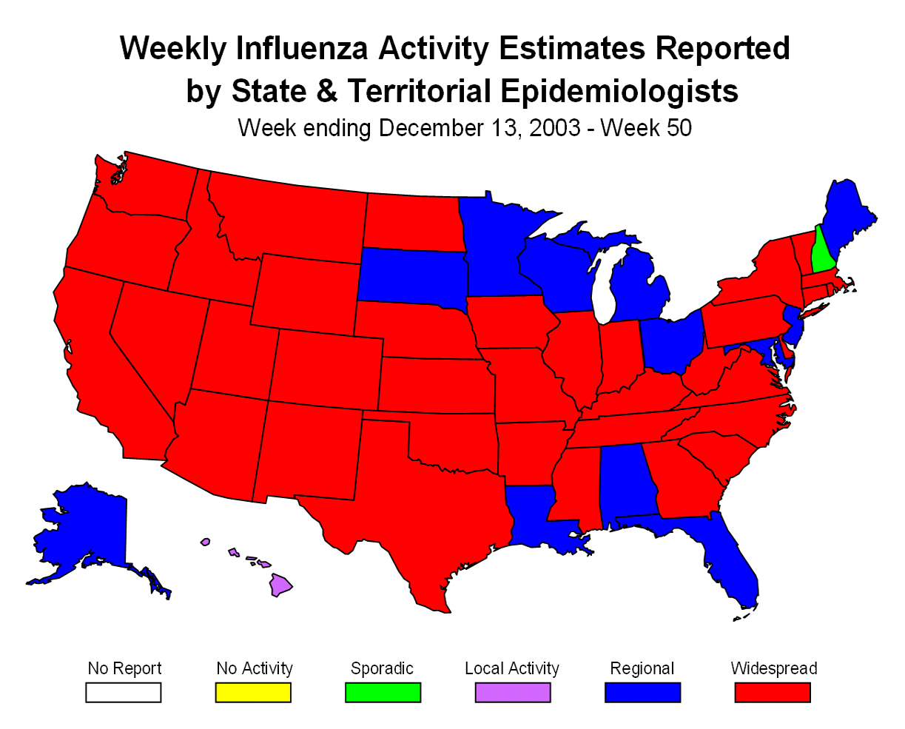
Notes:
Now in this map here we see state activity levels as reported by the state and territorial epidemiologists. In week 50 we can see that 36 states shown here in red are reporting widespread activity. Twelve states shown in blue and New York City are reporting regional activity. New Hampshire, which is represented in green which sticks out nicely, is reporting sporadic activity levels.

Slide 11
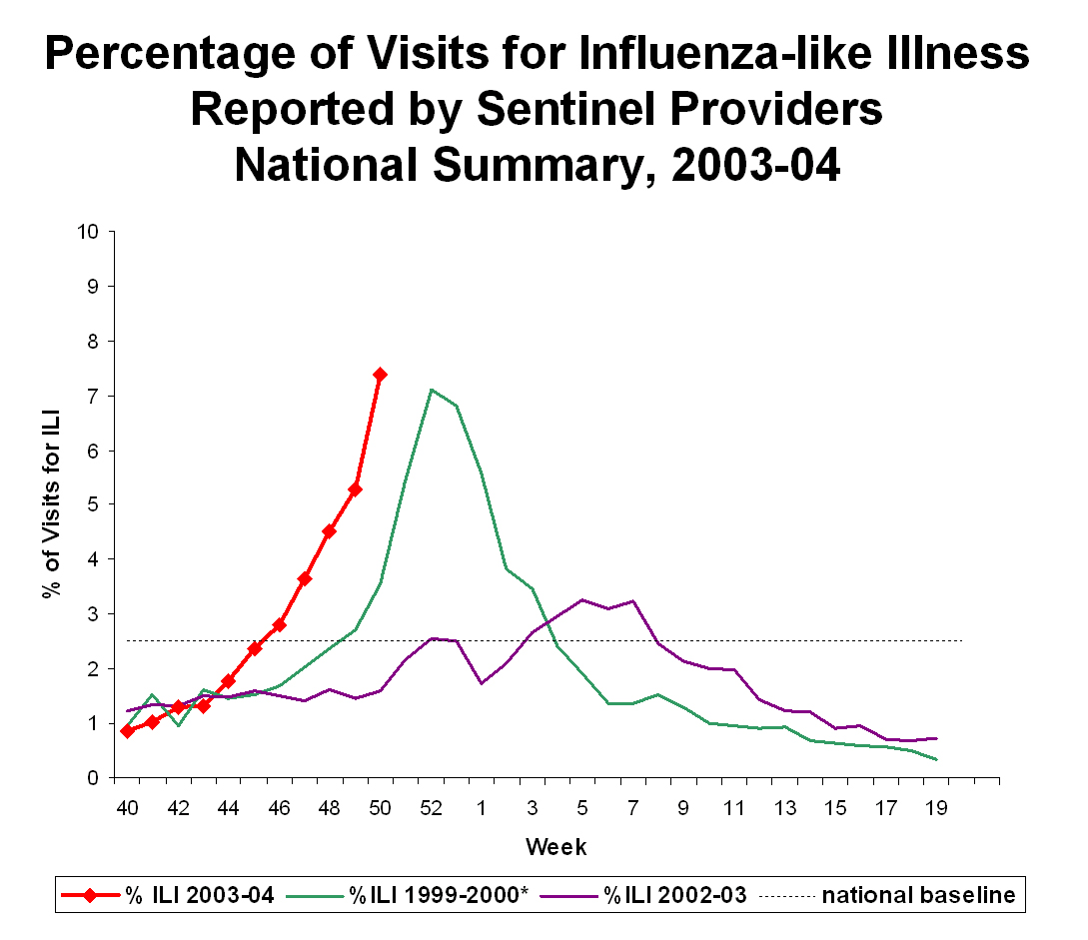
Notes:
Now in this graph here, we see the percentage of patient visits being made to sentinel providers for influenza-like illness. The 2003 season is represented by the red line which clearly shows that activity began early this year. Two other seasons, the 1999-2000 season in green, and the 2002 and 2003 season in purple are shown for purposes of comparison. In week 50, 7.4% of patient visits to U.S. sentinel providers were due to influenza-like illness which is about the national baseline of 2.5%. In the most recent surveillance results patients for influenza-like illness are increasing in 7 of the 9 surveillance regions. However, these visits are beginning to decline in two regions, the west-south central region where Texas is located, and the mountain region where Colorado is located.

Slide 12
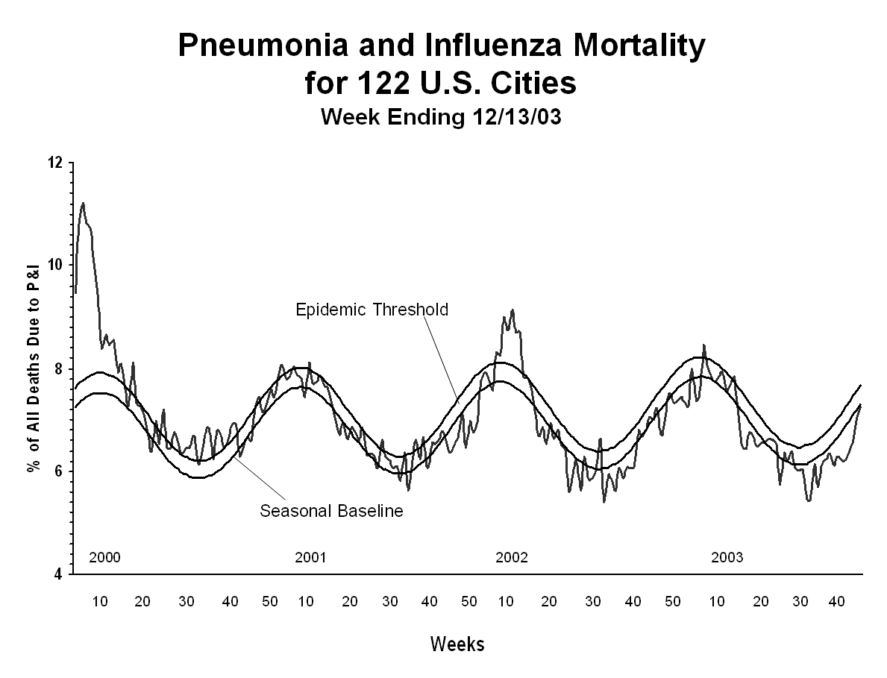
Notes:
Now in this graph here we see the pneumonia and influenza mortality reported by 122 cities in the United States. Now the sinusoidal baseline represents the expected pneumonia and influenza deaths throughout the year. The jagged line shows the actual deaths which occurred and which are measured. You can see from this graph that there’s a great deal of variability from year to year in terms of measured deaths. For example, if you look to the left you can see that for the 1999-2000 season there was a high peak in deaths occurring, whereas in the years between 2001 and 2003 there really were very small or minimal peaks. Now this year is represented at the far right of the graph and you can see that so far the P&I or pneumonia and influenza deaths have not yet gone above the baseline. However, increases in deaths typically lag other markers by about a few weeks, so we’ll have to watch this line carefully.

Slide 13
Influenza-Associated Deaths in Children, Oct. – Dec., 2003
42 deaths children <18 years
Mean age 6; Median age 4
20 male; 21 female
Located in several states
All with confirmed flu infections
17 (40%) underlying conditions
21 (50%) no known conditions
Secondary bacterial infections
Investigations underway
Notes:
Now I also want to comment upon some of the reports of influenza-associated deaths in children which have occurred this year. There has been a lot of media coverage about these deaths in children particularly in places such as Colorado. From October through December 17th, CDC has received reports of 42 deaths in children age younger than 18 years reported from multiple states. The mean age of these children is six years and the median age is four years. About half of them are males and about half of them are occurring in females. These deaths are located, or have been reported from several different states. Now all of the deaths reported to CDC have been laboratory or rapid test confirmed influenza-associated deaths. That is, infection has been confirmed in all of those children. Among these children about 40% of them have underlying medical conditions and 50% of them have no known underlying medical conditions. The medical status of 10% is unknown. I also want to add that the vaccination status of most of these children is still not known. Among six children, four who are healthy and two who had chronic medical conditions, there were several bacterial super infections which were identified. These included methicillin resistant Staphylococcus aureus infections, Streptococcus pneumoniae infections, group A Streptococcus infections, and Neisseria Meningitidis.
Today we should be having an MMWR dispatch coming out describing these cases in somewhat more detail. The MMWR report also contains a request for states to report all such influenza-associated deaths to CDC. Now the number of deaths being reported to CDC this year is striking. However, this is not a reportable condition and so right now we do not have a baseline of such deaths and it is uncertain whether this is an unusual number of cases to occur in an H3N2 year. Mathematical models have estimated that on average about 92 deaths each year occur from influenza in children younger than five years. CDC will be investigating whether the deaths being reported this year are unusual and whether this is a more severe year for influenza than usual.
The national Influenza surveillance reports are updated each week during influenza season. Previously, these reports were available on the CDC influenza website on Friday but now reports will be posted a day earlier on Thursday.

Slide 14
Influenza FAQ
Is this year’s influenza season going to be more severe than previous years?
  Virus activity widespread earlier than usual
  H3N2-predominant years typically more severe
  No evidence that A/Fujian is more virulent than other H3N2 viruses
Notes:
This season began earlier than usual. Also, most of the influenza has been type A (H3N2). Historically, A (H3N2) viruses have been associated with more severe seasons, with higher numbers of influenza related hospitalizations and deaths. However, we also have heard about many hospitals being overwhelmed by many patients. I do want to point out, however, that this occurs in all severe influenza seasons. We have no solid evidence that A/Fujian is more virulent than other H3N2 viruses. It is also possible that we will see other flu viruses such as B viruses predominate later in the season. Bottom line, we probably won’t know the answer to this question until the season ends.

Slide 15
Influenza Vaccine Supply and Recommendations
Raymond Strikas, MD
Notes:
There has been a marked increase in demand for influenza vaccine this year. Some health care providers have used - or may use - all of their supply of influenza vaccine. It's difficult to predict - months in advance- how many people will want an influenza vaccination. In past years, supply has generally been sufficient to meet demand, but this year, demand has continued to be very strong into the month of December. At a time when influenza vaccination clinics are typically winding down, people are still seeking flu shots.

Slide 16
Influenza Vaccine
Three companies produce influenza vaccine for the United States
Two of these companies produce only inactivated injectable vaccine
87 million doses of all influenza vaccines produced for the 2003-2004 season
Notes:
Three companies produce influenza vaccine for the United States. Two of these companies, Evans/Chiron and Aventis Pasteur, produce only inactivated vaccine. The three companies together made about 87 million doses of vaccine, which ordinarily would be enough to exceed U.S. demand. The third company - actually a pair of companies, Wyeth and Medimune- makes a live attenuated influenza vaccine which is given as a nasal spray.
The two manufacturers of inactivated influenza vaccine have shipped almost all of their inventory. There will be no more vaccine produced this year, because by the time it would be ready, influenza season will have ended.

Slide 17
Additional Influenza Vaccine Supply
DHHS purchased 100,000 additional doses of adult Aventis Pasteur vaccine – being shipped now
150,000 pediatric doses available in January
375,000 adult Chiron/Evans vaccine available in mid-January
Live attenuated vaccine available now for public health purchase through CDC contract
Notes:
The Department of Health and Human Services and CDC have been looking at all of our options as to possibly acquiring additional supplies of influenza vaccine.
The Department has purchased 100 thousand doses of adult vaccine from Aventis Pasteur. This vaccine was shipped to state health departments last week. Each state’s supply was based upon its population. We have also purchased from Aventis Pasteur an additional 150,000 doses of pediatric vaccine and expect to have it ready for shipment to the states by January of next year.
CDC has also arranged a contract with Chiron/Evans for 375 thousand doses of their injectable vaccine, which will be available for states to order in mid-January. States have been asked to work with their local health departments, federally qualified health centers, rural health centers, and Indian Health Service and tribal facilities to determine their needs.
Finally, CDC has signed a contract with Wyeth/Medimmune to purchase the live attenuated vaccine. We have also negotiated the ability for public entities, such as local health departments, in addition to Federal immunization grantees, to purchase vaccine through this contract.
We are working with the states to distribute the vaccine based on population in the states. At the state level, decisions about who should receive these extra doses will be based on what is the overall availability and need in that particular jurisdiction.

Slide 18
Priorities for Inactivated Influenza Vaccine
First priority is persons at high risk for complications from influenza
  all children aged 6-23 months
  adults aged >65 years
  pregnant women in their second or third trimester during influenza season
  persons aged > 2 years with underlying chronic conditions
Notes:
Because demand for vaccine exceeds supply in some areas, it is necessary to establish priorities for the vaccine that is available. The priority should be to vaccinate persons at highest risk of complications of influenza.
First priority should be placed on targeting trivalent inactivated vaccine to persons at high risk for complications from influenza: all children aged 6 to 23 months; adults aged 65 years and older; pregnant women in their second or third trimester during influenza season; and persons aged 2 years and older with underlying chronic conditions. Persons at high risk should be encouraged to search locally for vaccine if their usual healthcare provider no longer has vaccine available.

Slide 19
Priorities for Inactivated Influenza Vaccine
All children at high risk, including those aged 6-23 months, who report for vaccination should be vaccinated with a first or second dose, depending on vaccination status
Doses should not be held in reserve to ensure that two doses will be available
Notes:
All children at high risk, including those aged 6 to 23 months, who report for vaccination should be vaccinated with a first or second dose, depending on vaccination status. Doses should NOT be held in reserve to ensure that two doses will be available.

Slide 20
Priorities for Inactivated Influenza Vaccine
Next priority should be given to vaccinating those persons at greatest risk for transmission of disease to persons at high risk, including household contacts and healthcare workers
Notes:
Next priority should be given to vaccinating those persons at greatest risk for transmission of disease to persons at high risk, including household contacts and health-care workers.
Decisions about vaccinating healthy persons, including adults aged 50 to 64 years, with inactivated influenza vaccine should be made on a case-by-case basis, depending on local disease activity and vaccine supply.

Slide 21
LAIV Schedule
Age Group
5 - 8 years, no
previous influenza
vaccine
5 - 8 years, previous
influenza vaccine *
9 - 49 years
Number of Doses
2
(separated by
6-10 weeks)
1
1
* LAIV or inactivated vaccine
Notes:
The new live attenuated influenza vaccine – FluMist- can play an important role in our influenza vaccination efforts. Live attenuated influenza vaccine is approved by the Food and Drug Administration ONLY for use among healthy persons 5 through 49 years of age. Healthy persons aged 5 to 49 years should be encouraged to be vaccinated with this vaccine if possible.
This table shows the vaccination schedule for LAIV based on age and prior influenza vaccination history. A dose of LAIV is 0.5 milliliter, regardless of age, divided equally between nostrils. Children 5 to 8 years of age who have received NO previous influenza vaccine- either LAIV or inactivated influenza vaccine- should receive two doses of LAIV separated by 6 to 10 weeks. Note that this is longer than the 4 weeks recommended between the first two doses of inactivated influenza vaccine.
ACIP recommends that children 5 to 8 years of age previously vaccinated at any time with either LAIV or inactivated influenza vaccine receive one dose of LAIV. They do not require a second dose. This is different than the manufacturer’s labeling, which recommends that children who have not previously received LAIV should receive two doses, regardless of whether they may have previously received inactivated influenza vaccine. Persons 9 through 49 years of age should receive one dose of LAIV.

Slide 22
Persons Who Should Not Receive LAIV
Children <5 years of age*
Persons >50 years of age*
Persons with asthma, reactive airways disease or other chronic pulmonary condition*
Persons with cardiovascular disease*
*These persons should receive inactivated influenza vaccine
Notes:
LAIV is approved for use ONLY in healthy persons 5 through 49 years of age. Consequently, LAIV is NOT approved, and is not recommended for administration to most people for whom inactivated influenza vaccine has been recommended for many years.
Persons who should NOT receive LAIV include children less than 5 years of age; persons 50 years of age and older; persons with asthma, reactive airways disease or other chronic pulmonary or cardiovascular conditions. These persons should receive inactivated influenza vaccine.

Slide 23
Persons Who Should Not Receive LAIV
Persons with underlying medical conditions*
  metabolic diseases (e.g. diabetes)
  renal disease
  hemoglobinopathy (e.g. sickle cell disease)
  Children and adolescents receiving chronic salicylate therapy
*These persons should receive inactivated influenza vaccine
Notes:
Persons with other underlying medical conditions should not receive LAIV. These conditions include metabolic disease such as diabetes, renal disease, or hemoglobinopathy, such as sickle cell disease; and children or adolescents receiving chronic therapy with aspirin or other salicylates, because of the association of Reye syndrome with wild-type influenza infection.
Persons in these groups should receive inactivated influenza vaccine.

Slide 24
Persons Who Should Not Receive LAIV
Immunosuppression (e.g. HIV, immunosuppressive drugs)
Pregnant women
Severe allergy to egg or any other vaccine component
History of Guillain-Barre syndrome
Notes:
As with all live virus vaccines, persons who are immunosuppressed because of disease, including HIV, or who are receiving immunosuppressive therapy, should not receive LAIV.
Pregnant women should not receive LAIV.
Immunosuppressed persons and pregnant women should receive inactivated influenza vaccine.
Since LAIV contains residual egg protein, it should not be administered to persons with a history of severe allergy to egg or any other vaccine component.
Finally, the vaccine should not be administered to a person with a history of Guillain-Barré syndrome.

Slide 25
Use of LAIV Among Close Contacts of High-risk Persons
Inactivated influenza vaccine is preferred for household members, healthcare workers, and others who have close contact with immuno-suppressed individuals
No preference for vaccination of healthy persons aged 5-49 years in close contact with all other high-risk groups
Notes:
Close contacts of persons at high risk for complications from influenza should receive influenza vaccine. This reduces the risk of transmission of wild-type influenza viruses to high risk individuals. There are no data assessing the risk of transmission of LAIV from vaccine recipients to immunosuppressed contacts.
In the absence of such data, use of inactivated influenza vaccine is preferred for vaccinating household members, healthcare workers, and others who have close contact with immunosuppressed individuals. This preference is because of the theoretical risk that a live attenuated vaccine virus could be transmitted to the immunosuppressed individual and cause disease.
ACIP states no preference between inactivated vaccine and LAIV for vaccination of healthy persons aged 5 to 49 years in close contact with all other high-risk groups.
The influenza vaccine situation will continue to evolve during the next one to two months. Health departments and healthcare providers should work together to reallocate influenza vaccine to health-care providers in need when possible. We will post vaccine supply and recommendation information on the CDC influenza website as it becomes available.

Slide 26
Influenza FAQ
How much protection will one dose provide to children?
  Antibody studies indicate that 1 dose produces antibody in some children
  One dose might provide some protection for many children
  No 1-dose efficacy studies
Notes:
The first dose of vaccine provides some protection, and is better than no vaccination. But it is the second vaccination that provides the bulk of the protective antibodies.
A few antibody studies in the 1970s suggested that children without prior exposure to the influenza virus produce lower titer of antibody after one dose of influenza vaccine than after two doses, and two doses are needed to reach optimal protective antibody levels in most such children. So one dose of influenza vaccine might provide some protection for many children.
Because the child’s immune system has been “primed” by the first dose of vaccine, it is possible that influenza disease could be less severe in a child younger than 9 years of age who has received only one dose compared to an unvaccinated child. However, here are no vaccine efficacy studies to tell us how MUCH protection is provided by one versus two influenza vaccinations.

Slide 27
Influenza FAQ
Can I use Evan/Chiron vaccine (Fluvirin) for children <4 years of age?
  No
  Neither ACIP nor FDA recommends or approves the use of Fluvirin in children <4 years
Notes:
Fluvirin is not licensed for children younger than 4 years of age because data to demonstrate the efficacy of this vaccine in younger children have not been provided to FDA. We do NOT recommend that Fluvirin be administered to children 6 to 47 months of age. Only Aventis vaccine should be used for this age group.

Slide 28
Influenza FAQ
Can I double a pediatric dose of Aventis influenza vaccine and give it to a person who needs an adult dose?
  Yes
  Should be given as 2 separate shots
  NEVER attempt to transfer vaccine into another syringe
Notes:
Two pediatric doses of Aventis vaccine can be used for a person 3 years of age or older. Two 0.25 mL doses can be administered at the same visit and can be counted as a single valid 0.5 mL dose. However, there are no data as to the effectiveness or safety of this practice.
Providers who use two pediatric doses to vaccinate persons aged 3 years and older should do so using two separate injections at two different sites during the same visit. Under no circumstances should vaccine be transferred from one syringe into another syringe to administer two 0.25 mL doses with a single injection. Transfer of vaccine in this manner greatly increases the chance for contamination.

Slide 29
Influenza FAQ
Can I split an adult dose of Aventis influenza vaccine into two pediatric doses?
  No - 0.5 mL doses must not be split
  EXCEPTION: Drawing a 0.25 mL dose from a 10 dose vial is acceptable
  NEVER attempt to transfer vaccine into another syringe
Notes:
Adult doses cannot be divided into two pediatric doses. Single dose 0.5 mL syringes filled by the manufacturer cannot be split. Under no circumstances should vaccine be transferred from one syringe into another syringe to administer two 0.25 mL doses from a single dose 0.5 mL pre-filled syringe. Transfer of vaccine in this manner greatly increases the chance for contamination and the distribution of the active components of the vaccine may not be equal within the syringe, even after shaking. Therefore, splitting the 0.5 mL volume may result in unequal amounts of active vaccine ingredients in the two halves.
Similarly, a single dose 0.5 mL syringe filled by the manufacturer should not be used to give a single 0.25 mL dose, either by discarding half the volume prior to administration or by injecting only half the volume.
The only exception to the use of adult vaccine for children is for vaccine supplied in a 10 dose vial. In this case it is acceptable to remove a 0.25 mL dose from a 10 dose vial.

Slide 30
Influenza FAQ
Can providers who have a contraindication to LAIV administer LAIV?
  Environmental contamination with live influenza vaccine virus is probably unavoidable
  No data on the risk of infection with vaccine virus for the person administering the vaccine
  Prudent that providers who have a contra-indication to LAIV avoid administering the vaccine
Notes:
Environmental contamination with live attenuated influenza vaccine virus is probably unavoidable. There are no data on the risk of infection with vaccine virus for the person administering the vaccine. Until such data are available, it seems prudent that providers who have a contraindication to LAIV avoid administering the vaccine.

Slide 31
Influenza Diagnostics
Keiji Fukuda, MD
Notes:
There are a number of tests can help in the diagnosis of influenza. Before discussing these tests, one thing I want to emphasize is that a test does not need to be done on each individual patient to decide about therapy, including whether or not to use influenza antiviral drugs.
During a respiratory illness outbreak, testing for influenza is extremely helpful. If influenza has been established as the cause of an outbreak, testing of all ill persons is usually unnecessary.

Slide 32
Influenza Vaccine
Viral culture
PCR
Immunofluorescence antibody tests (DFA, IFA)
Rapid antigen detection tests
Notes:
Available tests to identify the presence of virus or virus antigens include viral culture, which is the gold standard, PCR, and immunofluorescence antibody tests such as DFA or IFA. In addition, several rapid antigen detection kits now are commercially available that are very useful in clinical and outbreak settings.

Slide 33
Influenza Diagnostic Tests
Appropriate samples include nasopharyngeal or throat swab, nasal wash, or nasal aspirates
Samples should be collected within the first 4 days of illness
Notes:
Appropriate samples for influenza virus testing include nasopharyngeal or throat swabs, nasal wash, or nasal aspirates. The type of specimen which is collected depends in part on what type of test is used. Samples should be collected as early as possible in the course of illness, because virus titers are highest early in the illness, and within the first 4 days of illness.

Slide 34
Influenza Diagnostic Tests
Rapid influenza tests provide results within 30 minutes
Viral culture provides results in 3-10 days
Notes:
Rapid influenza tests can provide results within half an hour. Viral culture generally takes 3-10 days. Most of the commercially available rapid antigen detection tests can be done in a physician's office. As a group, they are approximately 70 percent sensitive for detecting influenza and approximately 90 percent specific compared to viral culture. This means that in general these tests will detect fewer true infections than viral culture and that some positive results will be false positive results.
The rapid tests are least reliable when there the prevalence of circulating influenza viruses is low, for example at the start of a season. By contrast, the test results are most reliable when influenza infections are relatively common. A table listing currently available rapid diagnostic tests is available on the CDC influenza website.

Slide 35
Influenza Diagnostic Serology
Acute sample within the first week of illness
Convalescent sample 2 – 3 weeks later
Infection diagnosed by >4 increase in convalescent sample
Notes:
Serum samples also can be tested for influenza antibody to diagnose recent infections. Serologic tests are more often used in epidemiological studies than in clinical settings because an acute and convalescent serum sample is required. An acute influenza infection cannot be diagnosed on the basis of a single blood sample.
An acute or early sample should be collected within the first week of illness and a convalescent or late sample collected about 2-3 weeks later. Influenza infection is diagnosed if antibody levels in the late sample are at least 4 times higher than antibody levels in the first sample.
Based on these considerations, we can make some recommendations about testing. First, let’s discuss outbreak situations. If influenza is suspected to be the cause of a respiratory illness outbreak, then respiratory specimens should be collected from several ill persons and tested both by rapid tests and by viral culture. The rapid tests will provide preliminary results that can be acted upon.
If they are positive, then influenza specific control measures should be started as soon as possible. The viral culture results will provide definitive confirmation of the rapid test results and also will provide viral isolates that can be typed and subtyped. Further strain characterization of such isolates also may provide information needed to help select new strains for the next year's influenza vaccine. Viral culture will also help identify other viruses as the cause of the outbreak.
Now let’s discuss outpatient and hospital clinic settings. In these settings, influenza tests also are very useful for establishing the presence of influenza as a cause of respiratory illnesses occurring among the patient population. Once influenza has been established for the patient population, testing of each individual patient before deciding on appropriate therapy, including use of antiviral medications, is not necessary.

Slide 36
Influenza FAQ
Can a recent influenza vaccination cause a false positive rapid diagnostic test?
  Inactivated influenza vaccine will not cause a false positive rapid antigen detection test but could affect serology tests
  A recent vaccination with LAIV could cause a false positive with rapid antigen detection and other tests
Notes:
A recent vaccination with inactivated influenza vaccine will not cause a false positive result with any of the virus or antigen detection methods. Therefore, rapid antigen detection kits will not be affected. However, inactivated vaccine will induce antibody production and therefore could affect serology tests. A recent vaccination with live attenuated influenza vaccine, say within a week, could cause a false positive result with the virus and antigen detection tests, such as rapid antigen detection tests, immunofluorescene antibody tests, or culture.

Slide 37
Influenza Antiviral Drugs
Keiji Fukuda, MD
Notes:
There are four prescription medications with antiviral activity against influenza viruses in the United States. They are amantadine and rimantadine, which are the adamantane derivatives – and oseltamivir and zanamivir, which are the neuraminidase inhibitors. Controlled clinical trials have shown that when used for treatment, all four antiviral medications can reduce symptoms if started within 48 hours of the start of illness. Three of the antiviral drugs -- amantadine, rimantadine, and oseltamivir – also have been approved for use as chemoprophylaxis.

Slide 38
Adamantane Derivatives
Amantadine and rimantadine
Orally administered
Approved for treatment and chemoprophylaxis of influenza A
Not effective against influenza B viruses
Notes:
Amantadine and rimantadine, are chemically related drugs that are taken by mouth. They both are approved for treatment and chemoprophylaxis of influenza A. These two drugs are effective against influenza A viruses, but not influenza B viruses.

Slide 39
Adamantane Derivatives
Amantadine
Rimantadine
Both drugs
Treatment of influenza A in persons >1 year of age
Treatment of influenza A in persons >13 years of age
Prophylaxis to prevent influenza A in people >1 year of age
Notes:
Amantadine is approved for the treatment of influenza A in persons 1 year and older. Rimantadine is approved for treatment of influenza A in persons 13 years of age and older. Both drugs are approved for chemoprophylaxis of influenza A in people aged 1 year and older. [SO]
When administered within 48 hours of illness, both drugs decrease viral shedding and can reduce influenza A illness by approximately 1 day. The usual recommended duration of treatment is 5 days.
When used for chemoprophylaxis, amantadine and rimantadine are approximately 70 to 90 percent effective in preventing symptoms of influenza A illness. It is unknown whether amantadine and rimantadine can prevent secondary complications of influenza A. Both drugs have long been used as both treatment and chemoprophylaxis to control outbreaks of influenza A in institutional settings such as nursing homes.

Slide 40
Zanamivir (Relenza®)
Neuraminidase inhibitor
Orally inhaled powdered drug
Approved for treatment of influenza in persons >7 years
Not approved for prophylaxis
Notes:
The neuraminidase inhibitors, zanamivir and oseltamivir, are chemically related drugs that are active against both influenza A and B viruses. Zanamivir – is a powdered drug that is administered by an oral inhaler. It is approved for treatment of influenza in persons aged 7 years and older. Zanamivir is not approved for chemoprophylaxis of influenza.

Slide 41
Oseltamivir (Tamiflu®)
Orally administered capsule or liquid suspension
Approved for treatment of influenza in persons >1 year of age
Approved for prophylaxis in persons >13 years of age
Notes:
Oseltamivir – is an orally administered drug that comes in the form of capsules or, for children, a liquid suspension. Oseltamivir is approved for treatment of influenza in persons aged 1 year and older and for chemoprophylaxis of persons aged 13 years and older.
When used within 48 hours of illness onset, both drugs decrease shedding and reduce the duration of influenza symptoms by approximately 1 day compared. One randomized, placebo-controlled double-blinded studies of oseltamivir showed that this drug significantly reduced influenza related pneumonia and bronchitis associated with antibiotic use, and hospitalizations. These findings occurred in both healthy and high risk adolescents and adults. No studies have assessed whether antiviral drug therapy can reduce mortality. For both drugs, the recommended duration of treatment is 5 days.

Slide 42
Use of Influenza Antiviral Drugs
Should be used:
  Groups at increased risk of serious complications given priority
  Treatment and prophylaxis of residents or patients and staff to control outbreaks within institutions
Notes:
The decision of whether to use these antiviral drugs and how to use them must be made on an individual basis since several considerations and extenuating circumstances may reasonably be taken into account. For example, pharmacologic and approval differences among the drugs, the local availability of the drugs, and the population under consideration. Recognizing that there can many consideration, let me provide some general recommendations based on interim guidelines recently developed by CDC in response to this influenza season.
First, certain groups of people are at increased risk of serious complications from influenza and therefore it is likely that these groups will benefit most from antiviral drugs. So, in general, these groups should be given priority for use of influenza antiviral drugs if available supplies of antiviral drugs are limited. However, if the supplies are not limited, then use of these drugs certainly should also be considered for healthy persons as well.
Second, influenza antiviral drugs should be used for treatment and prophylaxis of residents or patients and staff to control outbreaks of influenza occurring within institutions or in other semi-enclosed settings housing many high risk individuals. Examples of such settings include nursing homes, long term care facilities, residential communities of high risk persons, hospitals, and some ship cruises.

Slide 43
Use of Influenza Antiviral Drugs
Should be considered:
  Treatment of persons > 1 year at high-risk of complications who have been ill for <48 hours
  Prophylaxis of unvaccinated high- risk persons >1 year of age during community outbreaks
  Prophylaxis of unvaccinated healthcare workers who have close contact with influenza-infected patients
Notes:
Otherwise, there are several situations in which use of the antiviral drugs should be considered. One situation is the treatment of persons 1 year and older at high risk of complications from influenza who have been ill with influenza for less than 48 hours.
Another situation is the chemoprophylaxis of unvaccinated high risk persons aged 1 year and older during community influenza outbreaks. In this situation, chemoprophylaxis could continue for several weeks but there is limited information about long term use of these drugs.
Influenza antiviral drugs should also be considered for the chemoprophylaxis of unvaccinated health care workers who have close contact influenza-infected patients.
Ideally, high risk persons and health care workers should be vaccinated before the influenza season starts. However, many such persons remain unvaccinated after an outbreak begins and in this situation, they should be vaccinated and given chemoprophylaxis for two weeks after vaccination. If vaccination is not possible, either because vaccine is not available or is refused, or if the person is unlikely to mount an adequate antibody response to vaccination because of an immunocompromising condition, then chemoprophylaxis for the duration of influenza activity should be considered.

Slide 44
Use of Influenza Antiviral Drugs
Should be considered:
  Treatment or prophylaxis of high-risk or healthy individuals in a variety of other settings
Notes:
Finally, treatment or chemoprophylaxis of high risk or healthy individuals in a variety of other settings can be considered. For example, treatment of influenza-infected patients in critical condition, or chemoprophylaxis of family members of high risk individuals. In each of these instances, the use of the antiviral agents should be guided by clear objectives for the use of these drugs, predefined limits on the duration of treatment or chemoprophylaxis, and an awareness of the locally available supply of the drugs.
Several documents on the CDC influenza website provide more information on side effects and dosing of all four drugs. This information is also summarized in the 2003 influenza ACIP statement.

Slide 45
Influenza Infection Control
L. Clifford McDonald, MD
Notes:
With widespread influenza in many states, hospitals and other health care facilities will have many infected people in their environments. Our goal is to minimize transmission of influenza to other people and staff in the facility.

Slide 46
Influenza Transmission
Large respiratory droplets
Requires close contact for spread
Direct contact with visible secretions
Limited data to suggest airborne route
Notes:
Influenza transmission is thought to occur predominantly through large respiratory droplets. These are particles that are greater than 5 microns in diameter and are expelled from the respiratory tract during coughing, sneezing, and talking. These particles do not remain suspended in the air and therefore require close contact for spread between persons, usually within 3 feet.
It is likely that influenza can also be transmitted through direct contact with visible secretions.
There are limited data, mostly from animal models but a few also in humans, to suggest an airborne route for transmission.
In contrast to large respiratory droplet transmission, airborne transmission is caused by smaller sized particles that can travel over larger distances. The very limited data from humans that could suggest airborne transmission of influenza would indicate that if airborne transmission does occur it does so under unusual circumstances.

Slide 47
Recommended Isolation
of Persons With Influenza
Standard precautions
  Careful attention to hand hygiene
  Gown and/or gloves: anticipated contact with secretions
Droplet precautions
  Private room or place ill patients together
  Use of a surgical mask within 3 feet of patient
Notes:
Therefore, the recommended isolation of influenza patients includes Standard and Droplet precautions.
Aspects of Standard Precautions that are especially important in the control of influenza include careful attention to hand hygiene and the use of gloves for contact with respiratory secretions. A gown should be worn if clothing is likely to come in contact with respiratory secretions, such as when picking up a small child. Gloves and gowns should be changed between patients.
Droplet precautions involve placing patients infected with influenza in private rooms with standard ventilation systems, or placing multiple influenza patients in the same room. In addition, all healthcare workers should wear a surgical mask whenever coming within 3 feet of the influenza patient. These masks should be removed when leaving the patient’s room.

Slide 48
Other Key Strategies
to Prevent Influenza Transmission
Vaccinate healthcare workers
Limit visitors with respiratory symptoms
Restrict ill healthcare workers
Develop a respiratory hygiene/cough etiquette policy
Notes:
Other key prevention strategies to prevent influenza transmission are listed on this graphic. Because infected healthcare workers often play an important role in the transmission of influenza in healthcare facilities, it is important to vaccinate healthcare workers.
Policies should be implemented to limit visitors with symptoms of respiratory infection, especially when influenza activity has increased in the surrounding community. Likewise policies should be enforced to restrict ill healthcare workers from caring for patients during periods when they are likely to be contagious.
Finally, if possible, healthcare facilities should develop a respiratory hygiene and cough etiquette policy to prevent transmission of respiratory pathogens, including influenza.

Slide 49
Respiratory Hygiene/Cough Etiquette: Measures For Patients
Patients should be instructed via visual alerts and verbal instructions to:
  Inform staff if they have symptoms of a respiratory infection
  Cover nose and mouth when coughing or sneezing with tissues or a surgical mask
  Perform hand hygiene frequently, especially after handling tissues
Notes:
Respiratory hygiene and cough etiquette includes measures for patients as well as healthcare providers. Patients should be instructed via visual alerts and verbal instructions to inform staff if they have symptoms of a respiratory infection; cover the nose and mouth with a tissue or a surgical mask when coughing or sneezing; and to perform hand hygiene frequently, especially after handling tissues.

Slide 50
Respiratory Hygiene/Cough Etiquette: Measures For Providers
Offer masks to coughing persons
Encourage coughing persons to sit >3 feet from others in common waiting areas, when possible
Ensure adequate supply of tissues, masks, hand hygiene products and no-touch waste receptacles
Droplet precautions when interacting with patients with respiratory symptoms
Notes:
There are also precautions that providers can take to reduce the risk of respiratory transmission. Healthcare providers should offer masks to coughing persons; encourage coughing persons to sit apart from others, for example at least three feet, in common waiting areas; ensure adequate supplies of tissues, masks (if applicable), hand hygiene products, and no-touch waste receptacles; and use Droplet Precautions - in other words wear a surgical mask - when interacting with patients who have symptoms of respiratory infection.

Slide 51
Healthcare Facility Outbreaks
Cohort patients with confirmed or suspected influenza apart from asymptomatic patients
Use droplet precautions
Offer vaccine to unvaccinated staff and patients
Restrict staff movement between units
Prescribe antiviral prophylaxis
Notes:
Despite our best efforts, influenza outbreaks will occur in healthcare facilities. There are several important action steps that should be rapidly implemented if this should occur.
The first of these is to cohort patients with confirmed or suspected influenza; all patients potentially involved in the outbreak should be quickly assessed and those who are potential or confirmed influenza cases should be separated from those who are asymptomatic.
Again, Droplet Precautions should be implemented for the care of all patients with confirmed or suspected influenza. In addition, depending upon availability, one should offer vaccine to unvaccinated staff and patients.
To prevent potentially infected healthcare workers from spreading influenza throughout the facility, authorities should restrict staff movement between units. Finally, antiviral prophylaxis and treatment of symptomatic patients and staff can play an important role in helping to control outbreaks of influenza in healthcare facilities.
It is critical that healthcare facilities have policies and procedures in place to prevent transmission of influenza virus. A vaccinated workforce, and attention to appropriate isolation and hand hygiene can help protect both staff and patients from influenza and other respiratory pathogens.

Slide 52
Unresolved Issues
Use of airborne isolation precautions
  Airborne Infection Isolation (negative pressure) rooms may not add benefit
  Current evidence is insufficient to make a recommendation
  Other measures (hand hygiene, droplet precautions) of likely much greater importance
Notes:
Although we know a lot about how to prevent and control influenza transmission in healthcare facilities, an unresolved issue is the use of airborne isolation precautions. The use of airborne infection isolation or negative pressure rooms may not add benefit to droplet precautions. Currently available evidence is insufficient to make a recommendation either for or against the use of such precautions. However, it appears that the measures I mentioned earlier, such as hand hygiene and droplet precautions, are likely of much greater importance in preventing transmission.

Slide 53
Unresolved Issues
Use of live attenuated vaccine in healthcare workers
  Inactivated vaccine preferred
  Can vaccinated healthcare workers reasonably avoid contact with immunocompromised patients?
Notes:
The concern about the use of live attenuated influenza vaccine among healthcare workers is due to shedding of the vaccine virus in respiratory secretions, and the possibility of infecting immuno-compromised patients with the vaccine strain. As a result, inactivated vaccine is the preferred vaccine for healthcare workers. Questions have arisen regarding what should be done with the healthcare worker who is inadvertently administered the live attenuated vaccine, and whether live attenuated vaccine may be safely used in healthcare workers in the setting of a shortage of inactivated vaccine.

Slide 54
Additional Influenza Information
Hotline.............(800) 232-2522
Email................nipinfo@cdc.gov
Website............www.cdc.gov/flu

