Slide 1
2007 IC Postdoctoral Research Fellowship Colloquium
Quantum Teleportation
with Entangled Multimode Photons
Travis S. Humble
Oak Ridge National Laboratory
humblets@ornl.gov
PI: Warren Grice
IC: Susan Durham
Agenda
Quantum Information and Teleportation
Entangled Multimode Photons
Teleportation with Multimode Photons
Communicating and Computing Applications
Sensing and Security Applications
Notes:
2007 IC Postdoctoral Research Fellowship Colloquium, 20 April 2007, Chantilly, VA

Slide 2
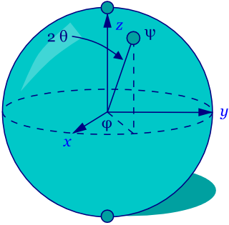
“Information is Physical”
Classical bit: 0 or 1
Quantum bit:
1
High voltage
0
Low voltage
Notes:
An outline of the talk, which will start with an introduction to quantum information and the teleportation protocol. The importance of entangled, and entangled photons in particular, will discussed, and an explanation of teleportation, entanglement swapping, and type-I fusion will be given in terms of a suitable multi-mode analysis. Finally, we will discuss the use of quantum teleportation for sensing and communication.

Slide 3
“Information is Physical”
Multiple Qubits
Entanglement
Notes:
An outline of the talk, which will start with an introduction to quantum information and the teleportation protocol. The importance of entangled, and entangled photons in particular, will discussed, and an explanation of teleportation, entanglement swapping, and type-I fusion will be given in terms of a suitable multi-mode analysis. Finally, we will discuss the use of quantum teleportation for sensing and communication.

Slide 4
Quantum Teleportation
ψ₁ = (α, β)
ψ₃ = U_{j}ψ₁
2 bits
classical
Entanglement
expended
entanglement
1
BSM
2
3
1. Qubit at 1 destroyed, entanglement expended.
2. Qubit at 3 encrypted ψ₁
3. Encryption key is BSM outcome (2 bits).
4. Qubit does not traverse intervening space.
Notes:
First, an analog to clarify the use of quantum teleportation.
A conventional fax machine transmits information, not paper, between two locations.
Similarly, teleportation transmits qubits of information, not matter.
Particle 1 stores the qubit initially. Particles 2 and 3 are entangled and will act like a quantum communication channel through which the qubit is transferred to particle 3.
To do this, particles 1 and 2 are subjected to a Bell-state measurement, which is a means of jointly measuring two particles.
If successful, particle 3 will be left in a state that is unitarily related to the initial qubit.
Here are the caveats. First, qubit stored in particle 3 is encrypted, and it is encrypted perfectly. In order to recover the information, we have to know the outcome of the Bell-state measurement, and that requires some classical information be sent from here to there. So in short, you don’t get something for nothing.
The second caveat, and why the analogy with a conventional fax machine fails, is that particle 1 now no longer stores any information. The qubit is gone, it is at particle 3. Hence the name teleportation.

Slide 5
From Theory to Practice
Quantum bit
Quantum system
Photon
0 = h and 1 = v
Other physical properties complicate this relationship!
Information may be loss: decoherence and decay
Qubits may be distinguishable: spatial and spectral modes
Notes:
An outline of the talk, which will start with an introduction to quantum information and the teleportation protocol. The importance of entangled, and entangled photons in particular, will discussed, and an explanation of teleportation, entanglement swapping, and type-I fusion will be given in terms of a suitable multi-mode analysis. Finally, we will discuss the use of quantum teleportation for sensing and communication.

Slide 6

Entangled Multimode Photons
Pulsed Spontaneous Parametric Down-conversion (SPDC)
2
p
ω_{p} = ω₂ + ω₃
pulsed
laser
ω ₃
χ⁽²⁾
k_{p} = k₂ + k₃
3
ω ₂
Polarization-entangled single-mode photon pair

Slide 7
Entangled Multimode Photons
Pulsed Spontaneous Parametric Down-conversion (SPDC)
2
p
ω_{p} = ω₂ + ω₃
pulsed
laser
ω ₃
χ⁽²⁾
k_{p} = k₂ + k₃
3
ω ₂
Polarization-entangled multi-mode photon pair

Slide 8

Entangled Multimode Photons
Pulsed Spontaneous Parametric Down-conversion (SPDC)
2
p
ω_{p} = ω₂ + ω₃
pulsed
laser
ω ₃
χ⁽²⁾
k_{p} = k₂ + k₃
3
ω ₂
Type-I SPDC
Type-II SPDC

Slide 9


Joint Spectral Amplitude
Analytical Approximation
σ₂, σ₃ bandwidth, μ linear spectral correlation
σ₂=σ₃, μ =0
σ₂=σ₃, μ =-1
ω ₃
ω ₃
ω ₂
ω ₂

Slide 10
How much entanglement?
Concurrence
Type-I SPDC
Type-II SPDC

Slide 11
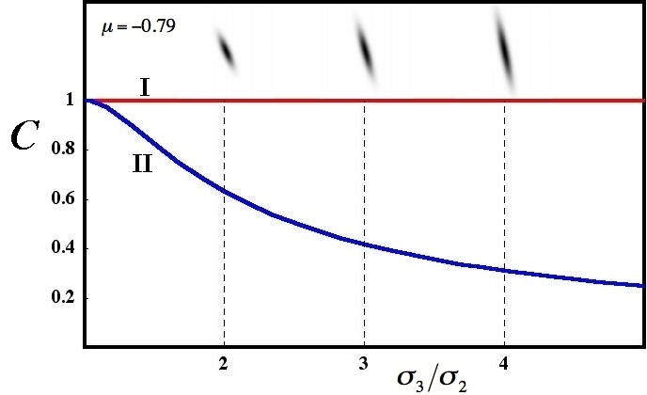
How much entanglement?
Concurrence

Slide 12
Quantum Teleportation
with Entangled Multimode Photons
BSM
Input
Output
Error

Slide 13
How good is it?
Fidelity: overlap between input and output
Optimal input photon
Type I
Type II

Slide 14
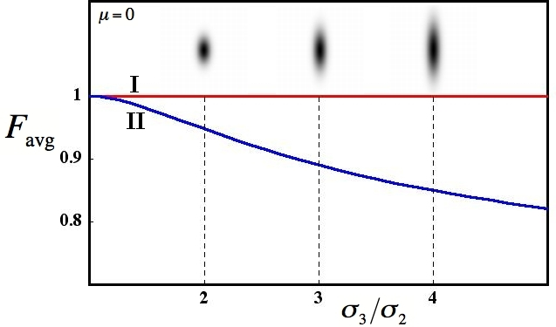
How good is it?
No spectral correlation

Slide 15
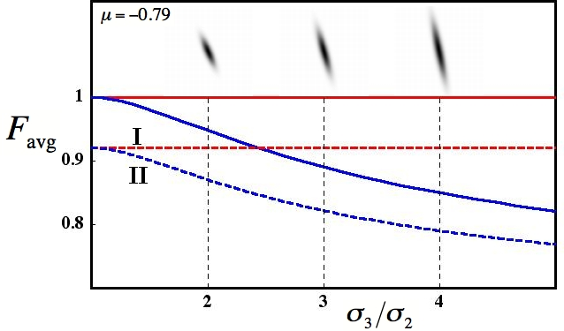
How good is it?
Spectrally correlated

Slide 16
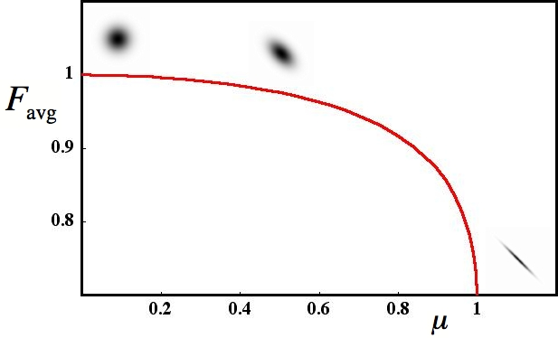
How good is it?
Equal bandwidths: Type-I = Type-II

Slide 17
2007 IC Postdoctoral Research Fellowship Colloquium
Review of Quantum Teleportation
with Entangled Multimode Photons
Purpose:
Related Protocols:
Characterize multimode effects in QT
Entanglement Swapping
Quantify polarization entanglement
(Quantum Repeater)
Quantify fidelity
Fusion Gates and Cluster States
Optimize fidelity
(Quantum Computing)
Quantum Key Distribution
Results:
Contact Information
Travis Humble
Oak Ridge National Laboratory
humblets@ornl.gov
865.574.6162
ornl.gov/~hqt

Slide 18
2007 IC Postdoctoral Research Fellowship Colloquium
Quantum Teleportation
with Entangled Multimode Photons
Travis S. Humble
Oak Ridge National Laboratory
humblets@ornl.gov
PI: Warren Grice
IC: Susan Durham
Agenda
Quantum Information and Teleportation
Entangled Multimode Photons
Teleportation with Multimode Photons
Communicating and Computing Applications
Sensing and Security Applications
Notes:
2007 IC Postdoctoral Research Fellowship Colloquium, 20 April 2007, Chantilly, VA

Slide 19



Quantum Teleportation
1
2
3
1. Distribute entangled particles
2. Teleport quantum information
3. Relay classical information
Notes:
First, an analog to clarify the use of quantum teleportation.
A conventional fax machine transmits information, not paper, between two locations.
Similarly, teleportation transmits qubits of information, not matter.
Particle 1 stores the qubit initially. Particles 2 and 3 are entangled and will act like a quantum communication channel through which the qubit is transferred to particle 3.
To do this, particles 1 and 2 are subjected to a Bell-state measurement, which is a means of jointly measuring two particles.
If successful, particle 3 will be left in a state that is unitarily related to the initial qubit.
Here are the caveats. First, qubit stored in particle 3 is encrypted, and it is encrypted perfectly. In order to recover the information, we have to know the outcome of the Bell-state measurement, and that requires some classical information be sent from here to there. So in short, you don’t get something for nothing.
The second caveat, and why the analogy with a conventional fax machine fails, is that particle 1 now no longer stores any information. The qubit is gone, it is at particle 3. Hence the name teleportation.

Slide 20

Entanglement Swapping
Teleporting entanglement
BSM

Slide 21
Quantum Repeater
Repetitive entanglement swapping
N
1
4,5
6,7
N-2,N-1
N
1
2,3
Concurrence

Slide 22
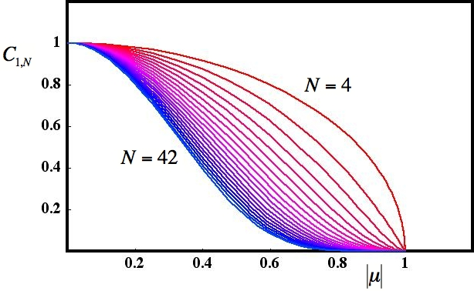
Entanglement Swapping
Concurrence versus N
Equivalent bandwidths
Does not incorporate entanglement distillation

Slide 23
Fusion Gates and Cluster States
Adding together entangled states
Linear
type-I
fusion
Branched
type-II
fusion

Slide 24
Fusion Gates and Cluster States
Adding together entangled states
Linear
type-I
fusion
N particles
+
+
+
+ …
type-I
fusion
n=N/2 +1
…

Slide 25
Fusion Gates and Cluster States
Concurrence versus N
Equivalent bandwidths
Same as entanglement swapping (for identical sources)

Slide 26
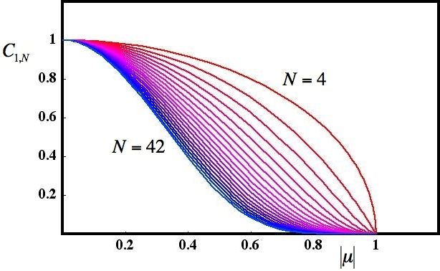
2007 IC Postdoctoral Research Fellowship Colloquium
Review of Quantum Teleportation
with Entangled Multimode Photons
Purpose:
Related Efforts:
Analyze protocols related to QT
Quantum Repeater
Entanglement swapping, type-I fusion
Incorporate Distillation
Quantify entanglement (concurrence)
Building Quantum Networks
Optimize configurations
One-way quantum computing
Results:
Architecture modeling
Contact Information
Travis S. Humble
Oak Ridge National Laboratory
humblets@ornl.gov
865.574.6162
ornl.gov/~hqt

