Slide 1
Fidelity of Intervention Implementation
David S.Cordray, PhD
Vanderbilt University
Prepared for:
The IES Summer Training Institute on Cluster Randomized Control Trials
June 17-29, 2007
Nashville, TN

Slide 2
Overview
Definitions and Prevalence
Conceptual foundation
Identifying core components of intervention models
Measuring achieved implementation fidelity
  Methods of data gathering
  Sampling strategies
Examples
Summary

Slide 3
Definitions and Prevalence

Slide 4
Distinguishing Implementation Assessment from Implementation Fidelity Assessment
Intervention implementation can be assessed based on a:
  A purely descriptive model
    Answering the question “What transpired as the intervention was put in place (implemented).
  An a priori intervention model, with explicit expectations about implementation of program components.
    Fidelity is the extent to which the intervention, as realized, is “faithful” to the pre-stated intervention model.

Slide 5
Dimensions Intervention Fidelity
Little consensus on what is meant by the term “intervention fidelity.
But Dane & Schneider (1998) identify 5 aspects:
  Adherence – program components are delivered as prescribed;
  Exposure – amount of program content received by participants;
  Quality of the delivery – theory-based ideal in terms of processes and content;
  Participant responsiveness – engagement of the participants; and
  Program differentiation – unique features of the intervention are distinguishable from other programs (including the counterfactual)

Slide 6
Prevalence
Across topic areas, it is not uncommon to find that fewer than 1/3rd of treatment effectiveness studies report evidence of intervention fidelity.
Durlak – of 1200 studies, only 5% addressed fidelity;
Gresham et al. – of 181 studies in special education, 14% addressed fidelity;
Dane & Schneider, 17% in the 1980s, but 31% in the 1990s.
Cordray & Jacobs, fewer than half of the “model programs” in a national registry of effective programs provided evidence of intervention fidelity.

Slide 7
Types of Fidelity Assessment
Even within these studies, the models of fidelity and methods used to assess or assure fidelity differ greatly:
  Monitoring and retraining
  Implementation “Check” based on small samples of observations
  Few involve integration of fidelity measures into outcome analyses as a:
    Moderator
    Mediator

Slide 8
Implications for Planning and Practices
Unlike statistical and outcome measurement and other areas, there is little guidance on how fidelity assessment should be carried-out
FA depends on the type of RCT that is being done
Must be tailored to the intervention model
Generally involves multiple sources of data, gathered by a diverse range of methods

Slide 9
Some Simple Examples

Slide 10
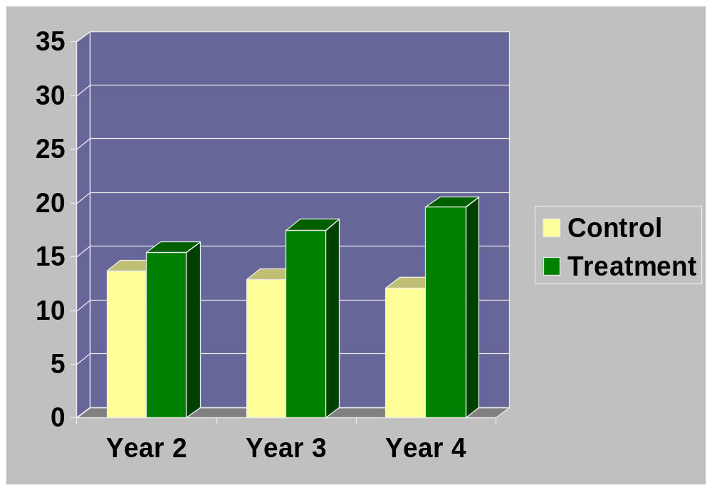
Challenge-based Instruction in “Treatment” and Control Courses: The VaNTH Observation System (VOS)
Percentage of Course Time Using Challenge-based Instructional Strategies
Adapted from Cox & Cordray, 2007

Slide 11
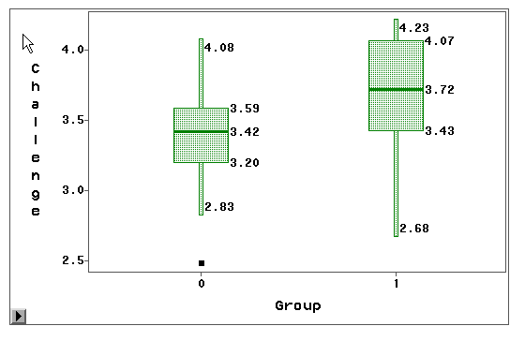
Student Perception of the Degree of Challenge-based Instruction: Course Means
Control
Treatment

Slide 12
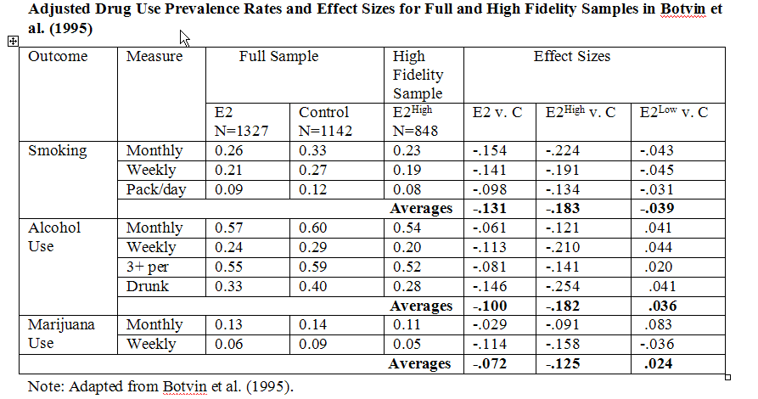
Fidelity Assessment Linked to Outcomes

Slide 13
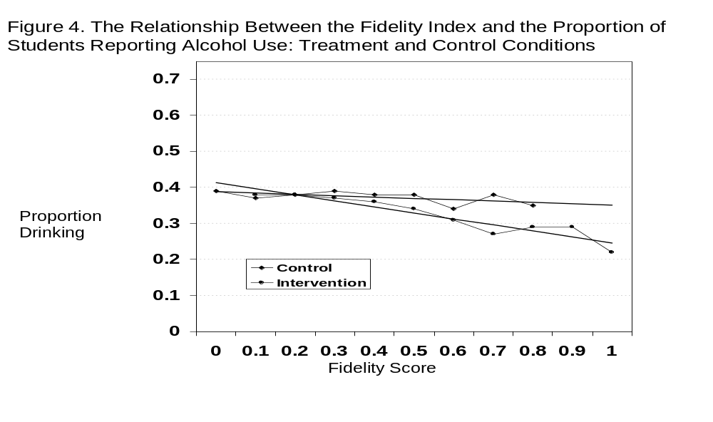
With More Refined Assessment, We Can Do Better ……
Adapted from Cordray & Jacobs 2005

Slide 14
Conceptual Foundations

Slide 15
Intervention Fidelity in a Broader Context
The intervention is the “cause” of a cause-effect relationship. The “what” of “what works?” claims;
Causal inferences need to be assessed in light of rival explanations; Campbell and his colleagues provide a framework for assessing the validity of causal inferences;
Concepts of intervention fidelity fit well within this framework.

Slide 16
Threats to Validity
Four classes of threats to validity of causal inference. Based on Campbell & Stanley (1966); Cook and Campbell (1979); Shadish, Cook and Campbell (2002).
Statistical Conclusion Validity: Refers to the validity of the inference about the correlation (covariation) between the intervention (or the cause) and the outcome.
Internal Validity. Refers to the validity of the inference about whether observed covariation between X (the presumed cause) and Y (the presumed effect) represents a causal relationship, given the particular manipulation and measurement of X and Y.

Slide 17
Threats Continued
Construct Validity of Causes or Effects: Refers to the validity of the inference about higher-order constructs that represent the particulars of the study.
External Validity. Refers to the validity of the inferences about whether the cause-effect relationship holds up over variations in persons, settings, treatment variables, and measured variables.

Slide 18
An Integrated Framework

Slide 19
Treatment Strength
Outcome
.45
.40
.35
.30
.25
.20
.15
.10
.05
.00
100
90
85
80
75
70
65
60
55
50
T^{tx}
Infidelity
t ^{tx}
Achieved Relative Strength =.15
(85)-(70) = 15
tx^{C}
T^{C}
“Infidelity”
Expected Relative Strength =.25

Slide 20
Infidelity and Relevant Threats
Statistical Conclusion validity
  Unreliability of Treatment Implementation: Variations across participants in the delivery or receipt of the causal variable (e.g., treatment). Increases error and reduces the size of the effect; decreases chances of detecting covariation.
Construct Validity – cause
  Mono-Operation Bias: Any given operationalization of a cause or effect will under-represent constructs and contain irrelevancies.
  Forms of Contamination:
      Compensatory Rivalry: Members of the control condition attempt to out-perform the participants in the intervention condition (The classic example is the “John Henry Effect”).
      Treatment Diffusion: The essential elements of the treatment group are found in the other conditions (to varying degrees).
External validity – generalization
  Setting, cohort by treatment interactions

Slide 21
Implications for Design and Analysis
Choosing the level at which randomization is undertaken to minimize contamination.
  E.g., School versus class depends on the nature and structure of the intervention;
    Empirical analysis
    Logical analysis
Scope of the study
  Number of units (and subunits) that can be included in the study will depend on the budget, time, and how extensive the fidelity assessment need to be to properly capture the intervention.

Slide 22
Identifying Core Components

Slide 23
Model of Change
Feedback
Professional Development
Achievement
Differentiated Instruction

Slide 24
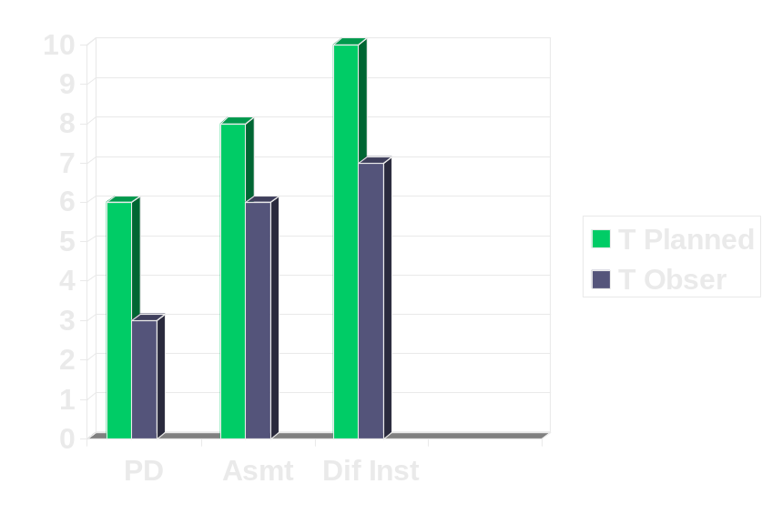
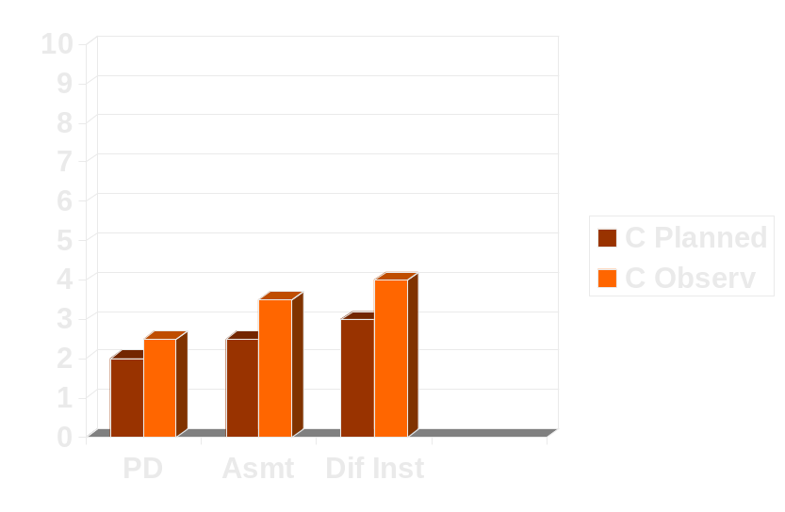
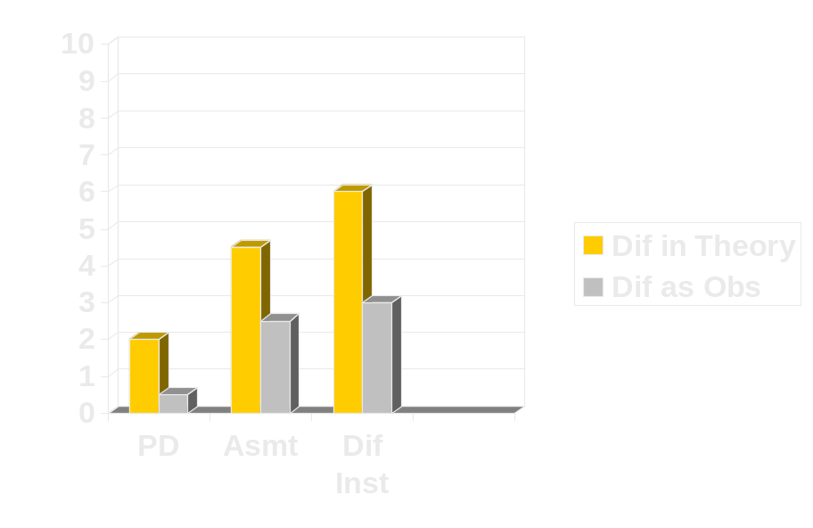
Intervention and Control Components
Infidelity
Augmentation of Control
PD= Professional Development
Asmt=Formative Assessment
Diff Inst= Differentiated Instruction

Slide 25
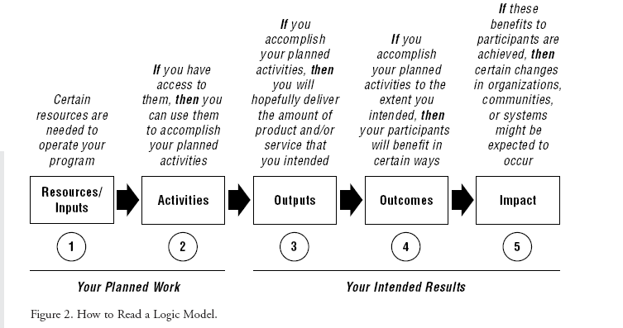
Translating Model of Change into Activities: the “Logic Model”
From: W.T. Kellogg Foundation, 2004

Slide 26
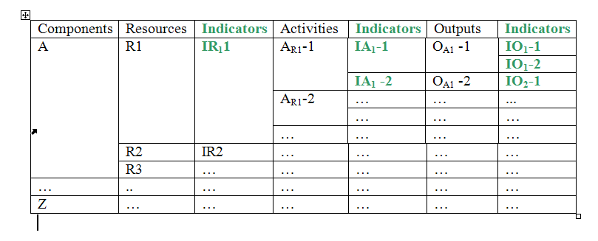
Moving from Logic Model Components to Measurement

Slide 27
Measuring Resources, Activities and Outputs
Observations
  Structured
  Unstructured
Interviews
  Structured
  Unstructured
Surveys
Existing scales/instruments
Teacher Logs
Administrative Records

Slide 28
Sampling Strategies
Census
Sampling
  Probabilistic
    Persons (units)
    Institutions
    Time
  Non-probability
    Modal instance
    Heterogeneity
    Key events

Slide 29
Some Additional Examples

Slide 30
Conceptual Model for Building Blocks Program
Professional Development (PD) and Continuous PD support
Receipt of Knowledge by Teachers
Quality Curriculum Delivery
Child-level Receipt
Child-level Engagement
Enhanced Math Skills.

Slide 31
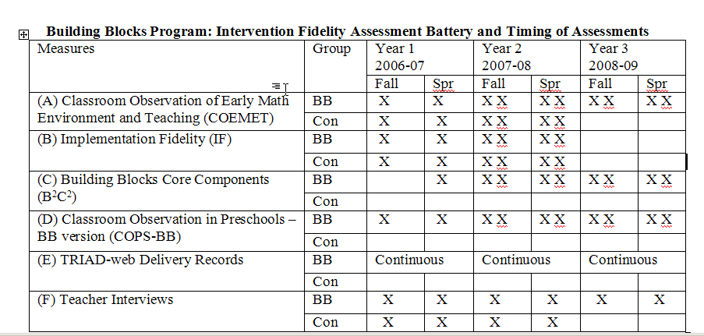
Fidelity Assessment for the Building Blocks Program

Slide 32
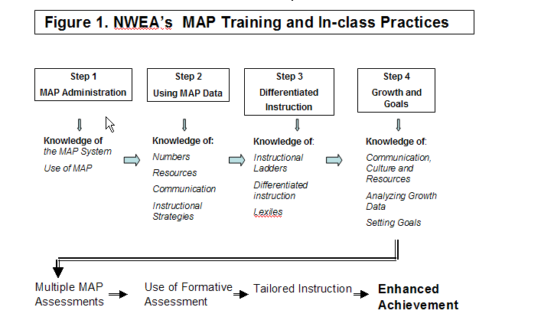
Conceptual Model for the Measuring Academic Progress (MAP) Program

Slide 33
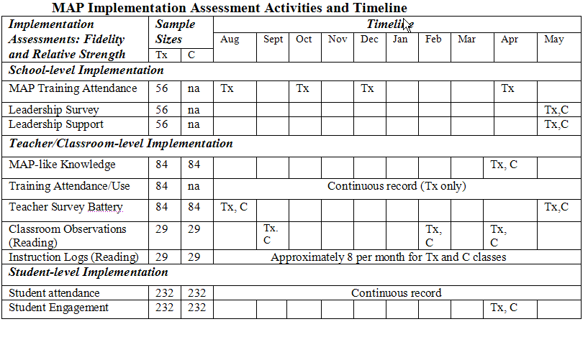
Fidelity Assessment Plan for the MAP Program

Slide 34
Summary

Slide 35
Summary Observations
Assessing intervention fidelity is now seen as an important addition to RCTs
Its conceptual clarity has improved in recent years
But, there is little firm guidance on how it should be undertaken
  Different demands for efficacy, effectiveness and scale-up studies
Assessments of fidelity require data gathering in all conditions
They require the specification of a theory of change in the intervention group
In turn, core components (resources, activities, processes) need to be identified and measured

Slide 36
Summary Observations
Fidelity assessment is likely to require the use of multiple indicators and data gathering methods
Indicators will differ in the ease with which the can yield estimates of “discrepancies from the ideal”
  Scoring rubrics can be used
Indicators will be needed at each level of the hierarchy within cluster RCTs
Composite indictors will be needed in HLM models with few classes/teachers/students
Results from analyses involving fidelity estimates do not have the same inferential standing as intent-to-treat models
But they are essential to learn about what works for whom under what circumstances, how and why.

