Slide 1
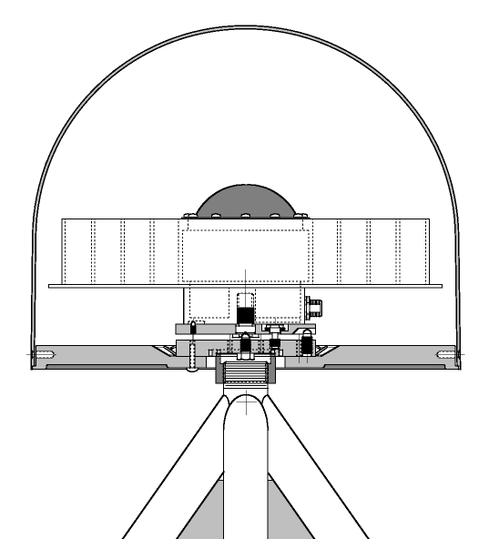


SCIGN Adaptors and Radomes
This presentation will probably involve audience discussion, which will create action items. Use PowerPoint to keep track of these action items during your presentation
In Slide Show, click on the right mouse button
Select “Meeting Minder”
Select the “Action Items” tab
Type in action items as they come up
Click OK to dismiss this box
This will automatically create an Action Item slide at the end of your presentation with your points entered.
Kenneth W. Hudnut
U. S. Geological Survey

Slide 2
Status Summary
Delivery to installation contractor took place on March 23, 1999
Second P.O. initiated to produce units for purchases by others
  plastic in stock for making approx. 1000 more
  orders received for 250; 500 more ordered
  fill orders as needed (2^{ry} operations only)

Slide 3
Progress
http://www-socal.wr.usgs.gov/scign/group/dome/
Since October 1998 presentation:
  SCIGN radome first article parts received, tested and measured
    met or exceeded all design goal expectations
  machining of tools to improve part fits
  production and delivery to contractor
  deployment at SCIGN stations

Slide 4
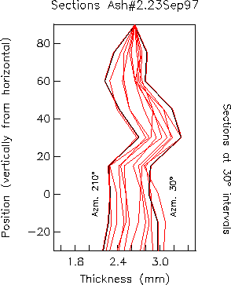
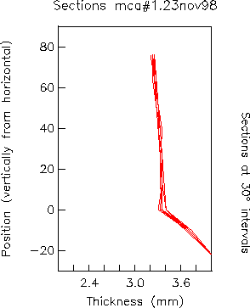
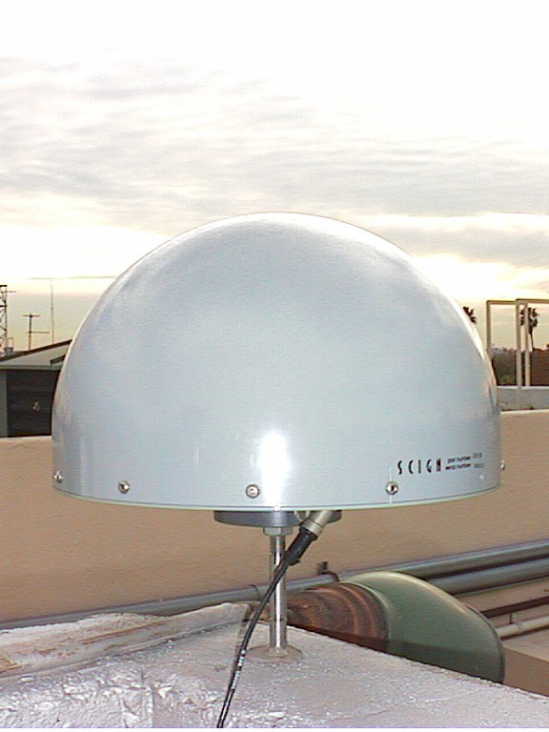
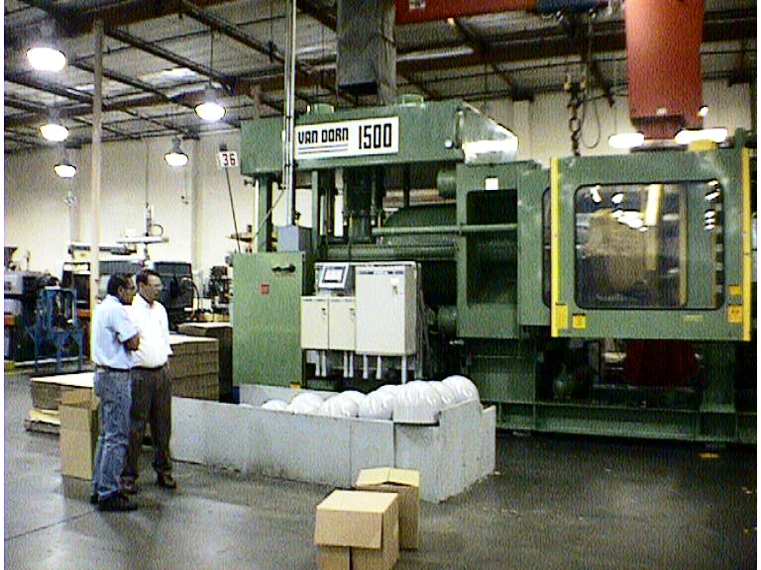
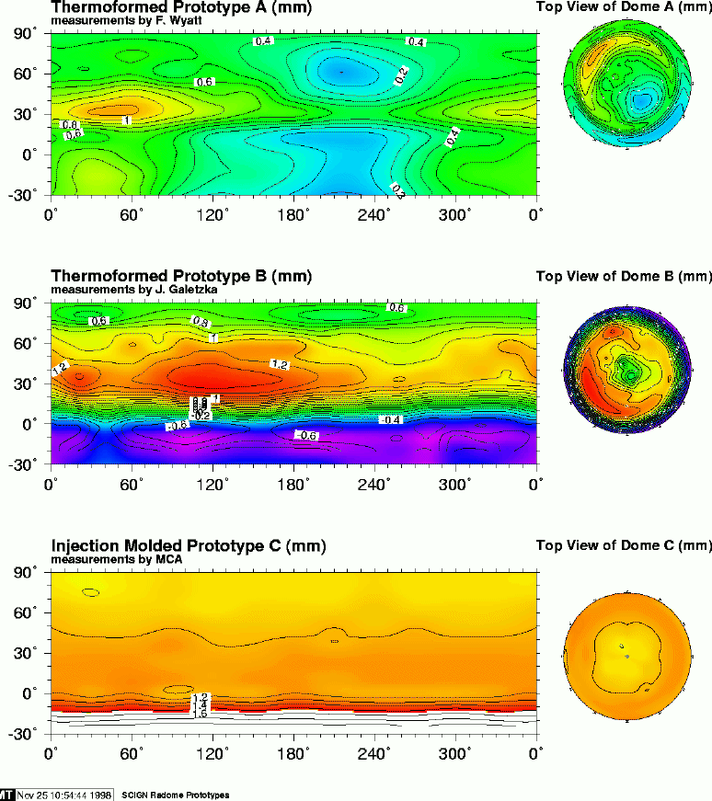
First article parts
Wall thickness variations are < +/-0.005” (0.13 mm)
barely distinguishable from having no dome present (in short baseline testing)

Slide 5
Costs
Initial & fixed costs (hope to recover)
  set-up costs approx. $80K
  personnel costs $80K
  original estimates had less personnel time
Cost recovery projections
  decided on non-exclusive rights licenses
  only one GPS company has ordered so far
  need more orders

Slide 6
Summary
SCIGN adaptors and domes delivered
  development efforts completed
  deployment in SCIGN under way
Distribution of these items
  to enhance precise GPS worldwide
  to help SCIGN recover its costs

