Slide 1
NC π⁰ Production in the MiniBooNE Antineutrino Data
Van Nguyen
Columbia University
for the MiniBooNE collaboration
NuFact07
August 8th, 2007

Slide 2
Outline
MiniBooNE detector
NC π⁰ production
Objective and method of current analysis
MC/Data comparisons
Summary

Slide 3
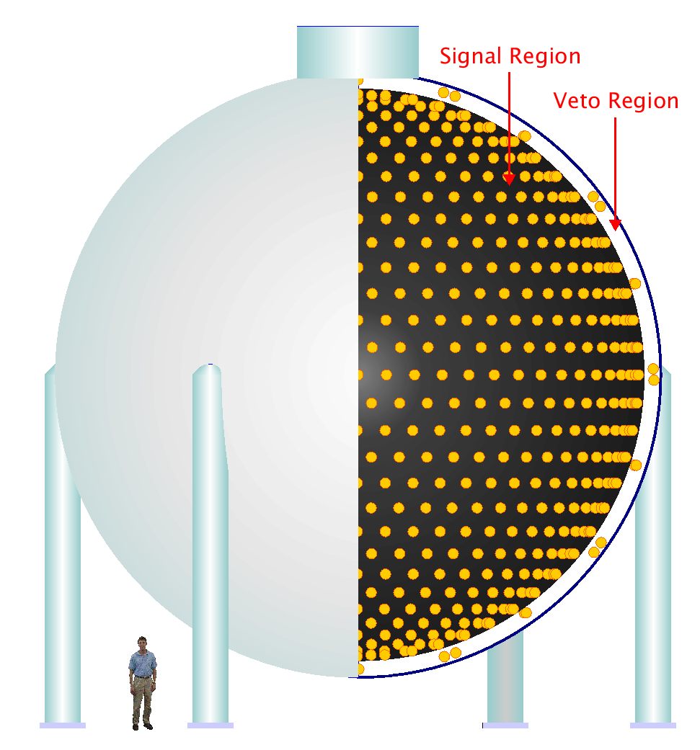
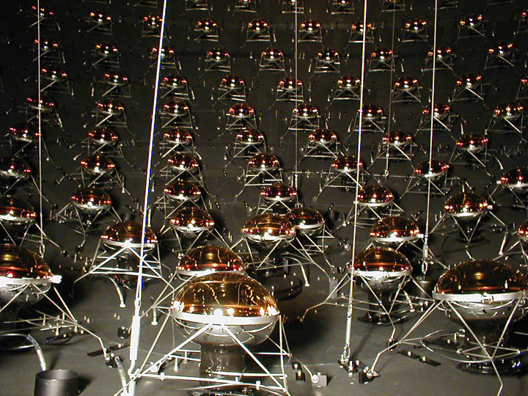
The MiniBooNE Detector
12-meter diameter spherical tank
1280 PMT in inner region
240 PMT in outer veto region
800 tons pure mineral oil

Slide 4
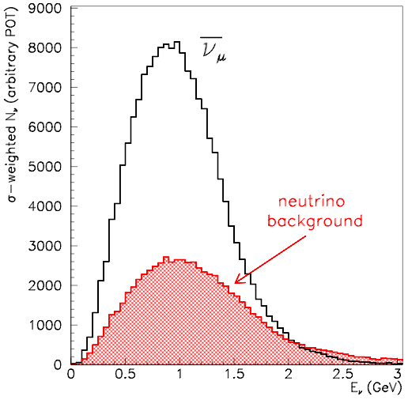
MiniBooNE Antineutrino Running
Started antineutrino running in January 2006
Has the world’s largest sample of reconstructed π⁰'s produced by antineutrinos (over 1500 events)!
Need to contend with neutrino aka “wrong-sign” (WS) background
In antineutrino mode, neutrinos are ~30% of the total events (as opposed to neutrino mode where antineutrinos are ~2% of the total events)
G. Zeller

Slide 5
NC π⁰ Production
NC π⁰'s can be created through resonant and coherent
production:
Resonant NC π⁰ production:
Coherent NC π⁰ production:
(Signature: π⁰ which is
highly forward-going)
_
_
ν
ν
Z⁰
p (n)
¹²C
Δ⁺ (Δ⁰)
π⁰
_
_
ν
ν
Z⁰
π⁰
¹²C

Slide 6
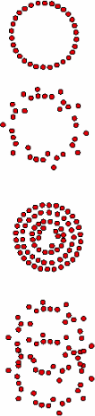

NC π⁰ Production cont’d
MiniBooNE event signatures
  A π⁰ decays promptly into two photons
  (τ_{π}0 ~ 8x10⁻¹⁷ s).
π⁰
  This event can be misidentified if there are not two resolvable tracks.
misID
_
ν_{e}
e⁺
e⁺
  Understanding of these
  events is crucial!
W⁻
p
n
p
_
ν_{μ}
μ⁺
μ⁺
W⁻
p
n
Notes:
So why are NC π⁰'s a source of oscillation search background?
Well, we know that a π⁰ decays promptly into two photons.
These photons pair produce and the Cherenkov radiation from the electron-positron pair is detected by the PMTs. Using the energy and direction of the Cherenkov rings, we can reconstruct the kinematics of the original π⁰.
(An electromagnetic shower begins when a high-energy electron or photon enters a material. At high energy, photons interact with matter primarily via pair production—that is, they convert into an electron-positron pair, interacting with an atomic nucleus or electron in order to conserve momentum. High-energy electrons and positrons primarily emit photons, a process called bremsstrahlung. These two processes continue in turn, until the remaining particles have lower energy. Electrons and photons then lose energy via scattering until they are absorbed by atoms.)
However, the energies of the two photons can be highly asymmetric, the two rings can overlap, or one photon may exit the tank. This will not yield two resolvable tracks and can cause the event to be misidentified as a single-ring shower-type, the signature of a ν_{e}-CC interaction.

Slide 7
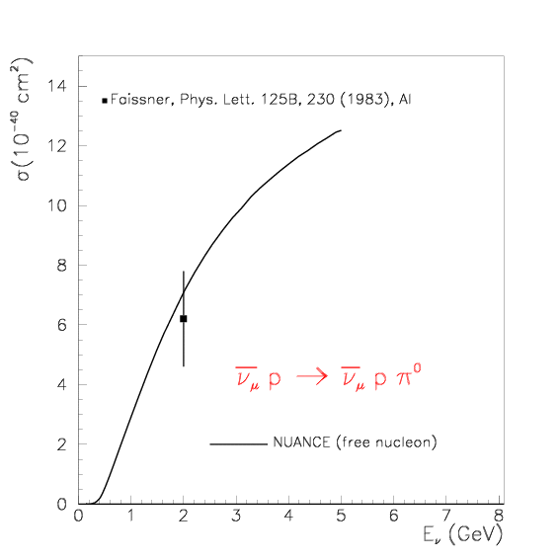

Present Antineutrino NC π⁰ Data
Only one published measurement of the absolute rate of antineutrino NC π⁰ production; this measurement was reported with 25% uncertainty at 2 GeV.
Current theoretical models on coherent π⁰ cross sections can vary by up to an order of magnitude in their predictions at low energy, the region most relevant for oscillation experiments.
( )
( )

Slide 8
Objective
To measure the rate of π⁰ production and use it to constrain this background in an oscillation search.
  Specifically, we aim for a measurement of the total π⁰ production in bins of true π⁰ momentum.

Slide 9
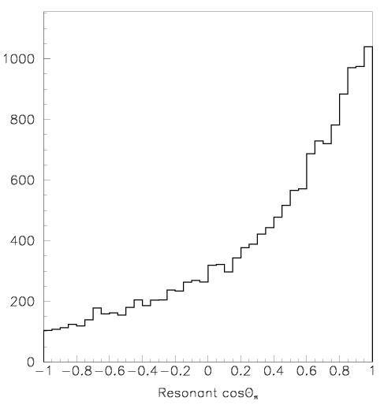
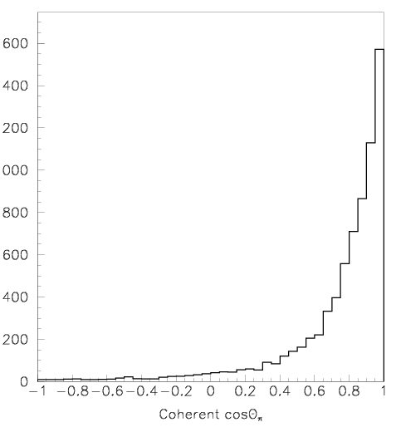
Cosθ and Coherent π⁰ Production
Coherent and resonant production are distinguishable by cosθ_{π}, which is the cosine of the lab angle of the outgoing π⁰ wrt to the beam direction.
J. Link
We can use this fact to extract a measure of the coherent fraction.

Slide 10
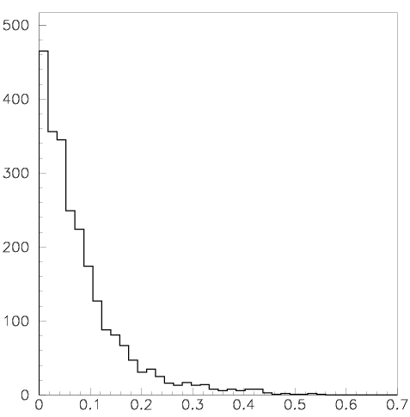
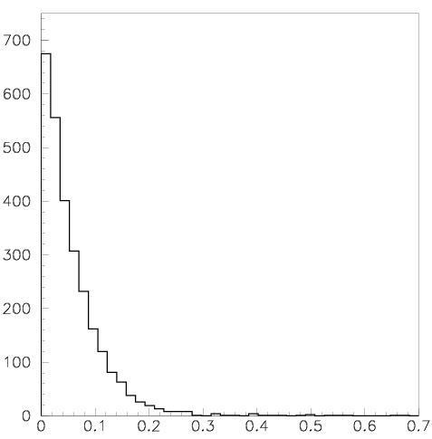
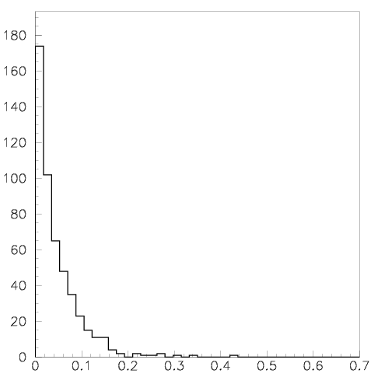
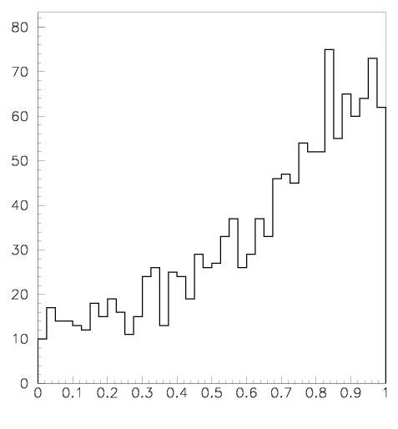
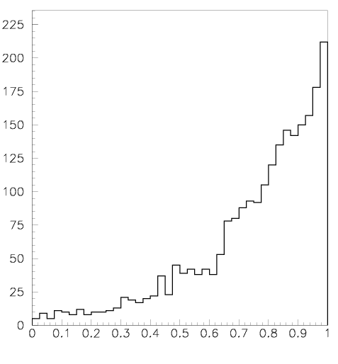
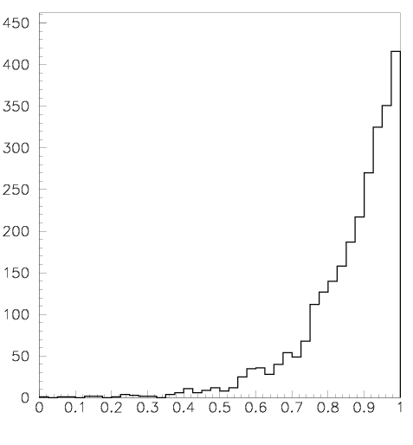
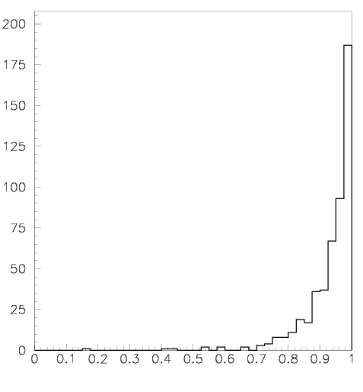
Study Coherent π⁰'s in Terms of E_{π}(1-cosθ_{π})
J. Link
P_{π}<200 MeV
200 MeV<P_{π}<300 MeV
300 MeV<P_{π}<500 MeV
P_{π}>500 MeV
E_{π}(1-cosθ_{π})
E_{π}(1-cosθ_{π})
E_{π}(1-cosθ_{π})
E_{π}(1-cosθ_{π})
E_{π}(1-cosθ_{π})
E_{π}(1-cosθ_{π})
P_{π}<200 MeV
200 MeV<P_{π}<300 MeV
300 MeV<P_{π}<500 MeV
P_{π}>500 MeV
cosθ_{π}
cosθ_{π}
cosθ_{π}
cosθ_{π}
In coherent events, E_{π}(1-cosθ_{π}) has a more regular shape, as a function of momentum, than cosθ_{π} alone, so we’ll fit for the coherent content as a function of this energy weighted angular distribution.

Slide 11
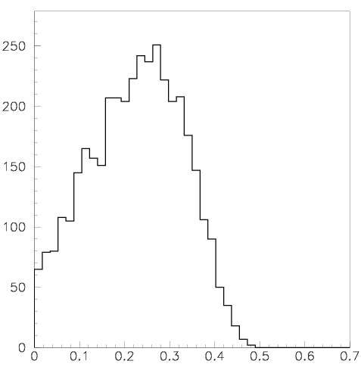
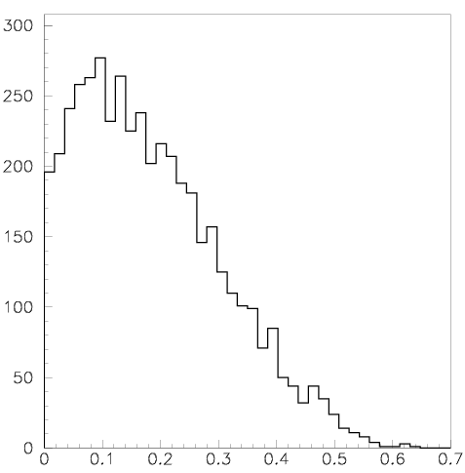
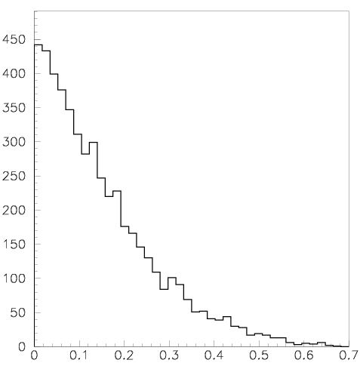
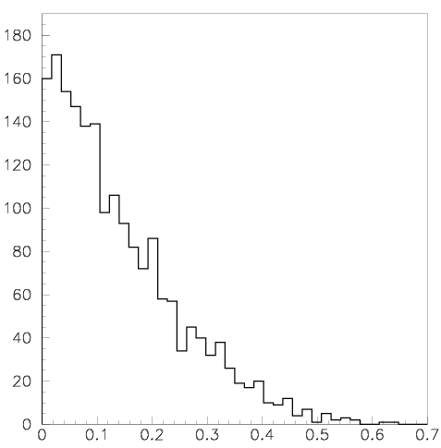
Study Coherent π⁰'s in terms of E_{π}(1-cosθ_{π})
P_{π}<200 MeV
200 MeV<P_{π}<300 MeV
300 MeV<P_{π}<500 MeV
P_{π}>500 MeV
E_{π}(1-cosθ_{π})
E_{π}(1-cosθ_{π})
E_{π}(1-cosθ_{π})
E_{π}(1-cosθ_{π})
Meanwhile E _{π}(1-cosθ _{π}) can have a large variation in the resonant process in this energy range.
J. Link

Slide 12
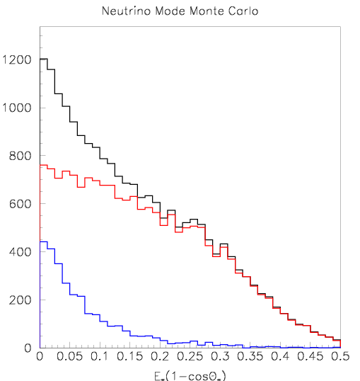
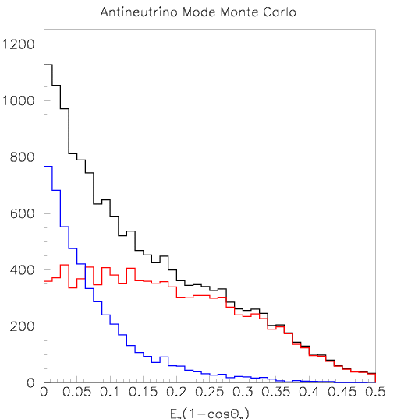
Coherent NC π⁰'s in ν vs. Running
G. Zeller
ν_{μ} coh π⁰
_
ν_{μ} coh π⁰
ν_{μ} res π⁰
_
ν_{μ} res π⁰
20% is coherent production
40% is coherent production
“enhanced” coherent sample
_
ν
Generated π⁰ angular distribution for NC ν (left) and (right) scattering.

Slide 13
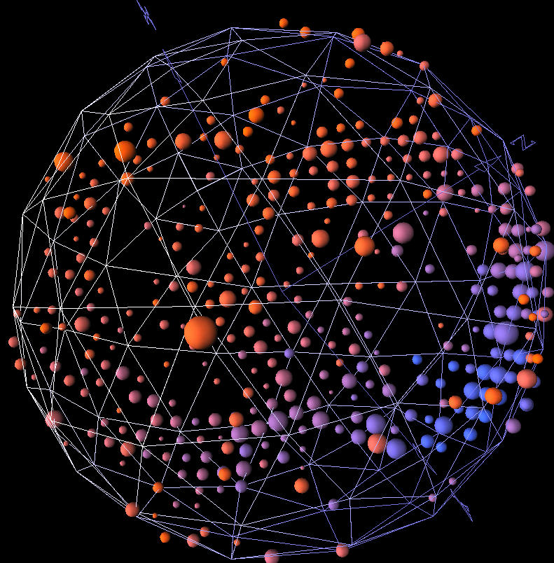
Event Selection
Pre-cuts:
Only one sub-event (no decaying μ, NC)
Veto hits < 6 (eliminates cosmic rays)
Tank hits > 200 (above Michel endpoint)
Event radius < 500 cm (fiducial cut)
NC π⁰ analysis cuts:
eμ likelihood prefers e hypothesis (EM-like)
eπ likelihood prefers π⁰ hypothesis (2ring)
80 MeV/c²<m _{γγ} <200 MeV/c² (mass window)
MiniBooNE π⁰ candidate

Slide 14
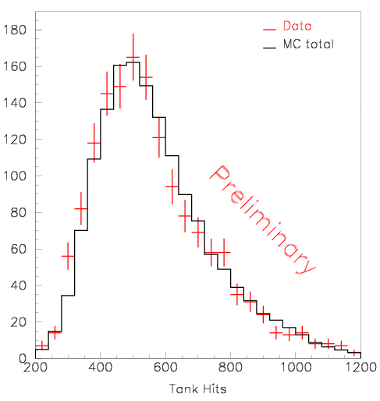
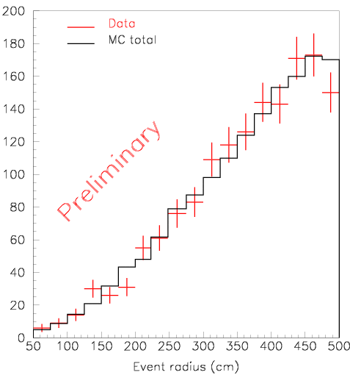
Data/MC Comparison for Variables We Cut On
Note: Plots are relatively normalized with statistical errors only.

Slide 15
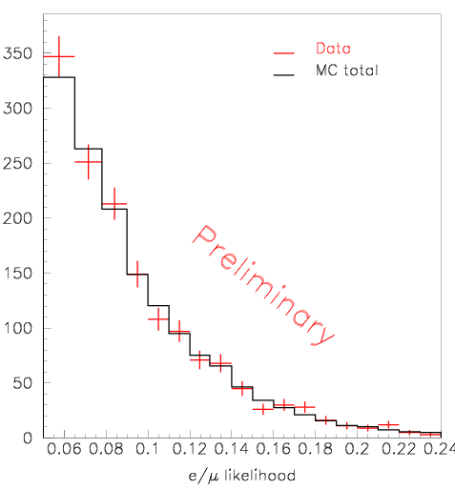
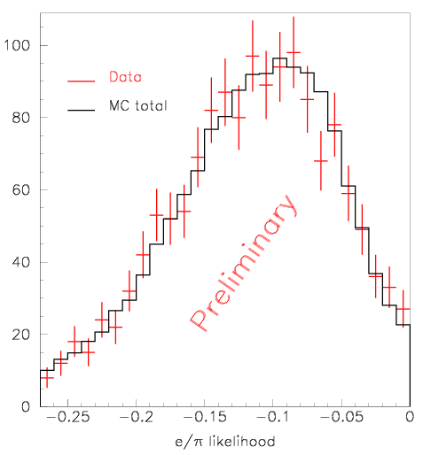
Note: Plots are relatively normalized with statistical errors only.

Slide 16
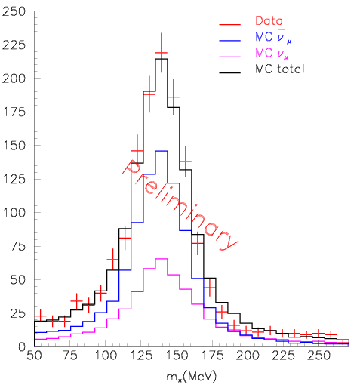
π⁰ Kinematics
m_{γγ}(MeV)
Note: Plots is relatively normalized with statistical errors only.

Slide 17
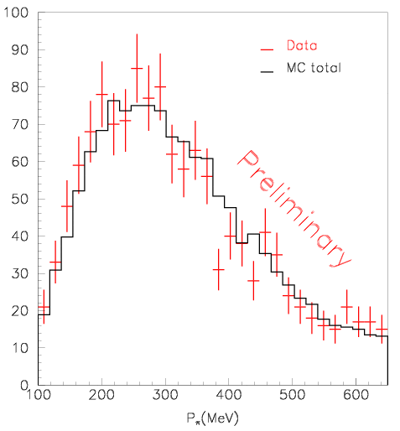
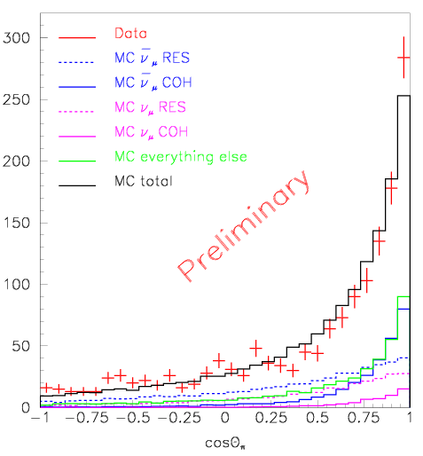
Note: Plots are relatively normalized with statistical errors only.

Slide 18
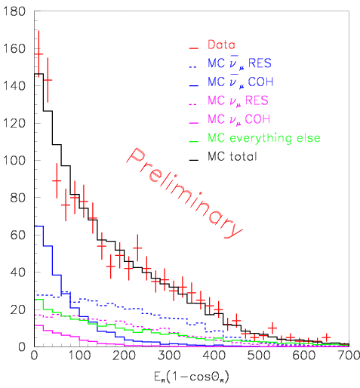
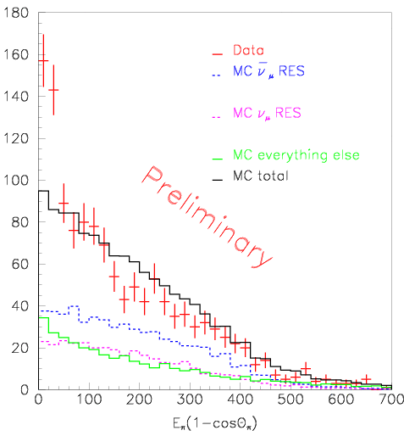
Suggestive of antineutrino
NC coherent π⁰ production
_
No COH contribution
Note: Plots are relatively normalized with statistical errors only.

Slide 19
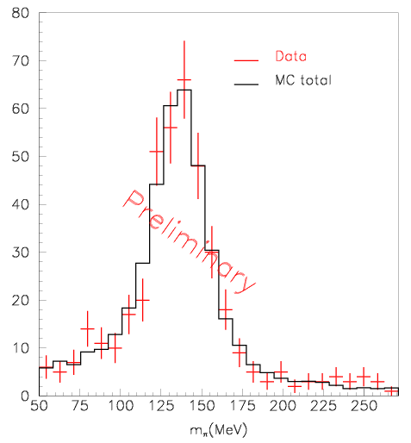
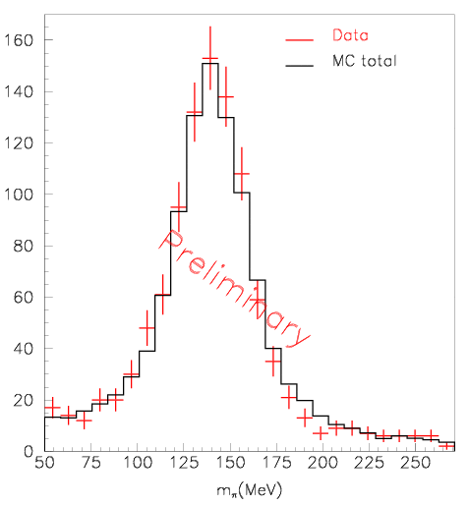
m_{γγ}(MeV)
m_{γγ}(MeV)
Left: m_{γγ} with 0<E_{π}(1-cosθ_{π})<50 MeV
Right: m_{γγ} with 50<E_{π}(1-cosθ_{π})<700 MeV
Note: Plots are relatively normalized with statistical errors only.

Slide 20
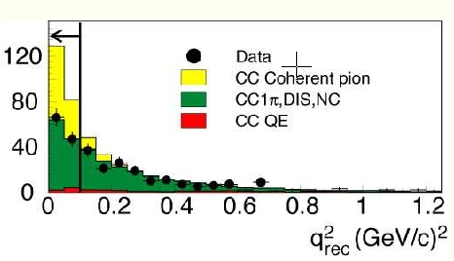
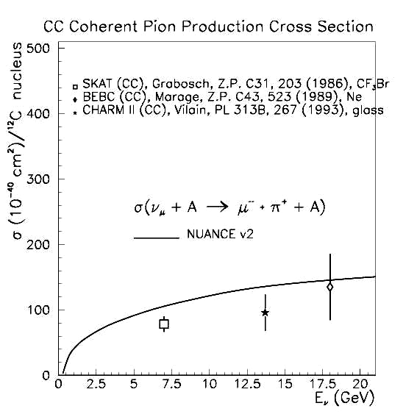
K2K CC Coherent π⁺ Results
(PRL 95, 252301 (2005))
Saw no evidence for coherent CC π⁺ production
Models need to explain both MiniBooNE and K2K coherent NC π⁰ results along with K2K CC π⁺ results

Slide 21
Summary
There is good agreement between data and MC for π⁰'s in the MiniBooNE antineutrino data
The data suggests antineutrino NC coherent π⁰ production
Next step: fit for an exact coherent fraction in the nubar data (been done for the neutrino sample) with systematic errors

Slide 22
Acknowledgments
I would like to give many thanks to:
Janet Conrad
Sam Zeller
Richard Van de Water
Hirohisa Tanaka
Kendall Mahn
Alexis Aguilar
Jon Link
Heather Ray
and the NSF

