Slide 1
Better-Informed Decision Making through LED
Using LED to Inform Local Workforce Investment Board’s Planning and Implementation

Slide 2
Training Partners
ETA / DOL
U.S. Census Bureau (LED Program)
Jacob France Institute
National Center on Education and the Economy
TATC Consulting
Advanced Workforce Systems
Corporation for a Skilled Workforce

Slide 3
Participant Introductions
Who is Here?
Name, Organization, Local Area, etc.
What information needs do you have beyond what you are currently receiving (from LMI/other sources)?
What do you know about the LED program?
Have you seen/used any of the data?
Notes:
“Who is here” is meant to introduce the various people in the room (Ray, Mark, Ed, Gary, Jim, others) and why.
As part of who is here, mention the LMI training that just took place and that LMI participants will be in our session through the end of the first afternoon

Slide 4
Course Learning Objectives
Participants will:
  gain understanding of the Local Employment Dynamics (LED) program with particular emphasis on the Quarterly Workforce Indicators
  become familiar with the information available on the Internet templates and how to develop template queries of the Indicators
  gain understanding of customizable applications of LED data
  gain experience in applying LED data for practical uses in their communities
  provide feedback to ETA and Census that helps to improve the LED Program and related training content
Notes:
Set up to appear one at a time for emphasis

Slide 5
Agenda
Module 1: Introduction to LED
  Wednesday afternoon
Welcoming Reception
  Wednesday evening
Module 2: WIB Template
  Thursday morning
Module 3: Employer Template, Customized Tools, and Other Workforce Information
  Thursday afternoon
Module 4: Product Development and Next Steps
  Friday morning

Slide 6
Interaction is Essential
We want to hear from you throughout!!!
Facilitated discussions
Planning for use and marketing
Computer exercises
Feedback by module on LED data, LED web-based templates
Evaluation
Notes:
Stress that we want their constant feedback throughout to improve the value of this information for WIBs, your partners, and your customers
They are beta testers and we need their help to improve this training for others, therefore the feedback by module is important, as is the evaluation at the end of the training.
To help with the evaluation, encourage them to fill it out after each module

Slide 7
Module 1
Introduction
To Local
Employment
Dynamics (LED)

Slide 8
Module 1: Learning Objective
Participants will become familiar with the Local Employment Dynamics and the Quarterly Workforce Indicators and potential application of the data for use by Local Workforce Investment Boards

Slide 9
Module 1: Agenda
Introduction to LED
What’s in it for Local Workforce Investment Boards?
The Role of State Labor Market Information in the LED Program
Introduction to Quarterly Workforce Indicators
Feedback
Evening Reception

Slide 10
What is LED?
Local:
State, County, sub-County, Metro Area, Workforce Investment Area
Employment:
Demographics (age, gender)
Industry (NAICS, SIC)
Earnings
Dynamics:
Timing (quarterly, historical back to 1990)
Worker employment change (new hires, separations, turnover rates)
Firm employment change (firm job gains and losses)
Notes:
NAICS – North American Industrial Classification System
SIC – Standard Industrial Classification

Slide 11
What LED is Not…
Is not… a picture of “today” but rather about 9 months rear view image
Is not… occupation specific but rather industry-based
Is not… distinguishable by race or other demographic characteristics other than age and gender
Is not… a static program or web page (pending new web screens, new nomenclature, new tools, new state partners, etc.)

Slide 12
LED Quarterly Workforce Indicators
All Quarterly Workforce Indicators can be analyzed at the detailed industry level
Total Employment
Net Job Flows
Job Creation
New Hires
Separations
Turnover
Average Monthly Earnings
Average New Hire Earnings
Notes:
This list is not intended to supplant or replace the list that has been previously brainstormed. But we want to share it with you today to see if anything makes sense.
Many of these should be considered for “Macro Indicators” – those indicators that are unique and innovative but for which you have minimal impact. These probably include:
Total Employment
Net Job Flows
Job Creation
Average Monthly Earnings
Some of these could reflect TRWIB goals in which you potentially have more than a minimal impact:
New Hires
Separations and Turnover
Average New Hire Earnings

Slide 13
How Does It Work?
Surveys
Administrative
Records
Censuses
Longitudinal Employer-Household Dynamics Program
(LEHD)
Local
Immigration
Dynamics
Local
Employment
Dynamics
Local
Transportation
Dynamics
Maps
QWI
Online
Reports
Notes:
(NEW)
The LED information is possible because of an innovative system that merges data already collected from various sources. That system is called LEHD or Longitudinal Employer-Household Dynamics. By combining data from different administrative sources, censuses and surveys, the Census Bureau produces useful information that was not available before. The LED information is based on state wage and unemployment records submitted each quarter combined with current demographic information.
Mention that LED is a subset of the larger LEHD program
Note that Local Immigration Dynamics does not include data by race. Immigrants are available by birth status, but race is not a demographic in the program

Slide 14
Clients
Questions
Businesses
Economic development agencies
Chambers of commerce
Federal, state and local agencies
Current
New
Where are the workers?
How much are they paid?
Jobs
Total payroll
Gross job gain
Gross job loss
Net jobs
New hires
Recalls Layoffs/quits Individual earnings
Current
New
Jobs
Total payroll
National
State
Metro
County
Sub-county
WIA
National
State
County
Workforce Investment Boards
Chambers of commerce
School career counselors
Job search professionals
Businesses
Federal, state, and local agencies
Indicators
Geography
Where are the jobs?
How much do they pay?
Who needs training?
Demography
Location
New
Male Female Age categories 14-18 19-21 22-24 25-34 35-44 45-54 55-64 65+ Immigrant
Native born
New
How can workers
get to their jobs?
Where should a business
locate?
Current
Workplace
Residence
Current
Businesses
Transportation planners
Federal, state and local agencies
Workplace
None

Slide 15
The Ins and In-betweens
Data on Web: (21 states)
California, Colorado, Florida, Iowa, Idaho, Illinois, Kansas, Kentucky, Maine, Maryland, Missouri, Montana, New Jersey, New Mexico, Oregon, Pennsylvania, Texas, Virginia, Washington, Wisconsin, West Virginia
Coming Soon to the Web:
Alabama, Arkansas, Delaware, D.C., Georgia, Indiana, Michigan, Minnesota (map only), North Carolina, North Dakota, Oklahoma, Tennessee, Vermont
As of June 2004
Notes:
Numerous state labor market information agencies are partners and more are joining. Once a state signs a Memorandum of Agreement with the Census Bureau, they begin to supply the necessary data for processing. It generally takes about six months to produce Quarterly Workforce Indicators for the first time.
More than 30 states and the District of Columbia are currently participating.

Slide 16
What’s in it for Local Workforce Investment Boards?
Unique intelligence, also at specific levels of geographic and industrial detail
Ability to query key indicators at the workforce area level
Provides answers to….
  “What is my market penetration of job seekers?”
  “Which training programs should I concentrate on?”
  “What are key benchmarks around turnover and retention?”
  “What are the industry sectors in which we should direct our time and resources?”
  “What is the pattern of new hires in my area?”
  “What is the labor supply pool of recently employed persons in my area?”
Notes:
The first point is really two points – the information has never been available before, plus the never before available information is now available at geographic and industry detail

Slide 17
What’s in it for Local Workforce Investment Boards? p.2
Provides Answers to…
“To which industries should I direct displaced workers?”(guide rapid response)
“What are the industries hiring X type of worker?”
“Where are the people in relation to the jobs?”
“What is the overall labor market activity in my area?”
“Where should I locate a new one-stop office?”
…and many other critical questions
Notes:
Note – at end of slide comment that they will have an opportunity to discuss and further add to this list later in the training

Slide 18
Role of State Labor Market Information Offices
Traditional LMI available
  Industry and occupational employment and wages for current period, historical, and projected
  Employment, unemployment, and labor force
  Other information varies by state
LMI Role in the LED Project
  State consortium guiding the LED work
  Technical assistance to Boards, others
  Creation of Customized Reports
Notes:
Acknowledge the participation of labor market information staff
LMI Role in LED Project – briefly mention state consortium of participating state LMI offices, lead partner is the State of Illinois (Ray, in response to your question, the original LMI offices that participated in the pilot for this formed a working consortium, that eventually morphed into all the participants and Julie that meet regularly to discuss program issues)
LMI Analyst Training – mention that it just ended and that this training was discussed and that they are aware you are all going back with likely requests to follow
Role in WIB Training – not just today, but that LMI analysts could play a more focused role down the road in helping WIBs understand and apply LED.
Clearly, LMI has a vital role in the creation of customized reports. State that we will cover customization in much more detail on Thursday afternoon.
IL is lead state for LMI shops.

Slide 19
Increasing Value for LMI
TEGL 01-04 provides an opportunity for LMI shops:
  Stresses market-driven approach
  Fosters planning and decision making by state and local WIBs
  Calls for more access/interpretation of data
  Improves accountability framework
  Builds and maintains products affirmed by consumers and informed by markets and competition
Customized LED has tremendous potential in this arena
Notes:
Option for Ray: Depending on timing and flow to this point, consider asking for “local area testimonials regarding LMI shops” or something of the like
Note: After this slide and testimonials if applicable, suggest this as a natural point for a 15 minute break

Slide 20
Introduction to Quarterly Workforce Indicators
Permanent Site :
  http://lehd.dsd.census.gov/led/01/index.html
Development site:
  http://lehd4.dsd.census.gov/
Search Engine-Friendly (Google, Dogpile, etc., can find via “Quarterly Workforce Indicators”)
Notes:
Note – we need to have the URL on their pages already to take them directly there. Also, should do a quick google or dogpile search to show them how easy it is to get to the page without a bookmark or knowing the URL

Slide 21
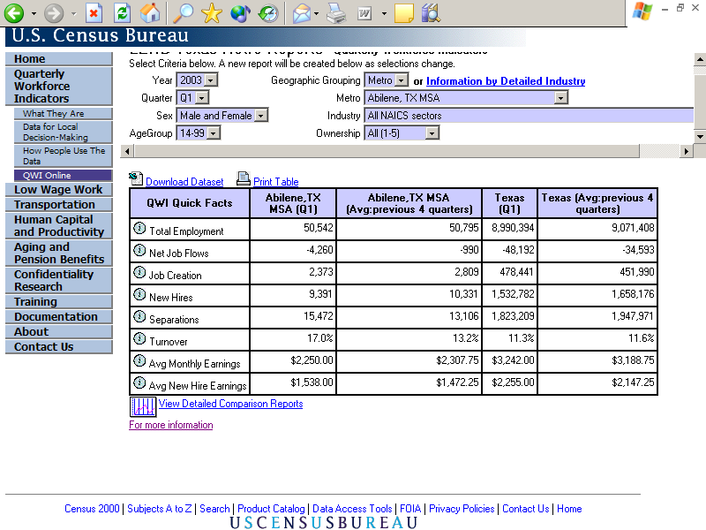
QWI Online
Notes:
This slide is from the current site. Notice that from this general site you can query on a variety of variables including year, quarter, sex, age group, geographic grouping, and detailed industry. Notice also the guide to various supporting materials in the side left hand box.
Also, use this page as a “bookmark”
State that these screens are “dynamically refreshed” (i.e. don’t need to click “go” but rather it activates after your selections)
SIMPLE EXERCISE: Identify the number of new hires for the Prince George’s WIA (home of Census) for the 3rd quarter of 2002. Also find for 2nd Quarter 2002. Which was higher?

Slide 22
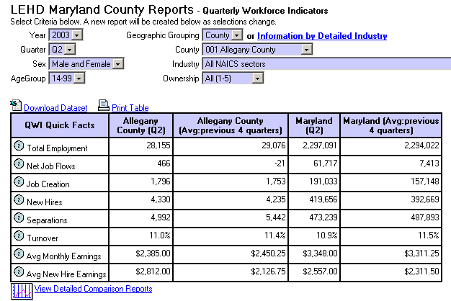
Indicators and Definitions
Notes:
The QWIs are shown in the first column. The icon in (color) to the left of the indicator name gives you more detail on what each indicator is.
HANDOUT: “Appendix Definitions” from “LMI Training Institute June 16-20, 2003” but with an additional supplement page that gives definitions for the 8 indicators in the slide
VERY IMPORTANT: We need to “slow this part down” to make sure participants are comfortable with all of the definitions that are going to be used throughout the web site.
SIMPLE EXERCISE: Compare the Prince George’s MD WIA turnover rate to that of Frederick County MD WIA. Which is higher?

Slide 23
Employed, Hire, Separate, Stable and None of the Above
1Emp - 0
2Emp - $
3Emp - $
4Emp - 0
5Emp - 0
1Emp - $
2Emp - 0
3Emp - $
4Emp - 0
5Emp - $
1Emp - $
2Emp - 0
3Emp - $
4Emp - $
5Emp - $
1Emp - 0
2Emp - $
3Emp - 0
4Emp - 0
5Emp - $
Q1 Q2 Q3 (Ref) Q4

Slide 24
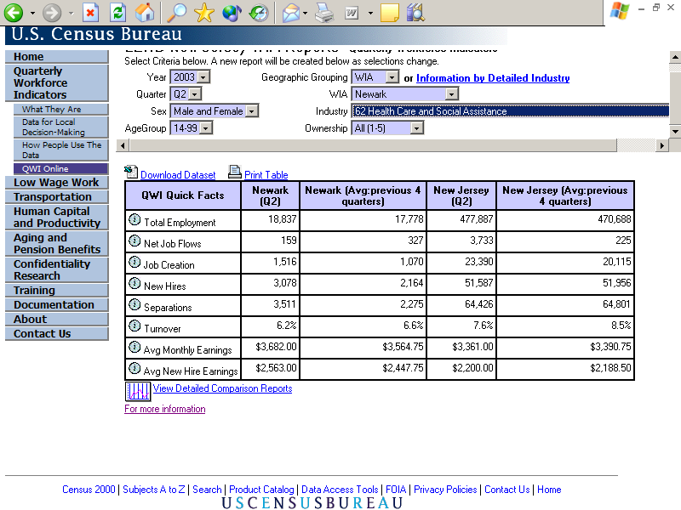
Accessing Detailed Industries

Slide 25
Demographic and Time Queries
Notes:
Note that you can query by year, quarter, sex, and age group
Simple Exercise: Compare Turnover Rate for Prince George’s County between Male 25-34 and Female 25-34 year olds. What is the difference?

Slide 26
Accessing Comparison Reports
Notes:
Comparison reports (tables) can be viewed by clicking on the char or link at the bottom of the chart.
This graphic doesn’t do the message justice. So we’ll need to go to the current web site, pull up a local area like “Maryland – Montgomery County”, and click on the detailed comparison report and then choose “Industry” and “New Hire Earnings”
Interestingly enough, doing this actually is a great segue to why the new templates are needed – the information in this particular view is interesting but you need to do a little “concentration” in order to figure out which the top industries are. The templates on the new test site do that very work for you!!!

Slide 27
Exercise (for 2003-Q2)
Identify the job creation for health care, retail trade, and manufacturing in your local area.
Which is higher? lower?
Does the industry with the highest job creation change if you limit the query to 25-34 year old males?
What do these questions tell you about how to place job seekers? Dislocated workers?
Notes:
Dislocated worker question in last bullet can’t be answered explicitly. But if you tell participants that through customized information, they can tell whether manufacturing workers were more likely not to have high turnover compared to construction workers when being hired for professional jobs, might that help inform training programs for dislocated workers.

Slide 28
Feedback
Wrap-Up and Q&A
Initial Reactions to LED Data and Internet pages
Suggestions for future training improvements
Notes:
Keeping in mind that you are the training program beta audience, what are your suggestions for future training improvements?
Keep in mind that the second question is focused on LED and related data and site, third question is about the training course itself

