Slide 1

Elliptic flow and HBT radii from a relativistic hydrodynamic model with early chemical freeze out
Tetsufumi Hirano
Physics Dept., Univ. of Tokyo
hirano@nt.phys.s.u-tokyo.ac.jp
Contents:
Introduction & motivation
EOS of chemically equilibrium &
non-equilibrium hadronic matter
Hydrodynamic simulations
p_{t} spectra, v₂ & HBT radii
Summary & discussion
Talk based on
T. Hirano and K. Tsuda, nucl-th/0205043.
T. Hirano and K. Tsuda, nucl-th/0202033.
See also,
T. Hirano, PRC65, 011901 (2002).
T. Hirano, PRL86, 2754 (2001).
Workshop on two-particle interferometry and elliptic flow at RHIC, June 14-15, 2002, BNL.

Slide 2

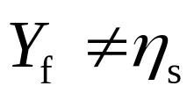
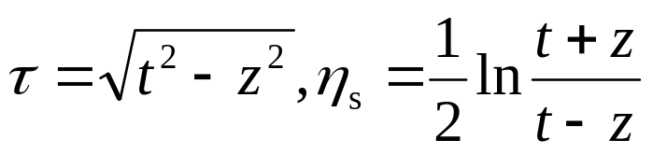
Full 3D Hydro in the τ-η_{s} Coordinate*
No cylindrical symmetry
  Enables us to simulate non-central collisions.
    → Elliptic flow, HBT radii in collisions
No Bjorken’s scaling ansatz ( )
  Enables us to obtain the (pseudo-)rapidity
  dependence of observable.
    →→ v₂(η), R_{i}(Y) (i=out, side, long), etc.
Not the Cartesian coordinate, but the τ-η_{s} coordinate
  It is relevant to the collider energies.
    → Observables at RHIC
*T.Hirano, Phys.Rev.C 65, 011901 (2002).

Slide 3
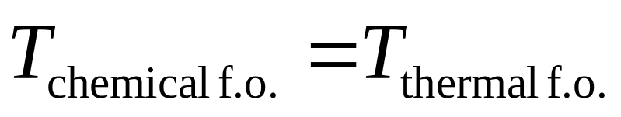
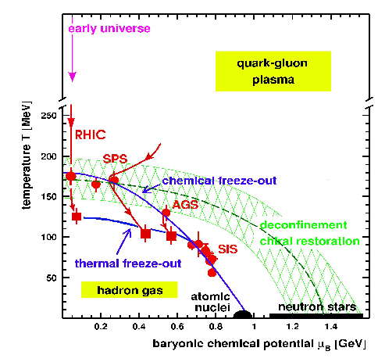
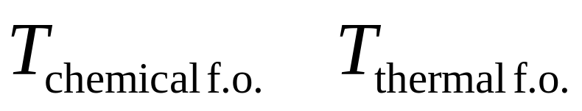

Early Chemical Freeze Out
In the conventional hydrodynamics, one assumes
Figure from
U. Heinz, hep-ph/0109006.
motivation
Chemically frozen but
thermally equilibrated
“Early” means that chemical freeze out in our model happens
earlier than in the conventional one. So, in our hydro model,
  (Approximation μ_{B}=0 for the RHIC energy)
See, for example, T.Hirano and K.Tsuda, nucl-th/0205043; D.Teaney, nucl-th/0204023.

Slide 4
Model EOS
*H.Bebie et al., Nucl.Phys.B378(1992)95.
QGP phase (massless free u, d, s and g : P=(E-4B)/3)
Mixed phase (T_{c}=170 MeV)
Hadron Phase (All hadrons up to Δ(1232).)
  Model 1 Chemical Equilibrium (CE)
  Model 2 Chemical Freeze-Out (CFO)
  Model 3* Partial Chemical Equilibrium (PCE)
Temp.
(MeV)
Model 1
(CE)
Model 2
(CFO)
Model 3*
(PCE)
170
(=T_{ch})
π
ρ
π
ρ
π
ρ
ρ
140
(=T_{th})
π
ρ
π
ρ
π
ρ
ρ
ππ→ρ→ππ
Conserved
quantities
S
S, N_{π}, N_{ρ}
S, N_{π}=N_{π}+2N_{ρ}
Notes:
We use three models EOS and compare the results with each other. The QGP phase is composed of massless free up, down, strange quarks and gluons and this is common to three models. As for the hadron phase, we introduce three models. First one is a conventional resonance gas model with chemical equilibrium, which I call `model CE’. Second and third models are new EOS. Second one is the simplest model to describe the chemical freeze-out property of nuclear matter, which I call `model CFO’. Third one is more realistic model, which I call `model PCE’.

Slide 5
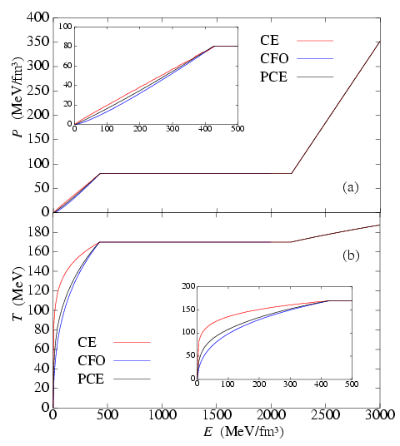
Equation of State
CE: Chemical Equilibrium
CFO: Chemical Freeze-Out
PCE: Partial Chemical Equilibrium
Approximation μ_{B}=0 for the RHIC energy
PRESSURE:
Three models are very
similar to each other.
TEMPERATURE:
At a fixed T, E in PCE and
CFO are larger than in CE due
to large fraction of resonances.
PCE looks like CFO rather
than CE.
Notes:
Let me show you the result of EOS. This figure shows the pressure as a function of energy density. This region corresponds to the hadron phase, this region corresponds the mixed phase, and this region corresponds to the QGP phase. As I enlarge the hadron phase, we find three models are very similar to each other.
On the other hand, these three models split when we represent the temperature as a function of energy density. Here, red line shows the conventional EOS and brack and blue lines are new EOS. This is an enlargement of the hadron phase. At a fixed temperature, for example, 140 MeV, energy density in models PCE and CFO is larger than that in conventional model due to large fraction of resonance particles. This is a reson why the difference appears in this figure.

Slide 6
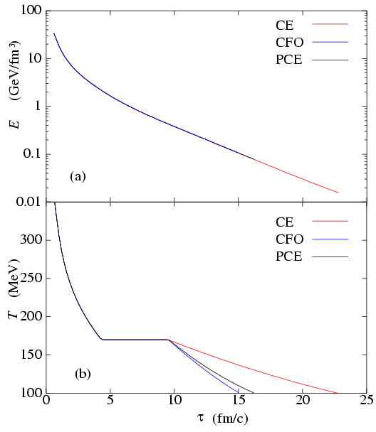
Time Evolution of E and T
Initial condition in central
collisions at the RHIC energy:
τ₀ = 0.6 fm
b = 2.4 fm
E(τ₀,0) = 33.7 GeV/fm³
T(τ₀,0) = 357.5 MeV
Energy density:
Not distinguishable
Chemical freeze-out makes the hadron phase cool down
more rapidly !

Slide 7
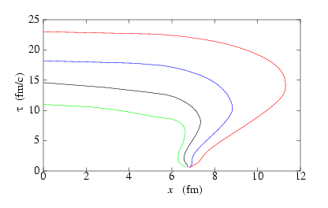
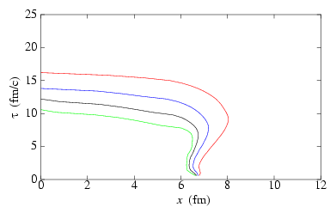
Time Evolution of Hypersurface
Chemical Equilibrium model
Explosive expansion in the
hadron phase
100
120
140
160
y=η_{s}=0
CE
Partial Chemical Equilibrium
Expansion is not so
explosively due to early
chemical freeze out.
120
100
160
140
y=η_{s}=0
PCE
Effects on HBT Radii ? → I’ll show you later.

Slide 8
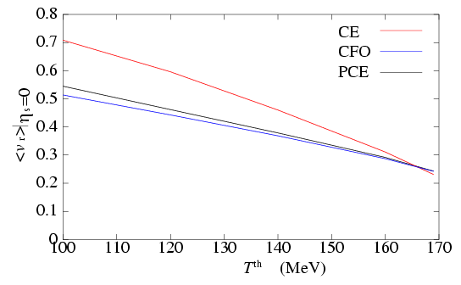
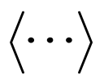
T^{th} vs. <v_{r}> at η_{s}=0
CE: Chemical Equilibrium
CFO: Chemical Freeze-Out
PCE: Partial Chemical Equilibrium
: average over thermal
freeze out hypersurface
Suppression of <v_{r}>:
17.7 % (T^{th}=140 MeV)
22.5 % (T^{th}=120 MeV)
Radial flow is suppressed.
Chemical freeze-out affects the p_{t} slope.

Slide 9
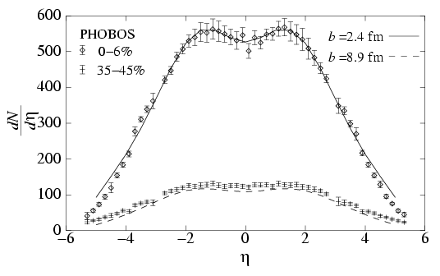
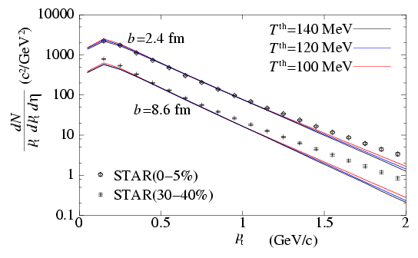
Single Particle Distribution of Charged Particles in Au+Au 130A GeV Collisions
Model PCE
Pseudorapidity distribution
Transverse momentum spectra
Almost T^{th} independent !
←Due to suppression of transverse flow in the
model PCE
T^{th}=140 MeV
Binary collision scaling
Data from PHOBOS (QM2001)
Data from STAR, PRL87, 112303 (2001);nucl-ex/0111004.

Slide 10
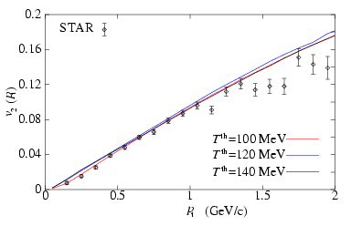
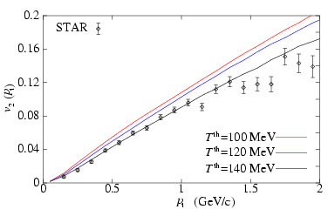
v₂(p_{t}) for Charged Hadrons
Chemical Equilibrium
Partial Chemical Equilibrium
Almost T^{th} independent
v₂ depends on T^{th}
in the model PCE !
T^{th}=140 MeV ?
Data from STAR, PRL86,402(2001).

Slide 11
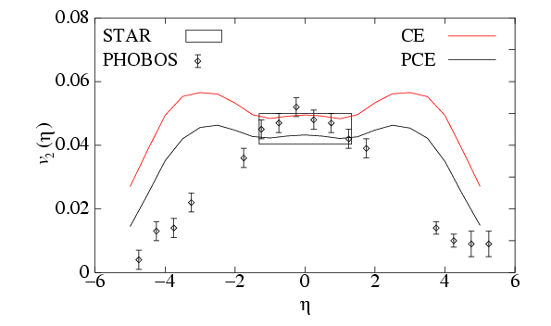
v₂(η) for Charged Hadrons
T^{th}=140 MeV
Our results:
0<p_{t}<2 GeV/c
PHOBOS:
All p_{t}
STAR:
0.1<p_{t}<2 GeV/c
Elliptic flow is also suppressed !
Note: v₂ in forward and backward region is sensitive
to the initial shape of energy density. → Detailed analyses are needed !
Data from PHOBOS, (QM2001); STAR, PRL86,402(2001).

Slide 12
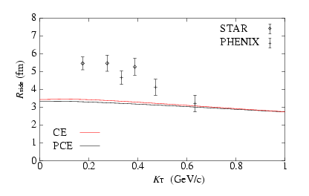
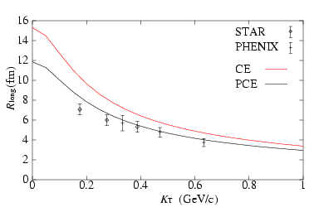
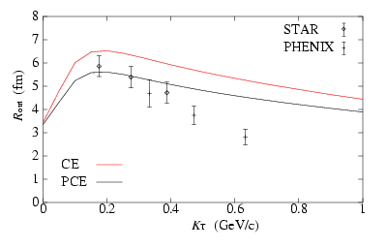
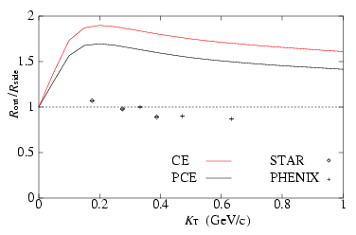
K_{T} dependence of HBT Radii
T^{th}=140 MeV, negative pions, neglecting resonance decays.
R_{side}
R_{long}
R_{out}
R_{out}/R_{side}
Data from STAR, PRL87, 082301 (2001), PHENIX, PRL88, 192302 (2002).

Slide 13
Summary
Fully 3D hydrodynamic simulations at the RHIC energy by using
EOS with/without chemical equilibrium
In comparison with the model CE, the model PCE shows that
  radial flow is suppressed.
  temporal/spatial size of the fluid is reduced.
  elliptic flow is also suppressed and the resultant v₂ depends on T^{th}.
  HBT radii are also reduced.
Nevertheless, it is not enough to completely interpret the HBT puzzle.
Anyway, one should really include the properties of
chemical freeze out in hydrodynamic simulations !

Slide 14
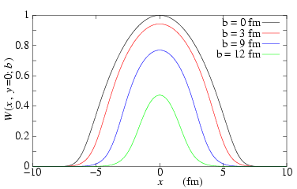
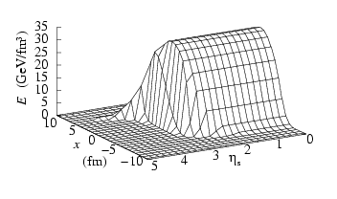

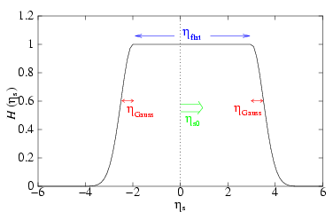
Initial Condition of Energy Density
Binary collision scaling:
W = α T(x+b/2,y)T(x-b/2,y)
Initial energy density
in the reaction plane
transverse
longitudinal
Parameters for central collisions:
b=2.4 fm
τ₀=0.6 fm
E_{max}=35 GeV/fm³
η_{flat}=5.8
η_{Gauss}=0.2

Slide 15
Local Rapidity Shift
Global center of rapidity = 0
z
z
Local rapidity shift
η_{s0}(x<0)<0
η_{s0}(x>0)>0
x
x
BEFORE
AFTER

Slide 16
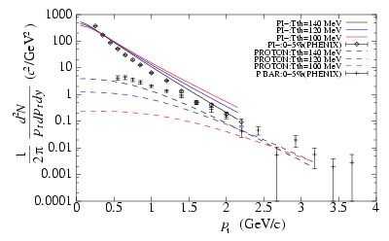
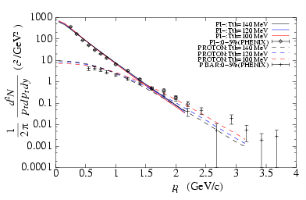
p_{t} Spectra for Identified Particles
Chemical Equilibrium
Partial Chemical Equilibrium
The p_{t} slope depends on T^{th}
in the conventional model EOS.
The slopes of π are almost
independent of T^{th}.
Data from PHENIX, nucl-ex/0112006.

Slide 17
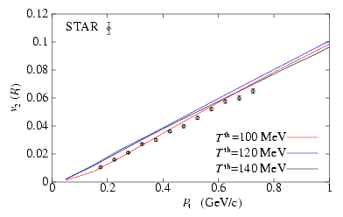
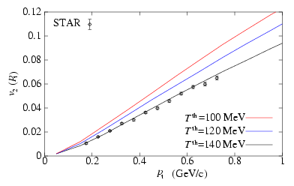
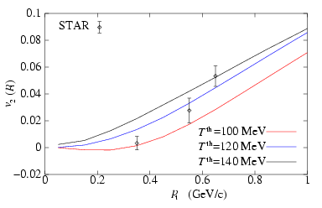
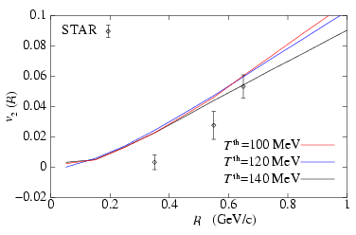
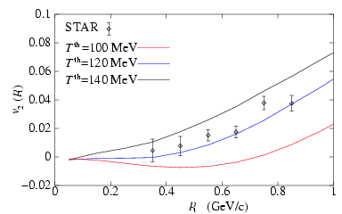
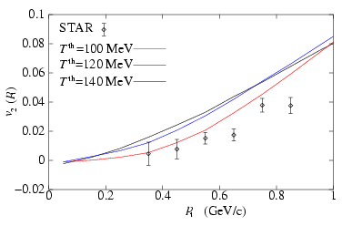
v₂(p_{t}) for Pions, Kaons and Protons
Chemical Equilibrium
Partial Chemical Equilibrium
π
K
p

Slide 18
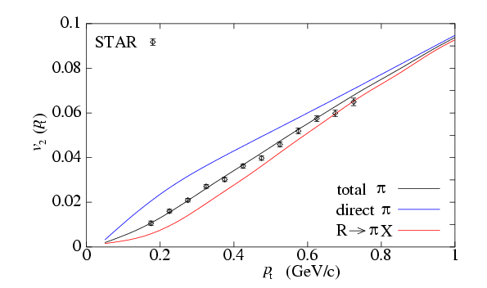
v₂(p_{t}) for direct and indirect pions
Resonance decays
dilute elliptic flow
from direct pions.
→For its mechanism, see,
T.Hirano,PRL86,2754(2001).
Population of resonances is very important
in low pt region !
→ Need to include early chemical freeze out.

Slide 19
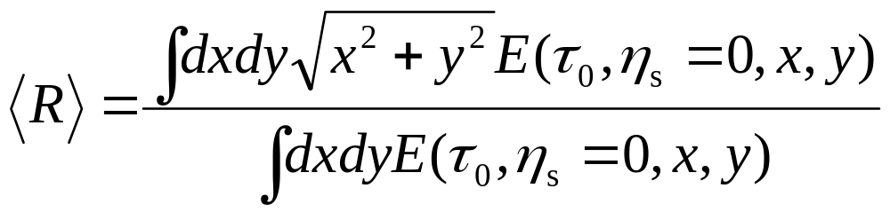
Variance of Initial Energy Density in the Transverse Plane
For nuclear density, the standard Woods-Saxon parameterization
with
Results (fm):
  3.26 (binary collision scaling, b=2.4 fm)
  3.40 (binary collision scaling, b=0 fm)
  3.74 (wounded nucleon model, b=2.4 fm)
  3.88 (wounded nucleon model, b=0 fm)
  4.44 (prop. to Woods-Saxon)
  5.78 (flat + Gauss)

Slide 20
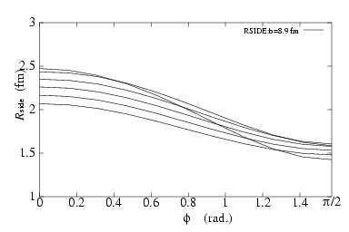
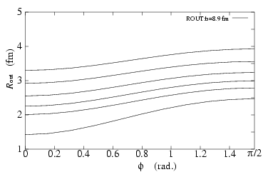
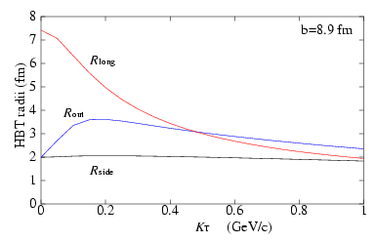
HBT Radii in Non-Central Collisions
K_{T}(GeV/c)
0.
0.2
0.4
0.6
0.8
1.0
K_{T}(GeV/c)
0.2
0.4
0.6
0.8
1.0
0.

Slide 21
Discussion
Transverse dynamics
p_{t} spectra
p_{t} spectra
???
v₂(p_{t})
R_{side}, R_{out}
v₂(p_{t})
R_{side}, R_{out}
present initial condition
future !?
Are there any initial conditions
compatible with all three
observables ?

